Slide 1


ENGINEERING CAPSTONE PROJECT – 1/INDUSTRIAL INTERNSHIP/ INDUSTRIAL INTERNSHIP PHASE-I
Project Review-2
Context-Aware Role-Based Zero Trust Network Architecture
Team No-18
Roll No | Name
2320030067 | D. Ritesh
2320030429 | M. Uday Kiran
2320030468 | Y. Hemanth Reddy
Under the Guidance of
Dr. K. Swanthana
Assistant Professor
Department of Computer Science and Engineering
KONERU LAKSHMAIAH EDUCATION FOUNDATION

Slide 2
OUTLINE
Methodology
System Design and Architecture
Modern Tools and Technologies
Implementation
Implemented Functionality
Experimental Setup
Results

Slide 3
Methodology
Follow the Zero Trust principle: Never Trust, Always Verify.
Authenticate users securely using Spring Security and BCrypt password hashing.
Collect contextual information, including user role, device posture, IP address, and resource sensitivity.
Evaluate access requests using deterministic RBAC and ABAC policies.
Apply default-deny access control and give explicit deny rules priority.
Reassess active sessions and record security events for monitoring.

Slide 4
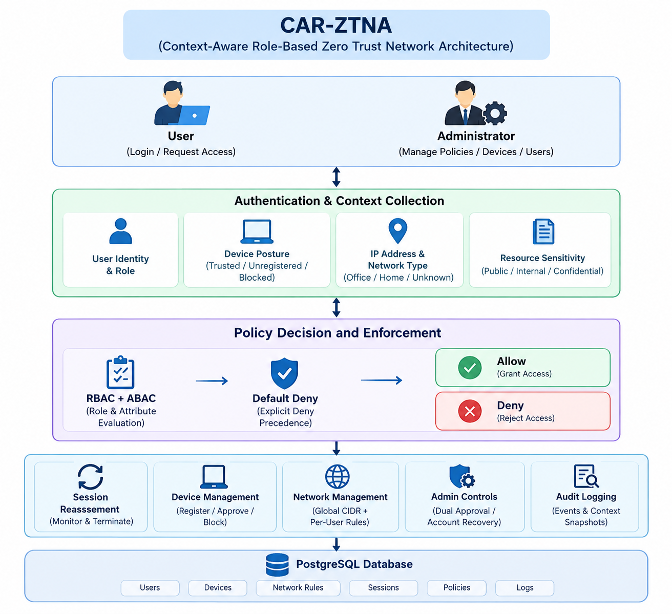
System Design and Architecture

Slide 5
Modern Tools and Technologies
Backend
Java
  Core programming language
  Object-oriented implementation
Spring Boot
  REST API development
  Service-based application architecture
Spring Security
  Security configuration
  Request authorization

Slide 6
Modern Tools and Technologies
Database
PostgreSQL
  User information
  Context data
  Risk assessments
  Security logs
Development & Testing
Maven
  Dependency management
  Build and project lifecycle
Postman
  REST API testing
  Authentication and access testing
Git & GitHub
  Version control
  Project collaboration and submission

Slide 7
Implementation
Developed secure registration, login, and role-based authorization.
Implemented account lockout after repeated failed login attempts.
Added device registration, approval, blocking, and posture management.
Configured global CIDR-based network rules and per-user network restrictions.
Developed a contextual policy engine based on roles, device states, network classifications, and resource sensitivity.
Implemented session reassessment and session termination.
Added dual-admin approval for administrator promotion and controlled recovery of locked accounts.
Integrated security logs and an administrative dashboard.

Slide 8
Implemented Functionality
Module | Functionality
Authentication | Registration, login, BCrypt password hashing, account lockout
User management | USER and ADMIN roles, dual-admin promotion approval
Device management | Trusted, unregistered, and blocked device states
Network management | Office, home, unknown, and blocked network classifications
Access control | RBAC + ABAC, default deny, explicit-deny precedence
Resource protection | Access policies based on resource sensitivity
Session management | Periodic reassessment and session termination
Recovery | Short-lived, session-bound Super Recovery Key
Audit and dashboard | Security events, context snapshots, session and device statistics

Slide 9
Experimental Setup
Test scenario | Expected result
Valid user with permitted role and context | Access allowed
User requests a resource without permission | Access denied
Device is marked as blocked | Access denied
Request originates from a blocked network | Access denied
Explicit deny policy matches | Access denied
Account reaches the configured failed-login threshold | Account locked
Administrator uses a valid recovery key | Account unlocked, subject to recovery policy
Active session's device or network becomes disallowed | Session terminated at reassessment
Administrator changes a security policy | Change recorded in audit logs

Slide 10
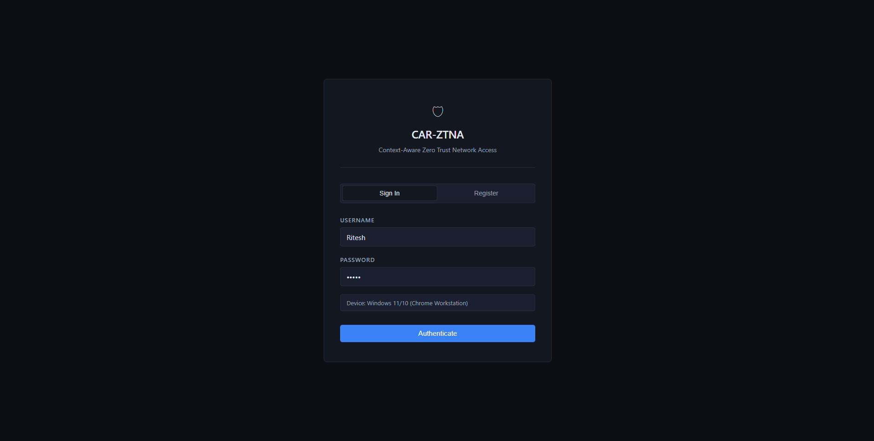
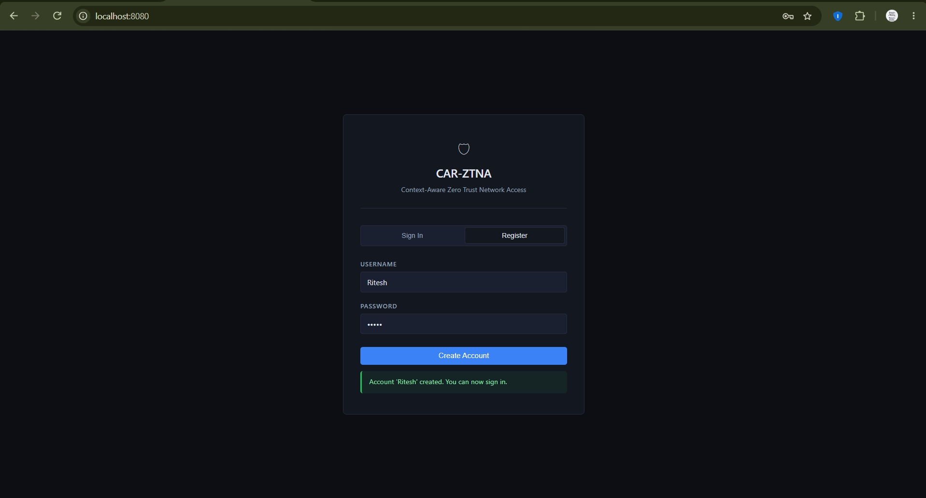
Results

Slide 11
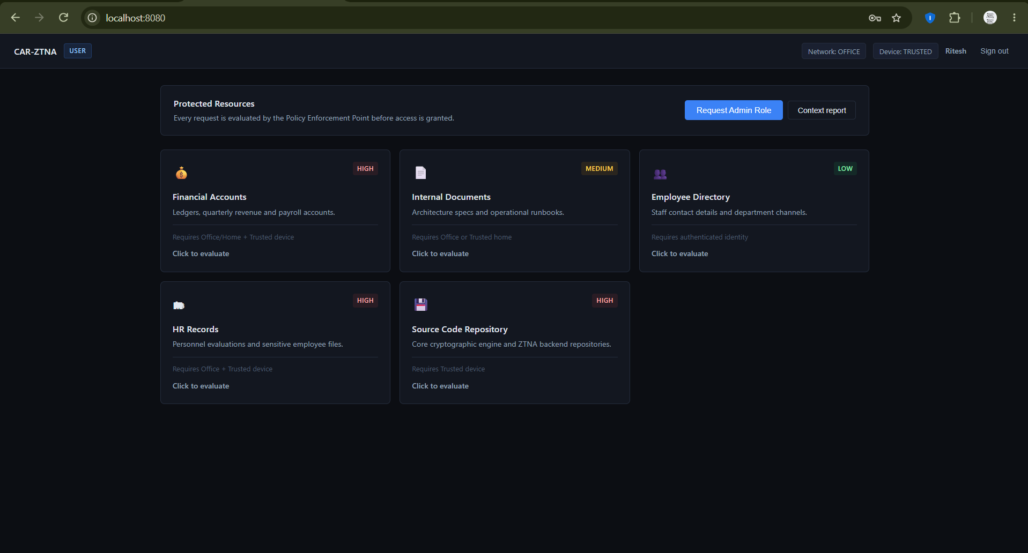
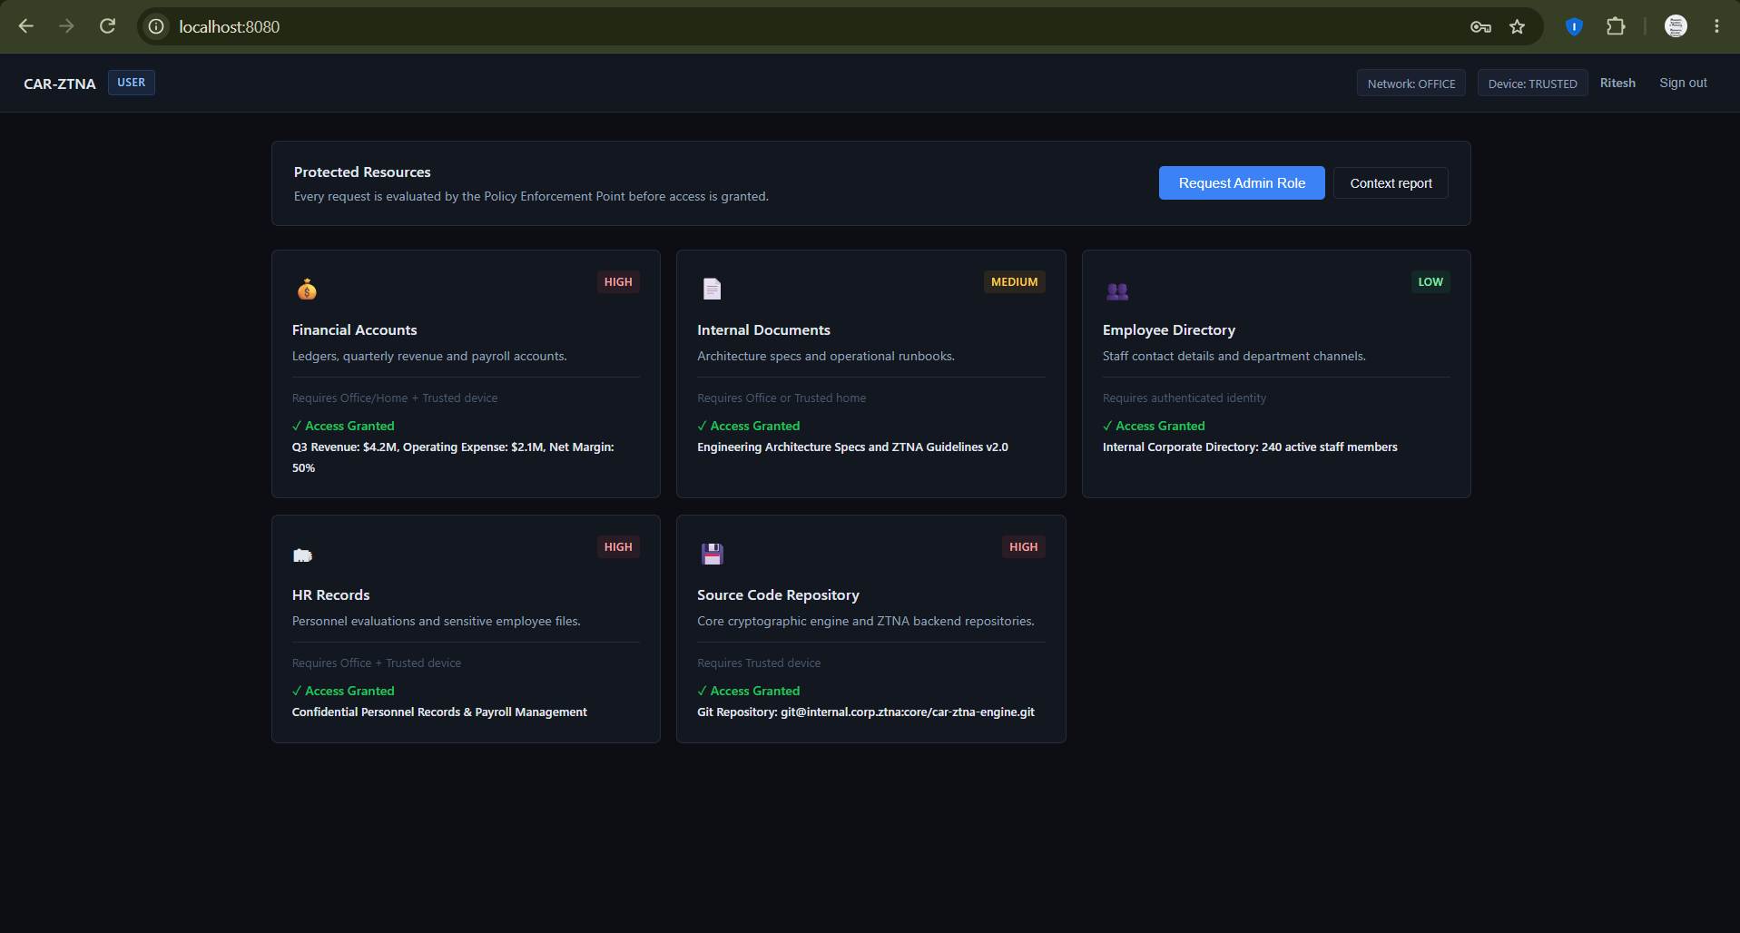
Results

Slide 12
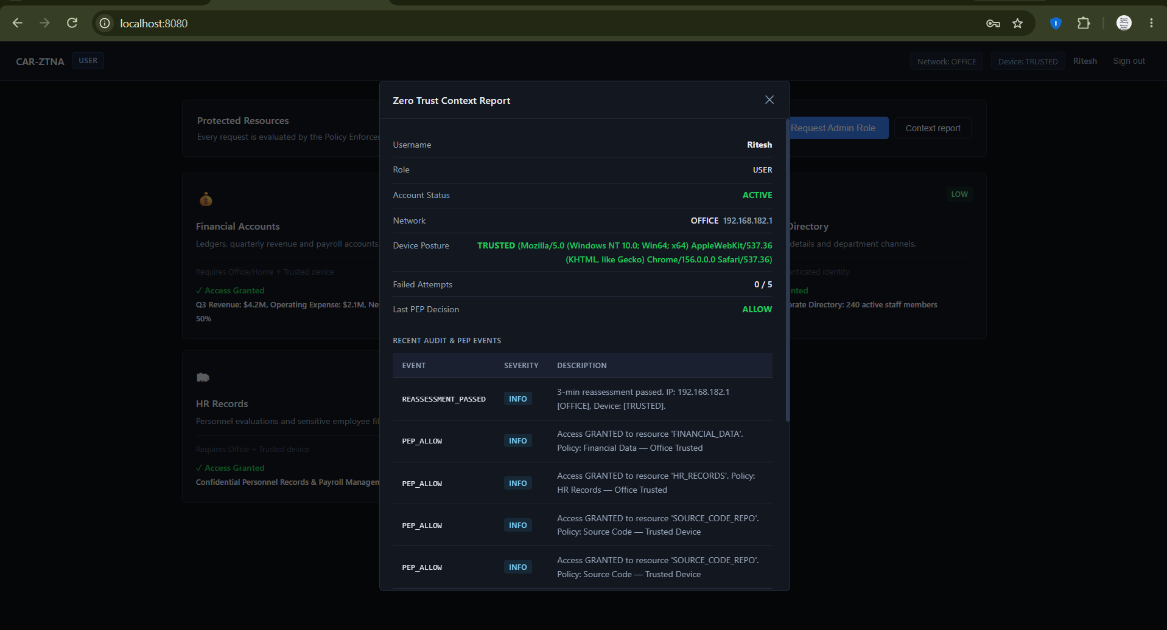
Results

Slide 13
THANK YOU

