Slide 1


ENGINEERING CAPSTONE PROJECT – 1/INDUSTRIAL INTERNSHIP/ INDUSTRIAL INTERNSHIP PHASE-I
Project Review-3
Context-Aware Role-Based Zero Trust Network Architecture
Team No-18
Roll No | Name
2320030067 | D. Ritesh
2320030429 | M. Uday Kiran
2320030468 | Y. Hemanth Reddy
Under the Guidance of
Dr. K. Swanthana
Assistant Professor
Department of Computer Science and Engineering
KONERU LAKSHMAIAH EDUCATION FOUNDATION

Slide 2
OUTLINE
Introduction
Problem Statement
Objectives
Literature Survey
Research Gap Identification
Existing Model
Proposed Model
System Architecture
Results
Conclusion
References

Slide 3
Introduction
Background of the Topic
  Traditional access-control systems often rely on user authentication and predefined permissions. However, successful authentication alone does not guarantee that a user, device or network environment is trustworthy. Zero Trust Architecture follows the principle of “Never Trust, Always Verify”, requiring access requests to be evaluated before granting access to protected resources.
Importance of the Selected Project
  Strengthens organizational network security through context-aware access decisions.
  Reduces unauthorized access by considering user roles, device status and network location.
  Provides additional protection against brute-force login attempts.
  Prevents unauthorized privilege escalation through dual-admin approval.
  Improves security monitoring and accountability through audit logging.
Applications
  Corporate Networks: Secure access to internal organizational resources.
  Remote Work Environments: Differentiate office and home network access.
  Enterprise Applications: Enforce role-based and context-aware permissions.
  Administrative Systems: Protect privileged operations using dual-admin approval.
  Sensitive Data Platforms: Restrict access to resources based on authorization policies.
  IT Infrastructure: Monitor access activities and maintain security audit records.

Slide 4
Problem Statement
Existing Zero Trust and access-control approaches emphasize identity verification and predefined permissions but may not sufficiently integrate user roles, device trust, network location and resource sensitivity into a unified access-control process. Additionally, challenges remain in controlling administrative privilege escalation and reassessing active sessions.
Proposed Solution – CAR-ZTNA: Develop a context-aware, role-based Zero Trust architecture that combines network and device verification, policy-based authorization, dual-admin approval, session reassessment and centralized security auditing to strengthen organizational access security.
Research Gap: Lack of an integrated approach combining these access-control requirements within a unified framework.

Slide 5
Objectives
Secure Authentication: Implement BCrypt-based authentication and account lockout after five consecutive failed login attempts.
Context-Aware Access Control: Evaluate user roles, office/home network information, device status and resource sensitivity before granting access.
Policy-Based Authorization: Enforce explicit access-control policies using the default-deny principle, with deny rules overriding allow rules.
Controlled Privilege Management: Implement dual-admin approval for USER-to-ADMIN role promotion.
Continuous Session Monitoring: Reassess active sessions to identify changes in access context and enforce applicable security policies.
Security Auditing: Maintain centralized security event logs in PostgreSQL for access monitoring and accountability.

Slide 6
Literature Survey
Sl. No. | Year | Authors | Title of the paper | Source | Objective of the paper | Techniques used | Dataset used | Parameters analysed | Research inference | Research gap relevant to CAR-ZTNA | DOI
1 | 2021 | Christoph Buck et al. | Never Trust, Always Verify: A Multivocal Literature Review on Current Knowledge and Research Gaps of Zero-Trust | Computers & Security | Review existing Zero Trust research and identify research gaps. | Multivocal literature review and thematic analysis. | Published academic and practitioner literature. | ZTA adoption, architecture, security benefits and research maturity. | ZTA offers a strong alternative to perimeter-based security, but empirical and organizational research remains limited. | Need for an implemented and testable context-aware access-control prototype. | 10.1016/j.cose.2021.102436
2 | 2021 | Javier Junquera-Sánchez et al. | Access Control beyond Authentication | Security and Communication Networks | Examine methods for verifying identity continuously beyond initial authentication. | Systematic literature review of continuous authentication techniques. | Previously published studies; no original dataset reported. | Authentication methods, data sources and continuous identity verification. | Authentication can be extended beyond the initial login. | Need to combine continuous verification with role, device and network-based authorization. | 10.1155/2021/8146553
3 | 2021 | Binanda Sengupta, Anantharaman Lakshminarayanan | DistriTrust: Distributed and Low-Latency Access Validation in Zero-Trust Architecture | Journal of Information Security and Applications | Improve distributed access validation and avoid dependence on one PDP. | Distributed PDPs, threshold signatures and cryptographic validation. | Prototype and experimental evaluation; no public benchmark dataset specified in the abstract. | PDP distribution, security, communication overhead and validation latency. | Distributing policy decisions can improve resilience but introduces overhead. | Need for a practical, manageable policy-based authorization implementation. | 10.1016/j.jisa.2021.103023
4 | 2022 | Naeem Firdous Syed et al. | Zero Trust Architecture (ZTA): A Comprehensive Survey | IEEE Access | Review ZTA principles, authentication, access control and security challenges. | Survey of authentication, encryption, micro-segmentation and access-control techniques. | Existing research publications; no original dataset. | Authentication, access control, encryption, micro-segmentation and trust assessment. | ZTA depends on multiple coordinated security components. | Need to combine selected ZTA components in a working application-level model. | 10.1109/ACCESS.2022.3174679
5 | 2022 | Shiyu Xiao et al. | SoK: Context and Risk Aware Access Control for Zero Trust Systems | Security and Communication Networks | Examine the relationship between context awareness, risk-based access control and Zero Trust. | Systematic examination of context-aware and risk-aware access-control models. | Existing research literature; no original dataset. | Context attributes, risk-aware decisions and ZTA access-control models. | Context awareness can improve access decisions in dynamic environments. | Need for explicit, deterministic context-based policies without requiring a numerical risk score. | 10.1155/2022/7026779

Slide 7
Sl. No. | Year | Authors | Title of the paper | Source | Objective of the paper | Techniques used | Dataset used | Parameters analysed | Research inference | Research gap relevant to CAR-ZTNA | DOI
6 | 2022 | P. García-Teodoro et al. | A Novel Zero-Trust Network Access Control Scheme Based on the Security Profile of Devices and Users | Computer Networks | Improve access control using the security profiles of users and devices. | Security Attribute-Based Dynamic Access Control (SADAC), device/user attributes and dynamic supervision. | Not specified in the available article summary. | User/device security attributes, dynamic supervision and access restrictions. | User and device security conditions can be evaluated over time. | Need for an integrated role-based system that also considers office/home network context and administrative controls. | 10.1016/j.comnet.2022.109068
7 | 2022 | Yuanhang He et al. | A Survey on Zero Trust Architecture: Challenges and Future Trends | Wireless Communications and Mobile Computing | Examine ZTA architecture, authentication, access control and trust assessment challenges. | Comparative survey and analysis of existing approaches. | Existing literature; no original dataset. | ZTA architecture, identity authentication, authorization and trust evaluation. | Existing approaches face implementation and adoption challenges. | Need for a practical implementation that integrates authentication, authorization and session monitoring. | 10.1155/2022/6476274
8 | 2024 | Nurun Nahar et al. | A Survey on Zero Trust Architecture: Applications and Challenges of 6G Networks | IEEE Access | Study ZTA applications, authentication and security challenges in 6G networks. | Literature survey, comparison of techniques and case-study analysis. | Published studies and case studies; no single original dataset reported. | 6G security requirements, access control, authentication and deployment challenges. | ZTA principles can address security in distributed network environments. | Need for a simpler organizational access-control implementation beyond specialized 6G environments. | 10.1109/ACCESS.2024.3425350
9 | 2024 | Seunghwan Son et al. | A Zero-Trust Authentication Scheme With Access Control for 6G-Enabled IoT Environments | IEEE Access | Develop secure Zero Trust authentication and dynamic access control for 6G IoT. | Blockchain-based mutual authentication and lightweight attribute-based encryption. | Comparative evaluation; no public dataset specified in the available record. | Authentication security, communication efficiency and dynamic authorization. | Cryptographic techniques can support Zero Trust in distributed IoT environments. | Need for an application-level framework with straightforward role and device-based policy enforcement. | 10.1109/ACCESS.2024.3484522
10 | 2024 | Safwa Ameer et al. | ZTA-IoT: A Novel Architecture for Zero-Trust in IoT Systems and an Ensuing Usage Control Model | ACM Transactions on Privacy and Security | Develop an integrated Zero Trust architecture and usage-control framework for IoT. | ZTA-IoT architecture, access-control framework, usage control and proof-of-concept implementation. | AWS IoT proof-of-concept environment; no public benchmark dataset identified. | IoT entities, resource interactions, usage control and continuous authorization. | Formal policy models can govern complex interactions across IoT environments. | Need for an implementation focused on organizational users, office/home networks, device states and administrative approval. | 10.1145/3671147

Slide 8
Research Gap Identification
S.No. | Paper Title | Author Name(s) | Methodology / Model Used | Key Findings | Research Gap Identified
1 | Never Trust, Always Verify: A Multivocal Literature Review on Current Knowledge and Research Gaps of Zero-Trust (2021) | Christoph Buck et al. | Multivocal literature review of Zero Trust research and industry publications | Identifies key Zero Trust principles, implementation approaches, and research challenges. | Does not provide a single integrated implementation model combining role, device, network, and resource context.
2 | Access Control beyond Authentication (2021) | Javier Junquera-Sánchez et al. | Context-based access control and analysis of access-control approaches | Highlights the importance of considering factors beyond user authentication when granting access. | Further integration of device trust, network location, and continuous session verification is needed.
3 | DistriTrust: Distributed and Low-Latency Access Validation in Zero-Trust Architecture (2021) | Binanda Sengupta and Anantharaman Lakshminarayanan | Distributed access validation model for Zero Trust environments | Focuses on reducing access-validation latency through a distributed architecture. | Does not fully address the combination of role-based permissions and multiple contextual attributes in one framework.
4 | Zero Trust Architecture (ZTA): A Comprehensive Survey (2022) | Naeem Firdous Syed et al. | Comprehensive survey of Zero Trust architecture, components, and implementation challenges | Explains Zero Trust principles, architecture, technologies, and deployment challenges. | Further practical implementation and evaluation of integrated context-aware access-control systems are required.
5 | SoK: Context and Risk Aware Access Control for Zero Trust Systems (2022) | Shiyu Xiao et al. | Systematization of Knowledge on context- and risk-aware access control | Examines how contextual information and risk considerations can support Zero Trust access decisions. | Practical integration of role-based access, device status, network zones, and session monitoring remains an area for development.

Slide 9
Research Gap Identification
S.No. | Paper Title | Author Name(s) | Methodology / Model Used | Key Findings | Research Gap Identified
6 | A Novel Zero-Trust Network Access Control Scheme Based on the Security Profile of Devices and Users (2022) | P. García-Teodoro et al. | Zero Trust access-control scheme using user and device security profiles | Demonstrates the importance of user and device security profiles in access decisions. | Additional integration of organizational roles, network zones, and resource sensitivity could improve access decisions.
7 | A Survey on Zero Trust Architecture: Challenges and Future Trends (2022) | Yuanhang He et al. | Survey of Zero Trust architecture, challenges, and future research directions | Discusses Zero Trust concepts, implementation challenges, and emerging research directions. | More practical frameworks are needed to address contextual authorization and continuous access verification together.
8 | A Survey on Zero Trust Architecture: Applications and Challenges of 6G Networks (2024) | Nurun Nahar, Karl Andersson, Olov Schelén, and Saguna Saguna | Survey of Zero Trust applications and challenges in 6G networks | Discusses the relevance of Zero Trust for securing future 6G network environments. | Its focus on 6G leaves room for practical, organization-level access-control implementations using role and device context.
9 | A Zero-Trust Authentication Scheme With Access Control for 6G-Enabled IoT Environments (2024) | Seunghwan Son et al. | Zero Trust authentication and access-control scheme for 6G-enabled IoT | Proposes an authentication and access-control approach for securing IoT environments. | The approach is focused on 6G-enabled IoT; organizational access scenarios involving office/home networks and administrative roles need further exploration.
10 | ZTA-IoT: A Novel Architecture for Zero-Trust in IoT Systems and an Ensuing Usage Control Model (2024) | Safwa Ameer et al. | Zero Trust architecture and usage-control model for IoT systems | Presents an architecture and usage-control approach for improving security in IoT environments. | Further work can explore applying integrated role-based and context-aware access policies to general organizational systems.

Slide 10
Existing Method
Working Methodology: Existing Zero Trust systems verify user identity, device security, and contextual information before granting access.
Models & Techniques: Zero Trust Architecture (PE, PA, PEP), RBAC, context-aware access control, risk evaluation, and device security profiling.
Dataset & Preprocessing: Studies mainly use literature reviews, security profiles, and experimental access requests. No common benchmark dataset is reported across the studies.
System Architecture: Identity Management → Context/Device Evaluation → Policy Engine → Policy Administrator → Policy Enforcement Point → Protected Resources.
Evaluation Metrics: Authentication success, authorization correctness, access latency, computational overhead, scalability, and security effectiveness.
Key Limitations:
  Limited integration of roles, device status, and network context.
  Increased processing overhead from repeated security checks.
  Challenges in scalability and policy management.
  Limited real-world implementation and evaluation in some studies.
  Incomplete continuous session verification.

Slide 11
Proposed Method
New Approach: Introduces a Context-Aware Role-Based Zero Trust model that evaluates user roles, network zones, device status, and resource sensitivity before granting access.
Models & Techniques: RBAC, context-aware ABAC, deterministic policy evaluation, default-deny authorization, BCrypt password hashing, account lockout, and continuous session monitoring.
Dataset & Preprocessing: No external dataset or machine-learning feature extraction is used. The system evaluates login requests, network details, device registration status, user roles, and resource attributes collected during operation.
Proposed Architecture: User Authentication → Context Collection → Policy Evaluation → Access Decision → Policy Enforcement → Session Monitoring & Audit Logging.
Workflow: Verifies identity, checks office/home network and device status, evaluates access policies, and allows or denies access. Sessions are periodically reassessed.
Expected Improvements:
  More consistent and context-aware access decisions.
  Reduced unauthorized access through default-deny policies.
  Improved account security through five-attempt lockout.
  Controlled ADMIN promotion through dual-admin approval.
  Better monitoring and accountability through audit logs.
Key Contribution: Integrates role, device, network, and resource context into one practical Zero Trust framework without relying on numerical risk scores or machine-learning predictions.

Slide 12
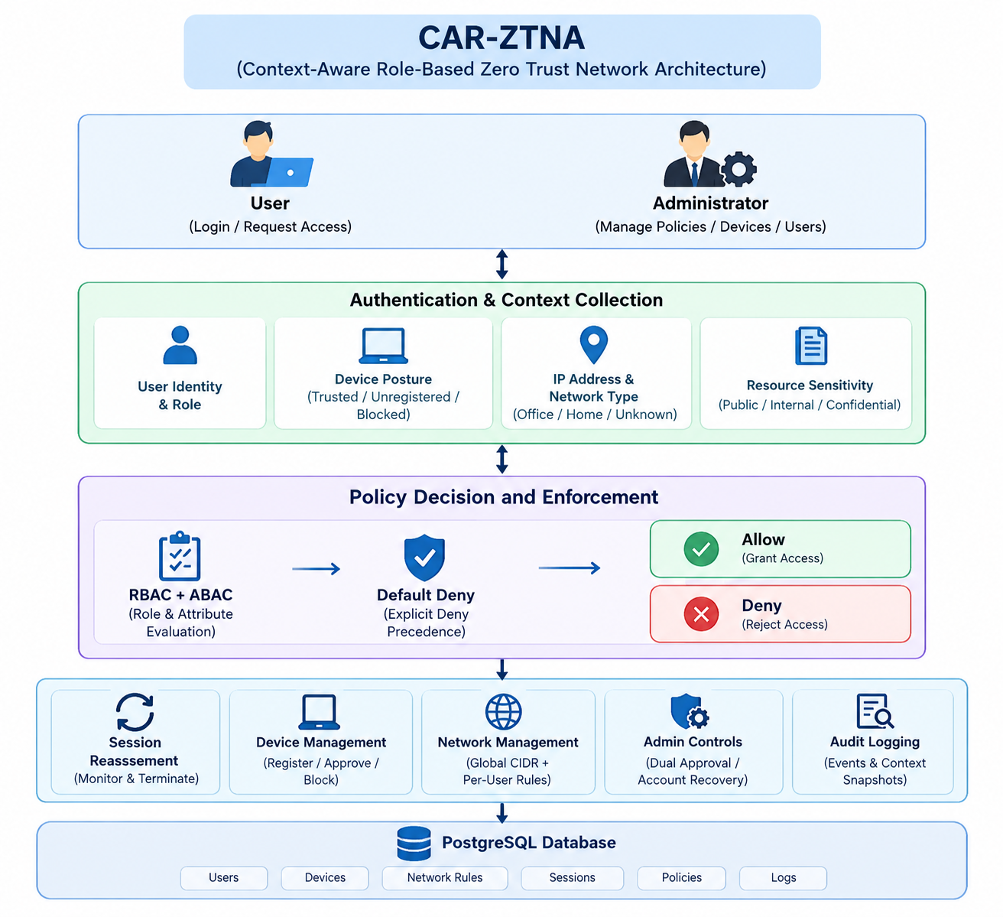
System Architecture

Slide 13
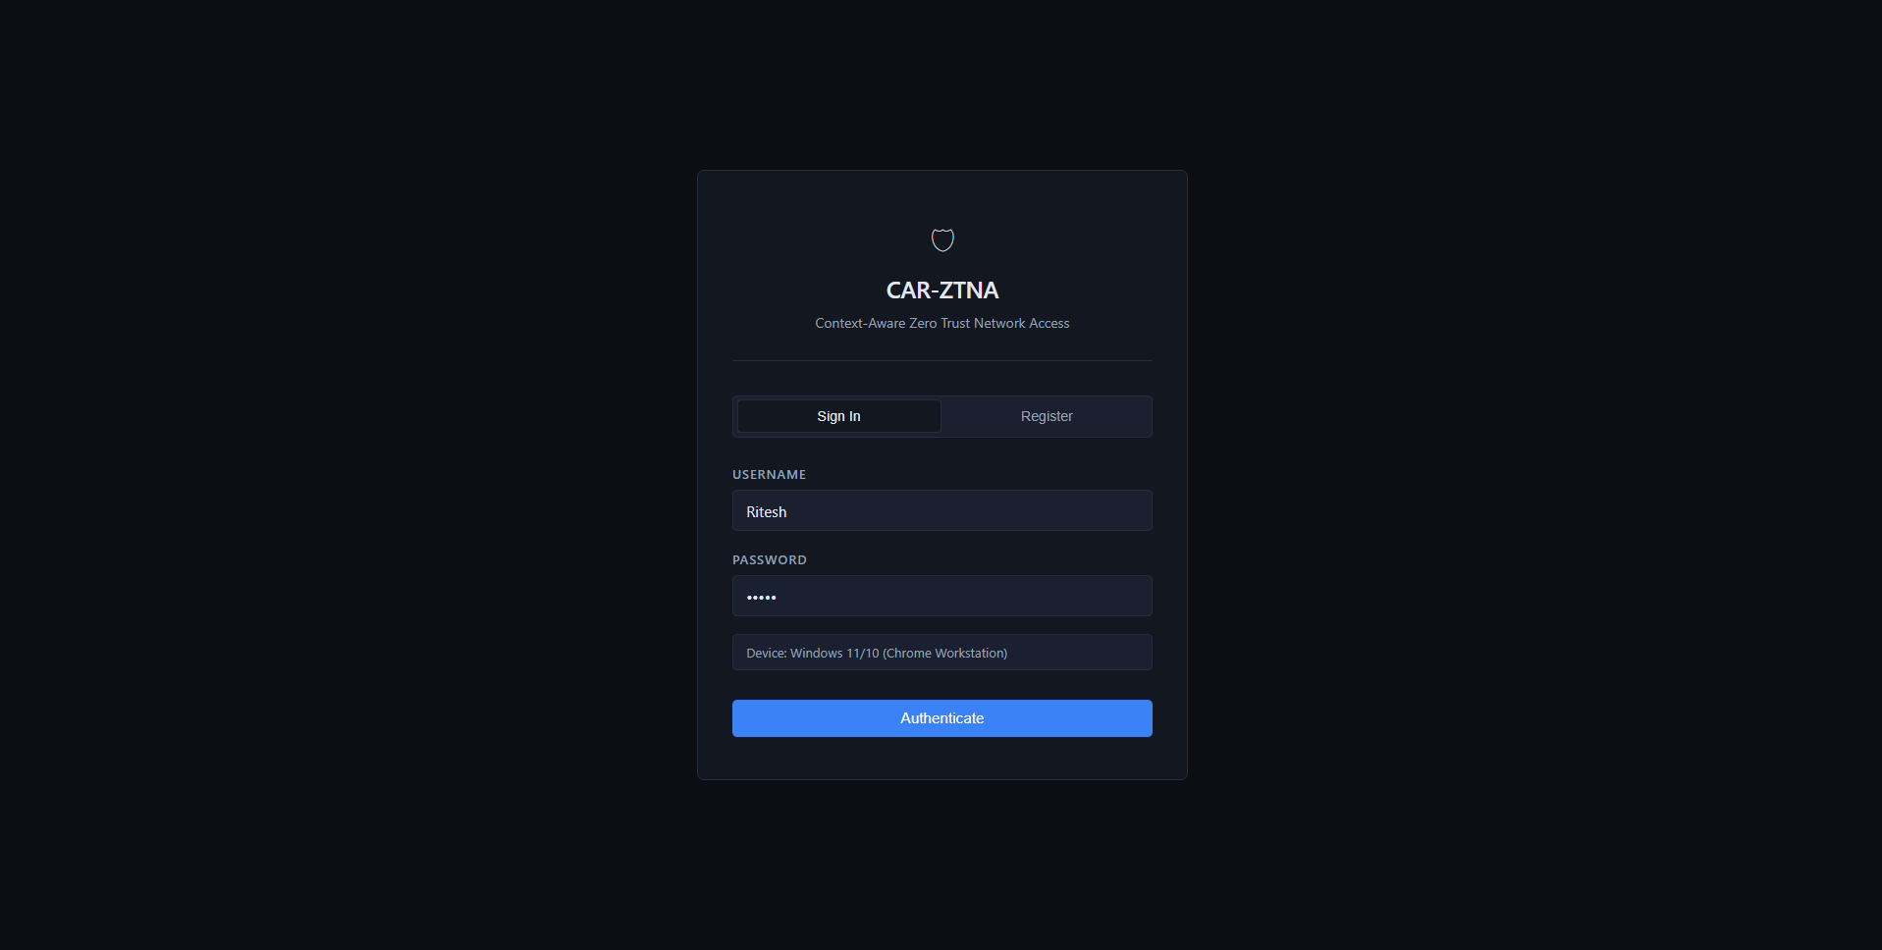
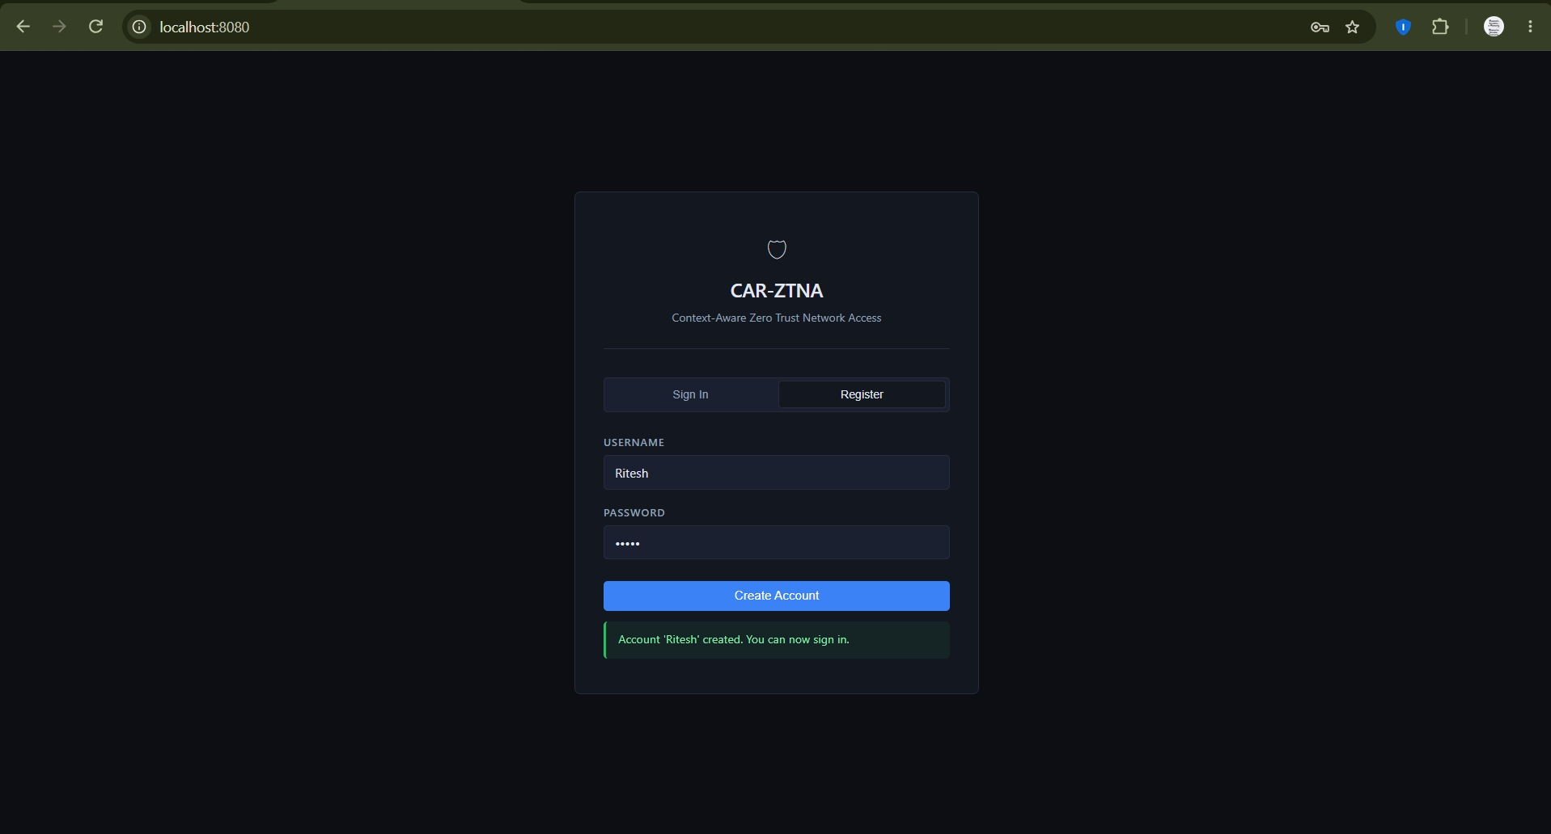
Results

Slide 14
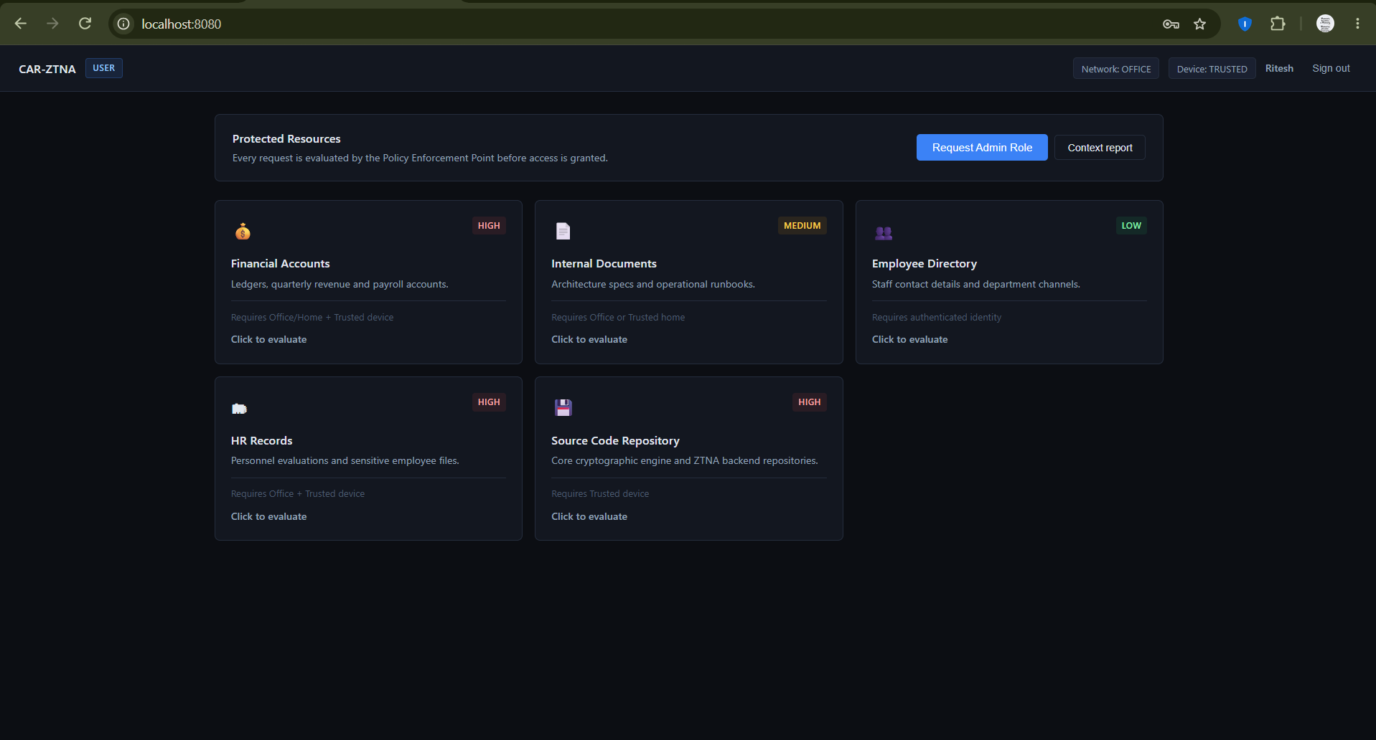
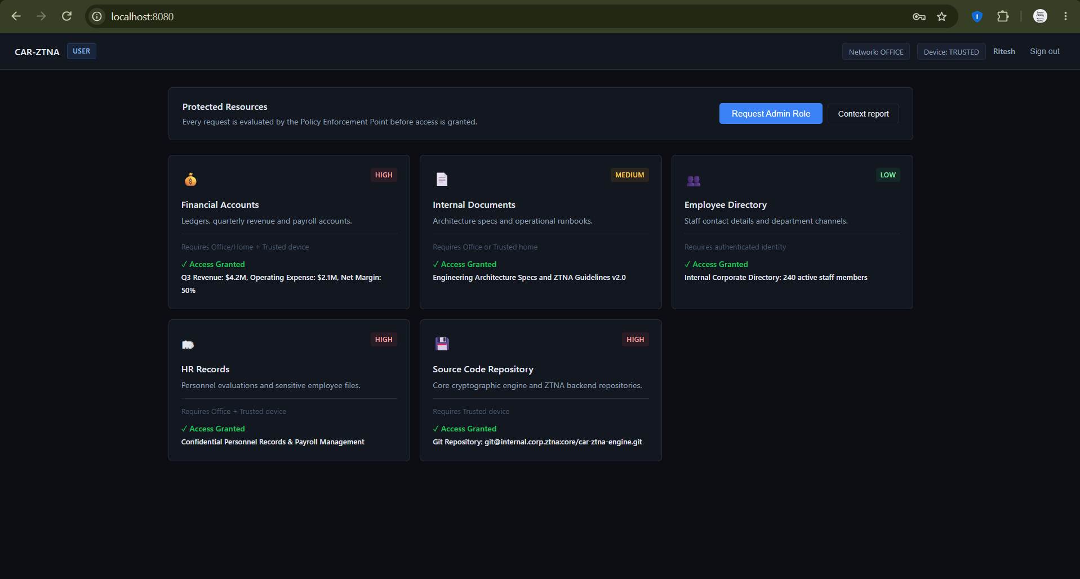
Results

Slide 15
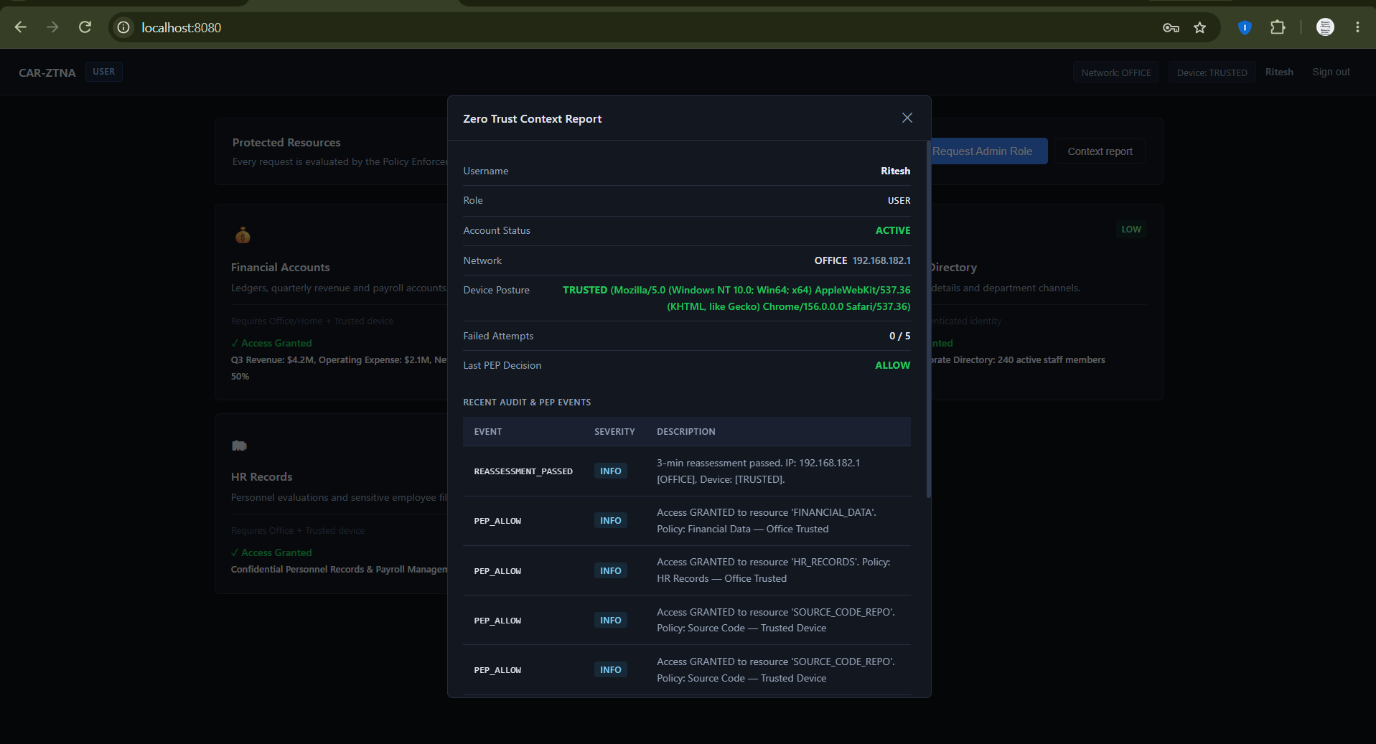
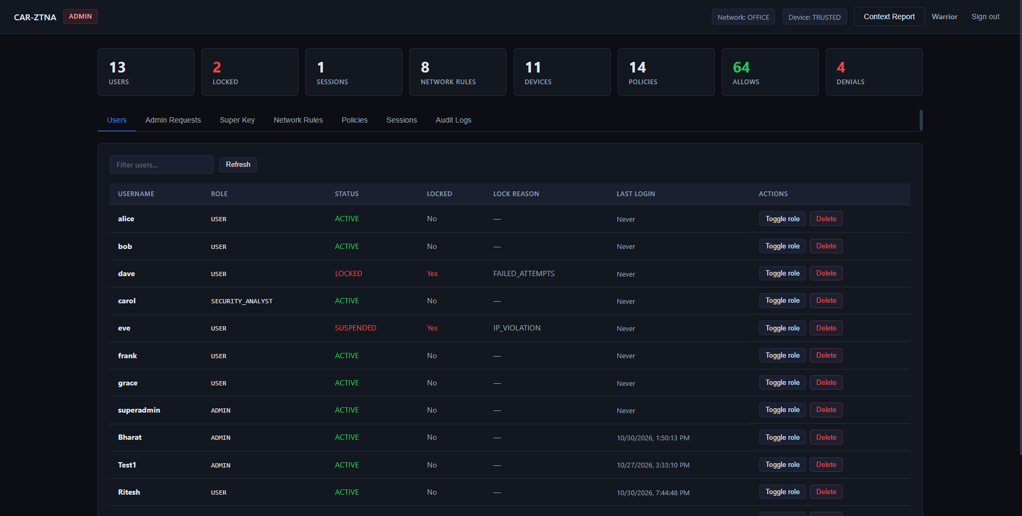
Results

Slide 16
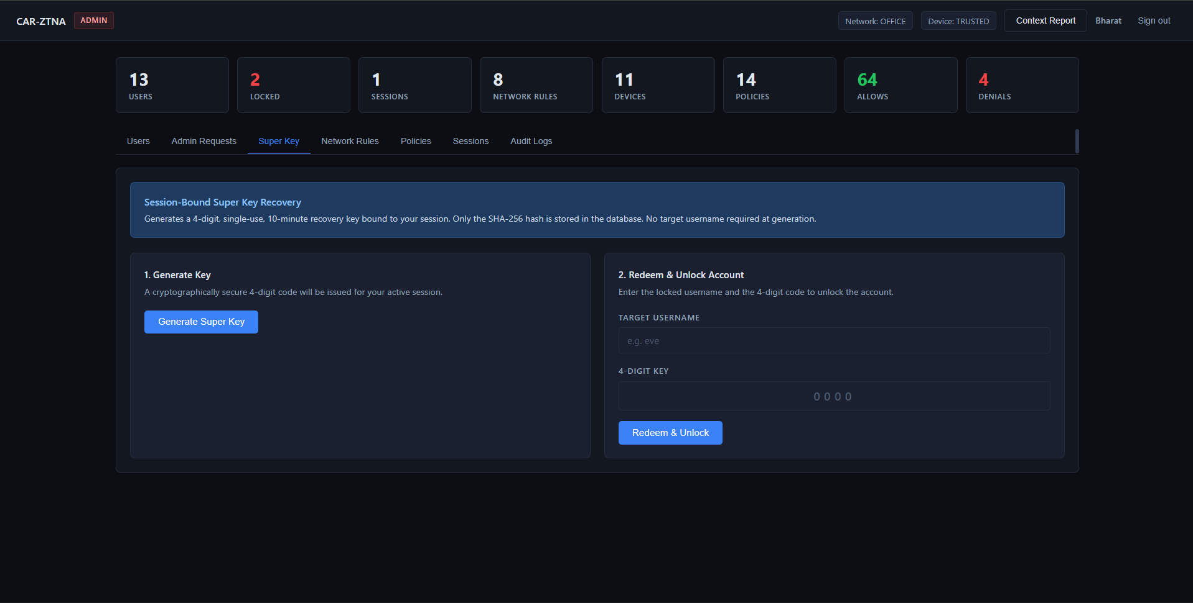
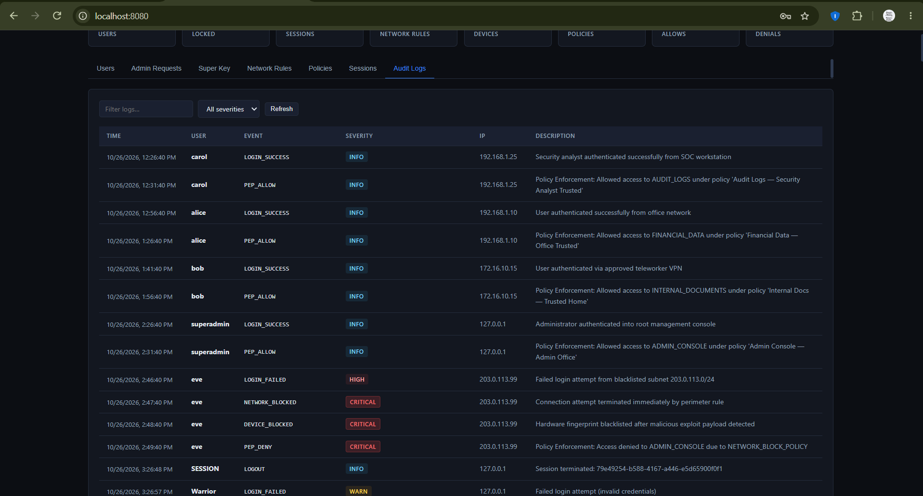
Results

Slide 17
Conclusion
Summary of the Proposal
  Proposed CAR-ZTNA to provide context-aware, role-based Zero Trust access control.
  Evaluates user roles, office/home network zones, device trust status, and resource sensitivity.
  Implements default-deny policies, account lockout, dual-admin approval, session monitoring, and audit logging.
  Aims to strengthen access security and reduce unauthorized access.
Next Steps – Upcoming Evaluation Phase
  Complete integration of all system modules.
  Perform functional and security testing using JUnit and Postman.
  Test different user roles, devices, network conditions, and resource sensitivity levels.
  Evaluate authorization correctness, response time, session reassessment, and audit-log accuracy.
  Identify issues, optimize performance, and document experimental results.
Expected Outcome: A functional and experimentally validated CAR-ZTNA prototype demonstrating context-aware access control and continuous security monitoring.

Slide 18
References
S. Rose, O. Borchert, S. Mitchell, and S. Connelly, “Zero Trust Architecture,” NIST Special Publication 800-207, Aug. 2020. https://doi.org/10.6028/NIST.SP.800-207.
C. Buck, C. Olenberger, A. Schweizer, F. Völter, and T. Eymann, “Never trust, always verify: A multivocal literature review on current knowledge and research gaps of zero-trust,” Computers & Security, vol. 110, Art. no. 102436, 2021. https://doi.org/10.1016/j.cose.2021.102436.
J. Junquera-Sánchez, C. Cilleruelo, L. De-Marcos, and J.-J. Martinez-Herráiz, “Access control beyond authentication,” Security and Communication Networks, vol. 2021, Art. no. 8146553, 2021. https://doi.org/10.1155/2021/8146553.
B. Sengupta and A. Lakshminarayanan, “DistriTrust: Distributed and low-latency access validation in zero-trust architecture,” Journal of Information Security and Applications, 2021. https://doi.org/10.1016/j.jisa.2021.103023.
N. F. Syed et al., “Zero Trust Architecture (ZTA): A comprehensive survey,” IEEE Access, vol. 10, pp. 57143–57179, 2022. https://doi.org/10.1109/ACCESS.2022.3174679.
S. Xiao et al., “SoK: Context and risk aware access control for zero trust systems,” Security and Communication Networks, vol. 2022, Art. no. 7026779, 2022. https://doi.org/10.1155/2022/7026779.
P. García-Teodoro et al., “A novel zero-trust network access control scheme based on the security profile of devices and users,” Computer Networks, vol. 212, Art. no. 109068, 2022. https://doi.org/10.1016/j.comnet.2022.109068.
Y. He, D. Huang, L. Chen, Y. Ni, and X. Ma, “A survey on zero trust architecture: Challenges and future trends,” Wireless Communications and Mobile Computing, vol. 2022, Art. no. 6476274, 2022. https://doi.org/10.1155/2022/6476274.
N. Nahar, K. Andersson, O. Schelén, and S. Saguna, “A survey on zero trust architecture: Applications and challenges of 6G networks,” IEEE Access, 2024. https://doi.org/10.1109/ACCESS.2024.3425350.
S. Son, D. Kwon, S. Lee, H. Kwon, and Y. Park, “A zero-trust authentication scheme with access control for 6G-enabled IoT environments,” IEEE Access, 2024. https://doi.org/10.1109/ACCESS.2024.3484522.
S. Ameer, L. Praharaj, R. Sandhu, S. Bhatt, and M. Gupta, “ZTA-IoT: A novel architecture for zero-trust in IoT systems and an ensuing usage control model,” ACM Transactions on Privacy and Security, 2024. https://doi.org/10.1145/3671147.

Slide 19
THANK YOU

