Slide 1
CUSTOMER INSIGHT
Customer shopping behaviour analysis
3,900 purchases. Five commercial lenses. Clearer decisions.

Slide 2
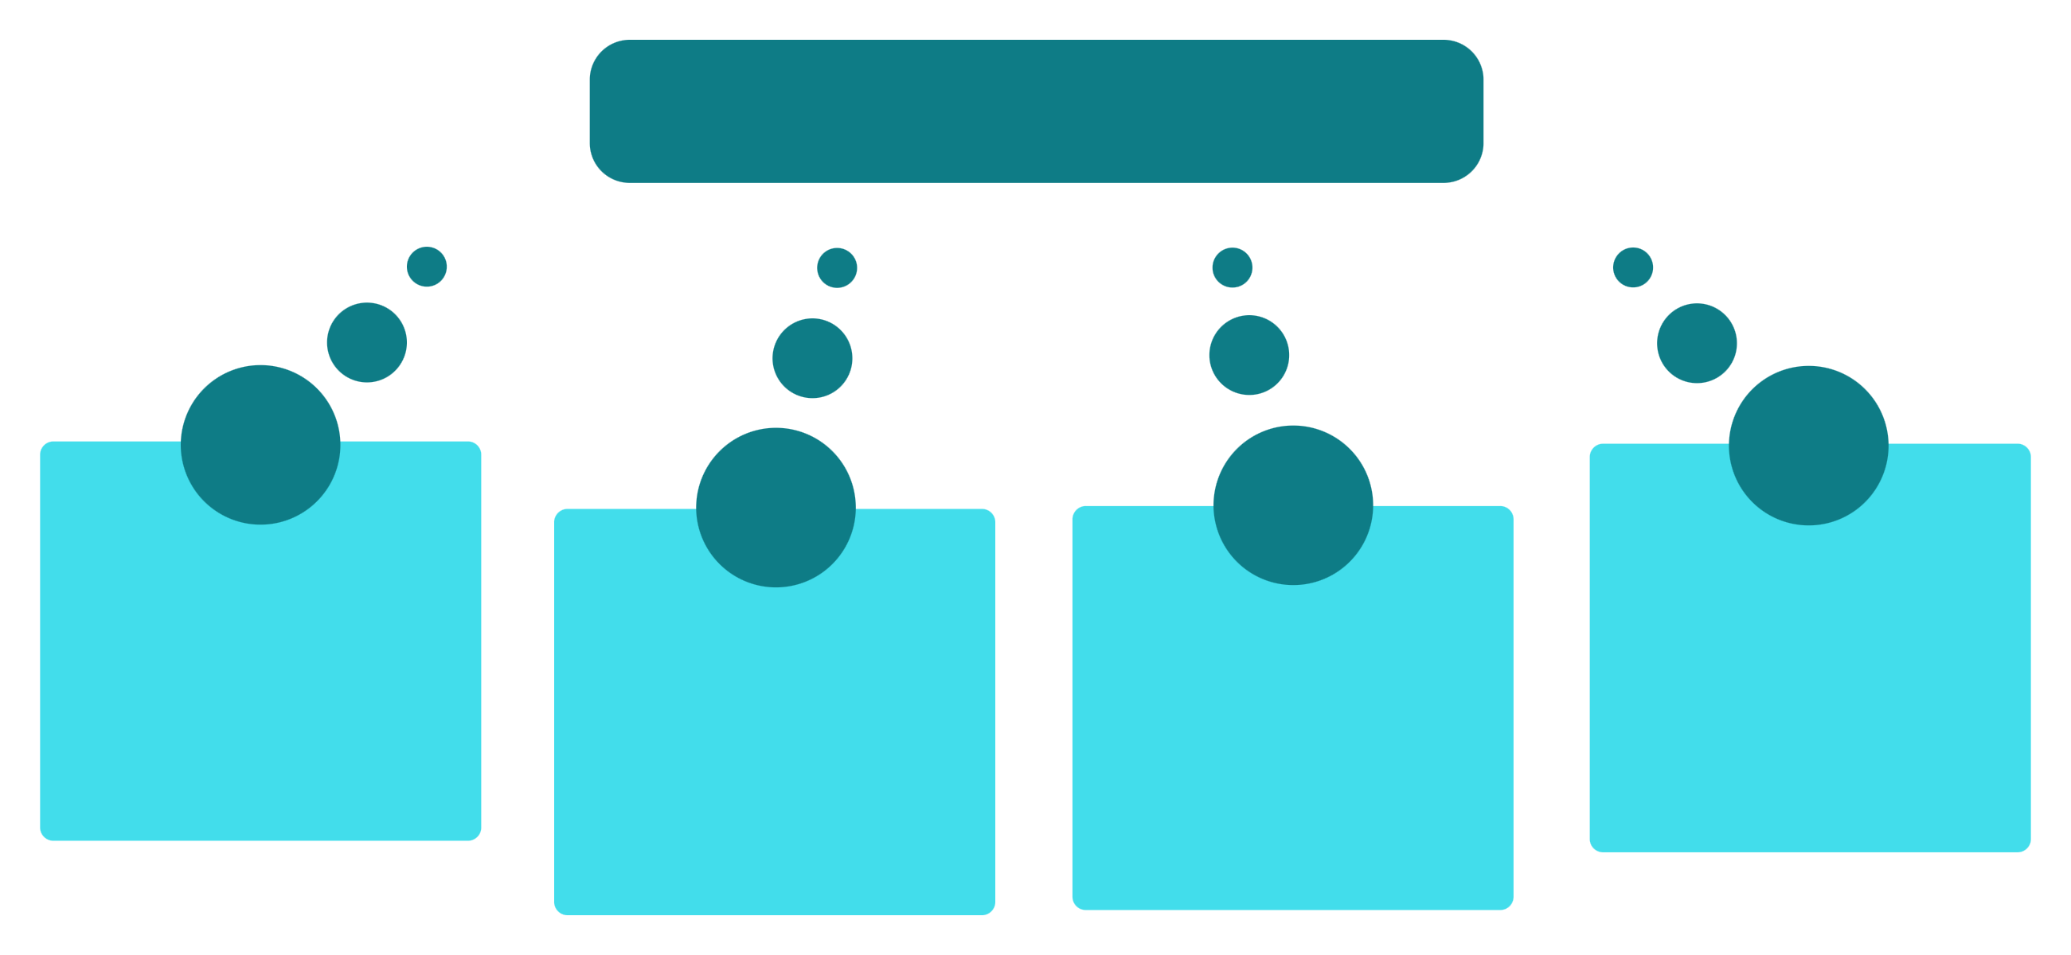




THE OPPORTUNITY
3,900 purchases reveal five decisions worth making
3,900 purchases, 18 columns
Spend Analysis
Subscriptions
02
Product Preference
Discount Behaviour
Identify high-value customers
Recurring revenue signals
Top SKUs and segments
Response to promotions

Slide 3

FOUNDATION
The analysis starts with a clean, usable foundation
Prepare
Loaded and explored in Python with pandas.
Impute
37 Review Rating values imputed with the median rating for each product category.
Standardize and remove redundancy
Standardized column names; created age_group and purchase_frequency_days; removed redundant promo_code_used after checking it against discount_applied.
03

Slide 4
FIVE COMMERCIAL LENSES
One dataset supports five commercial lenses
Who spends: compare revenue by gender and age group
What wins: find top-rated products and the top three products in each category
What converts: compare subscribers, non-subscribers, and repeat buyers
What costs margin: isolate high-spending discount users and discount-dependent products
What customers value: compare standard and express shipping purchase amounts
04

Slide 5
REVENUE → TARGETING
Revenue analysis should end in a targeting decision
Revenue by gender
Shipping type
Compare total revenue contribution across customer groups.
Compare average purchase amounts for Standard versus Express customers.
Use the strongest revenue signals to focus campaigns, offers, and service design.
Revenue by age group
Identify the segments contributing the most revenue.
05

Slide 6
RETENTION
Loyalty and subscriptions are linked questions
Classify
Test
Use purchase history to classify shoppers as New, Returning, or Loyal.
Test whether customers with more than five purchases are more likely to subscribe.
The commercial question is how to move more shoppers from repeat behaviour into durable loyalty.
Compare
Compare average spend and total revenue for subscribers versus non-subscribers.
06

Slide 7
PRODUCT SIGNALS
Product signals combine preference, quality, and price sensitivity
Preference: Rank the top three most purchased products within each category.
Quality: Identify the five products with the highest average review ratings.
Price sensitivity: Identify five products with the highest percentage of discounted purchases.
High-value behaviour: Isolate customers who used discounts but still spent above the average purchase amount.
07

Slide 8

POWER BI
The dashboard turns analysis into a decision surface
Present the cleaned data and business analysis visually in an interactive dashboard.
Lead with the decision.
Let stakeholders move from an overall view into customer, product, discount, subscription, and revenue questions—then show the segment or product evidence behind it.
08

Slide 9
FROM ANALYSIS TO ACTION
Five actions follow directly from the analysis
Boost subscriptions: Promote exclusive benefits for subscribers.
Build loyalty: Reward repeat buyers and move them into the Loyal segment.
Review discounts: Balance sales lift with margin control.
Position products: Feature top-rated and best-selling products in campaigns.
Target smarter: Focus on high-revenue age groups and Express-shipping users.
09

Slide 10

A REPEATABLE COMMERCIAL LOOP
Turn the findings into a repeatable commercial loop
Prioritize
Activate
Measure
Select the strongest segments, products, and subscription opportunities from the dashboard.
Pair loyalty benefits, product campaigns, and discount rules to those opportunities.
Revisit revenue, ratings, purchase frequency, discount dependence, and subscription behaviour as the next decision cycle begins.
The analysis is most valuable when it becomes a recurring way to decide, not a one-time report.
10

