Slide 1

COURSE RECOMMENDER SYSTEM (PERSONALIZED LEARNING EXPERIENCE)
TEAM MEMBERS
Sachchida Nand Tiwari (M23CSA527)
Balakrishna Kariveda (M23CSA511)
Ritesh Lamba (M23CSA544)

Slide 2
Introduction
What is a Course Recommender System?
The Course Recommendation System is designed to recommend educational courses to users based on their preferences and interaction history. The backend is built with Django and handles data management, API exposure, and recommendation logic, while the frontend is developed in React to provide a dynamic and responsive user interface.
Records various types of interactions between users and courses to inform and optimize the recommendation algorithms.
Stores personalized recommendations generated for each user, ensuring that users can view a history of their recommendations.
Manages the display and administration of course listings. It allows for the creation of new courses and lists all available courses in the system.

Slide 3

Backend Development Setup and Configuration Dependencies: Django, Django REST Framework, SQLite
Frontend Development Environment Setup Setting up the development environment for the frontend involves installing Node.js, setting up React, and configuring additional necessary libraries and tools.
Deployment:
Server Configuration Deploying the Course Recommendation System involves setting up a server environment that can robustly support both the Django backend and the React frontend.
The details on configuring the server:
Operating System: Ubuntu 20.04 LTS or any compatible Linux distribution.
Web Server: Nginx is recommended for serving the static files of the React application and as a reverse proxy for the Django application.
Application Server: Gunicorn (a Python WSGI HTTP server) for running the Django application.
Database: SQLite/PostgreSQL for data management. Ensure that the database is configured with adequate user permissions and secured access.
Python Environment: Use virtual environments (created via virtualenv) for Python dependency management. Install all Python dependencies specified in the requirements.txt file.
Node.js Environment: ○ Use Node.js to manage and build the React application. ○ Ensure all node packages are installed using npm install or yarn.
Containerization: Dockers

Slide 4
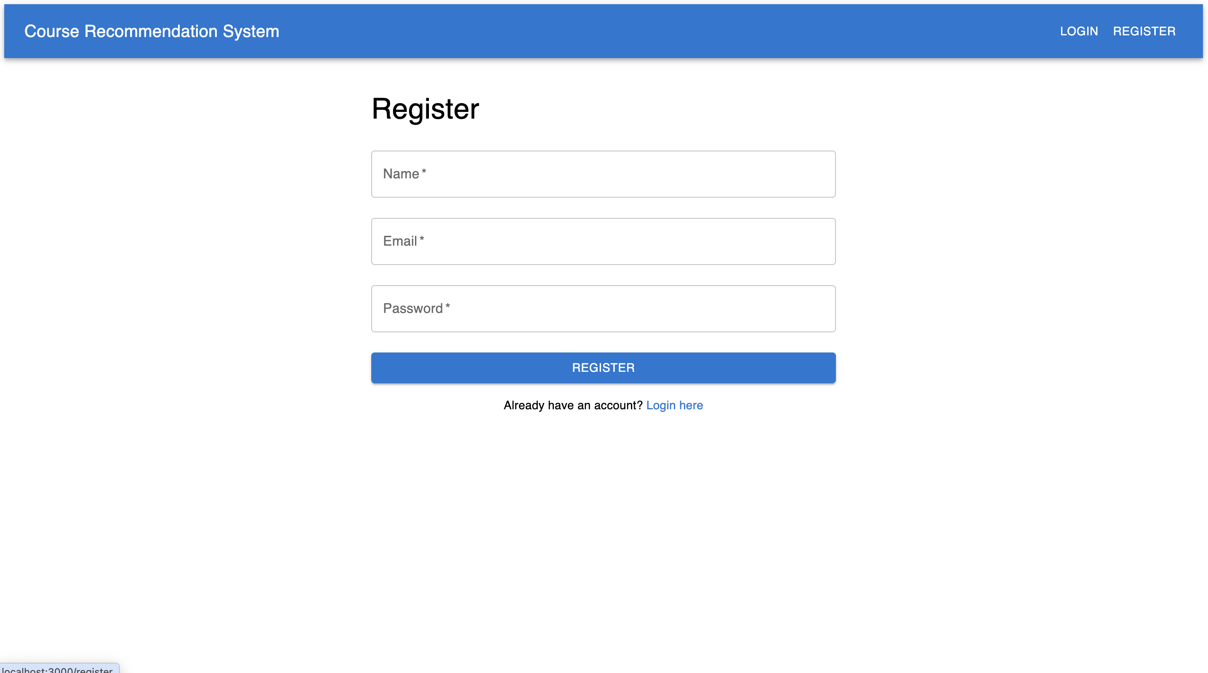
CRS Sample screens

Slide 5
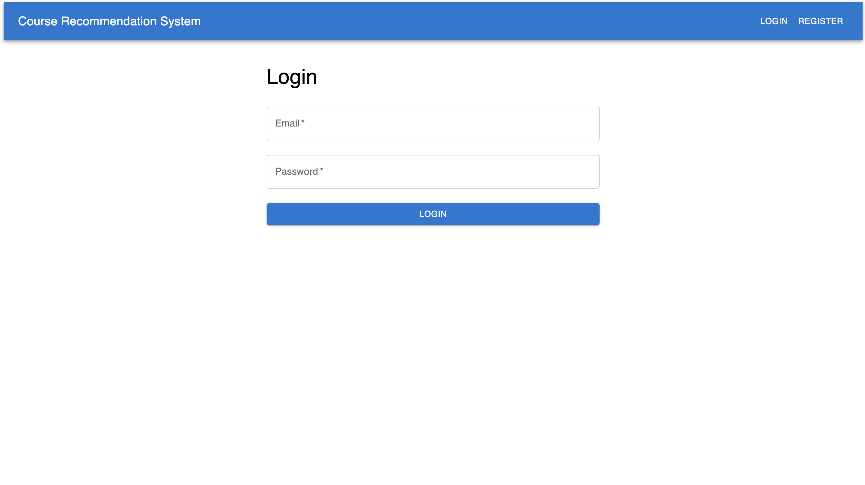

Slide 6
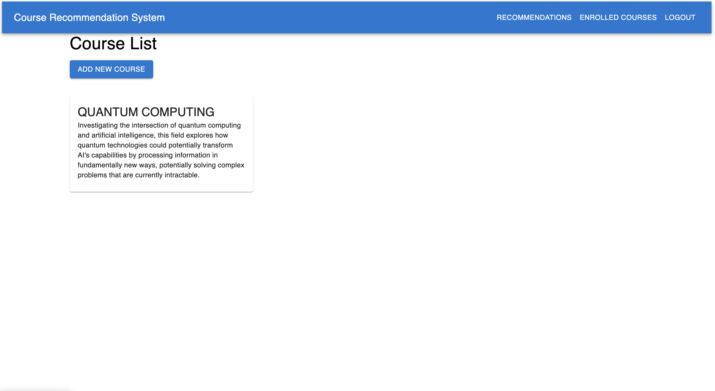

Slide 7
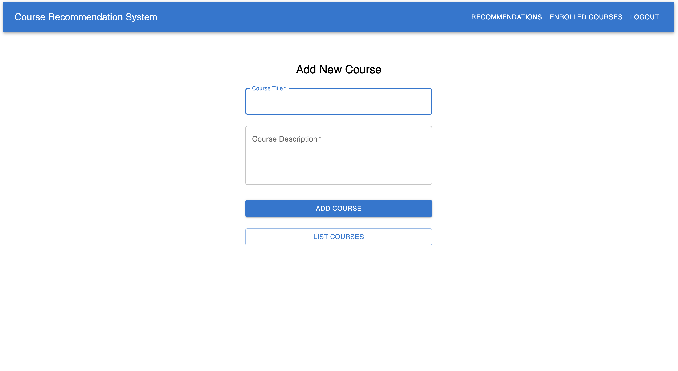

Slide 8
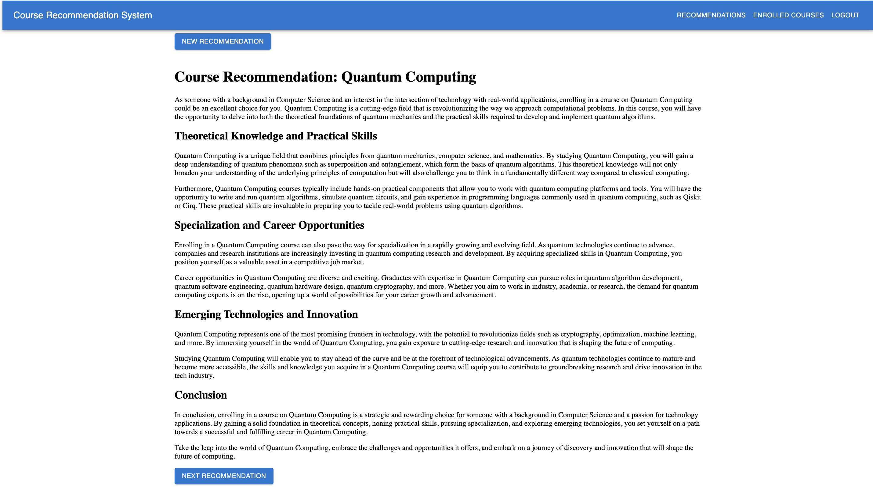

Slide 9
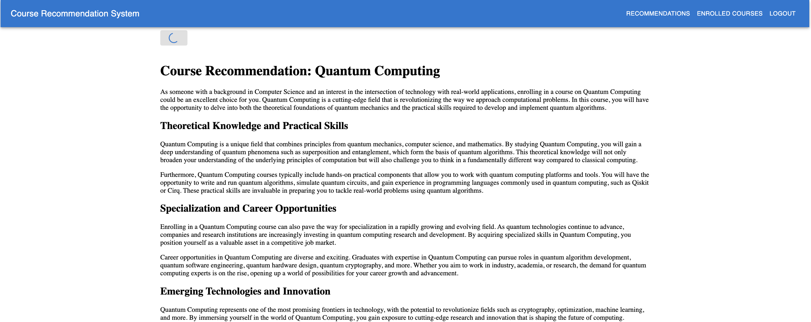

Slide 10
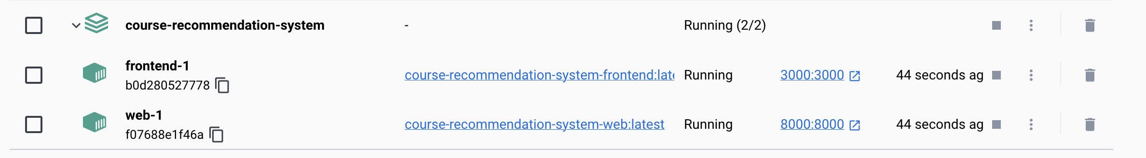

Slide 11

ARCHITECTURAL DESIGN PATTERNS USED:
1. Model-View-Controller (MVC):
- Model: Django models handle the data and business logic (e.g., `UserCourseInteraction`).
- View: Django views manage the API endpoints.
- Controller: React components serve as the controller that responds to user input and updates the view.
2. Microservices:
- While not fully implemented, the architecture can evolve into a microservices approach where different functionalities (e.g., user management, recommendation engine) are separated into independent services.
3. Client-Server Architecture:
- The clear separation between client (React) and server (Django) allows for easier scaling and deployment of each component.

Slide 12

RECOMMENDATIONS FOR IMPROVEMENTS:
1. Database Transition:
- Switch to a more scalable database (like PostgreSQL or MySQL) as user load increases to handle larger datasets and complex queries efficiently.
2. Caching Mechanisms:
- Implement caching strategies (e.g., Redis) to store frequently accessed data, reducing load times and database hits, especially for popular course recommendations.
3. Advanced Recommendation Algorithms:
- Integrate machine learning techniques for more sophisticated recommendation systems (e.g., collaborative filtering or content-based filtering) to enhance user experience.

Slide 13
RECOMMENDATIONS FOR IMPROVEMENTS:
4. Enhanced User Analytics:
- Develop a comprehensive analytics dashboard to track user interactions and engagement metrics, helping to refine recommendation algorithms.
5. Security Enhancements:
- Implement additional security measures (e.g., OAuth for authentication) to ensure user data protection and privacy.
6. Testing and Monitoring:
- Set up automated testing and monitoring tools (e.g., Jest for React, pytest for Django) to ensure system reliability and catch bugs early in the development cycle.

Slide 14
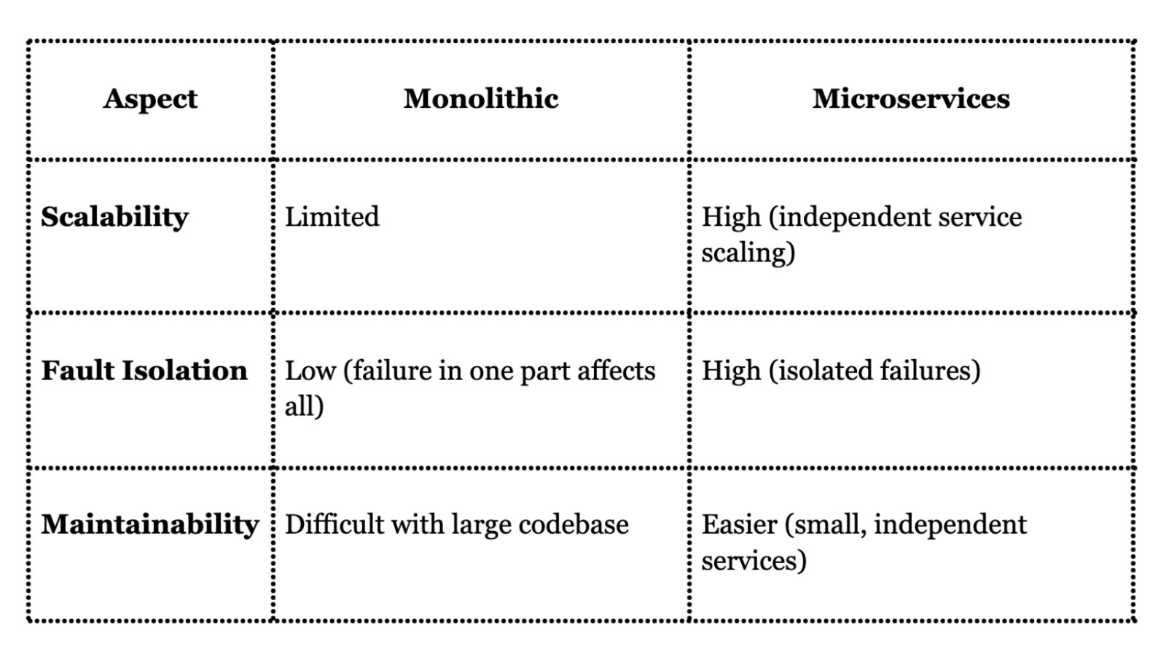
MONOLITHIC V/S MICROSERVICES

Slide 15
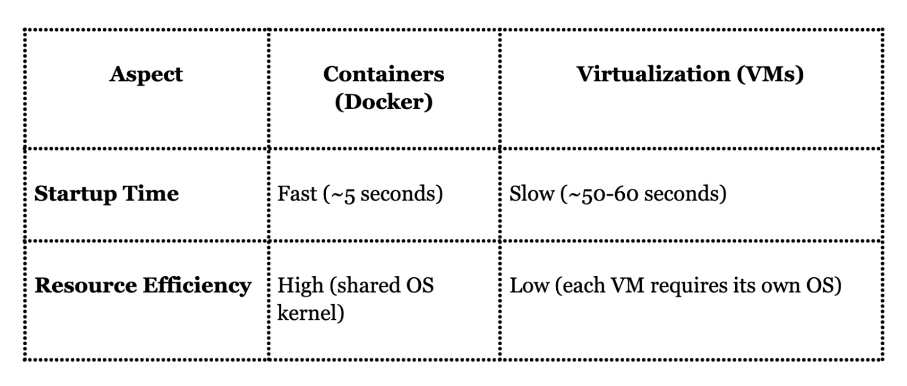
CONTAINERS V/S VIRTUAL MACHINE

Slide 16
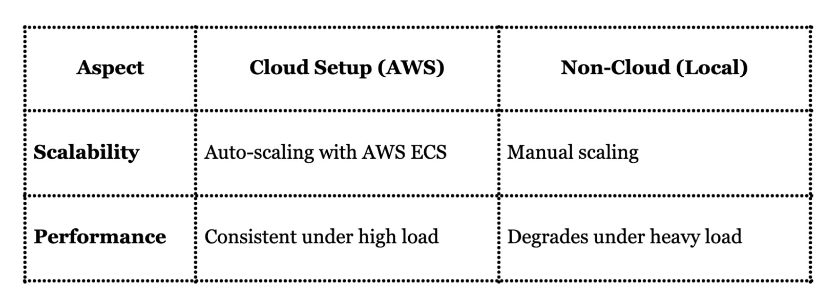
LOCAL V/S CLOUD

Slide 17

CONCLUSION

