Slide 1
Course Recommendation System
Team Members
Sachchida Nand Tiwari (M23CSA527)
Balakrishna Kariveda (M23CSA511)
Ritesh Lamba (M23CSA544)

Slide 2
Course Recommender System
Designed to recommend courses based on user preferences and course history.
Backend:
Built with Django.
Handles data management, API exposure, and recommendation logic.
Frontend:
Developed with React.
Provides a dynamic and responsive user interface.
Deployment:
Deployed using Docker.

Slide 3
Deployment Decisions
Initially, the system used a monolithic architecture where backend components (backend, database) resided in a single codebase.
The system, using SQLite, supported around 50 concurrent users before performance degradation.
PostgreSQL was deployed as a microservice, allowing for independent scaling and isolated failures. The system’s components (user management, recommendation engine, course management) were separated into distinct services.

Slide 4
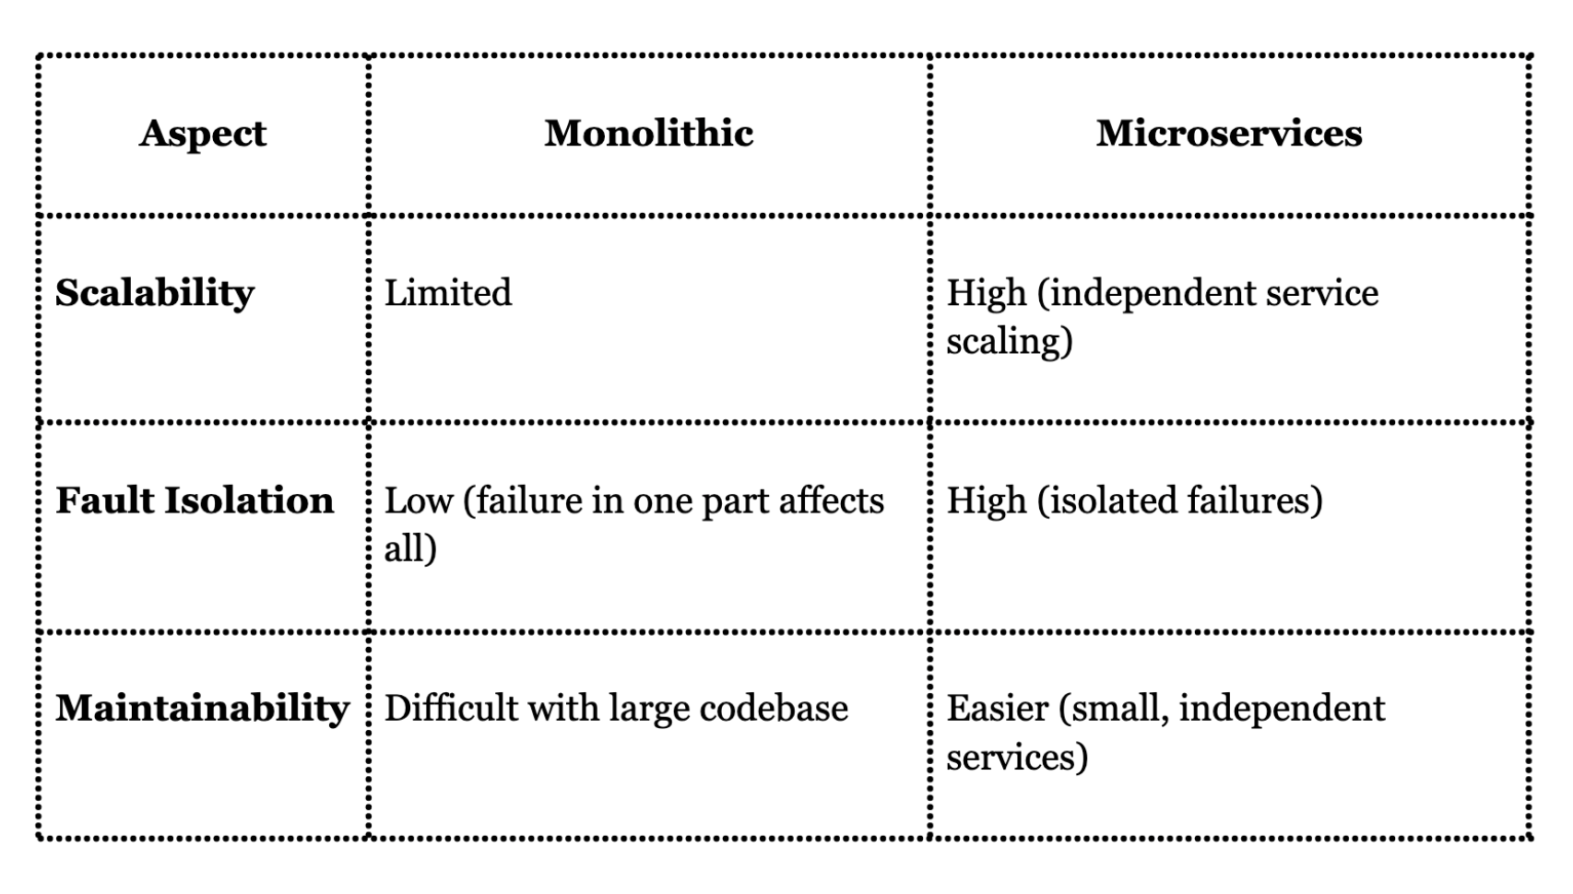
Monolithic vs. Microservices

Slide 5
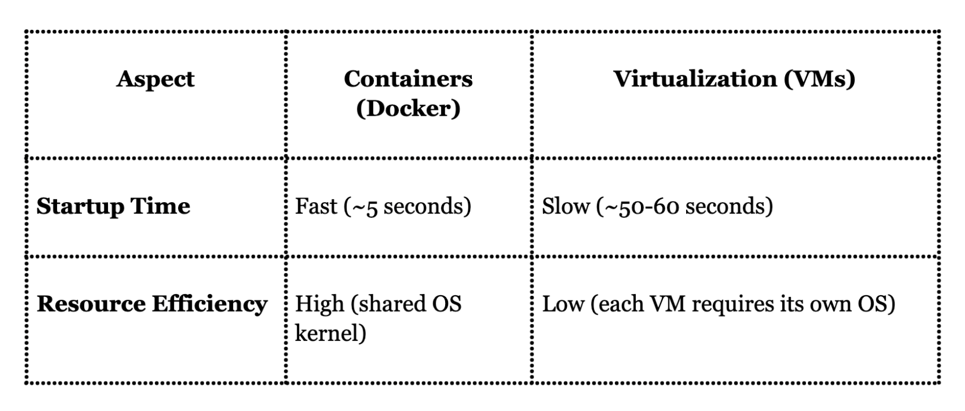
Containerization vs. Virtualization

Slide 6
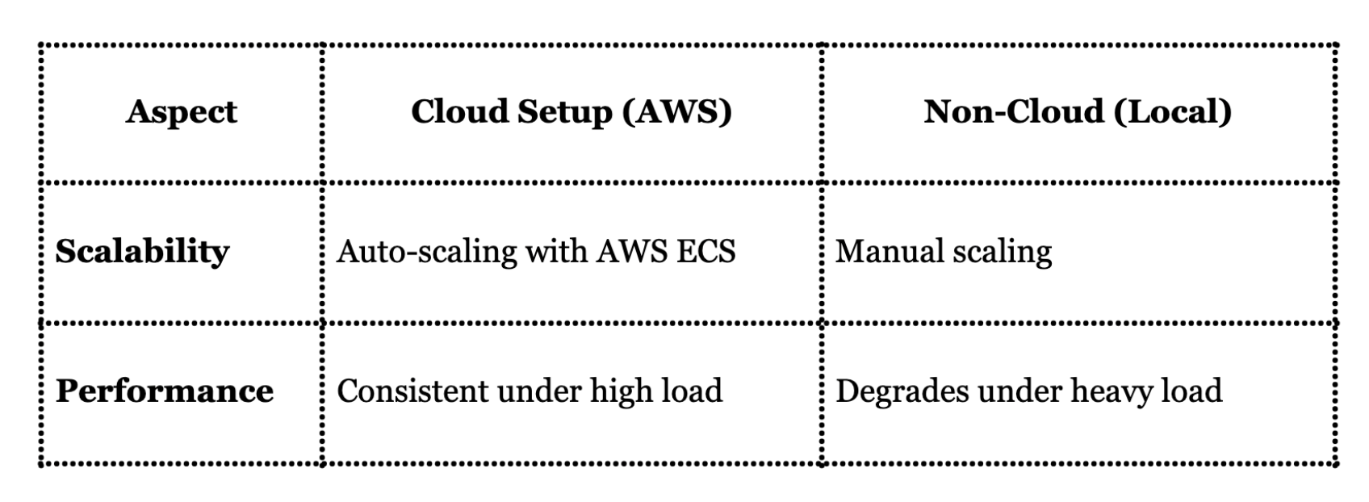
Cloud vs. Non-Cloud Setup

Slide 7
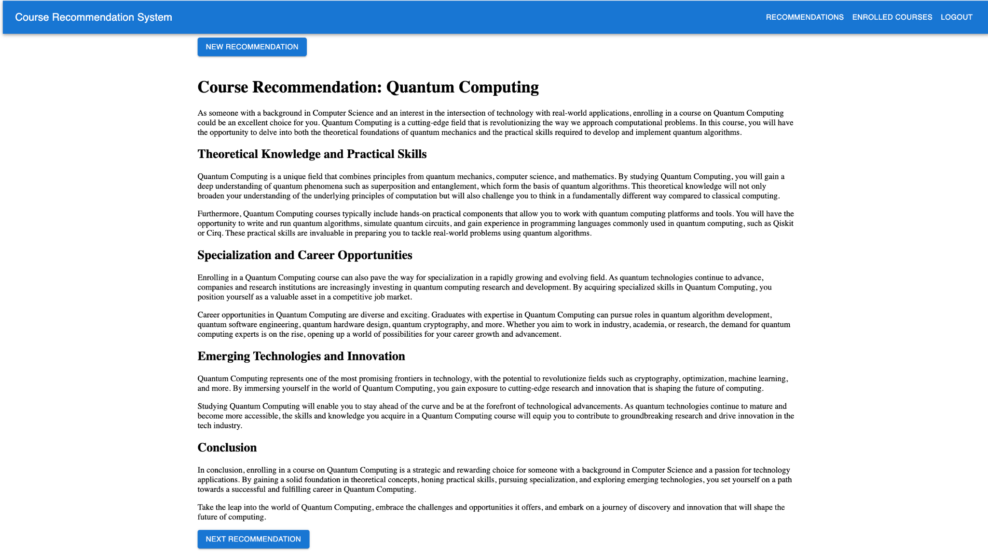
Course Recommendations
Course suggestions based on user preferences and Course history. It displays a curated list of recommended courses, allowing users to explore options tailored to their academic and career goals.

Slide 8
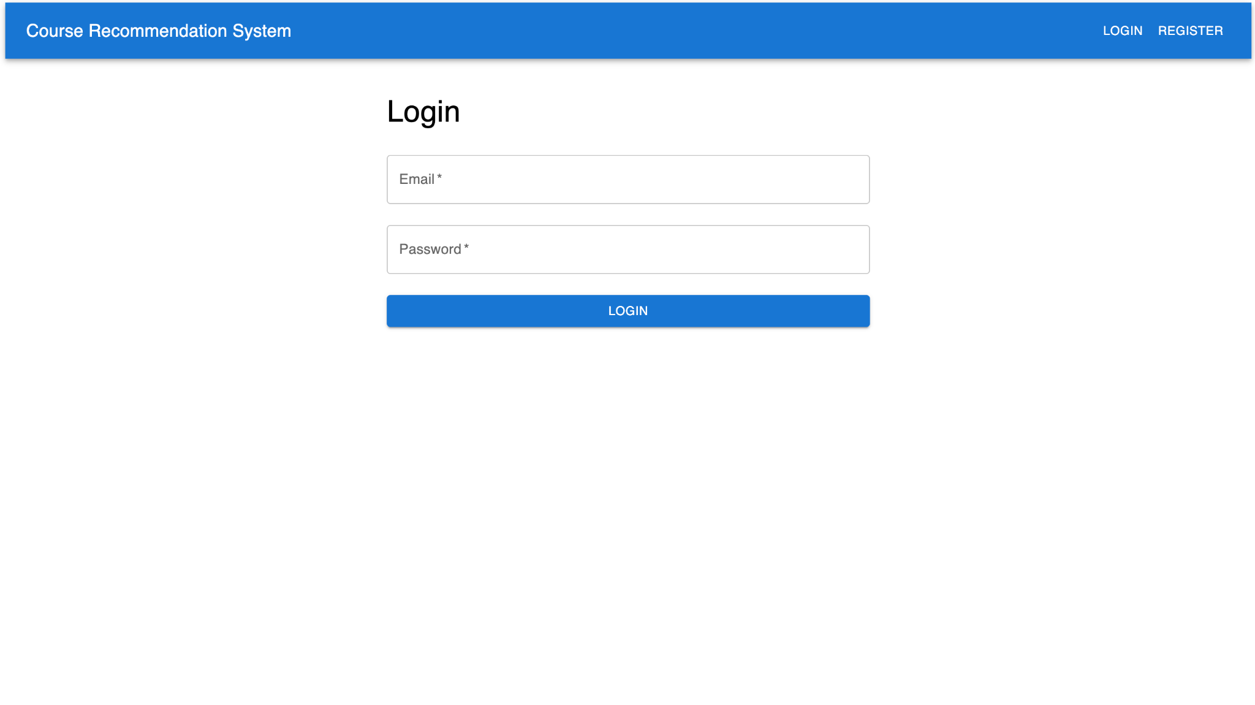
Login Page
Provides a simple interface for users to log in to the system using their email and password. Registered users can access personalized recommendations.

Slide 9
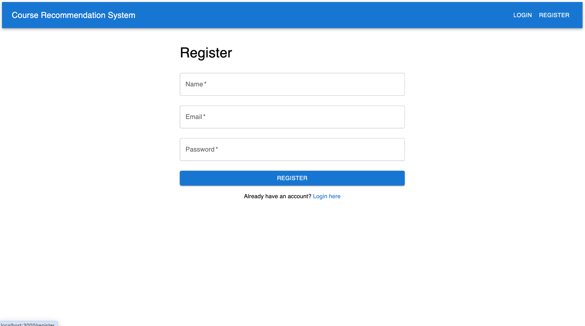
Register
Enables new users to create an account by entering their name, email, and password. The page simplifies the registration process and includes a link for existing users to log in.

Slide 10
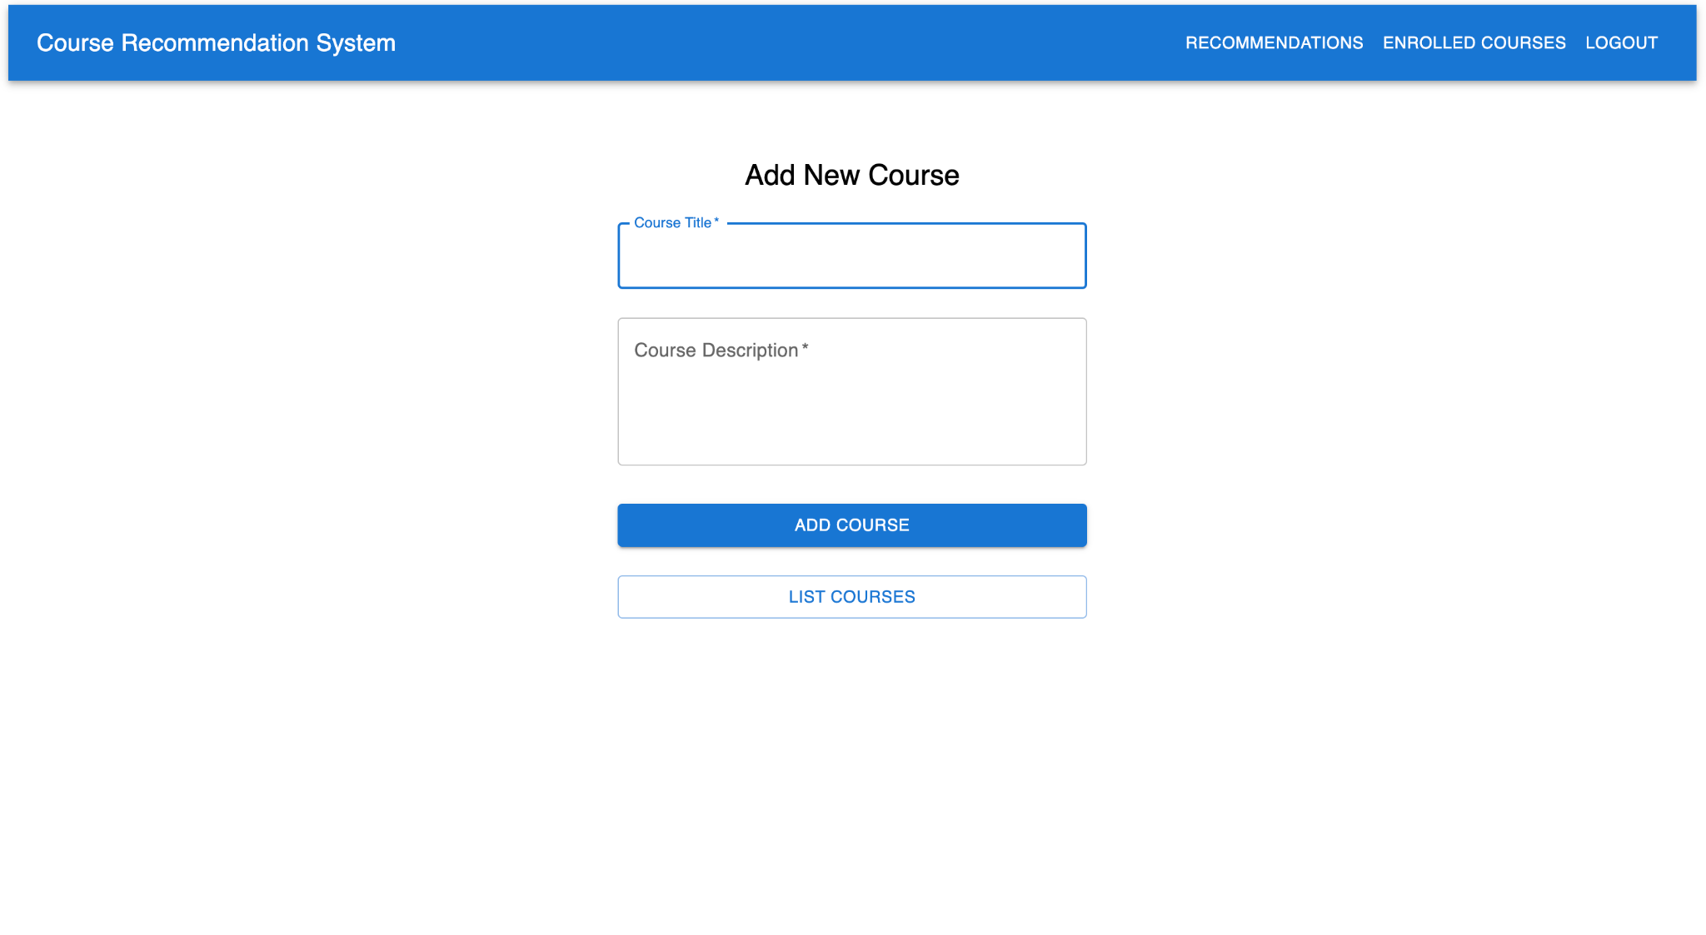
Add Running Courses
Add new courses to the system by entering a course title and description. The page also includes a button to list all existing courses. User will get recommendations as per their running courses

Slide 11
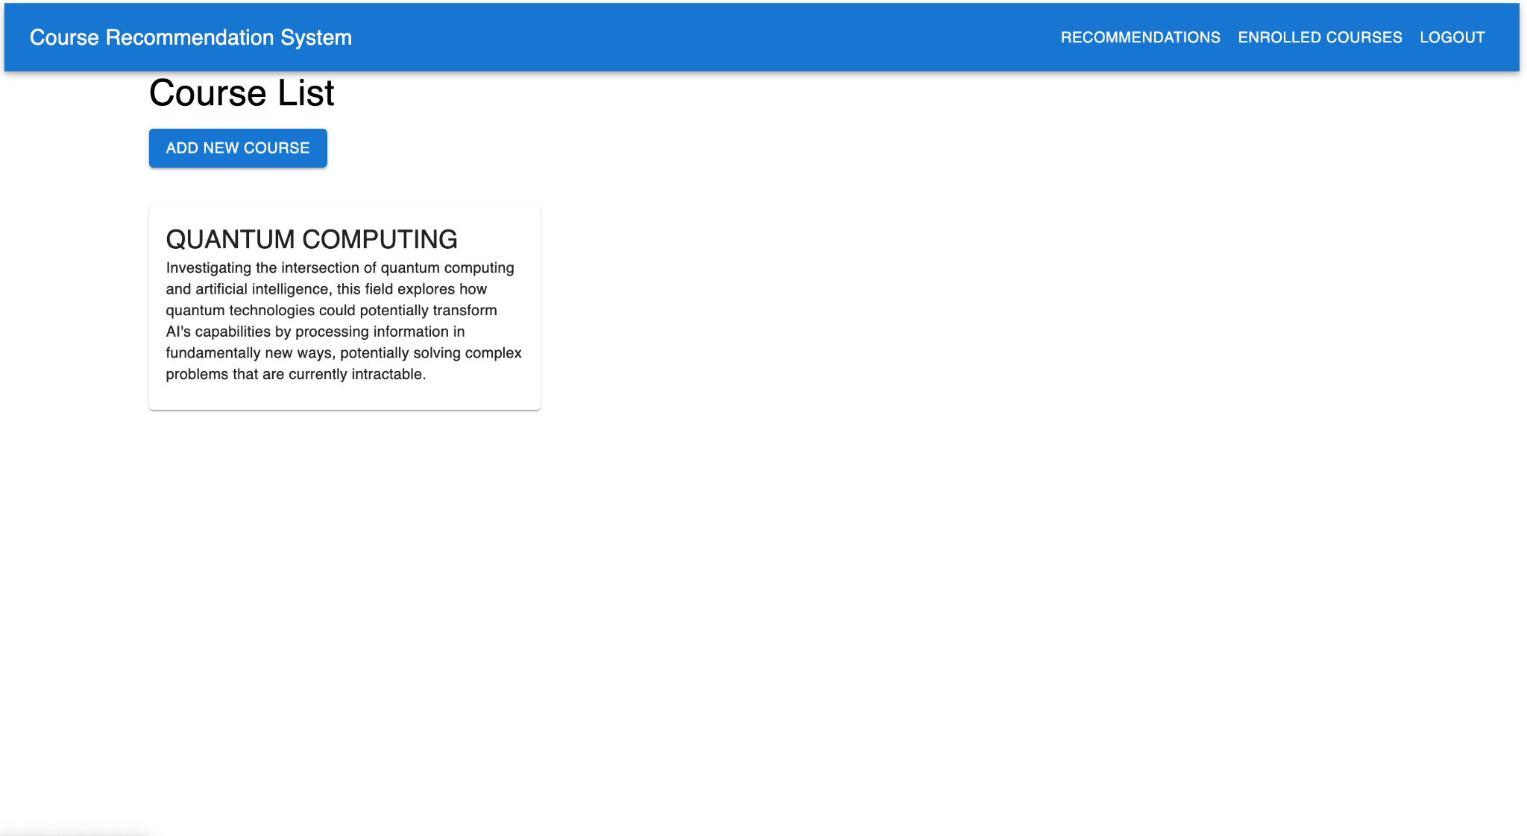
Course List
Displays all available courses. The "Add New Course" button allows users to add current courses. Each course card contains a brief description to help users understand the course content.

Slide 12
Recommendations
Presents detailed course recommendations personalized for each user. It includes sections highlighting theoretical knowledge, career opportunities, and emerging technologies for the suggested course.

Slide 13
New Recommendations
You can generate new recommendations by clicking on ‘New Recommendation’ and view the next recommendation by clicking on ‘Next Recommendation’.

Slide 14




Scalable CRS with React, Django, PostgreSQL, and Docker
built using React for the frontend to create a dynamic and responsive user interface, while Django serves as the backend, handling data management and API logic. PostgreSQL is used as the database to store user data, course information, and recommendations. The entire application is containerized with Docker, ensuring easy deployment and scalability across different environments.

Slide 15
Thank You

