Slide 1
Implementation of Docker and DevOps Principles in Django-React Web Project
Reference Paper - https://ieeexplore.ieee.org/document/10117715
Team Members
Sachchida Nand Tiwari (M23CSA527)
Balakrishna Kariveda (M23CSA511)
Ritesh Lamba (M23CSA544)

Slide 2
Introduction
Implements principles from the IEEE paper on Docker and DevOps.
Focus: Scalable and maintainable deployment for a Django-React web app.
Tools: Docker, Kubernetes, Prometheus/Grafana.

Slide 3
System Overview
Backend: Django + PostgreSQL.
Frontend: React.
Containerization: Docker for all components.
Orchestration: Kubernetes for scalability and high availability.

Slide 4
Alignment with Paper
Aspect | Paper Recommendations | Our Implementation
Containerization | Use Docker | Docker for Django, React, PostgreSQL
Microservices | Modularize services | Separate containers

Slide 5
Alignment with Paper
Aspect | Paper Recommendations | Our Implementation
Orchestration | Use Kubernetes for cluster management | Kubernetes for scalability
High Availability | Redundancy, self-healing | Kubernetes manages failovers

Slide 6
Key Features
Containerized Deployment:
Django, React, PostgreSQL in isolated Docker environments.
Kubernetes Orchestration:
Ensures availability and resource optimization.
Load Balancing:
Kubernetes ingress for routing and load handling.

Slide 7
Benefits Achieved
Scalability: Adjusts to workload changes dynamically.
Reliability: Redundancy and Kubernetes self-healing.
Efficiency: Optimized resource usage.
Observability: Actionable insights via monitoring tools.

Slide 8
Kubernetes Configurations Overview
File | Purpose
namespace.yaml | Isolates CRS resources.
django-config.yaml | Configures Django settings.
django-deployment.yaml | Deploys Django backend.
postgres-pv.yaml | Defines PostgreSQL storage.
ingress.yaml | Routes frontend/backend traffic.

Slide 9
Django Configuration
django-config.yaml: ConfigMap for environment variables.
django-secret.yaml: Secret for database credentials.
django-deployment.yaml: Deploys backend container on port 8000.

Slide 10
PostgreSQL Configuration
postgres-pv.yaml: PersistentVolume for database storage.
postgres-secret.yaml: Secret for PostgreSQL credentials.
postgres-deployment.yaml: Deploys PostgreSQL container on port 5432.

Slide 11
React Configuration
react-deployment.yaml: Deploys frontend container.
react-service.yaml: Exposes React app on port 3000.
ingress.yaml: Manages traffic routing for React and Django.

Slide 12
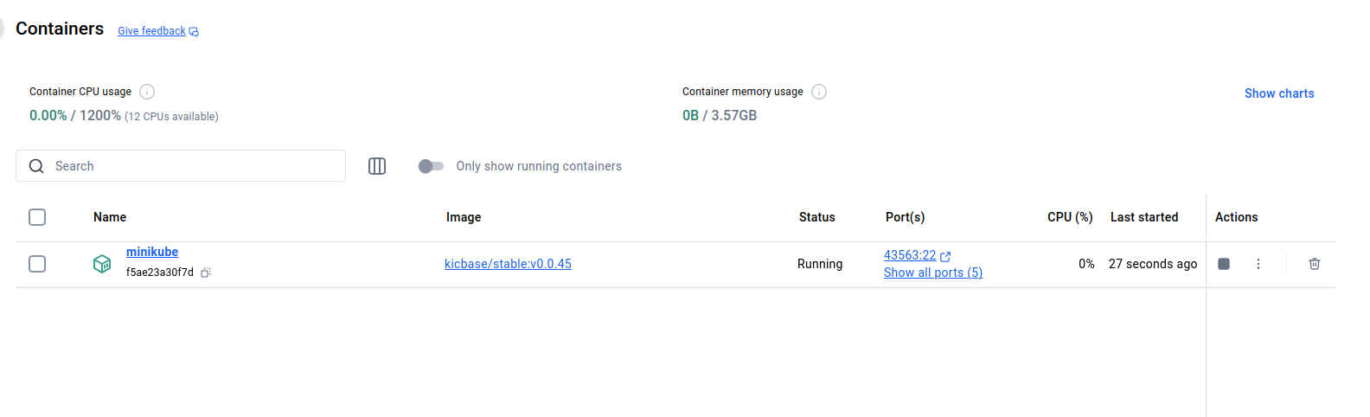
Screenshots- Containers

Slide 13
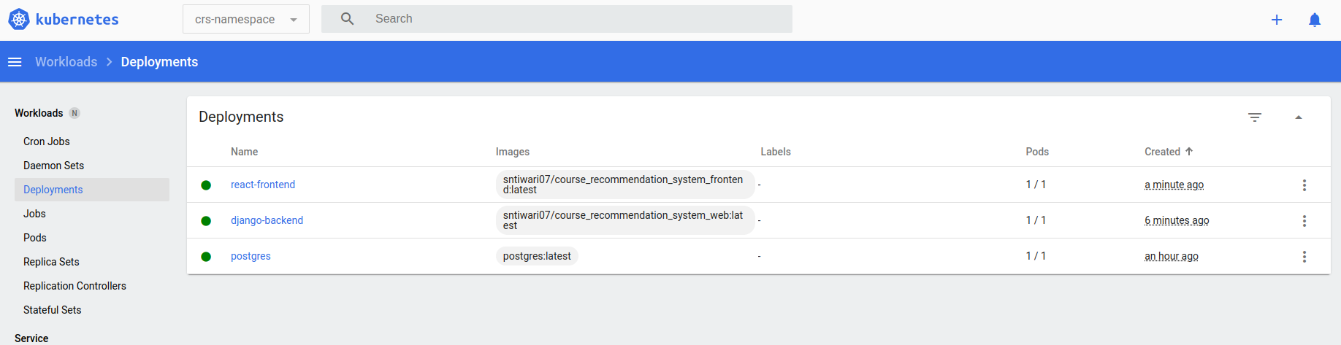
Screenshots- Deployments

Slide 14
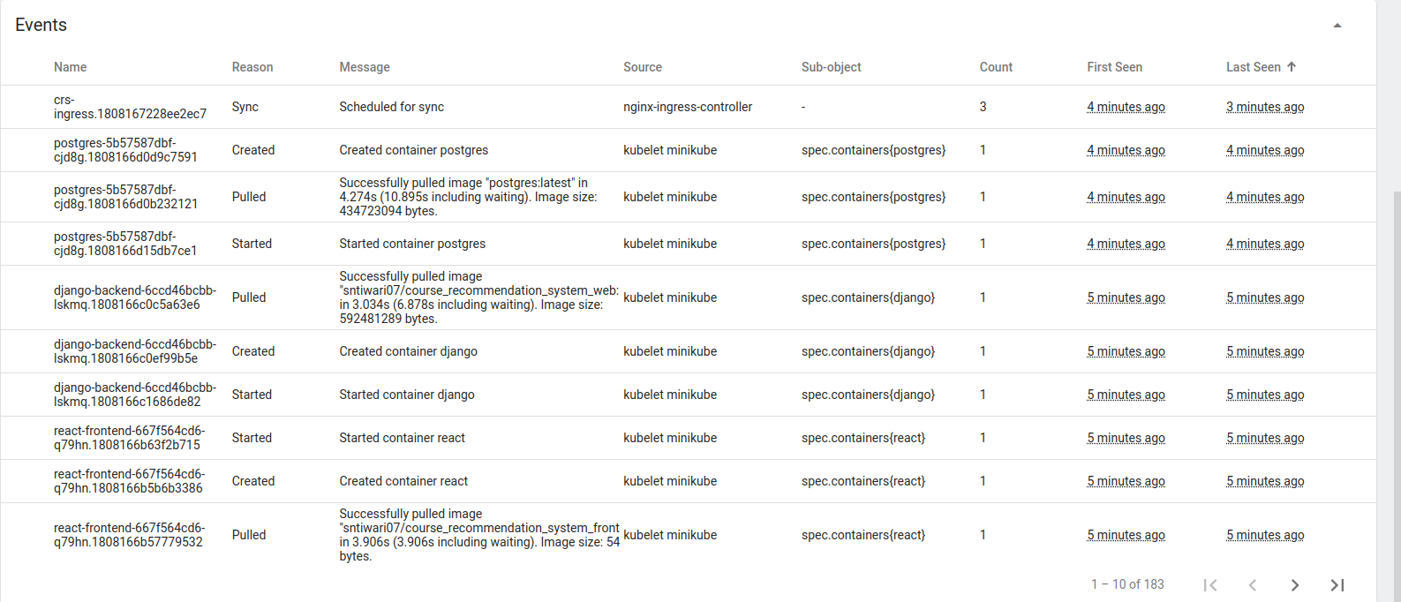
Screenshots- Events

Slide 15
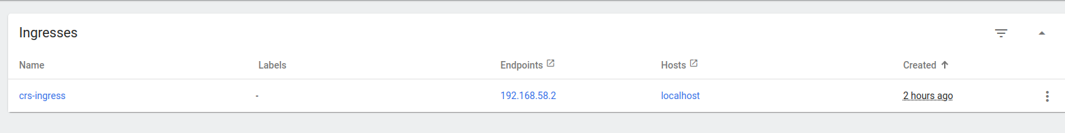
Screenshots- Ingresses

Slide 16
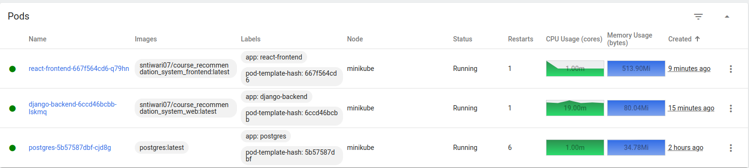
Screenshots- Pods

Slide 17
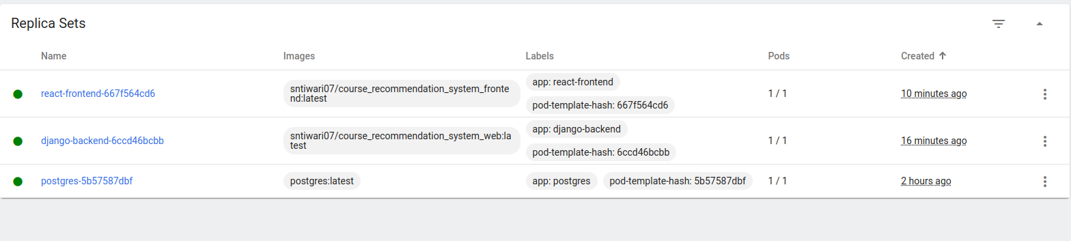
Screenshots- Replica Sets

Slide 18
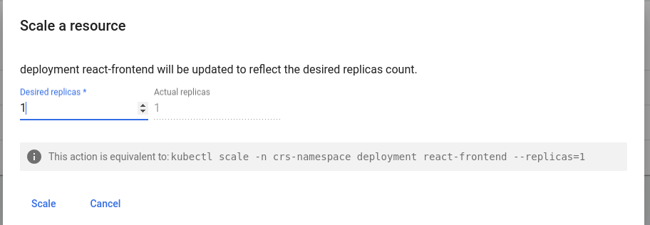
Screenshots - Scale

Slide 19
Conclusion
Integrated Docker, Kubernetes, and DevOps principles.
Achieved a scalable, efficient, and maintainable architecture.
Monitoring ensures proactive issue resolution.

Slide 20
Thank You!

