Slide 1

ANALYZING AMAZON SALES DATA

Slide 2
Introduction
Amazon, founded by Jeff Bezos in 1994, has grown from an online bookstore into one of the world's largest e-commerce and technology companies, offering a vast range of products and services.
Its innovative strategies, such as Prime membership and AWS cloud computing, have revolutionized industries and reshaped consumer expectations worldwide.

Slide 3
Main KPIs
H – High
C – Critical
L – Low
M - Medium

Slide 4
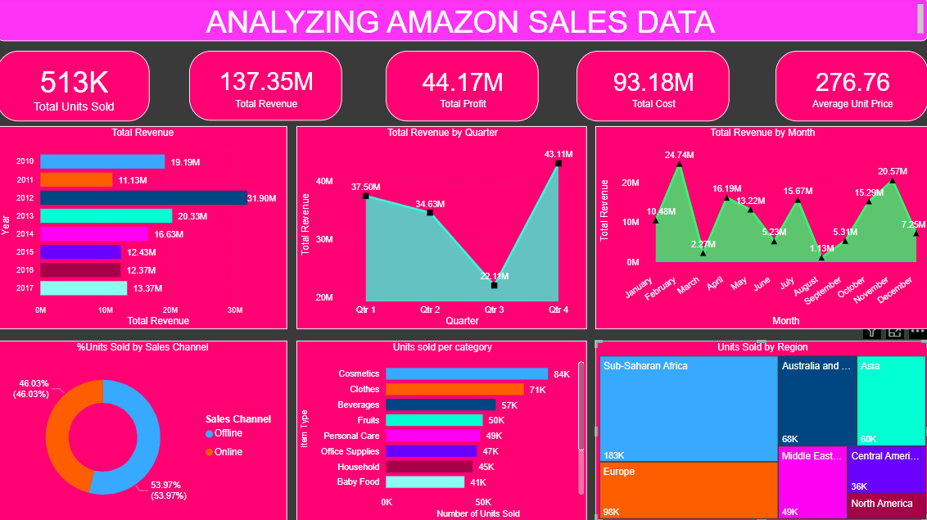
My Design

Slide 5
Outcome
Most orders were delivered in 2012, indicating a potential peak year for sales.
Quarter 4 accounted for the highest sales in Sub-Saharan Africa, totaling 183k orders.
Cosmetics emerged as the top-selling category, with offline sales at 53.97% and online sales at 47.07%.

Slide 6
Thank you

