Slide 1

Ecommerce Data Analysis
Project by:- Ritesh Singh
SQL Case study

Slide 2

CONTENT
DATASET
OBJECTIVES
INSIGHTS
DATA ANALYSIS USING SQL

Slide 3
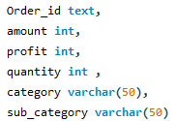


DATASET The dataset contains three Tables
The first table namely List-Of-Orders consists of Orders List along with the zone and category they fall into (5 columns).
The Second table namely Order-Details consists of all order details along with the delivery timings and customer Name(6 columns).
The Third table namely Target consists of Given Monthly Target (3 columns).

Slide 4
Here are the topics analyzed in the case study:
Top 3 customers by profit .
Rank customers by total sales.
Purchase Date of Each Customer
Categorize orders based on their profit.
Sales ,and Monthly Sales per Category .
Category-wise average sales, orders, and rating.
Get orders placed by customers from certain cities, and not from certain cities .

Slide 5

OBJECTIVES
01.
Analyze the orders and sales on the basis of zone, category
02.
Publish the findings based on the analysis.
CATEGORY WISE AVERAGE SALES, ORDERS AND RATING

Slide 6
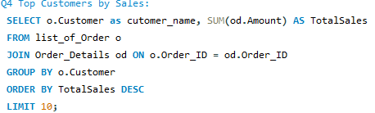
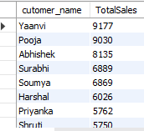
Output

