Slide 1
Project 2: A P2P Chat Application
Review
Ananth Rao

Slide 2
Overview
In this project, you will build a Peer-to-Peer chat application
  Good News: Only one program need to be written
  Bad News: The single program is considerably more complex because it does the job of both the client and the server, and it uses UDP
Feel free to interrupt with questions

Slide 3
Overlay Networks
Network
  defines addressing, routing, and service model for communication between hosts
Overlay network
  A network built on top of one or more existing networks
  adds an additional layer of indirection/virtualization
  changes properties in one or more areas of underlying network

Slide 4
P2P Networking
Each participant (user of the chat application in this case) is a “peer” and plays an identical role in the system
Users co-operatively build the service without relying on a third party to run a server
  Instead of the “control” being centralized at a server, it is distributed amongst all the users
  The users must trust each other at some level to be able to do this
Examples: Gnutella, FastTrack, Chord, CAN

Slide 5
Other key differences from Project 1
No “multicast” of messages
Have to use UDP sockets
  You must learn how to program with UDP sockets
  You must implement timers and retransmission of lost packets
Must be able to recover from failure
  Program is “killed” by a signal
  Network cable is disconnected

Slide 6
Programming with UDP Sockets (Create a Socket)
int udpSock = socket(AF_INET, SOCK_DGRAM, 0);
if(udpSock < 0)
perror(“Call to socket failed”);
UDP sockets a symmetric (no distinction between a server socket and a client socket)
You must SOCK_DGRAM instead of SOCK_STREAM
You cannot use “connect” on a datagram (UDP) socket
“udpSock” is the file descriptor
There is no single destination associated with a UDP socket, so each “peer” uses only one UDP socket

Slide 7
Bind Socket to a Port
sockaddr_in localAddr;
bzero(&localAddr, sizeof(localAddr))
localAddr.sin_family = AF_INET;
localAddr.sin_port = htons(localPort);
localAddr.sin_addr.s_addr = INADDR_ANY;
int retVal = bind(udpSock, (sockaddr*)&localAddr, sizeof(localAddr));
// check retVal for errors
Similar to “bind” used for a server TCP socket
The localPort to be used is given through the command line for each chatpeer

Slide 8
Send Packets
sockaddr_in toSockAddr;
bzero(&toSockAddr, sizeof(toSockAddr));
toSockAddr.sin_family = AF_INET;
toSockAddr.sin_addr.s_addr = toAddr;
toSockAddr.sin_port = htons(toPort);
int retVal = sendto(udpSock, packetBuf,
packetLen, 0,
(sockaddr*) toSockAddr, sizeof(toSockAddr));
// check retVal for errors
Each packet is individually addressed to a destination address and port
(retVal == packetLen) doesn’t guarantee anything at all

Slide 9
Receive Packets
sockaddr_in fromSockAddr;
bzero(&fromSockAddr, sizeof(fromSockAddr));
socklen_t fromLen = sizeof(fromSockAddr);
int retVal = recvfrom(udpSock, packetBuf, MAXBUFFERSIZE, 0,
(sockaddr*) &fromSockAddr, &fromLen);
Can receive a packet from any other chatpeer program on the same socket
The address of the sender is available in “fromSockAddr”

Slide 10
Programming with Timers
struct timeval currTime, mlpTimeout, ackDueTime;
gettimeofday(&currTime, NULL);
mlpTimeout.tv_sec = MLP_TIMEOUT/1000;
mlpTimeout.tv_usec = (MLP_TIMEOUT%1000)*1000;
timeradd(&currTime, &mlpTimeout, &ackDueTime);
“struct timeval” has two fields: “tv_sec” (seconds) and “tv_usec” (microseconds)
The macros “timeradd” and “timersub” are defined in “sys/time.h”
timercmp(&a, &b, CMP) may be used too, where CMP is a binary comparison operator (<,>,<=,>=,==)

Slide 11
Finding the address of the machine the program is running on
stuct utsname myName;
int retVal = uname(&myName);
// check retVal
struct hostent *localHost =
gethostbyname (myName.nodename);
// check localHost != NULL
myAddr =
(*(unsigned long *) localHost->h_addr_list[0]);
The local address is included in the header of some packets.

Slide 12
Using select with timeouts
To implement fine grained timers, you must find the earliest time at which the next event has to occur
struct timeVal nextEventTime = getNextTime();
struct timeVal currTime, waitTime;
gettimeofday(&currTime, NULL)
timersub(&nextEventTime, &currTime, &waitTime);
int retVal = select(maxFd+1, &readSet, NULL, NULL,
&waitTime);
“readSet” will contain “udpSock” and “stdin”

Slide 13
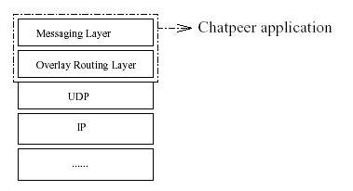
Structure of your Program (ORL and ML)
We think of the program as comprising two layers, the Messaging Layer and the Overlay Routing Layer

Slide 14
Why two layers?
Because it a natural way to think about the program
Because it is a good way to think about and organize your program
Because it is easier to write the specs this way
Hopefully, this project will help you understand layering concepts better
Not for standardization, multiplexing, demultiplexing or for other programs to use the ORL

Slide 15
ORL: High level description
Route a packet from end-to-end on the overlay
Maintain the topology of the overlay
Recover from failures of nodes on the overlay
Provide best-effort packet forwarding service

Slide 16
ML: High level description
Deal with user input and output
Use the services provided by the ORL to send packets to other users
Implement retransmissions and timeouts

Slide 17
Addressing in ORL (Hash function)
Addressing in the ORL is in terms of 32-bit identifier (similar to IP addresses)
Addressing in the ML is in terms of the userName (similar to FQDNs)
We use a simple hash function to map userNames to identifiers (as opposed to a mapping mechanism like DNS)

Slide 18
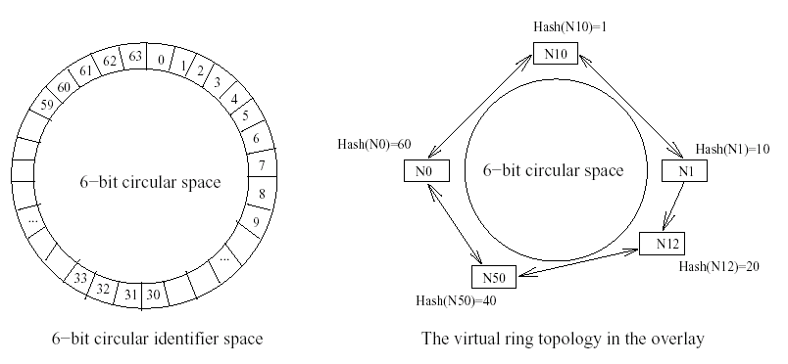
The Overlay Topology

Slide 19
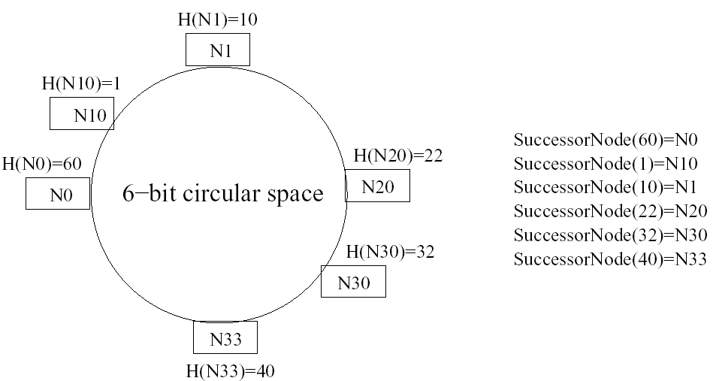
successorNode(x) explained

Slide 20
Packet Forwarding Algorithm
WrapBetween(l,h,x)
if (l < h)
return ((x > l) and (x < h))
else
return ((x > l) or (x < h))
Forward(packet, destinationId)
if ((destinationId = NodeId) OR WrapBetween(predecessorNode.NodeId, NodeId, destinationId))
stripORLHeader(packet)
HandleMLPPacket(packet)
else
send(packet, successorNode.address, successorNode.port)

Slide 21
ML Packet Types
MLP_MESSAGE
MLP_CHECK
MLP_NACK
MLP_ACK

Slide 22
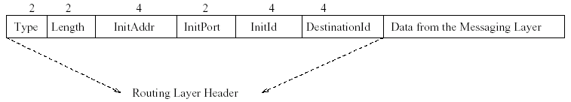
ORL Header Format
You don’t have to implement the ORL control packets for the check point!!

Slide 23
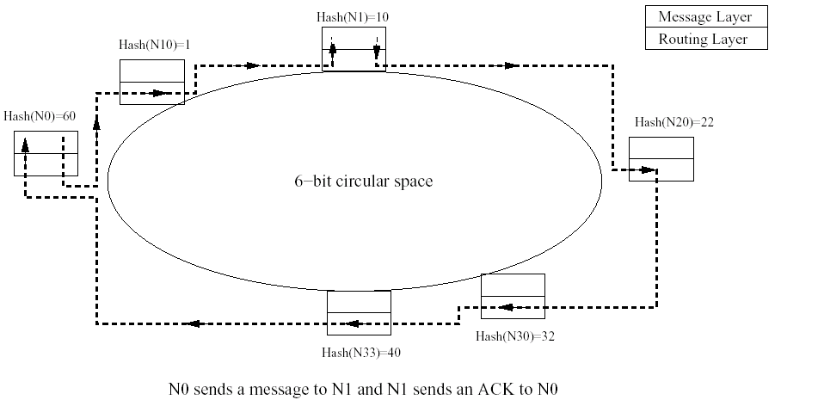
How routing works for MESG and ACK

Slide 24
Retransmissions, Timeouts, Past History
What happens if the ACK is lost and the message is retransmitted?
To avoid printing the same message twice, we have maintain a window of the past history

Slide 25
Beyond the Checkpoint
You have to implement Stabilize, Notify and Join
Give yourselves a lot of time to debug (more so for the part after the check point!!)
Need another review??
Sample binaries??

