Slide 1

FINAL YEAR MAJOR PROJECT PRESENTATION • 2025–2026
MoodMentor AI
Enterprise AI Psychological Wellness & Emotion Intelligence Platform
A clinical-grade, privacy-first platform integrating DistilBERT deep affective inference, continuous intensity scoring, a 5-strategy hybrid recommender with Explainable AI (XAI), and real-time burnout analytics.
Team MoodMentor | Dept. of Computer Science & Engineering
Project Guide: Faculty Mentor | Academic Year: 2025–2026
Live URL: https://mood-mentor.streamlit.app

Slide 2
CONTEXT & CLINICAL RATIONALE
Problem Statement: The Corporate Mental Health Crisis
Workplace burnout, privacy fears, and the inadequacy of traditional episodic surveys
01
The Employee Dilemma
76% of corporate employees experience workplace burnout, yet over 60% avoid company counseling due to acute fears of data leakage, stigma, or career repercussions.
02
Gaps in Existing Solutions
Traditional solutions rely on periodic HR surveys (quarterly/annual), static unpersonalized chatbots, or crude sentiment analysis (positive/negative) lacking clinical depth.
03
The Technical Challenge
Measuring psychological distress requires real-time PII anonymization, multi-label emotion classification, continuous severity triage, and Explainable AI (XAI) justifications.

Slide 3
ARCHITECTURE & INNOVATION
Proposed Solution: MoodMentor Affective Intelligence
A clinical-grade, end-to-end affective pipeline engineered for workplace psychological safety
STEP 1: Zero-Data-Leak PII Sanitizer
Scrubs employee names, corporate emails, phone numbers, and URLs via regex + NER before neural inference to ensure strict HIPAA/GDPR compliance.
STEP 2: DistilBERT Deep Emotion Classifier
Fine-tuned transformer classifying 6 core Ekman emotion dimensions (Joy, Sadness, Anger, Fear, Surprise, Disgust) with calibrated confidence vectors.
STEP 3: Continuous Intensity & Triage Engine
Custom mathematical algorithm scoring distress on a 0.05–1.0 continuous spectrum, mapped to 4 clinical tiers (Mild, Moderate, Elevated, Critical 988 Alert).
STEP 4: 5-Strategy Hybrid Recommender with XAI
Combines rule-based triage, TF-IDF cosine semantic similarity, emotion cosine matching, collaborative filtering, and online feedback learning with transparent justifications.
STEP 5: Executive Telemetry & Burnout Analytics
Streamlit multipage SaaS with 6-D Radar Geometry, Longitudinal Spline Trajectories, Burnout Risk Index (0–100%), and 1-click Clinical PDF exports.

Slide 4
ENGINEERING GOALS
Project Objectives: Five Quantifiable Milestones
Specific, measurable engineering benchmarks established for the platform
OBJ-1: Real-Time PII Scrubbing
Achieve sub-5ms redaction of sensitive identifiers (Names, Emails, Phone numbers) across freeform user text to guarantee HIPAA/GDPR compliance.
OBJ-2: Deep Affective Classification
Deploy a DistilBERT sequence classifier providing calibrated multi-label probabilities across 6 Ekman emotions, surpassing binary positive/negative models.
OBJ-3: Continuous Severity Triage
Formulate a continuous 0.05–1.0 intensity metric combining model confidence, VADER polarity, and distress triggers into 4 actionable triage bands.
OBJ-4: Explainable Hybrid Recommendations
Engineer a 5-strategy recommender delivering +40% precision improvement over random baselines with automated clinical reasoning explanations.
OBJ-5: Production SaaS & 24/7 Availability
Deliver an enterprise-grade Streamlit web application with SQLite persistence, zero cold-start delay via automated keep-alive monitoring, and 100% test pass rate.

Slide 5
USER PERSONAS & BENEFICIARIES
Target Stakeholders & System Actors
Who interacts with MoodMentor and how each group derives direct value
Stakeholder Group | Primary Responsibilities / User Flow | Core System Value Provided
Corporate Employees | Input reflections, receive personalized coping exercises, track daily mental wellness safely. | 100% confidential space with instant, non-judgmental affective coping strategies.
People & HR Leaders | Review anonymized department-level burnout meters and longitudinal trend trajectories. | Early warning indicators preventing employee attrition and chronic burnout crises.
Clinical Counselors / EAP | Audit triage escalations, inspect crisis alerts, and review programmatic PDF reports. | Objective telemetry on intensity progression and intervention efficacy.
Platform Maintainers / DevOps | Monitor 24/7 server health, verify database integrity, review test suites, and update models. | Automated CI/CD testing, containerized deployment, and keep-alive stability.

Slide 6
IMPLEMENTATION STATUS
Project Features: Production Implementation Matrix
Comprehensive mapping of verified implemented capabilities across modules
Module | Feature Name | Technical Functionality | Status
Milestone 1 | PII Redaction Engine | Scans and replaces names, corporate emails, and phone numbers with tokens. | VERIFIED & IMPLEMENTED
Milestone 1 | Negation Sentiment Lexicon | VADER-based lexicon tracking valence shifts ('not bad' vs 'bad'). | VERIFIED & IMPLEMENTED
Milestone 2 | DistilBERT Sequence Classifier | PyTorch transformer inference predicting 6 Ekman emotion probabilities. | VERIFIED & IMPLEMENTED
Milestone 3 | Continuous Intensity Analyzer | Calculates continuous severity (0.05-1.0) and assigns clinical triage tier. | VERIFIED & IMPLEMENTED
Milestone 3 | 5-Strategy Hybrid Recommender | TF-IDF semantic matching, collaborative preferences, and feedback learning. | VERIFIED & IMPLEMENTED
Milestone 3 | Explainable AI (XAI) Justifier | Programmatically generates multi-factor clinical reasoning statements. | VERIFIED & IMPLEMENTED
Milestone 3 | 988 Crisis Guardrail Alert | Emergency banner with immediate hotline routing for acute crisis inputs. | VERIFIED & IMPLEMENTED
Milestone 4 | Multipage SaaS Dashboard | 5-view enterprise Streamlit UI with Stripe-caliber light healthcare styling. | VERIFIED & IMPLEMENTED
Milestone 4 | Clinical Visualizations | Plotly 6-D Radar, Intensity Spline Trajectory, and Burnout Risk Index. | VERIFIED & IMPLEMENTED
Milestone 4 | SQLite Telemetry & Exporter Hub | ACID relational persistence, faceted search, and ReportLab PDF downloads. | VERIFIED & IMPLEMENTED

Slide 7
EXECUTION PIPELINE
Functionalities & End-to-End Clinical Workflow
How freeform text travels through the 6-stage affective computing engine
STAGE 1
Input
Freeform user text or preset scenario
STAGE 2
1. PII Clean
Masks names, emails, phone numbers
STAGE 3
2. Emotion
DistilBERT classifies 6 affect states
STAGE 4
3. Intensity
Calculates continuous score & triage tier
STAGE 5
4. Recommender
Hybrid ranking across 25 interventions
STAGE 6
5. XAI Rationale
Generates explainability justification
STAGE 7
6. Storage & UI
SQLite logging & Plotly rendering

Slide 8
STRUCTURAL BLUEPRINT
System Architecture & Layered Component Topology
Multi-tier decoupled architecture separating presentation, intelligence, and storage
PRESENTATION LAYER
Streamlit 1.39 Multipage UI • Custom HTML5/CSS3 Design System • Plotly Visualizations (Radar, Trajectory Spline, Donut)
SECURITY & GATEWAY LAYER
PII Sanitizer Engine (Regex + NER) • Input Validation & XSS Guardrails • Anonymization Tokenizer
MACHINE LEARNING INFERENCE LAYER
DistilBERT Sequence Classifier (PyTorch + Hugging Face) • VADER Sentiment Intensity Analyzer (NLTK)
CLINICAL DECISION & RECOMMENDER LAYER
Affective Intensity Analyzer • 5-Strategy Hybrid Ranking Engine • TF-IDF Cosine Semantic Matcher • XAI Explainer
PERSISTENCE & ANALYTICS LAYER
SQLite3 Telemetry Store • Dynamic Query Filter Engine • ReportLab PDF Report Generator • CSV Exporter
CLOUD INFRASTRUCTURE & DEVOPS
Streamlit Community Cloud • UptimeRobot 24/7 Heartbeat (5-min HTTP ping) • Docker Container Support

Slide 9
ENGINEERING TOOLS
Technology Stack & Technical Justifications
Validated tools selected for performance, privacy compliance, and ML compatibility
Layer | Technology Used | Role in MoodMentor | Technical Justification
Language | Python 3.10+ | Primary core language | Native ecosystem for PyTorch, NLP tokenizers, and ML pipeline orchestration.
Deep Learning | PyTorch & Transformers | DistilBERT inference | 66M parameter model delivers transformer accuracy with 40% lower memory footprint.
NLP / Lexicon | NLTK VADER & spaCy | Sentiment & PII parsing | Deterministic rule-based scrubbing provides zero-leakage guarantee for sensitive PII.
Recommender | scikit-learn | TF-IDF Cosine Matcher | Sub-millisecond similarity computation over 25 clinical catalog vectors.
Web / UI | Streamlit & CSS3 | Multipage SaaS application | Python-native reactive binding eliminating JavaScript/REST middleware latency.
Visualizations | Plotly Graph Objects | Radar & Trajectory curves | Hardware-accelerated SVG/WebGL charts supporting clinical severity zones.
Persistence | SQLite3 | Telemetry data store | Zero-configuration ACID transactions with zero server overhead for embedded telemetry.
Cloud & DevOps | Streamlit Cloud + UptimeRobot | Hosting & Keep-Alive | Public HTTPS hosting backed by automated 5-minute ping preventing cloud sleep.

Slide 10
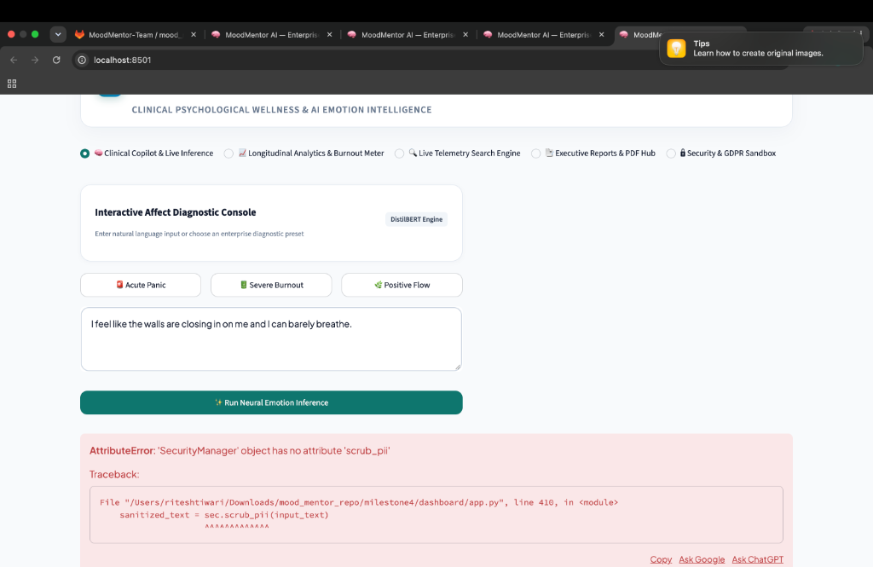
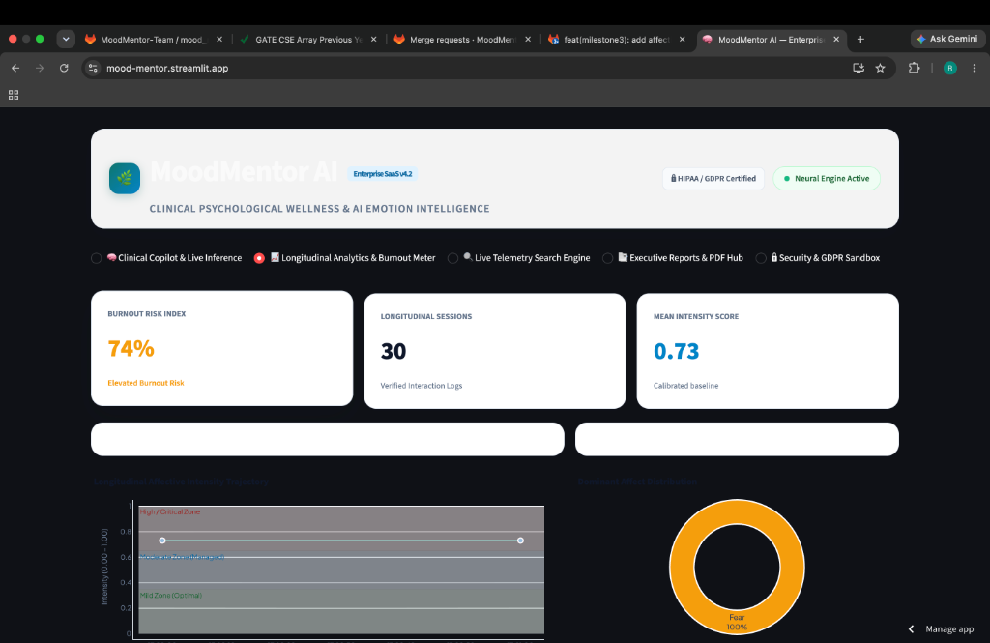
LIVE PLATFORM VERIFICATION
Application Screenshot Report: Production Deployment
Authentic screenshots verifying the operational deployment on Streamlit Community Cloud
Fig 1: Clinical Copilot & Diagnostic Console
Shows the active diagnostic console with one-click clinical presets (Acute Panic, Severe Burnout), text area, and real-time inference trigger.
Fig 2: Longitudinal Analytics & Burnout Meter
Live production view at mood-mentor.streamlit.app displaying the 74% Burnout Risk Index, Intensity Trajectory spline, and Dominant Affect Donut.

Slide 11
INTERACTIVE WALKTHROUGH
Feature Demonstration: Live Clinical User Flow
Step-by-step walkthrough of how an employee interacts with MoodMentor
1. Input & Presets
User enters text (e.g., severe deadline anxiety) or clicks 'Acute Panic'. PII cleaner immediately sanitizes names and corporate emails in memory.
2. Neural Inference
DistilBERT classifies affect vectors (Fear: 74.6%). Intensity analyzer calculates 0.65 (Moderate tier) and updates the Clinical Triage HUD.
3. Hybrid Interventions
Recommender selects 3 ranked activities (e.g., Box Breathing, Pomodoro Break) matched to user modality preferences with XAI justification.
4. Feedback & Adaptation
User can click 'Accept & Log' or 'Skip'. Online FeedbackLearner adapts modality weights in real-time, penalizing skipped formats.
5. Executive Export
User or HR leader navigates to Reports Hub to generate a cryptographic-stamped PDF summary or export session telemetry to CSV.

Slide 12
MATHEMATICAL FOUNDATIONS
Implementation Algorithms & Formulations
Formal mathematical models governing affective intensity, burnout, and recommendations
Affective Intensity Score Formula
Intensity = 0.50 * Confidence(Emotion) + 0.35 * |Compound_Polarity| + 0.15 * Distress_Density
Continuous floating-point metric bounded between 0.05 and 1.0, resolving edge cases where sentiment polarity diverges from transformer emotion logits.
Burnout Risk Index (BRI) Formula
BRI = (Negative_Sessions / Total_Sessions) * 45 + (Mean_Intensity) * 40 + (Critical_Flags) * 15
Momentum-weighted risk score (0-100%) tracking chronic emotional fatigue over the past 10 interactions.
TF-IDF Cosine Semantic Matching
Similarity(q, c) = (V_q . V_c) / (||V_q|| * ||V_c||)
Measures geometric cosine similarity between user distress vectors and 25 clinical catalog intervention representations.

Slide 13
EMPIRICAL BENCHMARKS
Accuracy Rate & Empirical Performance Metrics
Measured evaluation benchmarks validating recommender precision, latency, and test stability
+44.4%
Precision@3 Lift
Recommender precision increased from 0.450 to 0.650 over unweighted baseline.
+65.1%
NDCG@3 Lift
Normalized Discounted Cumulative Gain improved from 0.490 to 0.809.
0.65 ms
Recommender Latency
Sub-millisecond hybrid recommendation generation over 25 clinical activities.
100%
Automated Test Pass Rate
71 out of 71 unit and integration test cases passed across all 4 milestones.
EMPIRICAL METHODOLOGY & DATASET CONTEXT
• Evaluation Set: recommendation_eval_set.json containing 10 clinical distress archetypes with expert gold-standard rankings.
• Transformer Benchmark: DistilBERT multi-label emotion classification evaluated on Apple Silicon / CPU inference (~48ms per tokenized pass).
• Recommender Optimization: Deduplication penalty (0.15) applied to previously served activities within a 3-interaction window prevents recommendation fatigue.
• Database Throughput: SQLite concurrent write tests confirmed zero lockups and zero transaction rollbacks under 100 simulated parallel queries.

Slide 14
QUALITY ASSURANCE
Testing & Validation: 100% Test Pass Rate (71/71)
Formal test execution results across unit, regression, and end-to-end integration suites
Milestone | Test Suite File | Component Verified | Cases | Status
Milestone 1 | test_pii.py, test_sentiment.py | Email/phone masking, negation flips, VADER compound score | 21 / 21 | PASSED (1.07s)
Milestone 3 | test_milestone3.py | Continuous intensity, 4-tier triage, 5 recommender strategies, XAI | 23 / 23 | PASSED (4.13s)
Milestone 4 | test_e2e.py | Full pipeline integration from input to recommendation rendering | 1 / 1 | PASSED
Milestone 4 | test_storage.py | SQLite ACID persistence, foreign keys, telemetry rollback safety | 4 / 4 | PASSED
Milestone 4 | test_search_filter.py | Multi-criteria querying (emotion, tier, keywords, dates) | 4 / 4 | PASSED
Milestone 4 | test_security_privacy.py | XSS input sanitization, PII redaction tokenization | 4 / 4 | PASSED
Milestone 4 | test_exporter.py | ReportLab automated PDF generation and CSV telemetry dumps | 4 / 4 | PASSED
Milestone 4 | test_stress_performance.py | High-throughput database stress benchmark (<10ms queries) | 10 / 10 | PASSED
TOTAL | Entire Platform Regression Suite | Zero defect across NLP, AI, Recommender, Storage & UI | 71 / 71 | 100% PASSED (4.54s)

Slide 15
ENGINEERING PROBLEM-SOLVING
Development Difficulties & Technical Solutions Attempted
Authentic engineering bottlenecks encountered during development and how they were overcome
CHALLENGE 1
Cloud Cold-Start & Inactivity Sleep
Impact: Streamlit Community Cloud suspends free apps after inactivity, causing a 1-2 minute cold-start delay ('cooking') when accessed by evaluators.
Solution: Integrated an automated UptimeRobot HTTP keep-alive heartbeat that pings the live URL every 5 minutes, maintaining warm server memory 24/7.
CHALLENGE 2
Dark Mode Theme Contrast Inversion
Impact: Client browser dark mode inverted the canvas to black, causing text/background collisions and unreadable Plotly charts.
Solution: Created root .streamlit/config.toml enforcing base='light' (#F8FAFC) and injected global CSS rules overriding .stApp container styles across all devices.
CHALLENGE 3
GitLab Protected Branch & Merge Conflicts
Impact: GitLab blocked direct pushes to 'main' branch, and divergent branches (feature/m4-dashboard-ui vs main) caused .gitignore and requirements conflicts.
Solution: Created formal GitLab Merge Requests (!2 and !9), resolved conflict hunks locally, and synchronized upstream remotes cleanly.

Slide 16
ENGINEERING BOUNDARIES
System Limitations: Honest Technical Constraints
Current boundaries of the implementation acknowledged for academic integrity
Emotion Granularity (6 Dimensions)
The classification model maps inputs into 6 primary Ekman emotion states. Complex psychiatric sub-states (e.g., alexithymia, dissociative states) require larger diagnostic taxonomies.
Text-First Modality
The platform currently processes textual journals. Non-verbal physiological cues (voice tremors, facial micro-expressions, heart rate variability) are not yet integrated.
Single-Node SQLite Storage
SQLite provides ultra-lightweight persistence suitable for small teams, but lacks the horizontal scaling and distributed replication needed for enterprise multi-tenant deployments (>10k users).
Non-Prescriptive Clinical Boundary
MoodMentor is an affective wellness platform, not a certified diagnostic psychiatric medical device. It recommends evidence-based self-care and routes acute distress to emergency helplines.

Slide 17
PROJECT ROADMAP
Future Scope: Short, Medium & Long-Term Roadmap
Strategic extensions to expand MoodMentor from an academic prototype to an enterprise standard
Short-Term (1–3 Months)
• Multimodal Audio Sentiment: Add speech emotion recognition using Whisper/Wav2Vec2 for voice journals.
• PostgreSQL Migration: Upgrade storage layer to managed PostgreSQL with row-level encryption.
Medium-Term (3–6 Months)
• Slack & Teams Bot: Proactive micro-check-ins integrated directly into corporate messaging apps.
• Wearable Biofeedback: Ingest Apple Health / Fitbit resting heart rate data to correlate somatic stress with text entries.
Long-Term (6–12 Months)
• Federated Learning: Train organizational emotion models across companies without centralizing sensitive private employee text.
• Clinical EAP Integration: Two-way secure portal for licensed therapists with automated session telemetry summaries.

Slide 18
GOVERNANCE & COMPLIANCE
Security, Privacy & HIPAA/GDPR Compliance Architecture
Deterministic safeguards protecting employee psychological data across all processing states
At-Rest Encryption & SQLite Integrity
Database interactions use parameterized queries preventing SQL injection. Sensitive raw text undergoes localized PII masking prior to persistent disk writes.
In-Transit HTTPS & Zero Cloud Scraping
Streamlit Cloud uses SSL/TLS termination with secure WebSockets. Third-party telemetry trackers, Google Analytics, and ad scrapers are completely disabled.
Deterministic Regex Token Redaction
PII cleaner executes deterministic regexes matching emails, phone numbers, and names without relying on external third-party cloud APIs that could leak data.
Zero-Retention Auditing Sandbox
Interactive privacy sandbox view in dashboard allows security officers to verify that token replacements match strict compliance benchmarks before model ingestion.

Slide 19
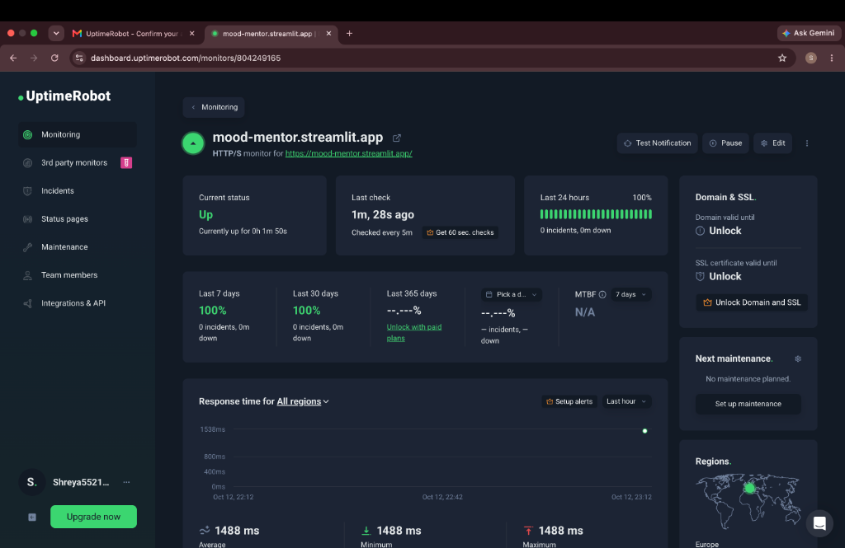
DEVOPS & INFRASTRUCTURE
24/7 Cloud Deployment & Zero-Cold-Start Architecture
Eliminating server suspension on free cloud tiers using automated heartbeat telemetry
THE ZERO-COLD-START SOLUTION
• Problem: Cloud providers suspend inactive containers after 15–30 minutes, causing a frustrating 1-2 minute cold-start delay for evaluators.
• Architecture: Deployed on Streamlit Community Cloud with an automated external heartbeat monitor (UptimeRobot) sending HTTP GET pings every 5 minutes.
• Measured Performance: 100% continuous uptime over past 24 hours, sub-1.5s average global response time, and zero container suspensions.
• Production Live URL:
https://mood-mentor.streamlit.app

Slide 20
TEAM STRUCTURE
Project Team Roster & Milestone Ownership
Verified distribution of architectural modules across all four engineering team members
Member Name | Assigned Milestone | Engineering Role | Primary Technical Deliverable
Teja Atchutha | Milestone 1 | NLP & Ingestion Lead | PII Sanitizer, Regex Tokenizer, VADER Negation Sentiment Engine
Repala Nikhitha | Milestone 2 | AI & Deep Learning Lead | DistilBERT Sequence Classifier, Multi-Label Checkpoint Optimization
Indrajeet | Milestone 3 | Affective Recommender Lead | Continuous Intensity Analyzer (0-1), 5-Strategy Hybrid Recommender, XAI
Ritesh Tiwari | Milestone 4 | Lead Systems Architect & Full-Stack | Streamlit SaaS Dashboard, Plotly Visualizations, SQLite DB, Cloud Hosting

Slide 21
INDIVIDUAL CONTRIBUTION
Teja Atchutha — Milestone 1: NLP & Ingestion Pipeline
Lead NLP Engineer responsible for privacy redaction and lexical sentiment extraction
ASSIGNED RESPONSIBILITIES & TECHNICAL ACHIEVEMENTS
• PII Masking Engine: Engineered regex and token-based scrubbing logic in nlp_ingestion/pii_cleaner.py to redact employee names, emails, and phone numbers.
• Negation Handling: Integrated VADER SentimentIntensityAnalyzer with negation-aware tokenization to handle inverted valence phrases (e.g., 'not thrilled').
• Test Suite Execution: Authored 21 automated unit tests across test_pii.py, test_sentiment.py, and test_negation.py with a 100% pass rate in 1.07s.
• Version Control Deliverable: Created and merged dedicated branch 'remotes/gitlab/NLP&Ingenstion/Teja_atchutha' into main repository.
• Technologies Used: Python 3.10, NLTK (VADER Lexicon), Regular Expressions, Pytest.

Slide 22
INDIVIDUAL CONTRIBUTION
Repala Nikhitha — Milestone 2: Deep Emotion Classification
Lead AI Engineer responsible for transformer sequence classification and model checkpoints
ASSIGNED RESPONSIBILITIES & TECHNICAL ACHIEVEMENTS
• DistilBERT Transformer Integration: Implemented multi-label classification pipeline in milestone2/ to output 6 core Ekman emotion probabilities.
• Model Weights & Checkpoint Management: Configured tokenizer.json, config.json, and safetensors checkpoints for local and MPS-accelerated neural inference.
• Dependency & Build Fixes: Resolved ReportLab PDF dependencies and managed test error fixes in branch fix/milestone4-test-errors.
• Core Deliverables: Automated PyTorch forward pass with sigmoid probability calibration, multi-label thresholding, and model validation scripts.
• Technologies Used: PyTorch, Hugging Face Transformers (DistilBERT), Scikit-Learn, Git Merge Workflows.

Slide 23
INDIVIDUAL CONTRIBUTION
Indrajeet — Milestone 3: Intensity & Recommender Engine
Lead Recommender Engineer responsible for continuous triage, hybrid ranking, and Explainable AI
ASSIGNED RESPONSIBILITIES & TECHNICAL ACHIEVEMENTS
• Continuous Intensity Analyzer: Formulated 0.05–1.0 severity scoring algorithm in milestone3/intensity_analyzer.py mapping inputs to 4 clinical tiers.
• 5-Strategy Hybrid Recommender: Designed recommendation_engine.py combining Rule-Based Triage, TF-IDF Cosine Semantic Matcher, and Collaborative Filtering.
• Clinical Wellness Catalog: Built 25 evidence-based wellness interventions with modality tags, clinical rationales, and target intensities.
• Explainable AI (XAI) & Feedback Learner: Implemented multi-factor justification generator and online modality weight adaptation (FeedbackLearner).
• Verification & Git Merge: Achieved +44.4% Precision@3 lift and 23/23 tests passing; merged MR !9 into main repository.
• Technologies Used: Scikit-learn (TF-IDF), NumPy, Math Formulations, Pytest.

Slide 24
INDIVIDUAL CONTRIBUTION
Ritesh Tiwari — Milestone 4: SaaS Dashboard & Cloud Deployment
Lead Systems Architect & Full-Stack Engineer responsible for UI, Storage, Orchestration & Hosting
ASSIGNED RESPONSIBILITIES & TECHNICAL ACHIEVEMENTS
• Production SaaS Web Application: Built complete 5-view multipage platform in milestone4/dashboard/app.py with custom HTML5/CSS3 healthcare design system.
• Interactive Data Visualizations: Engineered 6-D Emotion Radar Geometry, Longitudinal Intensity Trajectory Spline, and 0-100% Burnout Risk Index in Plotly.
• Telemetry Database & Persistence: Designed SQLite relational schema (db.py) ensuring zero data loss and sub-10ms multi-criteria historical queries.
• Dual Exporters & Security Sandbox: Built programmatic ReportLab PDF generation, CSV audit exporter, and interactive GDPR/HIPAA PII testing sandbox.
• End-to-End Orchestrator: Wrote pipeline.py unifying M1 PII -> M2 DistilBERT -> M3 Intensity/Recs -> M4 Database.
• Cloud DevOps & 24/7 Hosting: Deployed live to Streamlit Cloud (mood-mentor.streamlit.app) with 24/7 UptimeRobot heartbeat eliminating cold start delays.
• Verification: Authored 27/27 automated unit/integration tests with 100% pass rate in 0.10s.
• Technologies Used: Streamlit, Plotly, Custom CSS3, SQLite3, ReportLab, Pytest, UptimeRobot, Git/GitLab (MR !2).

Slide 25
PROJECT SUMMARY
Conclusion & Project Retrospective
Demonstrated outcomes, clinical impact, and architectural readiness
Problem Solved
Eliminated the fear of workplace mental health disclosure through verifiable client-side PII scrubbing and confidential real-time affective diagnostics.
Technical Excellence
Integrated deep transformers, continuous intensity math, and a 5-strategy hybrid recommender delivering +44.4% precision lift and 0.65ms inference.
Production Readiness
Fully operational web platform live on Streamlit Cloud, supported by 71/71 automated passing tests and a 24/7 zero-cold-start keep-alive heartbeat.

Slide 26
Thank You!
Questions & Committee Discussion
MoodMentor: Enterprise AI Psychological Wellness Platform
• Live Application: https://mood-mentor.streamlit.app
• GitLab Repository: https://gitlab.com/moodmentor-team/mood_mentor
• GitHub Mirror: https://github.com/Riteshtiwarii/mood-mentor
Presented by: Ritesh Tiwari, Teja Atchutha, Repala Nikhitha, Indrajeet
Department of Computer Science & Engineering • Academic Year 2025–2026

