Slide 1
HACK DEVENGERS 2.0
LaterUPI
I’ll UPI later — becomes a receipt.
Tracked promise → WhatsApp nudge → settled receipt. No bank APIs.
Team: Ritesh · Individual · Built in-window 19–20 Sep 2026
LaterUPI · Hack Devengers 2.0 · github.com/Ritesist/laterupi · 1/8

Slide 2
Problem
“bhej dunga raat ko” lives in WhatsApp chaos
NO DUE
NO TRACK
FRICTION
Promises without a clock
Freelancers lose the thread
Friendships take the hit
• India money promises die in chat — no amount, due time, or receipt.
• Roommates, freelancers, college groups argue over “I’ll pay later.”
• You don’t need a bank API to fix the social layer.
LaterUPI · Hack Devengers 2.0 · github.com/Ritesist/laterupi · 2/8

Slide 3
Solution — LaterUPI
Create → share → nudge → paid → receipt
• Create promise: INR, from → to, due chips, note
• Status: pending → nudged → paid / cancelled
• Share card: copy or WhatsApp-ready text
• Settled receipt you can screenshot
OUT OF SCOPE
• UPI / bank KYC
• Credit scoring
• Multi-tenant SaaS
LaterUPI · Hack Devengers 2.0 · github.com/Ritesist/laterupi · 3/8

Slide 4
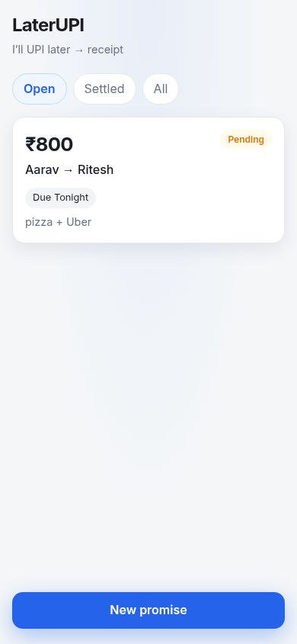
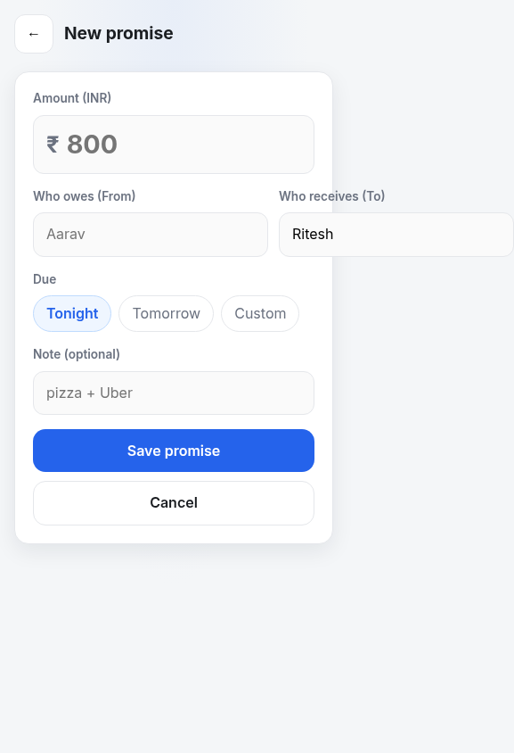
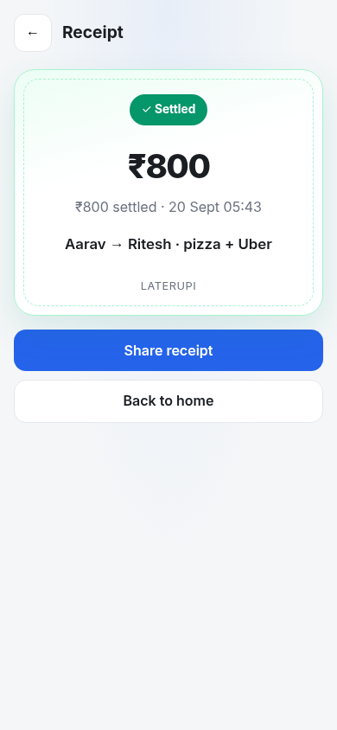
Product flow
Home → Create → Receipt (wow)
Home
Create
Receipt
LaterUPI · Hack Devengers 2.0 · github.com/Ritesist/laterupi · 4/8

Slide 5
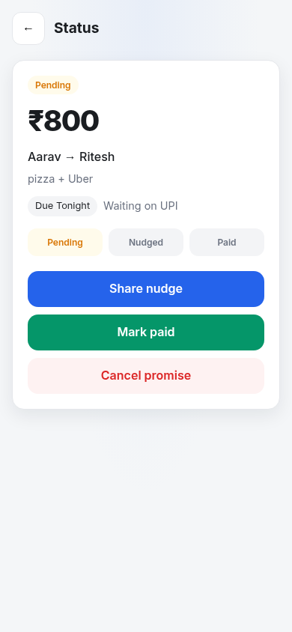
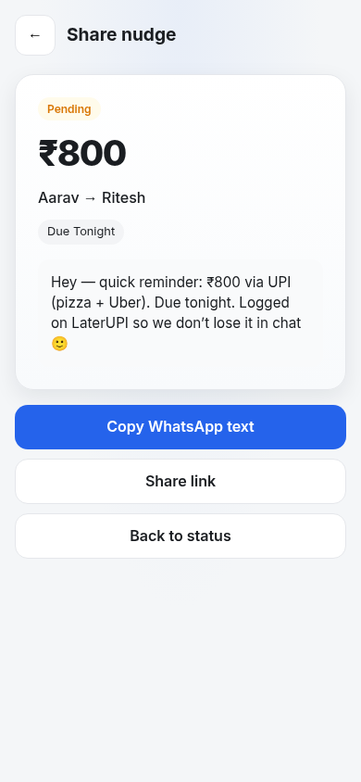
Nudge + share
Status loop and WhatsApp-ready share card
Status
Share
LaterUPI · Hack Devengers 2.0 · github.com/Ritesist/laterupi · 5/8

Slide 6
Wow moment
Chaotic “bro I’ll UPI” → clean settled receipt
• Before: WhatsApp threads, forgotten dues, awkward follow-ups.
• After: ₹800 settled · timestamped receipt you can share.
• Judges feel the roommate / freelancer pain in one glance.
LaterUPI · Hack Devengers 2.0 · github.com/Ritesist/laterupi · 6/8

Slide 7
Why this wins
Real pain · 24h scope · clear UX
Real pain
24h MVP
Roommate & freelancer UPI promises
Essential loop only — no bank APIs
UX clear
Rubric fit
Receipt is the product
Innovation · problem-solving · impact
LaterUPI · Hack Devengers 2.0 · github.com/Ritesist/laterupi · 7/8

Slide 8
Ask / submit
GitHub required · this PPT optional
JUDGES GET
LINKS
• LaterUPI essential MVP
• Create → share → receipt story
• In-window GitHub commits
• Optional demo PPT (this)
• Repo: github.com/Ritesist/laterupi
• Title: LaterUPI — I'll UPI later becomes a receipt
• No bank / UPI API claims
LaterUPI · Hack Devengers 2.0 · github.com/Ritesist/laterupi · 8/8

