Slide 1

Prediction of Insurance Premium
Name : Ritevik Bisht
Batch : DSFT12

Slide 2
DataSet details
This is a Supervised Dataset whose dependant is charges for this particular question. And its also a regressive dataset.
There are 1338 rows and 8 columns.
There were 8 missing values in the ‘classif’ feature in the dataset.

Slide 3
Business Objective
Build a model to predict the insurance policy amount.

Slide 4
We used 4 algorithms here
Linear Regression Algorithm
- Easier to implement, interpret and efficient to train
- It handles overfitting pretty well using dimensionally reduction techniques, regularization, and cross-validation.
Elastic Net Algorithm
Doesn’t have the problem of selecting more than n predictors when n<<p.
It is a simple regression method which helps in preventing overfitting.

Slide 5
Random Forest Regressor Algorithm
- Outliers do not significantly impact random forests.
- The random forest has a lower variance than a single decision tree.
Random forests are extremely adaptable and highly accurate.
Decision Tree Regressor Algorithm
- A decision tree does not require normalization of data.
- A decision tree does not require scaling of data as well.

Slide 6
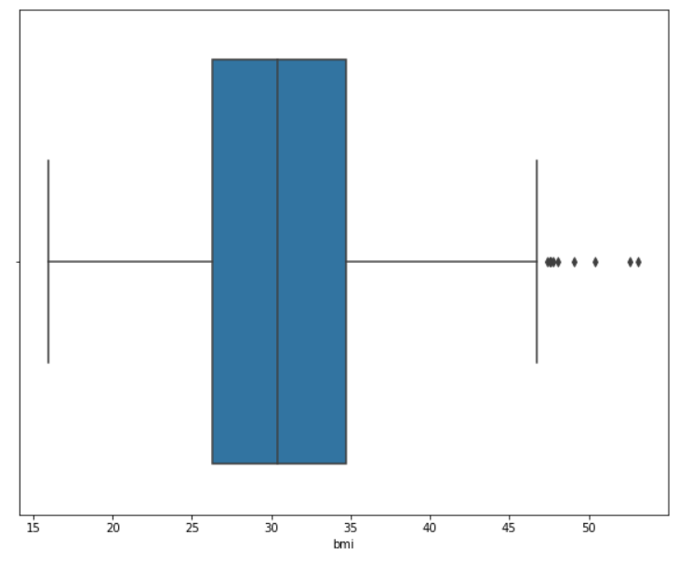
Range of BMI
Business Perspective

Slide 7
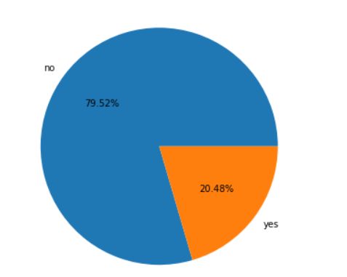
RAtio of Smokers to Non-Smokers
Amount of Non-Smokers is higher than the amount of smokers.

Slide 8
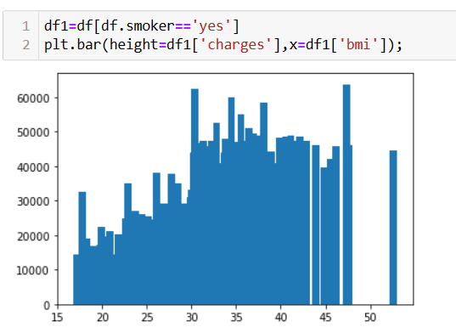
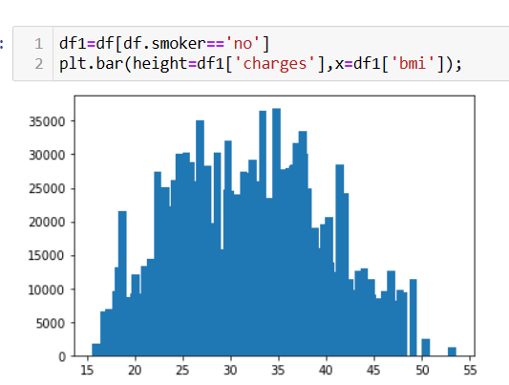
Here, We found that if they are smokers and their bmi is between 30 to 47.5 then they get higher charges.
We found that if they are not smokers and their bmi is between 22.5-42.5, they get higher charges.
From this, We can understand that smokers are a risk to the company. But we also cannot stop them from taking an insurance. So what we can do is that we increase the premium and reduce the bmi range for the smokers. And for the non-smokers , we can give small offers or discounts, so that more non-smoker customers take insurance from the company.

Slide 9
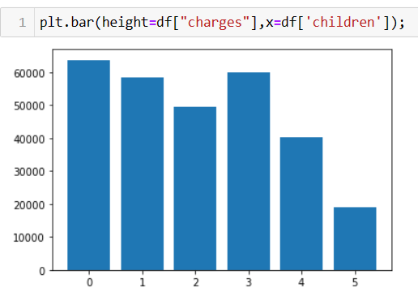
If there are no children or the customers have up to 3 children, the clients got higher charges.

Slide 10
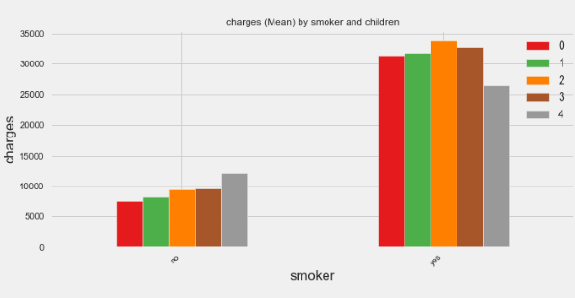
Here, We observed that the charges were higher for smokers with children and lower for non-smokers with children.

Slide 11
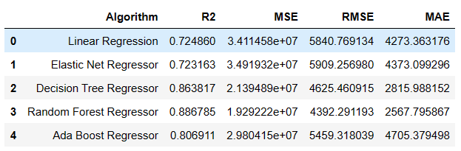
Final Result
Technical Perspective
We found that Elastic Net regressor gives us a better result compared to other models.

Slide 12
Observations
We found that Elastic Net Regressor gives us a better prediction value.
If there are no children or the customers have up to 3 children, the clients got higher charges.
If the customer is a smoker, We found that if the bmi is between 30 to 47.5 than they got higher charges.
If the customer is not a smoker, We found that if the bmi is between 22.5 to to 42.5,than they got higher charges.

Slide 13
Conclusion
After doing the analysis, We found that if the customers are non-smokers than their insurance charges will be less. And for the customers who are smokers it will be higher.
We can increase the premium of non-smokers to a value which doesn’t hurt them. So that even if one of the customers fall in a risk we also don’t become bankrupt.

Slide 14
Thankyou

