Slide 1

DEPARTMENT OF COMPUTER SCIENCE AND ENGINEERING
PROJECT REPORT ON –“Customer churn prediction”
Submitted to: Submitted by:
Mr Saumitra chattopadhyay Rithak
(class co-ordinator) University Roll. No.: 2018645
Class Roll No: 43
CSE-J-VI-Sem
Session: 2022-23

Slide 2

Table of content
Introduction
Data Collection
Exploratory Data Analysis
Model building
Results and Insights
Implementation and Deployment
Conclusion

Slide 3

INTRODUCTION
Customer churn prediction refers to the process of using historical customer data and predictive modeling techniques to identify customers who are at risk of ending their relationship with a business or discontinuing their use of its products or services. The objective is to predict which customers are likely to churn in the future, allowing the business to take proactive measures to retain those customers and minimize revenue loss.
Customer churn, also known as customer attrition, can have a significant impact on a business's profitability and growth. By accurately predicting which customers are likely to churn, companies can implement targeted retention strategies, such as personalized offers, improved customer service, or loyalty programs, to increase customer satisfaction and reduce customer churn rates.
To perform customer churn prediction, historical customer data is typically analyzed, including information such as demographics, transaction history, service usage patterns, customer interactions, and feedback. Machine learning algorithms, such as logistic regression, decision trees, random forests, gradient boosting, or neural networks, are applied to build predictive models based on these data.
The predictive models learn patterns and relationships between customer attributes and churn behavior from the historical data. These models are then used to make predictions on new or unseen customer data, indicating the likelihood of churn for each customer. The predictions can be used to prioritize customer retention efforts, allocate resources efficiently, and develop proactive strategies to retain valuable customers.
Customer churn prediction models can provide businesses with valuable insights into customer behavior and enable them to take timely actions to reduce churn rates, improve customer satisfaction, and drive long-term business success.

Slide 4
Problem Statement
The objective of this project is to build a predictive model that can accurately identify customers who are likely to churn.
By identifying potential churners in advance, businesses can implement targeted retention strategies and reduce customer attrition.
Data collection
We have use data set from kaggle
It is in form of of csv file

Slide 5
Exploratory Data Analysis
Descriptive statistics and visualizations were used to gain insights into the data.
The distribution of the target variable (churn) was analyzed, and patterns or trends in customer behavior were identified.
Correlations between variables were explored to uncover potential predictors of churn.
Univariate Analysis:Univariate analysis focuses on examining individual variables in isolation. It helps to understand the distribution and characteristics of each variable independently.
Bivariate Analysis:Bivariate analysis involves exploring the relationship between two variables, usually the predictors and the target variable (churn). It helps identify patterns, associations, and dependencies.

Slide 6
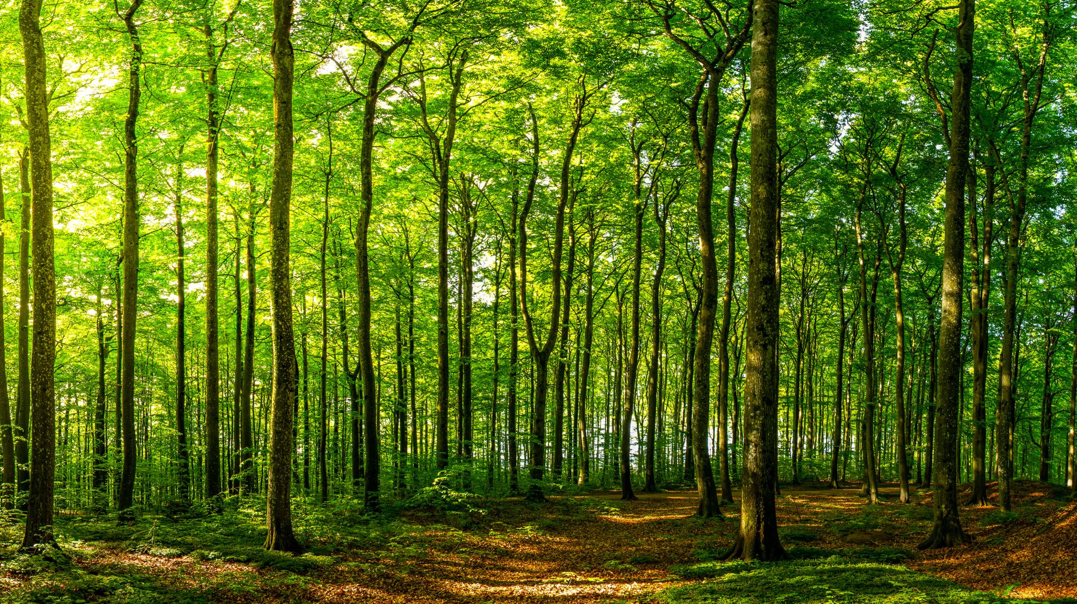
Model Building
Decision Tree Classification:
Decision tree classification is a popular machine learning algorithm used for both binary and multi-class classification problems, including customer churn prediction. It builds a tree-like model of decisions and their possible consequences.
Random Forest Classification:
Random Forest is an ensemble learning method that combines multiple decision trees to improve predictive performance and mitigate overfitting.
For building customer churn prediction we use Random forest classification because of its High Predictive Accuracy, Robustness and Feature Importance.

Slide 7

Models building
Decision tree classification
Classification report
0.934412265758092
precision recall f1-score support
0 0.97 0.88 0.93 540
1 0.91 0.98 0.94 634
accuracy 0.93 1174
macro avg 0.94 0.93 0.93 1174
weighted avg 0.94 0.93 0.93 1174
confusion matrix
[[477 63]
[ 14 620]

Slide 8
Random forest classification​
Classification report​
0.9427350427350427​
precision recall f1-score support​
​
0 0.95 0.92 0.93 518​
1 0.94 0.96 0.95 652​
​
accuracy 0.94 1170​
macro avg 0.94 0.94 0.94 1170​
weighted avg 0.94 0.94 0.94 1170​
confusion matrix​
[[478 40]​
[ 27 625]]​
with RF Classifier, also we are able to get quite good results, infact better than Decision Tree.​

Slide 9
Implemenation and deployement
We save our model using pickle in python
And deploy it using python API flask
Flask is a popular web framework for building APIs in Python. It provides a lightweight and flexible approach to developing web applications and APIs. Here's an example of how to create a basic Flask API:
Conclusion
The customer churn prediction project successfully developed a model that accurately identifies customers at risk of churn.
The insights provided by the model have enabled the business to take proactive measures to retain valuable customers and improve overall customer retention rates.
Ongoing monitoring and continuous improvement of the model will be crucial for maintaining its effectiveness and adapting to changing customer behaviors.

Slide 10
Thank you

