Slide 1

ParkPulse AI
Transforming Parking Violations
into Urban Mobility Intelligence
FLIPKART GRID 6.0 | SMART CITY TRACK
Prototype Phase Submission
By : Rithanya Raj & Anjan Mahapatra
Data → Intelligence → Action → Better Mobility
2026

Slide 2






THE CHALLENGE
The Urban Mobility Crisis
Illegal parking is not an inconvenience — it is a systemic threat to urban mobility.
Congestion
Emergency Delays
Productivity Loss
Illegal parking reduces effective road width by up to 30%, creating bottlenecks
Blocked corridors delay ambulances and fire trucks by 4-7 minutes
India loses $80B+ annually to traffic congestion in major cities
Transit Disruption
Economic Impact
Public Safety
Bus routes diverted, causing cascading delays across public transport
Fuel wastage and idle time cost commuters 2-3 hours daily
Pedestrian zones compromised, accident risk increases 2.5x
ParkPulse AI
2 / 27

Slide 3


CURRENT GAPS
Why Current Approaches Fail
CURRENT STATE
WHAT'S NEEDED
Reactive patrol-based enforcement
AI-driven proactive enforcement
No hotspot intelligence or prediction
Predictive hotspot intelligence
No congestion impact visibility
Real-time congestion impact scoring
Inefficient resource allocation
Data-driven resource optimization
Manual reporting and documentation
Automated reporting & briefings
ParkPulse AI
3 / 27

Slide 4
PROBLEM STATEMENT
How can AI-driven parking intelligence detect
illegal parking hotspots and quantify their
impact on traffic flow to enable
targeted enforcement?
ParkPulse AI
4 / 27

Slide 5
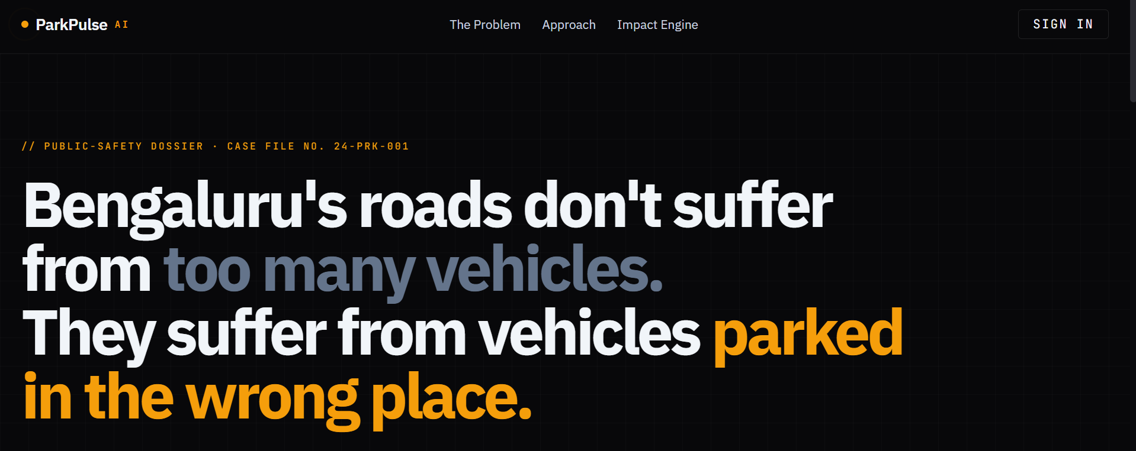
PROBLEM STATEMENT
ParkPulse AI
4 / 27

Slide 6



MARKET OPPORTUNITY
The Opportunity
68%
100+
298K+
$15B
Urban population
by 2050
Smart City
Missions globally
Records in
our dataset
Smart parking
market by 2030
KEY DRIVERS
Rapid urbanization outpacing infrastructure
Government push for data-driven governance
Growing IoT and sensor deployment in cities
Need for measurable outcomes in smart city projects
ParkPulse AI
5 / 27

Slide 7
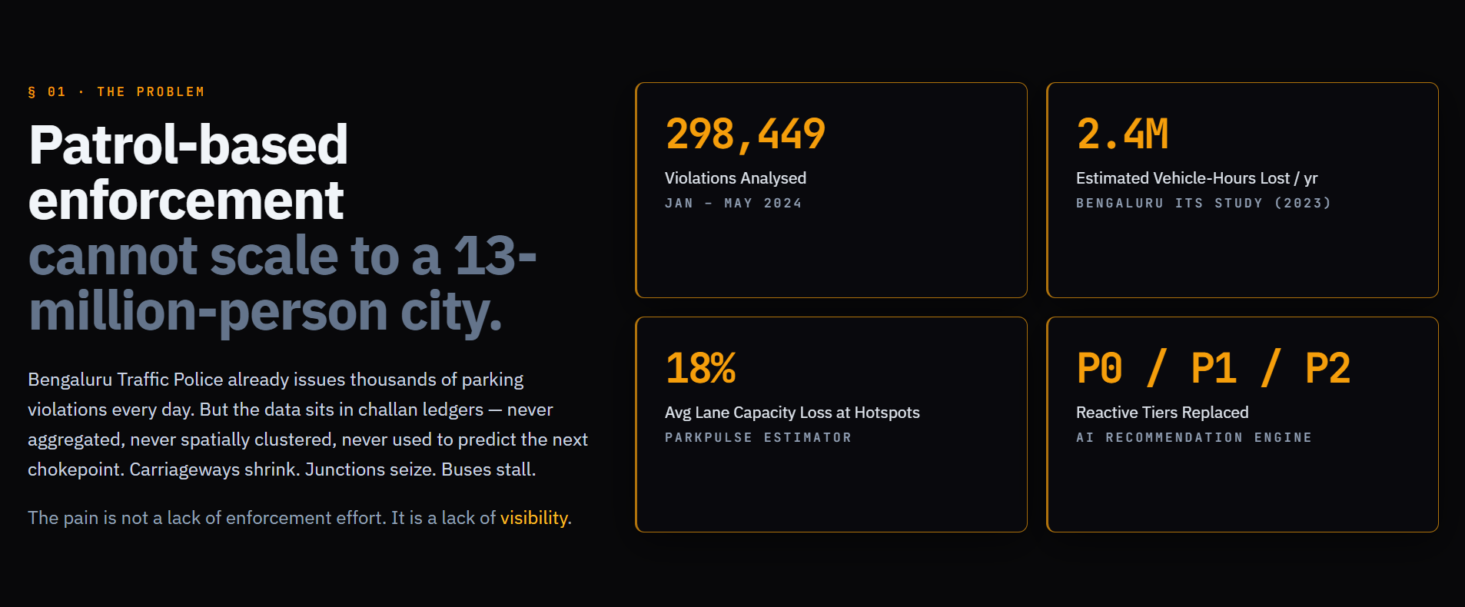


INTRODUCING
ParkPulse AI
AI-powered urban parking intelligence platform that transforms
violation data into actionable enforcement strategies.
AI-Powered
ML clustering algorithms detect violation hotspots with geospatial precision
Impact Quantified
Measures congestion impact, capacity loss, and junction criticality
Actionable Intel
Generates enforcement briefings and priority recommendations automatically
ParkPulse AI
6 / 27

Slide 8





ARCHITECTURE
Solution Architecture
→
→
→
→
→
→
→
Parking
Violations
Data
Validation
Geospatial
Intel
Hotspot
Detection
Congestion
Impact
Forecasting
Engine
AI
Recommend
Command
Dashboard
End-to-end pipeline from raw violation data to actionable intelligence
DATA LAYER
ANALYTICS LAYER
INTELLIGENCE LAYER
PRESENTATION LAYER
MongoDB · Ingestion · Validation
DBSCAN · HDBSCAN · K-Means · XGBoost
Congestion Scoring · Capacity · Forecasting
React · Leaflet Maps · LLM Reports
ParkPulse AI
7 / 27

Slide 9
WORKFLOW
How ParkPulse AI Works
01
Data Ingestion
04
Capacity Analysis
Parking violation records from 60+ police stations ingested and validated
Lane blockage and throughput reduction quantified per corridor
02
Geospatial Clustering
05
Predictive Forecasting
DBSCAN & HDBSCAN algorithms identify spatial violation clusters
XGBoost models predict hotspot emergence hourly/daily/weekly
03
Impact Scoring
06
AI Enforcement Briefing
Each hotspot scored on density, peak frequency, junction criticality
LLM generates prioritized action reports for duty officers
ParkPulse AI
8 / 27

Slide 10

DATA PIPELINE
Data Pipeline & Engineering
Ingestion
Validation
Feature Eng.
Spatial Intel
Intel Generation
298K+ records
→
GPS verification
→
Spatial encoding
→
Coordinate mapping
→
Hotspot clusters
60+ stations
Timestamp audit
Temporal features
Zone classification
Impact scores
5 months data
Duplicate removal
Violation typing
Road segment linking
Priority ranking
298,449 Records · 60+ Police Stations · 5 Months · 4 ML Algorithms
ParkPulse AI
9 / 27

Slide 11
GEOSPATIAL INTELLIGENCE
Geospatial Intelligence Engine
HDBSCAN
Hierarchical density clustering. Handles varying density clusters across urban and suburban zones. No eps parameter needed.
DBSCAN
MiniBatch K-Means
Density-based spatial clustering. Identifies core violation zones with 80m kernel radius. Parameters: eps=0.001, min_samples=5
Partition-based clustering for scalable hotspot grouping. Optimized for large datasets with mini-batch processing.
ParkPulse AI
10 / 27

Slide 12
IMPACT SCORING
Congestion Impact Intelligence
Violation Density
Weight: 30%
Peak Hour Frequency
Weight: 25%
Concentration of violations per sq. km in the hotspot zone
Violation frequency during peak traffic hours (8-11 AM, 5-8 PM)
Junction Criticality
Weight: 25%
Repeat Offender Index
Weight: 20%
Proximity to major intersections and signal-free corridors
Frequency of repeat violations at the same location
Composite Score = 0.30×Density + 0.25×PeakFreq + 0.25×JunctionCrit + 0.20×RepeatIndex
ParkPulse AI
11 / 27

Slide 13


CAPACITY ANALYSIS
Road Capacity Analysis
Lane Blockage
Capacity Degradation
Throughput Reduction
3.9%
41.3
1.1%
Avg Capacity Loss
Avg Impact Score
Lane-Metre-Hours
Illegal parking reduces effective lane width, forcing traffic into adjacent lanes and creating merge conflicts
Composite scoring measures throughput reduction on a 0-100 normalized scale across all monitored corridors
Quantified loss per 3-lane corridor segment, enabling prioritization of enforcement resources by economic impact
ParkPulse AI
12 / 27

Slide 14

PREDICTIVE ANALYTICS
Predictive Intelligence
Hourly Forecast
Daily Forecast
Weekly Forecast
Predicts violation intensity for each hour, enabling shift-level resource deployment
Aggregated daily violation trends for strategic planning and weekly roster optimization
Macro-level trend analysis for policy planning and infrastructure investment decisions
XGBoost · Station × DOW × Hour
Time Series · Rolling Window
Trend Decomposition · Seasonal
ParkPulse AI
13 / 27

Slide 15
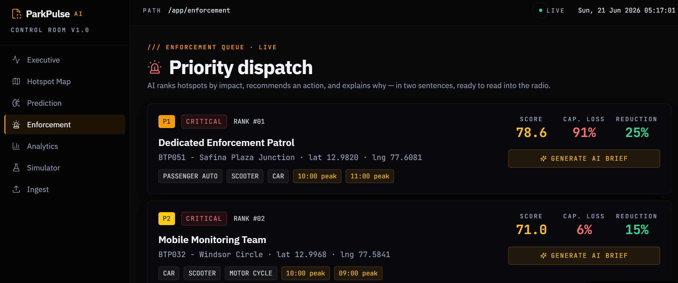


AI ASSISTANT
AI-Powered Enforcement Assistant
AI-Generated Reports
Automated operational briefings synthesized from hotspot data
Smart Recommendations
Priority actions ranked by impact score and resource availability
Priority Hotspots
Top-N zones flagged for immediate enforcement deployment
Risk Assessment
Junction-level risk scoring with congestion propagation analysis
ParkPulse AI
14 / 27

Slide 16
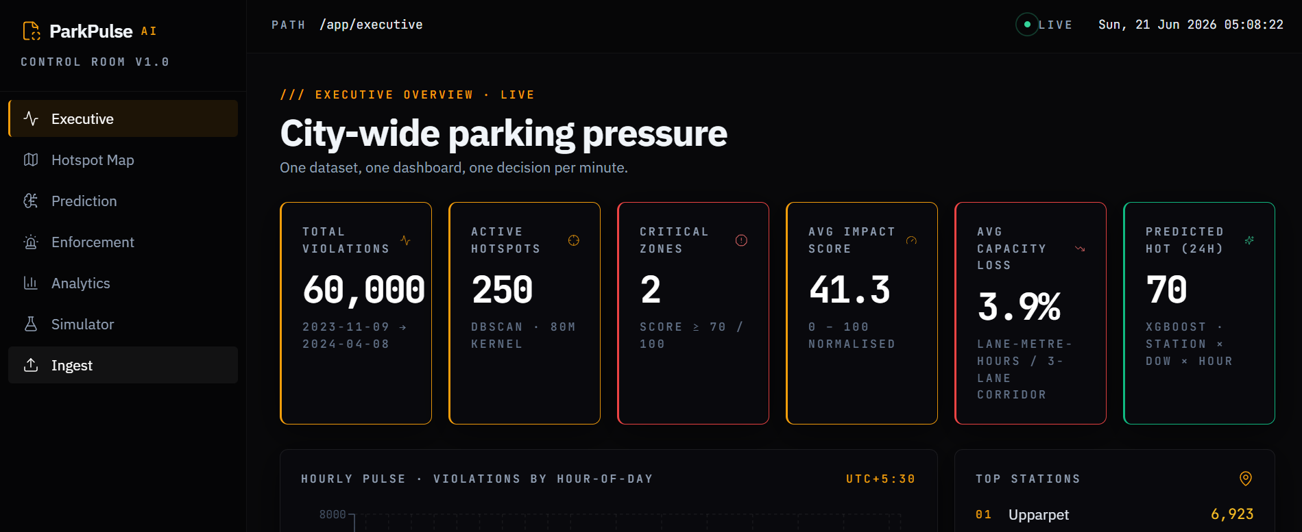
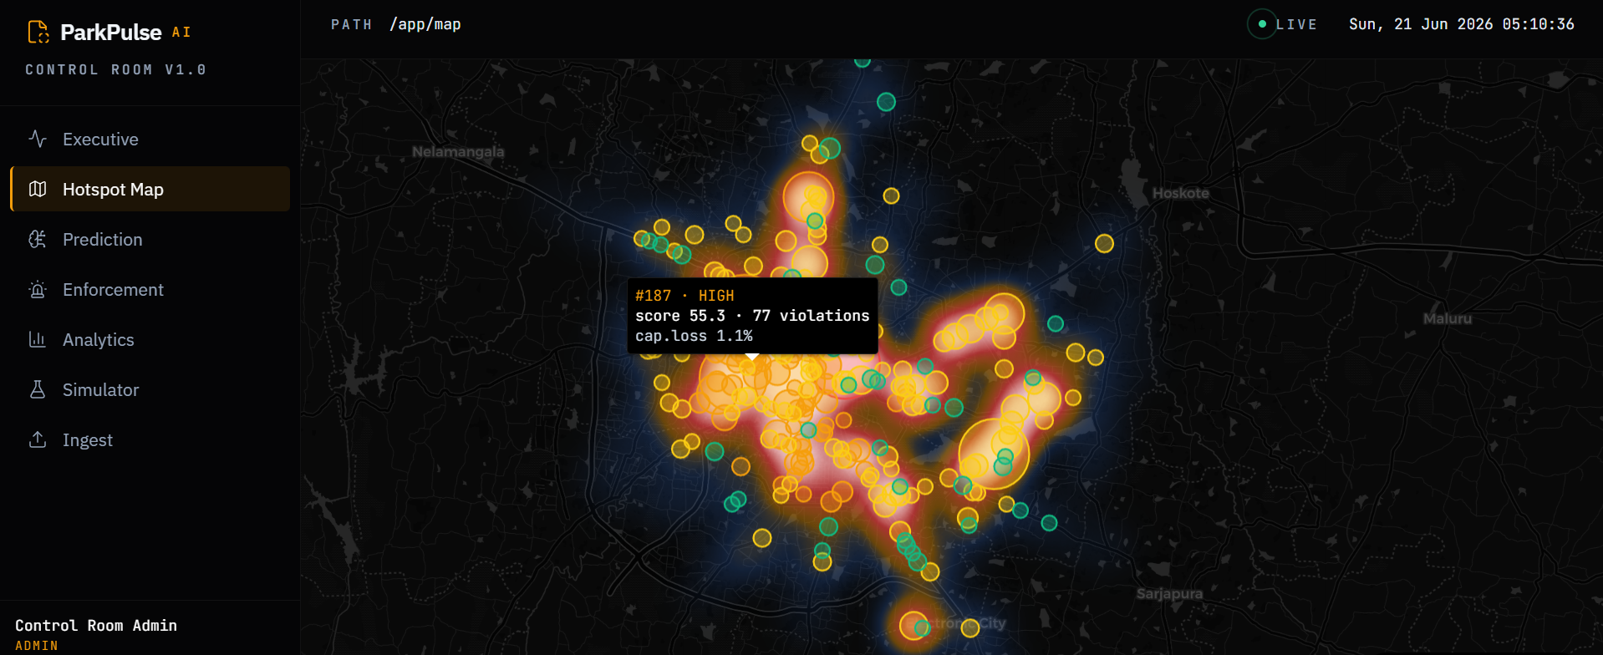
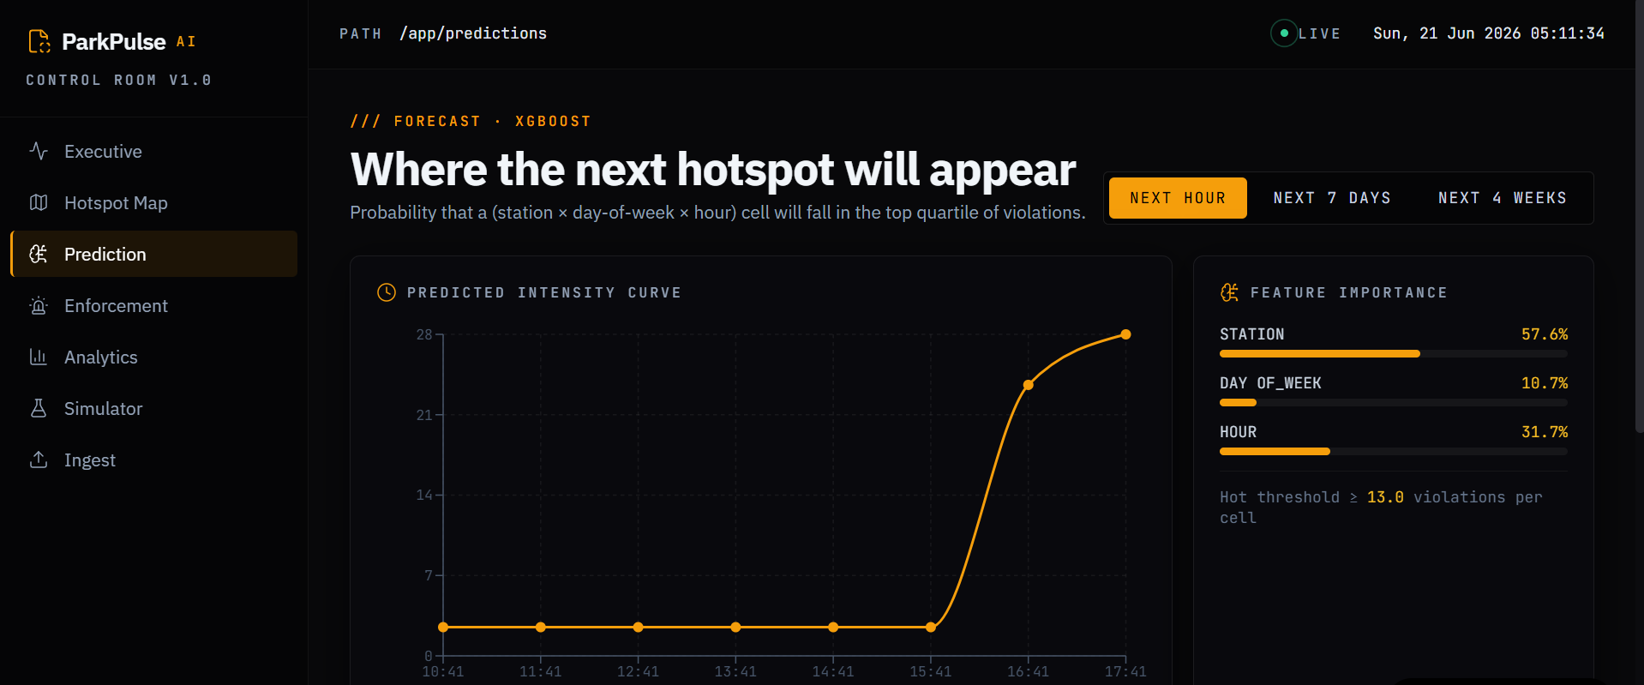
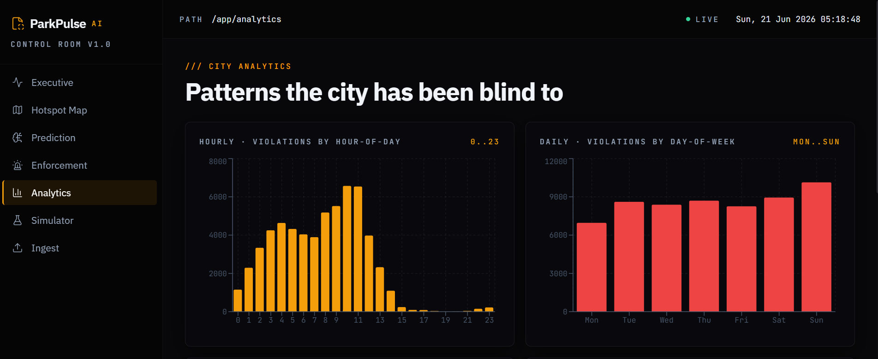
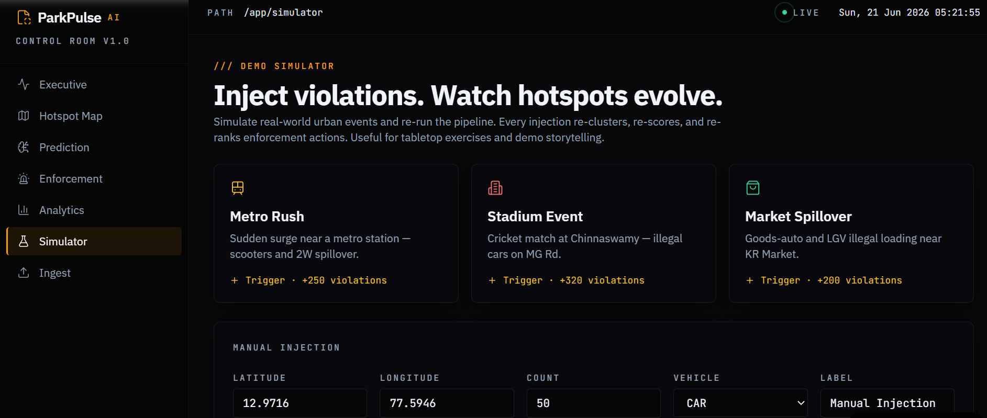
PRODUCT DEMO
Product Demo Overview
Executive Command Center
Hotspot Intelligence
Predictive Analytics
Live KPIs, city-wide overview
Geospatial violation mapping
Hourly/daily/weekly forecasts
Enforcement Intel
Analytics Module
Scenario Simulator
AI briefings & prioritization
Deep-dive data exploration
Intervention planning
ParkPulse AI
15 / 27

Slide 17
MODULE: EXECUTIVE
Executive Command Center
Real-time operational KPIs for city-wide parking pressure monitoring
60K
Total Violations
250
Active Hotspots
2
Critical Zones
41.3
Avg Impact Score
3.9%
Capacity Loss
70
Predicted Hot (24H)
ParkPulse AI
16 / 27

Slide 18
MODULE: HOTSPOTS
Hotspot Intelligence Module
Geospatial analytics powered by DBSCAN, HDBSCAN & MiniBatch K-Means
ParkPulse AI
17 / 27

Slide 19
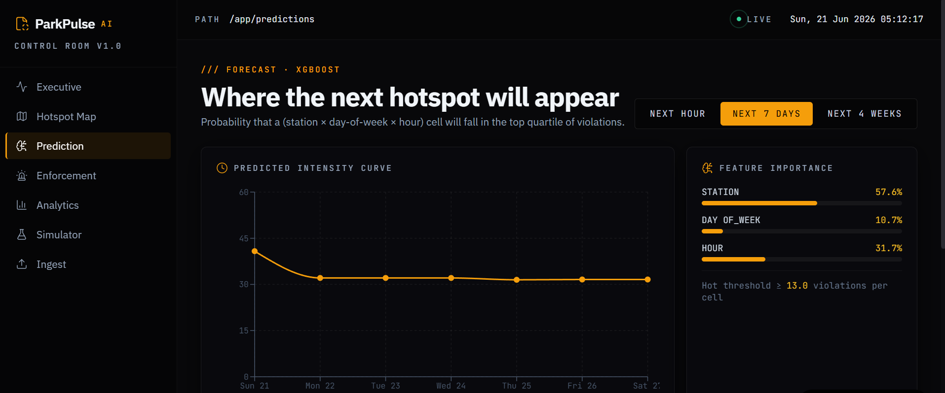
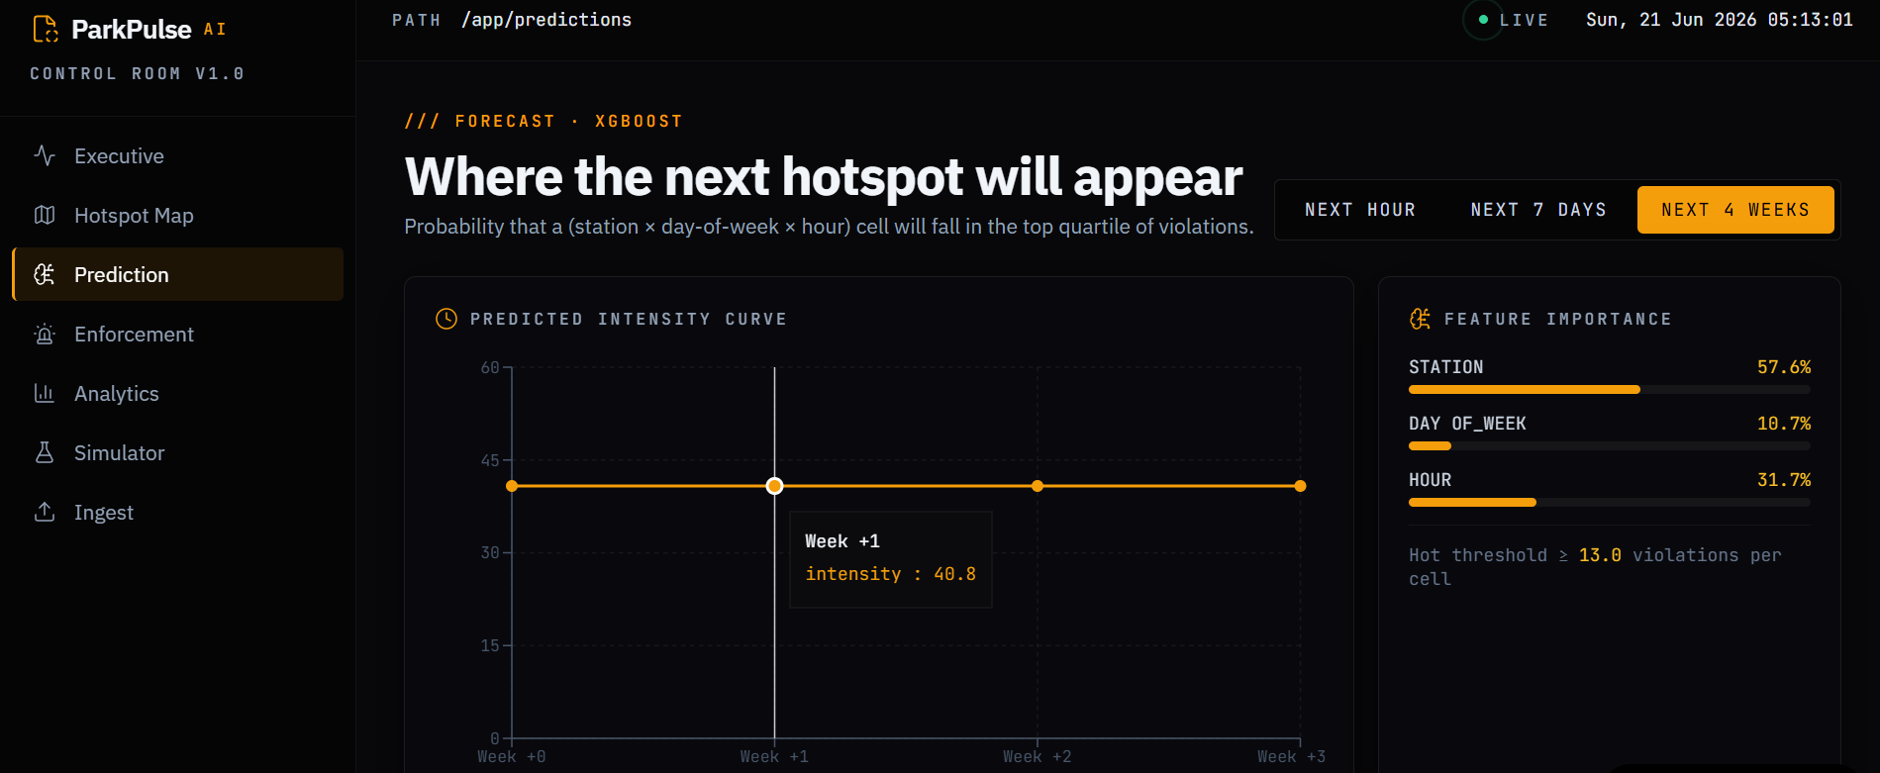
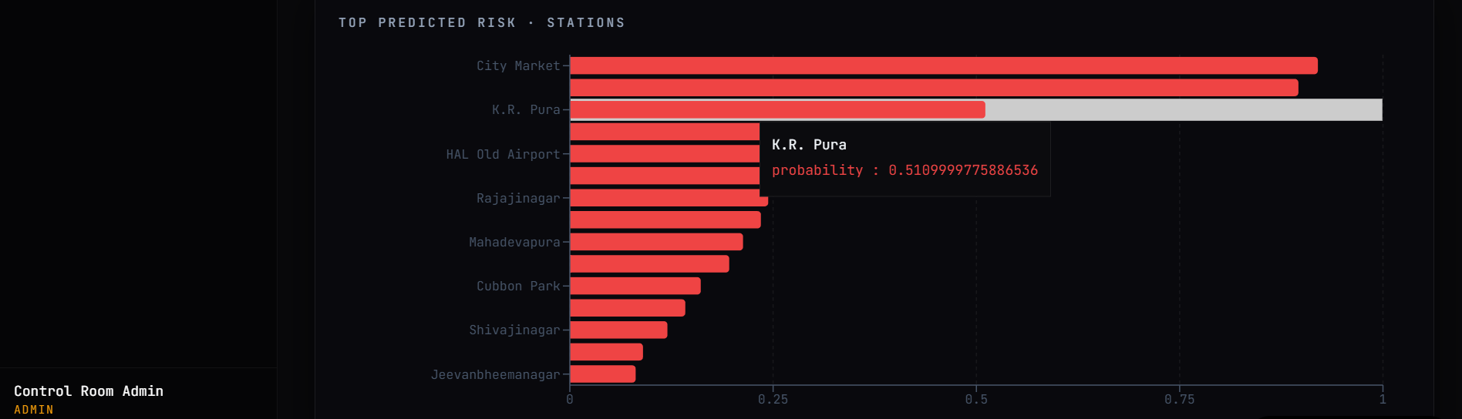
MODULE: PREDICTIONS
Predictive Analytics Module
XGBoost-powered forecasting across hourly, daily, and weekly horizons
PREDICTIVE INSIGHTS
Hourly granularity: Pinpoint exact hours for patrol deployment
Station-level forecasting: Per-police-station violation predictions
Day-of-week patterns: Weekday vs weekend violation behavior modeling
ParkPulse AI
18 / 27

Slide 20
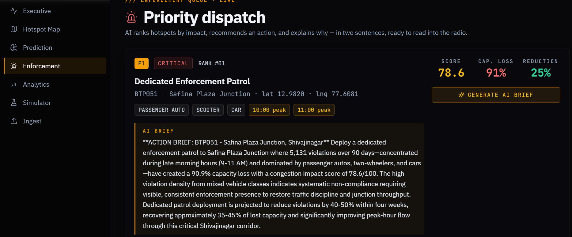
MODULE: ENFORCEMENT
Enforcement Intelligence Module
AI-generated enforcement briefings with prioritized action items
ParkPulse AI
19 / 27

Slide 21
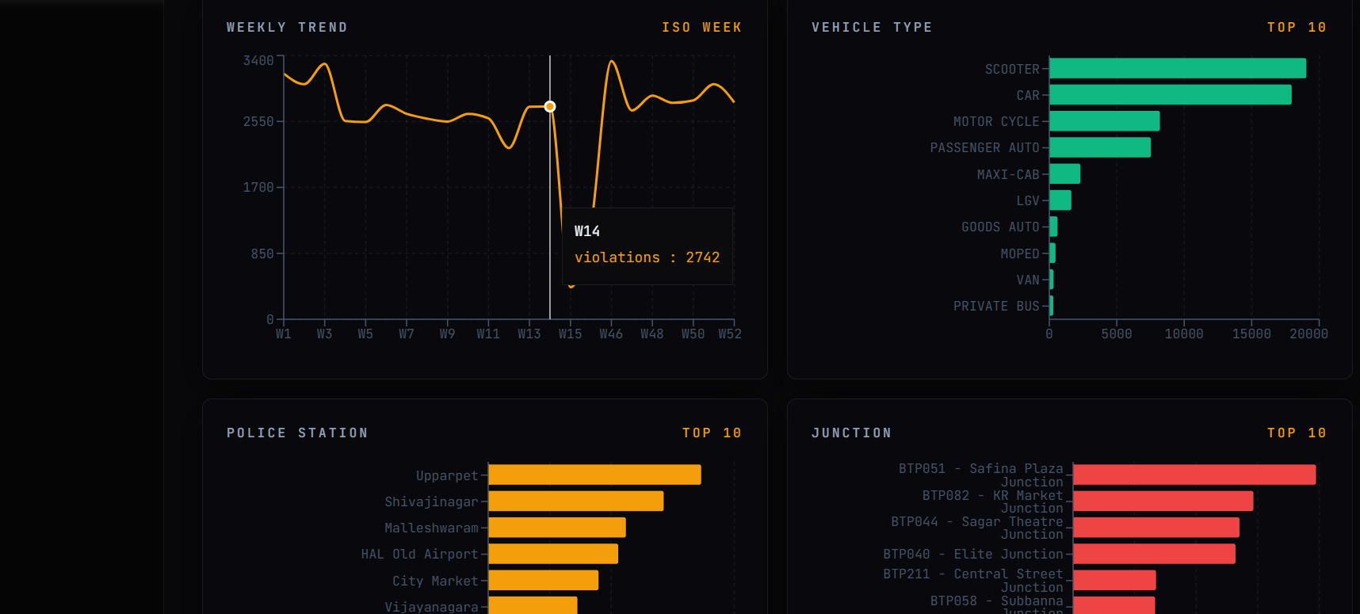
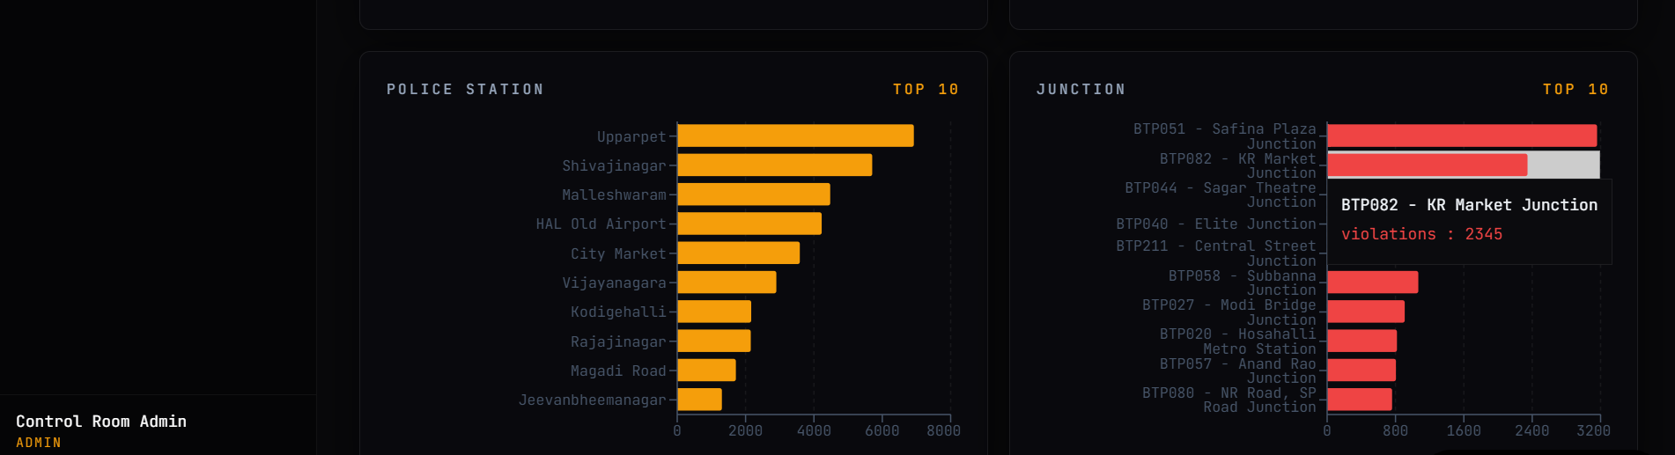

MODULE: ANALYTICS
Analytics Module
Deep-dive data exploration and decision-support analytics
Violation distribution by type and zone
Temporal trend analysis with drill-down
Station-wise comparative performance
Correlation: violations vs congestion
ParkPulse AI
20 / 27

Slide 22
MODULE: SIMULATOR
Scenario Simulator
Model intervention outcomes before deploying resources
What-if analysis for enforcement scenarios
Resource allocation optimization
Impact projection modeling
Before/after comparison
ROI estimation for interventions
ParkPulse AI
21 / 27

Slide 23
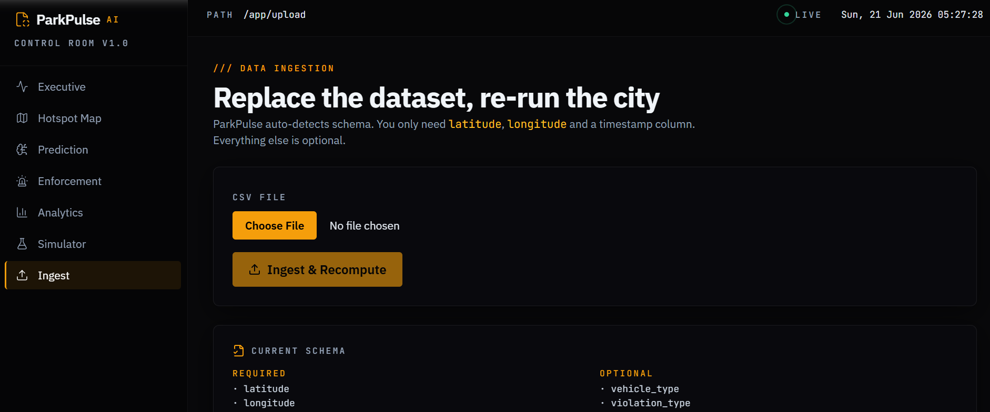

MODULE: DATA INGESTION
Data Ingestion Module
Automated pipeline for multi-source violation data processing
Source Integration
Connect to 60+ police station databases
Validation Layer
GPS, timestamp, and format verification
Transformation
Feature engineering and spatial encoding
Storage
MongoDB with indexed geospatial queries
ParkPulse AI
22 / 27

Slide 24

TECHNOLOGY
Technical Stack
FRONTEND
BACKEND
DATABASE
React.js
FastAPI
MongoDB
Leaflet Maps
Python
Geospatial Index
Dark Theme UI
REST APIs
Time-series
ML / ANALYTICS
AI LAYER
MAPS & GEO
DBSCAN
LLM-Powered Reporting
Leaflet
HDBSCAN
Natural Language Briefs
GeoJSON
MiniBatch K-Means
Spatial Clustering
XGBoost
ParkPulse AI
23 / 27

Slide 25
BUSINESS IMPACT
Business Impact
10x
40%
30%
25%
3x
Faster Hotspot
Identification
Better Enforcement
Efficiency
Reduced
Congestion
Improved Roadway
Utilization
Faster Emergency
Response
Enabling data-driven governance for smarter, safer, more efficient cities
ParkPulse AI
24 / 27

Slide 26



FUTURE VISION
The Road Ahead
PHASE 1
City-Scale Digital Twin
Full 3D mapping of parking infrastructure with real-time sensor integration
PHASE 2
Real-Time Intelligence
IoT sensor fusion for live violation detection and instant alerting
PHASE 3
Integrated Traffic Management
Unified platform connecting parking, signals, and emergency response
PHASE 4
Smart Mobility Command
Autonomous enforcement coordination across city departments
ParkPulse AI
25 / 27

Slide 27
WHY PARKPULSE AI MATTERS
→
→
→
DATA
INTELLIGENCE
ACTION
BETTER MOBILITY
From reactive patrols to predictive intelligence.
From scattered data to unified command.
From congestion to mobility.
ParkPulse AI
26 / 27

Slide 28
Thank You
ParkPulse AI
Transforming Parking Violations into Urban Mobility Intelligence
TEAM
ParkPulse AI Team
Flipkart Grid 6.0 | Smart City Track | Prototype Phase
2026
Data → Intelligence → Action → Better Mobility

