Slide 1
LICENSE PLATE DETECTION
AI-BASED
AND RECOGNITION
Team Members: M Rithanya (22011101090), VJ Vasudharini (22011101120)
Mentor: Dr. U Padmavathi, Assistant prof., Dept. of CSE, SNUC

Slide 2
INTRODUCTION,AIM & OBJECTIVES
Due to the increasing number of vehicles nowadays, the modern city needs to establish the effective and efficient automatic traffic system for the management of the traffic law enforcement. Number plate recognition leads the significant role in this condition. We are using AI to detect license plates from images and in real-time from video, Apply an Easy OCR to license plates to extract the plate number, and Save license plates detected for future analysis and searching. The detection and recognition accuracy can be achieved by using leveraging technology such as Tensor Flow
AIM: To develop an AI-powered Automatic Number Plate Recognition (ANPR) system using TensorFlow, capable of accurately detecting and recognizing license plates from images and real-time video feeds. The system will extract plate numbers using Easy OCR and store them for future analysis, contributing to improved traffic management in urban areas with a high volume of vehicles
OBJECTIVES: The objective of this project is to propose a method to implement an Automatic detection and recognition of license plates that overcomes the complex difficulties caused by the previous systems such as smoke and fog, rain and snow, different angles of sunlight, and so on, the quality of some license plate images varies in varying degrees This system has high accuracy by leveraging technologies such as CV, OCR, filtering OCR, and Tensor Flow object detection.

Slide 3
Workflow of methadology
01
02
03
04
Import Required Libraries:
Data fetching:
In this project the virtual environment is created and the necessary dependencies are installed.
The image is cloned from Kaggle and the TF records are created.
Preprocessing:
Model Training:
The input image is then fed into the system, for further preprocessing such as RGB to grayscale, noise removal, normalization, etc.
pipeline is created and the model is trained for 10000 steps. After training the model the plates from the images and videos are recorded.

Slide 4
Workflow of methadology
05
06
07
08
OCR Application:
character recognition:
OCR is applied and the detection threshold is set.
The final step involves performing optical character recognition on the segmented plate i.e. the width and height of the image are extracted.
display of number:
Future Analysis:
Now, The vehicle number is displayed and the character is obtained with high accuracy.
saving results for future purposes, and analysis.

Slide 5
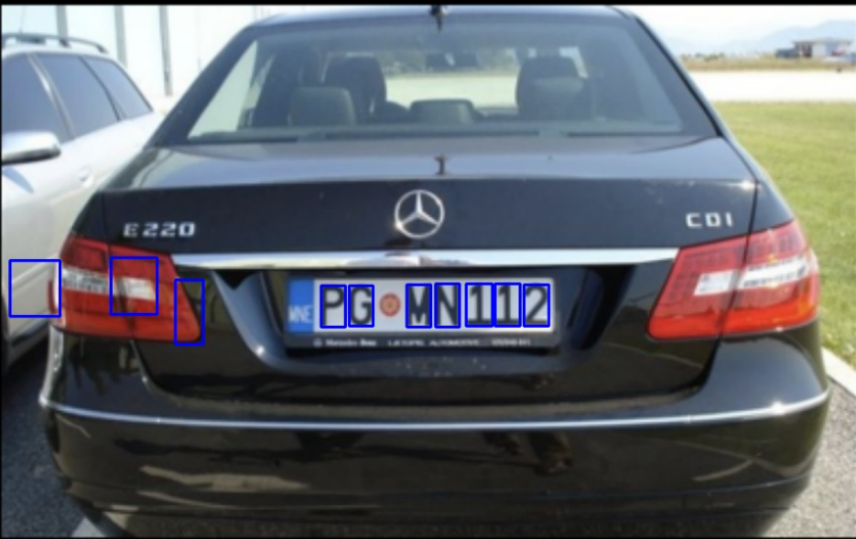
IMPLEMENTATION AND RESULTS:
Primary image used to train the model:
Character recognition

Slide 6





Various stages of recognition:
1.
2.
3.
4.
5.

Slide 7
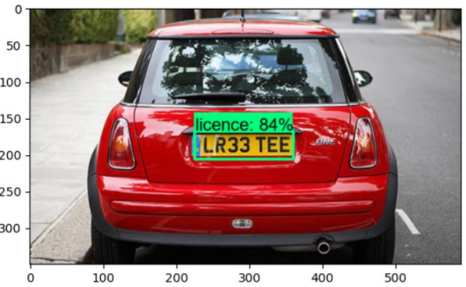
RESULTS
The ANPR system has achieved remarkable success in both license plate detection and recognition. It exhibits exceptional accuracy in identifying alphanumeric characters within license plates, whether in still images or real-time video streams. Furthermore, the system efficiently archives this information for subsequent analysis, establishing its robust reliability across a diverse range of operational scenarios. These outcomes highlight its effectiveness and versatility.

Slide 8
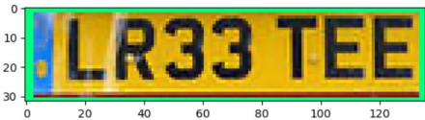
INFERENCES
The implications of these results are project-specific and hold practical value. The ANPR system, with its high accuracy, is poised to enhance traffic management in modern cities. Its ability to reduce manual intervention will result in more efficient resource allocation, streamlining traffic law enforcement and contributing to public safety by enabling the tracking of vehicles. The structured database created by the system will empower detailed traffic analysis, supporting better urban planning decisions, traffic optimization, and congestion alleviation. Furthermore, the system's adaptability and scalability are well-suited to address the evolving requirements of contemporary urban development.

Slide 9
Conclusion and Future scope
The ANPR system has significant potential, seamlessly integrating into real-time traffic management and surveillance networks. Ongoing machine learning enhancements will further refine recognition capabilities. The structured database empowers in-depth traffic analytics for urban planning and optimization. Its scope extends to security and law enforcement, including tracking stolen vehicles. User-friendly interfaces streamline adoption, and scalability ensures adaptability to evolving urban needs.
The ANPR system, driven by AI and TensorFlow technology, has successfully demonstrated its efficiency and reliability in accurate license plate detection and recognition. It effectively stores this data for future analysis. The system's adaptability positions it as a valuable asset for modern urban environments, promising enhanced traffic management, public safety, and urban development.

Slide 10
THANKS!

