Slide 1
Digital Portfolio
STUDENT NAME:RITHANYAA K
REGISTER NO AND NMID:2428k0393/77CED3214C280EFA082411D6C1F22EB5
DEPARTMENT: B.Sc Computer Science with Artificial Intelligence and Data Science
COLLEGE: KPR College of Arts Science and Research
UNIVERSITY:Bharathiyar University

Slide 2
PROJECT TITLE
SIMPLE CONTACT BOOK

Slide 3


AGENDA
Problem Statement
Project Overview
End Users
Tools and Technologies
Portfolio design and Layout
Features and Functionality
Results and Screenshots
Conclusion
Github Link
3/21/2024 Annual Review

Slide 4

PROBLEM STATEMENT
The goal of this project is to create a simple contact book application that allows users to manage their personal contacts. The application should support basic features such as adding new contacts with names and phone numbers, viewing all saved contacts, searching for a contact by name, and deleting a contact. This project helps in understanding how to store, retrieve, and manage data using basic programming concepts such as lists or dictionaries, as well as implementing simple user interactions through a menu-driven interface.

Slide 5

PROJECT OVERVIEW
This project is a simple Contact Book application designed to help users store and manage personal contact information. It allows users to add, view, search, and delete contacts through a user-friendly interface. The main goal of this project is to understand and implement basic programming concepts such as data storage, input/output operations, and menu-driven systems. This project also serves as a foundation for building more advanced contact management systems in the future.

Slide 6

WHO ARE THE END USERS?
The end users of this Contact Book application are:
Students – to save and manage their friends’ or classmates’ contact details.
Teachers or Professionals – for keeping track of important contacts.
Anyone who wants a simple tool to store and search for phone numbers easily.
This app is useful for people looking for a basic and easy way to manage their personal contacts without using complex software.

Slide 7

TOOLS AND TECHNIQUES
IDE/Editor: VS Code, PyCharm, or any text editor
Data Storage: Dictionary or List (for storing contacts in memory)
Techniques Used:
Basic Input/Output handling
Conditional statements and loops
Functions for modular code
Programming Language: Python (or any language used)
Menu-driven program design

Slide 8
POTFOLIO DESIGN AND LAYOUT
The portfolio for this project is designed in a clean and organized format. It includes:
Title Page – Project name, student details, and date.
Project Overview – Brief explanation of what the project does.
Objectives – Goals of the project.
Tools & Techniques Used – Programming languages, IDEs, and concepts applied.
Screenshots/Code Snippets – To showcase the design and functionality.
Output Samples – Example results from running the project.
Conclusion – Summary of what was learned and achieved.
8

Slide 9
FEATURES AND FUNCTIONALITY
Add Contact Allows users to save a new contact by entering a name and phone number.
View All Contacts Displays a list of all saved contacts in an organized format.
Search Contact Users can search for a contact by name to quickly find details.
Delete Contact Removes a contact from the list based on the name.
Simple Interface Easy-to-use, menu-driven system suitable for beginners.

Slide 10

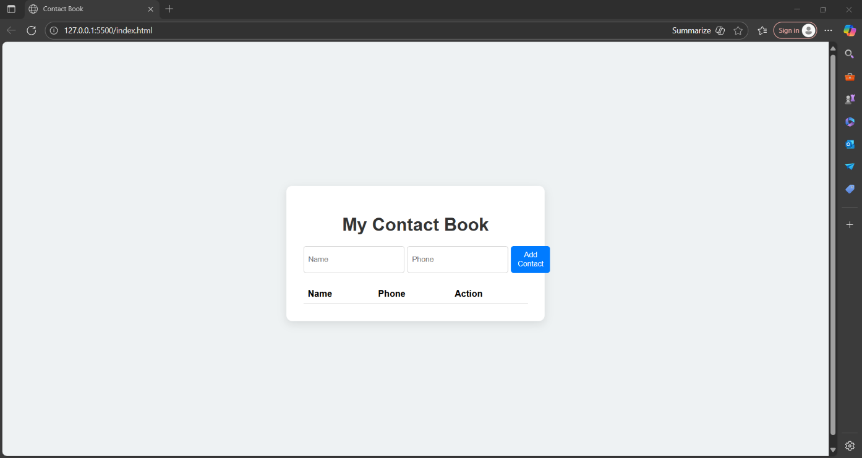
RESULTS AND SCREENSHOTS
The Contact Book project was successfully implemented in Python.
It allows users to add, view, search, update, and delete contacts in a simple menu-driven format.
The program stores basic details like Name, Phone Number, and Email ID.
3/21/2024 Annual Review
10

Slide 11
CONCLUSION
The Contact Book project successfully demonstrates how to build a basic data management application using simple programming concepts. Through this project, we learned how to collect, store, search, and delete data efficiently using user input. It helped improve problem-solving skills, logic building, and understanding of real-world application development. This project lays a strong foundation for creating more advanced systems in the future.
11

