Slide 1
COLLEGE MANAGEMENT SYSTEM
React + Vite | FastAPI | Python
Developed by Rithesh Reddy

Slide 2
Project Overview
• Secure Admin & Faculty Login
• Dashboard with Analytics
• Colleges Management
• Students Management
• Departments Management
• Courses Management
• Faculty Management

Slide 3
Technology Stack
Frontend : React + Vite
Backend : FastAPI
Language : Python
Database : SQLite / MySQL
IDE : VS Code

Slide 4
System Architecture
React Frontend ➜ FastAPI Backend ➜ Database

Slide 5
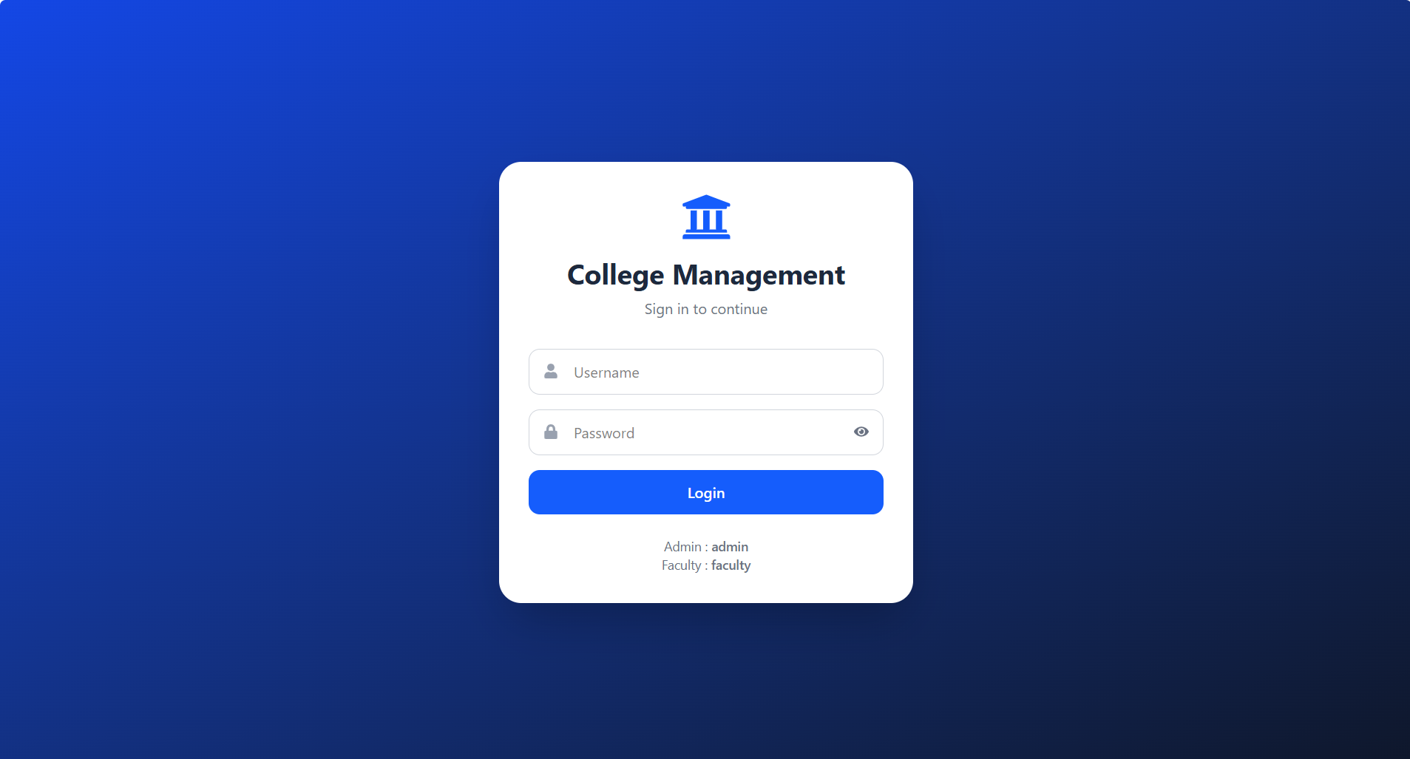
Login Module

Slide 6
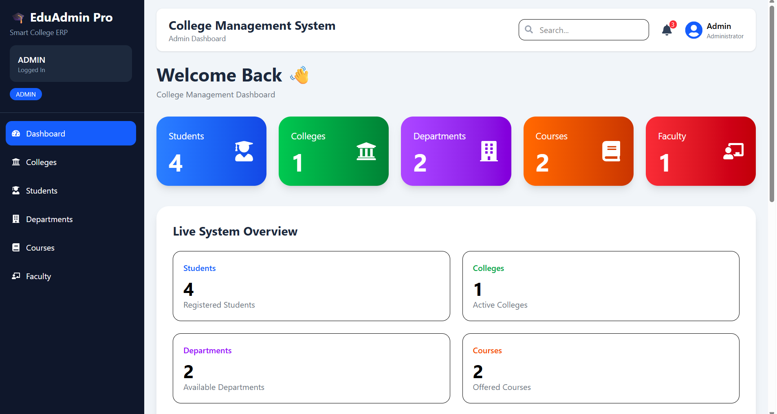
Dashboard

Slide 7
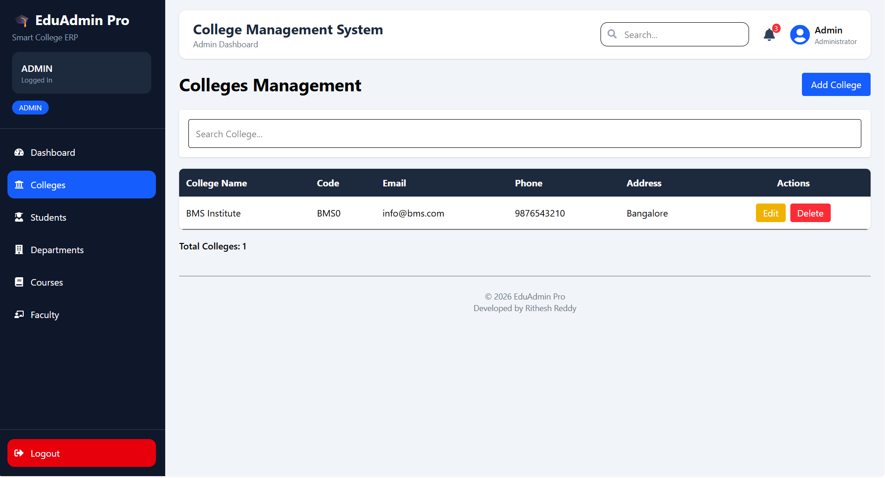
Colleges Management

Slide 8
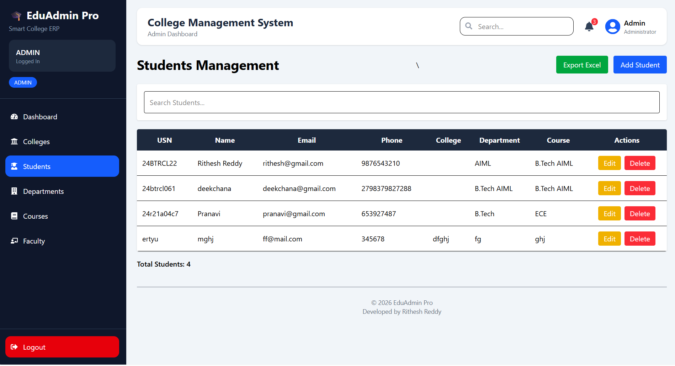
Students Management

Slide 9
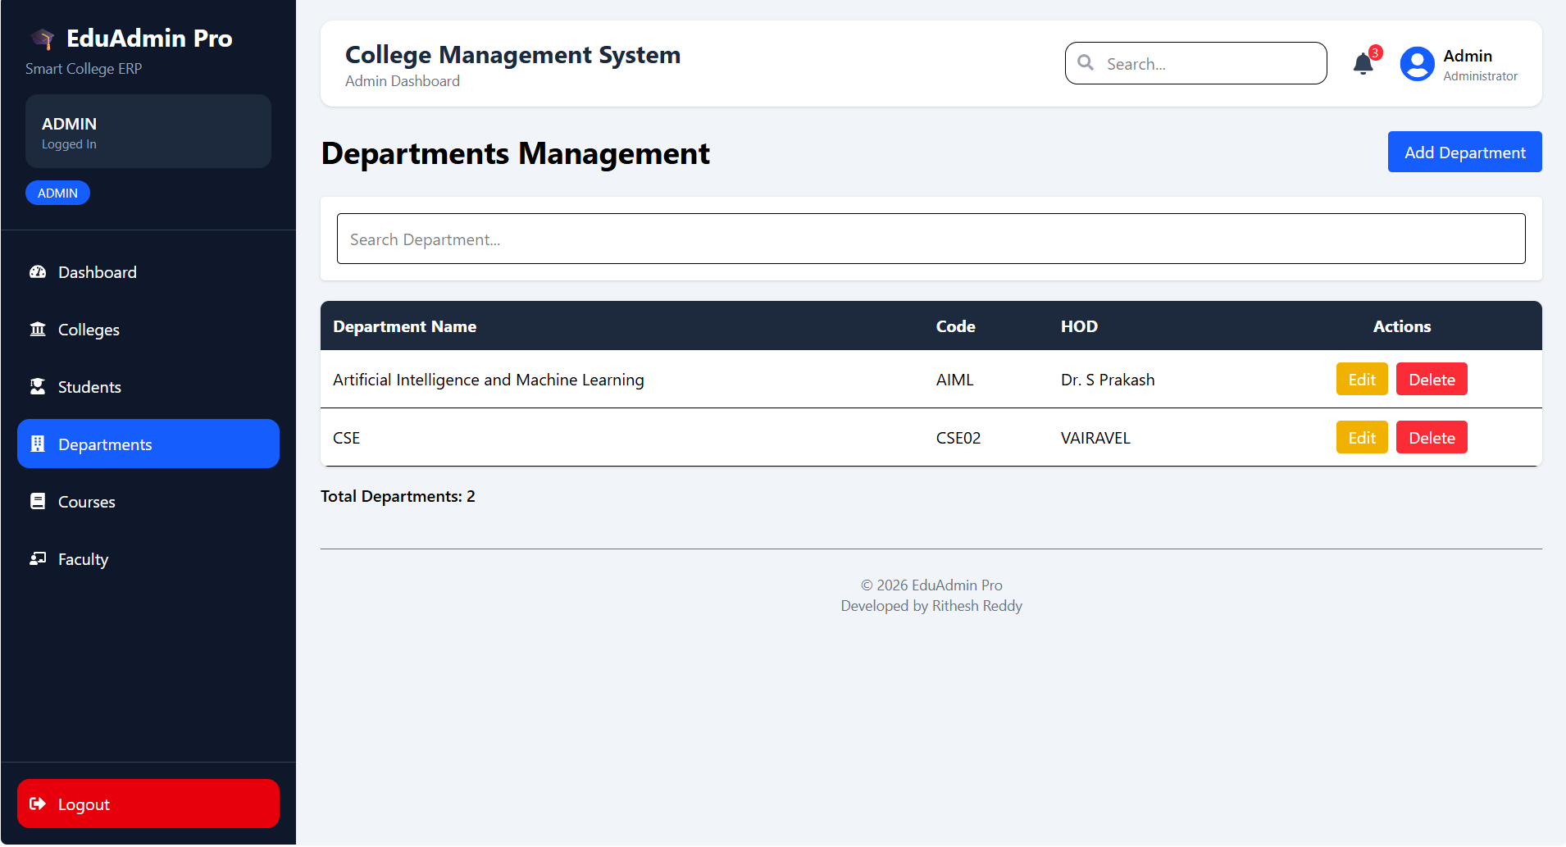
Departments Management

Slide 10
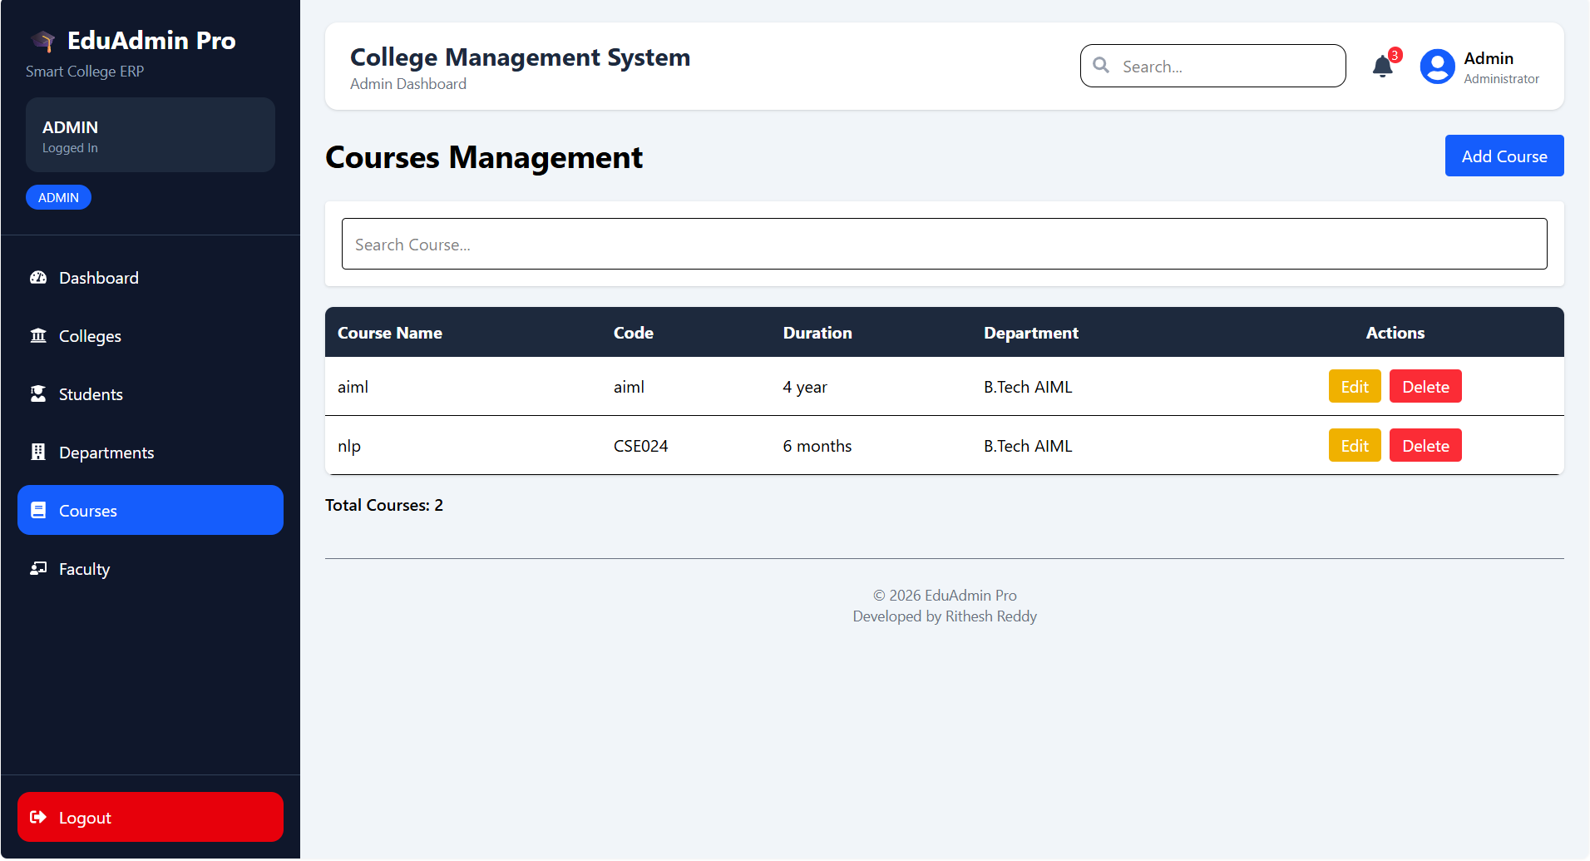
Courses Management

Slide 11
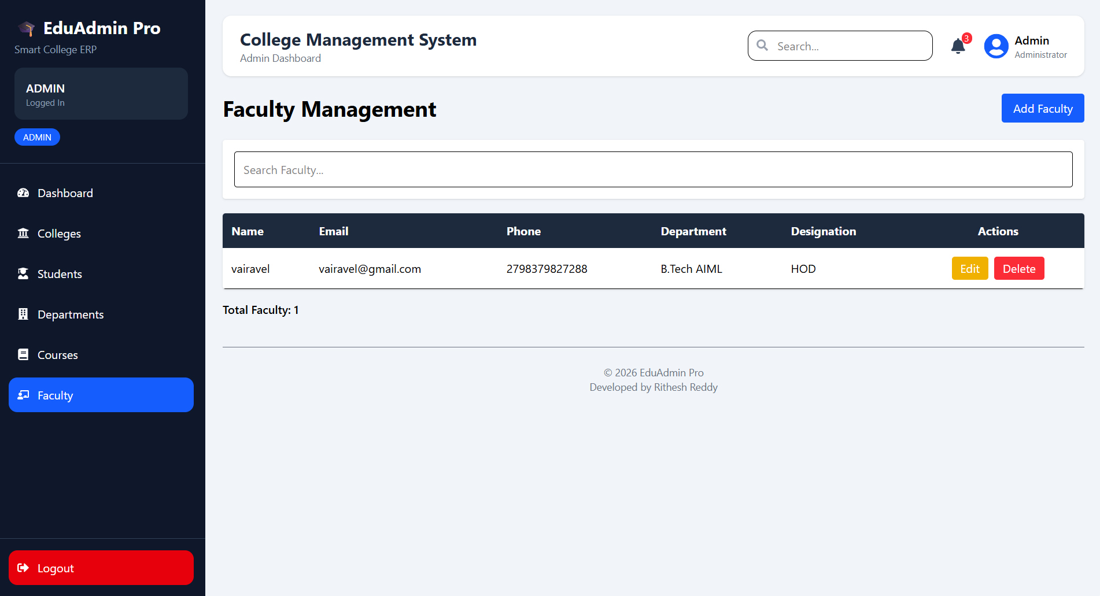
Faculty Management

Slide 12
Key Features
✓ Authentication
✓ CRUD Operations
✓ Search Functionality
✓ Dashboard Analytics
✓ Responsive UI
✓ Centralized Data Management

Slide 13
THANK YOU

