Slide 1

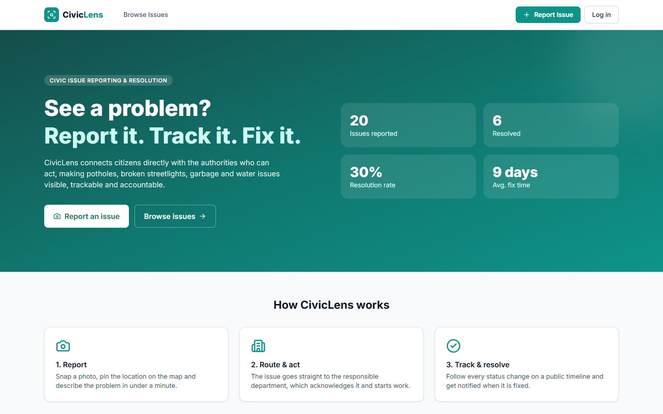
VISION2WEB · Full Stack Web Development Hackathon
CivicLens
Report it. Track it. Fix it.
A centralized civic issue reporting and resolution platform that connects citizens with authorities, making local problems visible, trackable and actionable.
Live: civiclens-goh6.onrender.com
Code: github.com/Rithi-byte/civic-lens
Notes:
Introduce the team and CivicLens: a platform where citizens report local civic problems and the responsible department resolves them publicly.

Slide 2



The problem
Problem statement given to us
“CivicLens is a centralized civic issue reporting and resolution platform that connects citizens with authorities, making local problems visible, trackable, and actionable.”
Why this matters today
Invisible
Untrackable
No accountability
No data
Complaints go into phone calls, WhatsApp groups or paper files. Nobody else can see them.
Citizens never learn whether a complaint was received, who owns it or when it will be fixed.
Departments can close complaints silently. There is no record of what was done.
The city cannot see which areas or categories keep failing, so it cannot plan ahead.
Notes:
Read the problem statement. Explain the four pain points with the current way civic complaints work.

Slide 3



Our solution: one platform, three roles
Every issue flows from citizen → department → resolution, in public
Citizen
Authority officer
Admin
Report an issue with photo, category, urgency and a map pin / GPS
Track own reports with a live status timeline
Upvote “I face this too” and comment
Instant in-app notifications on every update
Department queue: sees only their category
Sorted by priority and community support
Move issues through the enforced workflow
Must add a note when resolving or rejecting
City-wide analytics dashboard
Assign officers and change priority
Create and deactivate officer accounts
Department performance: assigned vs resolved
Notes:
Explain the three roles and how an issue moves from a citizen to the right department and finally to resolution.

Slide 4







Key features
Everything below is built, deployed and working in the live demo
Smart reporting
Live issue map
Status timeline
Auto-routing
Photo upload with in-browser compression, 6 categories, 4 urgency levels.
Leaflet + OpenStreetMap. Click-to-pin or GPS. Markers colored by status.
Every change stored with who, when and a note. Fully public.
Each issue goes straight to the officers of the matching department.
Notifications
Search & filter
Analytics
Secure by role
Officers alerted on new issues. Reporter and upvoters alerted on updates.
Full-text search, filters by category and status, 4 sort orders, pagination.
Status donut, category bars, 14-day trend, hotspot areas, avg. fix time.
JWT login, bcrypt passwords, role guards on every protected API.
Notes:
Walk through the eight main features quickly. Point out that all of them are live.

Slide 5




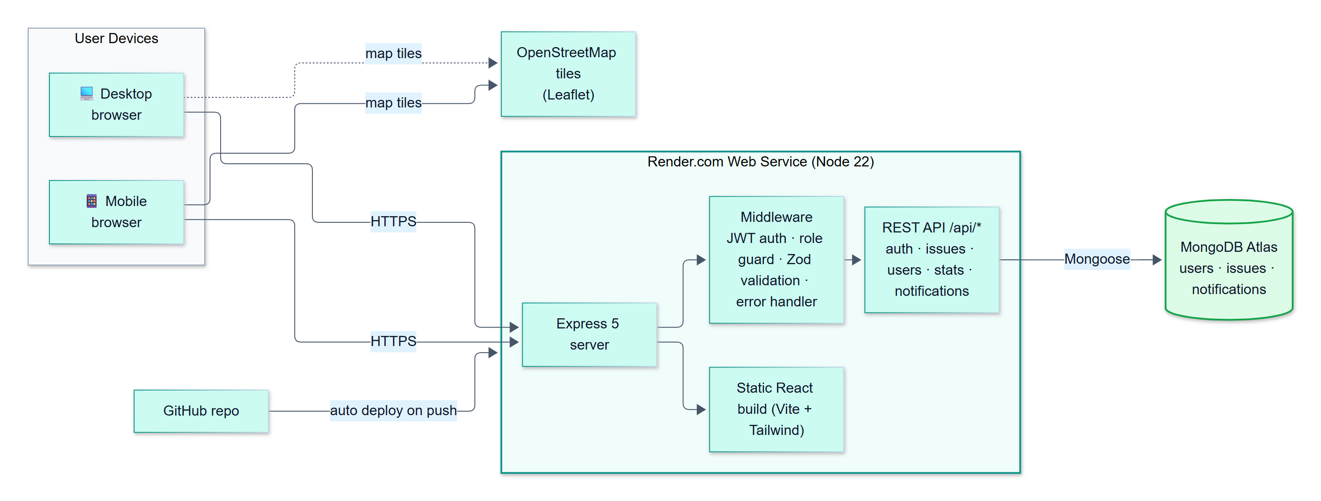
Tech stack & deployment architecture
MERN stack, deployed as a single web service
Frontend
Backend
Database
Hosting
React 19 · Vite · Tailwind CSS v4 · React Router · Leaflet · Recharts
Node.js 22 · Express 5 · Zod validation · JWT · bcrypt
MongoDB Atlas · Mongoose schemas, text + compound indexes
Render (auto-deploy from GitHub on every push)
Deployment diagram
Notes:
One Express server serves both the REST API and the built React app. MongoDB Atlas stores the data. Pushing to GitHub redeploys automatically.

Slide 6
UML · Use case diagram
Who can do what in CivicLens
CivicLens System
Register / Login
View department queue
Report issue
(photo + map pin)
Update status
with note
Authority
officer
Browse, search & filter
Assign officer
& priority
Citizen
Track reports &
notifications
View analytics
dashboard
Admin
Upvote & comment
Manage officer
accounts
Authority and Admin also log in and comment (links omitted for clarity).
Notes:
Citizens report and track. Authority officers work their department queue. Admins manage people and see analytics.

Slide 7
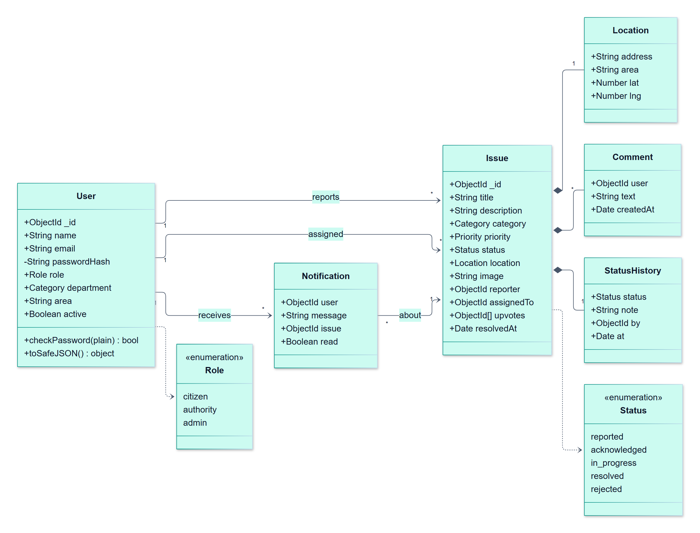
UML · Class diagram (data model)
MongoDB collections modelled with Mongoose
User
One collection for all roles. Authorities carry a department. Passwords stored as bcrypt hashes.
Issue
Core entity. Embeds Location, Comments and StatusHistory so one read returns the full story.
StatusHistory
Append-only audit trail: status, note, who changed it and when.
Notification
Per-user inbox, created automatically on new issues, status changes and comments.
Notes:
Explain the four main classes. Comments and history are embedded in the issue document for fast reads.

Slide 8
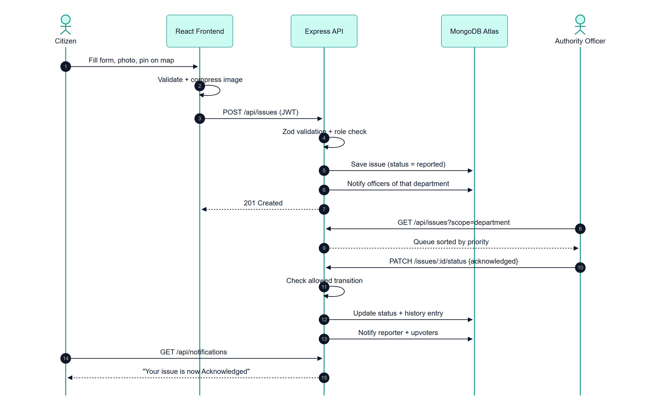
UML · Sequence diagram
Report an issue → department acknowledges → citizen is notified
Notes:
Walk the 15 steps: client-side validation, JWT-protected POST, server validation, routing notification, officer update with transition check, and citizen notification.

Slide 9
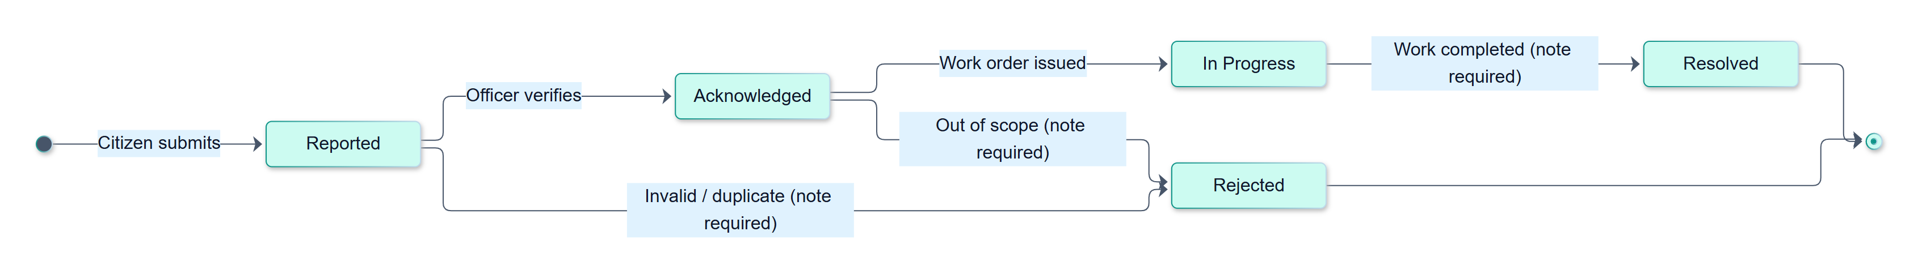

UML · State diagram (issue lifecycle)
The workflow is enforced by the server, not just shown in the UI
No shortcuts
Mandatory notes
Department scope
Citizen control
An officer cannot jump from Reported to Resolved. Invalid transitions return HTTP 400.
Resolving or rejecting requires a written note, shown publicly on the timeline.
Officers can only change issues in their own department or assigned to them.
A citizen can delete their report only while it is still in the Reported state.
Notes:
This is the accountability core of CivicLens. The server enforces the lifecycle and records every step.

Slide 10
Meeting the VISION2WEB general expectations
Every requirement from the hackathon brief, and how CivicLens satisfies it
Expectation | How CivicLens delivers it | Met
Responsive & user-friendly UI | Mobile-first Tailwind layout (tested at 390 px phone → desktop), toasts, loading and empty states, one-click demo logins | ✔
Frontend–backend via REST APIs | React + Axios talk to 19 Express REST endpoints; JWT sent as a Bearer token | ✔
Persistent database storage | MongoDB Atlas (cloud) with Mongoose schemas for users, issues and notifications, plus indexes | ✔
Input validation & error handling | Zod schemas on every API input + client-side checks; central error handler returns clear 400/401/403/404/409/413 messages | ✔
Role-based / workflow feature | Three roles (Citizen, Authority, Admin) and a server-enforced 5-state issue workflow | ✔
Functional demo with sample data | Auto-seeded 10 users and 20 realistic Chennai issues; publicly deployed on Render | ✔
Auth, dashboards, search, analytics, notifications only where specified | Each one serves the brief: search + map = visible, timeline + notifications = trackable, roles + dashboards = actionable | ✔
Notes:
Map each hackathon requirement to the implementation. All seven are met.

Slide 11
What makes CivicLens different
Typical complaint portal vs CivicLens
 | Typical portal | CivicLens
Visibility | Complaint is private between citizen and office | Every issue, status and officer note is public, with no login needed
Tracking | A ticket number and no updates | Live timeline and a notification on every status change
Accountability | Can be closed silently | Enforced workflow; resolving or rejecting needs a written note
Prioritisation | First come, first served | Community upvotes + urgency drive the officer queue
Routing | Manually forwarded between offices | Automatically routed to the right department
Planning data | None | Hotspot areas, trends and average resolution time
CivicLens doesn’t just collect complaints. It makes resolution public, enforces an accountable workflow, and lets citizens decide what gets fixed first.
Notes:
Our novelty is accountability and transparency, not just collecting complaints.

Slide 12
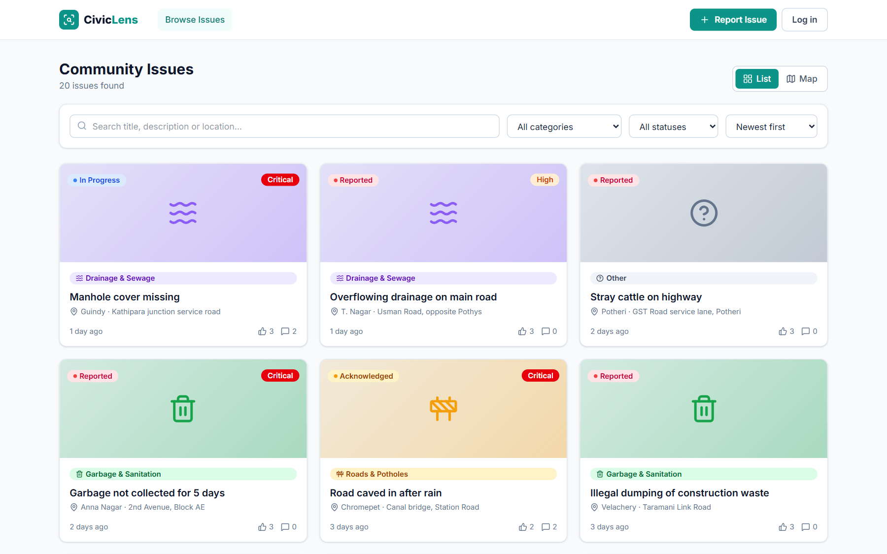
Screenshots · Public portal
Anyone can browse issues without logging in
Home: live stats, how it works, map, top issues
Browse: search, filter by category/status, sort
Notes:
Show the landing page and the public issue list with search and filters.

Slide 13
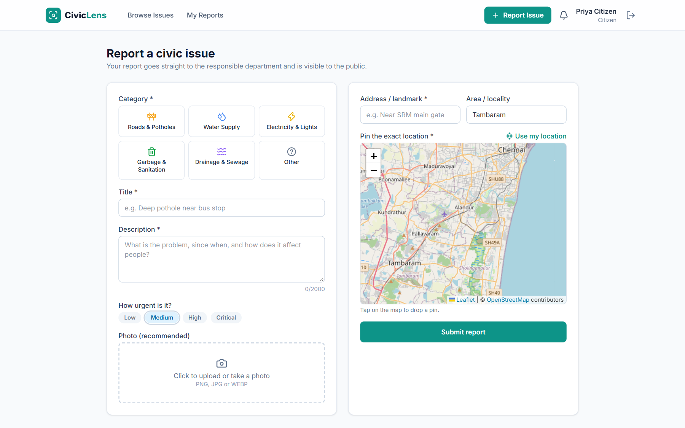
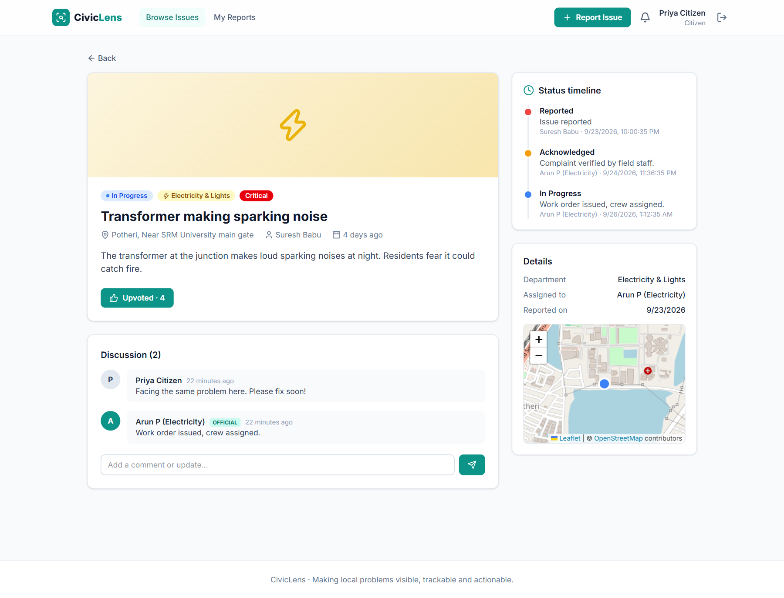
Screenshots · Citizen: report & track
Report in under a minute, then follow every step
Report form: category, photo, urgency, map pin / GPS
Issue page: timeline, upvotes, official replies
Notes:
Show the report form with the map picker and the issue detail page with the status timeline.

Slide 14
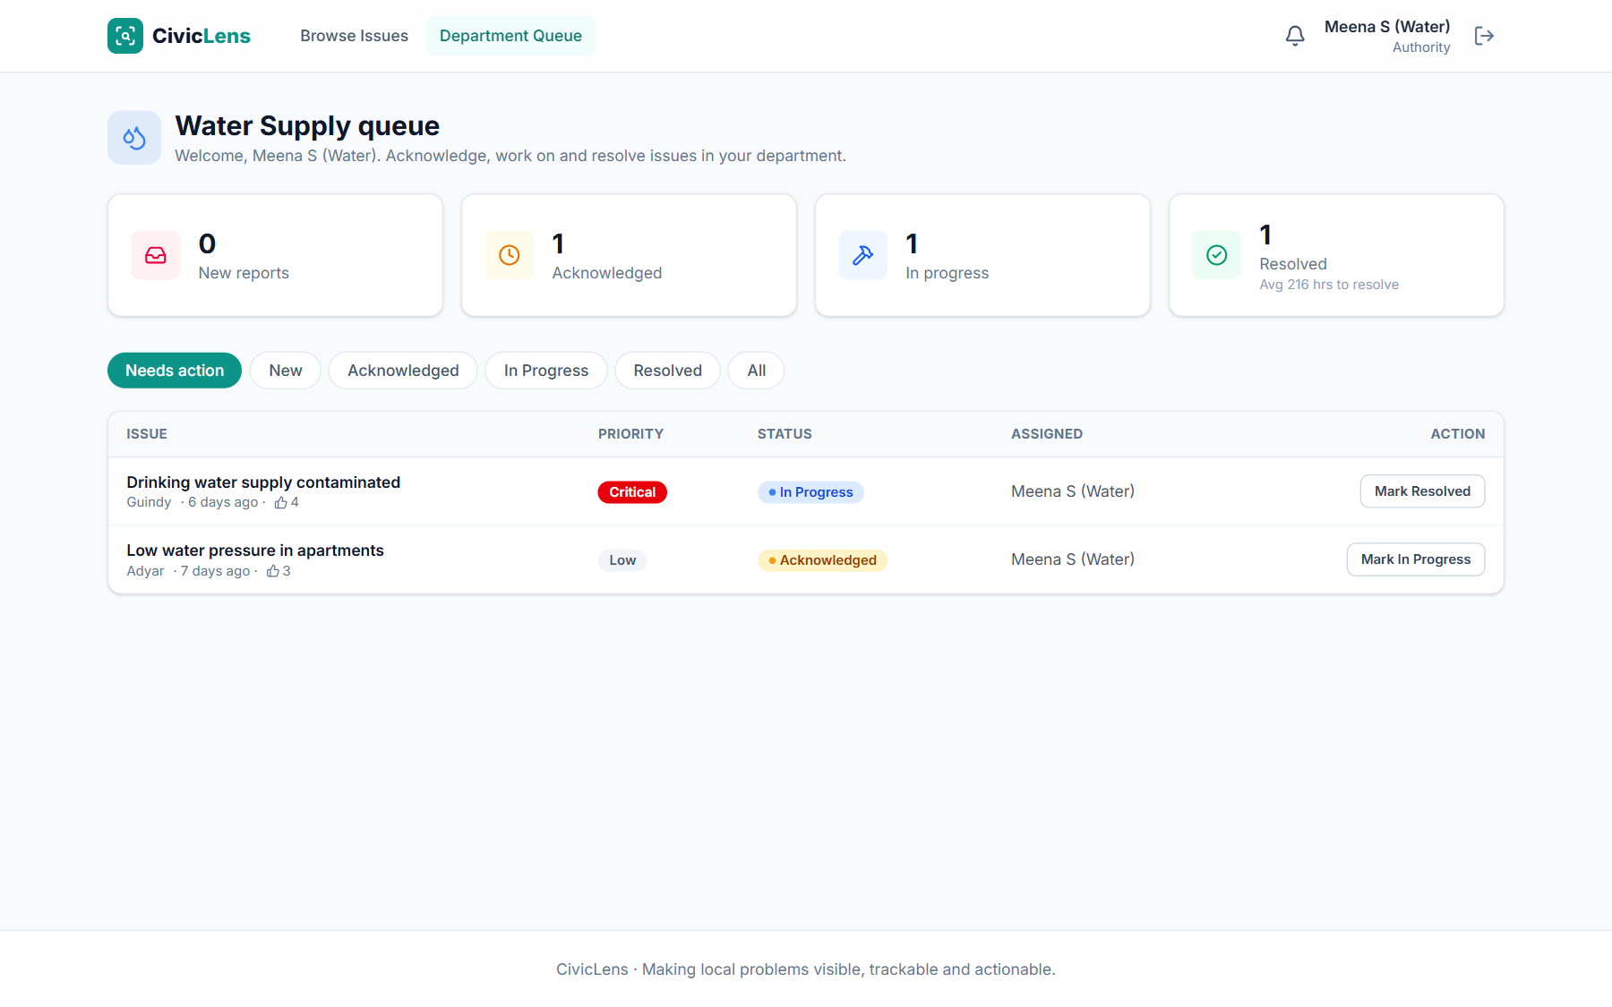
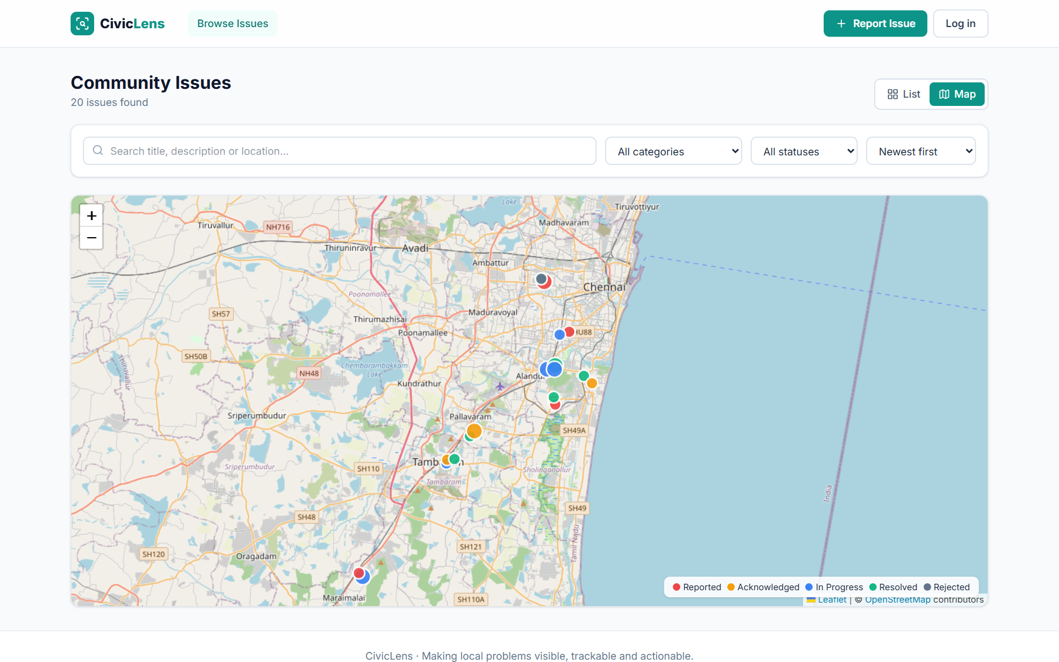
Screenshots · Authority queue & live map
Officers act on their department’s issues; everyone sees the city map
Department queue with one-click workflow actions
Live map: every issue colored by status
Notes:
Show the water department officer queue and the live map view.

Slide 15
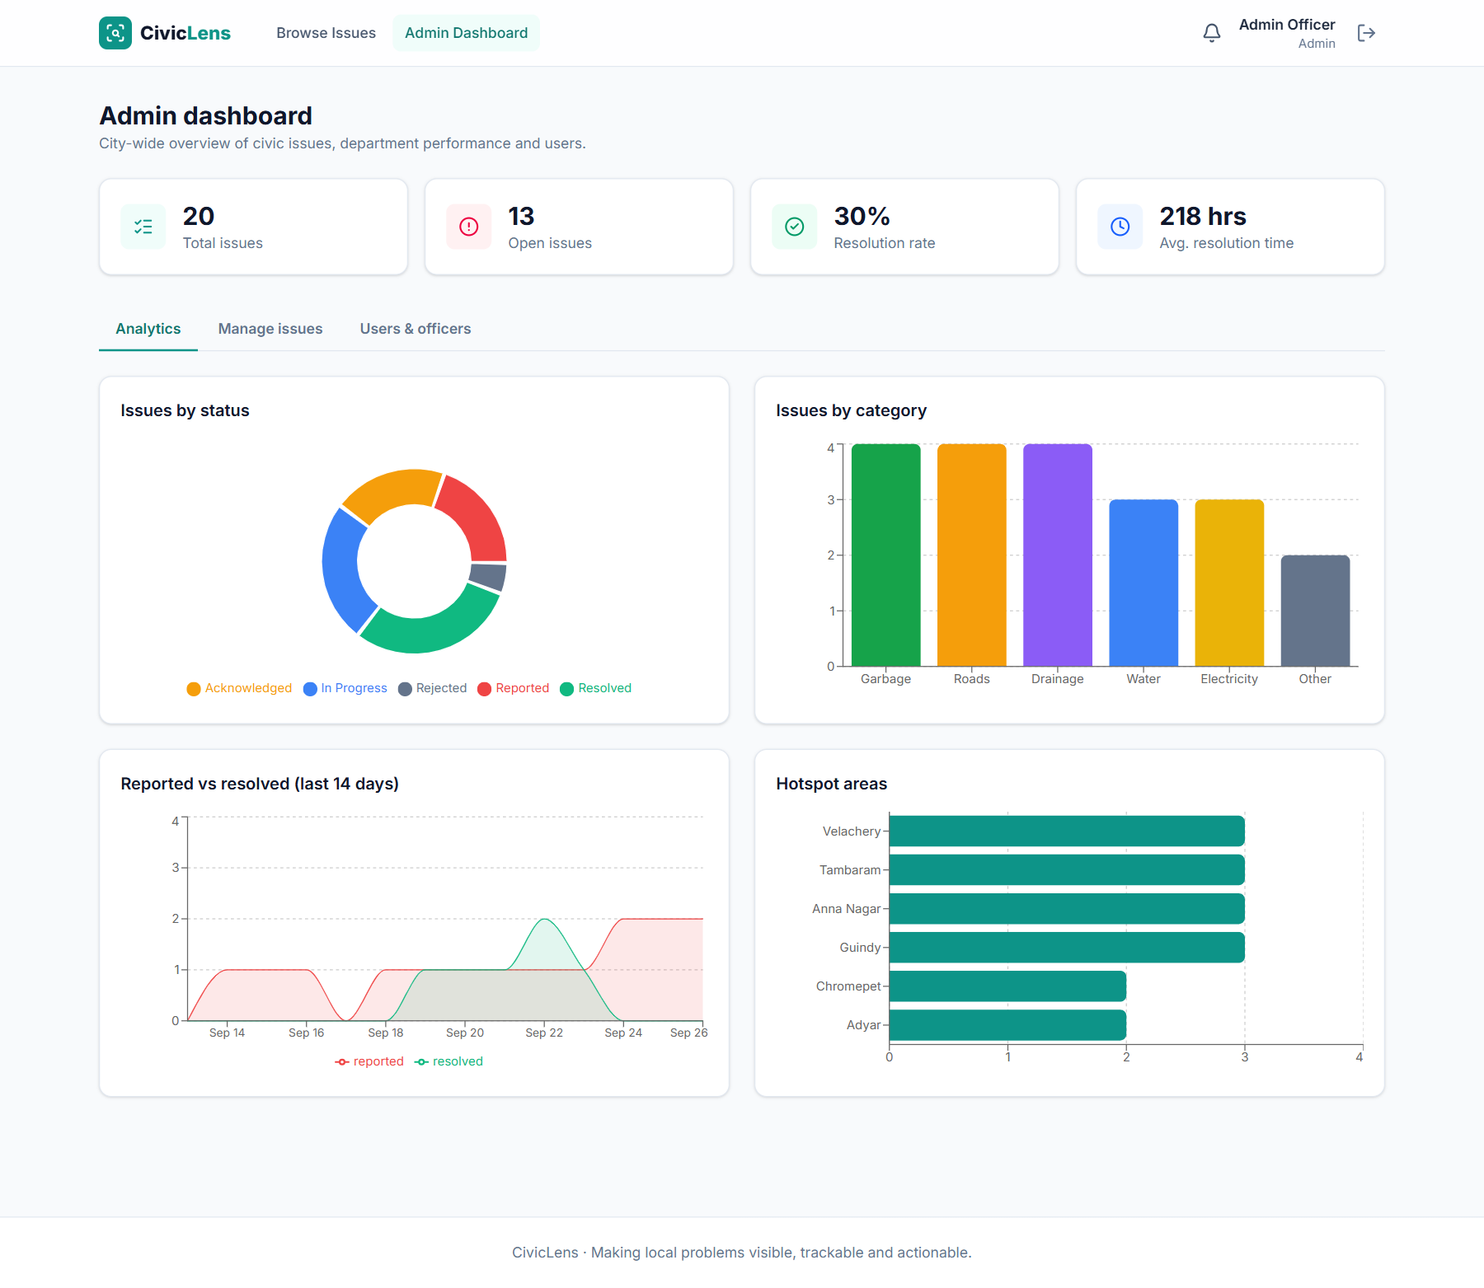
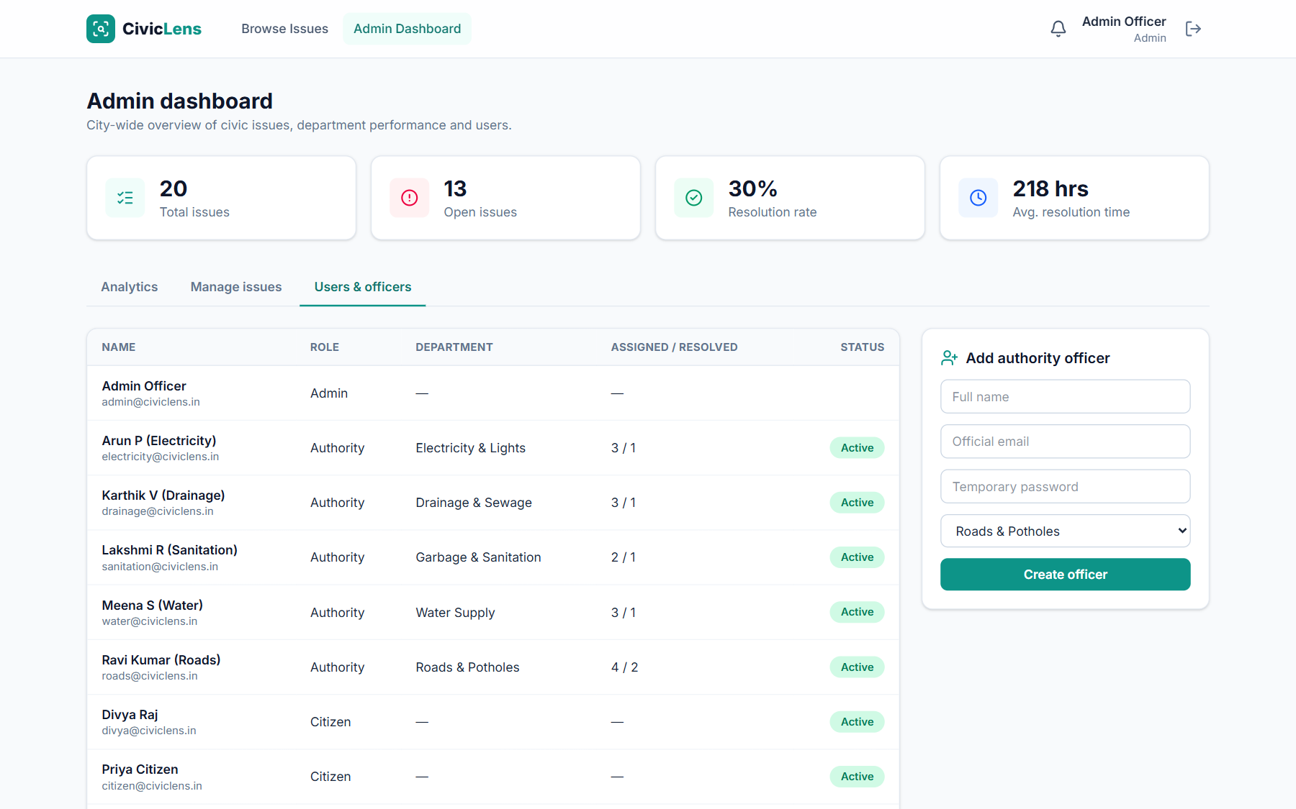
Screenshots · Admin control centre
Analytics, assignment and user management
Analytics: status, category, trend, hotspots
Users & officers: create and deactivate accounts
Notes:
Show the admin analytics and user management.

Slide 16
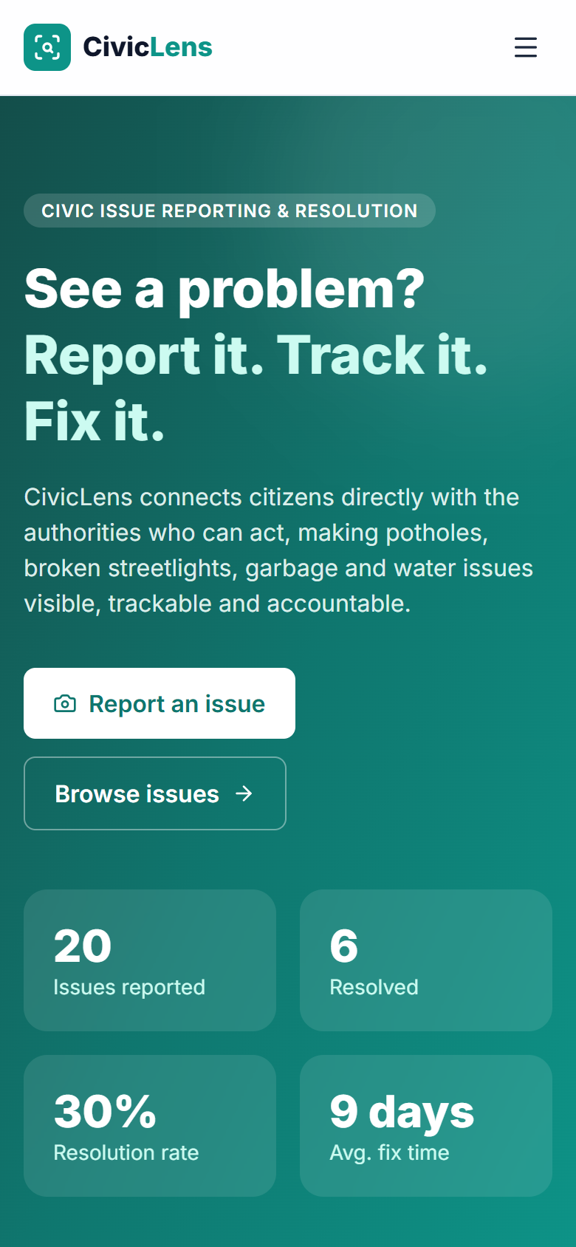
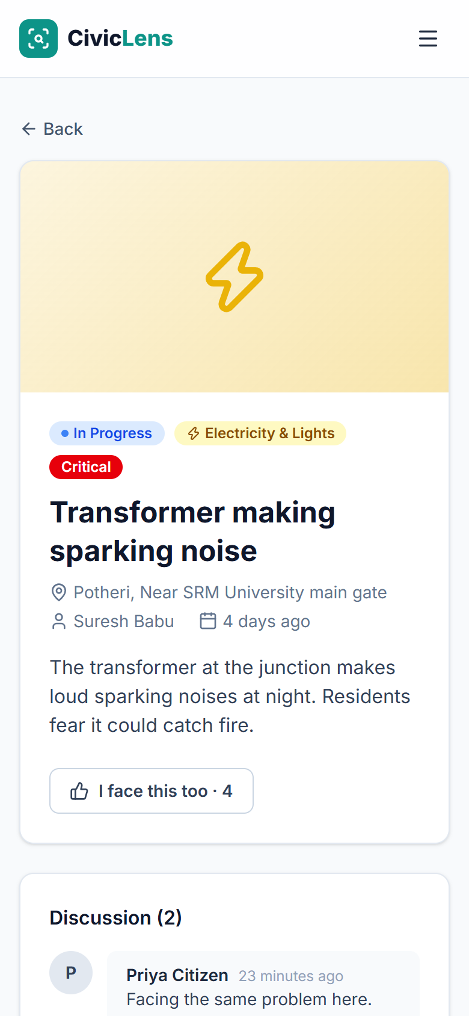

Screenshots · Fully responsive on mobile
Same web app, no install needed. Works on any phone browser
Mobile-first layout
Collapsible menu, stacked cards and touch-friendly buttons.
Phone camera upload
Opens the rear camera directly; images compressed before upload.
GPS location
“Use my location” pins the issue at the exact spot.
Lightweight
Images resized in the browser to about 150 KB to save mobile data.
Notes:
Citizens report from the street, so mobile matters. Show the phone views.

Slide 17





Improvements & future scope
Roadmap from hackathon prototype to city-scale product
1. Next sprint
2. Scale-up
3. Vision
Citizen verifies the fix
Cloud image storage
AI auto-categorisation
Reporter confirms or reopens a “Resolved” issue with a photo
Move photos to Cloudinary / S3 with a CDN
Detect category and severity from the photo
SLA deadlines & escalation
SMS, email & WhatsApp alerts
Predictive hotspots
Per-category deadlines; overdue issues escalate to the admin
Reach citizens outside the app
Forecast failures (e.g. flooding) before they are reported
Duplicate detection
Tamil / Hindi UI + PWA
Public department scorecard
Warn about similar issues within 200 m and suggest upvoting instead
Multilingual and installable, with offline drafts
Open data API and ward-level rankings
Notes:
The next-sprint items make accountability even stronger. Scale-up and vision items show the path to a real city deployment.

Slide 18


Thank you
Demo accounts
Questions & live demo
Citizen
citizen@civiclens.in
Authority (Roads)
roads@civiclens.in
Live app
civiclens-goh6.onrender.com
Authority (Water)
water@civiclens.in
Source code
Admin
admin@civiclens.in
github.com/Rithi-byte/civic-lens
Password for all: password123
Notes:
Invite questions and offer a live demo using the accounts shown.

