Slide 1
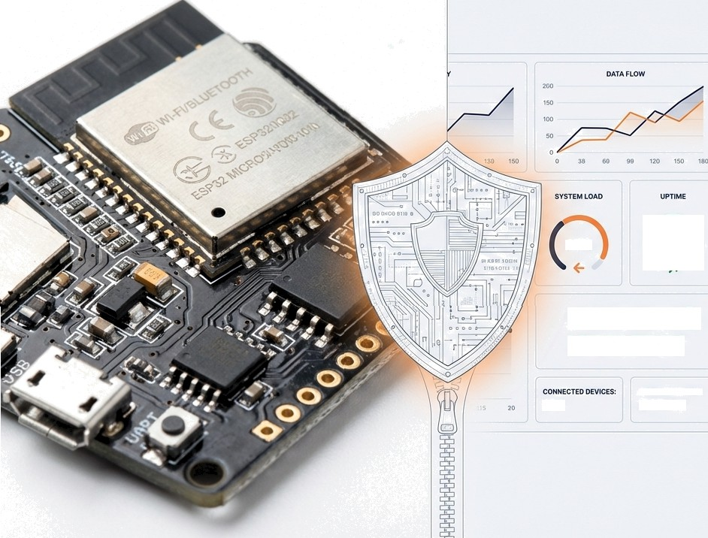

SentinelOTA
A Resilient, Heterogeneous Lifecycle Framework for Industry 5.0
SYSTEM
HEALTHY
Bridging Embedded Constraints and Lifecycle Security
A Unified, Resilient Framework for the Industry 5.0 Heterogeneous IoT Ecosystem.
120
SF€URU7STATUS!
ACTIVE

Slide 2




The Industry Imperative
From Connected to Resilient.
Industry 4.0 Industry 5.0
Efficiency Connectivity Frag1le
In Industry 5.0, a system that cannot heal itself is a liability.
Resilience human-Centric Sustainable
As factory floors rely on mixed fleets of devices, the risk shifts from simple downtime to human safety.
Resilience means automatically recovering from compromise, not just preventing it.

Slide 3
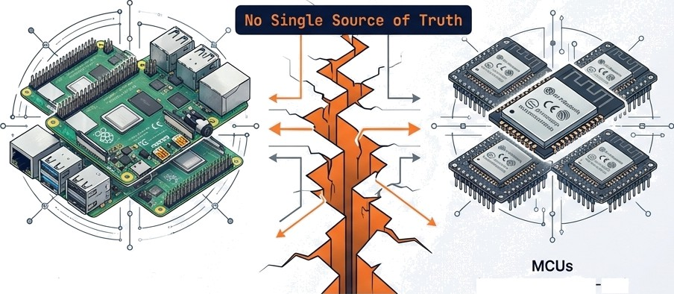

The Attack Surface: Updates as the Primary Vector
Viewing the update cycle through an Offensive Security lens.
Anatomy of an OTA Attack
Server
MiTM
Device
Linux SBCs (Managed by Mender)
(Managed by ESP IDF)
The Deploy-and-Forget Risk: Current systems confirm code delivery but fail to verify post deployment
behaviour.
Top Threats:
Man-in-the-Middle (MitM) attacks intercepting firmware.
Rollback attacks forcing devices to older, vulnerable versions.
“I viewed the update cycle not as a feature, but as the largest gap in the security perimeter.”

Slide 4
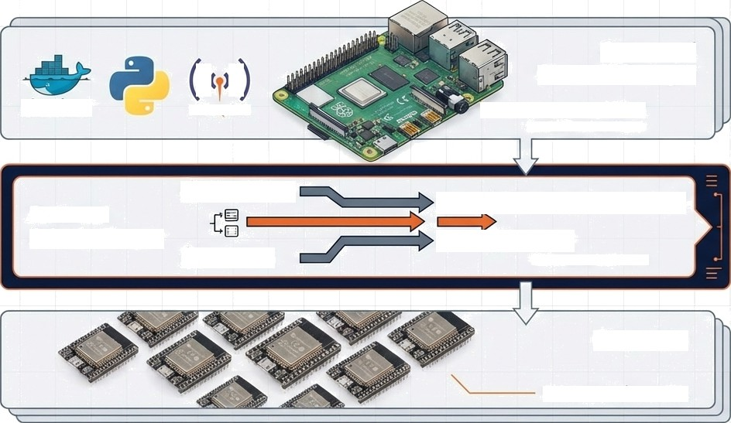




Architecture: From Central Manager to Edge Sensor
Gateway / Central Manager
1. Trust: Certificate Authority (CA) and NVS Storage.
docter
Raspberry Pi 4
in Jet Brains bono
MOSQUITTO
Modbus TCP
2. Delivery: Binary signing and distribution via MQTT/HTTPS.
Protocol
Adapter Layer
MQTT/ Sparkpluq B
@ HTTPS
in JetBrains Nano
BLE Mesh
3. Defense: Local TinyML baseines vs. Global analysis via Scikit-Learn.
Endpoints
FneeRTOS
/ TinyNL

Slide 5
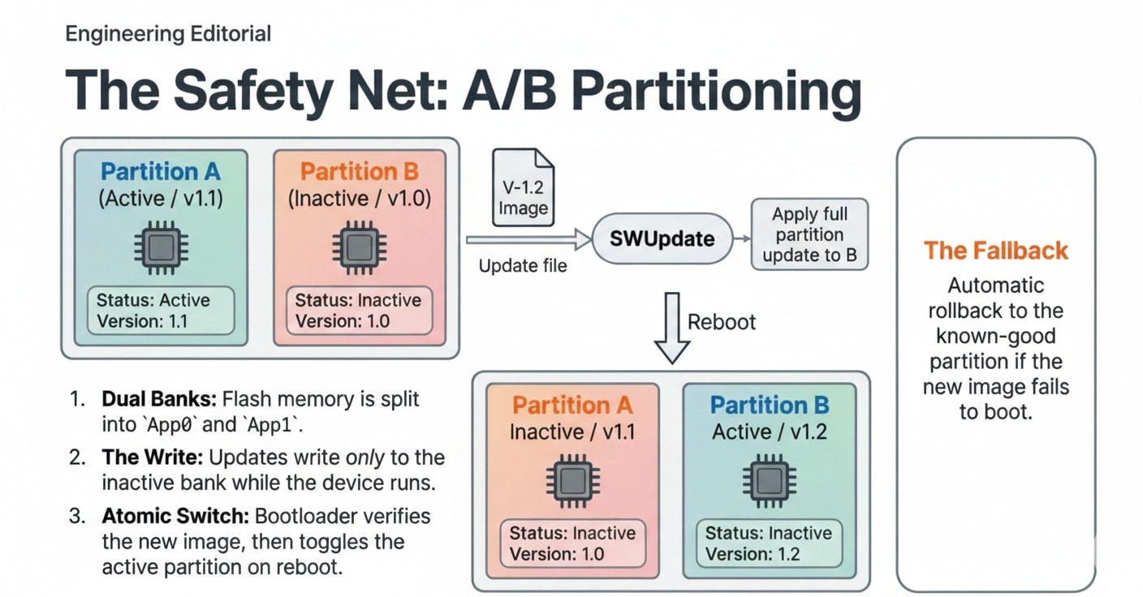

Slide 6
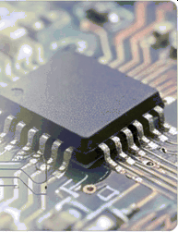








Implementation Stack
Hardware
Software & Backend
o Raspberry Pi 4 (Gateway) or any SBC’s
ESP32 (Endpoint) or Microcontroller’s
Python / Flask
o Docker Containers
Mosquitto (MQTT Broker)
Firmware & Edge
FreeRTOS o ESP-IDF
TinyML Lite
. Security & VAPT
liboqs (Post-Quantum Crypto)
Parrot OS Tools (Stress Testing)
Built with industry-standard, scalable tools to ensure real-world applicability.

Slide 7
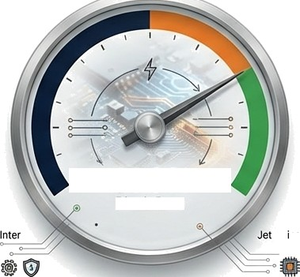
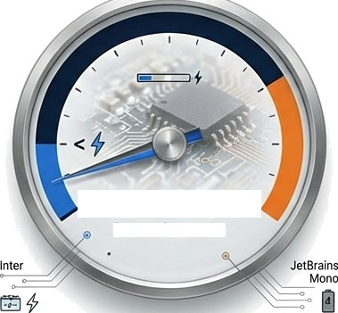
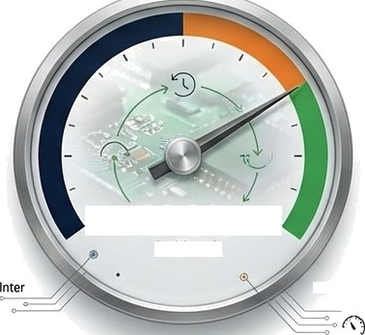
Validating Resilience: Evaluation Metrics
The system adds high security with minimal resource penalty.
Security Success Performance Overhead Reliability
00
,o
1oo
.o _{100°}p oo.
Rollback
0
1 00%
Block Rate
< 10°
Power Increase
Bra ns
Mono
JetBrains
Mono
100% Block Rate
(Replay Attacks & Unauthorized Uploads)
< 1O⁰ X Power Increase
(During Monitoring Phase)
100⁰a Auto-Rollback Success
(Simulated Malicious Update)

Slide 8


Roadmap Future Scope
Scaling SentinelOTA from a single factory floor to a global fleet.
Current Status
Functional Prototype
Local Anomaly Detection
mTLS Enforced.
Phase 2 Integration
Enterprise SIEM Integration
Dashboarding.
Future Scope
Federated Learning
Fleet-wide immunity sharing.

