Slide 1

Secure Heterogeneous
OTA Update Mechanism
A Lightweight, Serverless Approach for Constrained IoT Devices
Presented by:
Rithik Sharma A 9123128040
Ritesh V 9123128039
Priyanka Devi S 9123128034
Guide: Dr. Gokilam
Dept. of Computer Science & Engineering

Slide 2




PROBLEM STATEMENT
High Operational Cost
Resource Constraints
The Version Gap
Standard cloud OTA services (AWS IoT, Azure Device Update) charge per active device per month destroying profit margins for low-cost $5 sensors deployed at scale.
Secure protocols like RSA-4096 demand ~64 KB of RAM. Most 8-bit and 16-bit microcontrollers have only 2 KB free making enterprise-grade security physically impossible.
A disconnect exists between code in Git and the binary on the OTA server. Manual upload steps introduce human error, stale firmware, and critical security vulnerabilities.
$5 Avg. device cost
64KB RSA RAM needed
0% Automation today

Slide 3
OBJECTIVES — ACHIEVEMENT TRACKER
Existing systems
Our solution
01
Automated GitHub Release Pipeline
02
Firmware Version Tracking
Auto-commit + push source & binary on every flash with version tagging
Complete history of every firmware flashed per device with rollback support
Existing:
Manual only
5%
Existing:
Not supported
10%
SecureOTA:
Fully automated
100%
SecureOTA:
Full SQLite log
100%
03
Preprocessing Agent Injection
04
Live Device Monitoring
Silently inject tracking agent into generated main() at compile time
Real-time panel showing online/offline status and firmware version per device
Existing:
Does not exist
0%
Existing:
Serial only
15%
SecureOTA:
Core innovation
100%
SecureOTA:
UDP dashboard
95%
05
Board-aware Feature Detection
06
Secure OTA Channel
Auto-detect board capabilities (Wi-Fi, dual-core) and adjust features accordingly
AES-256 + HMAC-SHA256 + NVS counter secured firmware delivery over Wi-Fi
Existing:
Not present
20%
Existing:
Plaintext only
30%
SecureOTA:
FQBN detection
100%
SecureOTA:
Future module
75%
5/6 Fully achieved
1/6 Future module (OTA)
100% Avg. improvement

Slide 4



PROPOSED ALGORITHMS — CHAIN FLOW
AES-256-CBC
HMAC-SHA256
01
02
03
04
Registry check
ECDSA P-256
Symmetric Encryption
Message Authentication
Digital Signature
Tiered Crypto Verification
Encrypts the entire firmware binary before transmission
Signs every UDP packet to prove it came from a real device
Proves firmware was signed by a legitimate IDE — not forged
4-stage filter check for previously flashed device
256-bit session key generated per upload
Unique secret key per device (injected at flash)
IDE holds ECDSA private key (generated once)
Stage 1: Manifest check (version, size)
128-bit IV randomised per session
HMAC = Hash(secret_key + message)
Signs SHA-256 digest of firmware binary
Stage 2: SHA-256 hash verify
Hardware accelerated on ESP32 (80µs)
Any 1-bit change → completely different HMAC
Device verifies using embedded public key
Stage 3: Format & structure validate
Ciphertext = unreadable to network observer
Forging impossible without secret key
32-byte key — fits in ESP32 flash easily
Stage 4: HMAC-SHA256 authenticate
Encrypted .bin ciphertext
64-char HMAC tag appended to payload
ECDSA signature attached to firmware package
PASS → flash | FAIL → abort + health score down
5-Stage
Pipeline
S1
Manifest Check
S2
SHA-256 Hash
S3
Format Validate
S4
HMAC-SHA256
S5
ECDSA P-256
PASS
→ Flash
version · size · target board
integrity end-to-end
structure · header · magic
authenticity · per packet
signature · IDE origin proof
FAIL
→ Abort
AES-256 → Confidentiality
HMAC-SHA256 → Authenticity
ECDSA P-256 → Integrity
TCV → Tiered Verification
All 4 must pass to flash

Slide 5





EXISTING SYSTEMS
Commercial Cloud Platforms
Custom MQTT / HTTP Servers
Blockchain-Based Solutions
AWS IoT Core · Azure Device Update · Golioth
Python / Node.js self-hosted servers
Ethereum · IPFS firmware hashes
Robust, fully managed services
Developer-controlled binaries
Decentralized trust model
Global distribution & redundancy
Zero vendor lock-in
Immutable firmware records
High cost per active device
Requires 24/7 maintenance
Extremely heavy overhead
Overkill for simple edge sensors
Single point of failure risk
Impractical for 2KB MCUs

Slide 6




OUR SOLUTION —SecureOTA
· LIGHTWEIGHT GITHUB-INTEGRATED OTA
Serverless Infrastructure
COST: $0
Tiered Crypto Verification (TCV)
RAM: ~2KB
GitHub Releases acts as the OTA update server free, globally distributed, and 99.9% available. Zero infrastructure cost.
5-stage pipeline: manifest → size → hash → format → Ed25519. Cheap checks filter first; heavy crypto only runs if needed.
Anomaly-Scored Heartbeat (ASH)
RESILIENT
Automated Git→Release Workflow
AUTOMATED
Device maintains health score (0–100). Repeated failed updates or suspicious patterns lower the score. Below threshold → self-quarantine.
Tagging v1.0 in Git triggers CI pipeline: compile → sign with Ed25519 → publish GitHub Release. No manual steps.

Slide 7


TECHNOLOGY STACK
IDE & Frontend
Device Side (ESP32)
Security Layer
Arduino IDE 2.x
Base fork (Theia/Electron)
ESP-IDF v5.x
ESP32 development framework
AES-256-CBC
Firmware payload encryption
Eclipse Theia
IDE shell & extension system
FreeRTOS
Core 0 task scheduling
HMAC-SHA256
Packet authenticity signing
Electron
Desktop app wrapper
mbedTLS
AES-256, HMAC-SHA256, TLS 1.3
ECDSA (P-256)
Firmware digital signature
TypeScript
Extension development language
Arduino Core ESP32
Arduino compatibility
TLS 1.3
Encrypted OTA transport
Node.js 20 LTS
IDE runtime environment
ArduinoJson
UDP packet JSON serialization
NVS Counter
Anti-replay protection
React
Panel UI components
ESPmDNS
Device network advertisement
MAC Registry
Device identity verification
GitHub Integration
Network & Comms
Build & Toolchain
GitHub REST API v3
Repo, release & asset creation
MQTT (port 8883)
Future OTA command channel
Arduino CLI (Go)
Sketch compile & upload backend
GitHub Releases
Firmware binary hosting (free)
UDP Broadcast
Live device status (port 5007)
xtensa-esp32-gcc
ESP32 cross-compiler toolchain
OAuth2 / PAT
User authentication token
mDNS (secureota)
Device discovery on local
esptool.py
Flash firmware via USB serial
SQLite
Local version history database
IEEE 802.11 b/g/n
Wi-Fi connectivity layer
Yarn / npm
IDE package management
Node.js crypto
AES + HMAC IDE-side ops
TCP/IP Stack
ESP32 lwIP network stack
Webpack 5
IDE frontend bundler
Git
Source version control
gRPC
IDE ↔ Arduino CLI interface
6 Categories
36 Technologies
Zero Cloud Cost
Cross-Platform
Open Source Base

Slide 8
PROJECT MODULES
ID
Module Name
Layer
Technology
Functionality
Status
MOD-01
Arduino IDE Core
TypeScript · Theia · Electron
Code editor, compiler trigger, board manager — cloned unchanged from Arduino IDE 2.x
IDE Host
Cloned
MOD-02
mDNS Discovery
TypeScript · mDNS
Discovers SecureOTA-capable devices on local network via _secureota._tcp service records
IDE Host
Extended
MOD-03
ArduinoOTA Base Library
C++ · Arduino
Original OTA reception library — extended by MOD-08 with encryption and authentication layer
ESP32 Device
Base
MOD-04
SecureOTA Upload Engine
TypeScript · Node.js crypto
Intercepts upload, encrypts firmware (AES-256), signs (ECDSA), transmits over TLS 1.3 TCP
IDE Host
NEW
MOD-05
Version History Panel
TypeScript · React · SQLite
Logs every OTA upload — sketch, version, device, timestamp, result. Supports one-click rollback
IDE Host
NEW
MOD-06
Update Relevance Checker
TypeScript · React
Scores sketch function tags against device profile. Warns if relevance score is below threshold
IDE Host
NEW
MOD-07
Live Device Dashboard
TypeScript · React · Node.js UDP
UDP port 5007 listener with 4-layer security verify. Displays online/offline status per device
IDE Host
NEW
MOD-08
SecureArduinoOTA Library
C++ · mbedTLS · FreeRTOS
Drop-in replacement for ArduinoOTA. TLS 1.3 listener, AES decrypt, SHA-256 + ECDSA verify, NVS counter
ESP32 Device
NEW
5 NEW modules
2 Cloned / Base
1 Extended module
2 Device-side (ESP32)
6 IDE Host modules

Slide 9
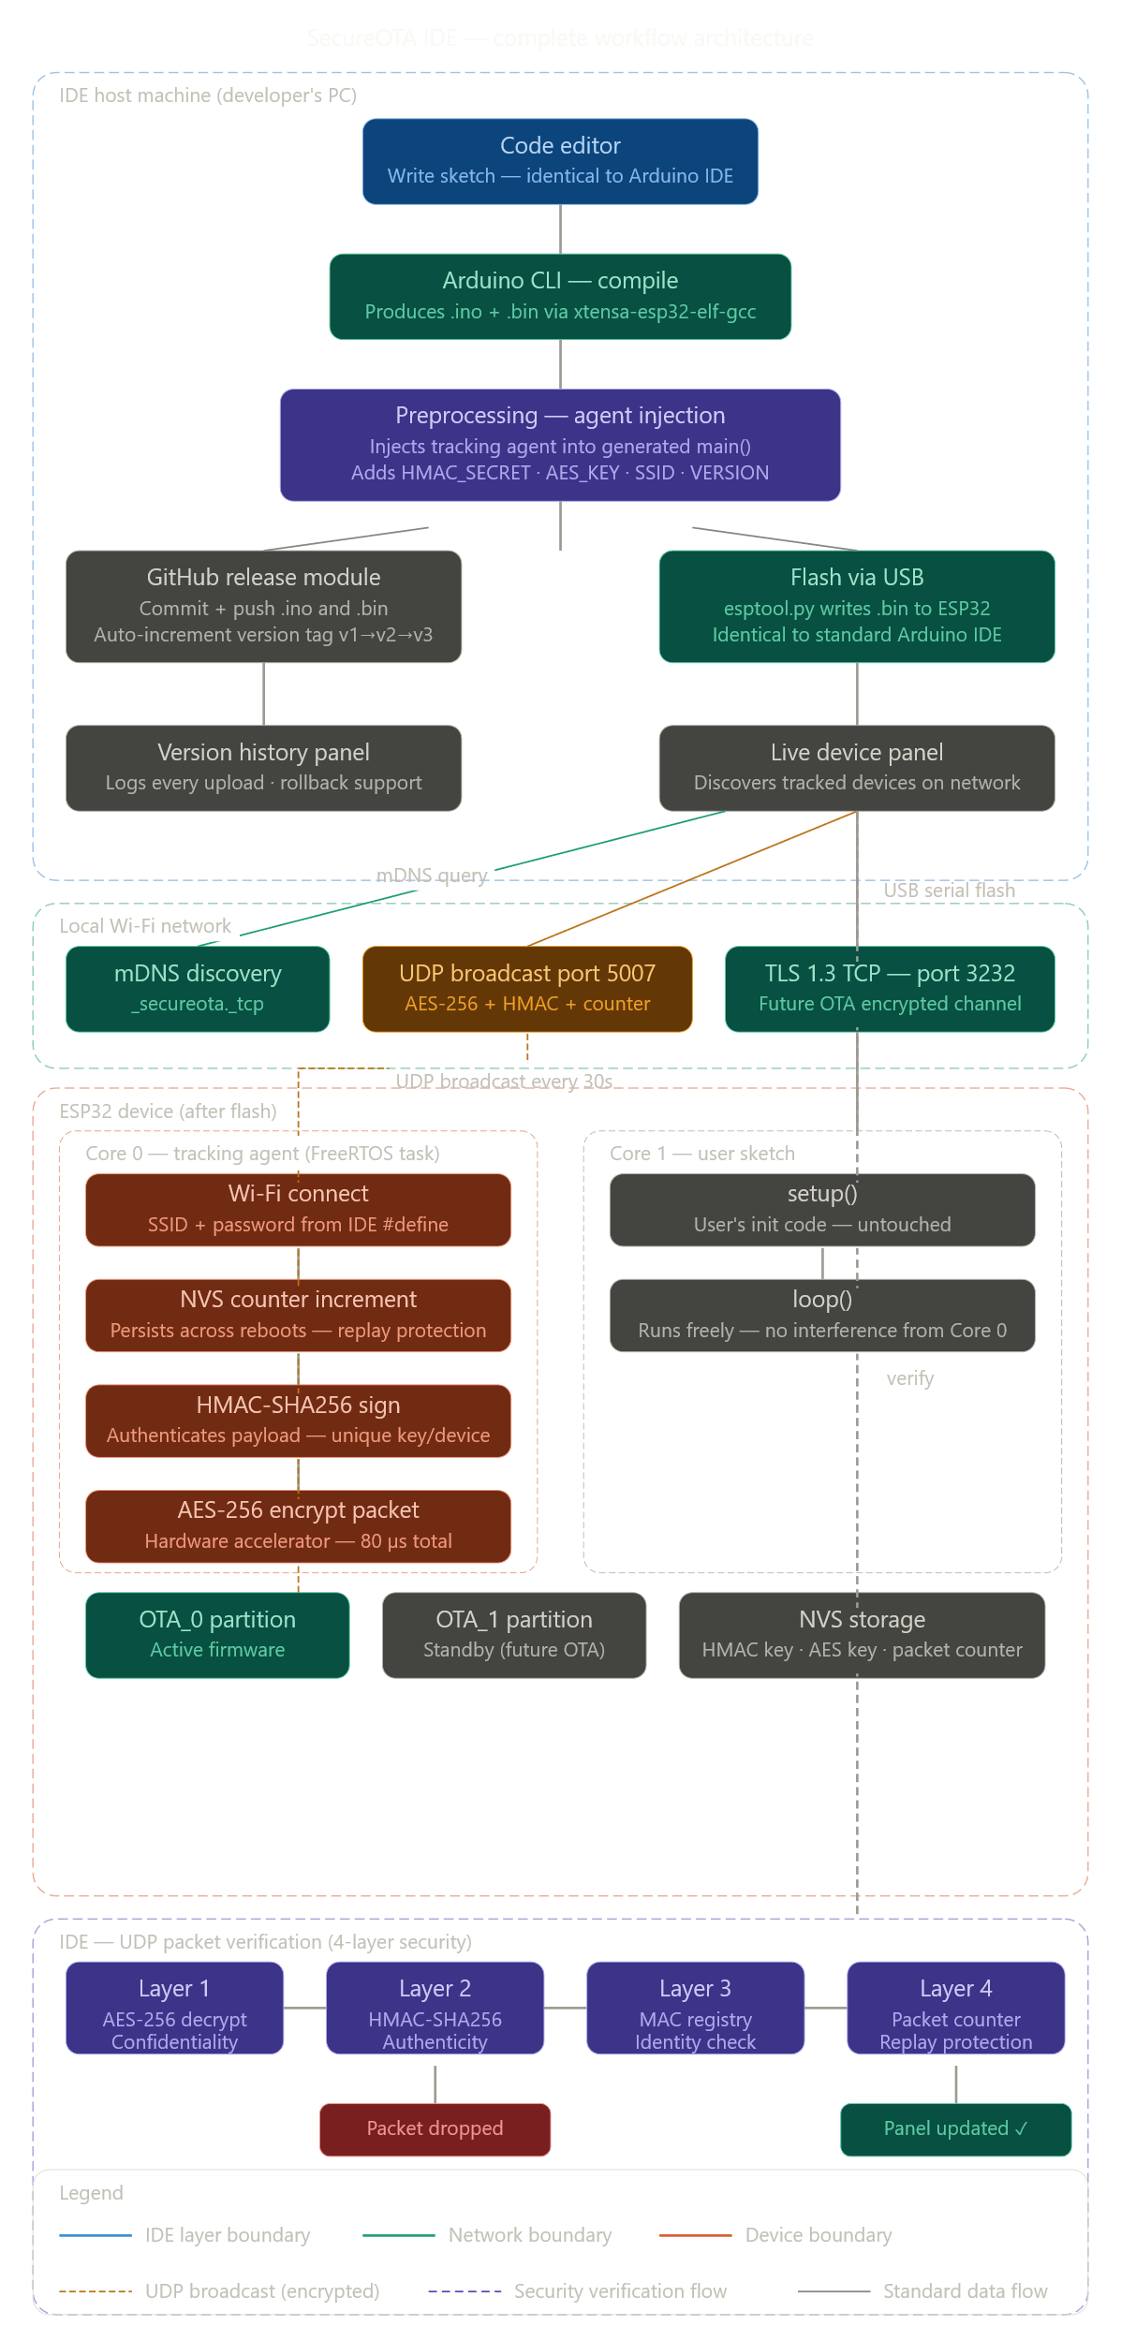
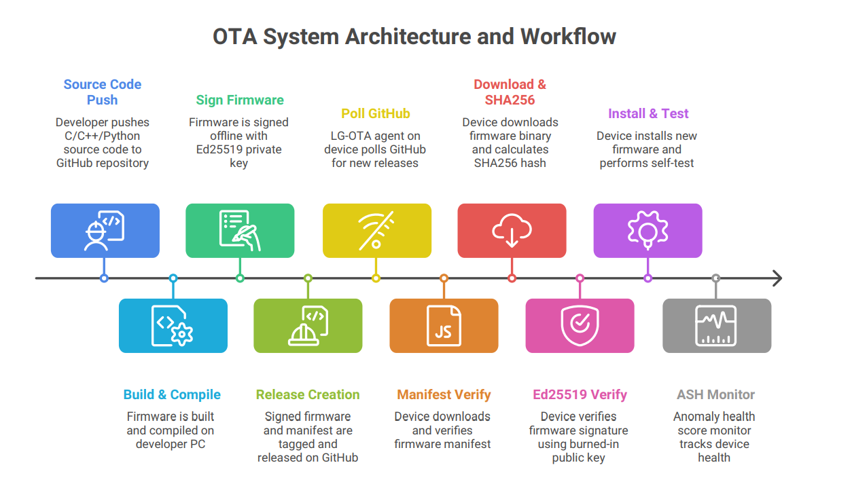
05 OUR SOLUTION — SecureOTA
SYSTEM ARCHITECTURE
Serverless Infrastructure
COST: $0
Tiered Crypto Verification (TCV)
RAM: ~2KB
Anomaly-Scored Heartbeat (AS)

Slide 10

ADVANTAGES — WHY THIS IS BETTER
Feature | Existing Systems | LG-OTA (Ours)
Cost | High ($/device/month) | Zero — GitHub API
RAM Usage | ~64 KB (RSA-4096) | ~2 KB (Ed25519)
Workflow | Manual upload / sync | Automatic (Git Tag Trigger)
Security Model | Pass / Fail only | Adaptive Health Score
Trust Source | Custom server database | Source code repo + Ed25519
Anti-Rollback | Hardware OTP (costly) | Version manifest check
Democratized Security
Enterprise-grade Ed25519 signatures on a $2 MCU. Zero cost. Open standard.
Adaptive Resilience
Health score prevents infinite update loops and denial-of-service bricking attacks.
Anti-Rollback Built-In
Version manifest prevents attackers from downgrading devices to known-vulnerable firmware.

Slide 11
CONCLUSION & FUTURE SCOPE
Conclusion
We have successfully designed LG-OTA — a framework that bridges the gap between sophisticated security and constrained hardware. By leveraging GitHub's CI/CD infrastructure and lightweight Ed25519 cryptography, even the cheapest IoT devices can be updated securely, reliably, and at zero infrastructure cost.
~2 KB
$0
5-stage
Ed25519
RAM footprint
Infra cost
TCV pipeline
Signature algo
Future Scope
Encrypted firmware (AES-256 confidentiality tier)
RISC-V architecture support expansion
Secure Heterogeneous OTA Update Mechanism · Rithik Sharma A · Ritesh V · Priyanka Devi S · Guide: Dr. Gokilam

