Slide 1

Applied Data Science PROJECT Setting up a new restaurant
By Rithik Kotha

Slide 2
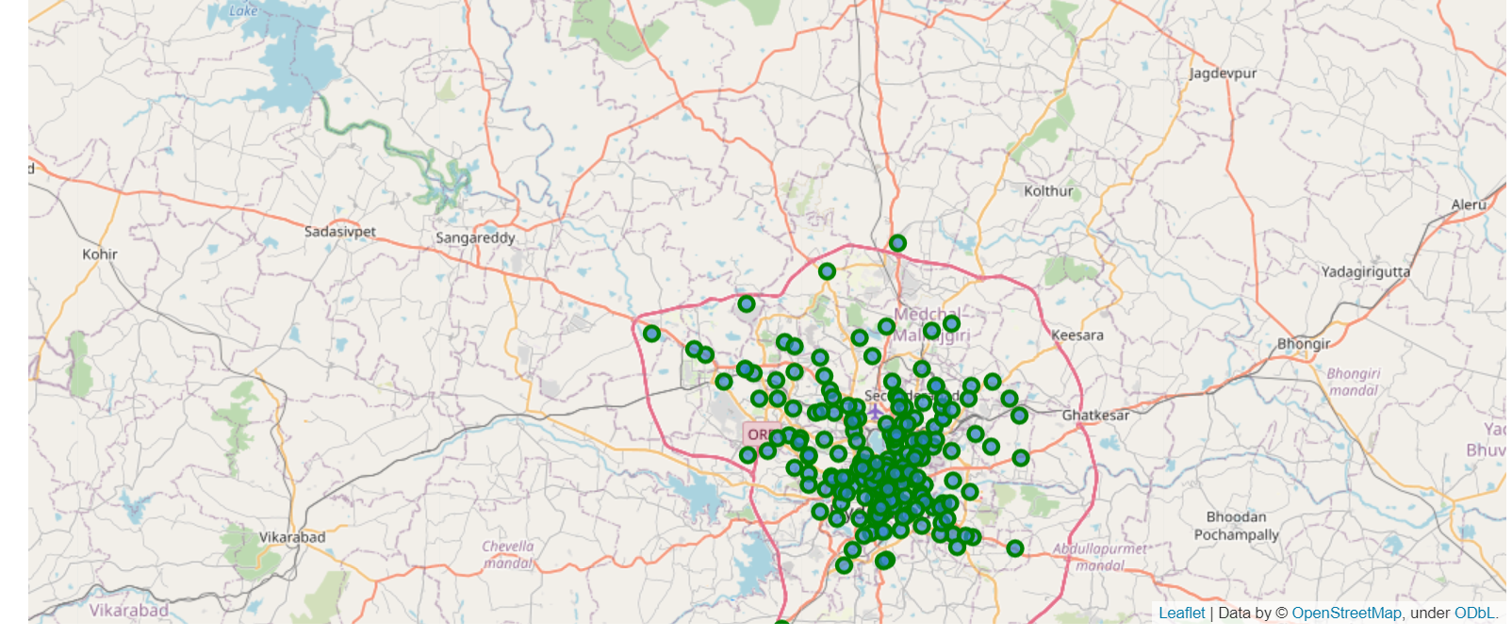
HYDERABAD , INDIA

Slide 3
INRODUCTION
Restaurants have always been the leading edge of reshaping neighbourhoods. In certain places, people dine more outside the home. People do crave the social experience of dining. Economy and Employment depend on restaurants in a certain way.
Beyond the basic purpose of restaurants to provide food and drink, restaurants have fulfilled a human need for connection and shaped social relations. Restaurants occupy an increasingly important place in shaping our overall economy and the nature and makeup of our cities.
So we are looking to open up a new restaurant at a favourable place.

Slide 4
BUSINESS PROBLEM
The objective of this capstone project is to analyse and select the best locations in the city of Hyderabad, India to open a new restaurant. Using data science methodology and machine learning techniques like clustering, this project aims to provide solutions to answer the business question:
In the city of Hyderabad, India if a property developer is looking to open a restaurant, where would you recommend that they open it?

Slide 5
TARGET AUDIENCE
This project is particularly useful to property developers and investors looking to open or invest in restaurants in the capital city of Telangana i.e. Hyderabad. This should be carefully planned and executed so that it will be beneficial to everyone. People can come and enjoy the variety of cuisines and delicious food.

Slide 6
METHODOLOGY
We need to register a Foursquare Developer Account in order to obtain the Foursquare ID and Foursquare secret key. We then make API calls to Foursquare passing in the geographical coordinates of the neighbourhoods in a Python loop. Foursquare will return the venue data in JSON format and we will extract the venue name, venue category, venue latitude and longitude. With the data, we can check how many venues were returned for each neighbourhood and examine how many unique categories can be curated from all the returned venues​.

Slide 7
METHODOLOGY(continued)
Then, we will analyse each neighbourhood by grouping the rows by neighbourhood and taking the mean of the frequency of occurrence of each venue category. By doing so, we are also preparing the data for use in clustering. Since we are analysing the data, we will filter the restaurant as venue allocates every data point to the nearest cluster, while keeping the centroids as small as possible. It is one of the simplest and popular unsupervised machine learning algorithms and is particularly suited to solve the problem for this project. We will cluster the neighbourhoods into 3 clusters based on their frequency of occurrence.The results will be obtained and then we can set up a restaurant.

Slide 8
RESULTS
After detailed analysis of the data and critical thinking of the data the neighbourhoods have been divided into clusters depending upon the frequency in which people go to these restaurants. To set up a new restaurant we will be looking at a place where people go more often or in other words where more population density is there.
They have been divided into clusters and the restaurant we will be looking to set up will be based on these clusters .
Clusters with high , moderate ,no restaurants are plotted and depicted in the below picture.

Slide 9
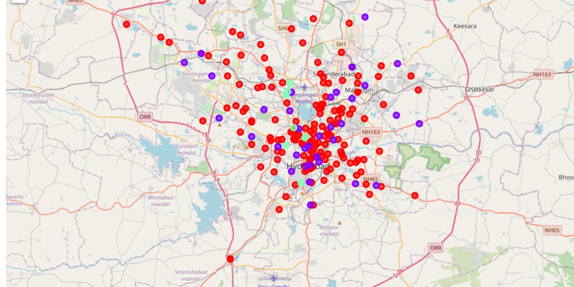
FAVOURABLE PLACES

Slide 10
DISCUSSION
They have been divided into clusters. Most of the suitable places are concentrated in the central area of Hyderabad city, with the highest number in cluster 1 and moderate number in cluster 0. On the other hand, cluster 2 has a very low number in the neighbourhoods. This represents a great opportunity and high potential areas to open new restaurants as there is very little to no competition from existing competitors.

Slide 11
CONCLUSION
We have narrowed down the possibilities so as to where we can set up a new restaurants so that it can be successful enough in its domain.
In this project, we have gone through the process of identifying the business problem, specifying the data required, extracting and preparing the data, performing machine learning by clustering the data into 3 clusters based on their similarities, and lastly providing recommendations to the relevant stakeholders i.e. property developers and investors regarding the best locations to open a new restaurants.

