Slide 1
Rithik Bike Sales – Online Booking System
Name : Rithik R
Batch : 2024-2027
Department : BCA
College : S.K.P Arts and Science College
University : Thiruvallur University

Slide 2
Problem Statement
Traditional bike booking requires physical visits
Lack of instant confirmation & centralized records
Time-consuming for both sellers & customers

Slide 3
Project Objectives
Provide a simple online booking portal
Allow customers to preview selected bike models
Auto-generate booking confirmation
Maintain records & export bookings easily

Slide 4
End Users
Bike Showroom Owners
Sales Executives
Customers interested in buying bikes online

Slide 5
Tools & Technologies
Frontend: HTML, CSS, JavaScript
Data handling: JavaScript arrays & CSV export
Deployment: Any static web server

Slide 6
System Workflow
User fills booking form (Name, Phone, Address, Bike)
Bike preview shown dynamically
Booking confirmation displayed instantly
Booking saved in records table
Download bookings as CSV

Slide 7
Feature 1 – Booking Form
User-friendly form with validation
Captures customer details
Dropdown for bike model selection

Slide 8
Feature 2 – Bike Preview
Dynamic preview image of selected bike
Enhances customer confidence
Uses JavaScript to switch images

Slide 9
Feature 3 – Booking Confirmation
Instant confirmation box with booking details
Shows Name, Phone, Bike Model, Address
Visual ✅ success message

Slide 10
Feature 4 – Booking Records
All bookings stored in an on-page table
Tabular format for easy viewing
Supports multiple records

Slide 11
Feature 5 – CSV Download
One-click export of all bookings
CSV format for data portability
Helps showroom maintain offline records

Slide 12
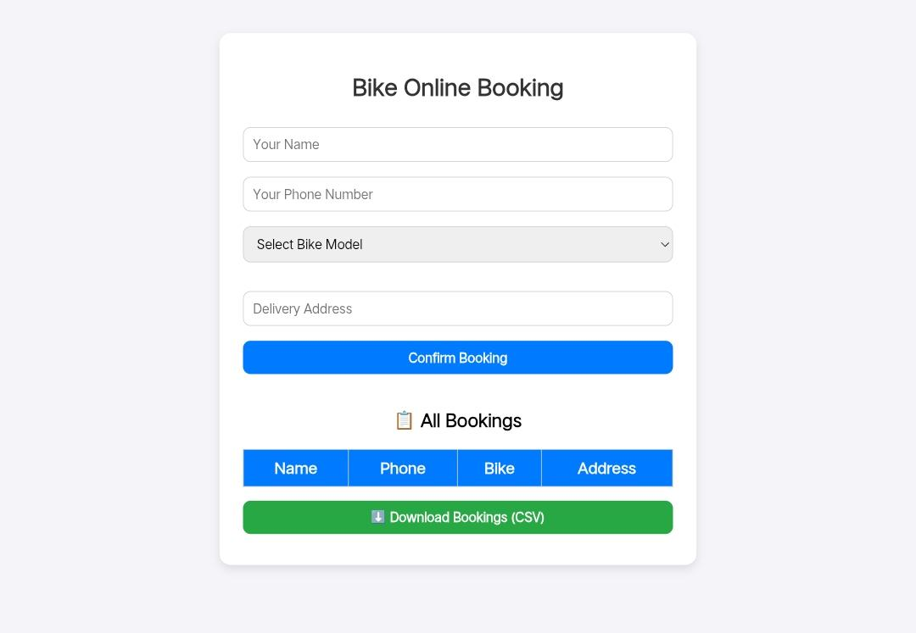
Screenshots – Home Page

Slide 13
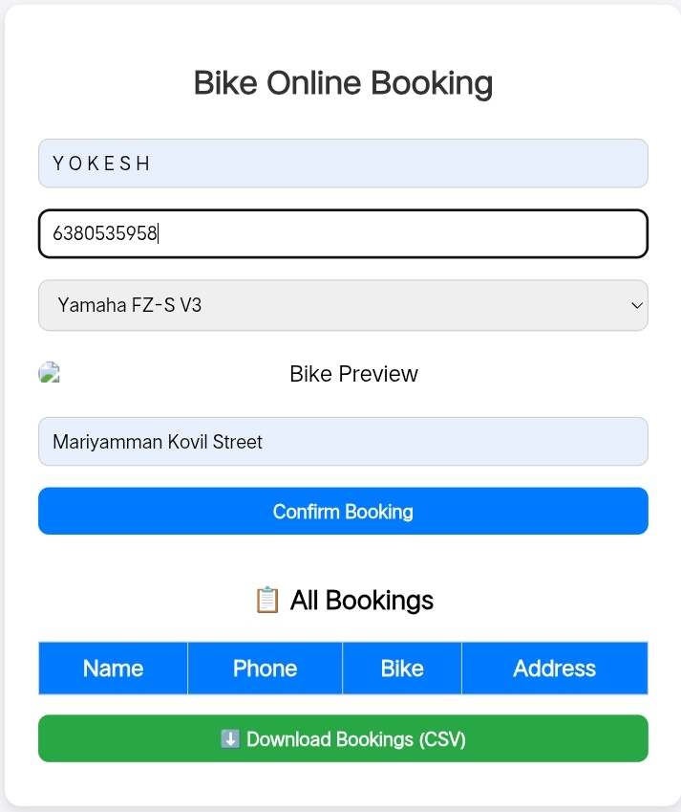
Screenshots – Bike Preview

Slide 14
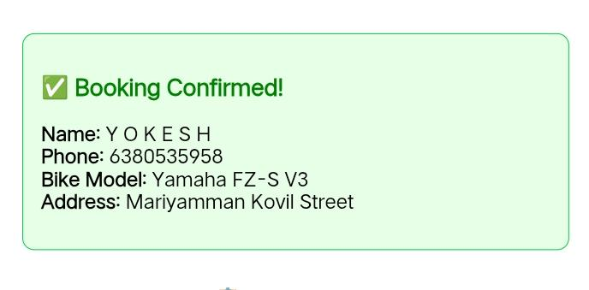
Screenshots – Booking Confirmation

Slide 15
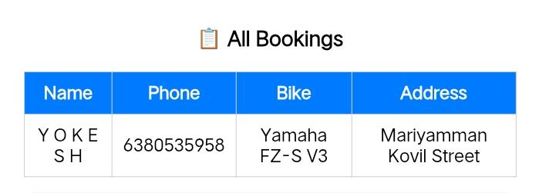
Screenshots – Booking Records

Slide 16
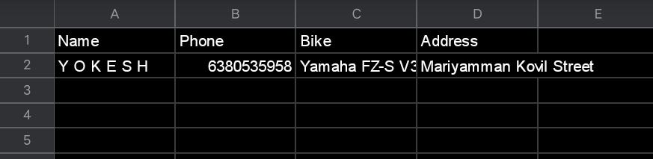
Screenshots – CSV Download

Slide 17
Results
Efficient online booking achieved
Customers get instant booking confirmation
Dealers maintain structured records

Slide 18
Future Enhancements
Payment Gateway Integration
User Login & History
Admin Dashboard
SMS/Email Booking Alerts

Slide 19
Conclusion
The system simplifies bike bookings
Improves customer satisfaction
Reduces manual workload
Provides digital record keeping

Slide 20
Thank You
Project: Rithik Bike Sales - Online Booking System
Presented By: Rithik R

