Slide 1

BLOCKCHAIN E-Voting
S.Sarath Kumar
M.Rithik

Slide 2
SYNOPSIS
Introduction
Blockchain
E-Voting using blockchain
Advantages of E-Voting using blockchain
Other applications
Conclution

Slide 3
BLOCKCHAIN
Blocks of data that are decentralized and stores data Across computers
Satoshi Nakamoto(a person or group of persons)in 2008
3 versions of block chain(1.0,2.0,3.0).
Separate hash code
Blocks are Interlinked

Slide 4

Block chain network

Slide 5
E-Voting
Electronic voting is method of voting throw digital system instead of on paper.
Introduced in early 2000.
Due to security risks during election process like human errors, hacking by domestic and foreign suboteors,other technical glitches and voters.
To overcome those issues block chain based e-voting was introduced.
Sierra Leone was the first country to implement e-voting through block chain. Other countries like Brazil,UK,Japan and Estonia were following e-voting.

Slide 6
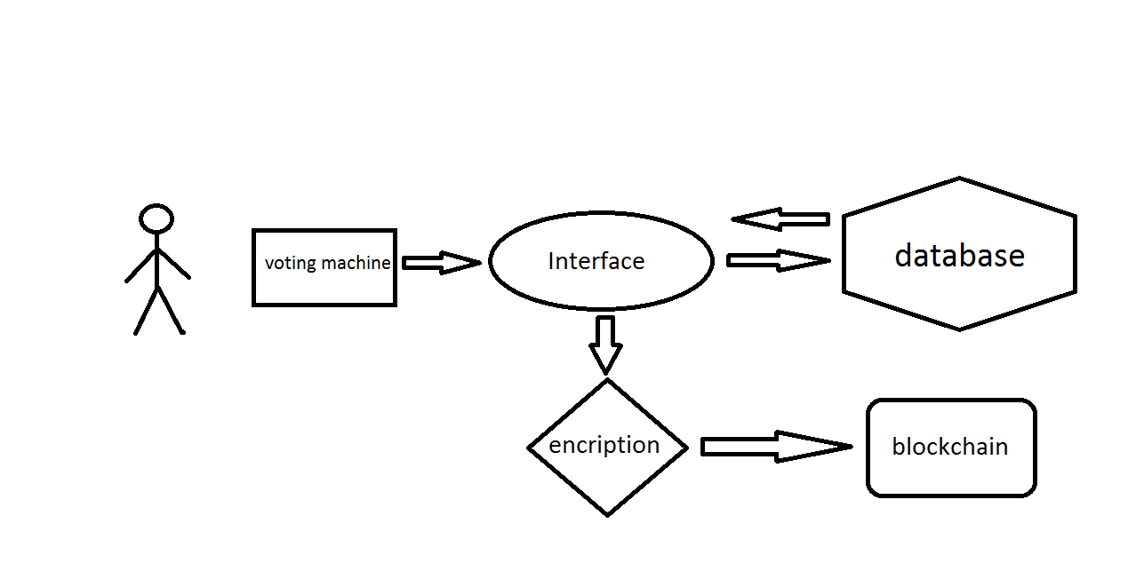
E-voting mechanism

Slide 7
Working of E-Voting system using block chain
Requesting to vote
user login using his/her identities
Casting a vote
voting
Encrypting votes
block formation.
Adding the vote to the Blockchain.
creation of chain

Slide 8
Advantages
Ensures security(protects from hackers).
Transparency.
system and data integrity.
Flexibility.
Decentralized.
No large amount of storage required

Slide 9
OTHER APPLICATIONS
Land registration
Healthcare
Vehicle registration
Education
Payment processing and money transfer
Food safety

Slide 10
conclusion
It makes voting mechanism cheaper and safer
Removes power barrier between voter and officer
It opens door for more direct form of democracy
It will bring great impact on society and a vital role in feature

