Slide 1

FOODIE😋 ~The gateway that cures the illiteracy on food!!!

Slide 2
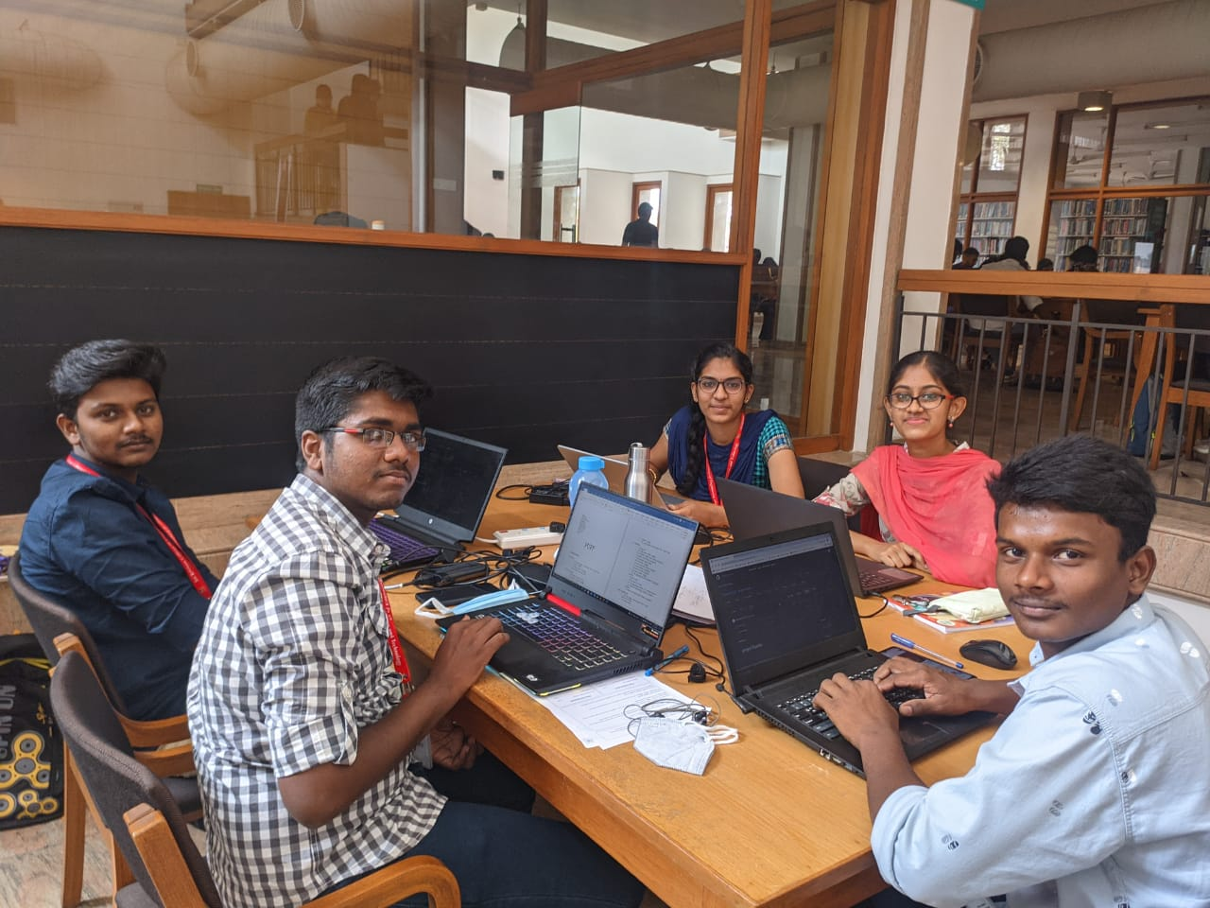
MEET THE SAVVY CODERZ!!!
TEAM LEADER:
Rithik Raj.K.S – Backend developer
CREW MEMBERS:
Ravikrishna.B – Content Developer
Nithya.S – Content creator
Mrinalini.K- Frontend developer
Praveen.T- Frontend developer

Slide 3
Hey! Hostellers of SKCET, fed up of having the mess food😞 Too tired to walk till the mess to have your daily dose of energy😩 And as far as the day scholars are concerned, want to spice up your tastebuds a little bit😉 Don’t worry, we have our amazing college canteen😜 Imagine you are at our food court planning to try a new item on the menu, but you are afraid if you are allergic to any of the ingredients or if you are on a diet, you might worry about the nutrient content. Now here comes to your rescue FOODIE!!!
P

Slide 4
Welcome to FOODIE, the gateway that cures the illiteracy on food, specially tailored for the foodies of SKCET. We are going to generate QR codes with links for each items in our food court and place it in the menu. The link will redirect you to a page with all the info(name, ingredients, nutrient chart and fun facts)about that item. We will also provide you with few making videos so that you can treat your taste buds with your eyes until the food is delivered.

Slide 5
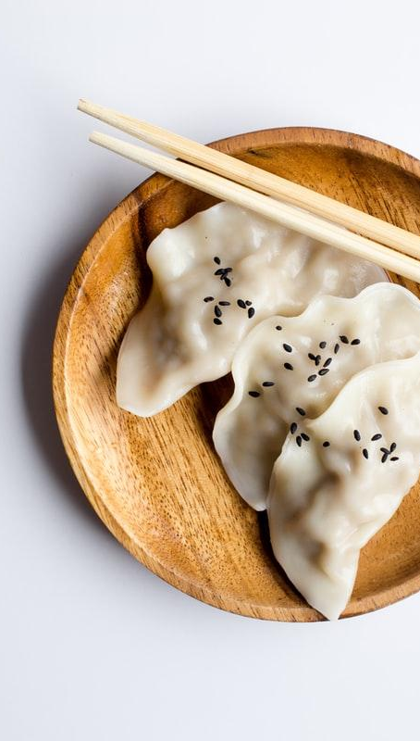
Novelty
Scanning QR codes to get a detailed description of the available items
We have added a digital order placing system that requires a computer with minimum system requirements to host a local database.
Check out the calorie count of every dish and a quantitative analysis of different nutrients present in each delicacy.
Including media and fun facts about every item on the menu to keep you entertained.

Slide 6
Business Model
Key Activities:
Creating an informative space for food enthusiasts.
Prioritizing the health of customers by preventing allergies.
Easy access via QR codes.
Efficient time management.
Key resources and channels:
web site
Value proposition:
A website that is easy to navigate
Helps the user to choose from multiple options
An ultimate user guide for indecisive foodies!!!
Key partners:
Food court(Sai foods)
Grocery shops
Canteen staff

