Slide 1

UNIVERSITY COLLEGE OF ENGINEERING VILLUPURAM
(A Constituent College of Anna University, Chennai)
DEPARTMENT OF INFORMATION TECHNOLOGY
RISK AND STAGE CLASSIFICATION OF NAFLD-HCC PATIENTS USING XGBOOST MODEL
GUIDED BY :
Mr.SATHEESH KUMAR N,
Department of Information Technology,
UCEV .
PRESENTED BY:
LEENA S (422521205019),
RITHIKA MS (422521205033),
SASANIYA S (422521205039),
SWETHA U (422521205044).

Slide 2
AGENDA
Abstract
Introduction
Literature Review
Existing Work
Proposed Work
System Architecture
Modules
Results & Graphs
Conclusion
References

Slide 3
Abstract
This project improves traditional mortality prediction models by adding disease stage prediction and real-time user interaction. It uses a dual-model architecture to separately predict mortality risk and disease stage, offering more detailed insights. Built with Python, scikit-learn, and XGBoost, it ensures strong model performance.
Enhanced data preprocessing improves accuracy and data quality. The system supports dynamic CSV uploads, allowing users to get instant predictions without retraining. Interactive visualizations make results easy to interpret. By combining predictive analytics with user-friendly design, the project helps healthcare professionals make faster, more informed decisions, ultimately improving patient care and treatment planning.

Slide 4
Introduction
This project uses machine learning to detect not only whether a patient might survive but also the stage of their disease.
It allows users to upload their own data and get real-time results with easy-to-understand visuals like charts and reports.
The system is designed to be interactive, so users can explore the detections in detail.
It also uses two powerful models to make the detections more accurate and reliable.

Slide 5
Literature Review
S.NO | TITLE | AUTHOUR & YEAR | TECHNIQUES USED | MERITS | DEMERITS
1. | Machine Learning-Based Assessment of Survival and Risk Factors in NAFLD-Related HCC (Base Paper) | Suárez M. et al., 2024 | XGBoost (ML), Clinical Data Analysis | The study effectively used machine learning (XGB) to identify key survival risk factors in NAFLD-related HCC with high accuracy and clinical relevance. | It had a small sample size, retrospective design, and lacked external validation, limiting its generalizability.
2. | Machine Learning for Early Detection of Hepatocellular Carcinoma | Li et al. 2024 | Random Forest, Gradient Boosting, SVM | Random Forest achieved 92% accuracy. Integrated clinical, demographic, and imaging data. | Limited to specific clinicaldatasets. Does not account for genetic or molecular data.
3. | Machine Learning for Hepatocellular Carcinoma Risk Prediction | Souvik Sarkar et al. 2024 | Gradient Boosting, Decision Trees | Achieved high accuracy (92.06%) even without advanced fibrosis markers.Enables early screening in MASLD patients. | Validation dataset smaller than training set.Clinical implementation requires

Slide 6
Literature Review(Cont…)
S.NO | TITLE | AUTHOURS & YEAR | TECHNIQUES USED | MERITS | DEMERITS
4. | Development of Predictive Models for Hepatocellular Carcinoma Recurrence | Shao et al. 2024 | Random Survival Forests, Cox Regression using Neutrophil-to-Eosinophil Ratio (NER) | Identifies NER as a strong independent biomarkers. Outperformed TNM staging system. | Needs large clinical datasets for better generalization. May not account for genetic or treatment-related variables

Slide 7
Existing Work
The existing system uses machine learning models like XGBoost, SVM, KNN, and Naïve Bayes to predict survival outcomes in NAFLD-related HCC patients.
It is based on retrospective data from 191 patients, with XGBoost achieving the highest accuracy.
Key predictors include alcohol consumption, obesity, cirrhosis, and portal hypertension.
The model aids in personalized risk assessment but lacks broader generalizability due to limited data sources.

Slide 8
Disadvantages of existing work
The small sample size of NAFLD-related HCC patients limits statistical power and generalizability.
Alcohol consumption data, a key predictor, may be inconsistently recorded, affecting prediction reliability.
The model is trained on data from only two hospitals without external validation, limiting its applicability.
XGBoost’s black-box nature reduces clinical interpretability without additional explainability tools.

Slide 9
Proposed Work
The proposed system predicts early-stage liver cancer in NAFLD patients using machine learning.
It uses a diverse dataset with clinical, demographic, and biomarker features like miRNA and genetic markers.
Advanced techniques such as SMOTE for class balancing and ExtraTreesClassifier for feature selection are applied.
The model is built with XGBoost and supports real-time prediction via user-uploaded data for early intervention.

Slide 10
System Architecture
Input Data
Data Preprocessing
Feature Extraction
Model Development
Mortality Classifier
Stage Classifier
Prediction
Evaluation and Visualisation
Report Generation

Slide 11
Modules
Data Collection
Data Preprocessing
Feature Selection
Model Training
Model Testing
Model Evaluation
Report Generation

Slide 12
Data Collection
The data collection module gathers clinical, demographic, and biomarker data of NAFLD patients from EHRs, research databases, and public datasets.
Collected features include age, gender, BMI, alcohol intake, liver enzymes (ALT, AST), AFP levels, and genetic/miRNA biomarkers like TP53 and miR-122.
Data is validated for completeness, and missing values are flagged for preprocessing.
Each record is labeled for supervised learning, indicating presence and severity of liver cancer.
Data is structured in CSV format and can be uploaded in real-time through Google Colab for model training and prediction.

Slide 13
Data Preprocessing
Missing values in clinical features like ALT and AFP are handled using mean or median imputation.
Outliers are removed using visualization tools such as box plots to improve model learning.
Categorical variables (e.g., gender, alcohol intake) are encoded using one-hot encoding.
Continuous features are standardized using StandardScaler to ensure uniform scaling.
All preprocessing steps are applied consistently to both training data and user-uploaded CSV files for real-time prediction.

Slide 14
Feature Selection
Feature selection begins with correlation analysis to remove highly correlated or redundant features.
Model-based techniques like XGBoost are used to identify the most impactful variables.
SHAP (SHapley Additive exPlanations) values help interpret and rank feature importance.
Key features retained include ALT, AST, AFP levels, bilirubin, and genetic biomarkers like TP53 and TERT.
This process improves model efficiency, reduces overfitting, and enhances clinical interpretability.

Slide 15
Model Training
The XGBoost algorithm is used to train models for predicting liver cancer risk in NAFLD patients.
Training involves learning patterns from clinical, demographic, and biomarker features.
Hyperparameters are tuned using techniques like cross-validation to optimize performance.
The dataset is split into 80% training and 20% testing for effective validation.
Model performance is evaluated using metrics such as accuracy, precision, recall, F1-score, and ROC-AUC.

Slide 16
Model Testing
Model testing begins by preprocessing the test dataset using the same scaling and encoding techniques as the training data.
The trained binary XGBoost model predicts mortality, while the multiclass model predicts disease stage.
Predictions are evaluated using classification reports and confusion matrices to assess performance.
Users can upload custom CSV files, which are automatically preprocessed and predicted in real time.
Results are displayed and downloadable in CSV and PDF formats, including summaries and sample predictions.

Slide 17
Model Evaluation
The model is evaluated using metrics like accuracy, precision, recall, and F1-score to assess predictive performance.
Confusion matrices are used to visualize true positives, true negatives, false positives, and false negatives.
Cross-validation ensures robustness and helps prevent overfitting of the model.
Hyperparameter tuning further enhances model accuracy and generalization.
Evaluation confirms that the model is clinically reliable for predicting mortality and disease stage in NAFLD patients.

Slide 18
Report Generation
The report generation module uses the FPDF library to create a structured PDF summarizing prediction results.
It includes total records, counts of predicted "Alive" and "Deceased", and stage-wise classifications.
A sample preview table displays the first five predictions with case ID, mortality, and stage.
The PDF is automatically downloaded along with the prediction CSV file after analysis.
This report provides a clear, professional summary suitable for clinical review or presentation.

Slide 19
Advantages of Proposed Work
Enables early prediction of liver cancer risk, allowing timely clinical intervention.
Achieves high accuracy using XGBoost with optimized hyperparameters and balanced datasets.
Supports real-time prediction and report generation through user-friendly interfaces.
Enhances clinical decision-making with interpretable results and integration of diverse biomarkers.

Slide 20
Tools Required
Programming Language:
Python
Libraries:
Xgboost ,scikit-learn, pandas, matplotlib ,seaborn ,fpdf
Tools:
Google Colab

Slide 21
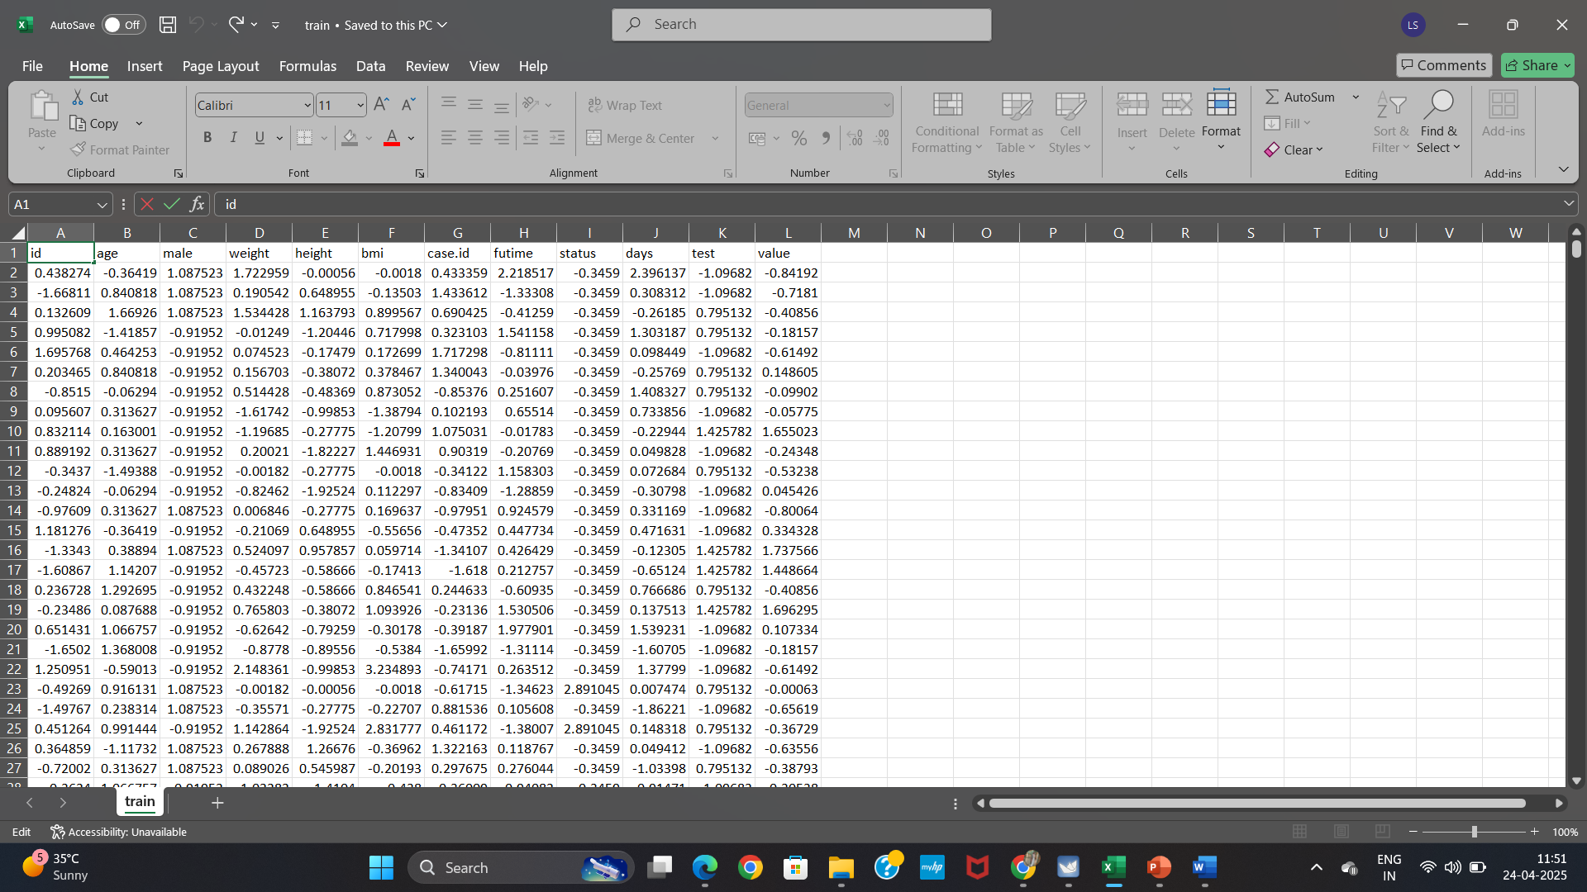
Input Data

Slide 22
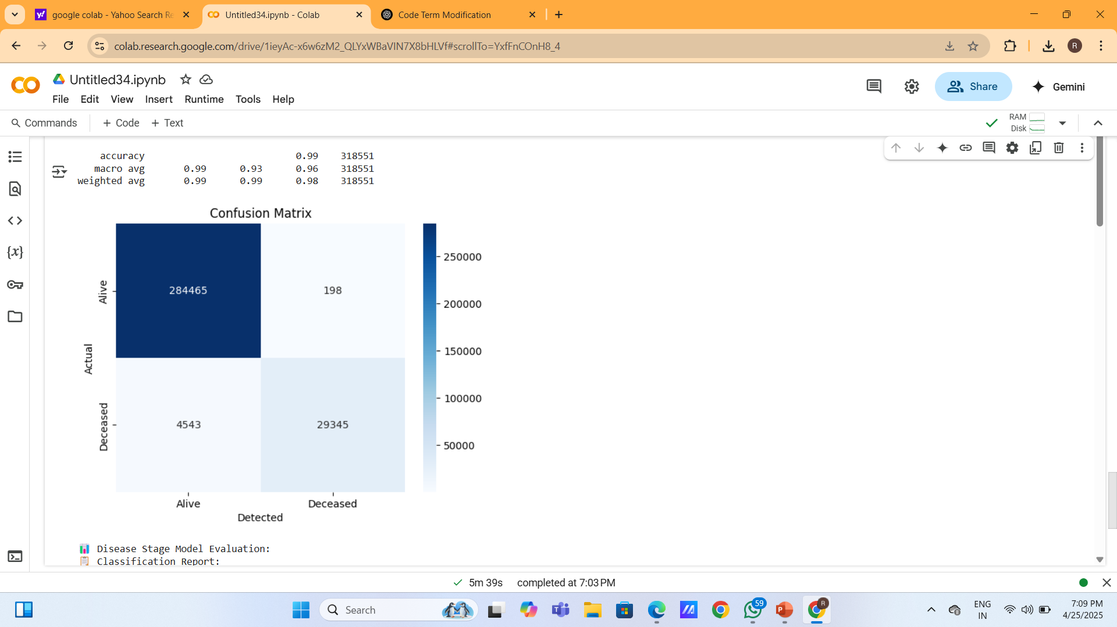
Performance Evaluation
Confusion Matrix For Mortality Prediction

Slide 23
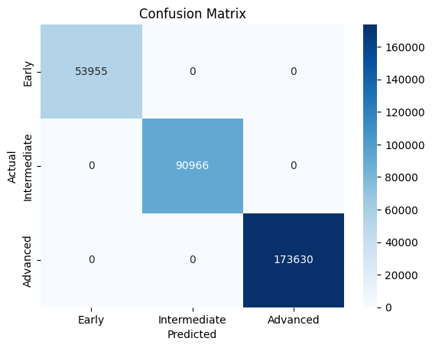
Confusion Matrix for Stage Prediction

Slide 24
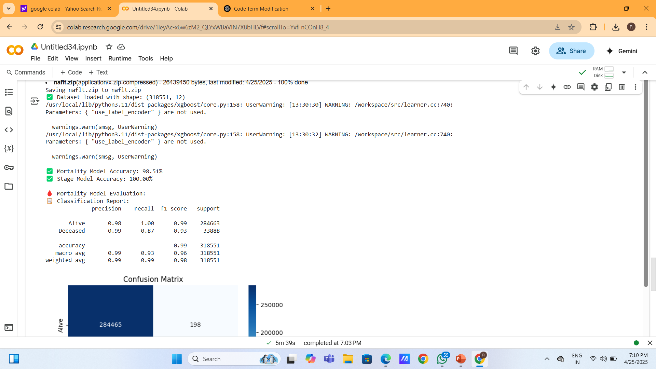
Classification Report

Slide 25
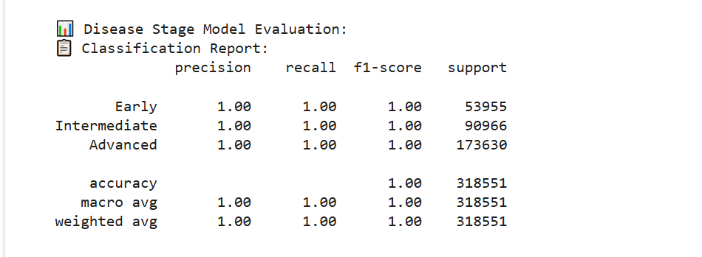
Classification Report(cont…)

Slide 26
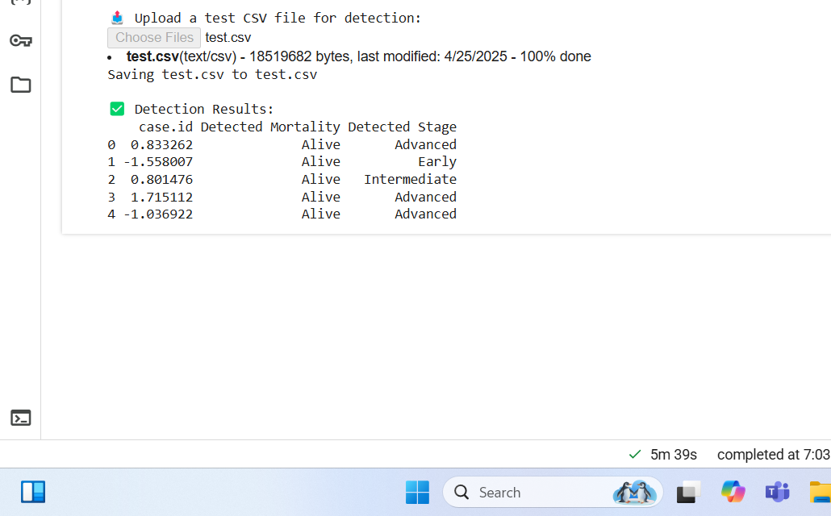
Result
Real World Data Upload

Slide 27
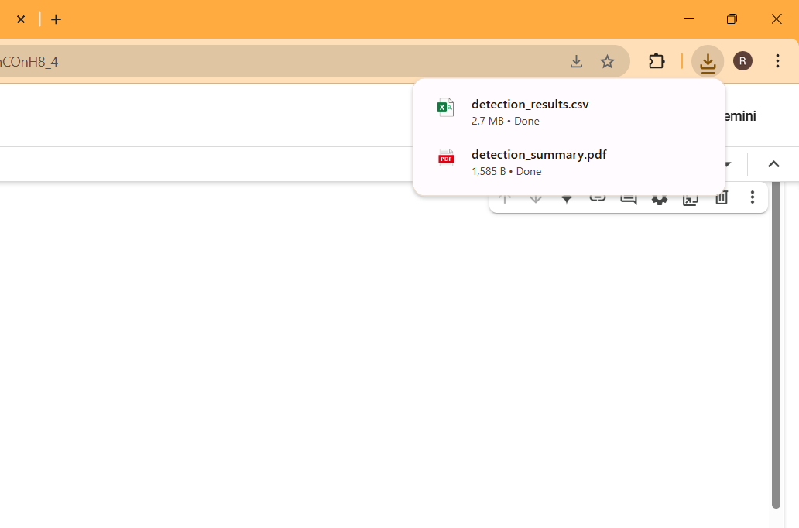
Report Generation

Slide 28
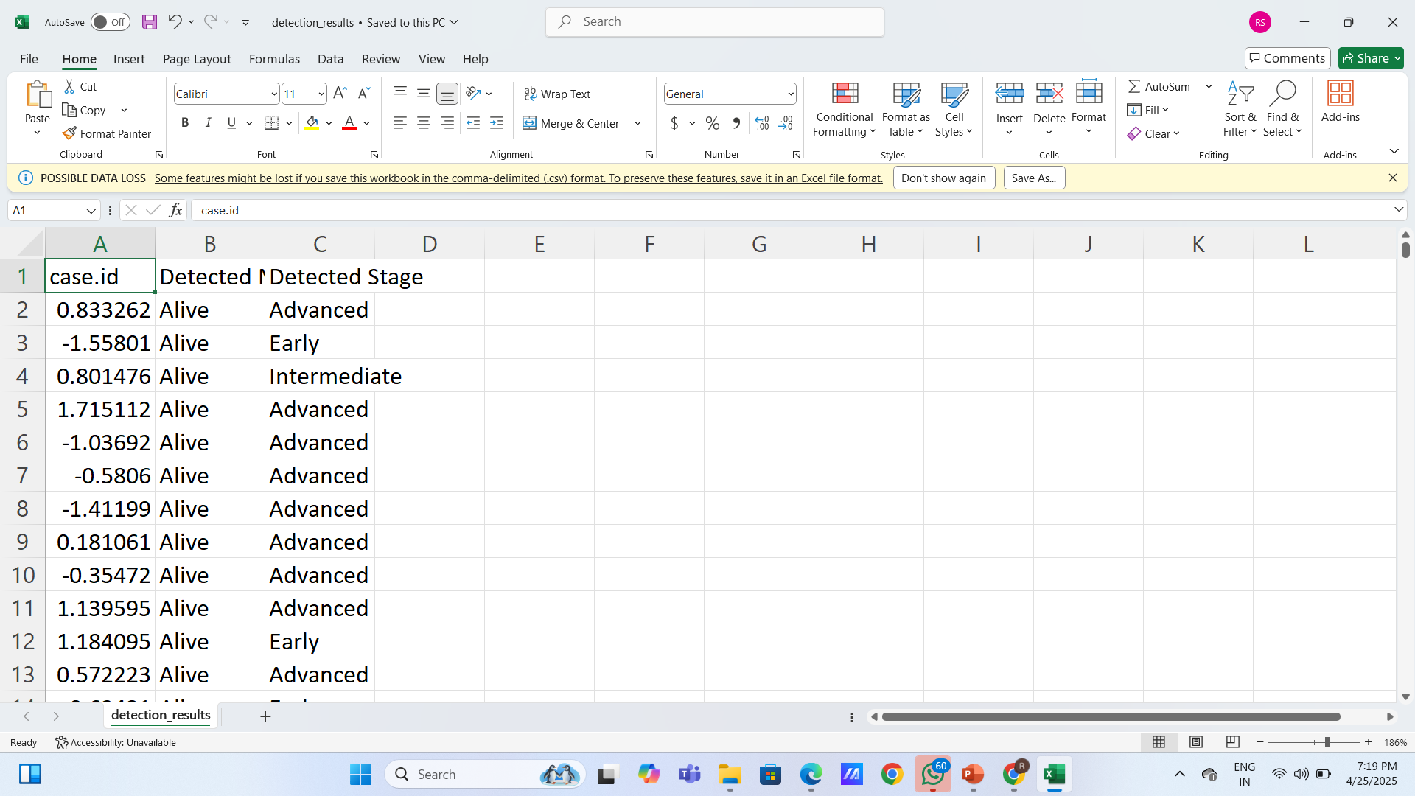
Output

Slide 29
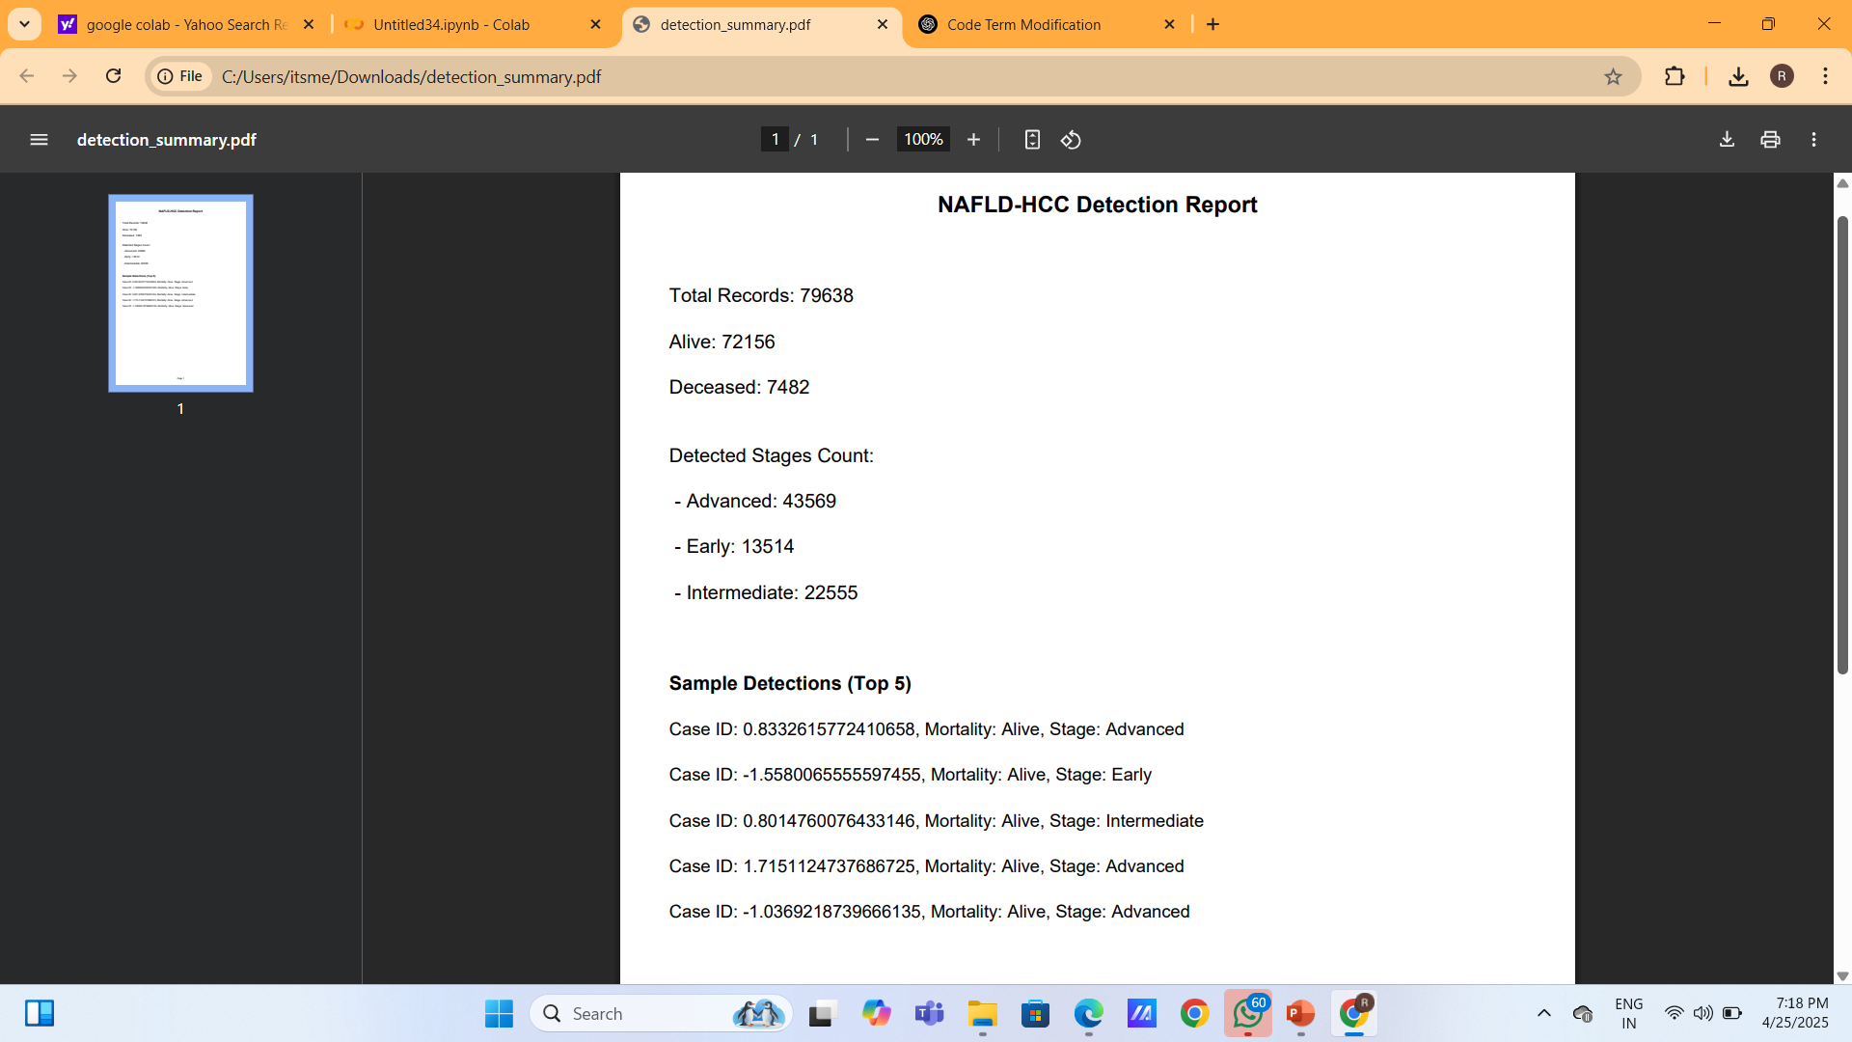
Output

Slide 30
Conclusion
Dual-model machine learning system was developed to predict both mortality and disease stage in NAFLD-related liver cancer patients. The approach addressed limitations in traditional methods by integrating real-time prediction, user-friendly interfaces, and detailed report generation. Extensive preprocessing and feature selection using SHAP ensured the model’s clinical relevance and interpretability. Evaluation results demonstrated high accuracy and robustness across both binary and multiclass predictions. Overall, the system supports early diagnosis and enhances decision-making in clinical environments.

Slide 31
References
Suárez, M., Gil-Rojas, S., Martínez-Blanco, P., et al.Machine Learning-Based Assessment of Survival and Risk Factors in Non-Alcoholic Fatty Liver Disease-Related Hepatocellular Carcinoma for Optimized Patient Management. Cancers 2024, 16, 1114.
Younossi, Z.M., et al. The Global Epidemiology of NAFLD and NASH: A Systematic Review. Hepatology, 77, 1335-1347.
Sagi, O., & Rokach, L. Approximating XGBoost with an Interpretable Decision Tree. Information Sciences, 572, 522-542.
Beam, A.L., & Kohane, I.S. Big Data and Machine Learning in Health Care. JAMA, 319(13), 1317-1318.

Slide 32
THANK YOU

