Slide 1

UNIVERSITY COLLEGE OF ENGINEERING VILLUPURAM
(A Constituent College of Anna University, Chennai)
DEPARTMENT OF INFORMATION TECHNOLOGY - 2025
RISK AND STAGE CLASSIFICATION OF NAFLD-HCC PATIENTS USING XGBOOST MODEL
FIRST REVIEW
GUIDED BY :
MR.SATHEESH KUMAR N,
Department of Information Technology,
UCEV .
PRESENTED BY:
LEENA S (422521205019),
RITHIKA MS (422521205033),
SASANIYA S (422521205039),
SWETHA U (422521205044).

Slide 2
AGENDA
Domain Introduction
Current Issues
Issues Planning to address
Tools Required
Literature review
Research Gaps
Existing System Architecture
Proposed System Architecture
Proposed Idea

Slide 3
Domain Introduction
Machine Learning (ML) is a field of artificial intelligence (AI) that focuses on building systems that can learn from data and make predictions or decisions without being explicitly programmed.
Types of Machine Learning:
Supervised Learning – learns from labeled data (e.g., predicting survival based on patient features)
Unsupervised Learning – finds hidden patterns in unlabeled data
Reinforcement Learning – learns through trial and error (used in robotics, games)

Slide 4
Current Issues
Only mortality prediction was implemented
No user interaction or real-time prediction support
Limited model evaluation
Basic data handling
No dual-model structure
Poor explainability for users

Slide 5
Issues planning to address
Added stage prediction
Enabled real-time predictions using user-uploaded CSV files.
Included interactive visualizations like confusion matrix & classification report.
Introduced clear data preprocessing, scaling, and stage binning steps.
Made the model suitable for clinical research and practical use.

Slide 6
Tools Required
Programming Language
Python – Core language for data processing, model building, and visualization.
Libraries and Frameworks
Pandas – For data loading, cleaning, and manipulation.
NumPy – For numerical operations and array handling.
Matplotlib – For data visualization (plots, charts).
Seaborn – For enhanced visualizations like heatmaps.

Slide 7
Tools Required(cont..)
scikit-learn (sklearn)
Data preprocessing
Model Evaluation
Train-Test splitting
XGBoost – For building high-performance machine learning models (binary and multiclass classification).
FPDF – To generate automated PDF prediction reports.
zipfile & os – For file extraction and path handling.
Google Colab Tools – Files upload() and file download() for real time interaction with Colab

Slide 8
Literature Review
S.NO | TITLE | AUTHOUR & YEAR | OBJECTIVES | TECHNIQUES USED | KEY FINDINGS
1. | Machine Learning-Based Assessment of Survival and Risk Factors in NAFLD-Related HCC (Base Paper) | Suárez M. et al., 2024 | Predict survival and risk factors in NAFLD-HCC patients | XGBoost (ML), Clinical Data Analysis | Alcohol, obesity, and cirrhosis affect prognosis; XGBoost had higher accuracy
2. | Preoperative Prediction for Early Recurrence of HCC Using ML-Based Radiomics | Mao B. et al., 2024 | Predict early recurrence of HCC after surgery | Radiomics (CT), Machine Learning | Combined radiomics + clinical data improved accuracy (AUC = 0.83)
3. | Prediction of Response to DEB-TACE in HCC Using CT Radiomics | Zhang X. et al., 2024 | Predict how patients respond to first DEB-TACE treatment | Logistic Regression, CT Radiomics + Clinical Data | Integrated model achieved best performance (AUC = 0.927)

Slide 9
Literature Review(Cont…)
S.NO | TITLE | AUTHOURS & YEAR | OBJECTIVES | TECHNIQUES USED | KEY FINDINGS
4. | Development of a ML-Based Prognostic Model for AFP-positive HCC | Dong B. et al., 2024 | Predict 1-, 3-, and 5-year survival for AFP+ HCC patients | XGBoost, LR, SVM, RF, KNN, ID3 | XGBoost outperformed all other models; 5-year AUC = 0.807
5. | Centrosome Amplification Signature Predicts Prognosis & Drug Response in HCC | Liu Y. et al., 2024 | Use CARGs to improve HCC diagnosis and therapy prediction | LASSO-Cox Regression, Single-cell RNA-seq | 6-gene signature linked to recurrence, immune evasion & drug sensitivity

Slide 10
Research Gaps
Limited Scope in Existing Models
Lack of Real-Time, User-Interactive Tools
Minimal Integration of Explainability
Absence of Imaging and Multimodal Data
Small and Imbalanced Datasets
Lack of Deployment and Clinical Validation

Slide 11
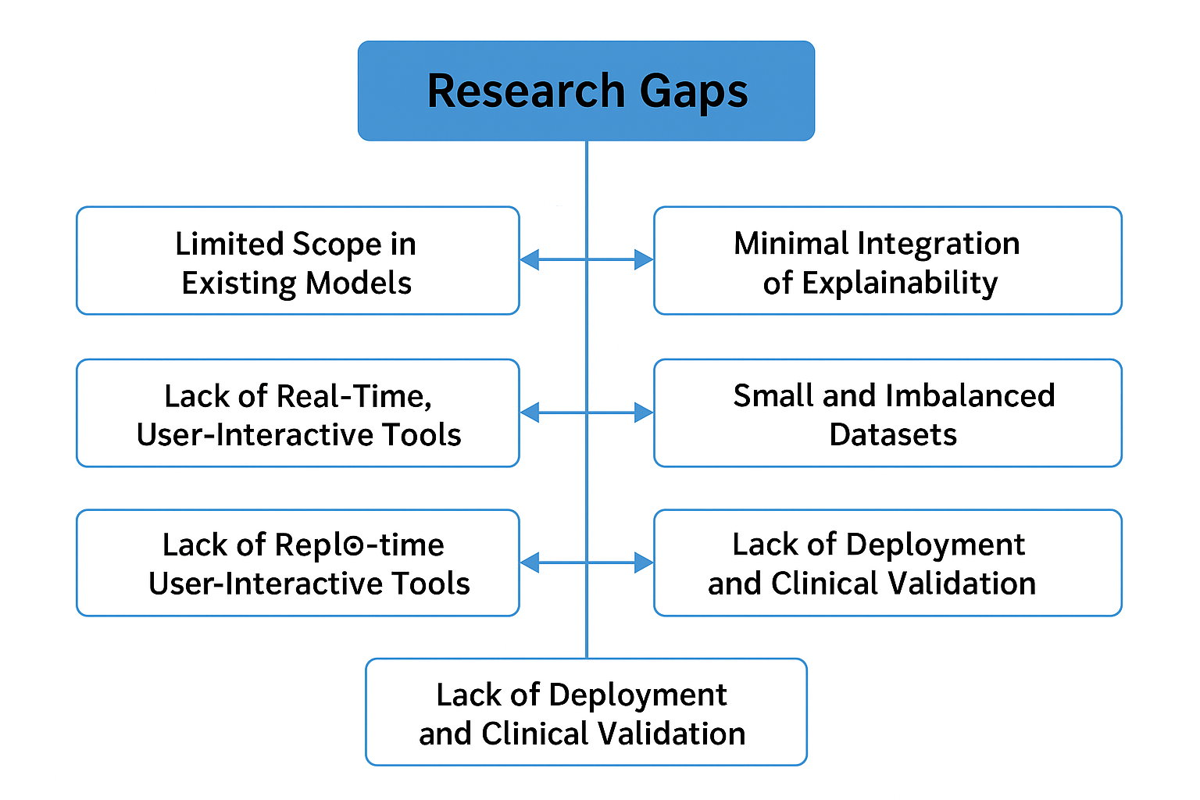
Research gaps

Slide 12
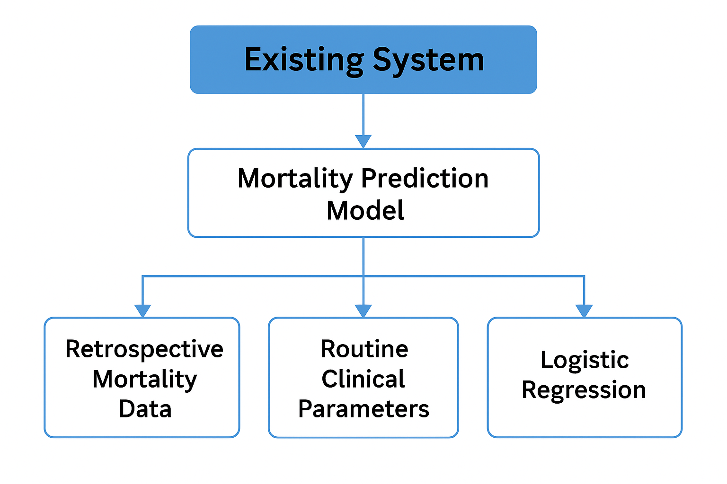
Existing System Architecture

Slide 13
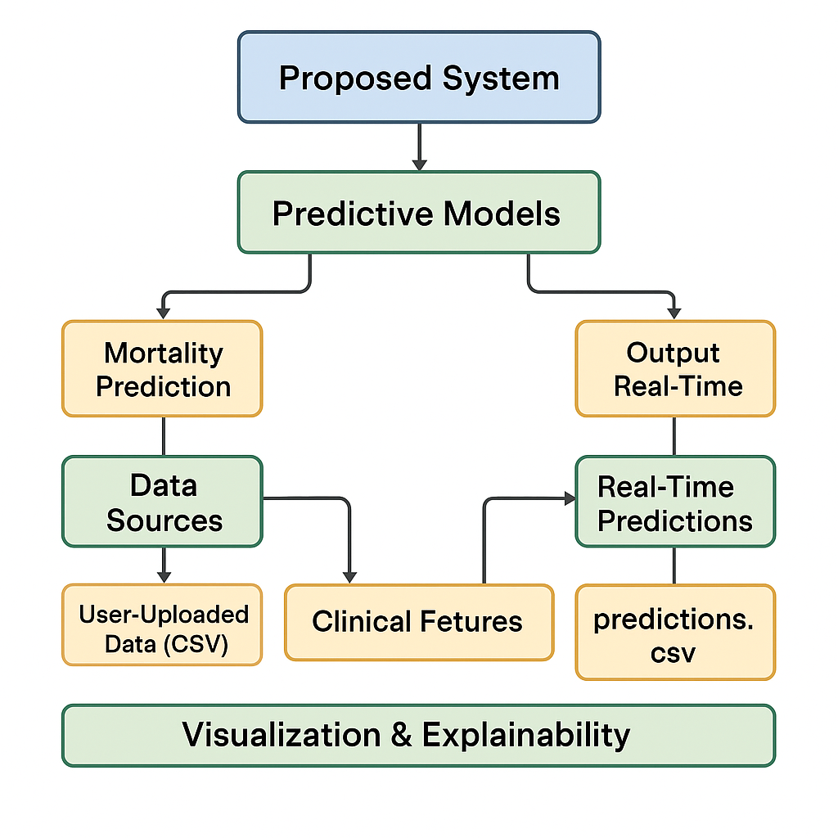
Proposed System Architecture

Slide 14
Proposed Idea
Added Disease Stage Prediction
Real-Time Prediction Output
Improved Visualization
Dual ML Models
Interactive ML Tool

