Slide 1
Human Computer Interface (HCI)
Rithika Gurram
Likhith Kolli

Slide 2
Introduction
HCI emphasizes creating user-friendly interfaces to improve interaction, satisfaction, and efficiency in healthcare, gaming, and business contexts.
User experience in HCI aims to ensure seamless interactions, intuitive design, and emotional satisfaction for enhanced engagement across diverse domains.
Accessibility and safety considerations in HCI involve accommodating diverse user needs and minimizing risks to create inclusive and secure digital experiences.

Slide 3
Why it is needed
1.Usability: Making technology user-friendly and efficient.
2.User Experience (UX): Ensuring a positive and intuitive interaction with technology.
3.Accessibility: Enabling people with diverse abilities to use computers effectively.
4.Safety: Especially in industries like healthcare and aviation, HCI helps prevent errors and accidents.
5.Entertainment and Gaming: Enhancing immersive experiences in video games and virtual reality.
6.Education and Training: Facilitating interactive learning and simulations.
7.Business and Productivity: Improving efficiency and performance in corporate environments.

Slide 4
Currently in market. Three examples.
1.Amazon Alexa utilizes NLP for voice commands, reminders, and smart home controls, enhancing user convenience and accessibility.
2.Twitter employs NLP for sentiment analysis, content personalization, and trending topics, improving user engagement and experience.
3.ChatGPT leverages NLP for conversational AI, customer support, and personalized responses, enhancing natural and fluid user interactions.

Slide 5
Amazon Alexa
Amazon Alexa is a virtual assistant that responds to voice commands, playing music, managing tasks, providing information, and controlling smart home devices.
Services include setting alarms, creating shopping lists, playing audiobooks, and accessing real-time information on weather, news, and traffic.
Stakeholders in the ecosystem include users, developers creating Alexa Skills, device manufacturers integrating Alexa, and Amazon as the platform provider.

Slide 6
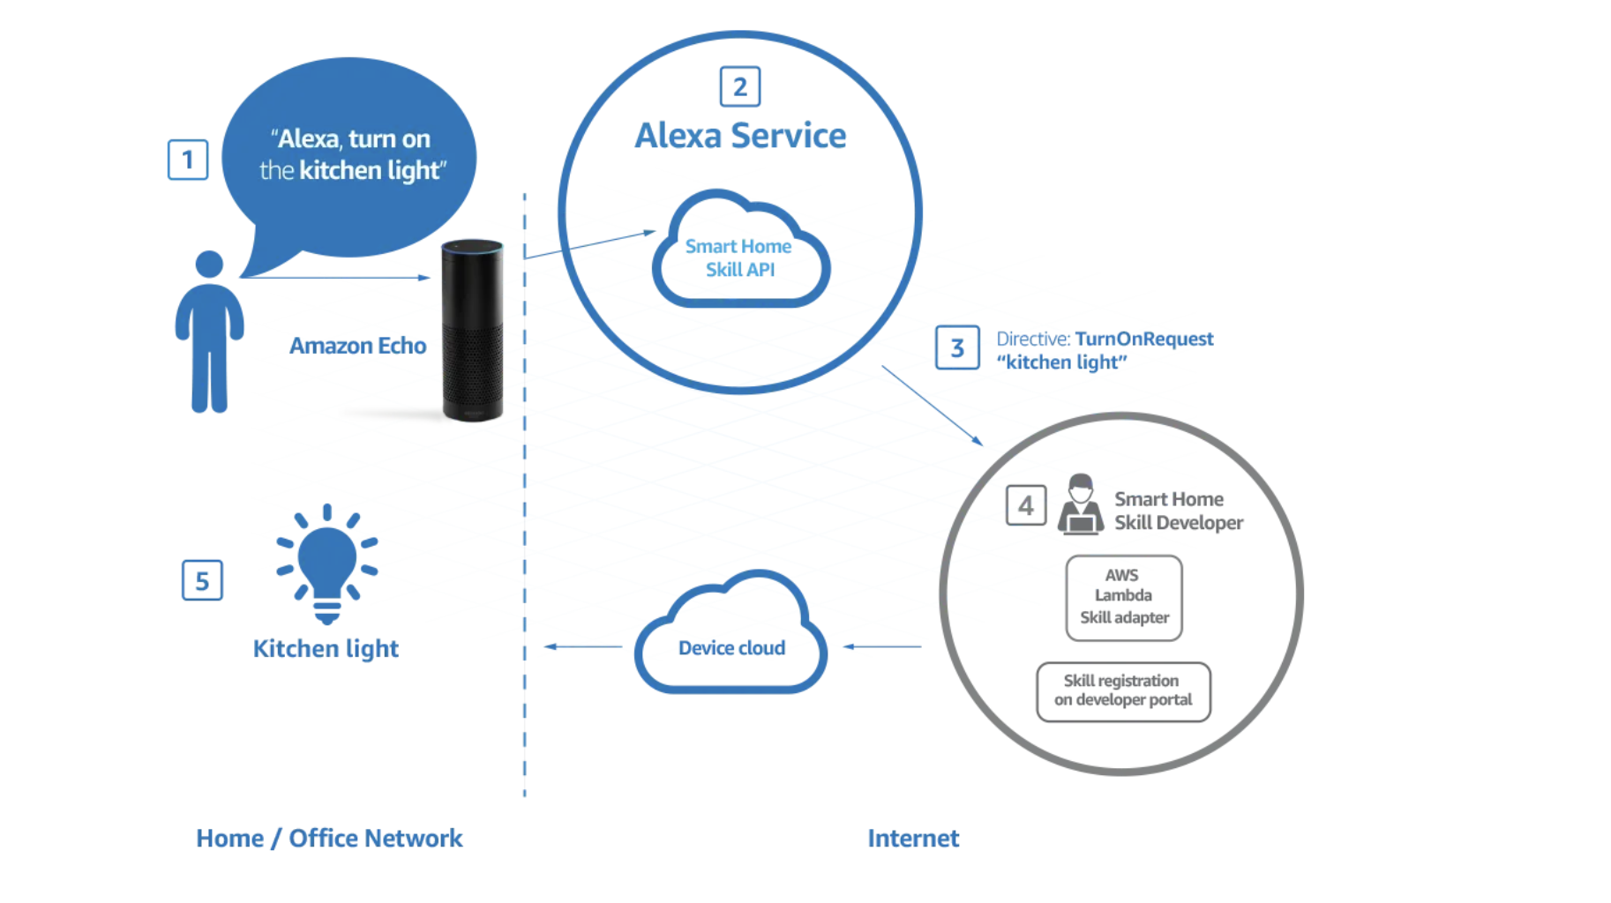

Slide 7
Amazon Alexa: NLP technologies used
Amazon Alexa's NLP technology comprises:
1. Automatic Speech Recognition (ASR): Deep neural networks transcribe speech accurately, pivotal for subsequent processing.
2. Natural Language Understanding (NLU): Tokenization, syntactic, and semantic analysis ensure precise interpretation of user commands.
3. Machine Learning and Deep Learning: Improve prediction accuracy and refine responses over time using various ML techniques.
4. Text-to-Speech (TTS): Advanced engines like Tacotron generate lifelike audio responses, enhancing user satisfaction.
5. Dialogue Management: State management techniques enable multi-turn conversations and coherent responses.
6. Entity Resolution and Slot Filling: Extract actionable data and categorize them accurately for understanding user requests.
7. Context Handling and Personalization: Algorithms consider past interactions and preferences to personalize responses for an enhanced user experience.

Slide 8
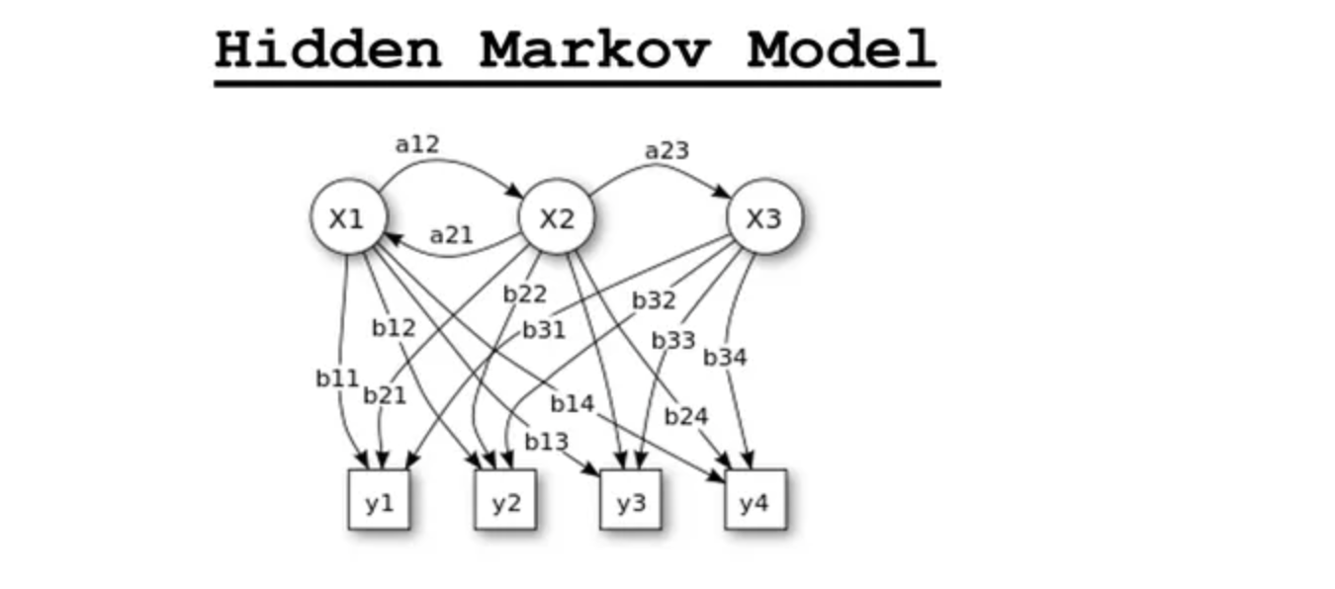
Hidden Markov Model
This diagram represents a Hidden Markov Model (HMM). An HMM is a statistical model which is often used to describe the evolution of observable events that depend on internal factors, which are not directly observable (hidden states).
The model consists of:
- States (X1, X2, X3), which are the hidden states of the system.
- Observations (y1, y2, y3, y4), which are the visible outputs.
- Transition probabilities (a12, a21, a23), which represent the probability of transitioning from one state to another.
- Emission probabilities (b11, b12, ..., b34), which represent the probability of an observation being generated from a state.
The arrows indicate the direction of transitions between states and the association of states to particular observations. The model can be used to predict a sequence of hidden states based on observed events.

Slide 9
Hidden Markov Model
Decoding HMMs involves several steps:
1. Model Initialization: Start with an initial HMM model, including parameters like transition and emission probabilities.
2. Forward Algorithm: Compute forward probabilities for each state at each time step to calculate the likelihood of observing the data sequence.
3. Viterbi Algorithm: Find the most likely hidden state sequence considering transition and emission probabilities.
4. Baum-Welch Algorithm: Use expectation-maximization to refine parameters like transition and emission probabilities.
5. Iteration: Continuously iterate steps 2-4 until model parameters converge, enhancing alignment with observed data for greater accuracy.

Slide 10
Twitter
Twitter functions as a microblogging platform where users can share updates, news, and interact with others in real-time.
Services include trending topics, hashtags, retweeting, liking tweets, direct messaging, and advertising opportunities for businesses.
Stakeholders encompass users, advertisers, developers, media outlets, governments, and organizations leveraging Twitter for communication and marketing purposes.

Slide 11
Twitter: NLP technologies used
Two methods to access Twitter data: REST API and Streaming API.
Required information: API key, API secret, Access token, Access token secret.
Example: Collected tweets for twenty FTSE 100 companies over a week, totaling 37,313 tweets.

Slide 12
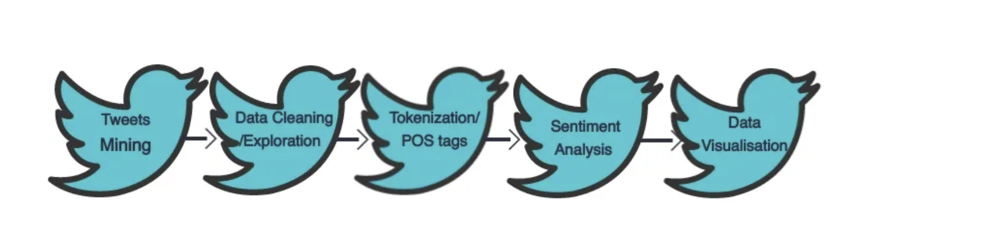
Twitter: NLP technologies used
Utilize REST or Streaming API
Parse API response into structured table.
Named Entity Recognition (NER)
Analyze sentiment: positive, negative, neutral.

Slide 13
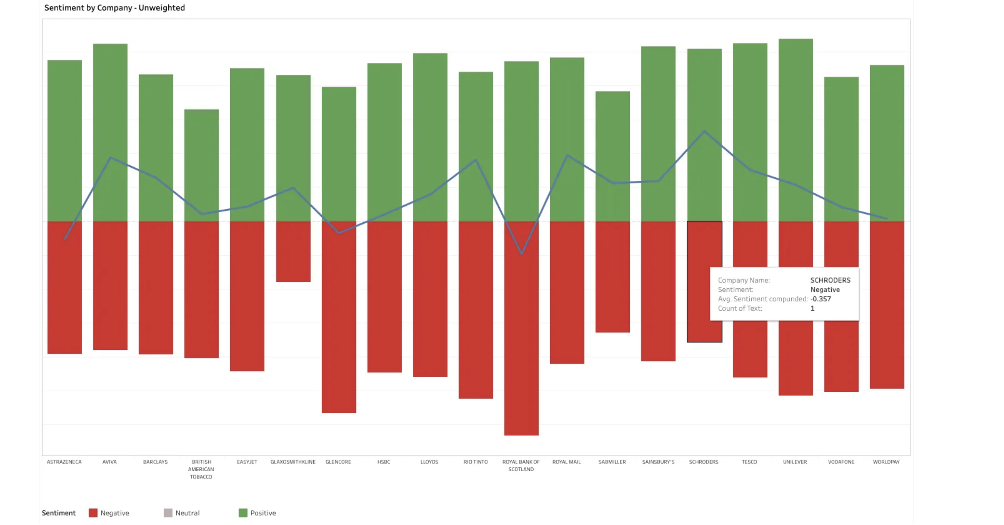
Sentiment Analysis
The visualization of the above results would help drive insights into the consumer opinion about the product or company. In the below section
The graph shown is the positive, negative and average sentiment (Blue line) of each company. The bars represent the average sentiment for the company and is not weighted for the number of tweets. This unweighted sentiment does not provide an accurate comparison between companies as it does not take into account the number of tweets.

Slide 14
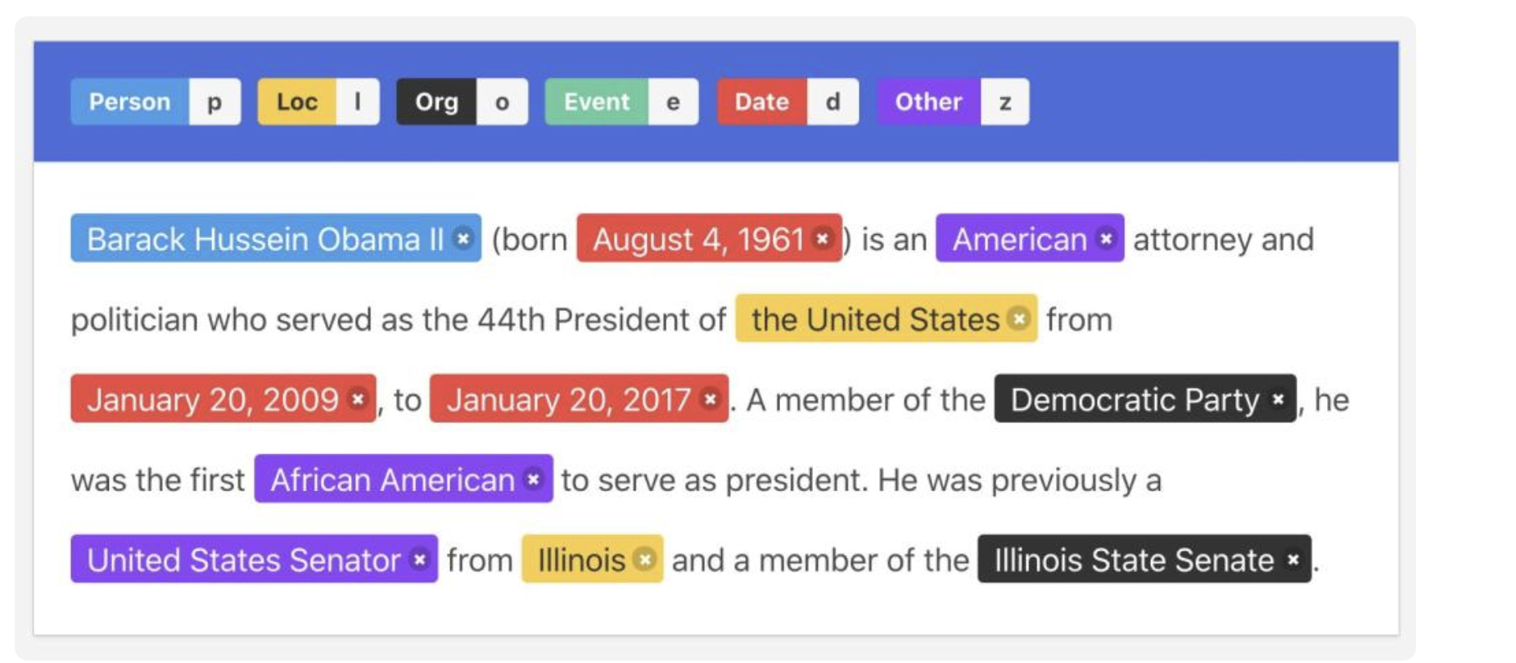
Name Entity Recognition(NER)
1.NER Model Process:
Detect named entities.
Categorize the detected entities.
2.Entity Categories:
Examples include Name, Location, Event, Organization, etc.
These categories form the basis of training data for the NER model.
3.Training Data Preparation:
Involves tagging words and phrases with their corresponding entities.
Trains the NER model to detect and categorize entities accurately.

Slide 15
ChatGPT
Functionalities of ChatGPT include natural language processing for communication, text generation, and content moderation.
Services provided by ChatGPT range from chatbot development to language translation and content creation assistance.
Stakeholders engaged with the platform are developers, businesses utilizing chatbots, content creators, and NLP researchers.

Slide 16
ChatGPT: NLP technologies used
The Generative Pre-trained Transformer (GPT) architecture serves as the foundation for building ChatGPT, which features a stack of transformer decoder layers.
Unlike BERT's bidirectional encoder, ChatGPT utilizes a left-to-right autoregressive decoder, generating each token in the output sequence based on preceding tokens.
ChatGPT undergoes pre-training on a large corpus of text data using an autoregressive language modeling objective, predicting the next token given the preceding context to capture syntactic and semantic patterns.
The core of the GPT architecture is the self-attention mechanism, enabling the model to attend to different parts of the input context, capturing long-range dependencies and token relationships.
Positional encoding is added to input embeddings to provide token position information, aiding in distinguishing between tokens at different positions and learning the sequence order.
Following pre-training, ChatGPT can undergo fine-tuning on specific downstream tasks or domains, adapting its learned representations to the target task, such as conversational data for contextually relevant responses.

Slide 17
References
1. https://www.analyticsvidhya.com/blog/2023/11/hidden-markov-models/
2. https://medium.com/analytics-vidhya/tweet-analytics-using-nlp-f83b9f7f7349
3. https://www.analyticsvidhya.com/blog/2021/06/part-10-step-by-step-guide-to-master-nlp-named-entity-recognition/
4. https://medium.com/@tahaasghar21/natural-language-processing-the-future-of-human-computer-interaction-7eb5d10dd8df
5. https://www.analyticsinsight.net/role-of-nlp-enhancing-human-computer-interaction/
6. https://towardsdatascience.com/your-guide-to-natural-language-processing-nlp-48ea2511f6e1
7.https://www.researchgate.net/publication/223853334_Natural_Language_Processing_A_Human-Computer_Interaction_Perspective
8. https://towardsdatascience.com/how-amazon-alexa-works-your-guide-to-natural-language-processing-ai-7506004709d3

Slide 18
THANK YOU

