Slide 1


Artificial Intelligence and Data Science
Data Science and Visualization 24ADI204
DATA-VIZ HACK-A-BIT (2026-2027)
Project Title: BLACK FRIDAY LOGISTICS NIGHTMARE
Course: Data Science and Visualization Course Code: 24ADI204
Department: Artificial Intelligence and Data Science Team Number: 7
Review: Final Review

Slide 2
Team Members
NEHA OTHIYANKODE - 25BAD065 NITHARSHANA S - 25BAD071 GOPIKA A - 25BAD504 SHUBIKSHA S.Y - 25BAD106 RITHIKA A.M - 25BAD088

Slide 3
Problem Statement
Supply chain management involves several interconnected processes, including customer orders, product distribution, sales, inventory management, and delivery operations. Managing these processes efficiently becomes challenging due to large volumes of transactions, varying customer demands, and unexpected delivery delays.
The project titled "Supply Chain Logistic Nightmare" focuses on analysing a real-world supply chain dataset containing 180,519 records and 53 features.
The dataset includes information about customers, products, orders, sales, profits, shipping methods, and delivery status. These attributes help us understand purchasing patterns, shipping performance, and factors associated with delayed deliveries.

Slide 4
Project Objectives
1. To collect and understand a real-world supply chain dataset.
2. To inspect the dataset and identify its structure, features, and data types.
3. To perform data cleaning by handling missing values, duplicate records, and outliers.
4. To conduct Exploratory Data Analysis using statistical techniques and visualizations.
5. To identify relationships between sales, profits, shipping duration, and delivery risk.
6. To analyse customer purchasing patterns and shipping performance.
7. To perform feature engineering through normalization, standardization, and categorical encoding.
8. To implement feature selection techniques to identify important variables.
9. To apply Principal Component Analysis (PCA) for dimensionality reduction.
10. To prepare the dataset for future predictive modelling.

Slide 5
Scope of the Project
Major Areas Covered:
Dataset Collection and Inspection
Data Cleaning and Preprocessing
Missing Value Treatment
Duplicate Detection
Outlier Detection and Handling
Univariate Analysis
Bivariate Analysis
Correlation Analysis
Statistical Analysis
Data Visualization
Feature Engineering
Applications:
Understanding delivery delays.
Identifying sales and profit patterns.
Analysing customer segments.
Understanding shipping performance.
Supporting inventory and logistics planning.
Improving data-driven decision-making.

Slide 6
Dataset Description
Dataset Name: Supply Chain Management Dataset
PARAMETER | DESCRIPTION
Data Type | Structured
Total Records | 180519
Total Features | 53
File Format | CSV
Domain | Supply Chain and E- Commerce
Target Variable | Late_Delivery_Risk
Programming Language | Python

Slide 7
Dataset Description
Dataset Feature Categories:
Customer Information – Customer ID, name, city, country and segment.
Product Information – Product ID, product name, category and price.
Order Information – Order ID, order date and order status.
Sales Information – Sales, discounts and order profit.
Shipping Information – Shipping mode, scheduled shipping days and actual shipping days.
Delivery Information – Delivery status and late delivery risk.
Target Variable: Late_delivery_risk
  0 – No late delivery risk.
  1 – Late delivery risk.

Slide 8
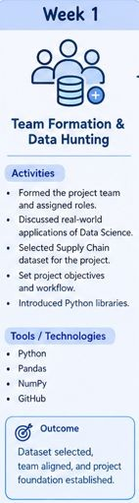
Methodology(Process / Workflow)
WEEK 1 – TEAM FORMATION AND DATA HUNTING
Activities Performed:
Formed the project team and distributed responsibilities.
Discussed real-world applications of Data Science.
Selected Supply Chain Management as the project domain.
Identified and selected a suitable supply chain dataset.
Established the project objectives and workflow.
Introduced Python libraries required for data analysis.
Learning Outcome:
Understood the importance of dataset selection and established the foundation for the project.

Slide 9
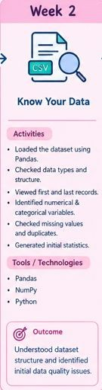
Methodology(Process / Workflow)
WEEK 2 – KNOW YOUR DATA
Activities Performed:
Loaded the dataset using Pandas.
Examined the first and last few records.
Identified numerical and categorical variables.
Checked dataset dimensions.
Inspected data types.
Examined missing values and duplicate records.
Generated statistical summaries.
Initial Findings:
180,519 records.
53 features.
Structured dataset containing numerical and categorical variables.
Identified Late_delivery_risk as the target variable.

Slide 10
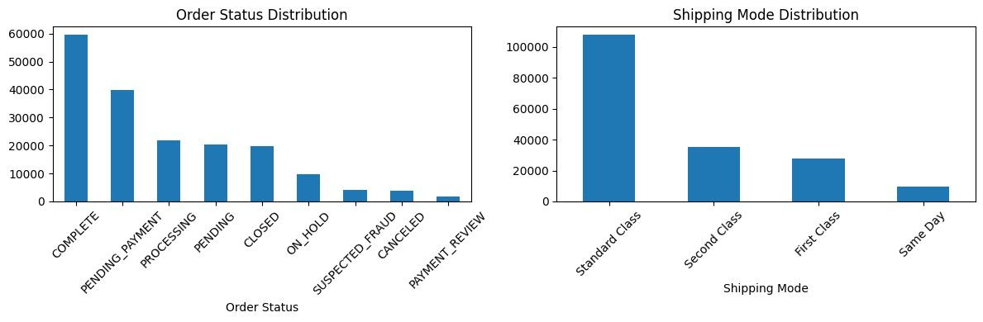
Methodology(Process / Workflow)

Slide 11
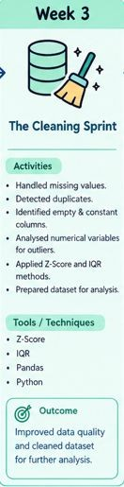
Methodology(Process / Workflow)
WEEK 3 – THE CLEANING SPRINT
Activities Performed:
Identified missing values.
Checked duplicate records.
Identified empty and constant columns.
Examined numerical variables for outliers.
Applied statistical techniques for outlier detection.
Prepared the dataset for further analysis.
Data Quality Findings:
8 missing values in Customer Lname.
Product Description column was completely empty.
No duplicate records were identified.
Constant columns were identified for removal.

Slide 12
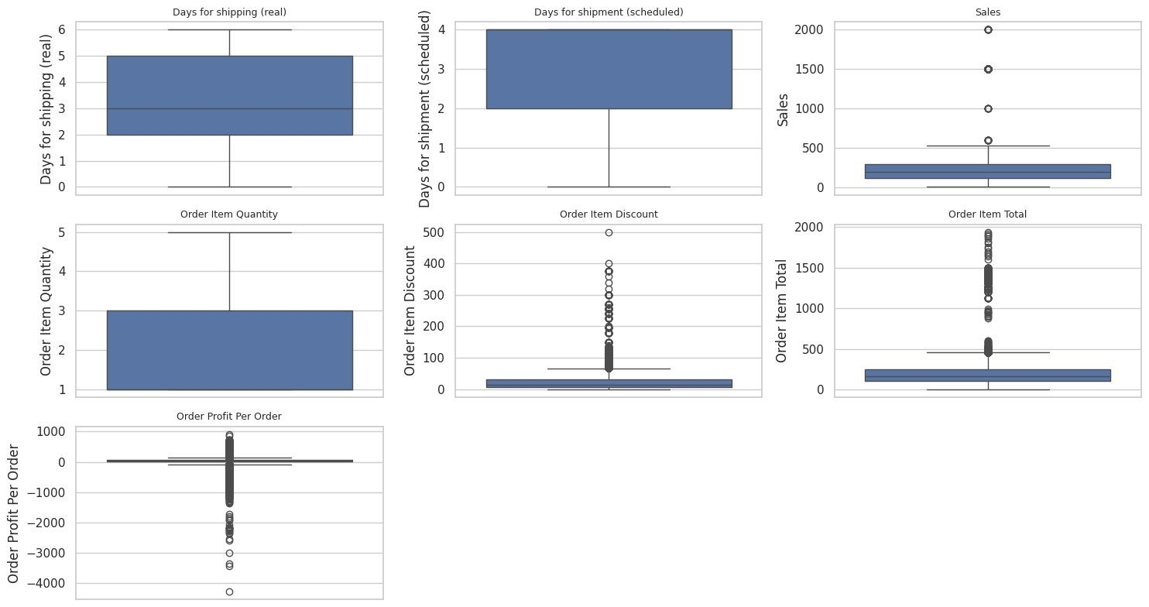
Methodology(Process / Workflow)

Slide 13
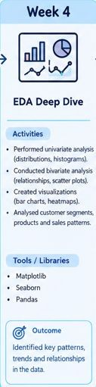
Methodology(Process / Workflow)
WEEK 4 – EDA DEEP DIVE
Exploratory Data Analysis
EDA involves examining datasets using statistical methods and visualizations to discover patterns, trends, and relationships.
1. Univariate Analysis
Analysis of one variable at a time. Techniques:
Histograms
Boxplots
Count plots
Frequency distributions
Variables analysed:
Sales
Order Profit
Order Quantity
Shipping Days
Customer Segment

Slide 14
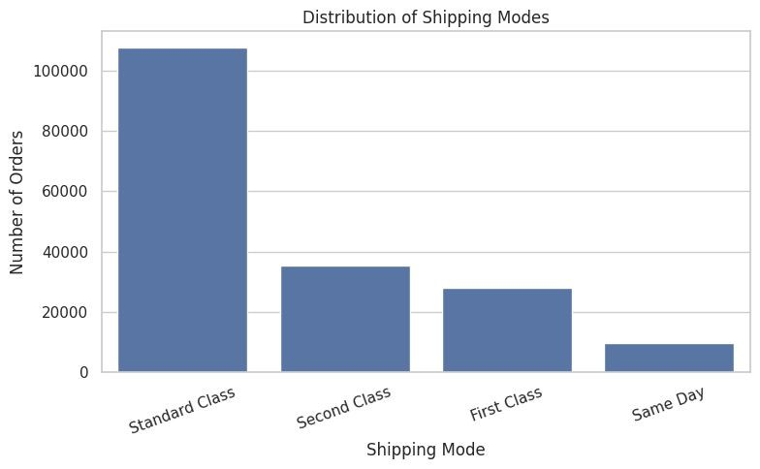
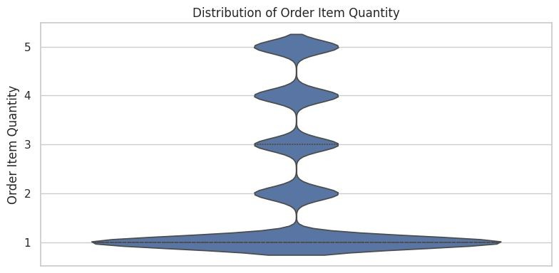
Methodology(Process / Workflow)

Slide 15
Methodology(Process / Workflow)
Bivariate Analysis
Analysis of relationships between two variables. Techniques:
  Scatter plots
  Bar charts
  Correlation analysis
  Heatmaps
Data Visualization
Libraries:
  Matplotlib
  Seaborn
Relationships examined:
Actual Shipping Days vs Scheduled Shipping Days.
Sales vs Profit.
Shipping Mode vs Delivery Risk.
Customer Segment vs Order Distribution.

Slide 16
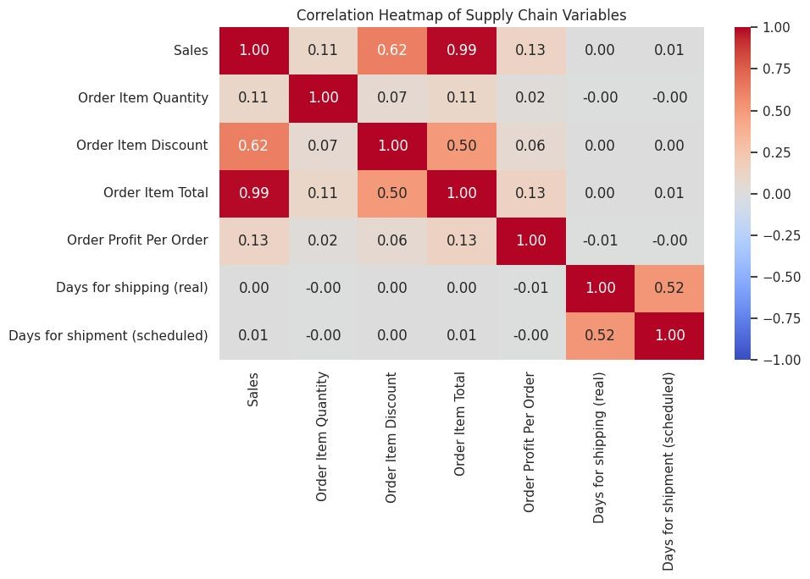
Methodology(Process / Workflow)

Slide 17
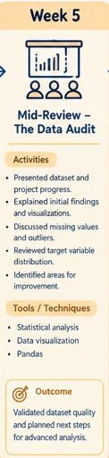
Methodology(Process / Workflow)
WEEK 5 – MID-REVIEW: THE DATA AUDIT
Activities Performed:
Consolidated dataset inspection findings.
Presented initial data preprocessing results.
Reviewed missing values and outlier detection.
Presented preliminary EDA findings.
Examined the distribution of the target variable.
Identified areas requiring further improvement.

Slide 18
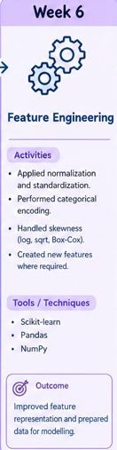
Methodology(Process / Workflow)
WEEK 6 – FEATURE ENGINEERING
Feature engineering involves transforming existing data into meaningful features suitable for analysis and machine learning.
Normalization
Transforms numerical values into a common range, generally between 0 and 1. Formula: X' = (X − Xmin) / (Xmax − Xmin)
Standardization
Transforms data to have a mean of 0 and standard deviation of 1. Formula:
Z = (X − μ) / σ

Slide 19
Methodology(Process / Workflow)
Categorical Encoding
Converts categorical variables into numerical representations. Methods:
  Label Encoding
  One-Hot Encoding
4. Handling Skewness
Skewness measures the asymmetry of a data distribution.
Types:
Positive Skewness
Negative Skewness
Zero Skewness
Transformation techniques:
Log Transformation
Square Root Transformation
Box-Cox Transformation

Slide 20
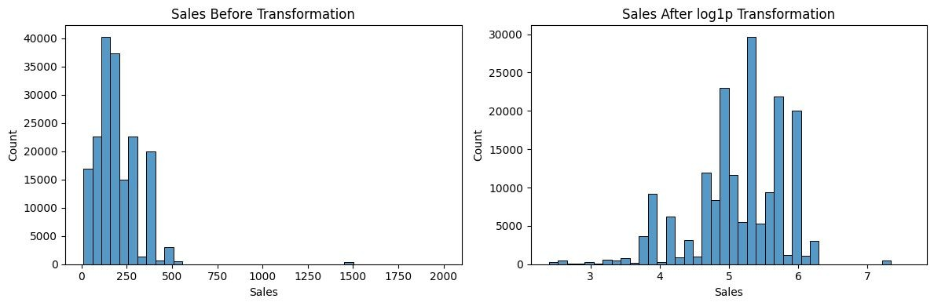
Methodology(Process / Workflow)

Slide 21
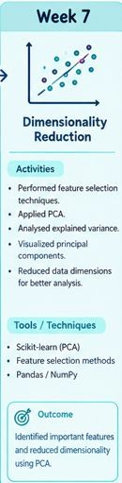
Methodology(Process / Workflow)
WEEK 7 – DIMENSIONALITY REDUCTION
Feature Selection and Principal Component Analysis
Dimensionality reduction reduces the number of features while preserving important information.
Feature Selection
Identifies the most relevant features from the original dataset. Methods:
  Filter Method
  Wrapper Method
  Embedded Method

Slide 22
Methodology(Process / Workflow)
2. Principal Component Analysis (PCA)
PCA transforms correlated numerical variables into a smaller set of uncorrelated variables called principal components.
Steps Involved:
Standardize numerical data.
Calculate the covariance matrix.
Calculate eigenvalues and eigenvectors.
Rank principal components based on explained variance.
Select important components.
Transform the original dataset into reduced dimensions.

Slide 23
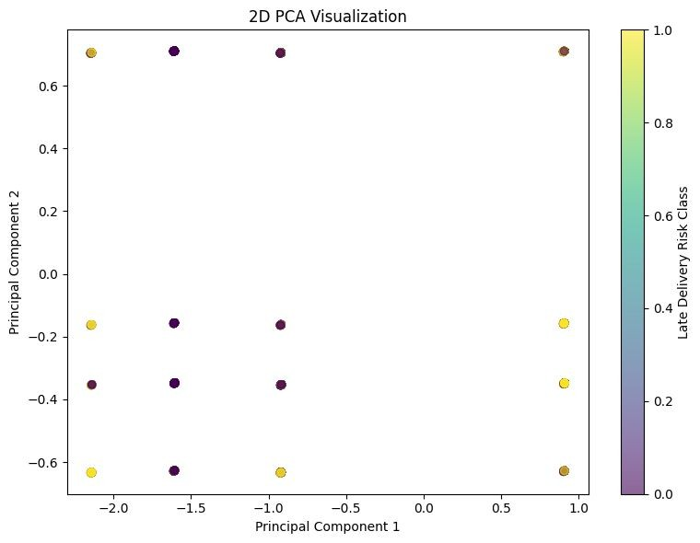
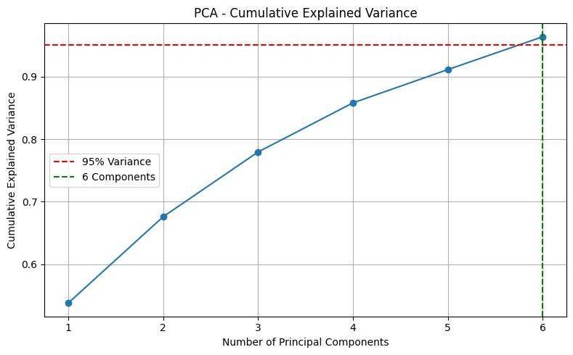
Methodology(Process / Workflow)

Slide 24
Methodology(Process / Workflow)
WEEK 8: INTERACTIVE DASHBOARD DEVELOPMENT
Activities Performed:
Dashboard Development
  Developed an interactive Supply Chain Performance Analytics Dashboard using Python and Streamlit.
  Integrated the processed supply chain dataset into the dashboard.
  Organized the dashboard into different analytical sections.
Interactive Dashboard Filters
  Market Selection
  Region Selection
  Product Category Selection
  Shipping Mode Selection
  Customer Segment Selection
  Order Date Range Selection

Slide 25
Methodology(Process / Workflow)
DASHBOARD ANALYSIS AND KEY INSIGHTS:
Sales Analysis:
Analysed sales performance across different regions.
Identified the top-performing product categories.
Examined sales trends over time.
Compared sales contributions across geographical markets.
Customer Analysis:
Consumer customers contribute the largest share of sales.
Identified the top 10 customers based on order count.
Compared customer purchasing patterns across segments.

Slide 26
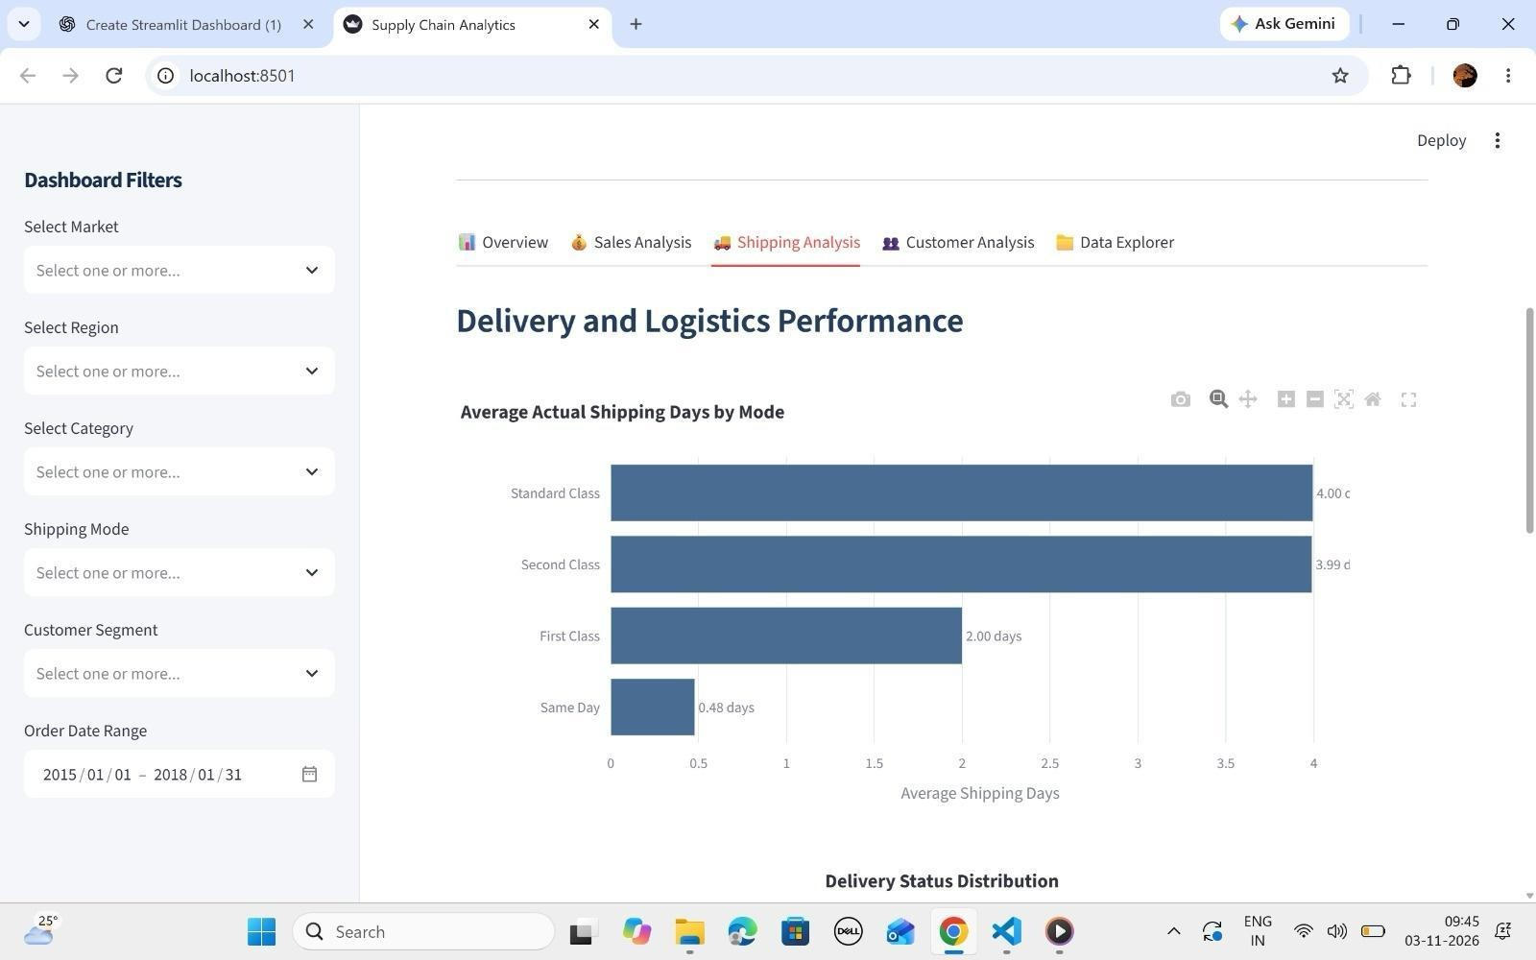
Methodology(Process / Workflow)

Slide 27
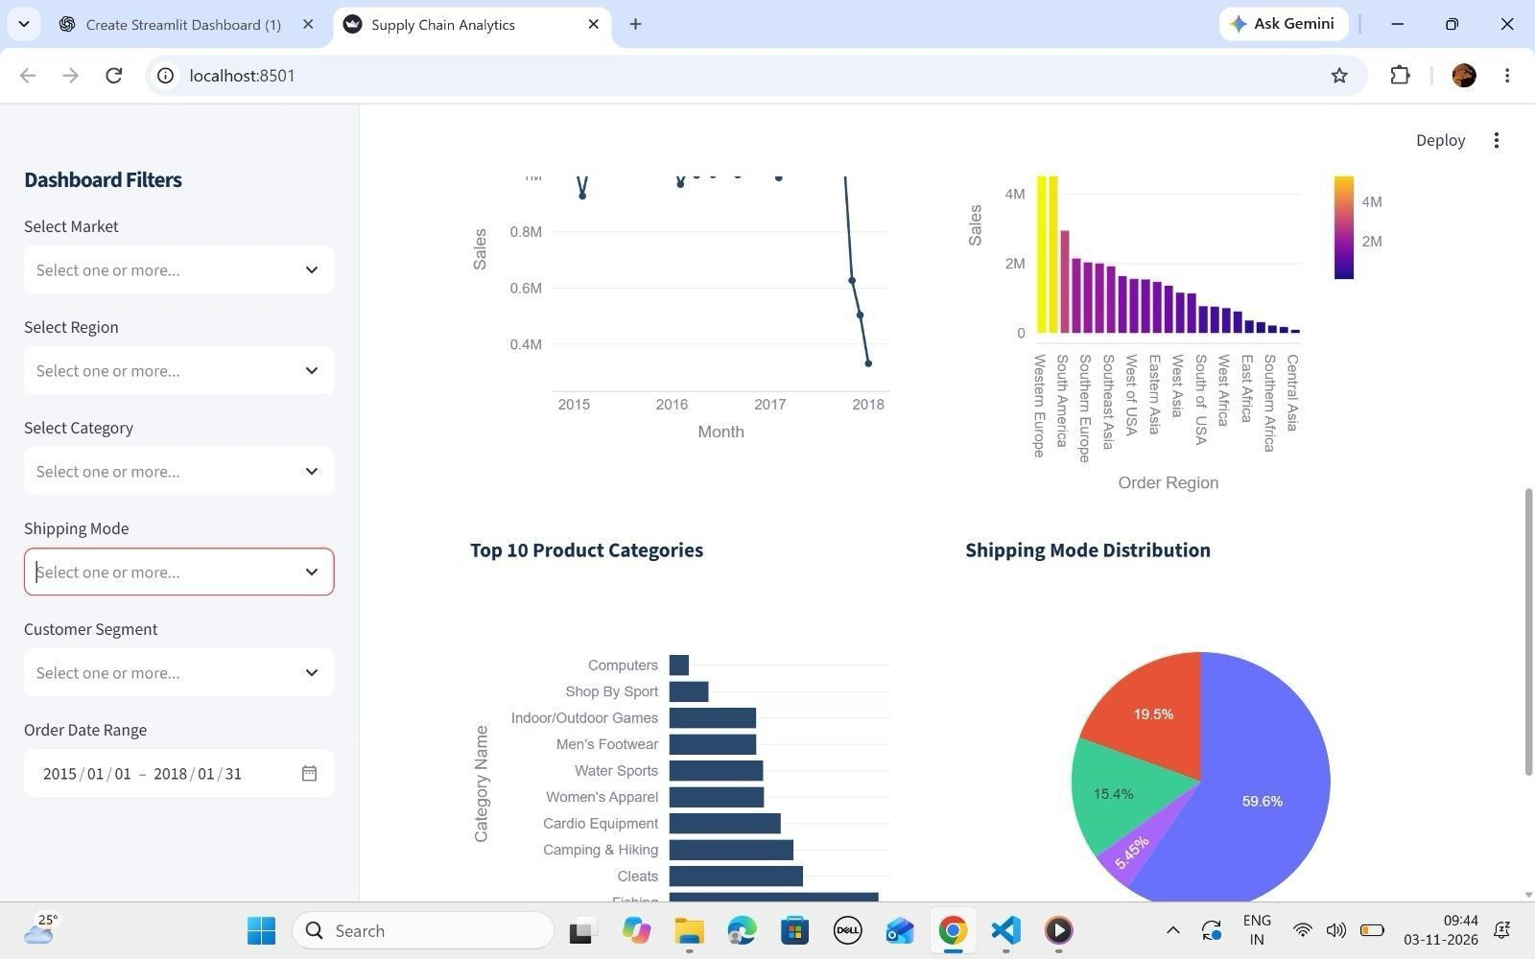
Methodology(Process / Workflow)

Slide 28
Results From Workflow
DATA PREPROCESSING
Preprocessing Activities:
Missing Value Handling – Identifying and treating incomplete records.
Duplicate Removal – Checking and removing duplicate entries.
Outlier Treatment – Identifying extreme values using statistical techniques.
Constant Column Removal – Removing columns that provide no useful variation.
Data Type Correction – Ensuring variables have appropriate data types.
Feature Transformation – Preparing variables for analysis and modelling.
Outcome:
Improved dataset quality, consistency, and suitability for exploratory analysis and feature engineering.

Slide 29
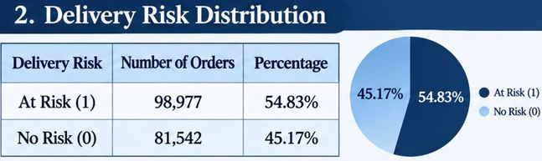
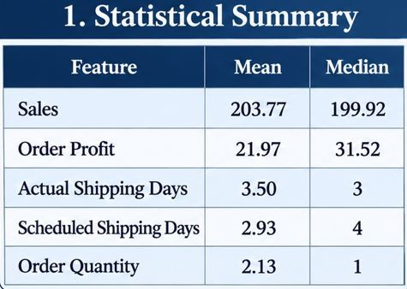
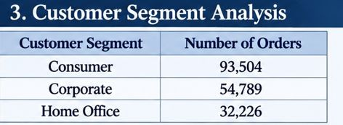
Results From Workflow
EXPLORATORY DATA ANALYSIS (EDA)

Slide 30
Challenges Faced
Missing Values :Identifying and handling incomplete data entries without affecting the overall dataset quality.
Outlier Detection: Identifying unusual values that could affect statistical calculations and visualizations.
Large Dataset Size: Processing 180,519 records and 53 features required efficient data manipulation.
Class Distribution :The target variable contains different proportions of late and non-late delivery records.
Feature Selection: Identifying the most relevant features from a large number of variables was challenging.
Data Transformation: Selecting appropriate encoding and scaling techniques for different variable types required careful consideration.
Dimensionality Reduction: Understanding principal components and retaining sufficient information during PCA required statistical analysis.

Slide 31
Future Work & Conclusion
Future Work
Develop machine learning models to predict late deliveries.
Compare algorithms such as Logistic Regression, Decision Trees, and Random Forest.
Evaluate models using accuracy, precision, recall, and F1-score.
Develop interactive dashboards using Power BI.
Identify important factors influencing delivery delays.
Improve supply chain decision-making through predictive analytics.

Slide 32
References
Original Supply Chain Dataset – [Insert actual source and URL]. Pandas Documentation – https://pandas.pydata.org/docs/ NumPy Documentation – https://numpy.org/doc/
Matplotlib Documentation – https://matplotlib.org/stable/ Scikit-learn Documentation – https://scikit-learn.org/stable/ Google Colab – https://colab.research.google.com/
Scikit-learn Preprocessing –
https://scikit-learn.org/stable/modules/preprocessing.html Scikit-learn PCA –
https://scikit-learn.org/stable/modules/decomposition.html

