Slide 1
Quarterly Evaluation I Project Submission TEAM - 6

Slide 2
Members of the Team
Arshdeep S Virdi Harshiya Saxena Rithika G Sangeetha S Srujan P

Slide 3
BREWNOVA
Responsive Coffee Shop Website Group project to build a responsive website that adapts to various devices.

Slide 4
Objective
Build a static, accessible, and visually appealing website for a coffee shop.
Ensure layouts, navigation, and forms adapt gracefully across screen sizes.
Demonstrate responsive design principles and practical media-query usage.

Slide 5
File overview and Roles
index.html — Main landing page: hero, menu, about, contact, product listings.
cart.html — Dedicated cart/checkout page for selected items and totals.
styles.css — All layout, responsive rules, typography, color palette, and forms.
swiper-bundle.min.css — Styles for the Swiper carousel.
main.js — Custom JavaScript for menu toggle, cart interactions, form validation, and initializing libraries.
swiper-bundle.min.js — Carousel functionality (product or testimonial sliders).
scrollreveal.min.js — Scroll-triggered entrance animations for UI polish.

Slide 6
Key features
Responsive multi-section homepage: menu grid, specials, about, contact.
Cart functionality and for demoing selection and totals.
Mobile-first design with breakpoints for tablet and desktop.
Sections showcasing products with images and responsive grid.
About section with brand story and values.

Slide 7
Responsive Techniques used
Base : base styles for small screens, progressively enhanced with larger breakpoints.
Layouts: Flexbox and CSS Grid to move from single-column to multi-column.
Images: max-width: 100% and object-fit to preserve aspect ratios.
Navigation: collapsible/hamburger on mobile (controlled by main.js) to horizontal on larger screens.

Slide 8
Example Media Query Strategy
Base (mobile): default styles for narrow screens.
Tablet breakpoint (~768px): switch to multi-column layouts for menu and about sections.
Desktop breakpoint (~1024px+): wider containers, larger typography, multi-column header/footer.

Slide 9
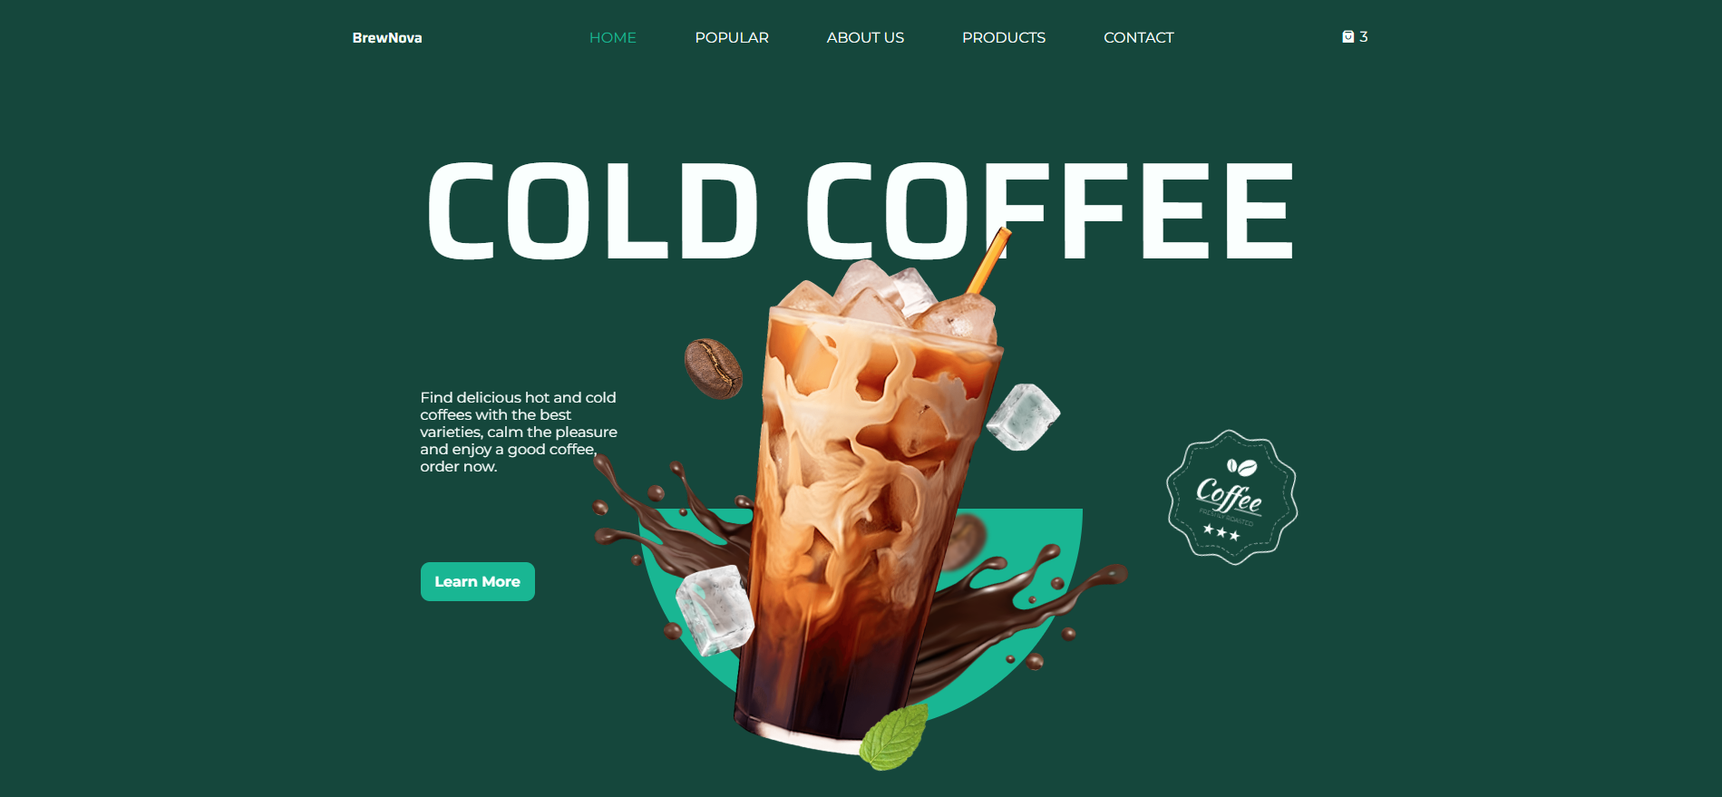
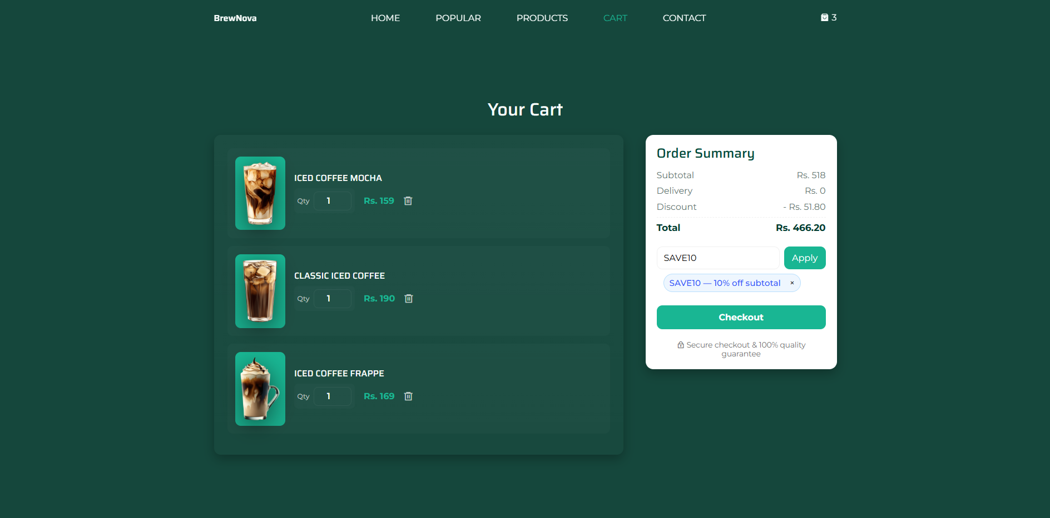
Images of the Website

Slide 10
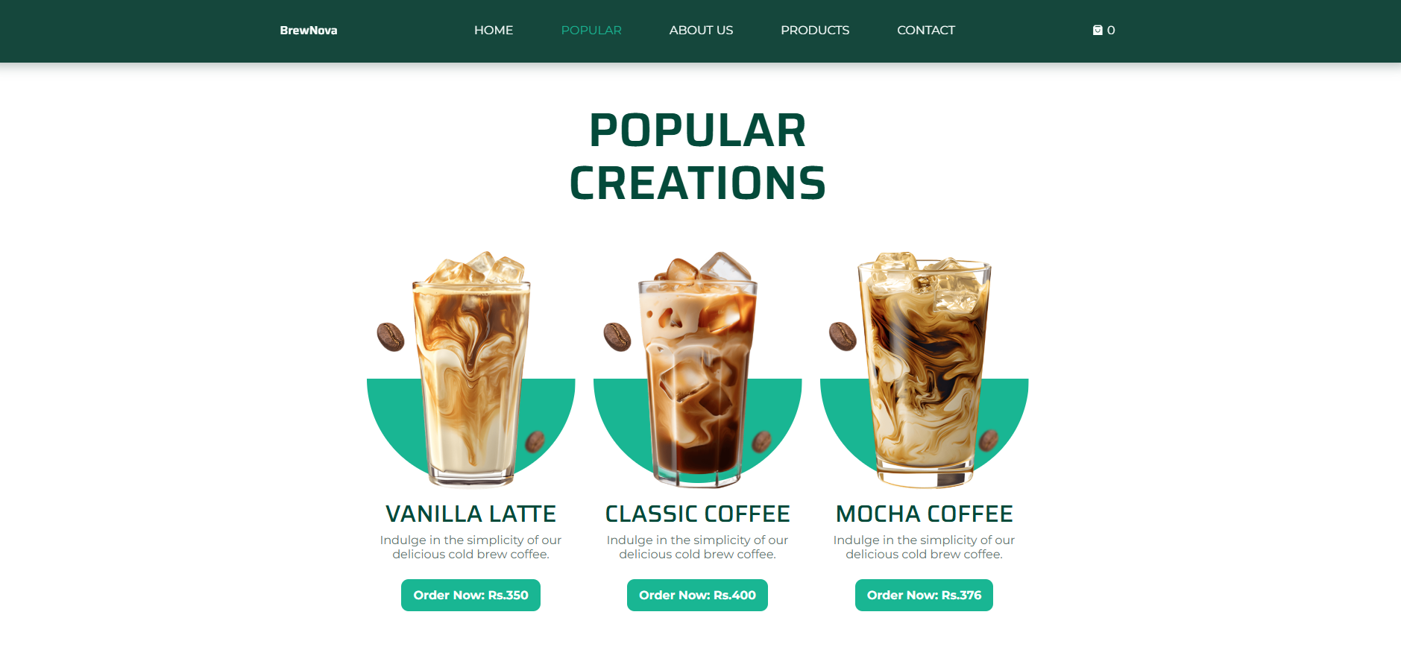
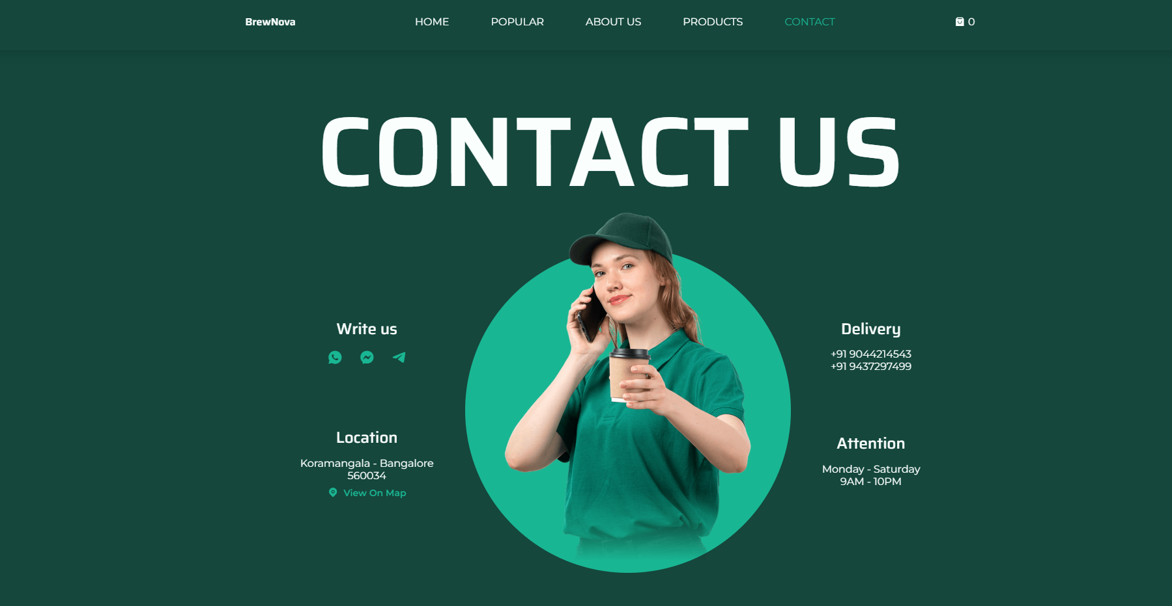
Images of the Website

Slide 11

DEMO

Slide 12
Thank You

