Slide 1




The Use of GenAI to Support the Formulation of Risk Control Measures
Name: Rithika Ravichandran
Matriculation number: 23177041
Study Program: Health and Medical Data Analytics (HMDA)
First supervisor: Prof. Dr. Jana Hutter
Second supervisor: M. Sc. Stephanie Heidepriem (Siemens Healthineers)
Notes:
The focus is on supporting hazard key formulation in CT system risk documentation.

Slide 2
Agenda
Context: CT risk documentation & hazard keys
Problem & research questions
Solution concept: retrieval-first GenAI assistant
Prototype architecture & Workflow
Governance & compliance considerations
Evaluation & results
Limitations & future work

Slide 3
Background & Industrial Content

Slide 4
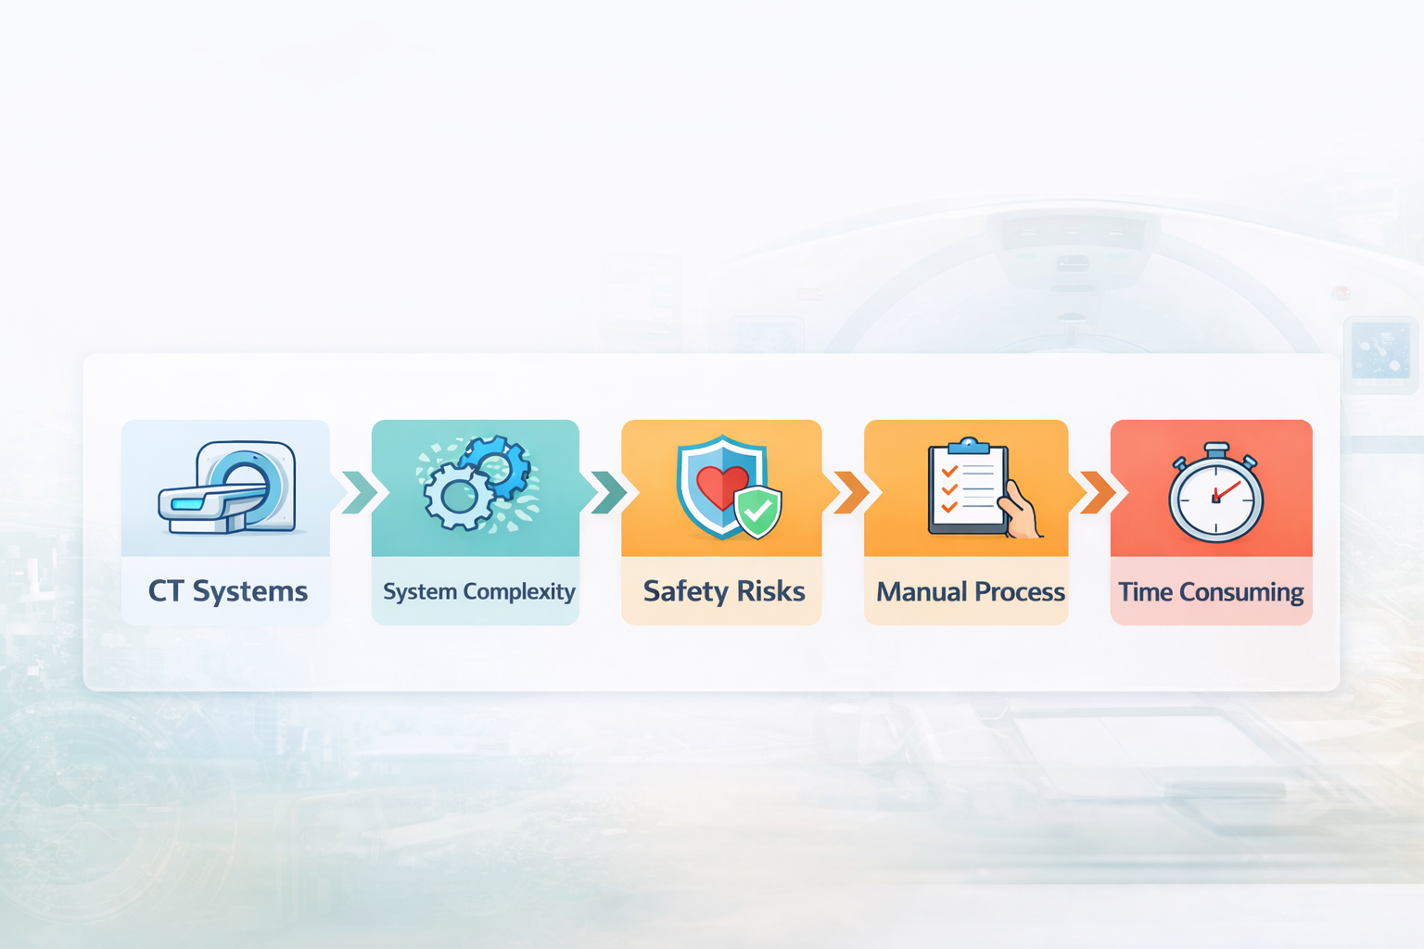
Background
Overview of the current situation and existing challenges.
CT systems are widely used diagnostic tools in medical imaging
Rapid technological advancement increases system complexity
Patient safety becomes increasingly critical
This process is currently manual and time-consuming
Image generated using AI

Slide 5
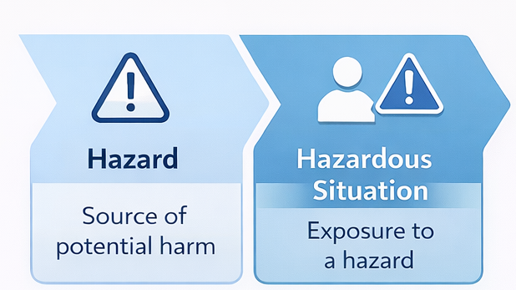
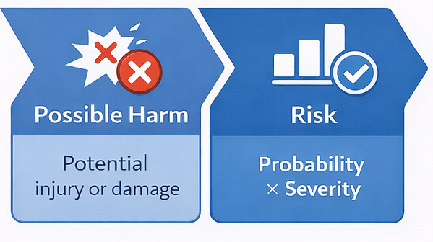
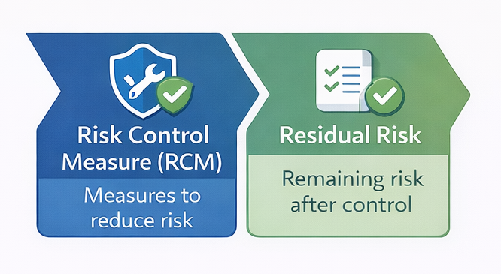
Risk Management & Hazard Keys
Key Concept used in Medical Device Risk Management
5

Slide 6
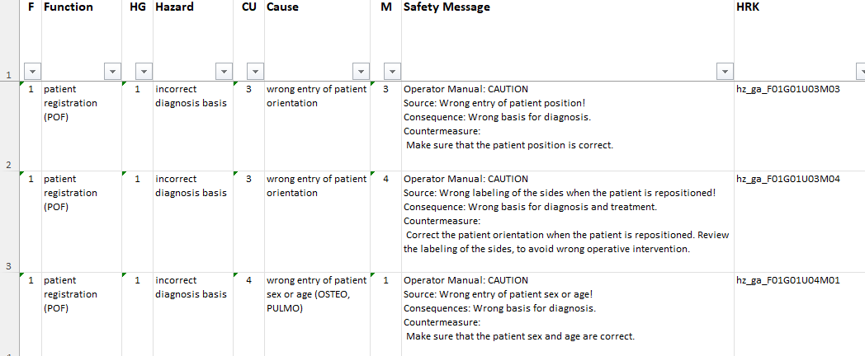
What is a Hazard Key?
Introduction to the concept of hazard keys
Hazard Key is a structured identifier used in Siemens Healthineers
It Consists of :
Function
Hazard
Cause
Safety Message
Hazard Requirement key
Hazard Requirement Key List

Slide 7
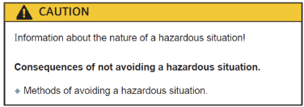
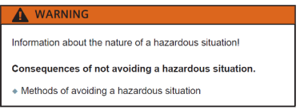
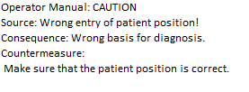
Safety Message Structure
How safety messages are defined and presented.
Safety Message Components:
⚠️Signal Word: Danger / Warning / Caution / Notice
☠️ Source: Cause of the hazard
💥Consequence: Possible harm
🛡️Countermeasure: Action to prevent harm
Technische Fakultät

Slide 8
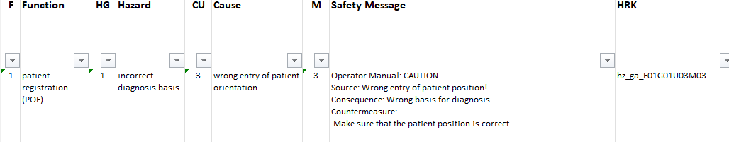

Hazard Requirement Key (HRK)
Internal Siemens Healthineers taxonomy
F01: Function
G01: Hazard
U03: Cause
M03: Safety Message
Example Key: hz_ga_F01G01U03M03
Used to track safety across the lifecycle

Slide 9
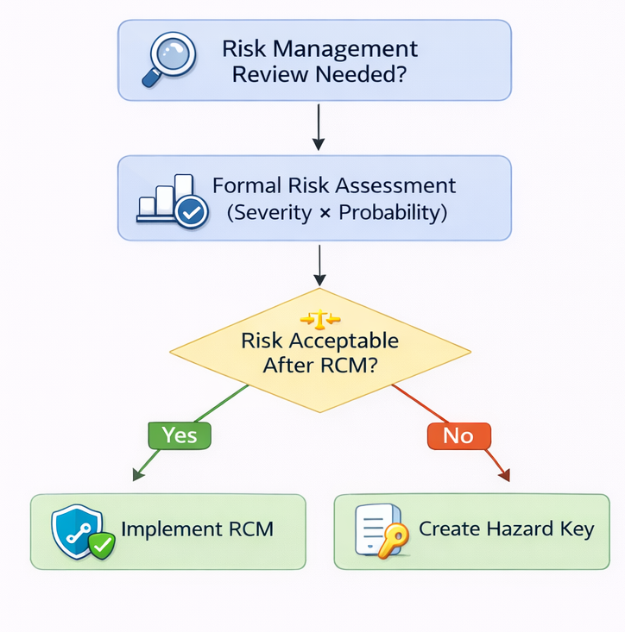

Manual Workflow for Hazard Key Creation
The current manual process used in risk management documentation

Slide 10
Challenges
Key limitations of the current manual approach
🧠 Human Effort
Expert-dependent
High cognitive load
⏱️ Process Inefficiency
Time-consuming documentation
Multi-team coordination
📈 Scalability & Quality
Consistency & traceability issues
Hard to scale with complexity

Slide 11
Problem Statement

Slide 12
Motivation
Why automation and support are necessary
Why is Support Needed?
📈 System Complexity
Growing CT system complexity
Increasing safety documentation volume
⚙️ Process Limitations
Manual process does not scale
Risk of inconsistent safety messages
👩‍💼 Expert Effort
High workload for expert teams

Slide 13
Problem Statement & Research Questions
Core problem definition and research focus
Problem Statements
⚠️PS1: User-friendly GenAI support for hazard key creation
⚠️PS2: Regulatory & data-protection compliant system design
Research Questions
🤔RQ1: How can GenAI support hazard key generation effectively?
🤔RQ2: How can compliance and data protection be ensured?

Slide 14
Methodology

Slide 15

Research Methodology and Goals
Design Science approach for developing and evaluating the solution
👁️ Observation: Analyze current hazard key workflow
📚 Theory Building: Study GenAI & retrieval-based methods
💻 System Development: Build GenAI chatbot prototype
🧪 Evaluation: Expert-based cognitive walkthrough
This research follows the Design Science Research methodology proposed by Nunamaker & Chen

Slide 16
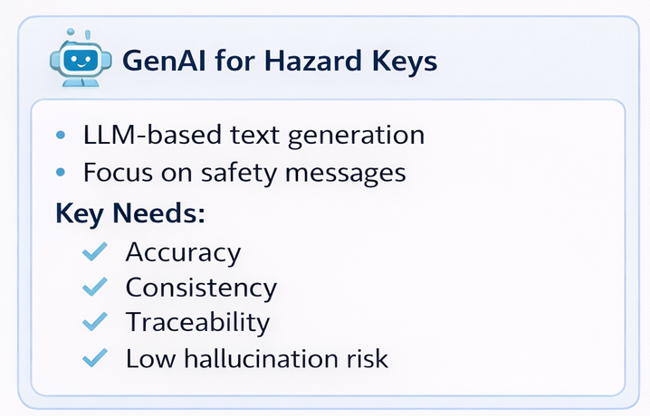
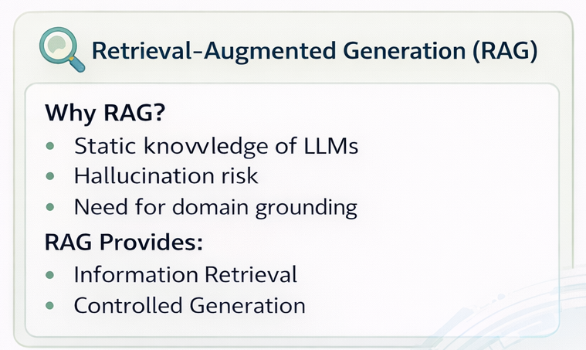

Technical Approach
GenAI and Retrieval-Augmented Generation for safe hazard key creation
Notes:
An LLM’s knowledge is fixed at the time it was trained and does not update automatically with new information or during use.

Slide 17




Retrieval-First Strategy
Ensuring safe and consistent Hazard key Generation
Retrieve existing hazard keys first
Reuse validated safety messages if a match is found
Generate with LLM only when no sufficient match exists
Human expert validates the final output
Retrieval before Generation reduces risks and improves consistency

Slide 18
System Architecture
Architecture of the GenAI-based Safety Chatbot
📝 User Input
Function
Hazard
Cause
⚙️ Processing Pipeline
🔎Embedding & Similarity Search
♻️ Retrieval of existing safety messages
🤖 LLM generation (fallback only)
📄 Output
Safety Message
HRK
Key Principle: 👉 🤖 LLM is used only when no reliable existing safety message is found.

Slide 19
Implementation

Slide 20



Implementation Details
Technologies used for the prototype implementation
Python-based prototype
🔎 FAISS for vector similarity search
🖥️ Streamlit UI
🤖 Local LLM via Ollama
Excel-based internal datasets
🧾 Logging for traceability
FAISS- Facebook AI Similarity Search
Notes:
FAISS stands for Facebook AI Similarity Search. It is a library for efficient similarity search and clustering of dense vectors. Because FAISS enables semantic similarity search rather than keyword matching, which is necessary for capturing meaning in safety documentation.

Slide 21
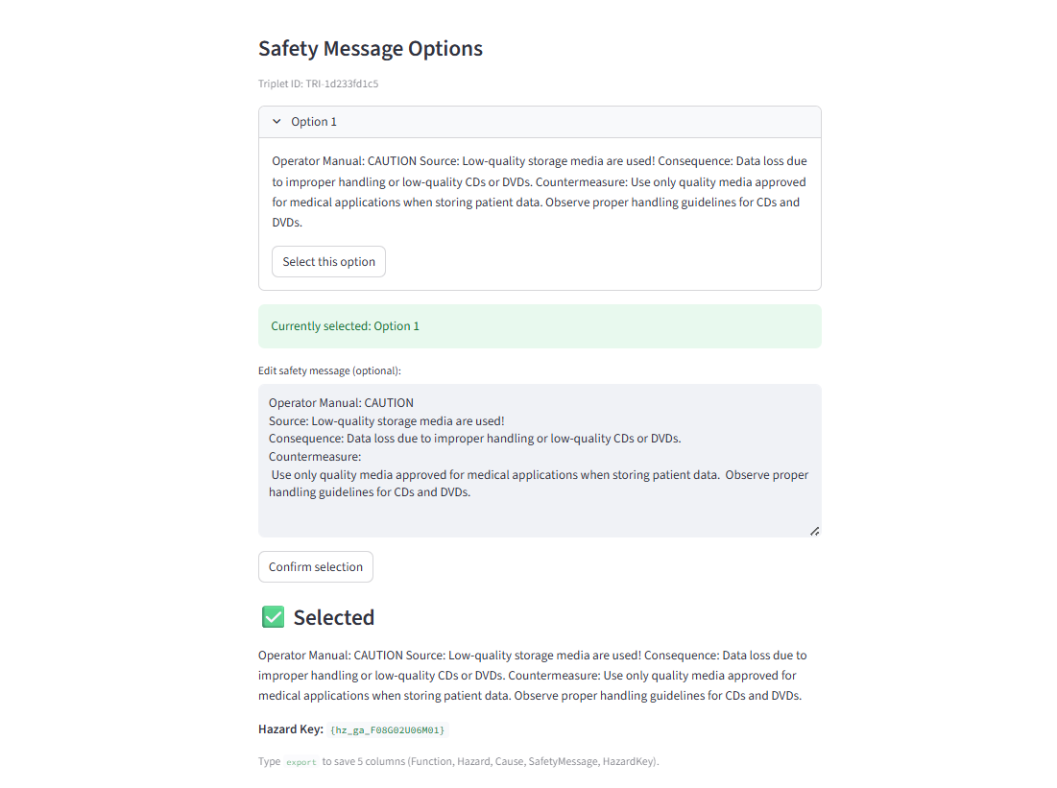
Safety Chatbot User Interface and workflow
Practical workflow of the safety chatbot interface.
📝 Structured input: Function – Hazard – Cause
✅ Format validation before search
🔎 Retrieval (k-NN)
📋 Multiple safety message options
✏️ User can select & edit
✔️ HRK retrieved after confirmation
📤 Export results to Excel
🤖 LLM used only if no match is found

Slide 22

Logging & Traceability
Ensuring auditability, compliance, and traceability of safety decisions
🆔 Local interaction ID for each query
📂 Outputs
📝 Stored Information
⏱️ Timestamp and local ID
📝 Function – Hazard – Cause
💬 Generated / Retrieved messages
✔️ Final selected message
🔑 Hazard Key (Safety Message + HRK)
📚 Reference context
Hazard Key List
Validation Log

Slide 23

Compliance by Design
Ensuring safe, transparent, and compliant AI usage
🔐 Data Protection
Anonymized, structured hazard data only
No personal or patient information
🏠 System & Processing
Local processing (no external APIs)
Transparent retrieval vs. generation
👩‍⚕️ Governance & Regulation
Human-in-the-loop validation
EU AI Act: Limited-Risk System
Key Principle
👉 This is a prototype demonstrating compliance-oriented design principles, not a claim of full regulatory compliance.

Slide 24

Evaluation Method
Expert-based evaluation of usability, correctness, and traceability
🔍 Evaluation Approach
🎯 Evaluation Focus
Cognitive Walkthrough
Domain experts involved
Structured action sequences
Usability
Interaction Flow
Traceability

Slide 25
Results and Future Work

Slide 26
Results
Evaluation outcomes of the proposed system.
✔️ Result 1 — Support for Hazard Key Selection (RQ1)
The retrieval-first approach successfully supported expert hazard key selection in predefined evaluation scenarios
Relevant candidates were identified and reviewed by experts during the cognitive walkthrough
✔️ Result 2 — Preservation of Governance & Oversight (RQ2)
Human-in-the-loop validation and interaction logging ensured traceability and governance during system use
The system supported expert decision-making without automating or replacing it
Key Principle
👉 Results demonstrate feasibility under controlled evaluation conditions.

Slide 27
Discussion
Interpretation of results, strengths, and limitations.
✅ Strengths & Implications
Demonstrates that a retrieval-first design is appropriate for safety-critical documentation workflows
Shows that GenAI can be integrated as decision support without disrupting expert-driven processes
⚠️ Limitations
Evaluation focused on feasibility and interaction behavior rather than quantitative performance
Findings are specific to the evaluated prototype and domain context

Slide 28
Conclusion & Future Work
Summary of contributions and directions for future research.
✅ Conclusion
GenAI can support hazard key formulation in a decision-support role
Retrieval-first strategy ensures reliability and consistency
Human oversight remains essential in safety-critical contexts
🔮 Future Work
Integration with enterprise systems (PLM / QMS)
Role-based access and governance mechanisms
Automated validation and review pipelines
Expansion and diversification of hazard datasets

Slide 29
Demo

Slide 30
Thank You and Open to Questions

