Slide 1
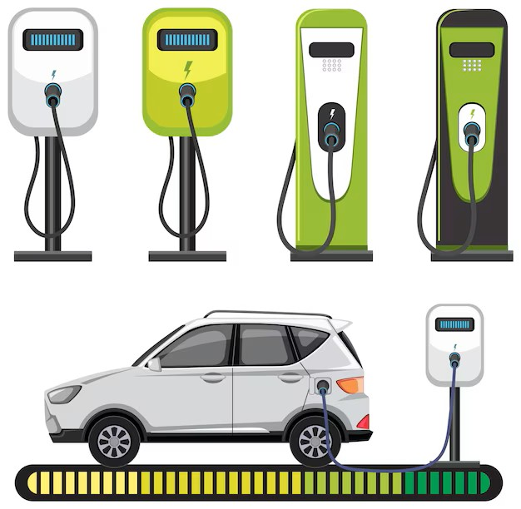
Electric Vehicle Charging Demand Forecasting
RITHIKKAA S J

Slide 2
Project Overview
Objective: Forecast EV charging demand to support infrastructure planning
Key Features:
Integrates weather, EV population, and traffic data
Uses Prophet and ARIMA models for time-series forecasting
Visualizes trends and forecasts via an interactive Streamlit dashboard
Impact: Informs optimal placement and scaling of charging stations

Slide 3
Data Sources
Weather Data:
Source: Multiple CSV files (temperature, humidity, etc.)
Cities: 36 cities (e.g., Seattle, Vancouver, San Diego)
Rows: ~271,554
EV Population Data:
Source: Electric_Vehicle_Population_Data.csv
Rows: ~239,747
Features: EV Count, Electric Range
Traffic Data:
Source: Metro_Interstate_Traffic_Volume.csv (Minneapolis)
Rows: ~48,204
Visual: Table summarizing data sources and shapes

Slide 4
Main Program Workflow
Steps
Load and validate weather, EV, and traffic data
Merge datasets into a time-series format
Apply Prophet and ARIMA for forecasting (2025–2027)
Generate visualizations (trends, scatter plots)
Produce a summary report with recommendations

Slide 5
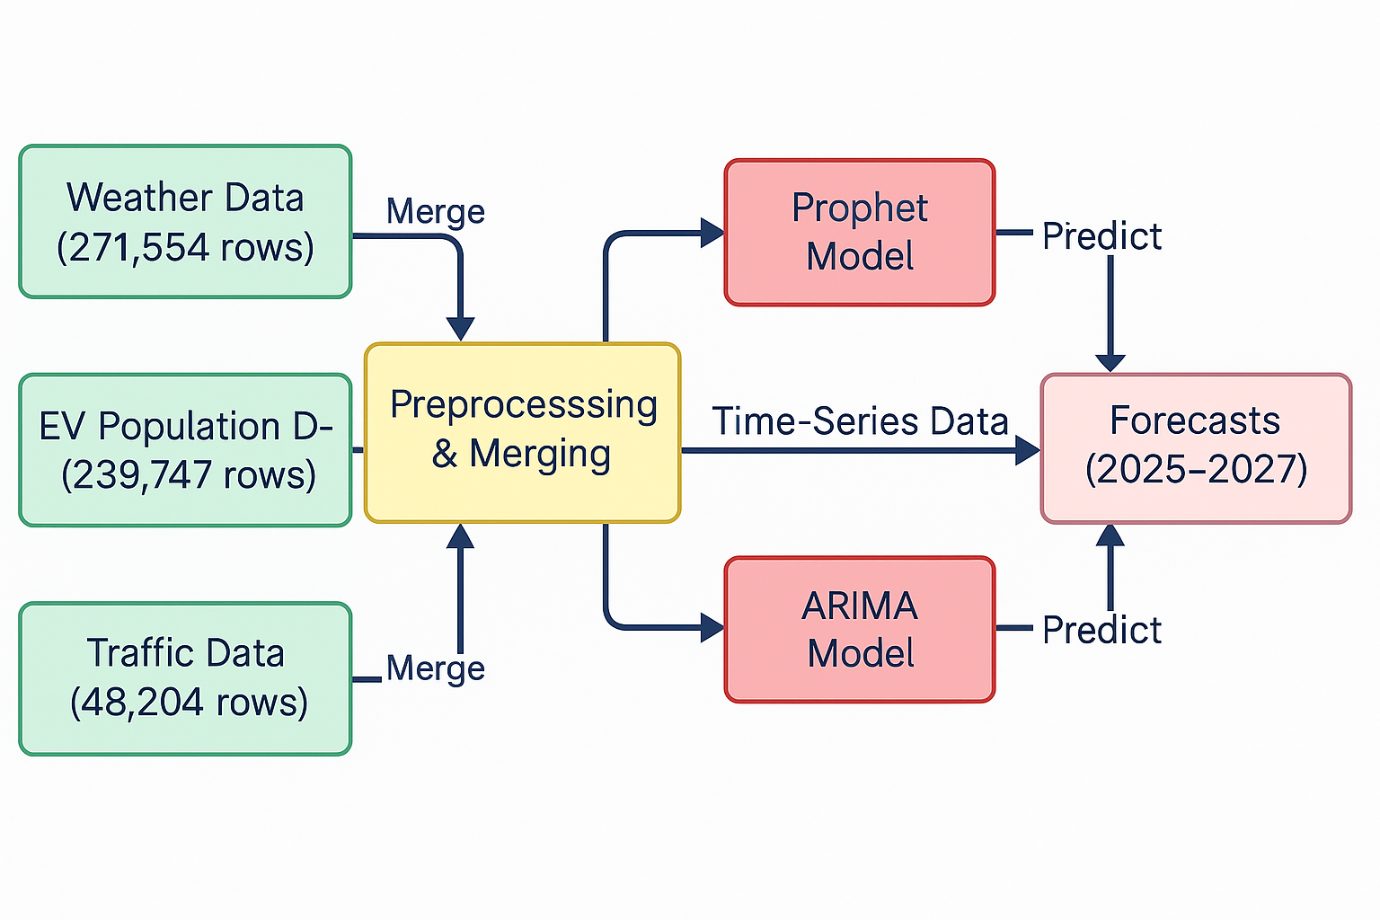

Slide 6
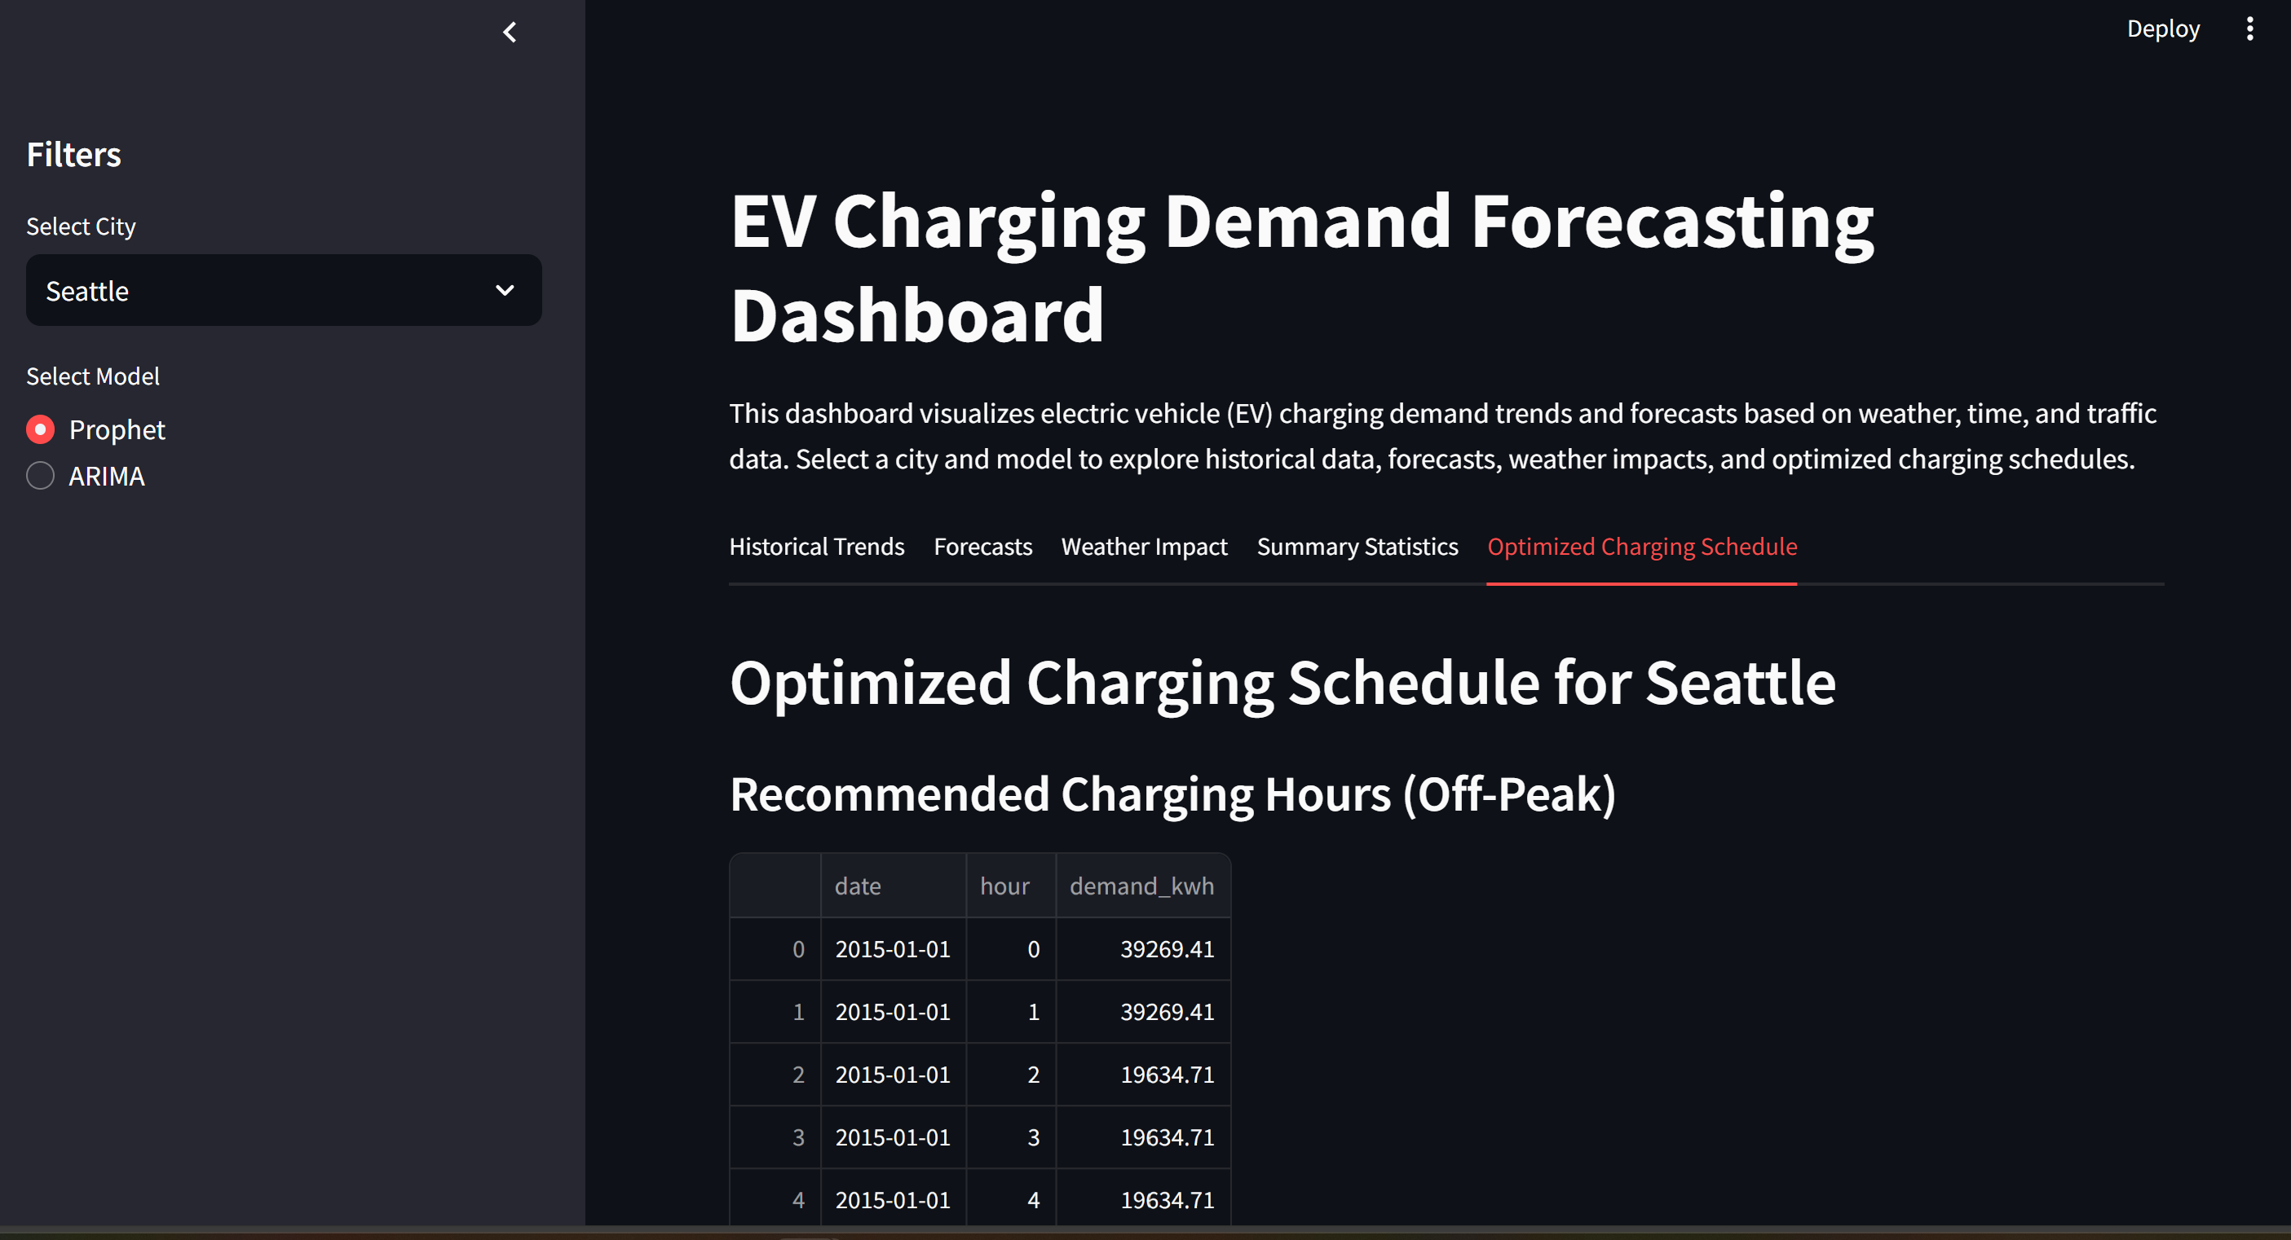
Dashboard Overview

Slide 7
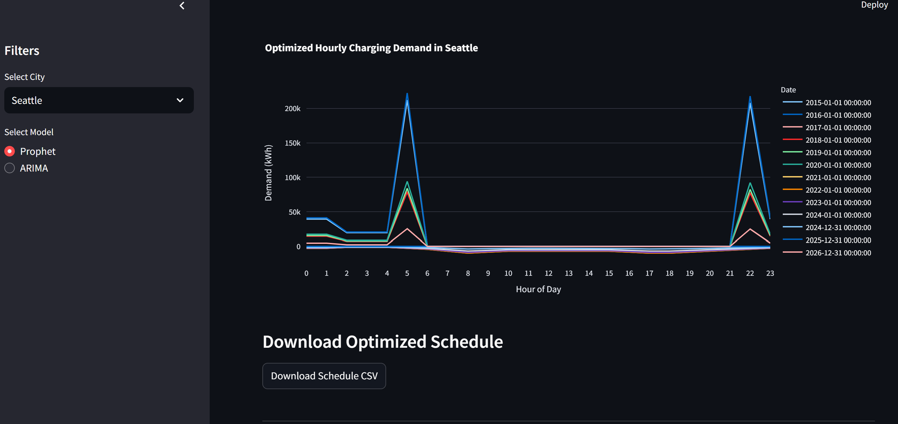

Slide 8
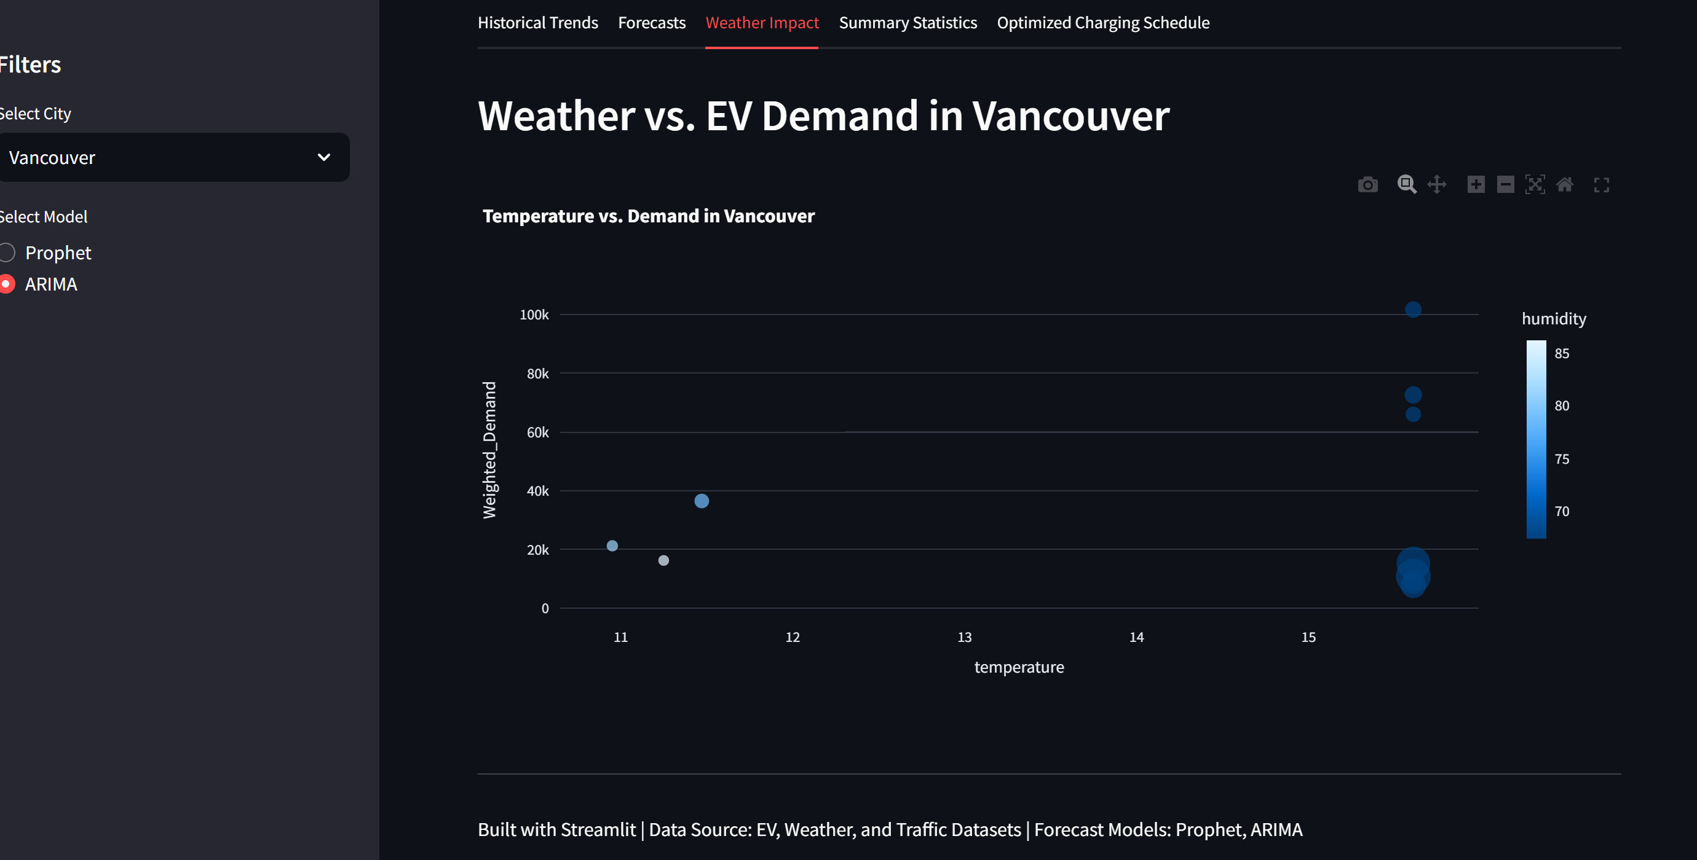

Slide 9
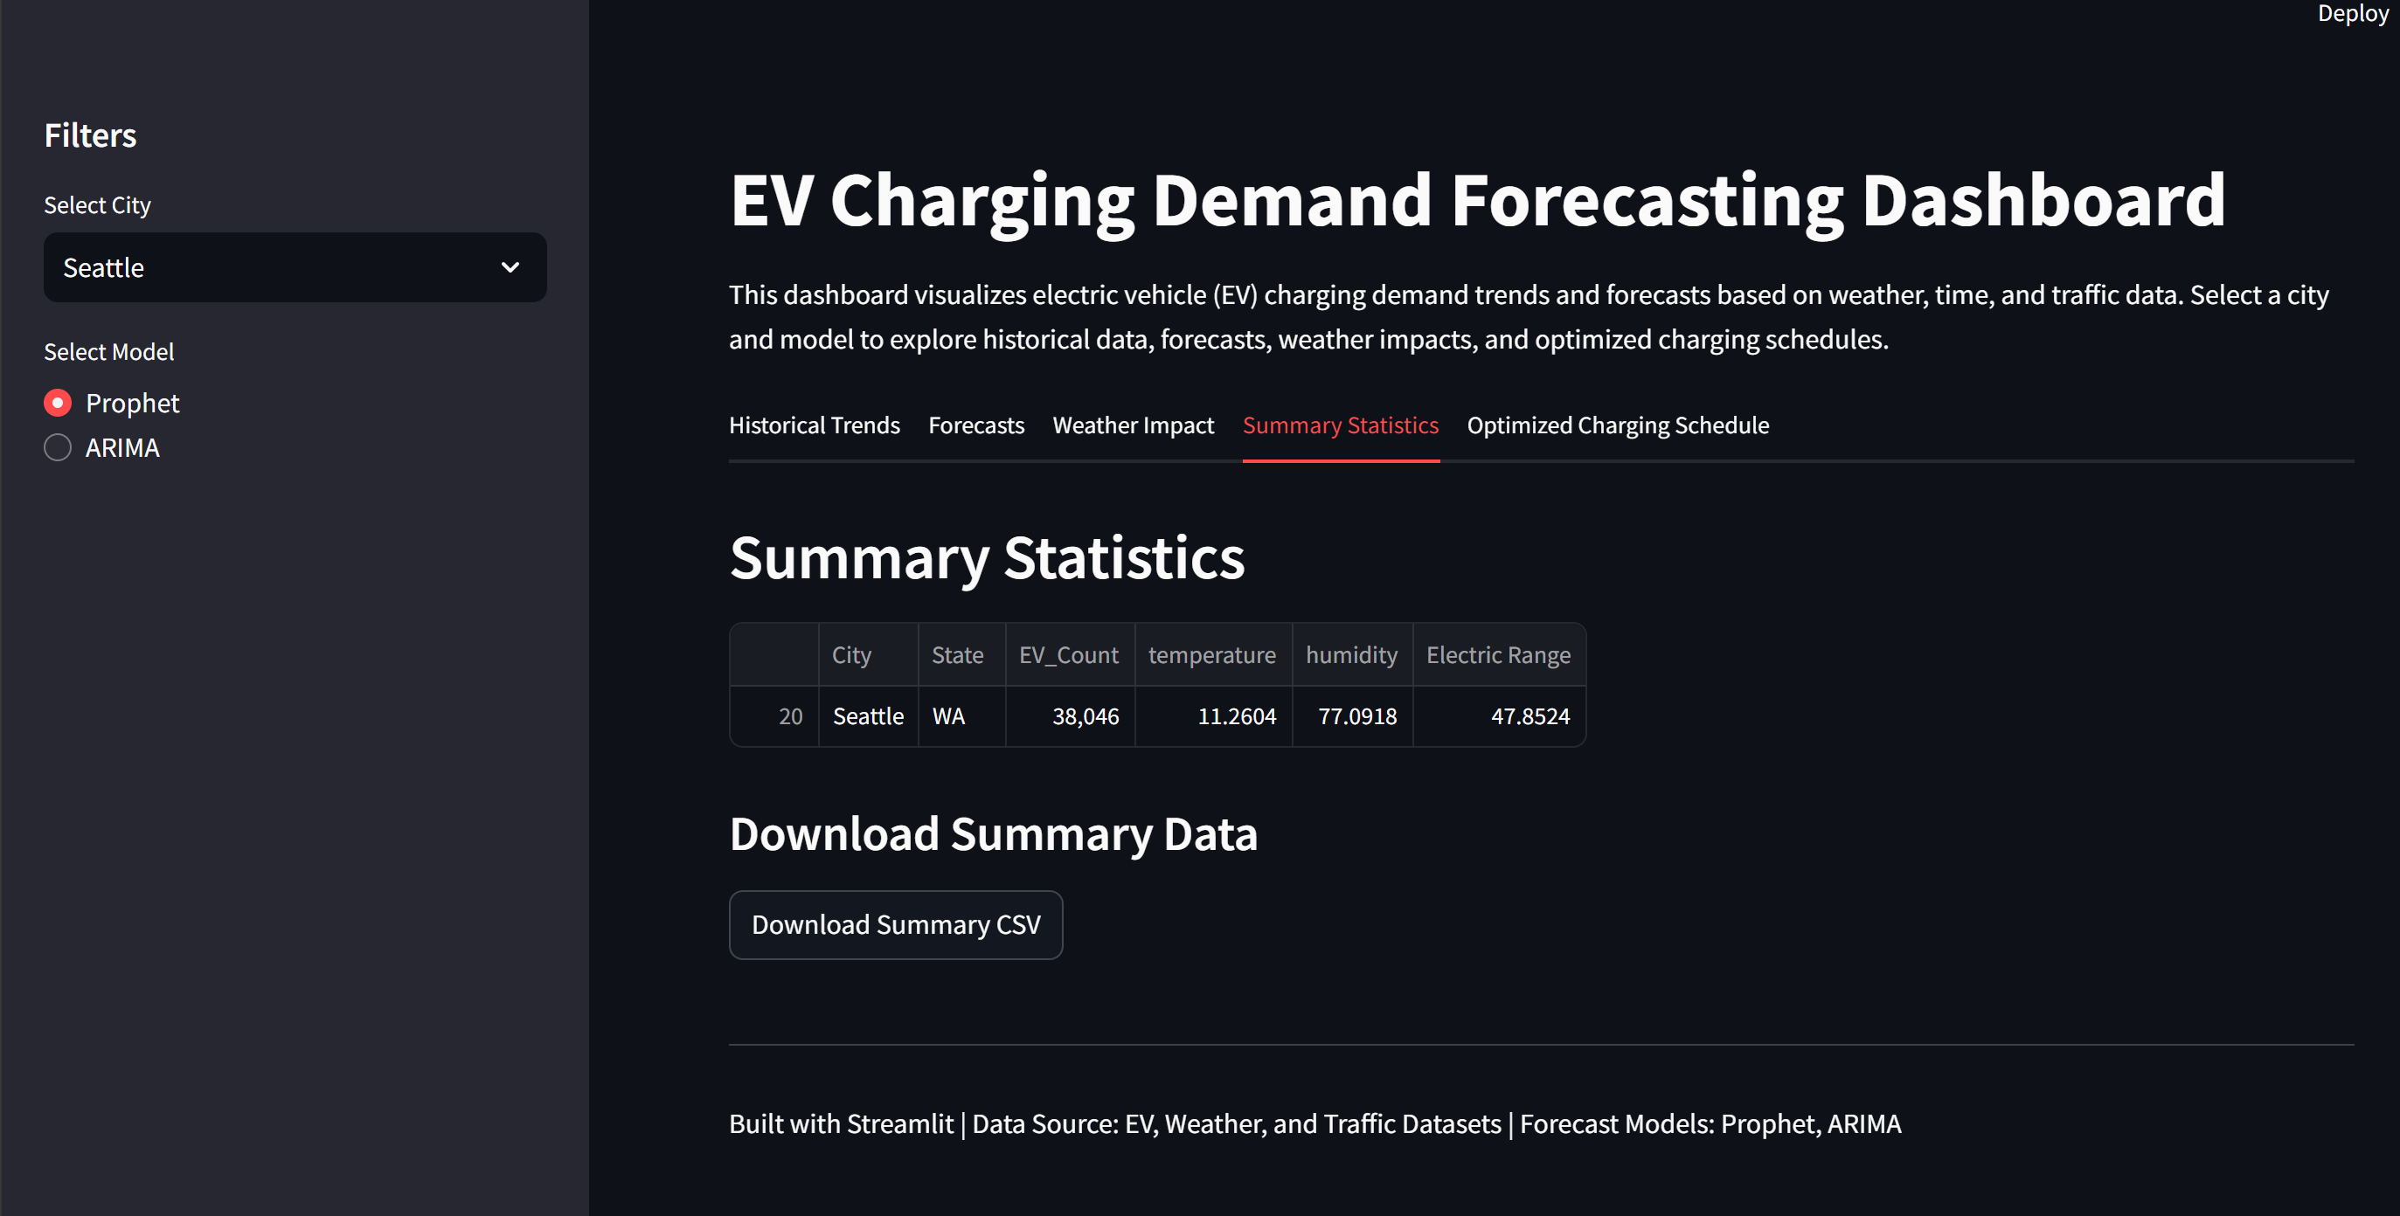

Slide 10
References
Data Sources:
Electric Vehicle Population Data(Electric Vehicle Population Data – Catalog)
Metro Interstate Traffic Volume(Search | Kaggle)
Weather datasets(Historical Hourly Weather Data 2012-2017)
Tools:
Python, Pandas, Prophet, Statsmodels
Streamlit, Plotly, Seaborn, Matplotlib

