Slide 1

Sales & Profit Insights from Global Superstore
Power BI Dashboard Summary – Key Business Takeaways
Rithikkaa S J

Slide 2
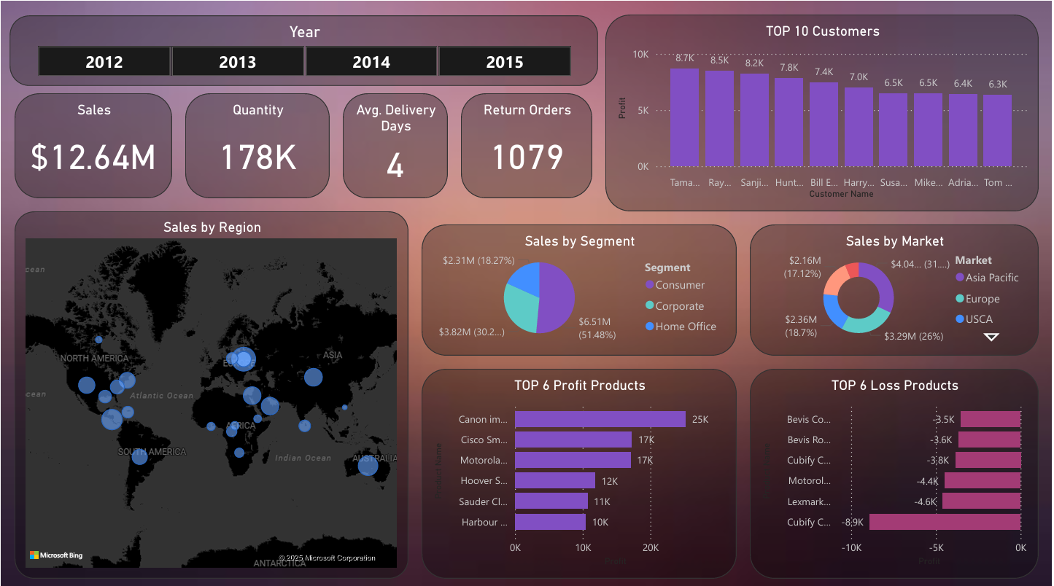
Key Business KPIs Overview
Visuals:
Big Number Cards for:
Total Sales: $12.64M
Total Quantity Sold: 178K
Average Delivery Days: 4
Return Orders: 1079
Insight:
“Total revenue reached $12.64M across four years, with a strong order volume but slightly concerning 1K+ return orders, which may hint at product or logistics issues.”

Slide 3
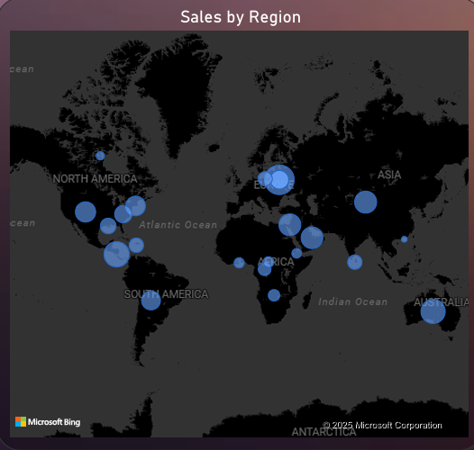
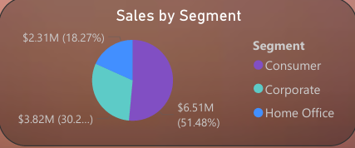
Regional & Segment Performance
Visuals:
Bar Chart: Sales by Region
Pie Chart: Sales by Segment
Insight:
“Asia Pacific leads the revenue race with over $4M (31%), followed by Europe and USCA. The Consumer segment dominates with over 51% of total sales, offering a clear focus area for promotions.”

Slide 4
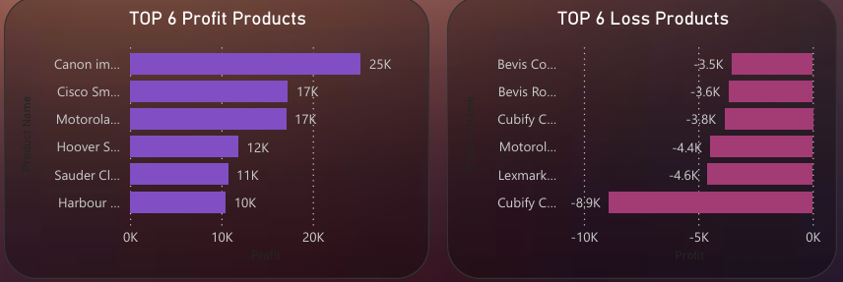
Profitability – Winners vs Losers
Visuals:
Bar Chart: Top 6 Most Profitable Products
Bar Chart: Top 6 Loss-Making Products
Insight:
“Canon, Cisco and Motorola products top profit charts, generating $25K–$17K in gains. On the flip side, Bevis and Cubify items cause heavy losses, signaling the need for reevaluation or phase-out.”

Slide 5

Customer Targeting & Takeaways
Visuals:
Bar Chart: Top 10 Customers by Profit
Mini-Table or Callout: Market vs Sales comparison
Insight:
“Loyal customers like Tamara and Ray contributed $8K+ profit each ideal for loyalty programs. Focus on customer retention, strategic product lines and top-performing markets for sustainable growth.”

