Slide 1

DEPARTMENT OF INFORMATION TECHNOLOGY
AI-BASED LASER QR CODE MARKING & MACHINE-VISION TRACEABILITY SYSTEM FOR RAILWAY TRACK FITTINGS

Slide 2
SMART RAILWAY: AI-BASED LASER QR CODE MARKING & MACHINE-VISION TRACEABILITY SYSTEM FOR RAILWAY TRACK FITTINGS
GUIDE NAME
Mr. S. Arun Kumar(AP/IT)
Team Members
V. KANISHKA SRI (723724205026)
K. RITHIKROSHINI (723724205045)
A. HARIDEVI (723724205020)

Slide 3
INDEX
PROJECT VISION & ABSTRACT
PROBLEM STATEMENT
EXISTING & PROPOSED SYSTEM
OBJECTIVES & SCOPE
TECHNOLOGY & SYSTEM ARCHITECTURE
END-TO-END WORKING PROCESS
AI, VISION & LASER QR MODULE
VERIFICATION & QUALITY CONTROL
DATABASE, BACKEND & SECURITY
DASHBOARD & PREDICTIVE MAINTENANCE
TESTING, RESULTS & BENEFITS
APPLICATIONS & FUTURE SCOPE
CONCLUSION & REFERENCES

Slide 4
ABSTRACT
Railway track fittings are small but critical components that require reliable identification and maintenance. Traditional manual identification and record keeping can be slow and difficult to trace across the asset lifecycle. The proposed system uses a unique QR code permanently engraved on each fitting using laser technology. AI and machine vision verify the fitting, inspect the engraved QR and support visible-condition assessment. Cloud-based records provide centralized traceability for authorized inspection and maintenance users.

Slide 5
LITERATURE SURVEY
AI & Machine Vision: Computer vision and deep learning research shows that automated image analysis can support object identification, condition inspection and defect detection.
Laser Marking & QR Identification: Laser-based permanent marking provides a durable digital identity, while QR encoding enables fast retrieval of asset information during inspection.
Railway Asset Management: Digital asset-management approaches emphasize unique identification, centralized records and lifecycle traceability for railway components.
Predictive Maintenance: Machine-learning approaches can use inspection and historical maintenance data to support condition monitoring and maintenance planning.
Cloud & Data Integration: Cloud databases and secure APIs enable centralized storage, controlled access and quick retrieval of fitting history from field devices.
Research Gap: Existing approaches are often separated across identification, inspection and maintenance. The proposed system combines laser QR marking, machine vision, verification and cloud traceability in one workflow.
Source basis: project PPT references — RDSO, Indian Railways, IEEE research and Ministry of Railways materials.

Slide 6
PROBLEM STATEMENT
01 IDENTIFICATION
02 MANUAL WORK
03 MARK WEAR
04 DATA GAP
Individual fittings are difficult to uniquely trace.
Inspection and recording depend heavily on human effort.
Conventional marks can fade, corrode or become difficult to read.
Maintenance history is not directly connected to the physical asset.

Slide 7
OBJECTIVES
IDENTIFY: Unique digital identity for every fitting.
AUTOMATE: AI-assisted marking and inspection.
TRACE: Lifecycle history from marking to maintenance.
VERIFY: QR quality, position and scannability.
PROTECT: Secure access, logs and safety monitoring.
PREDICT: Foundation for condition-based maintenance.

Slide 8
EXISTING SYSTEM
Paint / punch / handwritten marks on track fittings.
Paper registers & spreadsheets for record keeping.
Manual visual verification of fittings.
Limited searchable history of each asset.
Higher dependence on manual entry, which is slow and error-prone.

Slide 9
PROPOSED SYSTEM
Permanent laser QR identity engraved on every fitting.
AI-guided marking & verification.
Cloud-linked asset record for each fitting.
Digital inspection history retrievable by QR scan.
Analytics & predictive-maintenance path for the future.

Slide 10
SYSTEM ARCHITECTURE
INPUT
Fitting • Camera • Sensors
AI PROCESSING
Vision • Surface analysis • Decision logic
MARKING
QR generation • Fiber laser
VERIFICATION
Vision check • PASS / FAIL
DATA
Cloud database • Asset lifecycle
APPLICATION
API • Dashboard • Mobile • Analytics

Slide 11
END-TO-END BLOCK DIAGRAM
TRACK FITTING
CAMERA + SENSORS
AI VISION
QR DATA
LASER MARKING
AI VERIFY
ANALYTICS
DASHBOARD / APP
SECURE API
CLOUD DATABASE
Physical fitting → AI-guided laser marking → AI verification → cloud record → dashboard & analytics

Slide 12
HOW THE SYSTEM WORKS
01 PLACE
02 CAPTURE
03 ANALYZE
04 GENERATE
Fitting is positioned in the marking/inspection station.
Camera captures the fitting and its surface.
AI identifies fitting and suitable marking zone.
Unique QR payload is created.
05 ENGRAVE
06 VERIFY
07 STORE
08 INSPECT
Fiber laser permanently marks the QR.
AI checks quality, position and scannability.
Asset and inspection data enter the cloud.
Authorized users retrieve history and maintenance data.

Slide 13
TECHNOLOGY ECOSYSTEM
AI / ML
COMPUTER VISION
LASER
Detection • classification • analytics
Image capture • processing • QR verification
Fiber laser • permanent marking
CLOUD
BACKEND
FRONTEND
Central asset & lifecycle data
API • authentication • validation
Dashboard • field inspection

Slide 14
TECHNOLOGIES USED
AI / MACHINE LEARNING
COMPUTER VISION
LASER MARKING
Deep-learning models • defect & wear prediction
Camera & sensors • image processing • QR decode / verification
Fiber laser • QR code generator (ISO/IEC 18004)
CLOUD DATABASE
BACKEND
FRONTEND
Cloud database • asset & inspection records
REST APIs • authentication • role-based access • audit logs
Web dashboard (HTML, CSS, JavaScript) • QR scan • analytics

Slide 15
SYSTEM REQUIREMENTS
Hardware — Industrial camera & sensors, fiber laser marking unit, host PC/edge device (i5 or higher, 8 GB+ RAM).
Software — Python, OpenCV/deep-learning framework for AI vision, QR code generation library.
Backend — REST APIs, authentication & role-based access, cloud database for asset records.
Frontend — Web dashboard (HTML, CSS, JavaScript) for inspection, QR scanning and analytics.
Operating System — Windows/Linux on the marking station; any modern browser for the dashboard.
Connectivity — Stable internet/API access to sync data with the cloud database.

Slide 16
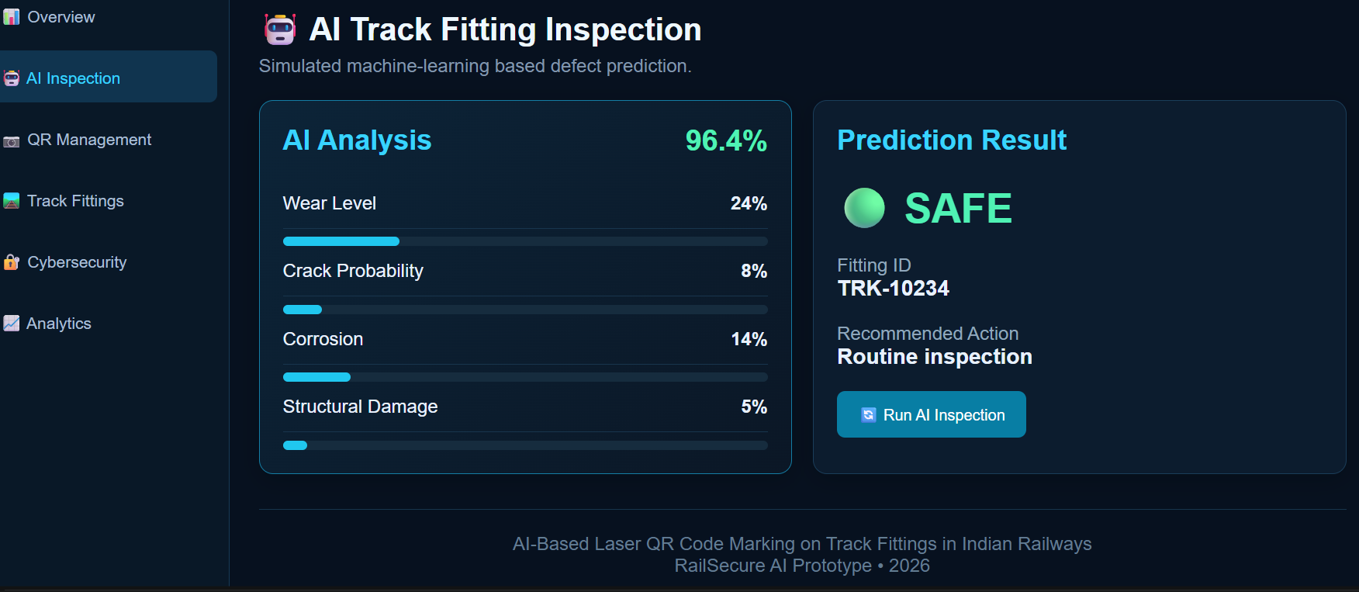
MODULE 1: AI FITTING INSPECTION
Simulated machine-learning based defect prediction for each track fitting.
AI Analysis reports wear level (24%), crack probability (8%), corrosion (14%) and structural damage (5%) with 96.4% confidence.
Prediction Result classifies fitting TRK-10234 as SAFE and recommends routine inspection.
The Run AI Inspection button starts a new analysis.

Slide 17
QR + LASER MARKING MODULE
UNIQUE QR ID
FIBER LASER
DIGITAL IDENTITY
Fitting ID
Type / Batch
Date / Zone
Asset reference
Non-contact
Permanent engraving
Controlled parameters
Metal surface marking
Physical fitting
↕
Cloud asset record
↕
Inspection history

Slide 18
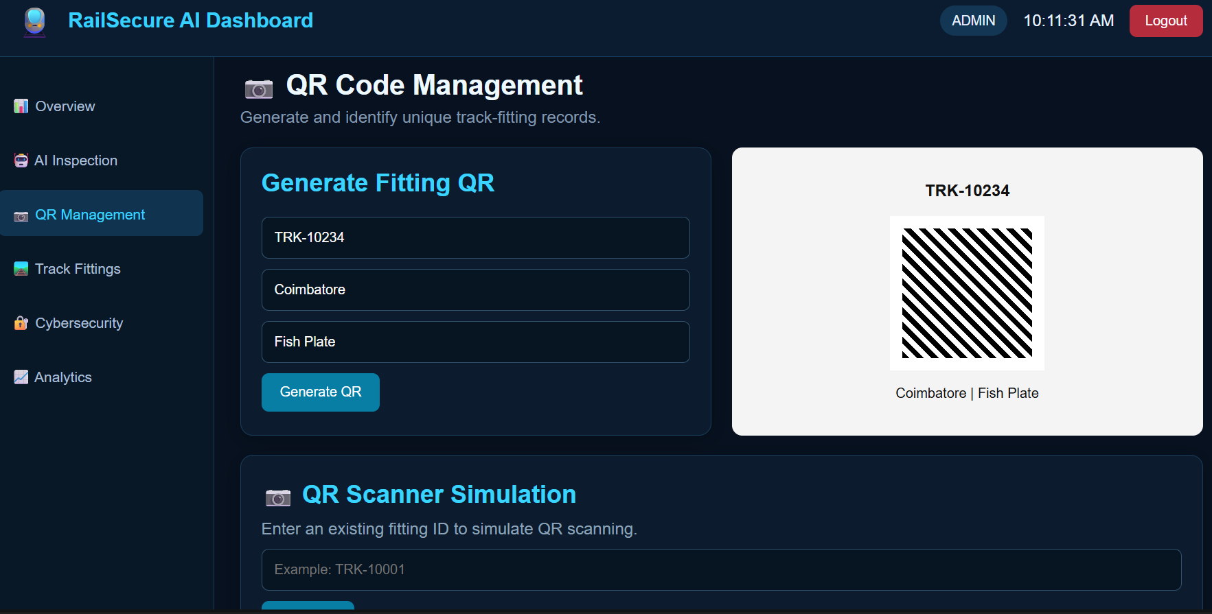
MODULE 2: QR CODE MANAGEMENT
Generates a unique QR code for each fitting from its ID, location and fitting type.
Example shown: TRK-10234 · Coimbatore · Fish Plate.
The QR Scanner Simulation retrieves an existing fitting record when its ID is entered.

Slide 19
AI VERIFICATION & QUALITY CONTROL
01 DETECT
02 QUALITY
03 POSITION
04 SCAN
Find the engraved QR
Check contrast & structure
Check placement and size
Confirm machine readability
PASS ✓
→ Store asset
FAIL ✕
→ Re-mark / manual check

Slide 20
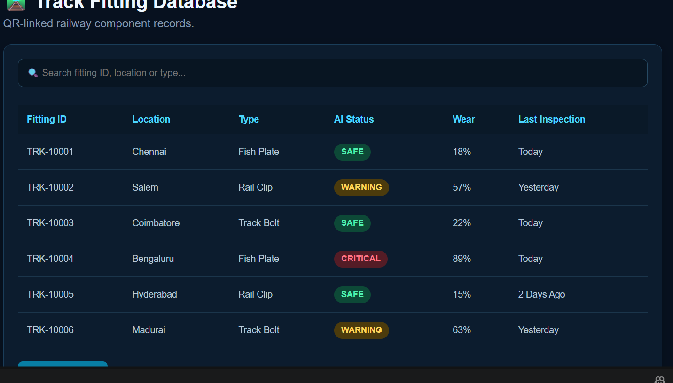
MODULE 3: TRACK FITTING DATABASE
QR-linked railway component records stored as a searchable database.
Search by fitting ID, location or type.
Each record lists fitting ID, location, type, AI status, wear percentage and last inspection.
AI status is tagged SAFE, WARNING or CRITICAL; for example TRK-10004 (Bengaluru, Fish Plate) is CRITICAL at 89% wear.

Slide 21
BACKEND & SECURE API
REST-style APIs connect the dashboard/mobile interface with asset and inspection data.
Authentication protects user accounts and authorized operations.
Role-based authorization can separate administrator, inspector and maintenance functions.
Validation checks asset and inspection information before storage.
Ownership/access checks prevent unauthorized asset operations.
Important actions can be recorded in secure event/audit logs.

Slide 22
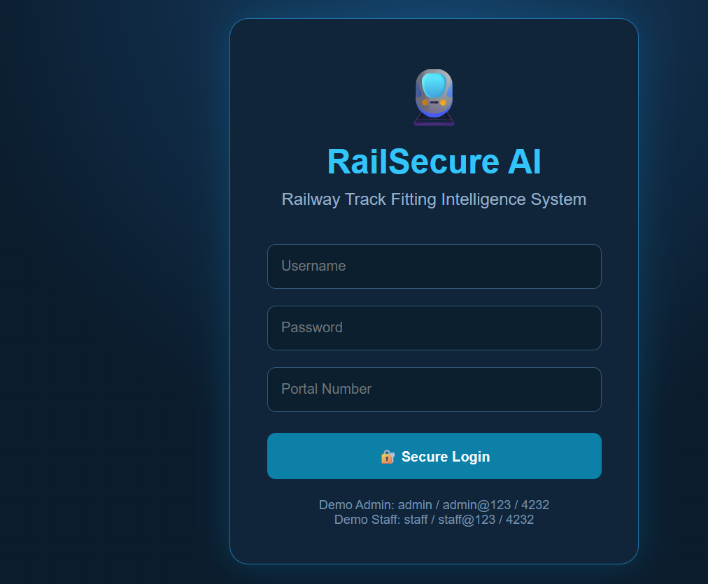
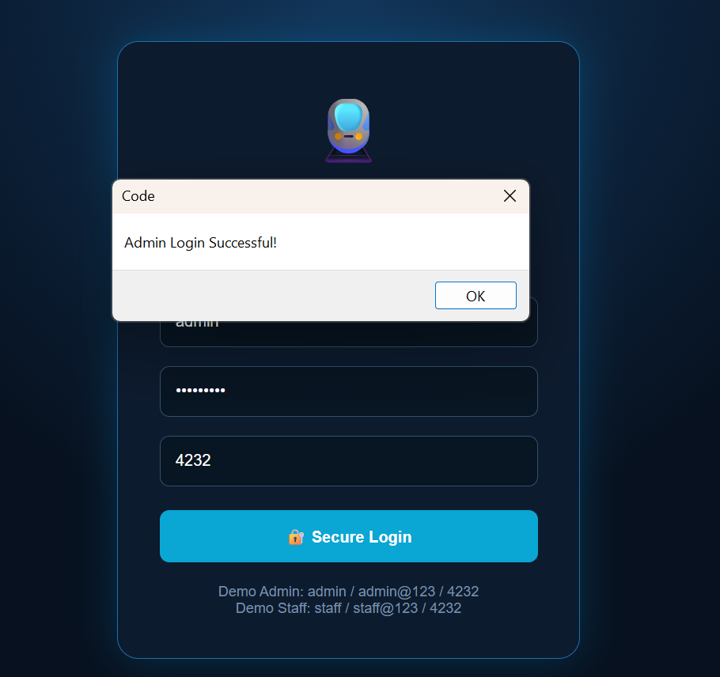
MODULE 4: SECURE LOGIN
Login requires username, password and portal number.
Separate Admin and Staff access levels.
Successful authentication confirms access to the dashboard.
Secure login screen
Admin login successful

Slide 23
DASHBOARD & FIELD INSPECTION
ASSET MANAGEMENT DASHBOARD
FIELD SCAN
1,248
Registered Assets
1,203
Verified QR
SCAN QR
→ Asset identity
→ Condition
→ Inspection history
→ Maintenance record
32
Inspection Due
13
Maintenance Alerts

Slide 24
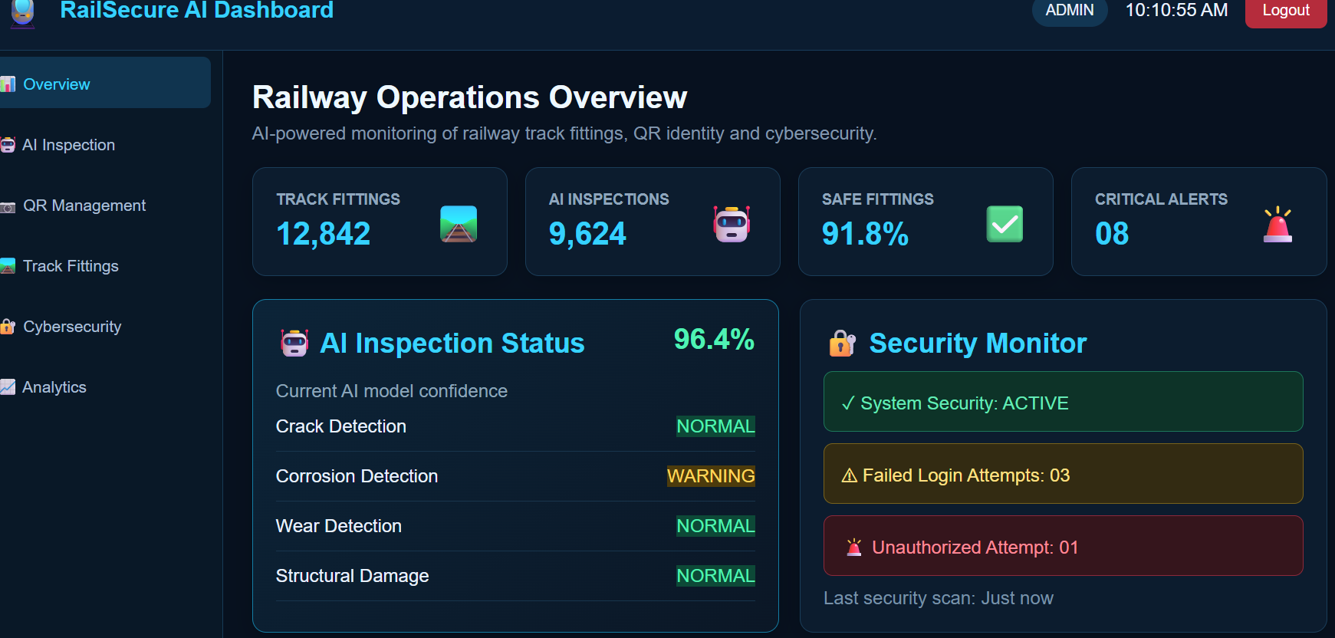
MODULE 5: OPERATIONS DASHBOARD
Summary cards: 12,842 track fittings, 9,624 AI inspections, 91.8% safe fittings and 08 critical alerts.
AI Inspection Status shows 96.4% model confidence across crack, corrosion, wear and structural checks.
Security Monitor tracks system status, failed logins and unauthorized attempts.
Sidebar links to Overview, AI Inspection, QR Management, Track Fittings, Cybersecurity and Analytics.

Slide 25
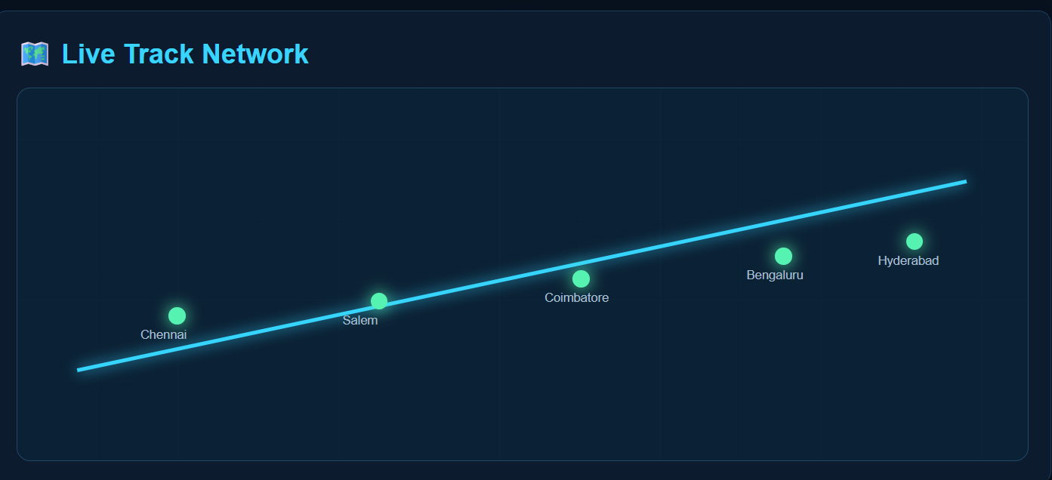
MODULE 6: LIVE TRACK NETWORK
Live Track Network view plots the monitored locations along the rail line.
Locations shown: Chennai, Salem, Coimbatore, Bengaluru and Hyderabad.
Each location is displayed as a marker on the track line.

Slide 26
CYBERSECURITY & OPERATIONAL SAFETY
Authentication limits access to authorized users.
Role-based authorization protects sensitive asset and maintenance operations.
Encrypted communication protects data between application components.
Secure event logs provide traceability for important system actions.
Camera-based danger-zone analysis can identify people near the laser operating area.
Protected alerts can notify authorized railway personnel of safety conditions.

Slide 27
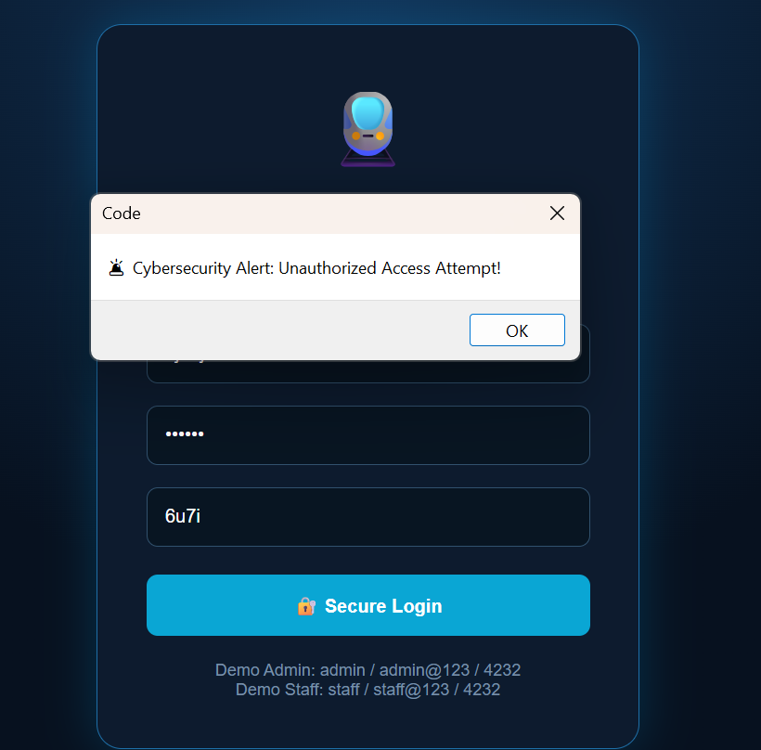
MODULE 7: CYBERSECURITY ALERT
An invalid login attempt raises the alert “Cybersecurity Alert: Unauthorized Access Attempt!”.
Failed and unauthorized attempts are reported in the dashboard's Security Monitor.

Slide 28
ANALYTICS & PREDICTIVE MAINTENANCE
IDENTIFY
INSPECT
ANALYZE
PREDICT
QR scans connect field observations to a persistent asset record.
Historical inspection data can reveal repeated issues and maintenance patterns.
Condition information can support maintenance prioritization.
Future ML models can estimate maintenance requirements from validated historical data.
Alerts can be generated for failed inspections or scheduled maintenance.

Slide 29
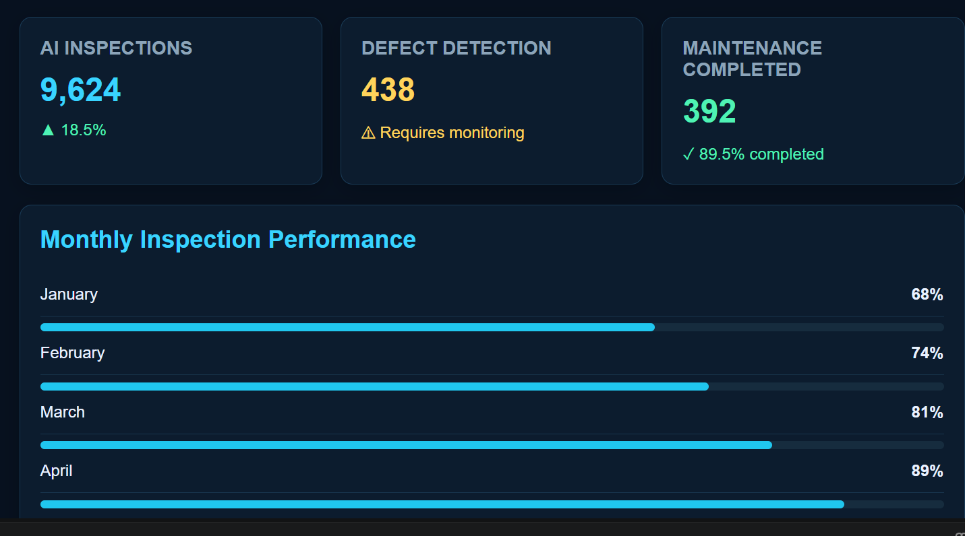
MODULE 8: ANALYTICS
AI inspections: 9,624 (up 18.5%).
Defect detection: 438 cases flagged as requiring monitoring.
Maintenance completed: 392 (89.5% completed).
Monthly Inspection Performance rises from 68% in January to 89% in April.

Slide 30
FUTURE ENHANCEMENTS
NOW
NEXT
THEN
LATER
SCALE
QR + laser + AI verification
Mobile app + richer dashboard
IoT condition sensors
Predictive maintenance models
Multi-zone railway deployment

Slide 31
CONCLUSION
PHYSICAL ASSET
DIGITAL IDENTITY
INTELLIGENT MAINTENANCE
The proposed architecture connects railway track fittings with a durable digital identity.
AI and machine vision automate marking analysis, QR verification and visual inspection.
Cloud traceability creates a searchable lifecycle record for authorized users.
The same platform can evolve toward analytics, IoT and predictive maintenance.

Slide 32
REFERENCES
Research Designs and Standards Organisation (RDSO), Ministry of Railways, Government of India. https://rdso.indianrailways.gov.in
Ministry of Railways, Government of India — Indian Railways. https://indianrailways.gov.in
J. Redmon, S. Divvala, R. Girshick and A. Farhadi, “You Only Look Once: Unified, Real-Time Object Detection,” IEEE CVPR, 2016, pp. 779–788.
Y. LeCun, Y. Bengio and G. Hinton, “Deep learning,” Nature, vol. 521, pp. 436–444, 2015.
ISO/IEC 18004:2015, Information technology — QR Code bar code symbology specification.
R. T. Fielding, “Architectural Styles and the Design of Network-based Software Architectures,” Ph.D. dissertation, Univ. of California, Irvine, 2000.

Slide 33
THANK YOU
AI-Based Laser QR Code Marking & Machine-Vision Traceability System
V. KANISHKA SRI • K. RITHIKROSHINI • A. HARIDEVI

