Slide 1


SCHOOL OF INFORMATION SCIENCES
Manipal
NEWSPAPER CONTENT ANALYSIS
RITHIN TL
161046017

Slide 2
Technologies used:
NLTK(Natural Language Tool Kit)
WordNet
WordCloud
Plotly
DID YOU KNOW???
NLTK is a leading platform for building Python programs to work with human language data. It provides easy-to-use interfaces to over 50 corpora and lexical resources such as WordNet, along with a suite of text processing libraries for classification, tokenization, stemming, tagging, parsing, and semantic reasoning, wrappers for industrial-strength NLP libraries, and an active discussion forum.

Slide 3

ANALYSIS
Categorizing the words using NLTK .
Categorizing according to synonyms and hypernyms using wordnet
Connecting them using networkx.
DID YOU KNOW???
WordNet is a large lexical database of English. Nouns, verbs, adjectives and adverbs are grouped into sets of cognitive synonyms (synsets), each expressing a distinct concept. Synsets are interlinked by means of conceptual-semantic and lexical relations.wordnet’s structure makes it a useful tool for Natural Language Processing and computational linguistics

Slide 4
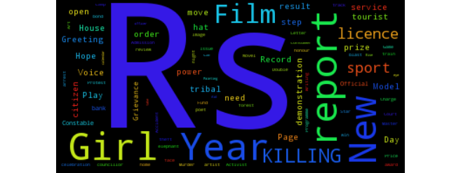
VISUALIZATION: HINDU-PAPER(WordCloud)

Slide 5
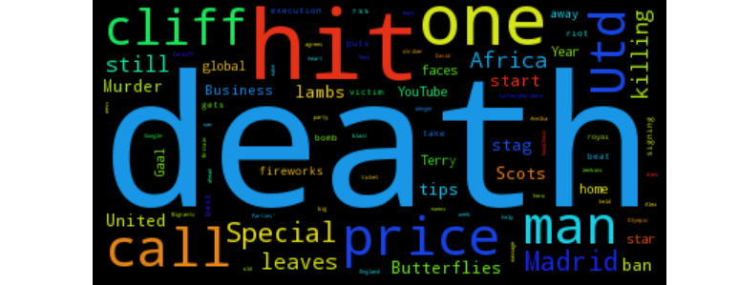
UK-PAPER(WordCloud)

Slide 6

GitHub
GitHub repository link : https://github.com/Rithin-gowda/term-project-monsoon16

Slide 7
Thank You !

