Slide 1
CSCE-704 Fake News Detection Using BERT
Chetan Nagavathi C, UIN: 833003051
Rithin Pullela, UIN: 233005679

Slide 2
Why?
Preserving Information Integrity
Limiting social division
Contribution to research.
Flag the extreme statements for human review.

Slide 3
Dataset
Liar, Liar Pants on Fire:
https://huggingface.co/datasets/liar
Reason: Closer to reality
6 classes:
True,
mostly-true,
half-true,
barely-true,
false,
pants-fire

Slide 4
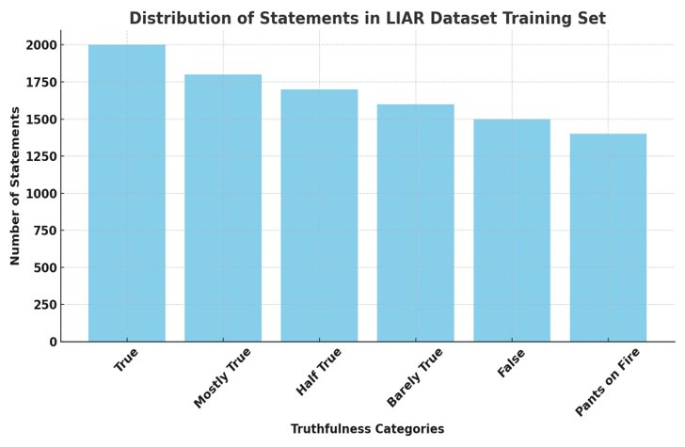
Dataset

Slide 5
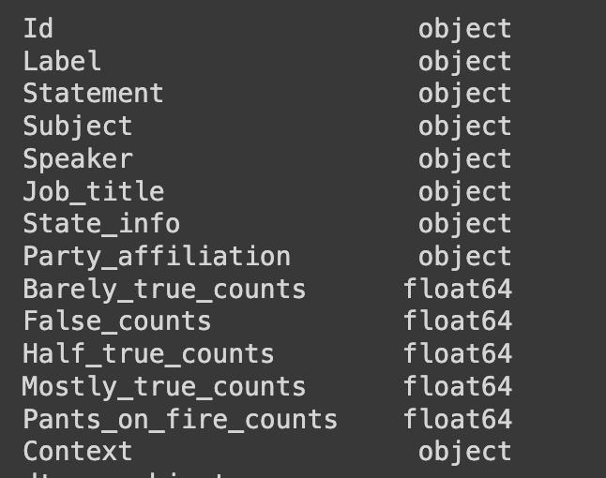
Dataset

Slide 6
Previous Work
Classification based on TF-IDF of bigrams, with Naïve Bayes, SVM, Gradient Boosting
Pattern recognition for detecting fake news
Bi-LSTM and CNN on LIAR

Slide 7
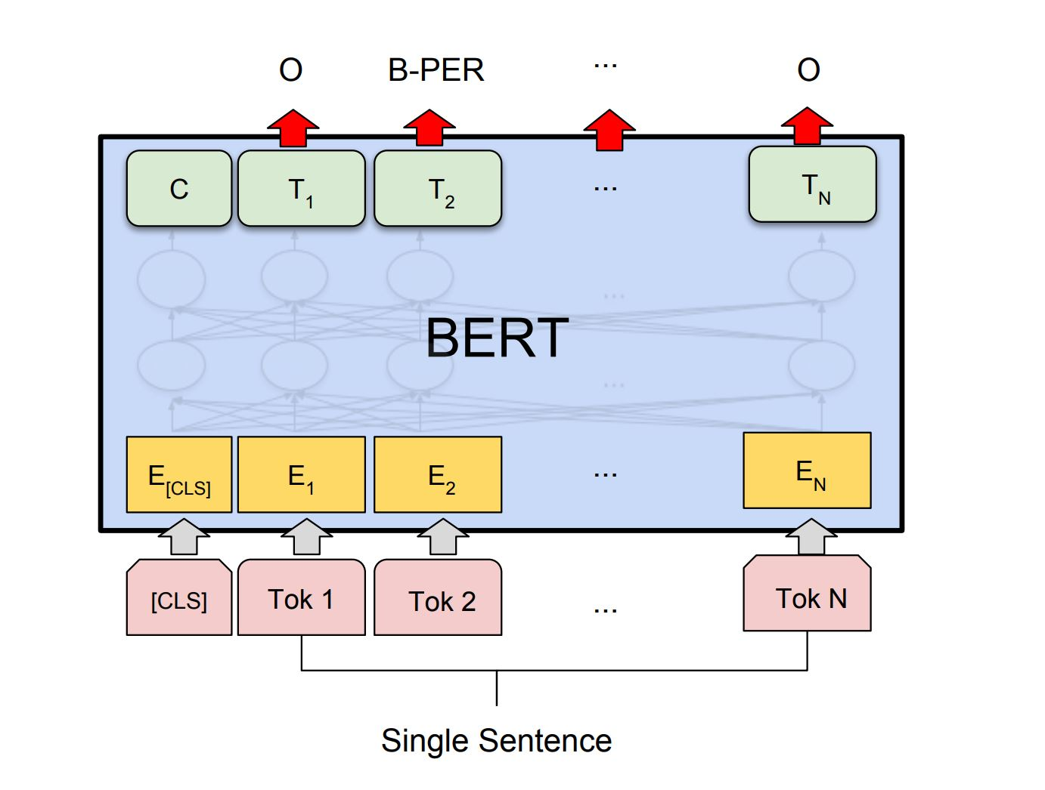
Method
Use Transformers!
Pre-Trained BERT
Why Pretrained
Understands Language
Untrained BERT needs very large Dataset to train

Slide 8
Method- Data Processing
Dropping Nan values
Labels to categorical

Slide 9
Experiment 1:
Use only the statements
Fine tuning vs Freezing BERT Weights
Freezing weights gave better results.
Model:
Sentence --> Tokenizer -->
BERT --> Deep Network --> Output

Slide 10
Experiment 2:
Use all textual features
Appending all the textual features into a single sentence.
Freeze the weights of BERT

Slide 11
Experiment 3
Use numerical Features as well
Test Accuracy of 45%
Architecture:
Sentence --> Bert --> 768 vector
Numerical --> Deep Network 1 --> 64 Vector
(Appended input) --> Deep Network 2 --> O/P

Slide 12
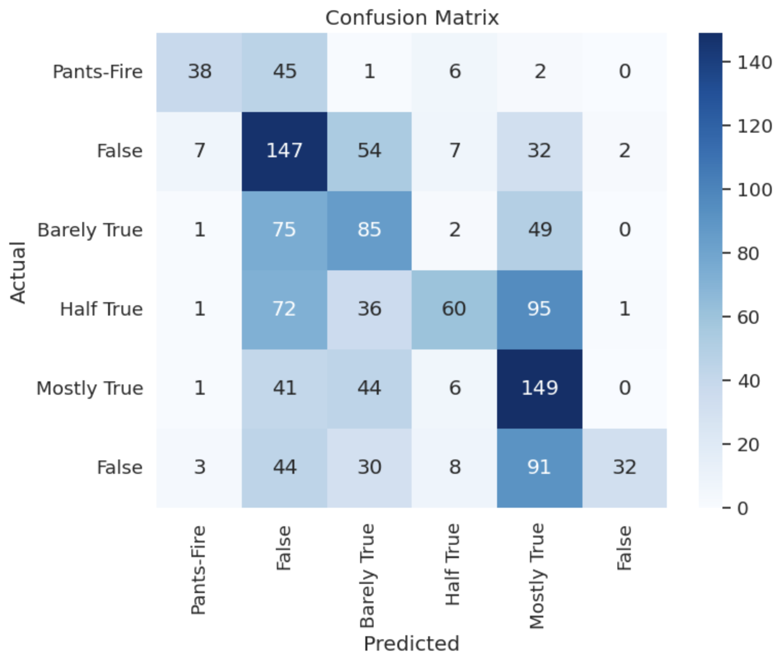
Results
The Best Model's accuracy: 45%
Confusion Matrix:
Trues are classified closer to trues and Falses are close to Falses.

Slide 13
Confusion Matrix

Slide 14
Comparision
Model | Test Accuracy
(WANG[1]) Hybrid CNN | 27%
Logistic Regression | 24.7%
SVMs | 25.5%
Bi-LSTMs | 23.3%
CNN | 27%
GRU | 21.7%
(Ranjan, 2009) CNN + BI-LSTM | 24.9%
Our Model BERT Transformer | 44.7%

Slide 15
Thank you!

