Slide 1



Machine Learning-Based Credit Risk Prediction with Safe Loan Amount and EMI Recommendation
22CSP72-PROJECT WORK II PHASE II
First Review
Team Members:
NAVEEN SRINIVAS V(23CSR145)
MENAHA R(23CSR130)
RITHISH R (23CSR178)
Mentor Name:
Dr. M GEETHA (Associate Professor)
Date:20.07.2026

Slide 2
Problem Statement
Existing Problem
Banks use manual checking or simple rules to evaluate loan applications.
This process takes more time and can lead to incorrect decisions.
Risky customers may be approved, while eligible customers may be rejected.
Proposed Solution:
Use Machine Learning to classify customers as Safe or Risky.
Generate a Risk Score and recommend a suitable Loan Amount and EMI.
Provide clear reasons for the prediction to support accurate loan decisions.

Slide 3
Objectives
Develop an Machine Learning model to predict customer loan default risk.
Collect and preprocess loan and customer data.
Train Random Forest model and XG Boost model.
Compare model performance using evaluation metrics.
Explain predictions using SHAP.
Develop a user-friendly interface for loan risk prediction.

Slide 4
Literature Survey
Author & Year | Methodology | Performance | Limitation
ML-Based Credit Scoring Models (2024) | Logistic Regression, Random Forest, XGBoost | 85–92% Accuracy | Low explainability
Credit Risk Prediction Using ML (2024) | Support Vector Machine, Random Forest | AUC 0.88 | No loan recommendation
Explainable AI for Loan Approval (2025) | XGBoost, SHAP | 90%+ Accuracy | Limited real-time use
Banking Risk Analysis Using ML (2024) | Logistic Regression, Neural Network | 87–91% Accuracy | No EMI recommendation
Hybrid Loan Default Prediction (2025) | XGBoost, SHAP, Topological Data Analysis | ROC-AUC 0.973 | Limited to maritime finance

Slide 5
Base Paper Selection
Title: A Novel Hybrid Model for Loan Default Prediction in Maritime Finance Based on Topological Data Analysis and Machine Learning.
Publication Details:
Journal: IEEE Access
Publisher: IEEE
Year: 2025
Best Model: XGBoost + SHAP + TDA (Topological Data Analysis)
Accuracy: ROC-AUC = 0.973 (very high performance)
Reason:
Recent IEEE publication (2025).
Uses advanced Machine Learning with TDA features.
Applies SHAP for explainable predictions.
Achieves high prediction accuracy.
Provides ideas for improving credit risk prediction systems.

Slide 6
Research Gap
Most existing studies only predict whether a customer will repay the loan or not.
They do not recommend a suitable loan amount or EMI based on the customer's financial condition.
Many models focus only on improving accuracy and provide limited explanation for their predictions.
There is a need for a user-friendly system that combines risk prediction, risk score, loan recommendation, and explainable results in one platform.

Slide 7
Novelty
Proposed Novel Contributions:
SHAP-based Explainability
Credit Risk Prediction
Risk Score Generation
Loan Amount Recommendation
EMI Recommendation
Real-time Web Application

Slide 8
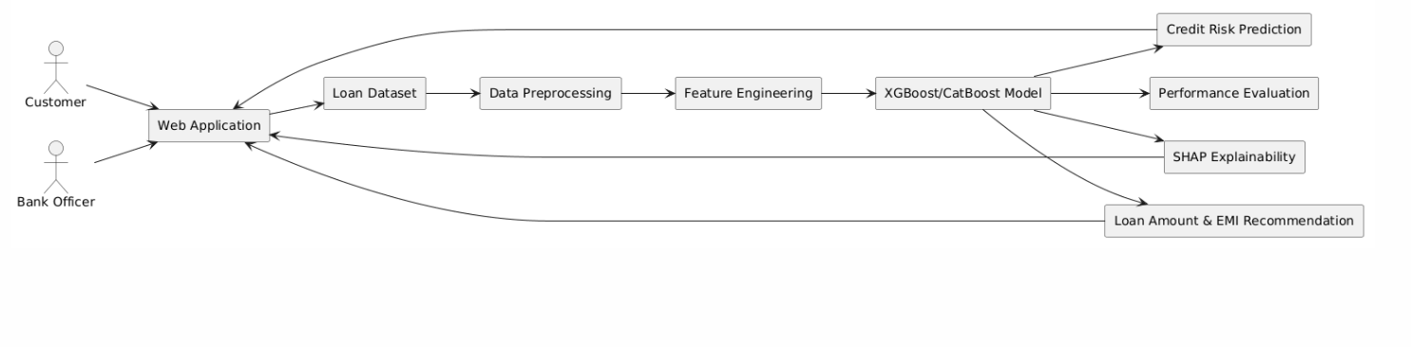
Architecture Diagram
Machine Learning-Based Credit Risk Prediction System

Slide 9
Proposed Work with Planned Innovation
Planned Innovation
Explainable AI using SHAP for transparent loan decisions.
Credit Risk Score prediction using Machine Learning.
Safe Loan Amount recommendation based on customer profile.
Personalized EMI recommendation based on affordability.
Real-time Loan Prediction through a web application.
Multi-criteria Decision Support considering risk, eligibility, and affordability.
Comparison of ML Models to select the best-performing model.
Hyperparameter Tuning for improved prediction accuracy.

Slide 10
Modules of the project
Module 1 – Dataset
Module 2 – Data Preprocessing
Module 3 – Feature Engineering
Module 4 – Machine Learning Model Training
Module 5 – Credit Risk Prediction
Module 6 – SHAP Explainability
Module 7 – Loan Amount & EMI Recommendation
Module 8 – Web Application
Module 9 – Performance Evaluation
Module 10 – Result Analysis

Slide 11
Methodology
Loan Dataset ↓ Preprocessing ↓ Feature Engineering ↓ Random Forest and XGBoost Training ↓ Risk Prediction ↓ SHAP Analysis ↓ Loan & EMI Recommendation ↓ Performance Evaluation

Slide 12
Expected Outcome
Accurate loan default risk prediction.
Faster loan approval process.
Better loan eligibility decisions.
Suitable loan amount recommendations.
Affordable EMI recommendations.
Reduced financial risk for banks.
User-friendly web application.
Improved and transparent decision-making.

Slide 13
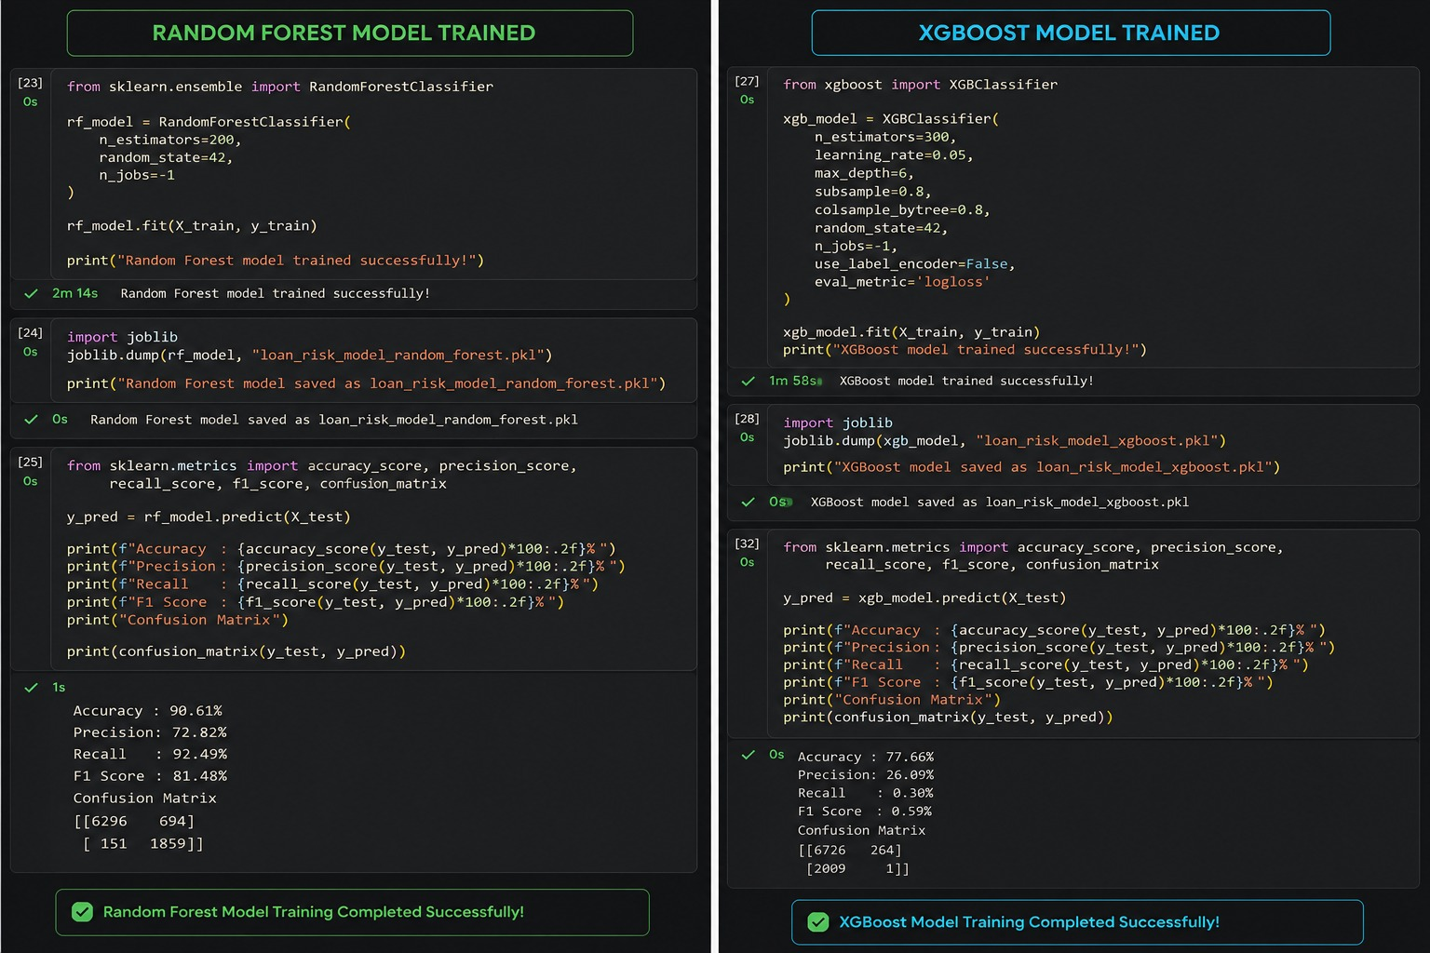
Implementation

Slide 14
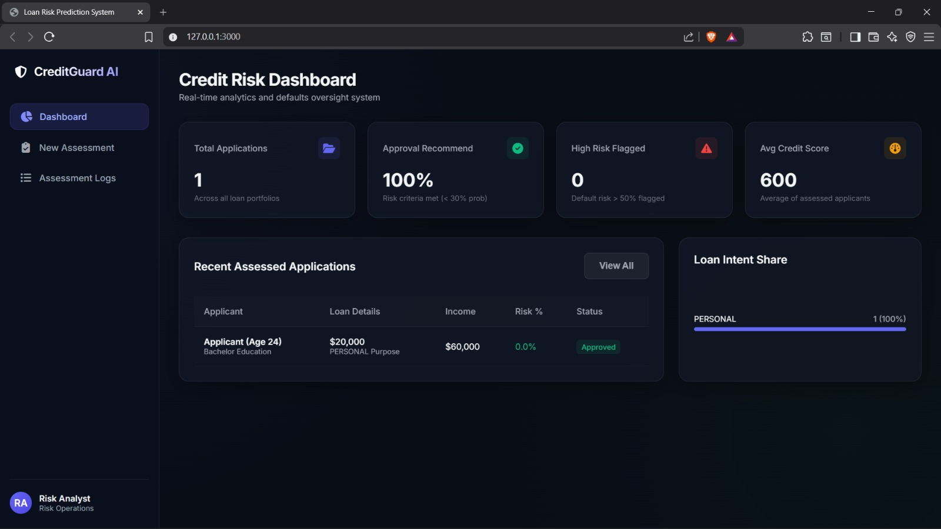

Slide 15
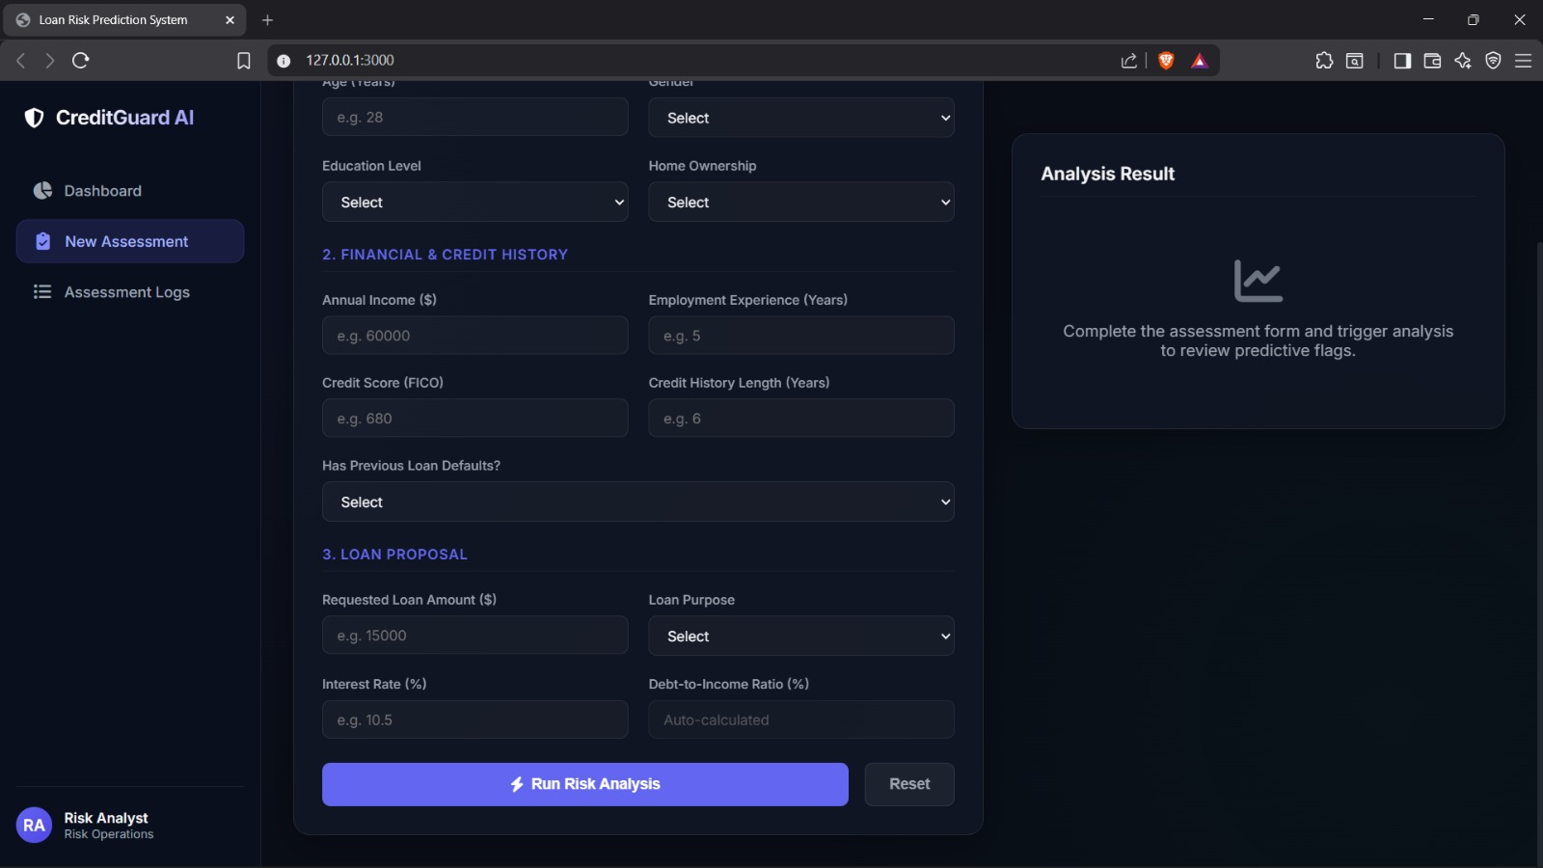

Slide 16
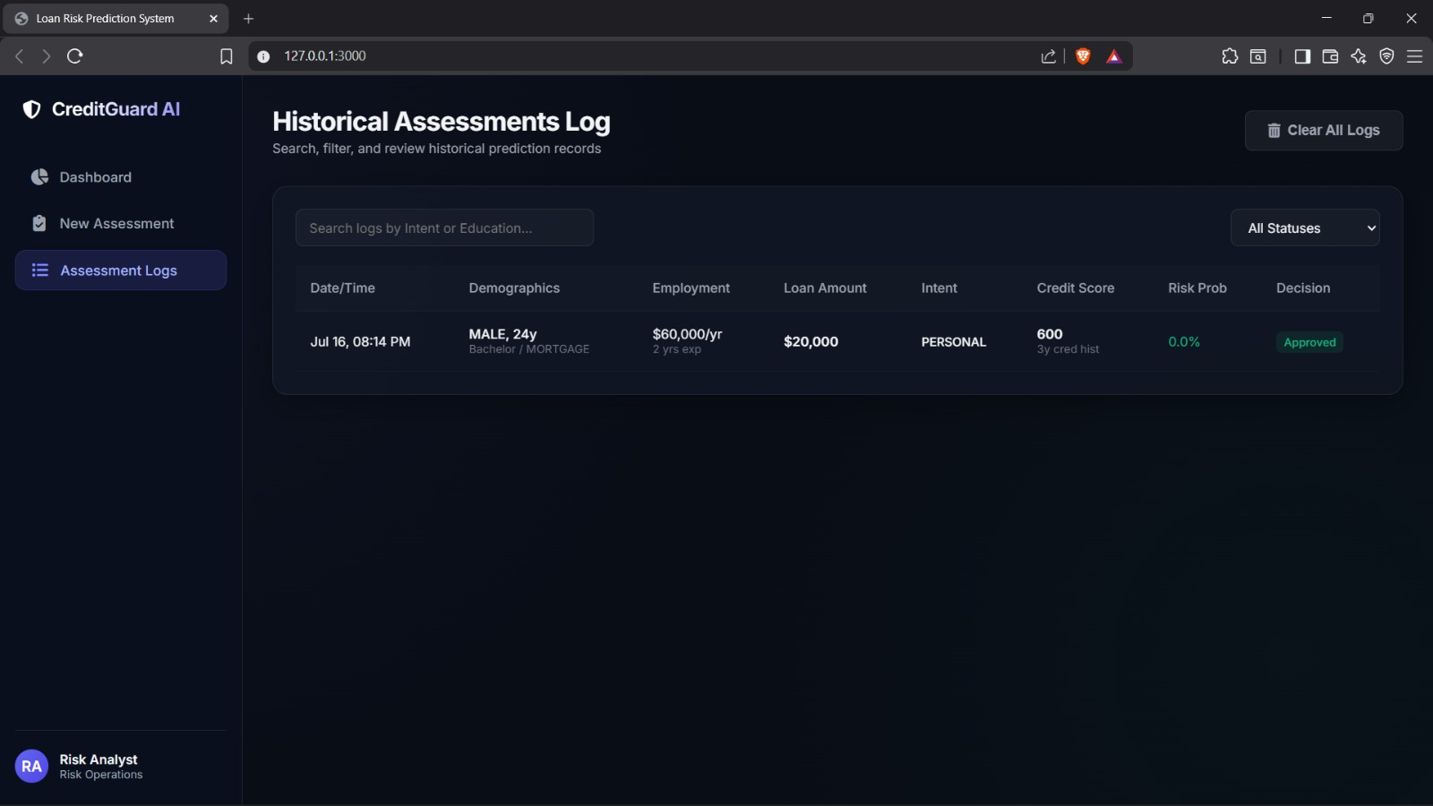

Slide 17
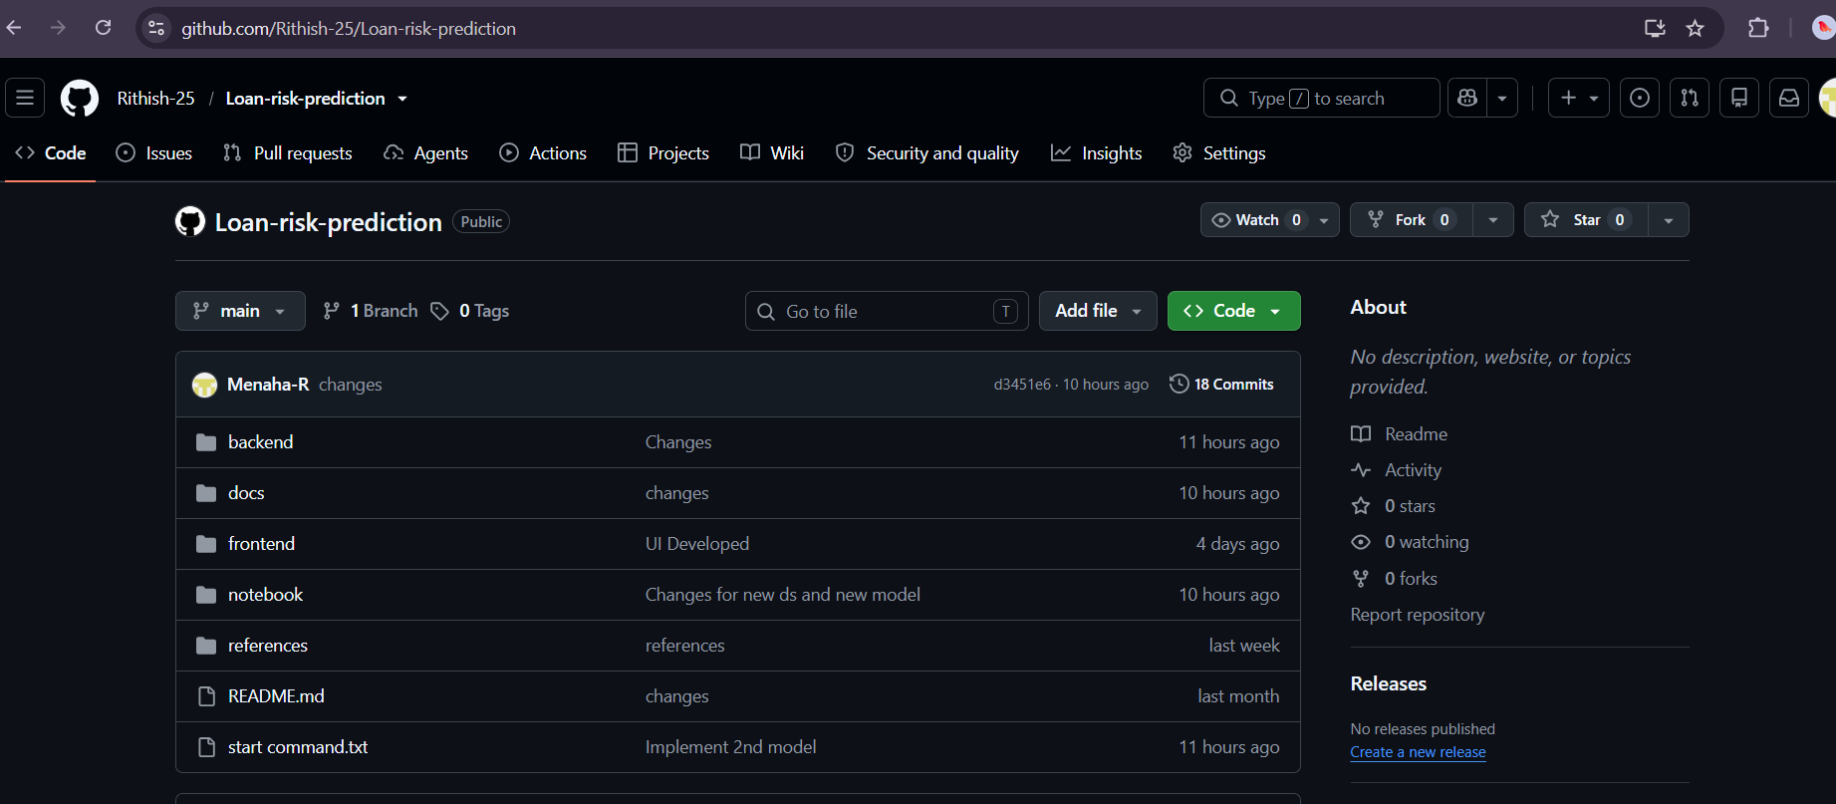
Git Documentation

Slide 18
THANK YOU

