Slide 1
PHASE - 1 INTERNSHIP PRESENTATION ON EMBEDDED SYSTEMS & IOT INTERN
Submitted by Internal Guide Rithish Kumar Chandrahas Gouda Mr.Faisal 4AL222EC078 Senior Assistant Profess AIET , Mijar. | External Guide Dhananjaya B P Senior Embedded Engineer Loginware Softtec Banglore

Slide 2
Industry Overview-Embedded System & IOT
Embedded Systems and IoT focus on developing smart, automated devices used in daily life and industries
Rapid growth in this field is driven by wireless communication, automation, and smart technologies
Platforms like ESP32 and Raspberry Pi are widely used for building IoT-based solutions
Increasing demand for engineers skilled in hardware-software integration and real-time systems
Strong problem-solving, debugging, and system design skills are essential for success

Slide 3
INTRODUCTION
Built a strong foundation in C programming as the core language for embedded systems development
Gained understanding of how software interacts with hardware components in real-time systems
Worked with ESP32 microcontroller to perform basic and advanced hardware operations
Practiced hands-on implementation which improved coding, logic building, and technical confidence

Slide 4
INTRODUCTION Cont…
Gained practical experience in debugging both hardware circuits and software programs
Learned to test systems using different conditions and edge cases to ensure reliability
Developed a structured approach to problem-solving by breaking tasks into smaller steps

Slide 5

ABOUT THE ORGANIZATION
Loginware Softtec is a Bangalore-based company specializing in embedded systems and IoT solutions
Focuses on developing real-world applications using modern hardware and software technologies
Provides hands-on training with industry tools and practical project-based learning
Helps students gain exposure to real-time development and engineering practices

Slide 6
INTERNSHIP OBJECTIVES
To build a strong foundation in C programming for embedded systems and real-time applications
To understand ESP32 microcontroller architecture and perform hardware interfacing operations
To implement IoT-based automation systems using wireless communication and Telegram Bot
To gain knowledge of Python programming and Raspberry Pi for advanced applications
To improve debugging, logical thinking, and real-world problem-solving skills

Slide 7
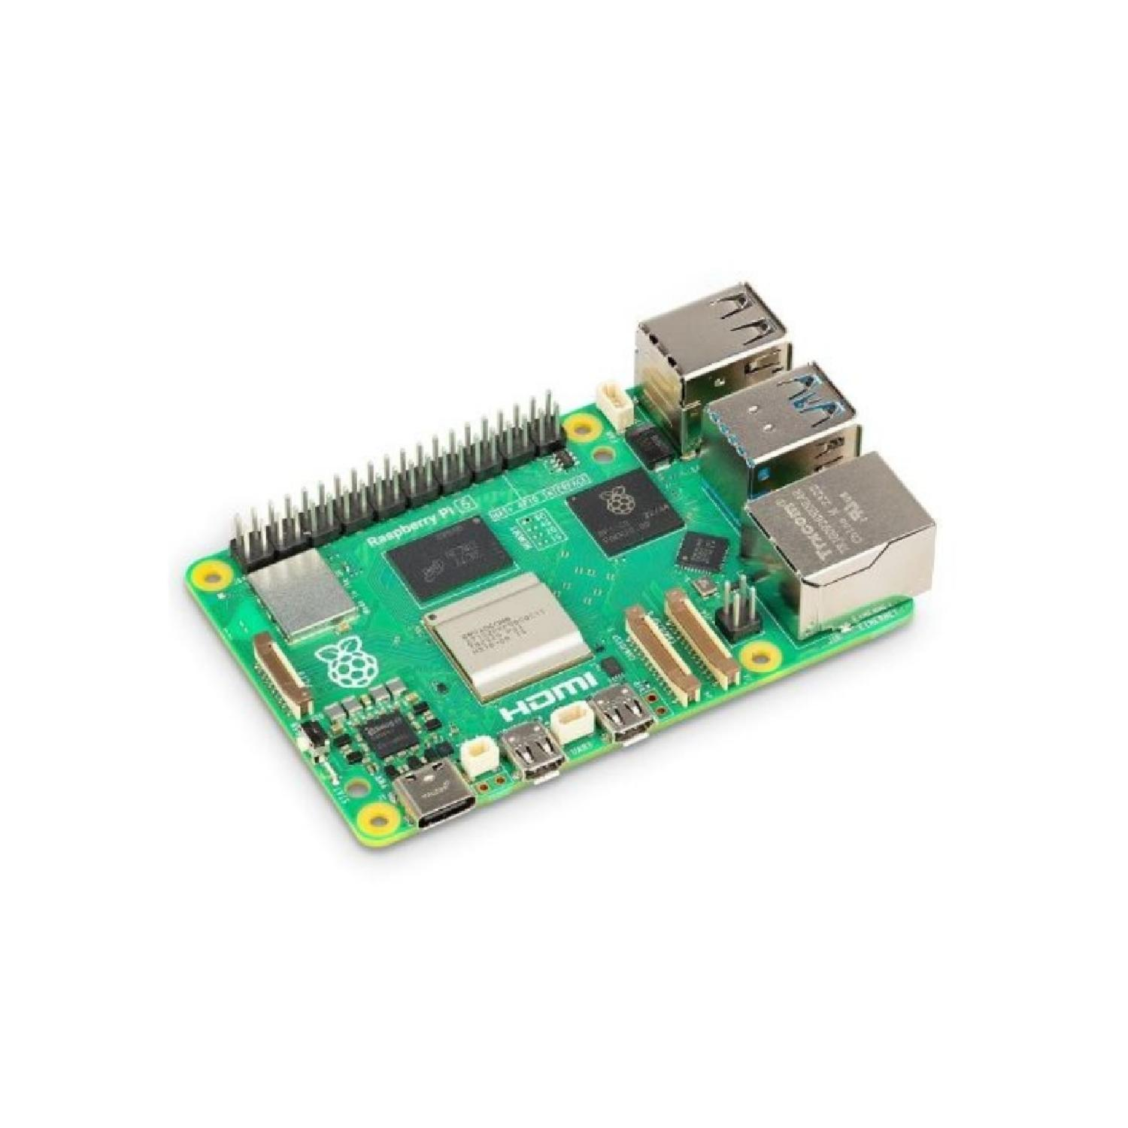
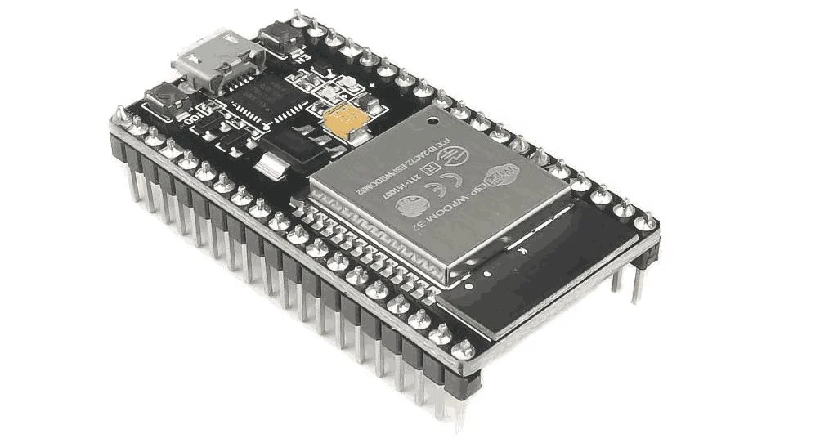
Technical Topics Covered
Learned C programming concepts including variables, data types, loops, and functions for embedded use
Understood program flow, memory handling, and efficient coding techniques for real-time systems
Studied ESP32 & Raspberry pi architecture including GPIO pins, input/output control, and wireless features
Raspberry Pi
ESP32

Slide 8
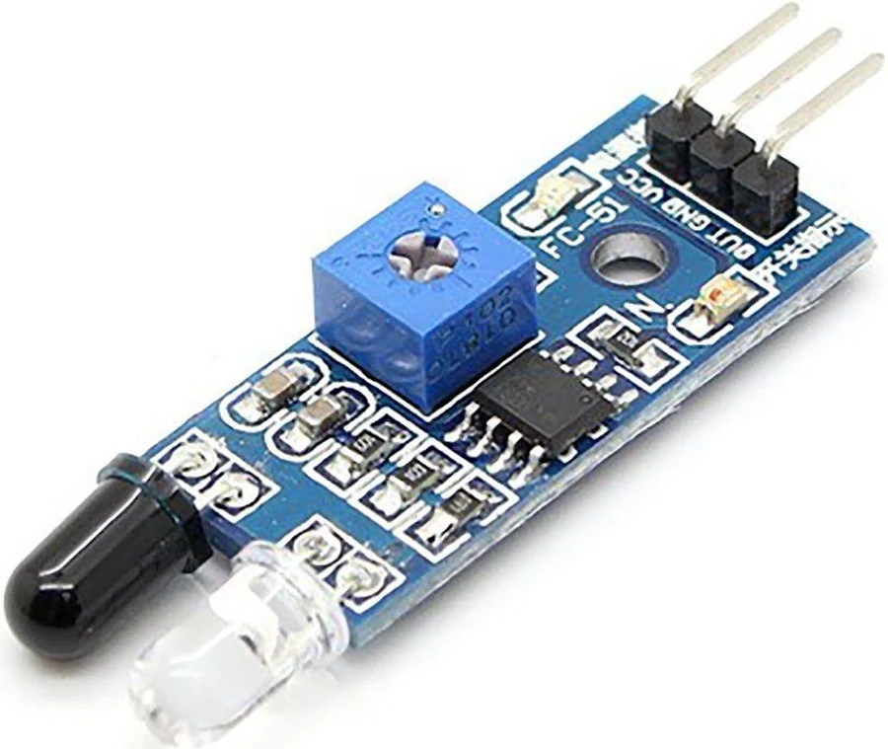
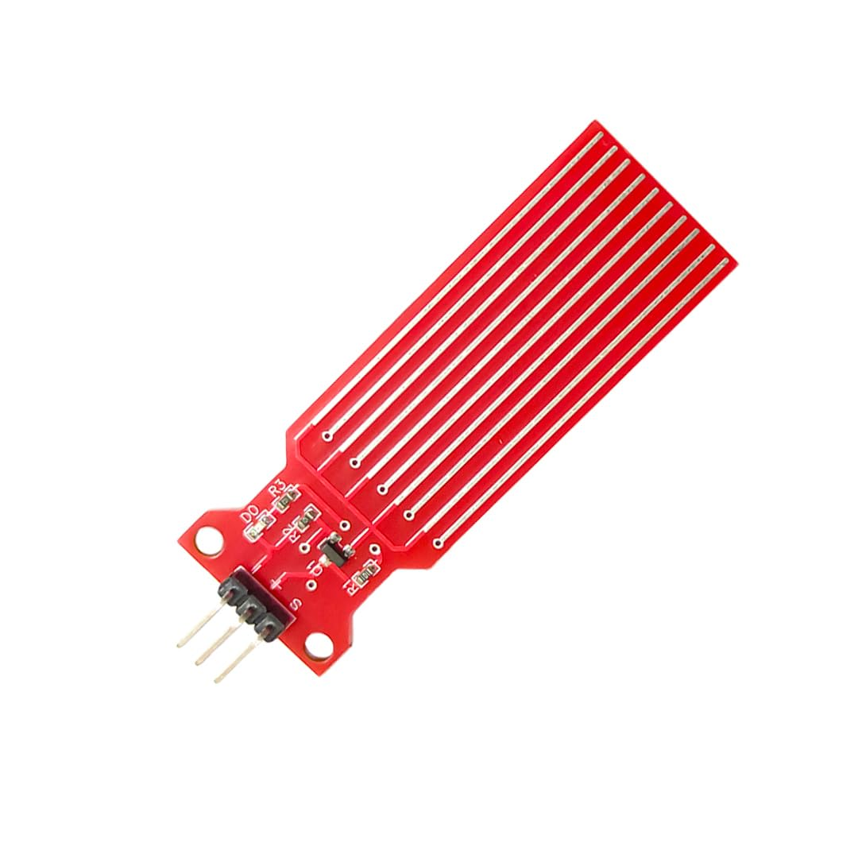
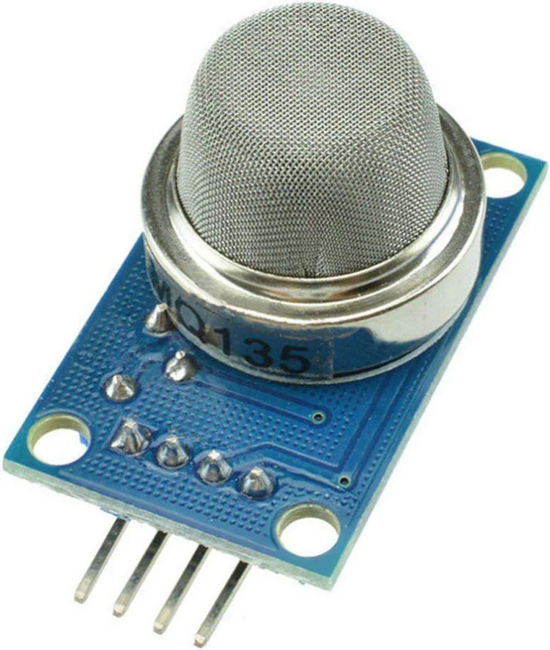
Technical Topics Covered Cont..
Integrated multiple sensors such as IR, water level, soil moisture, flame, and gas sensors
Developed IoT automation systems using Telegram Bot for remote device control
Worked with Raspberry Pi for GPIO operations and basic hardware interfacing
Used VNC for remote access and control of Raspberry Pi systems
IR Sensor
Water Level Sensor
Smoke Sensor

Slide 9
Tools and Software Used
Tool / Software | Purpose / Application
Arduino IDE | Used for writing, compiling, and uploading code to ESP32 microcontroller for hardware control and IoT applications
ESP32 (NodeMCU) | Used as the main microcontroller to interface sensors, control devices, and enable wireless IoT communication
Raspberry Pi | Used as a mini-computer to perform GPIO operations, run Python scripts, and develop embedded applications
Python | Used for controlling hardware components on Raspberry Pi.
t

Slide 10
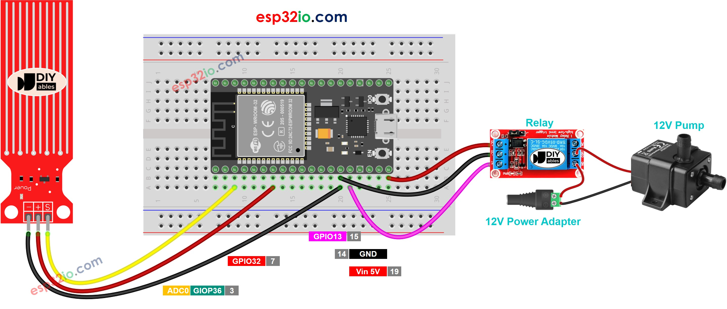
Hands-On Experience
Gained practical experience by writing and executing C programs for embedded systems
Worked with ESP32 to control LEDs, motors ,water level and other hardware components using GPIO pins
Tested circuits and programs under different conditions to ensure proper functionality
Water level sensor using ESP32

Slide 11
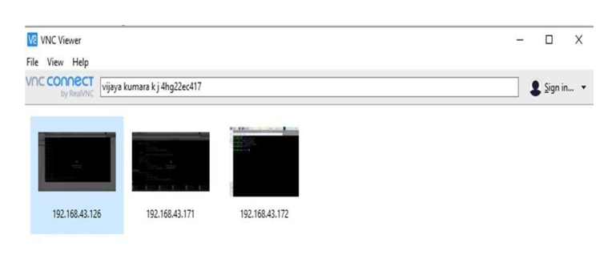
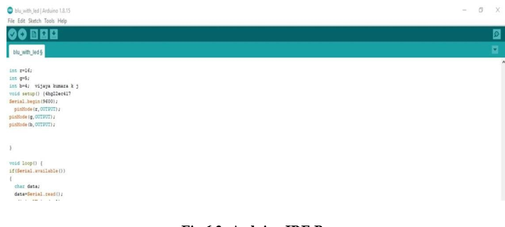
Hands-On Experience(Cont…)
Implemented IoT automation by connecting ESP32 with Telegram Bot for remote control
Worked on Raspberry Pi using Python to perform LED and GPIO-based operations
Used VNC to remotely access Raspberry Pi and manage development tasks efficiently
Improved ability to debug and integrate both hardware and software components
Developed confidence in handling real-time embedded system projects
VNC Viewer
Arduino IDE Page

Slide 12
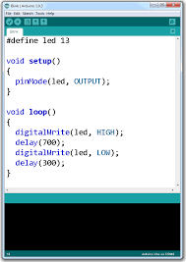
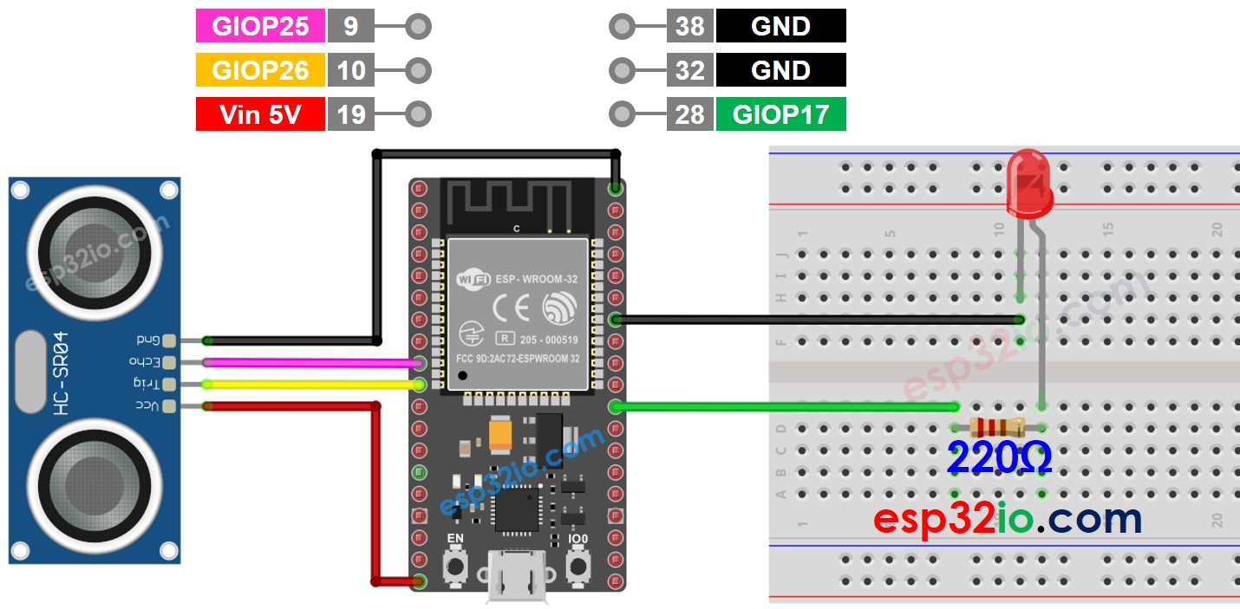
Technical Learnings
Technical Skills:
Developed strong programming skills in C for embedded systems development
Gained knowledge about Arduino software and how to implement the code for hardware
Learned sensor integration techniques for building smart monitoring systems
ESP32 with LED &Buzzer
C Code For LED ON OFF

Slide 13
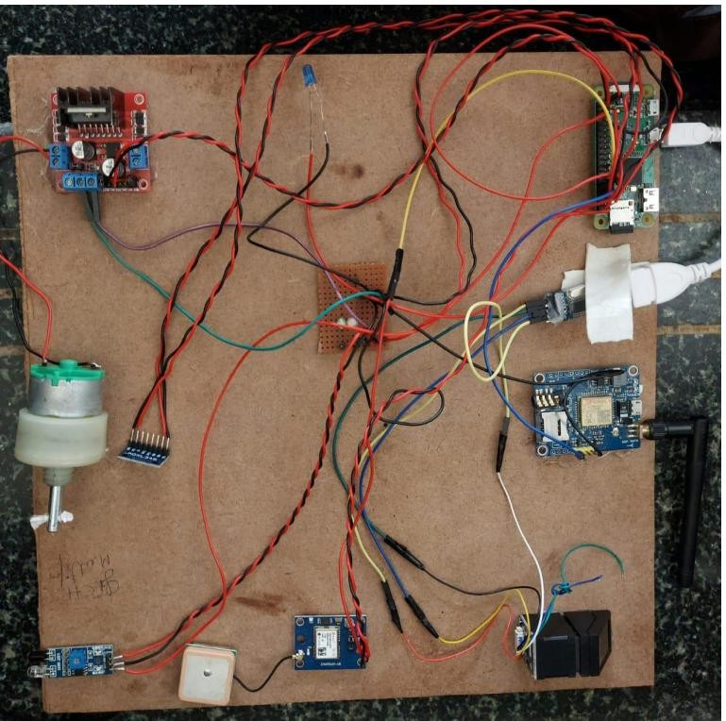
Technical Learnings(Cont…)
Conceptual Understanding:
Understood embedded system architecture and real-time processing concepts
Gained hands-on experience with ESP32 microcontroller and hardware interfacing
Understood IoT communication and remote device control mechanisms
Interfacing Of Hardware Components

Slide 14
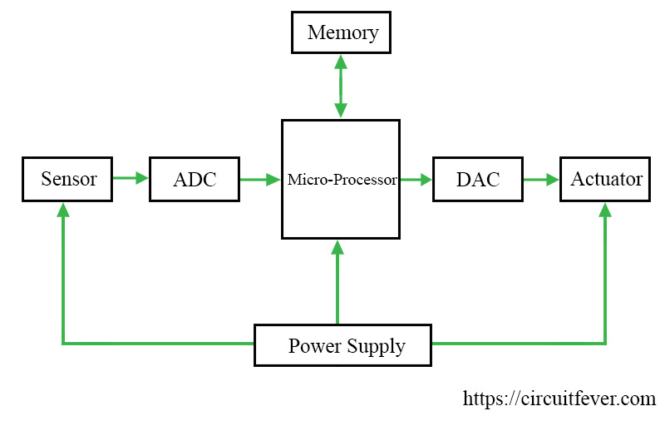
Technical Learnings(Cont…)
Professional Development:
Improved problem-solving skills through continuous hands-on implementation
Gained hands-on experience with ESP32 microcontroller and hardware interfacing
Learned structured thinking for designing and implementing embedded solutions
Embedded Systems Block Diagram

Slide 15
Conclusion
During this internship, I gained strong practical knowledge in embedded systems and IoT. I developed skills in C programming, ESP32, sensor integration, and Raspberry Pi. I improved my debugging, logical thinking. This experience has prepared me to work confidently in the field of embedded systems and IoT development.

Slide 16
THANK YOU

