Slide 1
Best possible geographical location and capacity of their 200 new aged care centres
By Sarith Fernando

Slide 2
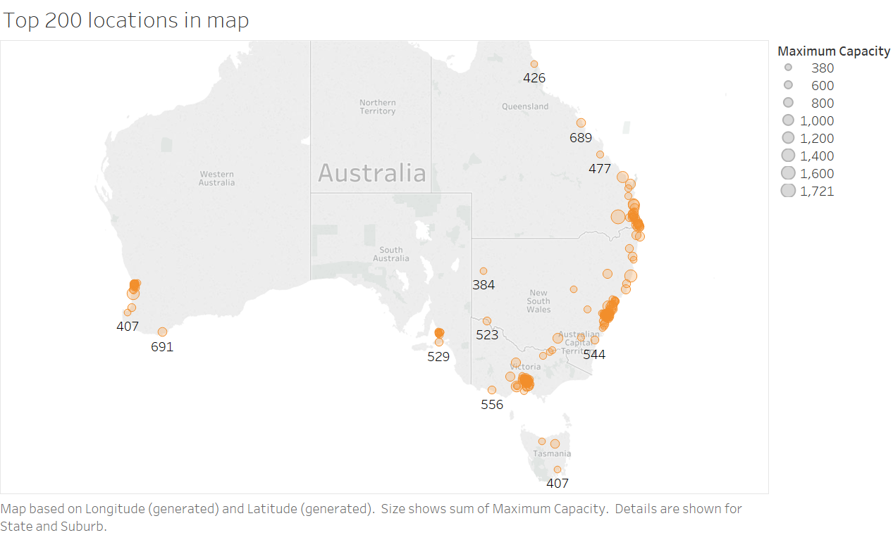
Geographical location and capacity

Slide 3
Top 10 Geographical location and capacity
# | State | Postal Code | Maximum Capacity
1 | QLD | 4350 | 1721
2 | WA | 6210 | 1315
3 | NSW | 2444 | 1305
4 | QLD | 4670 | 1235
5 | NSW | 2261 | 1188
6 | QLD | 4551 | 1175
7 | VIC | 3073 | 1117
8 | VIC | 3150 | 1105
9 | QLD | 4556 | 1067
10 | NSW | 2250 | 1063

Slide 4
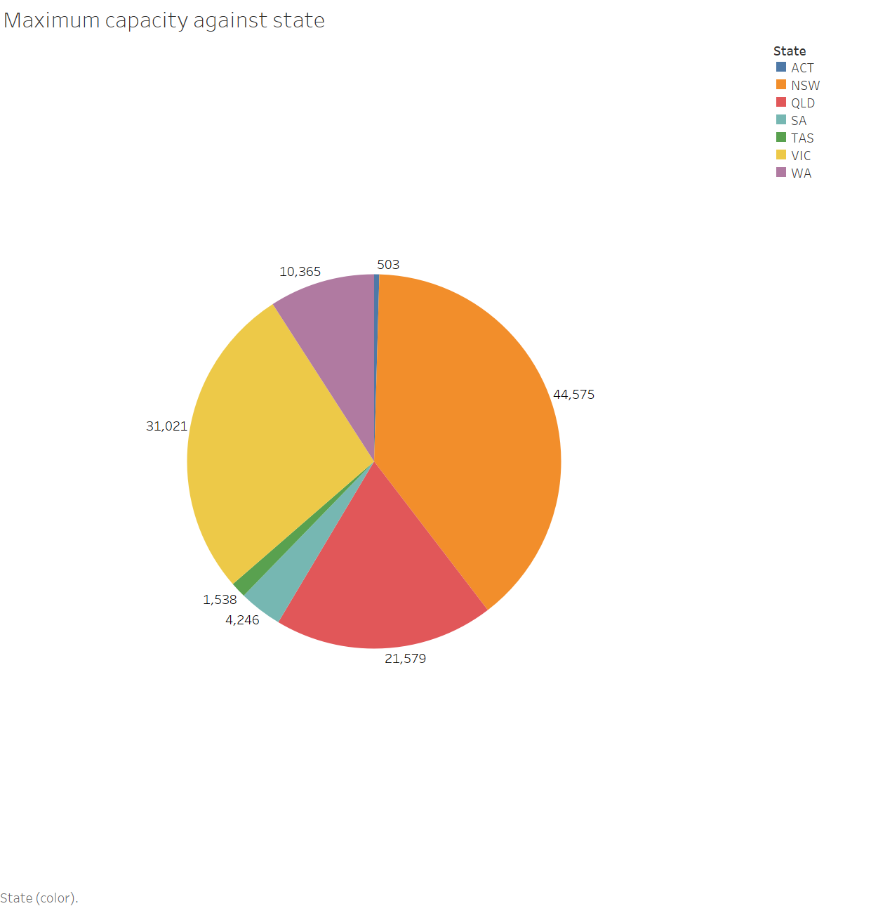
Maximum Capacity against State

Slide 5
Key characteristics of people using aged care
The three biggest aged care programs have different age profiles among their users
Home Support
Home Care
Residential Care
Age care centres should focus on residential care program
A higher proportion of people using residential care were aged 85 years and over (47% of men and 65% of women)
Home support had the lowest proportion of people aged 85 and over (29%), rising to 42% in home care and 59% in permanent residential aged care
The three biggest aged care programs have different age profiles among their users
Home Support
Home Care
Residential Care
Age care centres should focus on residential care program
A higher proportion of people using residential care were aged 85 years and over (47% of men and 65% of women)
Home support had the lowest proportion of people aged 85 and over (29%), rising to 42% in home care and 59% in permanent residential aged care
Age Care Centres

Slide 6
Key characteristics of people using aged care
Men and women using aged care have different age profiles. This is particularly pronounced in residential care
A higher proportion of women in residential care were in older age groups compared with men
For example, 1 in 10 women in residential care on 30 June 2017 were aged 95–99, compared with 1 in 20 men
There were more men in younger age groups than there were women;
For example, the 60–64 age group represented 3% of men using residential aged care, compared with 1% of women

Slide 7
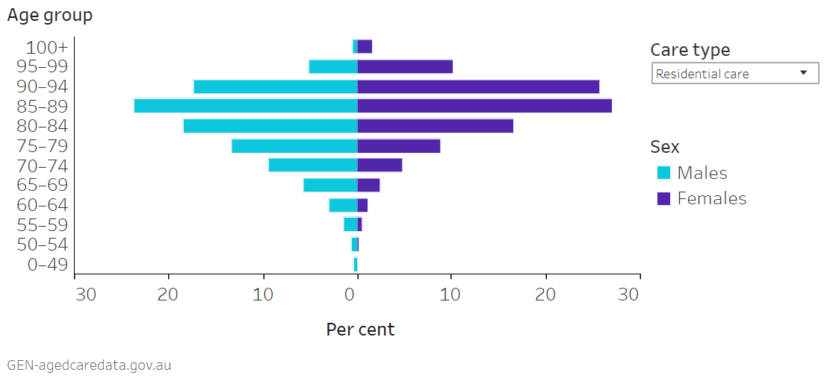
People using Residential aged care, age, and sex, 30 June 2017

Slide 8
Publicly available data sources
Australia Service List 2017 (ASL)
Information on available residential places against geographical location
https://www.gen-agedcaredata.gov.au/Resources/Access-data/2017/October/2017_Aged_Care_Services_List
Australian Bureau of Statistics 2016 (ABS)
Population with age-group and geographical location
http://www.abs.gov.au/websitedbs/D3310114.nsf/Home/2016%20TableBuilder
Accessible fields and data structure
Geographical location
State
Postal code
Age group
Sex
Residential care percentage against age
Residential care percentage against sex

Slide 9
Australia Service List 2017 (ASL)
Australia Service List 2017 (ASL)
Service name | 2015 Aged Care Planning Region (ACPR) | Organisation Type
Physical Address Line 1 | Care Type | ABS Remoteness
Physical Address Line 2 | Residential Places | Latitude
Physical Address Suburb | Home Care Places | Longitude
Physical Address State | Restorative Care Places | 2016-17 Australian Government Funding
Physical Address Post Code | Provider Name

Slide 10
Australian Bureau of Statistics 2016 (ABS)
Australian Bureau of Statistics 2016 (ABS)
Age goups | Indigenous Status | Significant urban areas
Sex | Marital Status | Birth of person
State | Religious Affection | Proficiency of spoken English
Postal Code | Electoral Divisions | Total person income
Suburb | Natural Resource management regions | Year of arrival in Australia
Employmenet | Remoteness areas | etc

Slide 11
Methodology
Hypothesis: All the people above 85 years or over need a residential care
How to analyse the hypothesis
Number of available age care centres
Sum of Residential care facilities with respect to Postal code
Requirement of age care centres
ASL Data
Find 200 postal codes where the difference is maximum
-
Sum of people who above 85 years of old with respect to Postal code
ABS Data
Number of people who need age care facility

Slide 12
Appendix I
Primary keys
ASL | State | Postal Code | No of available age care centres
Group by State, Postal Code
Table 1
ASL
ABS | State | Postal Code | 0-4y | 5-9y | 10-14y | 15-19y | 20-24y | 25-29y
Group by State, Postal Code
Table 2
ABS
30-34y | 35-39y | 40-44y | 45-49y | 50-54y | 55-59y | 60-64y | 65-69y | 70-74y | 75-79y | 80-84y | 85-89y | 90-94y | 95-99y | 100y over

Slide 13
Appendix I
Table 1
ASL
Table 2
ABS
Right Join with Primary keys of
State & Postal Code
Age care centre requirement = ∑ (population above 85 years) – Available age care centres
Top 200 locations = select(maximum(Age care centre requirement),200)

Slide 14
Limitations and possible improvements
Requirement is depend on
Population rise: Prediction for future age gaps, death rates
Sex : Men and women using aged care have different age profiles
Migration : Around one-third of people using each aged care program were born overseas. This reflects migration to Australia over past decades—37% of Australians aged 65 years and over were born overseas
Other development projects for age care facilities
Size of the suburb and nearest suburbs: Residential care services are concentrated in more densely populated urban areas, with around 3 in 5 (62%) of facilities located in Major cities
How to improve
Consider requirement base on sex and different age groups
Model sequential predictions to cover above facts

Slide 15
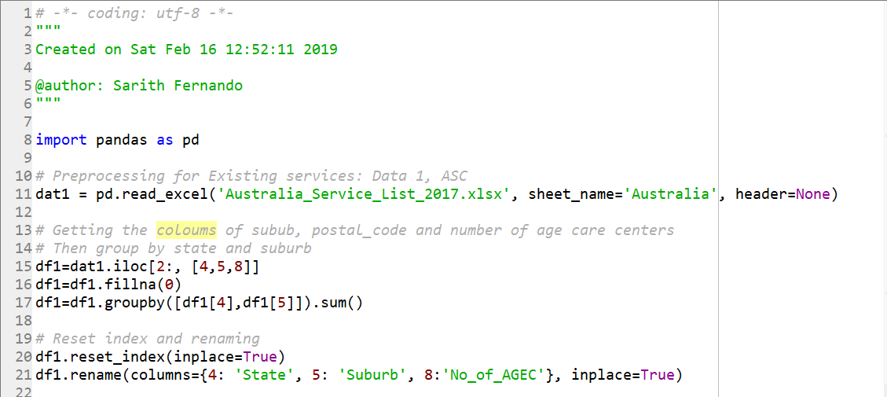
Appendix II
Preprocessing Table 1: ASC

Slide 16
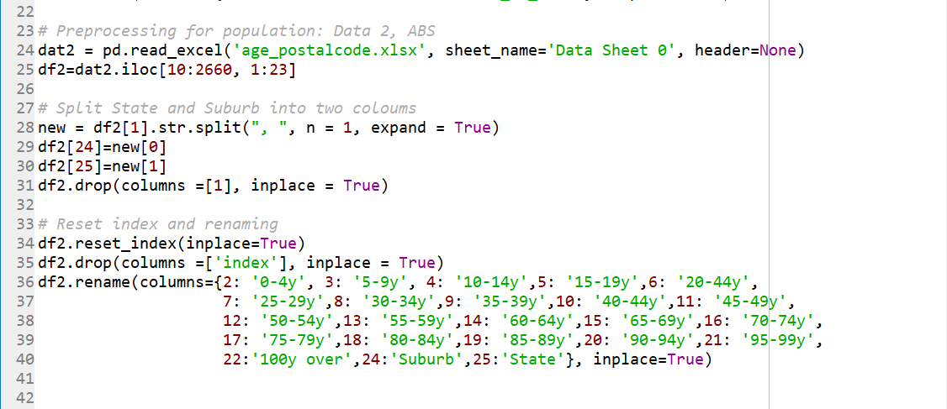
Appendix II
Preprocessing Table 2: ABS

Slide 17
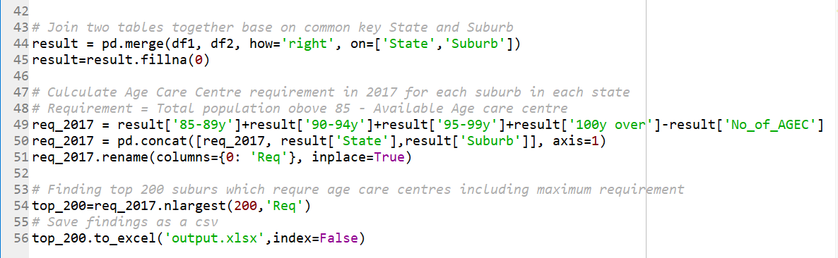
Appendix II
Table Joining and Computation

Slide 18
Thank you
Github: https://github.com/Rithmax/Annalect

