Slide 1


Knowing about: Convolutional Neural Network Algorithm
Rithu Shivani K

Slide 2
Introduction:
Brief explanation of artificial neural networks and their applications.
Overview of CNN as a specific type of neural network designed for image processing and pattern recognition.
Importance of CNN in various fields, such as computer vision, natural language processing, and speech recognition.

Slide 3
Basics of CNN:
Architecture of a CNN,
Input layer
Convolutional layer
Pooling layer
Fully connected layer.

Slide 4
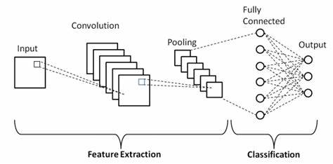
5 LAYERS OF CNN

Slide 5
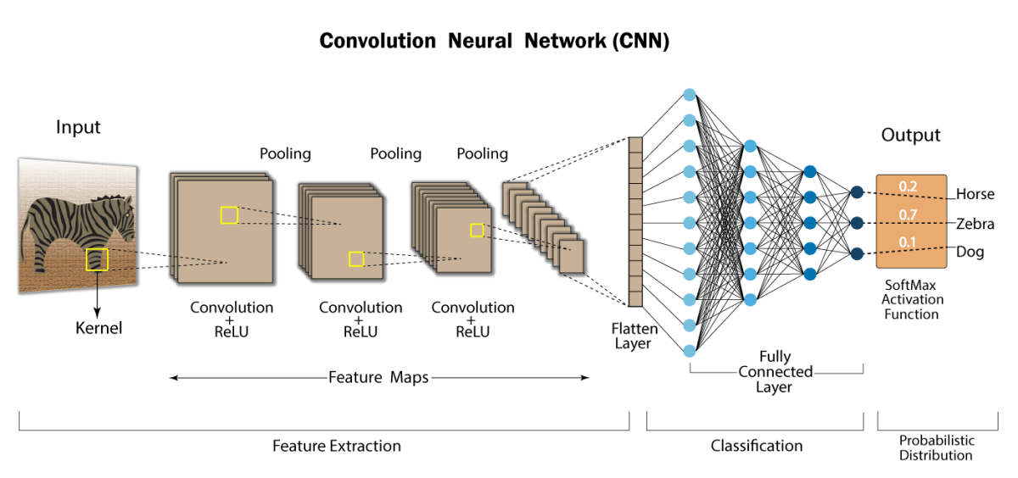
Convolutional Layers:

Slide 6
Pooling Layers:
Different pooling techniques
Max pooling
Average pooling.
Purpose
Reducing spatial dimensions
Increasing computational efficiency.

Slide 7
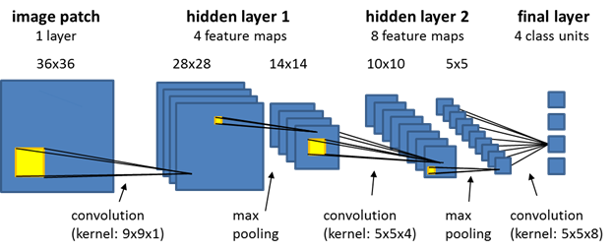
POOLING LAYERS

Slide 8
FULLY CONNECTED LAYER
Connects all the neuron from one layer to another .
Operates on flattened input .
Used to optimize objective such as class scores or other output

Slide 9
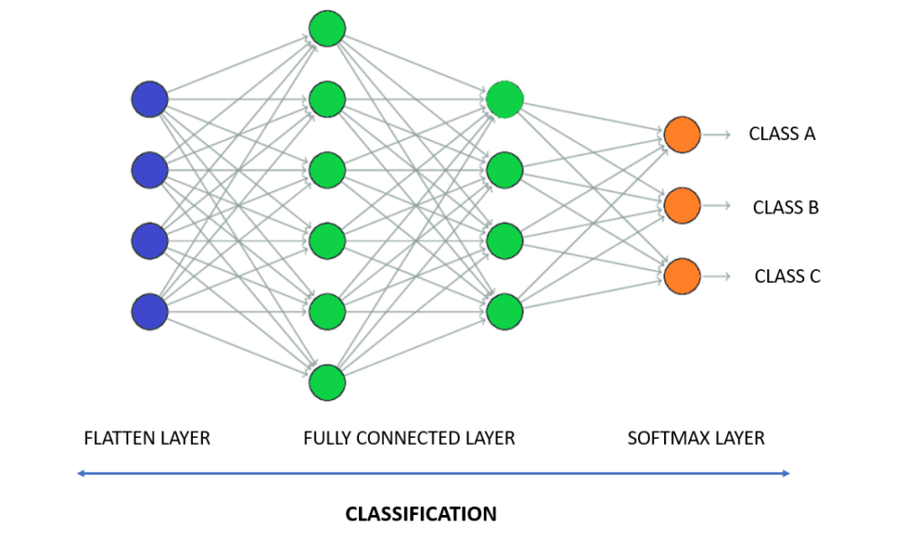
FULLY CONNECTED LAYER

Slide 10
Applications of CNN:
Image classification
Object detection
Image segmentation
Mentioning CNN's use in tasks like facial recognition, style transfer, and medical image analysis.

Slide 11
Challenges and Future Directions:
Challenges in training CNNs,
Overfitting,
Vanishing/exploding gradients,
computational requirements.
Transfer learning

Slide 12
Future Directions:
Discussing ongoing research and potential future directions for CNNs,
Attention mechanisms
Capsule networks.

Slide 13
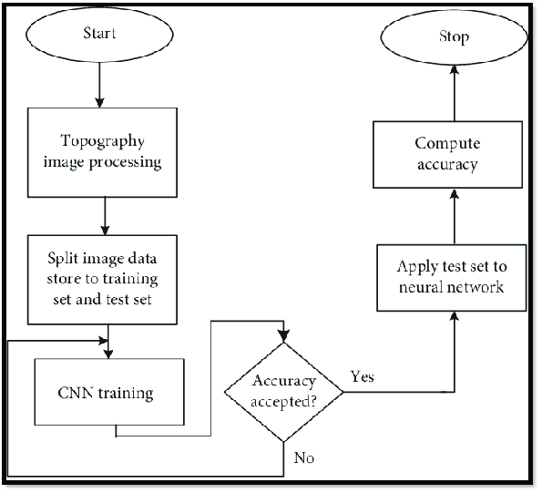
FLOWCHART OF CNN

Slide 14
Conclusion:
Emphasizing the significance of CNNs in advancing artificial intelligence and solving complex problems.
Encouraging further exploration and research in the field of CNNs.
Explaining the layers of CNN algorithm.
Learnt on the flowchart of the CNN algorithm.

Slide 15
THANK YOU

