Slide 1

Ipl auction project using sql
By T. RITHVIJA MANVI

Slide 2
Aim : developing auction strategy for new ipl franchise by analyzing past ipl data to create a strong and balanced squad.

Slide 3
CREATION OF TABLES
TABLE MATCHES
TABLE DELIVERIES
CREATE TABLE Matches (
id INT,
city VARCHAR(255),
date Date,
player_of_match VARCHAR(255),
venue VARCHAR(255),
neutral_venue INT,
team1 VARCHAR(255),
team2 VARCHAR(255),
toss_winner VARCHAR(255),
toss_decision VARCHAR(10),
winner VARCHAR(255),
result VARCHAR(20),
result_margin INT,
eliminator VARCHAR(10),
method VARCHAR(10),
umpire1 VARCHAR(255),
umpire2 VARCHAR(255)
);
CREATE TABLE Deliveries(
id INT,
inning INT,
over INT,
ball INT,
batsman VARCHAR(255),
non_striker VARCHAR(255),
bowler VARCHAR(255),
batsman_runs INT,
extra_runs INT,
total_runs INT,
is_wicket INT,
dismissal_kind VARCHAR(50),
player_dismissed VARCHAR(255),
fielder VARCHAR(255),
extras_type VARCHAR(50),
batting_team VARCHAR(255),
bowling_team VARCHAR(255)
);

Slide 4
INSERTION INTO TABLES
COPY IPL_Ball FROM ‘C:\Users\INDIA\Downloads\IPL Dataset\IPL Dataset\IPL_Ball.csv' DELIMITER ',' CSV HEADER;
COPY IPL_Matches FROM ‘C:\Users\INDIA\Downloads\IPL Dataset\IPL Dataset\IPL_matches.csv' DELIMITER ',' CSV HEADER;

Slide 5
BIDDING PLAYERS
BATTERS
The players who prove themselves to be potent batters by scoring high strike rate and can be bid in our budget.
BOWLERS
The players who prove themselves to be potent bowlers by bowling and not letting opposite team score many runs can be bid in our budget.
WICKETKEEPERS
The players who prove themselves to be potent Wicketkeepers by scoring wickets and can be bid in our budget.
ALLROUNDERS
The players who prove themselves to be potent batters, bowlers, wicketkeepers and fielders and can be bid in our budget.

Slide 6
BATTERS

Slide 7
TASK 1 - BATSMEN WITH HIGH STRIKE RATE
SELECT batsman,
SUM(batsman_runs) AS total_runs,
COUNT(CASE WHEN extras_type != 'wides' THEN ball END) AS total_balls,
ROUND((SUM(batsman_runs) * 100.0 / COUNT(CASE WHEN extras_type != 'wides' THEN ball END)), 2) AS strike_rate
FROM IPL_Ball
GROUP BY batsman
HAVING COUNT(CASE WHEN extras_type != 'wides' THEN ball END) >= 500
ORDER BY strike_rate DESC
LIMIT 10;

Slide 8
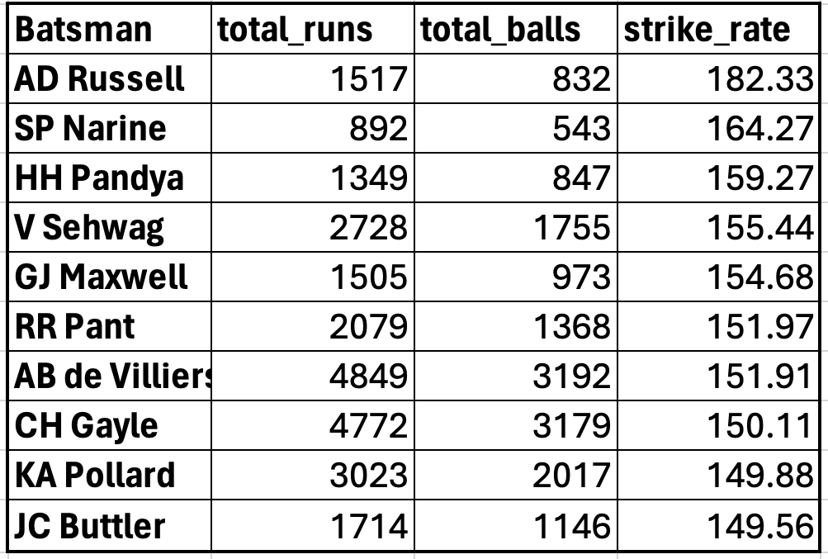
OUTPUT

Slide 9
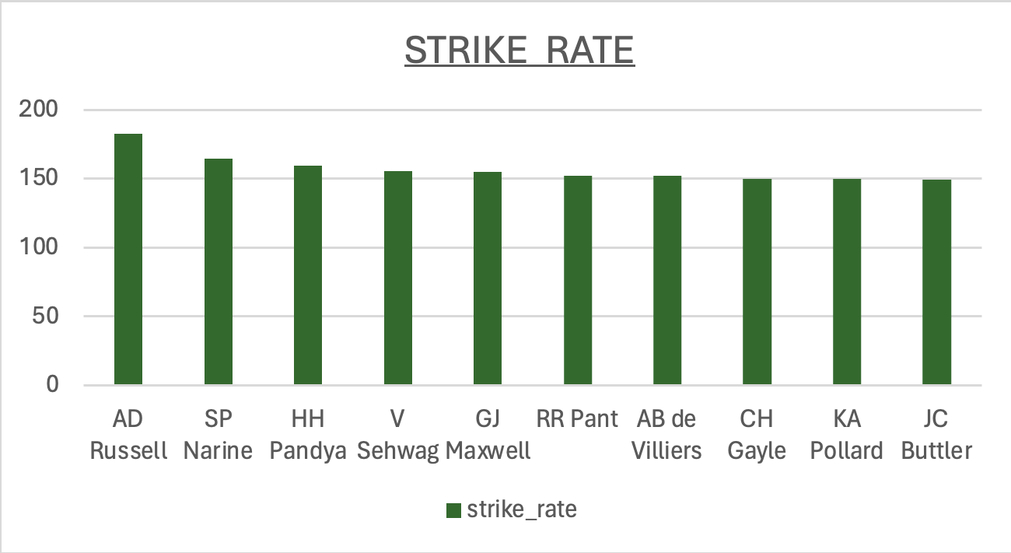

Slide 10
TASK 2- BATSMEN WITH GOOD AVERAGE
SELECT batsman,
COUNT(DISTINCT EXTRACT(YEAR FROM ipl_matches.date)) AS seasons_played,
COUNT(*) AS innings_played,
SUM(batsman_runs) AS total_runs,
SUM(is_wicket) AS times_dismissed,
SUM(batsman_runs) / NULLIF(SUM(is_wicket), 0) AS batting_average
FROM IPL_Ball
JOIN IPL_Matches ON IPL_Ball.id = IPL_Matches.id
GROUP BY batsman
HAVING COUNT(DISTINCT EXTRACT(YEAR FROM ipl_matches.date)) > 2 AND SUM(is_wicket) > 0
ORDER BY batting_average DESC
LIMIT 10;

Slide 11
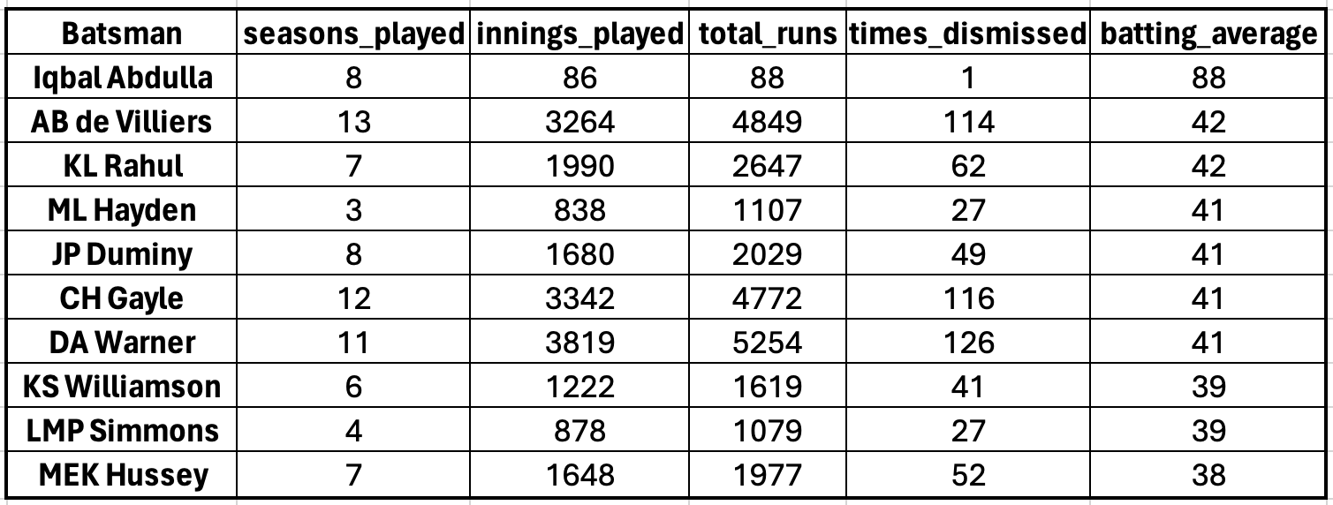
OUTPUT

Slide 12
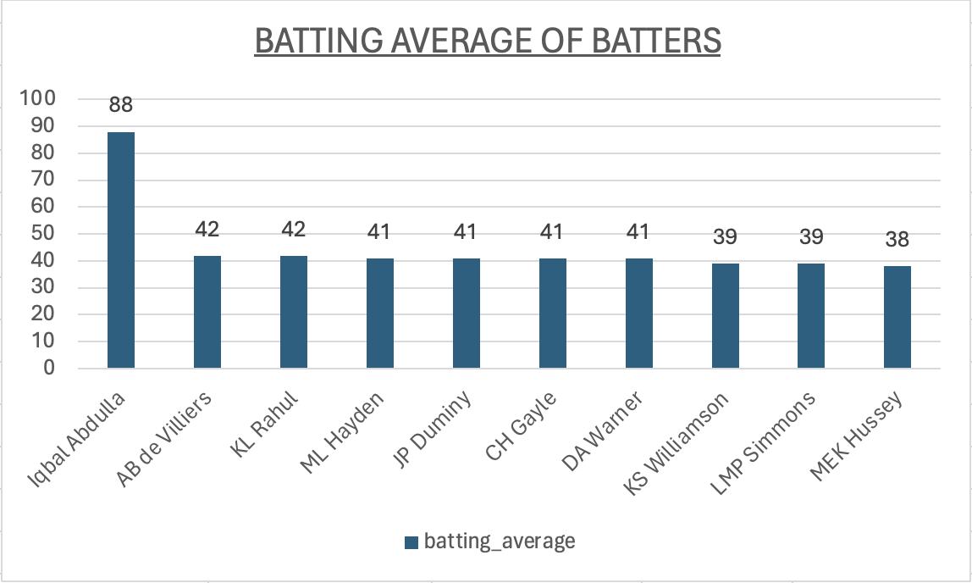

Slide 13
TASK 3- HARD HITTING BATSMEN
SELECT batsman,
COUNT(DISTINCT EXTRACT(YEAR FROM ipl_matches.date)) AS seasons_played,
SUM(CASE WHEN batsman_runs = 4 THEN 1 ELSE 0 END) AS fours_count,
SUM(CASE WHEN batsman_runs = 6 THEN 1 ELSE 0 END) AS sixes_count,
SUM(batsman_runs) AS total_runs,
(SUM(CASE WHEN batsman_runs = 4 THEN 1 ELSE 0 END) * 4 + SUM(CASE WHEN batsman_runs = 6 THEN 1 ELSE 0 END) * 6) AS boundary_runs,
CONCAT(ROUND(((SUM(CASE WHEN batsman_runs = 4 THEN 1 ELSE 0 END) * 4 + SUM(CASE WHEN batsman_runs = 6 THEN 1 ELSE 0 END) * 6) * 100.0) / NULLIF(SUM(batsman_runs), 0), 0), '%') AS boundary_percentage
FROM IPL_Ball
JOIN IPL_Matches ON IPL_Ball.id = IPL_Matches.id
GROUP BY batsman
HAVING COUNT(DISTINCT EXTRACT(YEAR FROM ipl_matches.date)) > 2
ORDER BY boundary_percentage DESC
LIMIT 10;

Slide 14
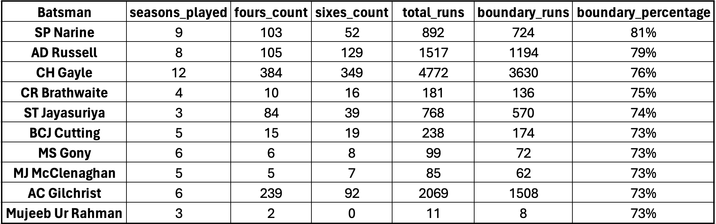
OUTPUT

Slide 15
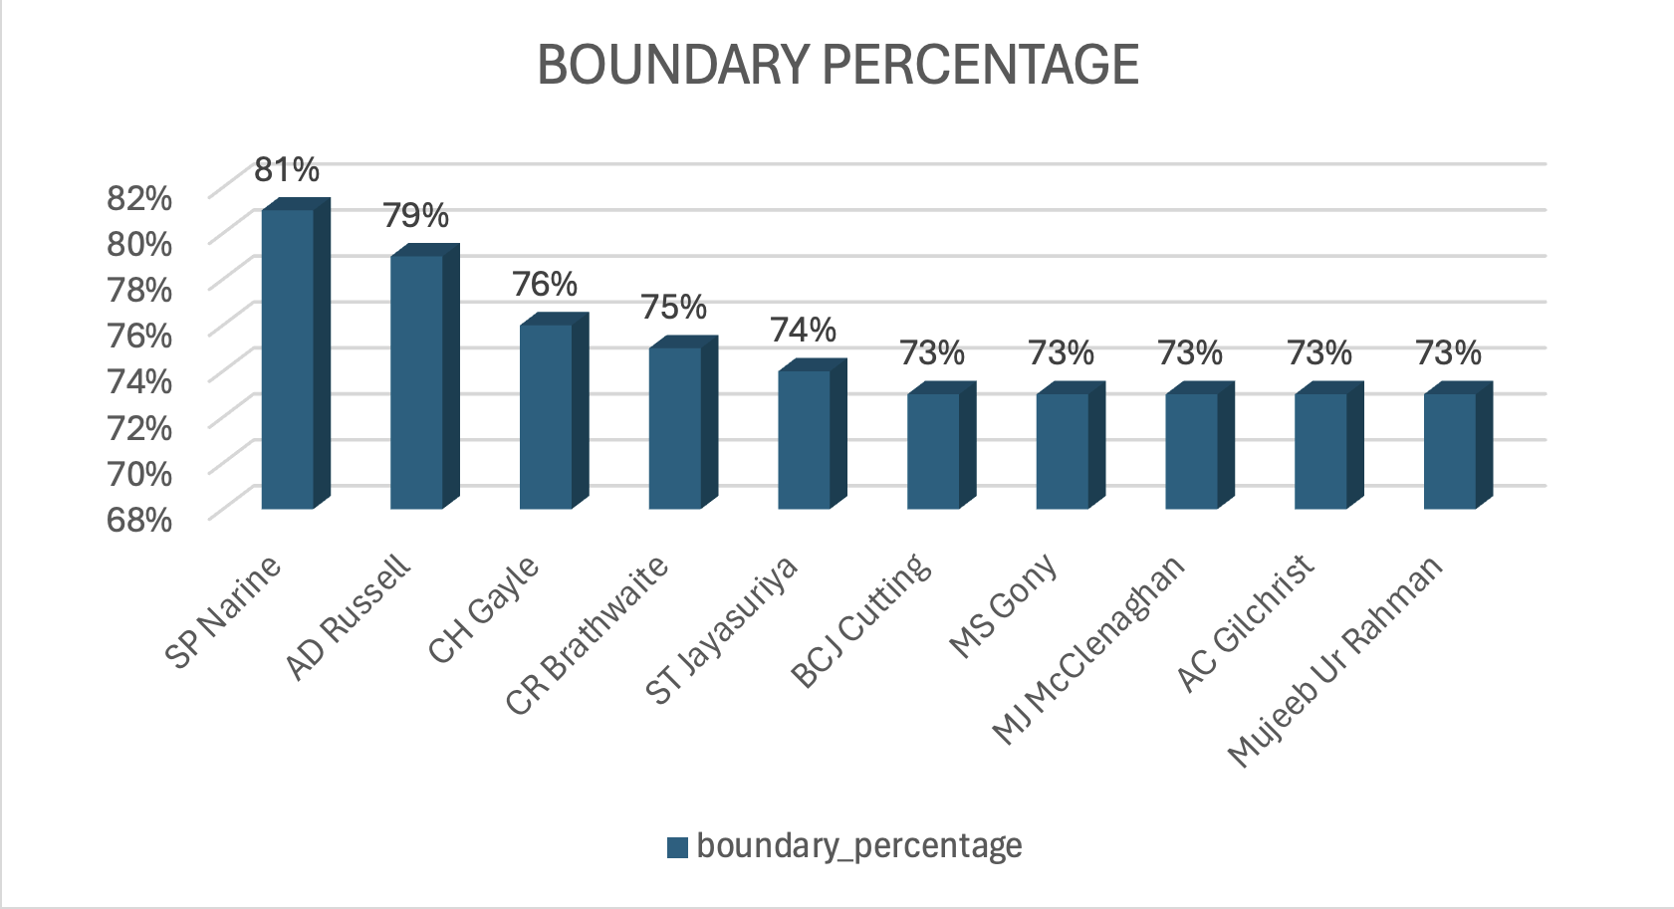

Slide 16
BOWLERS

Slide 17
TASK 4- BOWLERS WITH GOOD ECONOMY
SELECT bowler,
round((SUM(total_runs) / (count(bowler)/6.0)),2) AS economy
FROM ipl_ball
GROUP BY bowler
HAVING COUNT(bowler) >= 500
ORDER BY economy
LIMIT 10;

Slide 18
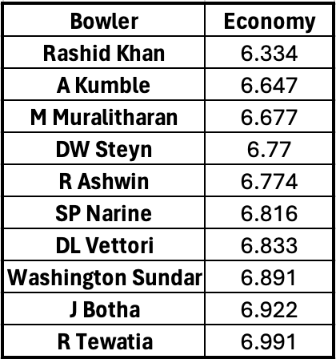
OUTPUT

Slide 19
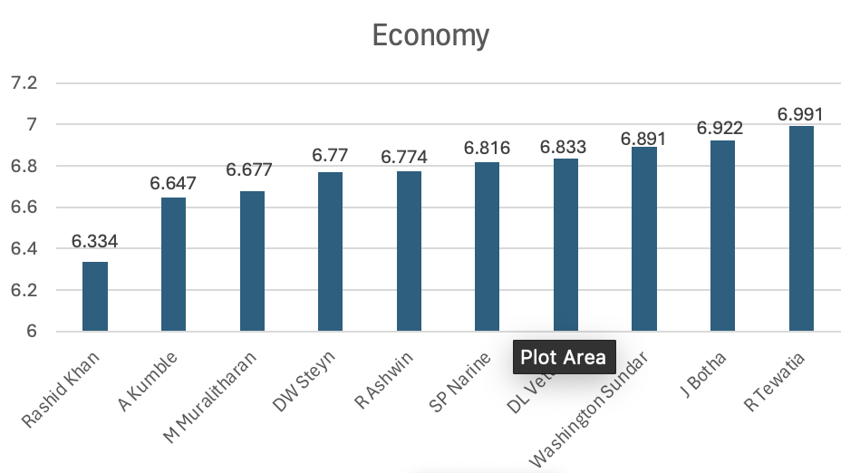

Slide 20
TASK 5- BOWLERS WITH BEST STRIKE RATE
SELECT bowler,
COUNT(ball) AS total_balls_bowled,
SUM(is_wicket) AS total_wickets_taken,
ROUND(COUNT(ball) / NULLIF(SUM(is_wicket), 0), 1) AS strike_rate
FROM IPL_Ball
GROUP BY bowler
HAVING COUNT(ball) >= 500
ORDER BY strike_rate DESC
LIMIT 10;

Slide 21
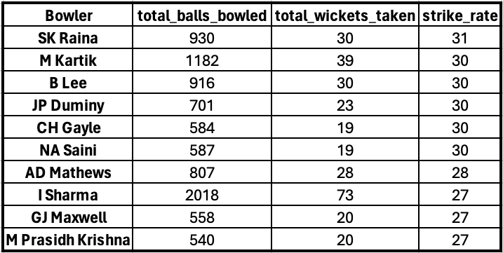
OUTPUT

Slide 22
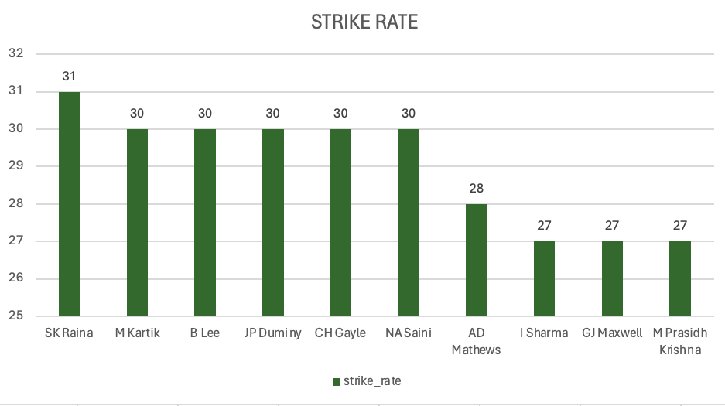

Slide 23
ALLROUNDERS

Slide 24
TASK 6- ALLROUNDERS
SELECT
batsman AS all_rounder,
ROUND((SUM(batsman_runs) * 1.0 / COUNT(ball) * 100), 2) AS bats_strike_rate,
b.bowl_strike_rate
FROM ipl_ball AS a
INNER JOIN (
SELECT
bowler,
COUNT(bowler) AS balls,
SUM(is_wicket) AS total_wicket,
ROUND((COUNT(bowler) * 1.0 / SUM(is_wicket)), 2) AS bowl_strike_rate
FROM ipl_ball
GROUP BY bowler
HAVING COUNT(bowler) > 300
ORDER BY bowl_strike_rate ASC
) AS b ON a.batsman = b.bowler
WHERE NOT extras_type = 'wides'
GROUP BY batsman, b.bowl_strike_rate
HAVING COUNT(ball) >= 500
ORDER BY bats_strike_rate DESC, b.bowl_strike_rate DESC
LIMIT 10;

Slide 25
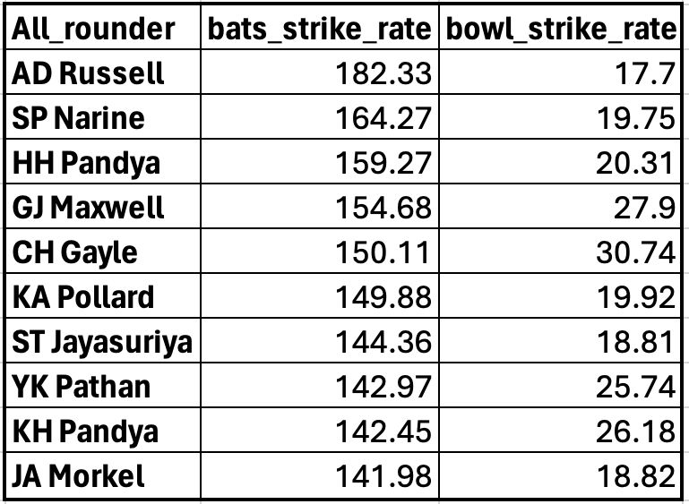
OUTPUT

Slide 26
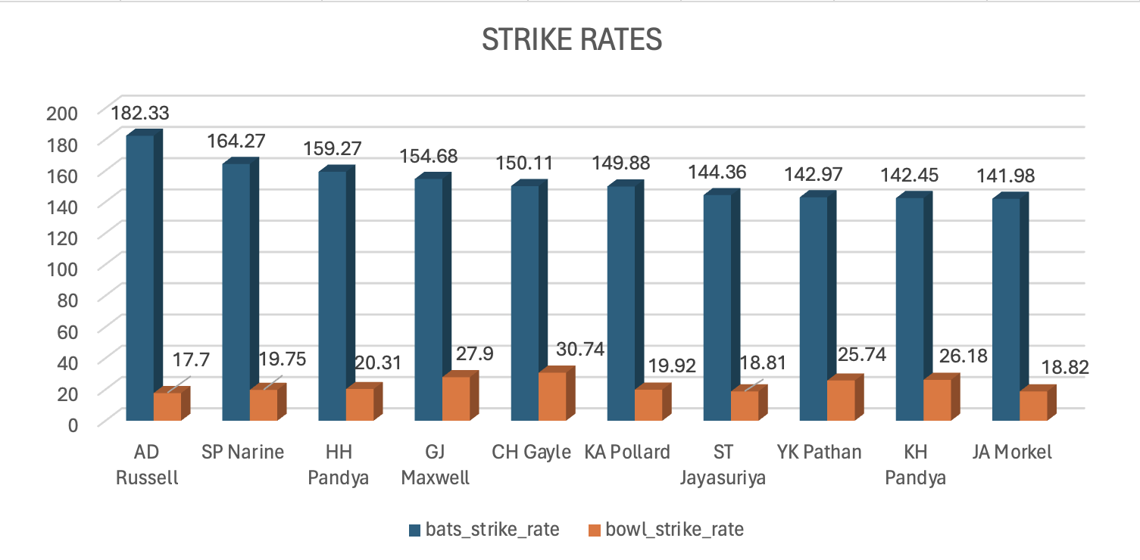

Slide 27
WICKET KEEPERS

Slide 28
TASK 7- WICKET KEEPERS
SELECT fielder AS wicketkeeper,
COUNT(*) AS stumpings_count
FROM IPL_Ball
WHERE dismissal_kind = 'stumped' AND fielder IS NOT NULL
GROUP BY fielder
ORDER BY stumpings_count DESC
LIMIT 1;

Slide 29
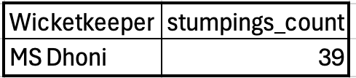
OUTPUT

Slide 30
ADDITIONAL QUESTIONS

Slide 31
1 . Get the count of cities that have hosted an IPL match
SELECT COUNT(DISTINCT city) AS count_of_cities
FROM IPL_Matches;

Slide 32
2 . Create table deliveries_v02 with all the columns of the table ‘deliveries’ and an additional column ball_result containing values boundary, dot or other depending on the total_run
CREATE TABLE deliveries_v02 AS
SELECT *,
CASE
WHEN total_runs >= 4 THEN 'boundary'
WHEN total_runs = 0 THEN 'dot'
ELSE 'other'
END AS ball_result
FROM IPL_Ball;

Slide 33
3 . Write a query to fetch the total number of boundaries and dot balls from the deliveries_v02 table.
SELECT
COUNT(CASE WHEN ball_result = 'boundary' THEN 1 END) AS total_boundaries,
COUNT(CASE WHEN ball_result = 'dot' THEN 1 END) AS total_dot_balls
FROM deliveries_v02;

Slide 34
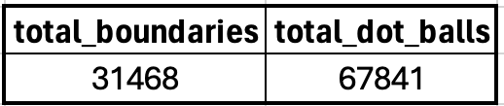
OUTPUT

Slide 35
4 . Write a query to fetch the total number of boundaries scored by each team from the deliveries_v02 table and order it in descending order of the number of boundaries scored.
SELECT batting_team,
COUNT(CASE WHEN ball_result = 'boundary' THEN 1 END) AS total_boundaries
FROM deliveries_v02
GROUP BY batting_team
ORDER BY total_boundaries DESC;

Slide 36
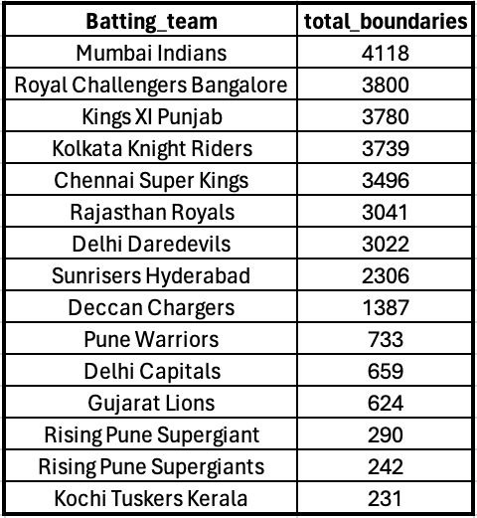
OUTPUT

Slide 37
5 . Write a query to fetch the total number of dot balls bowled by each team and order it in descending order of the total number of dot balls bowled.
SELECT bowling_team,
COUNT(CASE WHEN ball_result = 'dot' THEN 1 END) AS total_dot_balls
FROM deliveries_v02
GROUP BY bowling_team
ORDER BY total_dot_balls DESC;

Slide 38
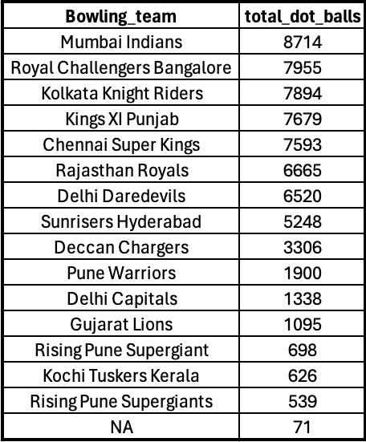
OUTPUT

Slide 39
6 . Write a query to fetch the total number of dismissals by dismissal kinds where dismissal kind is not NA
SELECT dismissal_kind,
COUNT(*) AS total_dismissals
FROM deliveries_v02
WHERE dismissal_kind <> 'NA'
GROUP BY dismissal_kind;

Slide 40
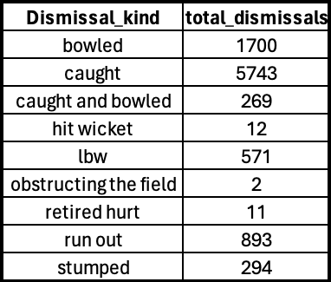
OUTPUT

Slide 41
7 . Write a query to get the top 5 bowlers who conceded maximum extra runs from the deliveries table
SELECT bowler,
SUM(extra_runs) AS total_extra_runs
FROM IPL_Ball
GROUP BY bowler
ORDER BY total_extra_runs DESC
LIMIT 5;

Slide 42
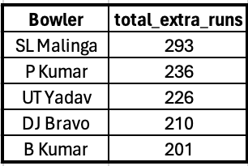
OUTPUT

Slide 43
8 . Write a query to create a table named deliveries_v03 with all the columns of deliveries_v02 table and two additional column (named venue and match_date) of venue and date from table matches
CREATE TABLE deliveries_v03 AS
SELECT dv02.*, im.venue, im.date AS match_date
FROM deliveries_v02 AS dv02
JOIN IPL_Matches AS im ON dv02.id = im.id;

Slide 44
9 . Write a query to fetch the total runs scored for each venue and order it in the descending order of total runs scored.
SELECT venue,
SUM(batsman_runs) AS total_runs_scored
FROM deliveries_v03
GROUP BY venue
ORDER BY total_runs_scored DESC;

Slide 45
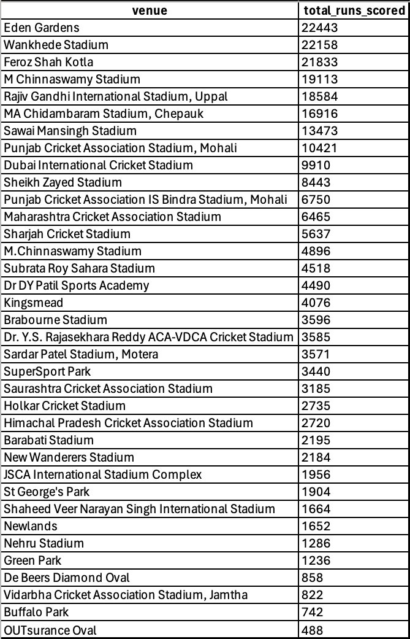
OUTPUT

Slide 46
10 . Write a query to fetch the year-wise total runs scored at Eden Gardens and order it in the descending order of total runs scored.
SELECT EXTRACT(YEAR FROM match_date) AS year,
venue,
SUM(batsman_runs) AS total_runs_scored
FROM deliveries_v03
WHERE venue = 'Eden Gardens'
GROUP BY year, venue
ORDER BY total_runs_scored DESC;

Slide 47
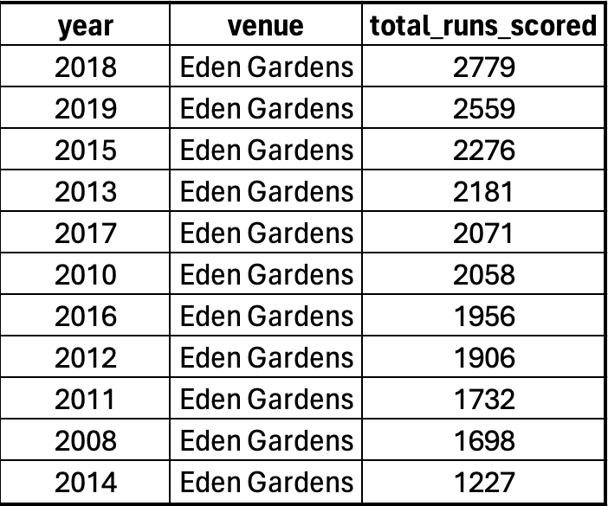
OUTPUT

Slide 48
THE END

