Slide 1


SMART INDIA HACKATHON 2026
TITLE PAGE
Problem Statement ID - SIH26179
Problem Statement Title - AI Powered Retail Intelligence Platform
Theme - Miscellaneous
PS Category- Hardware
Team Name - TECH TITANS

Slide 2
SMART RETAIL INTELLIGENCE
TECH TITANS
Proposed Solution
SENSE:
Shopper analytics
Queue monitoring
Inventory Visibility
PREDICT:
Stock-out Prediction
Anomaly Detection
Queue Congestion
Prediction
PRIORITIZE:
Risk Classification
Impact Prioritization
Critical Risk Detection
ACT:
Automated Alerts
AI Recommendations
Manager Action
KEY INNOVATION:
Prediction → Decision → Action

Slide 3
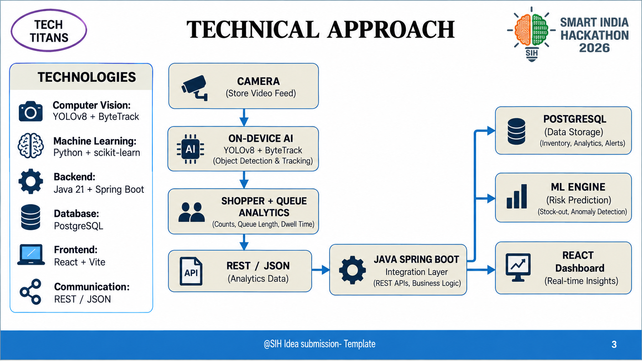
TECHNICAL APPROACH
TECH TITANS

Slide 4
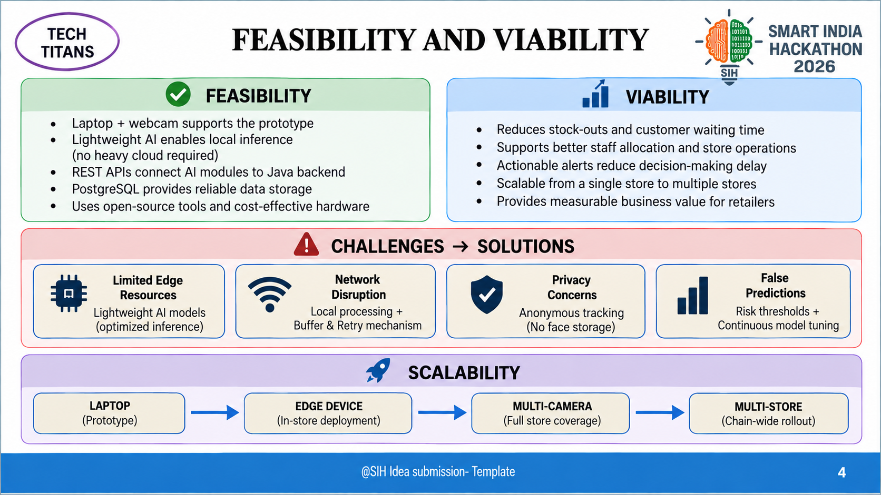
FEASIBILITY AND VIABILITY
TECH TITANS

Slide 5
IMPACT AND BENEFITS
TECH TITANS
Real-Time Data → AI Insights → Early Risk Detection
→ Prioritized Action → Better Operations
→ Better Customer Experience
INVENTORY
Reduce Stock-outs
CUSTOMER
Reduce Waiting Time
STAFFING
Better Staff Allocation
OPERATIONS
Faster Decisions
PRIVACY
Anonymous Tracking

Slide 6
RESEARCH AND REFERENCES
TECH TITANS
RESEARCH BASIS
AI-Driven Inventory Intelligence for
Large-Scale Retail Operations
Prasanna Kumar Natta
IJAESIT, Volume 5, Issue 2, 2022
DOI: 10.15662/IJAESIT.2022.0502002
TECHNICAL REFERENCES
• Qualcomm – Intelligent In-Store Retail
• Ultralytics – YOLOv8
• Spring Boot Documentation
• PostgreSQL Documentation
• React Documentation

