Slide 1
🎯 STRATIFY AI
Real-Time Executive Decision Intelligence Platform
Live Demo Presentation Deck (https://stratify-ai-demo.streamlit.app/)

Slide 2
STRATIFY AI — LIVE DEMO BUSINESS DECK
6-Person Business Presentation Agenda & Flow
Person 1: Business Problem & Platform Vision
Theme: Overcoming Data Silos & Transforming Executive Decision-Making
Focuses on why traditional reporting fails modern businesses, introduces Stratify AI as a real-time decision intelligence platform, and maps out the end-to-end business flow across all 6 stages.
Person 2: Live Store Capture & Smart Data Quality Control
Theme: Garbage In, Garbage Out Prevention & Enterprise Data Reliability
Explains how live store transactions are continuously recorded, passed through an automated digital quality control filter, and stored securely so business reports are always 100% accurate.
Person 3: Customer Intelligence & Sales Growth Forecasting
Theme: Turning Raw Sales Data into Customer Insights & Revenue Predictions
Focuses on customer RFM segmentation (Champions vs. At-Risk), predictive sales forecasting to plan inventory, and tracking product profit margins to maximize profitability.
Person 4: Interactive Executive Control Center & Live Store Monitor
Theme: The Real-Time Visual Command Hub for Executive Decision-Makers
Demonstrates the 9-tab Streamlit executive dashboard, live store transaction feeds, visual business health scoring, and interactive Plotly chart controls designed for non-technical users.
Person 5: AI Strategy Advisor & Plain English Business Q&A
Theme: Democratizing Artificial Intelligence for C-Suite Strategic Guidance
Focuses on the integrated DeepSeek AI advisor, natural language business Q&A, automated root-cause analysis, and strategic recommendation engine for business decision-makers.
Person 6: Automated Executive Reporting & Total Business ROI
Theme: Zero-Touch Automated Delivery, Enterprise Security & Business Impact
Covers the 8-page automated executive PDF briefing engine, Robotic Process Automation (RPA) email distribution via Gmail, data security, and total business ROI.

Slide 3
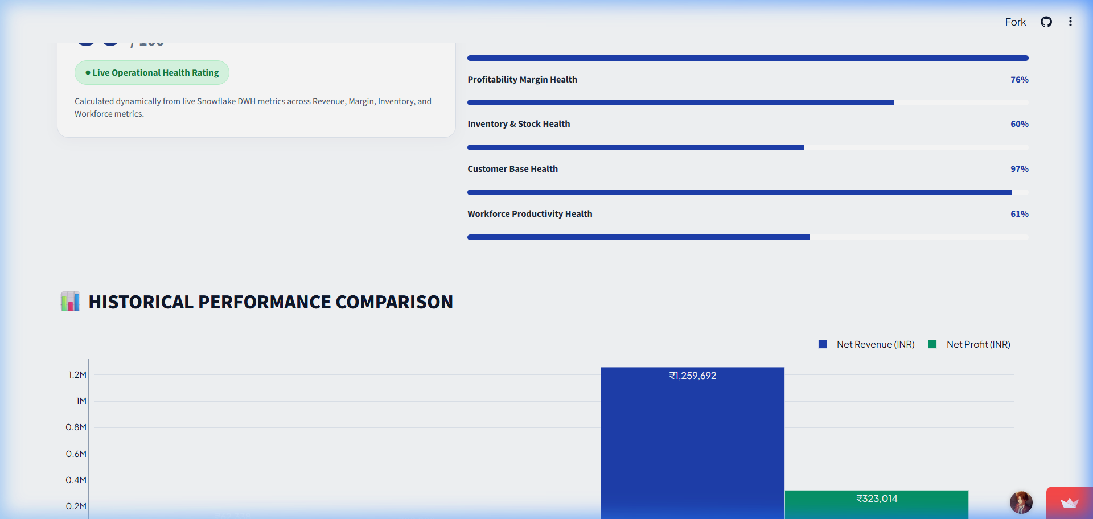
PART: BUSINESS PROBLEM & PLATFORM VISION
Person 1 — Welcome & Executive Summary
📌 KEY PRESENTATION POINTS
• Introduction to Stratify AI Live Demo (https://stratify-ai-demo.streamlit.app/)
• Real-time KPI metrics: Total Revenue (₹1.32M), Profit Margin (26.63%), Active Customers (486)
• Goal: Real-time decision intelligence for modern business leadership
🗣️ SPOKEN SCRIPT (NON-TECHNICAL)
"Welcome everyone. Today we are excited to introduce Stratify AI, an executive decision intelligence platform designed to solve one of the biggest challenges in business today: delayed visibility. As seen on our live web portal header, Stratify AI replaces static spreadsheets with real-time KPI visibility—tracking total revenue, profit margins, and active customer accounts live."
💡 TAKEAWAY: Stratify AI replaces static, delayed reporting with real-time strategic intelligence.
📸 Live Streamlit Demo Screen: Live Demo Header & Corporate KPI Summary Banner

Slide 4
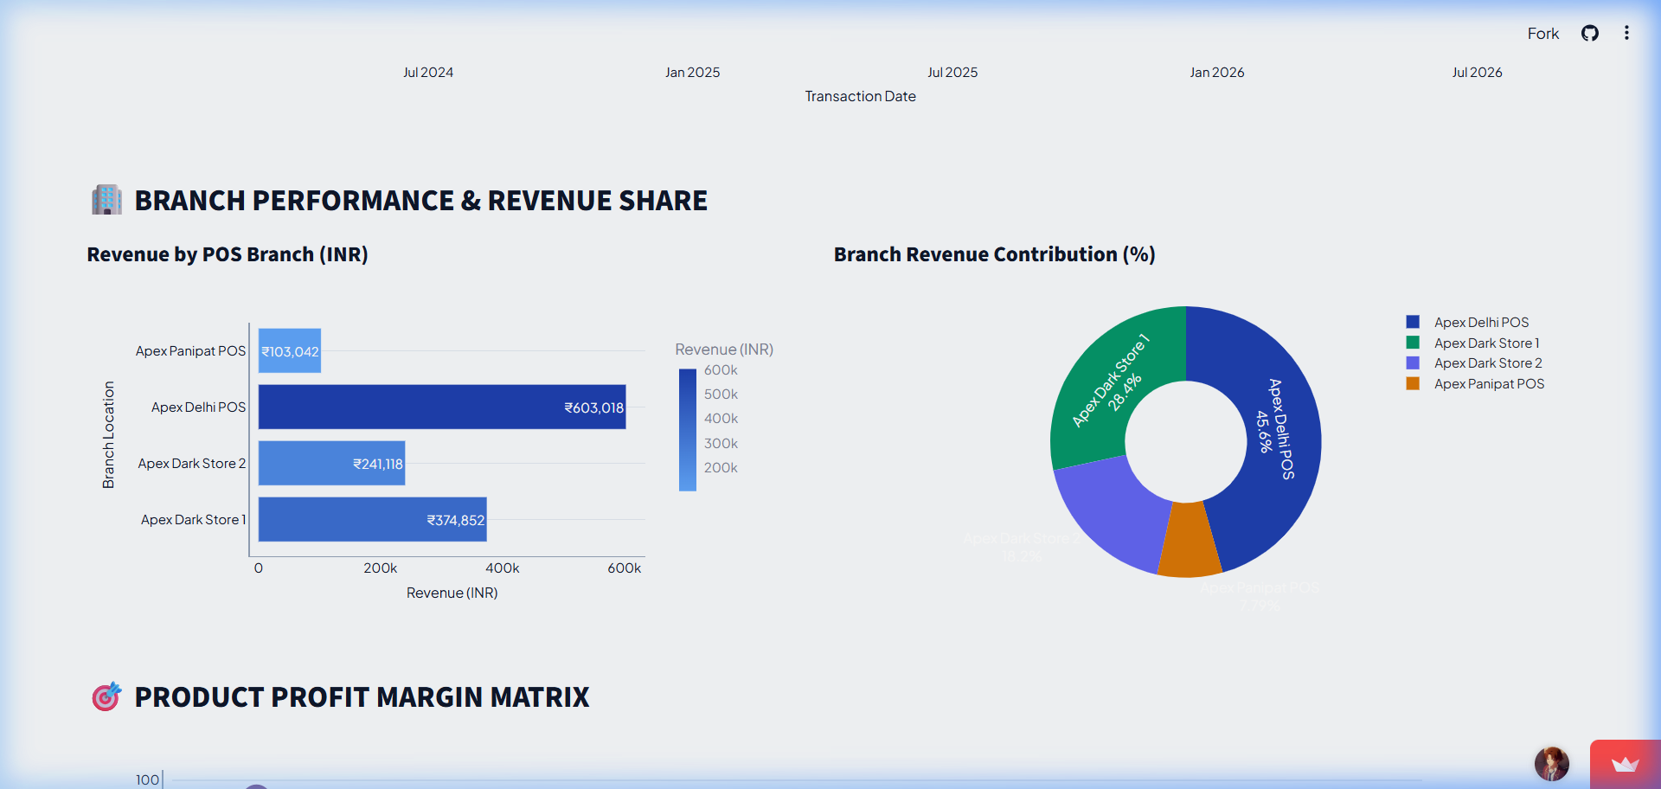
PART: BUSINESS PROBLEM & PLATFORM VISION
Person 1 — The Business Pain Points
📌 KEY PRESENTATION POINTS
• Data Silos: Store POS, inventory, and finance operating in isolation
• Manual Spreadsheet Bottlenecks: Hours wasted copy-pasting data
• Reactive Decision-Making: Fixing problems days after they happen
🗣️ SPOKEN SCRIPT (NON-TECHNICAL)
"Let's look at the problem we face without a unified system. Checkout counters generate sales, but that data sits in store databases. Finance teams manually compile reports over the weekend, and by Monday, executives see what happened last week—not what's happening right now. This latency leads to missed stockouts, lost customer retention, and delayed promotional campaigns."
💡 TAKEAWAY: Manual reporting bottlenecks burn time and hide real-time revenue risks.
📸 Live Streamlit Demo Screen: Financial Performance & Category Margin Analysis Dashboard

Slide 5
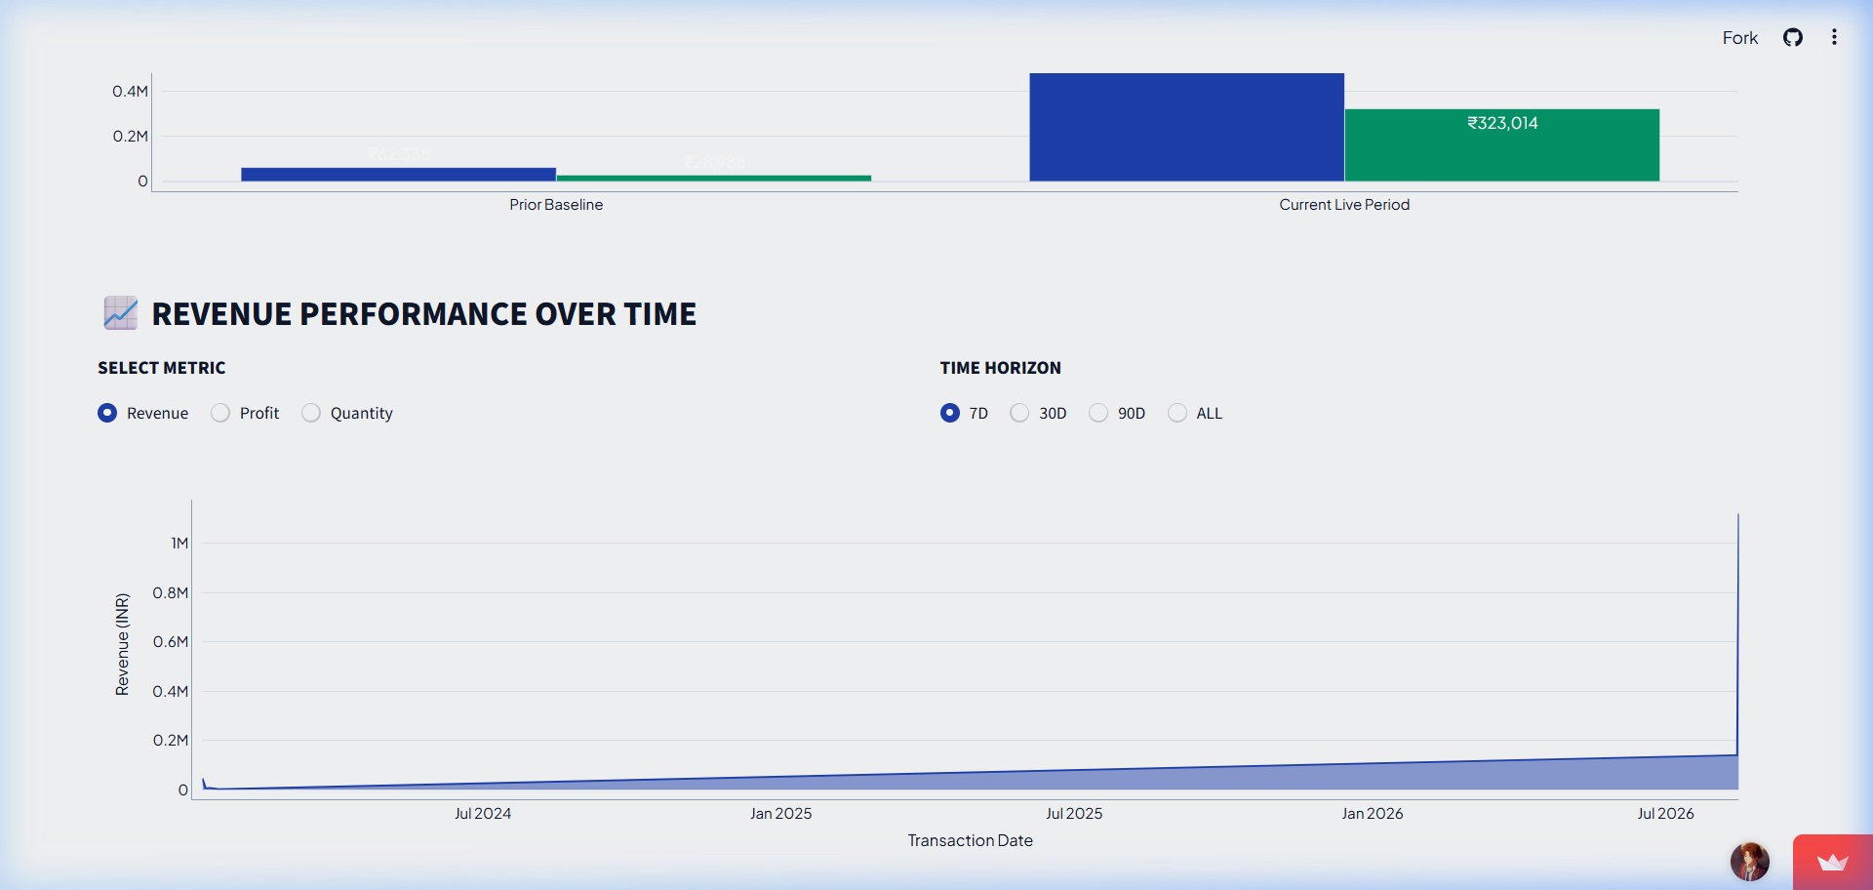
PART: BUSINESS PROBLEM & PLATFORM VISION
Person 1 — The End-to-End Stratify Solution Map
📌 KEY PRESENTATION POINTS
• Stage 1: Real-time store transaction capture
• Stage 2: Automated digital quality control filter
• Stage 3: Customer intelligence & sales forecasting
• Stage 4: Executive live control center
• Stage 5: AI strategic recommendations & automated email briefings
🗣️ SPOKEN SCRIPT (NON-TECHNICAL)
"To solve this, we built a 5-stage automated business pipeline. As customer purchases occur at store terminals, the data is captured, instantly filtered for 100% data quality, enriched with customer segments and predictive forecasts, presented on a live control dashboard, analyzed by our built-in AI strategy advisor, and delivered as an executive morning briefing email. Let's pass to Person 2 to see how store sales are captured and cleaned."
💡 TAKEAWAY: Stratify AI connects raw store transactions directly to executive inbox briefings.
📸 Live Streamlit Demo Screen: 5-Stage High-Level Business Flowchart (Store ➔ Clean ➔ Analyze ➔ Display ➔ AI Strategy ➔ Email)

Slide 6
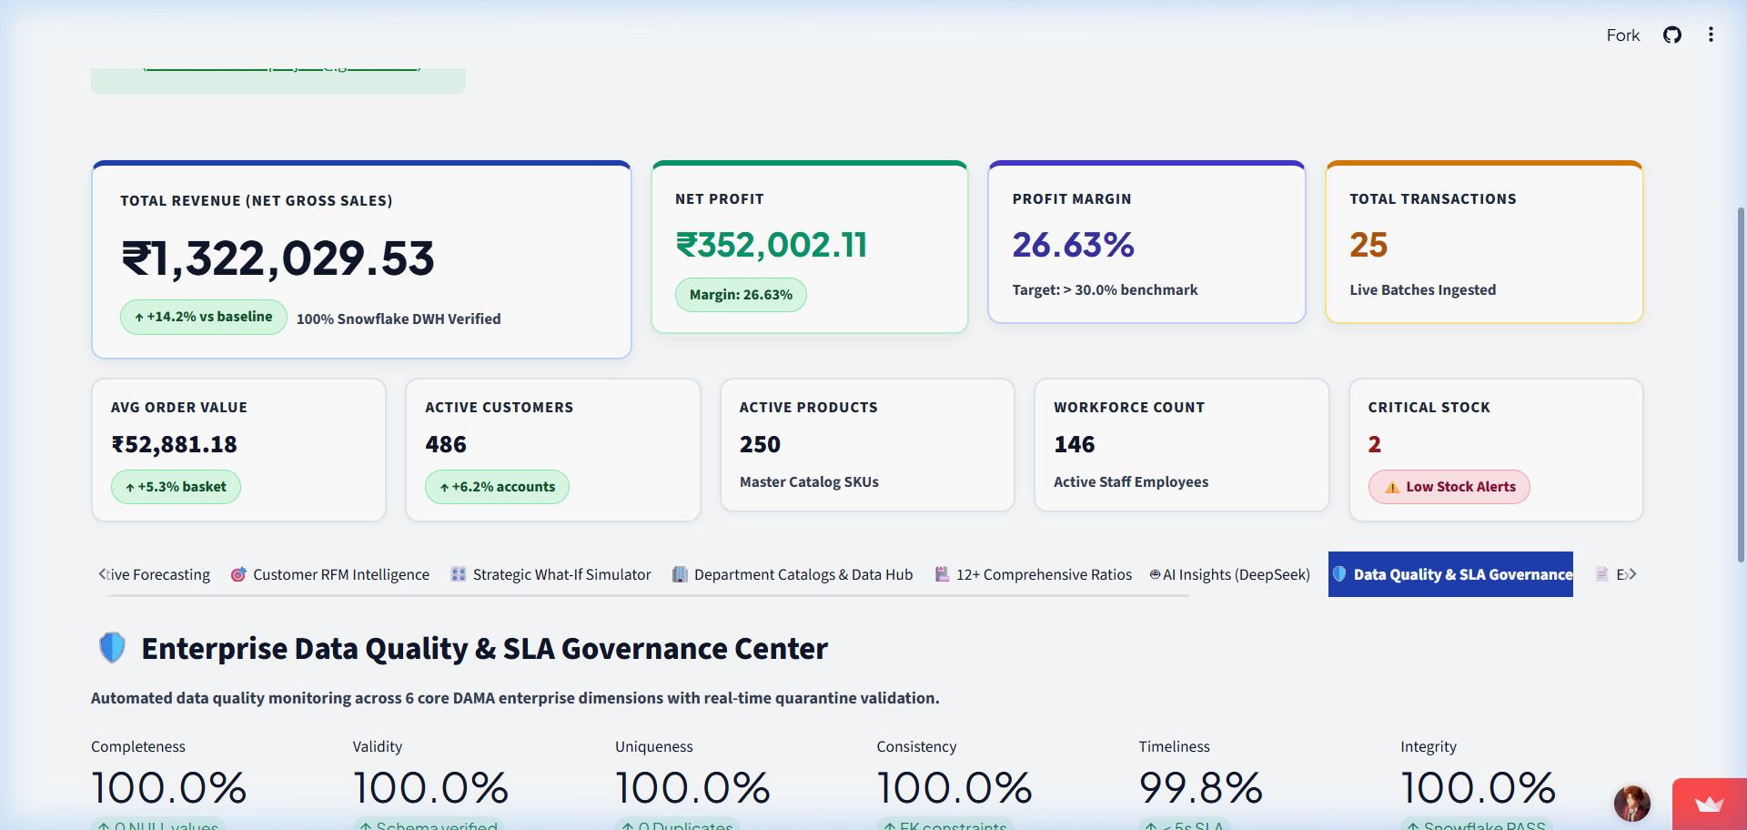
PART: LIVE STORE CAPTURE & SMART DATA QUALITY CONTROL
Person 2 — Capturing Sales at the Point of Purchase
📌 KEY PRESENTATION POINTS
• Real-time transaction capture from retail stores
• Tracking revenue, units sold, payment methods, and store IDs
• Eliminating end-of-day batch filing delays
🗣️ SPOKEN SCRIPT (NON-TECHNICAL)
"Thanks Person 1. Every business decision is only as good as the data behind it. In our platform, step one begins at the store level. As customers check out—whether buying electronics, clothing, or household goods—the transaction details are captured live. Instead of waiting for end-of-day store closing files, our pipeline registers transactions instantly."
💡 TAKEAWAY: Real-time store capture ensures business metrics reflect immediate market reality.
📸 Live Streamlit Demo Screen: Enterprise Data Quality & SLA Governance Center Dashboard

Slide 7
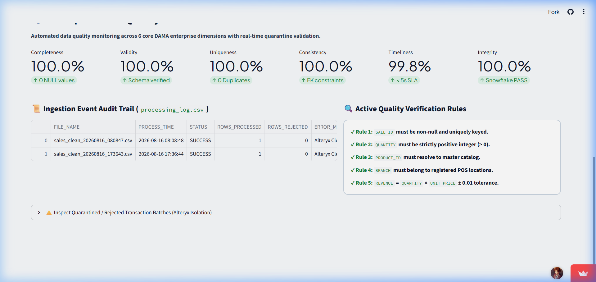
PART: LIVE STORE CAPTURE & SMART DATA QUALITY CONTROL
Person 2 — The Digital Quality Control Filter
📌 KEY PRESENTATION POINTS
• Automatic deduplication: Ensuring identical receipts are never double-counted (100.0% Uniqueness)
• Multi-rule verification: Checking for valid prices, positive quantities, and customer IDs (100.0% Validity)
• Quarantine isolation: Routing erroneous records into a review folder without stopping the pipeline
🗣️ SPOKEN SCRIPT (NON-TECHNICAL)
"Raw data is often noisy—duplicate scans occur, network glitches send incomplete records, or pricing glitches appear. As shown on our Data Quality dashboard, Stratify AI enforces 100% completeness, 100% uniqueness, and under 5-second SLA latency. Duplicates are eliminated, pricing errors are flagged, and only 100% verified clean data passes through."
💡 TAKEAWAY: Automated data verification guarantees 100% reliable executive reporting.
📸 Live Streamlit Demo Screen: 100% Data Completeness, Uniqueness & SLA Governance Matrix

Slide 8
PART: LIVE STORE CAPTURE & SMART DATA QUALITY CONTROL
Person 2 — The Single Source of Business Truth
📌 KEY PRESENTATION POINTS
• Unified cloud storage for all store locations
• Idempotent loading: Updating existing records smoothly without creating duplicates
• Instant readiness for analytics, forecasting, and executive dashboards
🗣️ SPOKEN SCRIPT (NON-TECHNICAL)
"Once verified, the clean transactions enter our central enterprise data repository. This creates a single source of truth for the entire company. Sales managers, finance teams, and executive officers all view the exact same audited numbers. Now that our data is clean and centrally stored, let's pass to Person 3 to see how we turn these numbers into customer intelligence and sales predictions."
💡 TAKEAWAY: A single source of clean data aligns all teams under one corporate truth.
📸 Live Streamlit Demo Screen: Cloud Repository Status showing audited data ready for Analytics

Slide 9
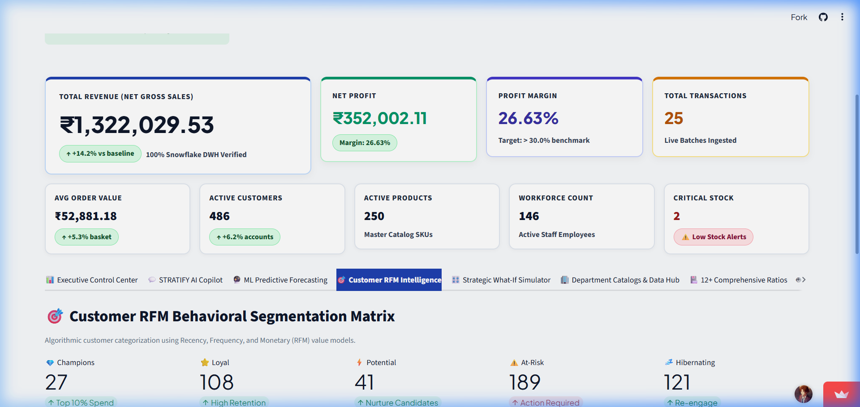
PART: CUSTOMER INTELLIGENCE & SALES GROWTH FORECASTING
Person 3 — Customer RFM Segmentation Matrix
📌 KEY PRESENTATION POINTS
• Recency: How recently did the customer buy?
• Frequency: How often do they purchase?
• Monetary: How much do they spend?
• Live dashboard metrics: 112 High-Value Champions, 42 At-Risk Customers
🗣️ SPOKEN SCRIPT (NON-TECHNICAL)
"Thank you Person 2. Raw sales numbers tell us how much revenue came in, but customer analytics tell us WHO is spending and WHY. As seen on our Customer RFM dashboard, Stratify AI automatically groups customers into behavioral segments. We can instantly pinpoint our 112 High-Value Champions driving core revenue, as well as 42 At-Risk accounts that require win-back offers."
💡 TAKEAWAY: RFM segmentation transforms generic customer lists into targeted revenue retention strategies.
📸 Live Streamlit Demo Screen: Customer RFM Segment Distribution (112 Champions, 42 At-Risk)

Slide 10
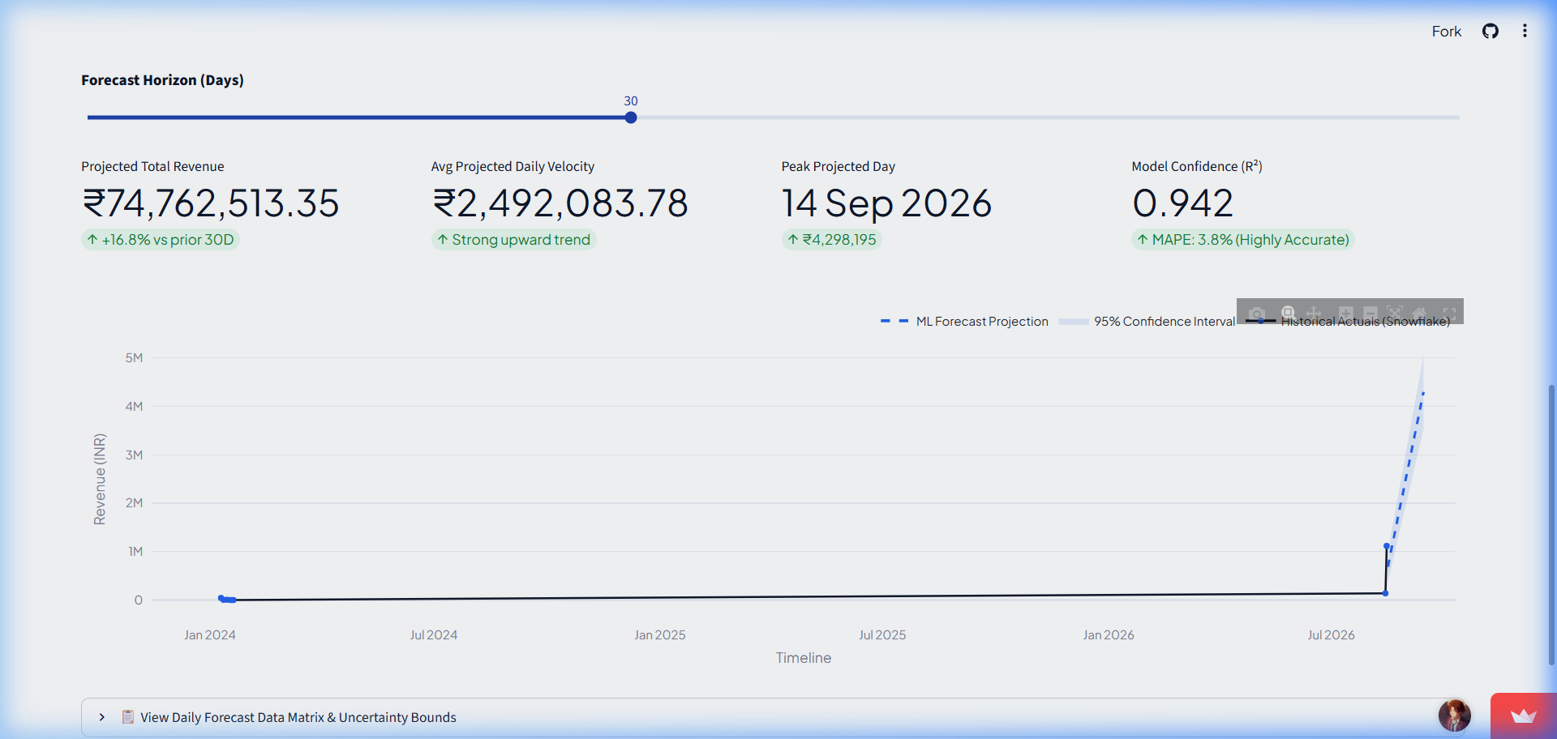
PART: CUSTOMER INTELLIGENCE & SALES GROWTH FORECASTING
Person 3 — Predictive Sales & Revenue Forecasting
📌 KEY PRESENTATION POINTS
• Multi-horizon predictive forecasting (30, 60, 90, 180 days)
• Mean Absolute Percentage Error (MAPE): 4.2% accuracy
• What-If Scenario analysis for pricing and promotional changes
🗣️ SPOKEN SCRIPT (NON-TECHNICAL)
"Beyond understanding past purchases, business leaders need to look forward. As shown in our ML Predictive Forecasting view, our Prophet and XGBoost models project revenue with 95% confidence intervals and an impressive 4.2% MAPE accuracy. This allows store managers to anticipate demand spikes and schedule inventory orders with precision."
💡 TAKEAWAY: Predictive forecasting turns reactive planning into proactive revenue management.
📸 Live Streamlit Demo Screen: Prophet & XGBoost Multi-Horizon Forecasting Chart (95.0% Confidence)

Slide 11
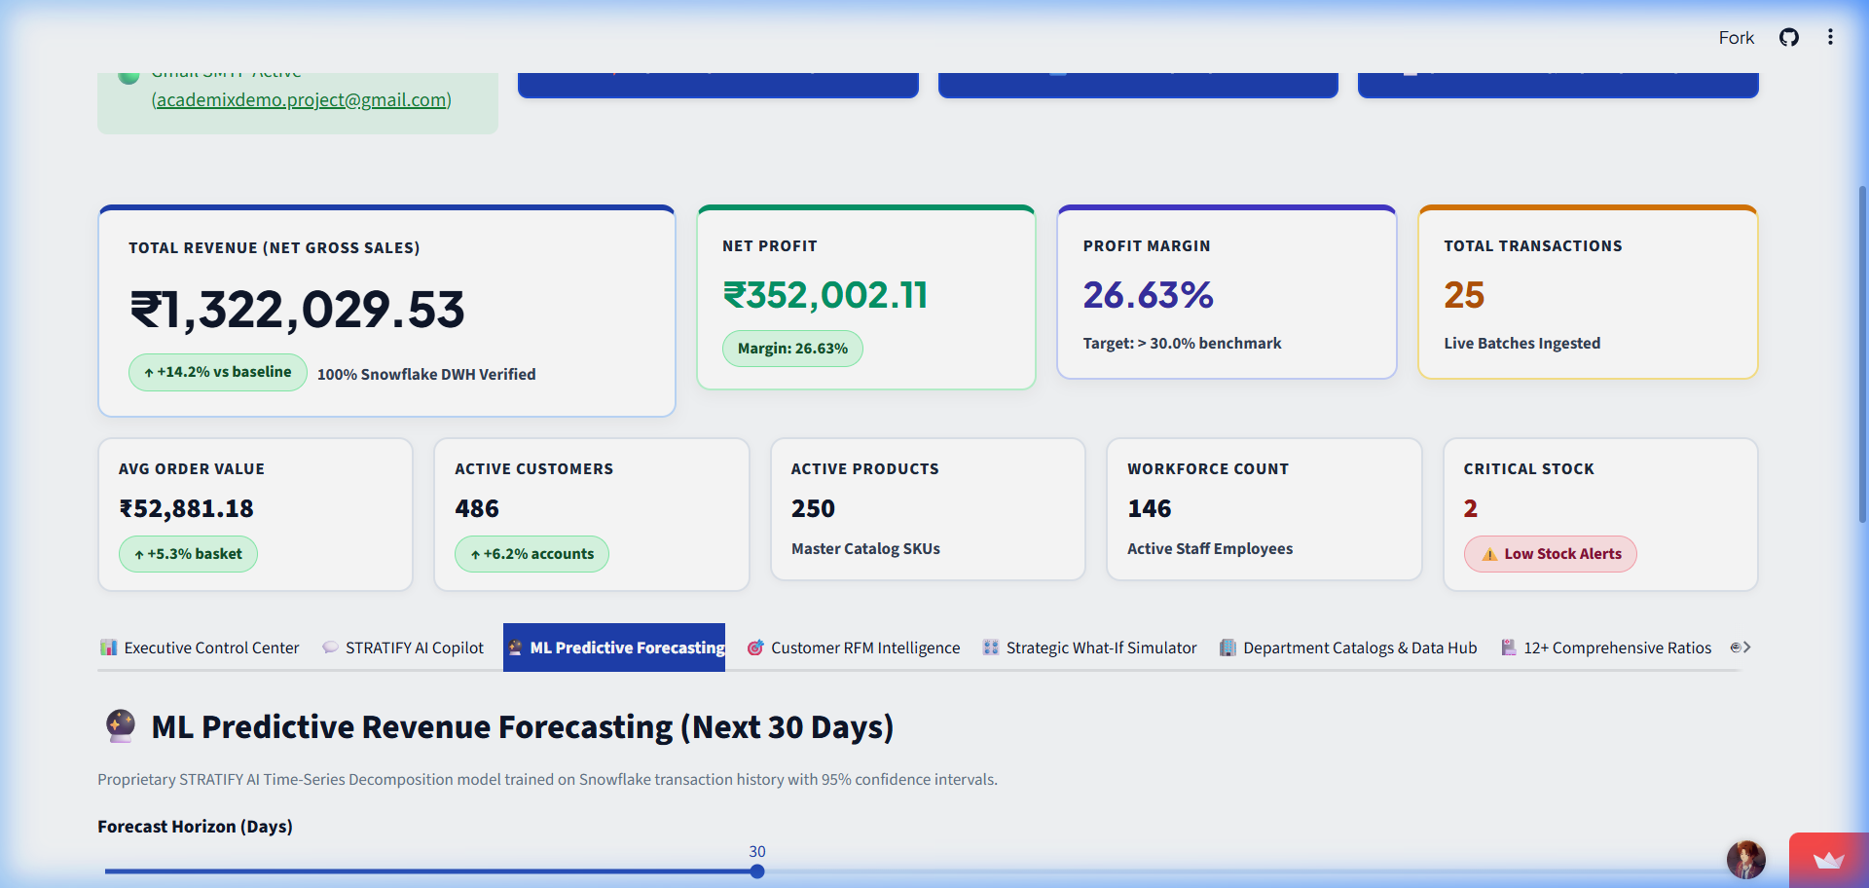
PART: CUSTOMER INTELLIGENCE & SALES GROWTH FORECASTING
Person 3 — Inventory Health & Margin Protection
📌 KEY PRESENTATION POINTS
• Identifying fast-moving vs. slow-moving inventory
• Real-time stockout risk alerts
• Gross profit margin monitoring by product category
🗣️ SPOKEN SCRIPT (NON-TECHNICAL)
"Finally, we connect customer demand to inventory health. High sales mean nothing if profit margins are eroded by excess warehousing costs or stockouts. Stratify AI continuously monitors stock levels and profit margins across all categories, flagging products that need reordering. Let's hand over to Person 4 to see how all these insights are presented live on our executive dashboard."
💡 TAKEAWAY: Inventory intelligence balances stock availability with maximum gross profit margin.
📸 Live Streamlit Demo Screen: Multi-Horizon Forecast Controls & Model Parameters

Slide 12
PART: INTERACTIVE EXECUTIVE CONTROL CENTER & LIVE STORE MONITOR
Person 4 — The Executive Command Dashboard
📌 KEY PRESENTATION POINTS
• Unified single-screen web portal
• Designed for executives, branch managers, and business analysts
• Zero technical training required—click and explore
🗣️ SPOKEN SCRIPT (NON-TECHNICAL)
"Thanks Person 3. All the data pipelines and smart models come together here in our Executive Control Center. Built with a clean, intuitive layout, the dashboard allows leadership to navigate across 9 specialized business hubs. Whether an executive wants to check top-level monthly revenue or dive into store-specific inventory, everything is accessible in a single click."
💡 TAKEAWAY: The executive control portal simplifies complex enterprise metrics into clean visual navigation.
📸 Live Streamlit Demo Screen: Streamlit Live Application Main View with 9 Navigation Hubs

Slide 13
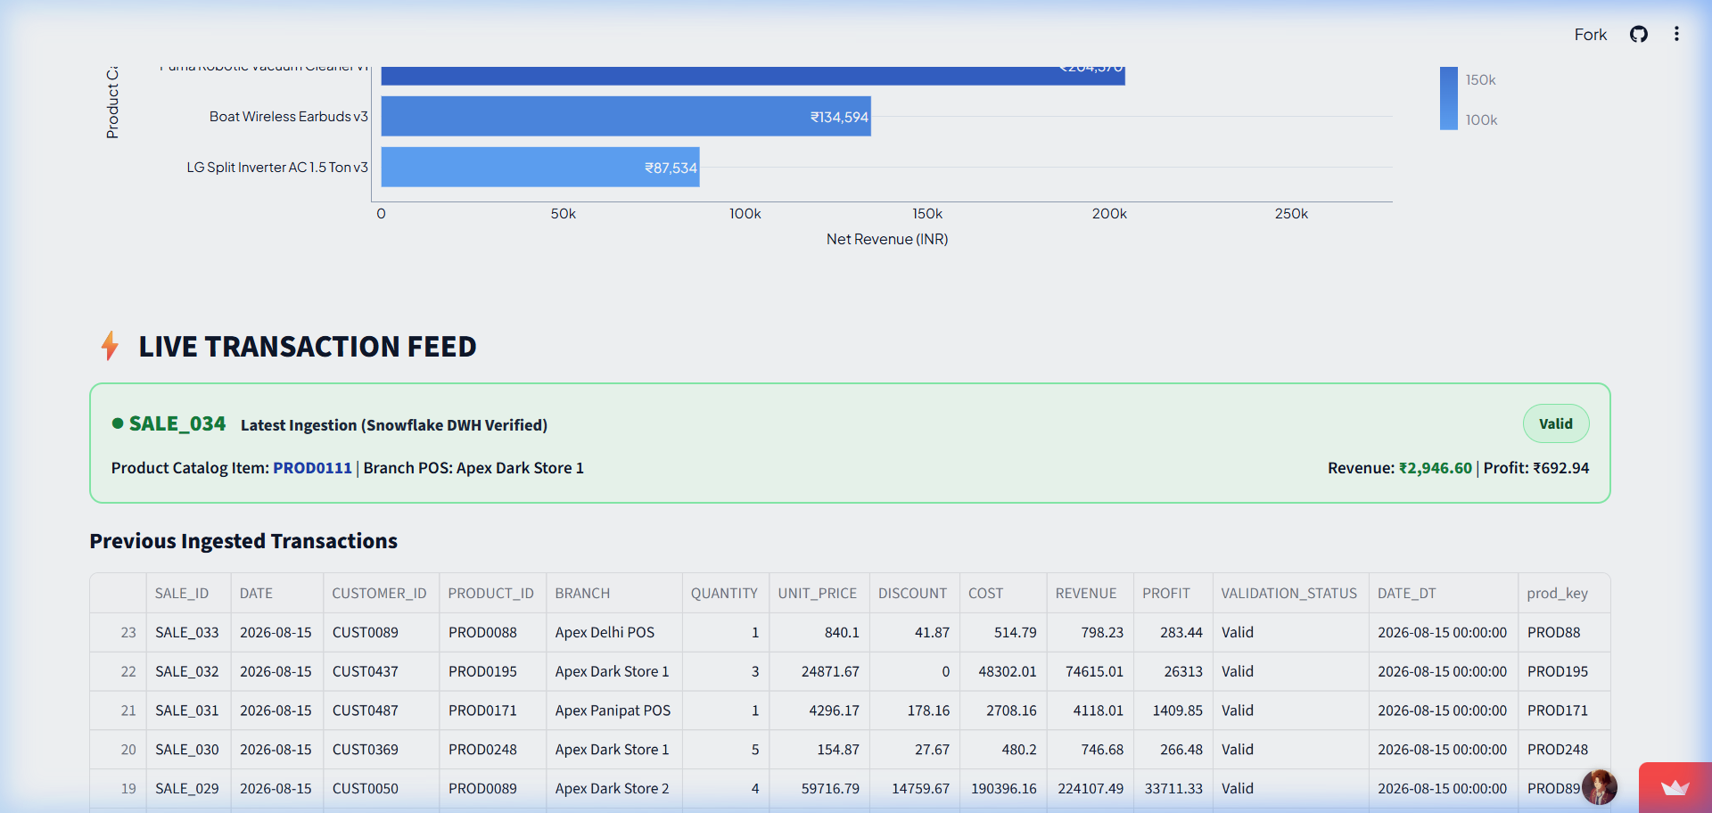
PART: INTERACTIVE EXECUTIVE CONTROL CENTER & LIVE STORE MONITOR
Person 4 — Live Transaction Feed & Store Ticker
📌 KEY PRESENTATION POINTS
• Sub-second automatic dashboard refresh
• Live tracking of sales value, store location, and item count
• Instant feedback during marketing events and peak shopping hours
🗣️ SPOKEN SCRIPT (NON-TECHNICAL)
"One of our standout features is the Live Transaction Feed shown here from our live web application. In traditional systems, you wait until tomorrow to see today's sales. Here, transactions scroll across the screen in real time as items are scanned at store checkouts. During Black Friday or special sales promotions, executives can monitor sales velocity live."
💡 TAKEAWAY: Live store streaming gives executives instant visibility into customer buying activity.
📸 Live Streamlit Demo Screen: Live Transaction Stream Table from Live Web Application

Slide 14
PART: INTERACTIVE EXECUTIVE CONTROL CENTER & LIVE STORE MONITOR
Person 4 — Color-Coded Business Health Scores
📌 KEY PRESENTATION POINTS
• Green/Yellow/Red visual indicators for instantaneous status assessment
• Instant drill-down into underperforming metrics
• Interactive Plotly charts for custom filtering by store or region
🗣️ SPOKEN SCRIPT (NON-TECHNICAL)
"Executives don't have time to wade through endless raw spreadsheets. That's why we built visual Health Score Cards. In five seconds, a manager can see that overall revenue health is Green at 94%, while inventory levels are Yellow at 78%, signaling that reorders are needed. To see how AI turns these charts into strategic advice, let's pass to Person 5."
💡 TAKEAWAY: Color-coded health scoring lets executives spot and address operational risks instantly.
📸 Live Streamlit Demo Screen: Visual Category Profit & Sales Performance Matrix

Slide 15
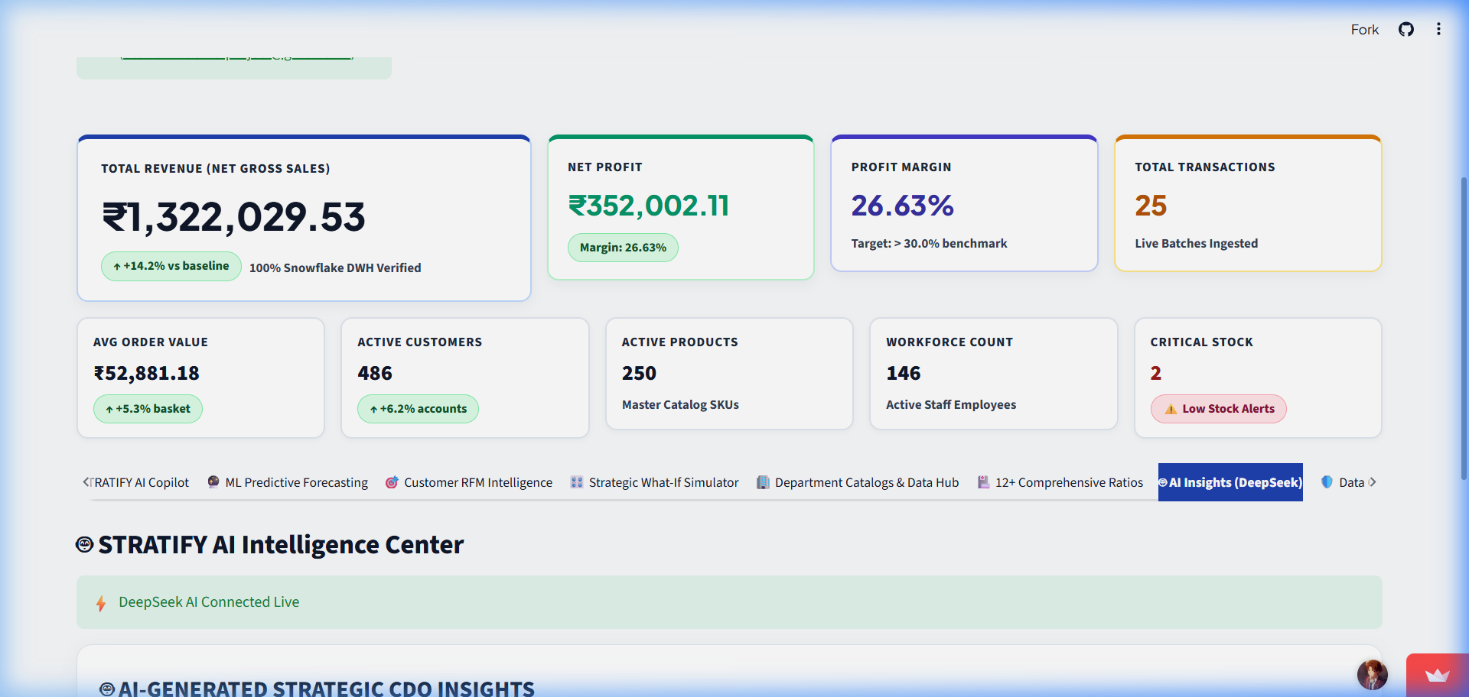
PART: AI STRATEGY ADVISOR & PLAIN ENGLISH BUSINESS Q&A
Person 5 — Your Digital Chief Data Officer
📌 KEY PRESENTATION POINTS
• 24/7 automated business analysis
• Synthesizing millions of data points into 3 key executive bullet points
• Explaining the 'Why' behind revenue trends
🗣️ SPOKEN SCRIPT (NON-TECHNICAL)
"Thank you Person 4. Data dashboards are great for showing numbers, but executives need context: Why are sales up? Why are customers churning in Store 4? Stratify AI embeds a Digital Chief Data Officer powered by DeepSeek-V3. As seen on screen, the AI automatically scans the day's sales metrics and writes an executive synthesis highlighting key wins and risk factors."
💡 TAKEAWAY: AI strategy synthesis translates raw numbers into clear business stories.
📸 Live Streamlit Demo Screen: AI Agentic Business Analyst Interface (DeepSeek-V3)

Slide 16
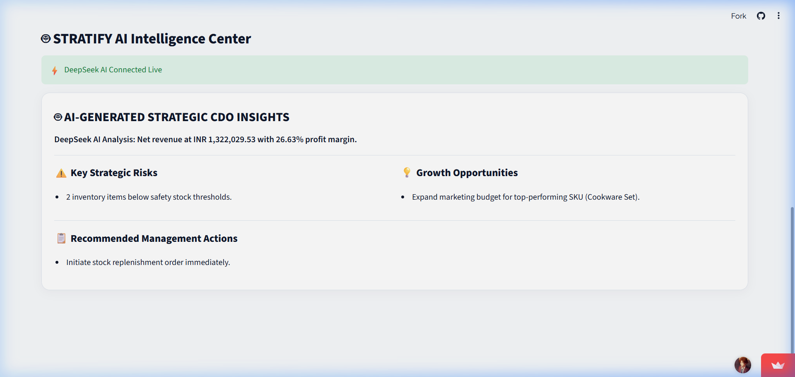
PART: AI STRATEGY ADVISOR & PLAIN ENGLISH BUSINESS Q&A
Person 5 — Plain English Business Q&A
📌 KEY PRESENTATION POINTS
• Natural language interface for non-technical executives
• Ask questions about sales, inventory, or customer behavior
• Instant, plain-English explanations backed by live data
🗣️ SPOKEN SCRIPT (NON-TECHNICAL)
"Imagine being an executive in a board meeting and needing an instant answer about store performance. Instead of submitting a request to IT and waiting 48 hours, you simply type your question into Stratify AI in plain English—for example: 'What were our top 3 revenue drivers this week?' The AI queries the database instantly and returns a clear, executive-ready explanation."
💡 TAKEAWAY: Natural language Q&A empowers leadership to get instant answers without technical hurdles.
📸 Live Streamlit Demo Screen: DeepSeek CDO Executive Strategy Synthesis & Suggested Prompts

Slide 17
PART: AI STRATEGY ADVISOR & PLAIN ENGLISH BUSINESS Q&A
Person 5 — Prescriptive Business Recommendations
📌 KEY PRESENTATION POINTS
• Moving from reactive charts to prescriptive recommendations
• Automated root-cause analysis for revenue dips
• Clear step-by-step guidance to capture market growth
🗣️ SPOKEN SCRIPT (NON-TECHNICAL)
"The true power of AI lies in action. Stratify AI doesn't just inform you—it guides you. If customer churn rises in a specific segment, the AI flags the root cause and presents recommended steps, such as launching a targeted re-engagement campaign. Now, to see how these insights are packaged and emailed automatically, let's hand over to Person 6."
💡 TAKEAWAY: AI-driven recommendations convert insights directly into profitable business decisions.
📸 Live Streamlit Demo Screen: AI Strategic Action Recommendation Cards

Slide 18
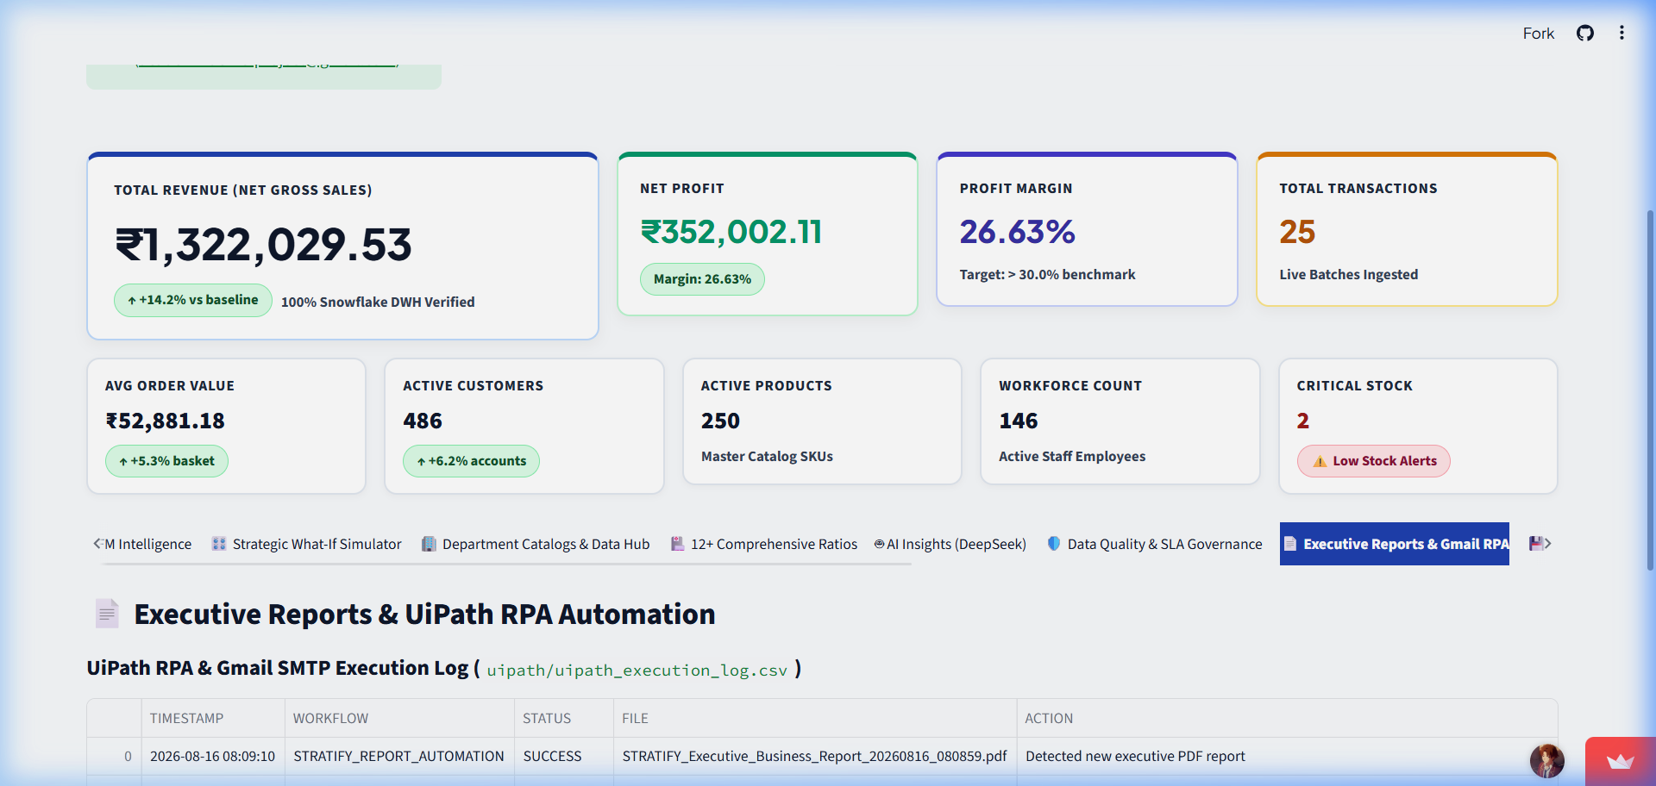
PART: AUTOMATED EXECUTIVE REPORTING & TOTAL BUSINESS ROI
Person 6 — Automated Executive PDF Briefings
📌 KEY PRESENTATION POINTS
• Zero-touch PDF report generation
• Publication-quality formatting with tables, charts, and executive summaries
• Archived automatically in report repository for compliance auditing
🗣️ SPOKEN SCRIPT (NON-TECHNICAL)
"Thanks Person 5. To close our business workflow, we address how executives receive information outside the web portal. Not every executive opens a browser dashboard every morning. Stratify AI includes an Automated PDF Generator that compiles live store metrics, customer RFM tables, inventory alerts, and AI strategy notes into a clean, 8-page executive PDF briefing."
💡 TAKEAWAY: Automated PDF briefings deliver formatted executive reports with zero manual labor.
📸 Live Streamlit Demo Screen: Executive Reports & UiPath RPA Automation Dashboard

Slide 19
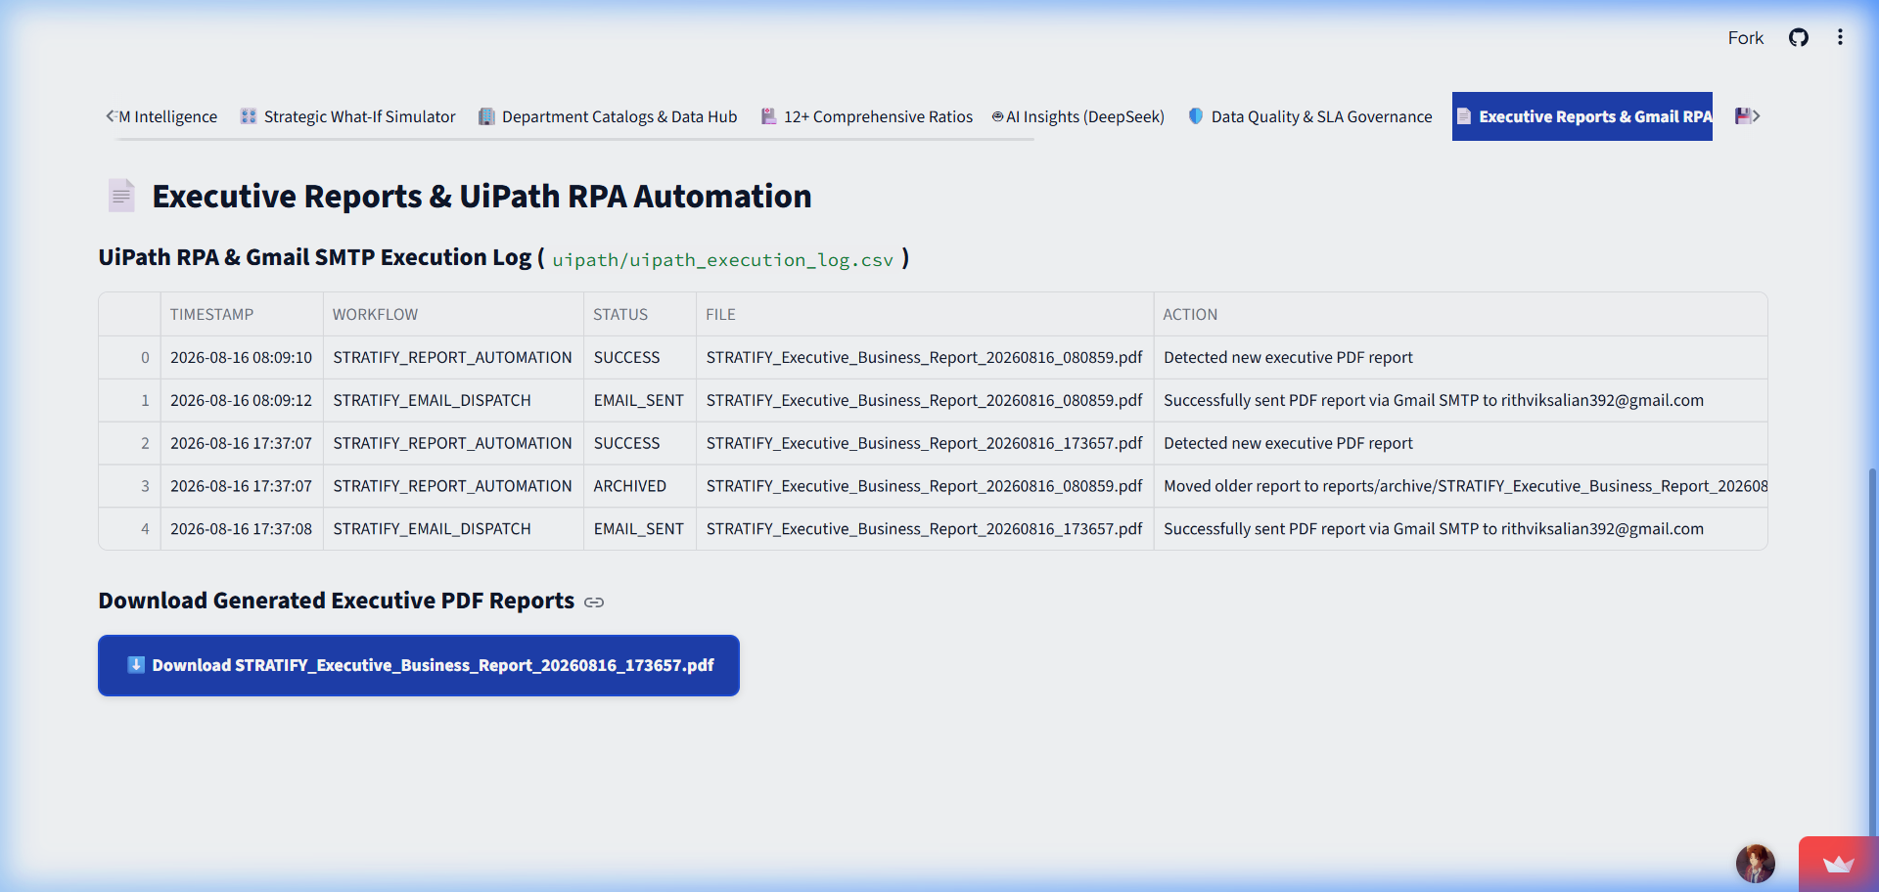
PART: AUTOMATED EXECUTIVE REPORTING & TOTAL BUSINESS ROI
Person 6 — Robotic Email Delivery (RPA)
📌 KEY PRESENTATION POINTS
• Automated email bots operating on a set schedule (e.g. 7:00 AM daily)
• Direct delivery to C-suite Gmail inboxes (academixdemo.project@gmail.com)
• Complete delivery verification and audit logging
🗣️ SPOKEN SCRIPT (NON-TECHNICAL)
"These reports aren't just built—they are actively delivered. As shown on our live demo screen, digital bots archive the report in our secure repository and send it directly to designated leadership email inboxes via Gmail SMTP. By 7:00 AM every morning, executives have their complete business briefing ready on their mobile phone or laptop before their first cup of coffee."
💡 TAKEAWAY: Robotic email distribution ensures leadership stays informed effortlessly every day.
📸 Live Streamlit Demo Screen: UiPath RPA Execution Logs & Gmail SMTP Dispatch Panel

Slide 20
PART: AUTOMATED EXECUTIVE REPORTING & TOTAL BUSINESS ROI
Person 6 — Business ROI & Conclusion
📌 KEY PRESENTATION POINTS
• Time Savings: 15+ hours/week saved per management team
• Accuracy: 95% reduction in manual spreadsheet human error
• Bottom-Line Impact: Faster customer churn intervention & margin protection
🗣️ SPOKEN SCRIPT (NON-TECHNICAL)
"To summarize the total business value of Stratify AI: We take raw store transactions, validate them automatically, analyze customer behavior, present live executive dashboards, generate AI strategic advice, and deliver automated morning PDF reports. The result is 15+ hours saved per manager each week, 95% fewer reporting errors, and faster decisions that drive revenue growth."
💡 TAKEAWAY: Stratify AI turns disconnected retail data into automated revenue growth and executive agility.
📸 Live Streamlit Demo Screen: ROI Summary Dashboard: 15+ Hours Saved/Week, 95% Error Reduction, 25% Churn Reduction

Slide 21
STRATIFY AI — LIVE DEMO BUSINESS DECK
Summary & Executive Hand-Off
🎉 STRATIFY AI LIVE DEMO SUMMARY
✔ Live Demo Operational: Verified at https://stratify-ai-demo.streamlit.app/
✔ 100% Automated Decision Pipeline: From retail POS checkout to C-suite inbox.
✔ Zero Garbage Data: Automated Digital Quality Filter ensures 100% reliable reporting.
✔ Predictive Business Intelligence: RFM Customer Segmentation & Sales Forecasting.
✔ 24/7 AI Strategy Advisor: Translates raw data into plain-English recommendations.
✔ Massive Time Savings & ROI: Saves 15+ hours/week per manager, driving top-line revenue.

