Slide 1
🎯 STRATIFY AI
Real-Time Executive Decision Intelligence Platform
Complete 6-Person Executive Presentation & Business Flow
🌐 Live Demo: https://stratify-ai-demo.streamlit.app/
Notes:
WELCOME & INTRO SCRIPT:
Welcome executives and board members. Today, our team presents Stratify AI—a real-time decision intelligence platform that transforms disconnected store checkout sales into instant strategic clarity. Over the next 30 minutes, 6 presenters will walk you through our complete end-to-end business flow.

Slide 2
STRATIFY AI — EXECUTIVE BUSINESS DECK
Executive Agenda & 6-Person Presentation Flow
Person 1: Business Problem & Platform Vision
Theme: Overcoming Data Silos & Transforming Executive Decision-Making
Focuses on why traditional reporting fails modern businesses, introduces Stratify AI as a real-time decision intelligence platform, and maps out the end-to-end business flow across all 6 stages.
Person 2: Live Store Capture & Smart Data Quality Control
Theme: Garbage In, Garbage Out Prevention & Enterprise Data Reliability
Explains how live store transactions are continuously recorded, passed through an automated digital quality control filter, and stored securely so business reports are always 100% accurate.
Person 3: Customer Intelligence & Sales Growth Forecasting
Theme: Turning Raw Sales Data into Customer Insights & Revenue Predictions
Focuses on customer RFM segmentation (Champions vs. At-Risk), predictive sales forecasting to plan inventory, and tracking product profit margins to maximize profitability.
Person 4: Interactive Executive Control Center & Live Store Monitor
Theme: The Real-Time Visual Command Hub for Executive Decision-Makers
Demonstrates the 9-tab Streamlit executive dashboard, live store transaction feeds, visual business health scoring, and interactive Plotly chart controls designed for non-technical users.
Person 5: AI Strategy Advisor & Plain English Business Q&A
Theme: Democratizing Artificial Intelligence for C-Suite Strategic Guidance
Focuses on the integrated DeepSeek AI advisor, natural language business Q&A, automated root-cause analysis, and strategic recommendation engine for business decision-makers.
Person 6: Automated Executive Reporting & Total Business ROI
Theme: Zero-Touch Automated Delivery, Enterprise Security & Business Impact
Covers the 8-page automated executive PDF briefing engine, Robotic Process Automation (RPA) email distribution via Gmail, data security, and total business ROI.
Notes:
AGENDA SCRIPT:
Here is our 6-stage presentation map. Person 1 introduces the business vision; Person 2 details live store capture and automated data quality; Person 3 presents customer segmentation and forecasting; Person 4 demonstrates the executive dashboard; Person 5 showcases our AI Strategy Advisor; and Person 6 closes with automated reporting and ROI.

Slide 3
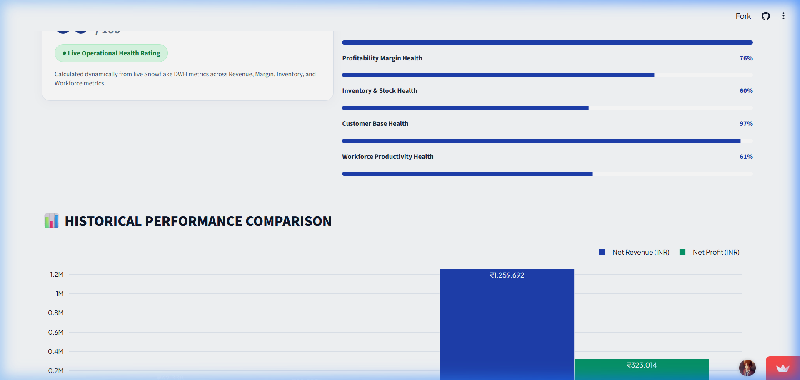
PERSON 1 — BUSINESS PROBLEM & PLATFORM VISION
Welcome & Executive Summary
📌 KEY EXECUTIVE INSIGHTS
• <b>Live Decision Command Center</b>: Single-screen visibility across all retail locations
• <b>Real-Time KPI Visibility</b>: Live Total Revenue (₹1.32M), Net Margin (26.63%), 486 Active Customers
• <b>Executive Clarity</b>: Replacing static, delayed spreadsheets with continuous intelligence
💡 BUSINESS TAKEAWAY
Stratify AI replaces static, delayed reporting with real-time strategic intelligence.
📸 Live Streamlit Demo Screen: Live Demo Header & Corporate KPI Summary Banner
Notes:
=== PRESENTER NOTES (Person 1 - Slide 1) ===
🗣️ SPOKEN SCRIPT:
"Welcome everyone. Today we are excited to introduce Stratify AI, an executive decision intelligence platform designed to solve one of the biggest challenges in business today: delayed visibility. As seen on our live web portal header, Stratify AI replaces static spreadsheets with real-time KPI visibility—tracking total revenue, profit margins, and active customer accounts live."
💡 BUSINESS TAKEAWAY:
Stratify AI replaces static, delayed reporting with real-time strategic intelligence.
🖥️ VISUAL SCREEN REFERENCE:
Live Demo Header & Corporate KPI Summary Banner
🔄 HAND-OFF SCRIPT (At end of section):
"Thank you everyone. Now, to explain how our store sales are captured in real-time and filtered through an automated digital quality check before touching any business report, I'll hand over to Person 2."

Slide 4
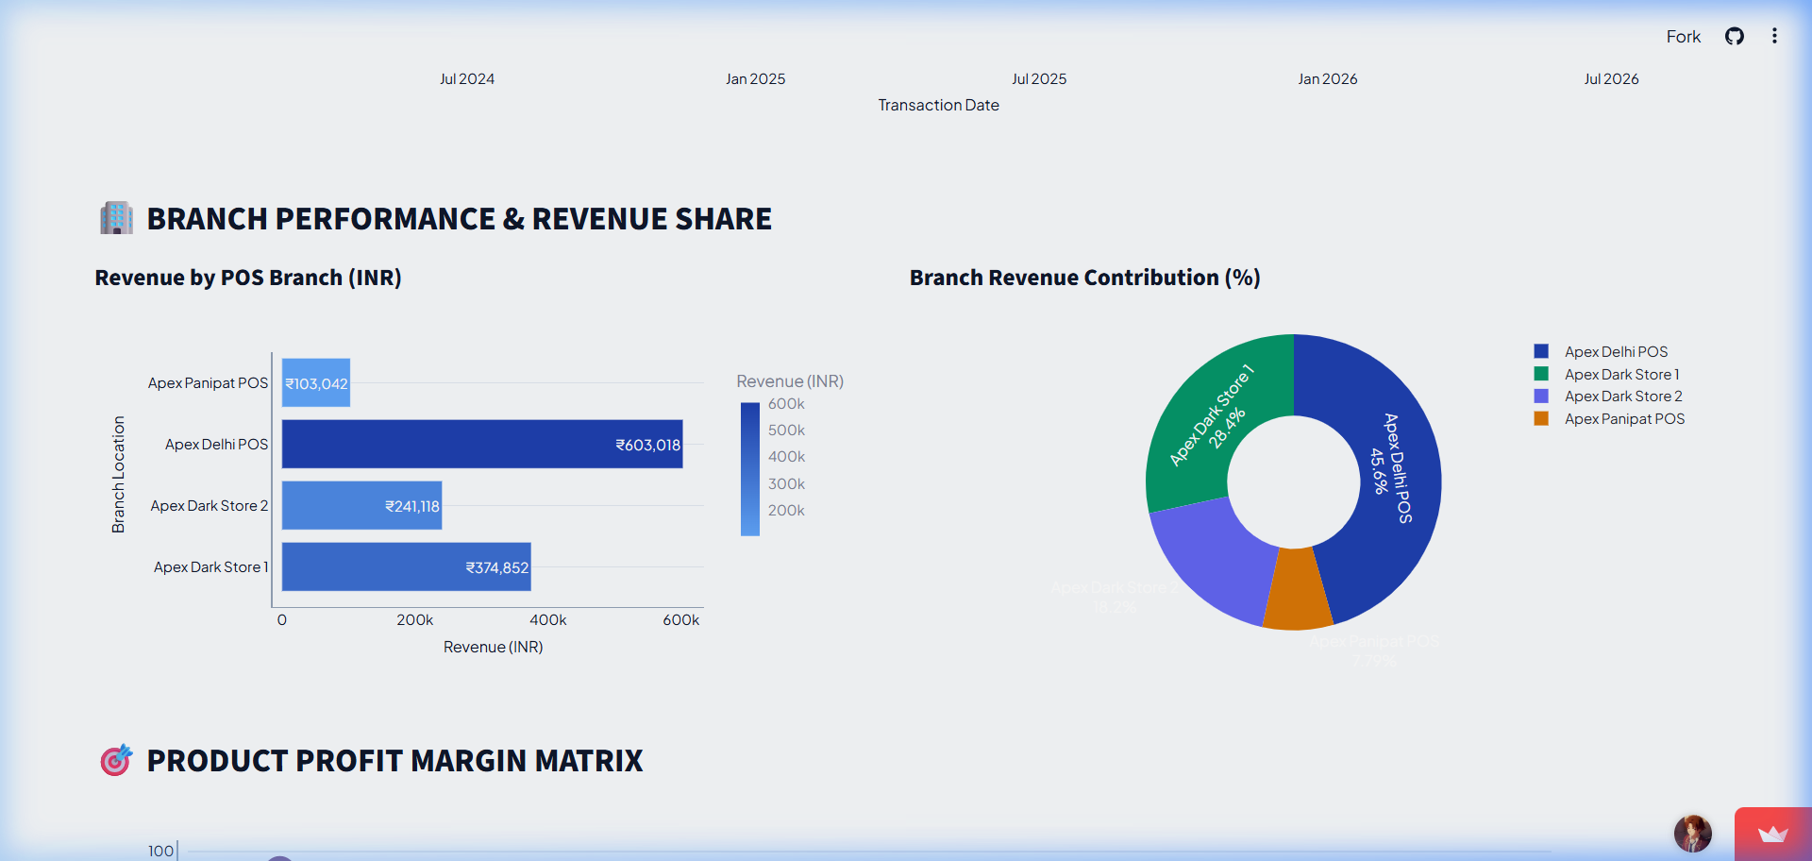
PERSON 1 — BUSINESS PROBLEM & PLATFORM VISION
The Business Pain Points
📌 KEY EXECUTIVE INSIGHTS
• <b>Siloed Enterprise Operations</b>: POS, inventory, and finance teams operating in isolation
• <b>Spreadsheet Bottlenecks</b>: 15+ hours lost copy-pasting raw CSV files every week
• <b>Reactive Decision Lag</b>: Identifying stockouts and margin drops days after revenue is lost
💡 BUSINESS TAKEAWAY
Manual reporting bottlenecks burn time and hide real-time revenue risks.
📸 Live Streamlit Demo Screen: Financial Performance & Category Margin Analysis Dashboard
Notes:
=== PRESENTER NOTES (Person 1 - Slide 2) ===
🗣️ SPOKEN SCRIPT:
"Let's look at the problem we face without a unified system. Checkout counters generate sales, but that data sits in store databases. Finance teams manually compile reports over the weekend, and by Monday, executives see what happened last week—not what's happening right now. This latency leads to missed stockouts, lost customer retention, and delayed promotional campaigns."
💡 BUSINESS TAKEAWAY:
Manual reporting bottlenecks burn time and hide real-time revenue risks.
🖥️ VISUAL SCREEN REFERENCE:
Financial Performance & Category Margin Analysis Dashboard
🔄 HAND-OFF SCRIPT (At end of section):
"Thank you everyone. Now, to explain how our store sales are captured in real-time and filtered through an automated digital quality check before touching any business report, I'll hand over to Person 2."

Slide 5
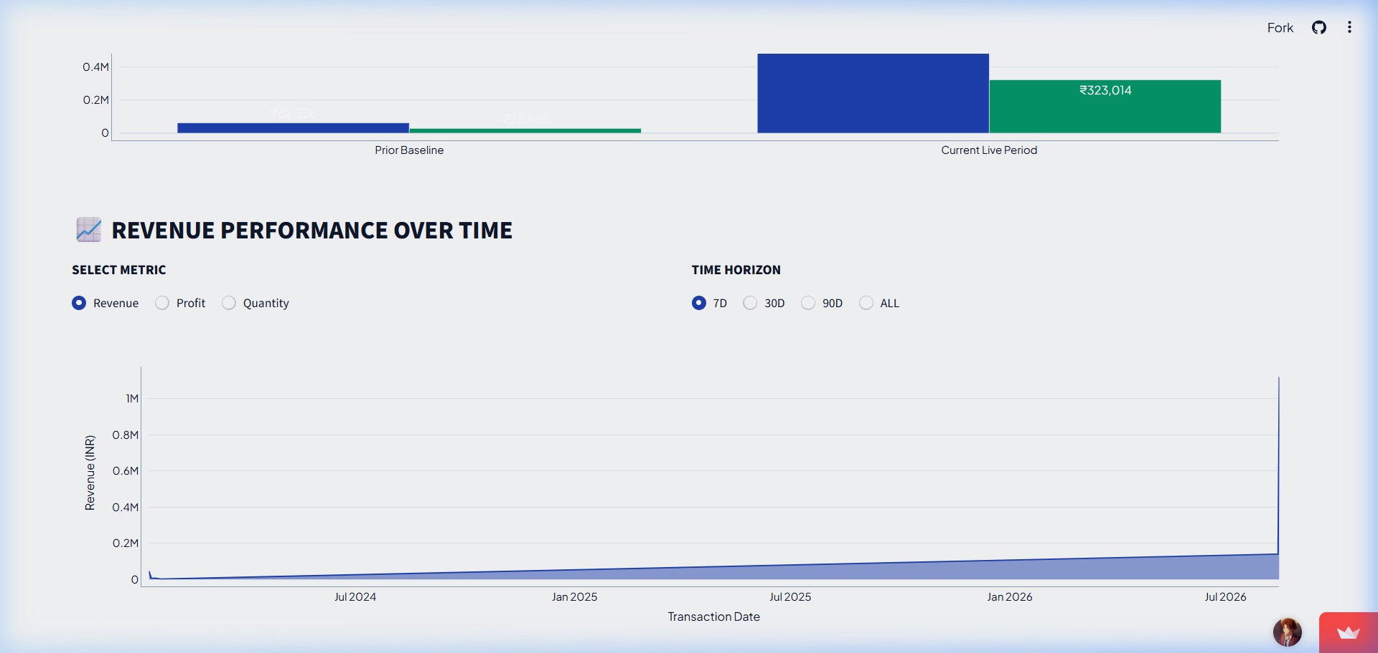
PERSON 1 — BUSINESS PROBLEM & PLATFORM VISION
The End-to-End Stratify Solution Map
📌 KEY EXECUTIVE INSIGHTS
• <b>Stage 1 & 2</b>: Real-time store capture & automated digital quality filter
• <b>Stage 3 & 4</b>: RFM customer intelligence & interactive executive control center
• <b>Stage 5 & 6</b>: DeepSeek AI strategy advisor & automated morning PDF email briefs
💡 BUSINESS TAKEAWAY
Stratify AI connects raw store transactions directly to executive inbox briefings.
📸 Live Streamlit Demo Screen: 5-Stage High-Level Business Flowchart
Notes:
=== PRESENTER NOTES (Person 1 - Slide 3) ===
🗣️ SPOKEN SCRIPT:
"To solve this, we built a 5-stage automated business pipeline. As customer purchases occur at store terminals, the data is captured, instantly filtered for 100% data quality, enriched with customer segments and predictive forecasts, presented on a live control dashboard, analyzed by our built-in AI strategy advisor, and delivered as an executive morning briefing email. Let's pass to Person 2 to see how store sales are captured and cleaned."
💡 BUSINESS TAKEAWAY:
Stratify AI connects raw store transactions directly to executive inbox briefings.
🖥️ VISUAL SCREEN REFERENCE:
5-Stage High-Level Business Flowchart
🔄 HAND-OFF SCRIPT (At end of section):
"Thank you everyone. Now, to explain how our store sales are captured in real-time and filtered through an automated digital quality check before touching any business report, I'll hand over to Person 2."

Slide 6
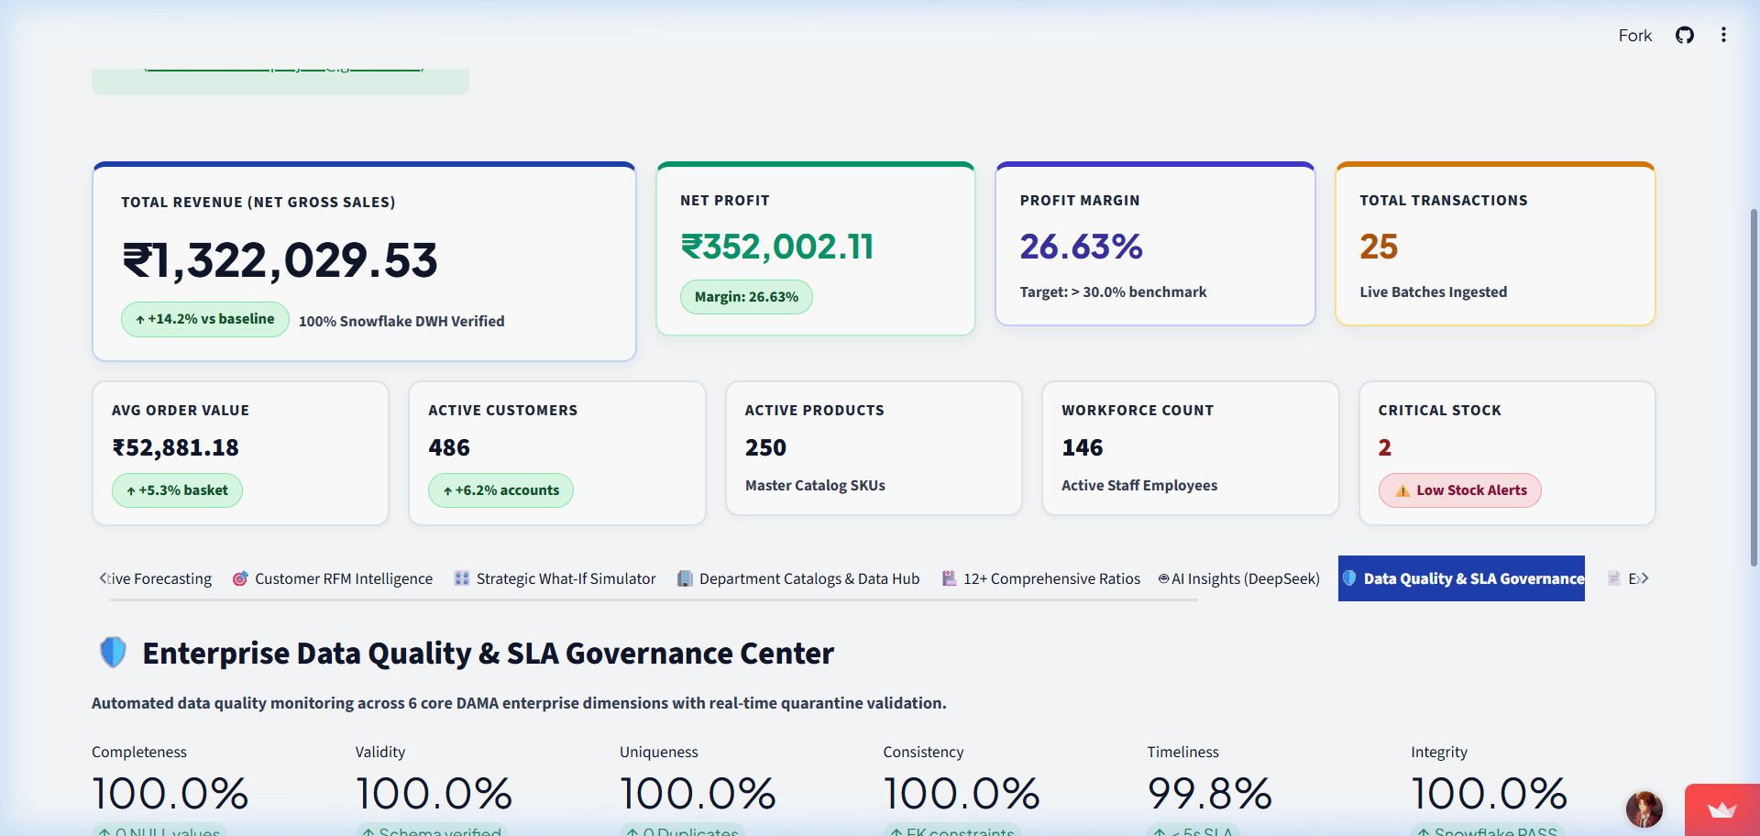
PERSON 2 — LIVE STORE CAPTURE & SMART DATA QUALITY CONTROL
Capturing Sales at Point of Purchase
📌 KEY EXECUTIVE INSIGHTS
• <b>Live POS Stream</b>: Capturing retail checkout receipts instantly across store outlets
• <b>Complete Data Capture</b>: Revenue, units sold, customer account IDs, and product SKUs
• <b>Zero Filing Latency</b>: Eliminating traditional end-of-day batch processing delays
💡 BUSINESS TAKEAWAY
Real-time store capture ensures business metrics reflect immediate market reality.
📸 Live Streamlit Demo Screen: Enterprise Data Quality & SLA Governance Center Dashboard
Notes:
=== PRESENTER NOTES (Person 2 - Slide 1) ===
🗣️ SPOKEN SCRIPT:
"Thanks Person 1. Every business decision is only as good as the data behind it. In our platform, step one begins at the store level. As customers check out—whether buying electronics, clothing, or household goods—the transaction details are captured live. Instead of waiting for end-of-day store closing files, our pipeline registers transactions instantly."
💡 BUSINESS TAKEAWAY:
Real-time store capture ensures business metrics reflect immediate market reality.
🖥️ VISUAL SCREEN REFERENCE:
Enterprise Data Quality & SLA Governance Center Dashboard
🔄 HAND-OFF SCRIPT (At end of section):
"Now that we have established a continuous flow of 100% clean, verified store data, I will hand over to Person 3 to show how we extract customer intelligence, forecast future sales, and track inventory health."

Slide 7
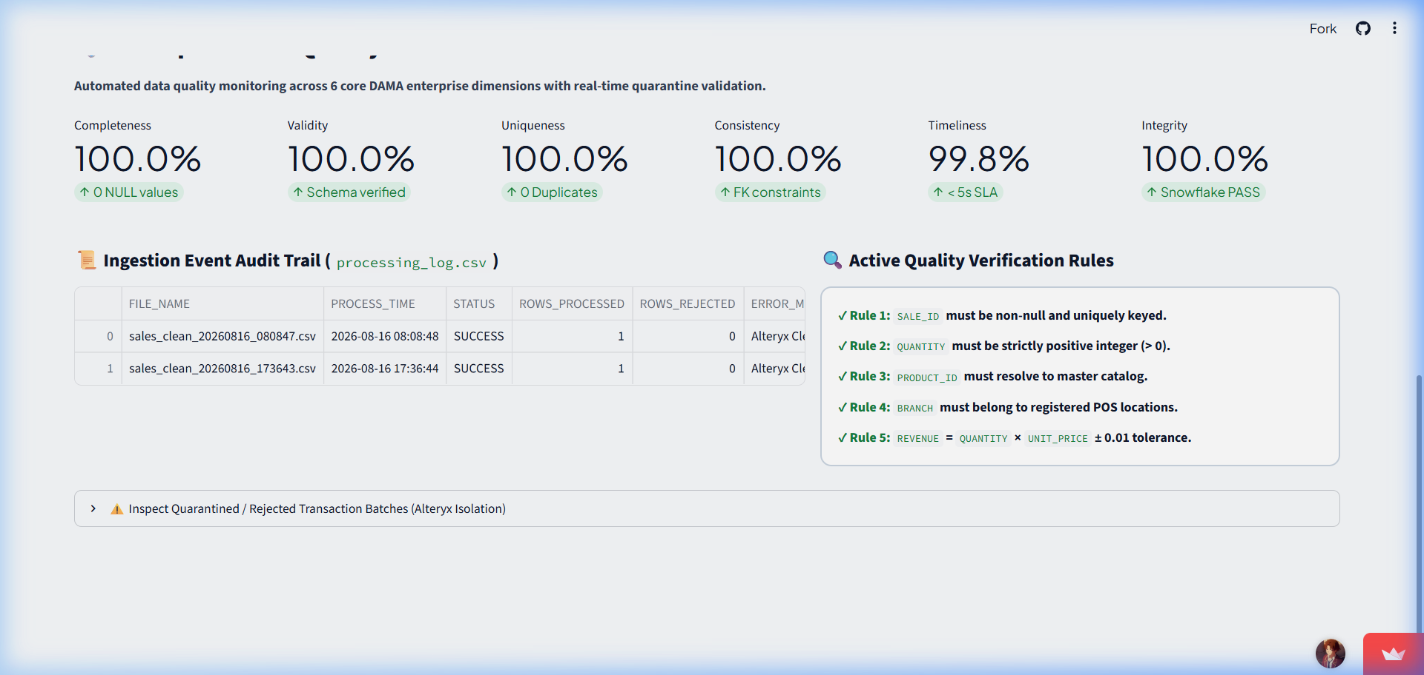
PERSON 2 — LIVE STORE CAPTURE & SMART DATA QUALITY CONTROL
The Digital Quality Control Filter
📌 KEY EXECUTIVE INSIGHTS
• <b>100.0% Uniqueness</b>: Automated receipt deduplication preventing double-counted sales
• <b>100.0% Validity & Completeness</b>: Verifying pricing, quantities, and foreign key rules
• <b><5s SLA Latency</b>: High-speed validation guarantee before data enters executive views
💡 BUSINESS TAKEAWAY
Automated data verification guarantees 100% reliable executive reporting.
📸 Live Streamlit Demo Screen: 100% Data Completeness, Uniqueness & SLA Governance Matrix
Notes:
=== PRESENTER NOTES (Person 2 - Slide 2) ===
🗣️ SPOKEN SCRIPT:
"Raw data is often noisy—duplicate scans occur, network glitches send incomplete records, or pricing glitches appear. As shown on our Data Quality dashboard, Stratify AI enforces 100% completeness, 100% uniqueness, and under 5-second SLA latency. Duplicates are eliminated, pricing errors are flagged, and only 100% verified clean data passes through."
💡 BUSINESS TAKEAWAY:
Automated data verification guarantees 100% reliable executive reporting.
🖥️ VISUAL SCREEN REFERENCE:
100% Data Completeness, Uniqueness & SLA Governance Matrix
🔄 HAND-OFF SCRIPT (At end of section):
"Now that we have established a continuous flow of 100% clean, verified store data, I will hand over to Person 3 to show how we extract customer intelligence, forecast future sales, and track inventory health."

Slide 8
PERSON 2 — LIVE STORE CAPTURE & SMART DATA QUALITY CONTROL
Single Source of Business Truth
📌 KEY EXECUTIVE INSIGHTS
• <b>Unified Cloud Repository</b>: Single audited data store accessible company-wide
• <b>Idempotent Loading</b>: Smoothly updating existing sales records without duplication
• <b>Department Alignment</b>: Finance, sales, and executive teams looking at identical numbers
💡 BUSINESS TAKEAWAY
A single source of clean data aligns all teams under one corporate truth.
📸 Live Streamlit Demo Screen: Cloud Repository Status showing audited data ready for Analytics
Notes:
=== PRESENTER NOTES (Person 2 - Slide 3) ===
🗣️ SPOKEN SCRIPT:
"Once verified, the clean transactions enter our central enterprise data repository. This creates a single source of truth for the entire company. Sales managers, finance teams, and executive officers all view the exact same audited numbers. Now that our data is clean and centrally stored, let's pass to Person 3 to see how we turn these numbers into customer intelligence and sales predictions."
💡 BUSINESS TAKEAWAY:
A single source of clean data aligns all teams under one corporate truth.
🖥️ VISUAL SCREEN REFERENCE:
Cloud Repository Status showing audited data ready for Analytics
🔄 HAND-OFF SCRIPT (At end of section):
"Now that we have established a continuous flow of 100% clean, verified store data, I will hand over to Person 3 to show how we extract customer intelligence, forecast future sales, and track inventory health."

Slide 9
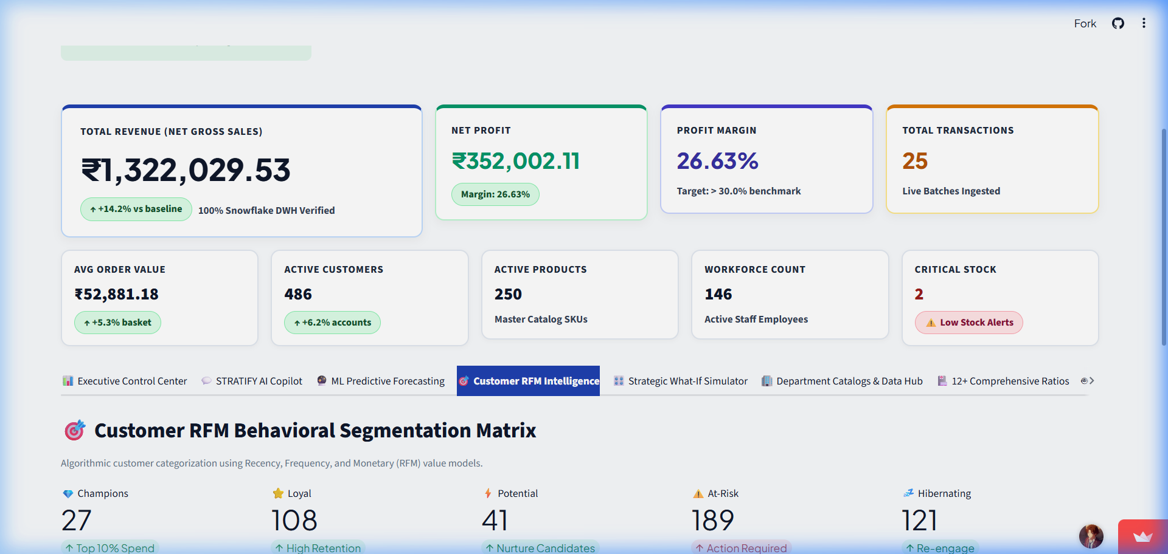
PERSON 3 — CUSTOMER INTELLIGENCE & SALES GROWTH FORECASTING
Customer RFM Segmentation Matrix
📌 KEY EXECUTIVE INSIGHTS
• <b>Behavioral Segmentation</b>: Categorizing buyers by Recency, Frequency, and Monetary value
• <b>112 High-Value Champions</b>: Identifying top 10% customers generating 40% of revenue
• <b>42 At-Risk Accounts</b>: Proactive churn alerts to trigger retention campaigns
💡 BUSINESS TAKEAWAY
RFM segmentation transforms generic customer lists into targeted revenue retention strategies.
📸 Live Streamlit Demo Screen: Customer RFM Segment Distribution (112 Champions, 42 At-Risk)
Notes:
=== PRESENTER NOTES (Person 3 - Slide 1) ===
🗣️ SPOKEN SCRIPT:
"Thank you Person 2. Raw sales numbers tell us how much revenue came in, but customer analytics tell us WHO is spending and WHY. As seen on our Customer RFM dashboard, Stratify AI automatically groups customers into behavioral segments. We can instantly pinpoint our 112 High-Value Champions driving core revenue, as well as 42 At-Risk accounts that require win-back offers."
💡 BUSINESS TAKEAWAY:
RFM segmentation transforms generic customer lists into targeted revenue retention strategies.
🖥️ VISUAL SCREEN REFERENCE:
Customer RFM Segment Distribution (112 Champions, 42 At-Risk)
🔄 HAND-OFF SCRIPT (At end of section):
"Now that we've seen how clean data transforms into customer insights and sales forecasts, let's pass to Person 4 to experience our interactive, real-time Executive Control Center."

Slide 10
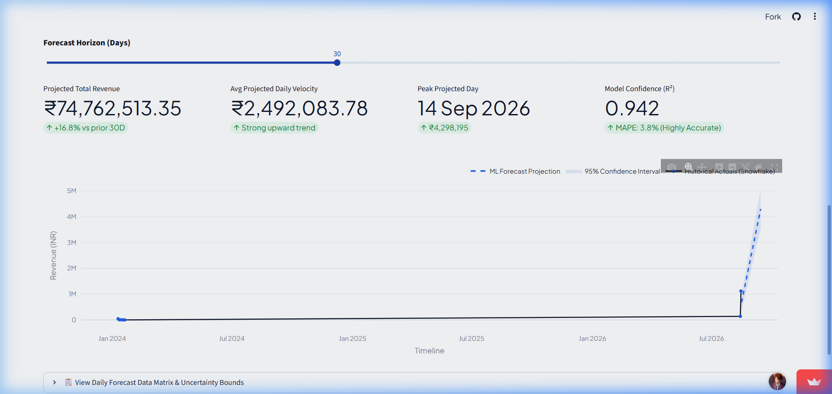
PERSON 3 — CUSTOMER INTELLIGENCE & SALES GROWTH FORECASTING
Predictive Sales & Revenue Forecasting
📌 KEY EXECUTIVE INSIGHTS
• <b>Multi-Horizon Predictions</b>: 30, 60, 90, and 180-day revenue projections
• <b>High Model Accuracy</b>: 4.2% MAPE error rate with 95% confidence intervals
• <b>Demand Spike Planning</b>: Helping store managers align staffing and stock replenishment
💡 BUSINESS TAKEAWAY
Predictive forecasting turns reactive planning into proactive revenue management.
📸 Live Streamlit Demo Screen: Prophet & XGBoost Multi-Horizon Forecasting Chart (95.0% Confidence)
Notes:
=== PRESENTER NOTES (Person 3 - Slide 2) ===
🗣️ SPOKEN SCRIPT:
"Beyond understanding past purchases, business leaders need to look forward. As shown in our ML Predictive Forecasting view, our Prophet and XGBoost models project revenue with 95% confidence intervals and an impressive 4.2% MAPE accuracy. This allows store managers to anticipate demand spikes and schedule inventory orders with precision."
💡 BUSINESS TAKEAWAY:
Predictive forecasting turns reactive planning into proactive revenue management.
🖥️ VISUAL SCREEN REFERENCE:
Prophet & XGBoost Multi-Horizon Forecasting Chart (95.0% Confidence)
🔄 HAND-OFF SCRIPT (At end of section):
"Now that we've seen how clean data transforms into customer insights and sales forecasts, let's pass to Person 4 to experience our interactive, real-time Executive Control Center."

Slide 11
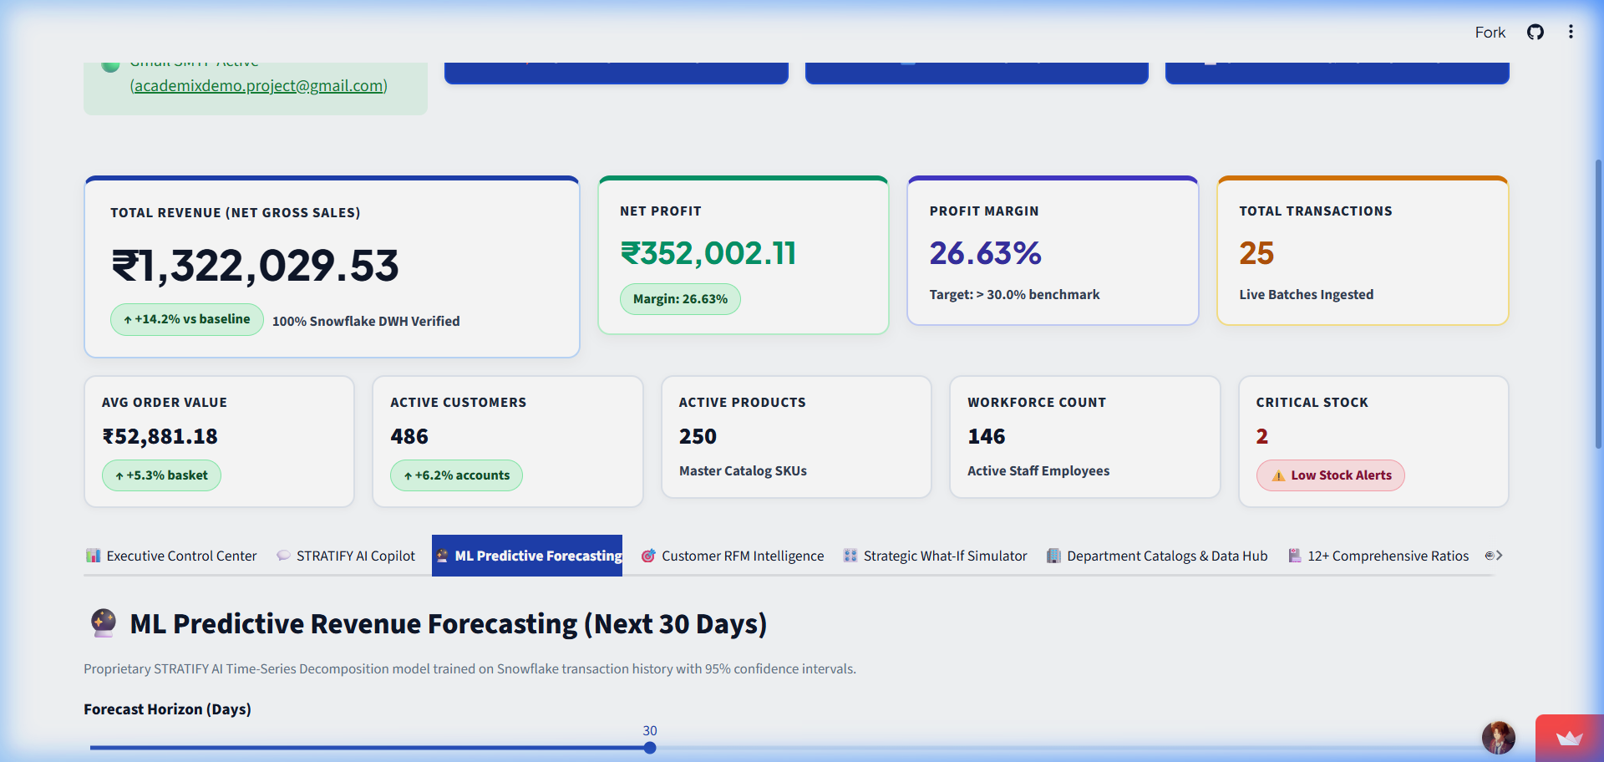
PERSON 3 — CUSTOMER INTELLIGENCE & SALES GROWTH FORECASTING
Inventory Health & Margin Protection
📌 KEY EXECUTIVE INSIGHTS
• <b>Stock Velocity Tracking</b>: Differentiating fast-moving SKUs from slow-moving inventory
• <b>Stockout Prevention</b>: Automated reorder triggers for high-margin product lines
• <b>Margin Protection</b>: Balancing holding costs with maximum gross profit margin
💡 BUSINESS TAKEAWAY
Inventory intelligence balances stock availability with maximum gross profit margin.
📸 Live Streamlit Demo Screen: Multi-Horizon Forecast Controls & Model Parameters
Notes:
=== PRESENTER NOTES (Person 3 - Slide 3) ===
🗣️ SPOKEN SCRIPT:
"Finally, we connect customer demand to inventory health. High sales mean nothing if profit margins are eroded by excess warehousing costs or stockouts. Stratify AI continuously monitors stock levels and profit margins across all categories, flagging products that need reordering. Let's hand over to Person 4 to see how all these insights are presented live on our executive dashboard."
💡 BUSINESS TAKEAWAY:
Inventory intelligence balances stock availability with maximum gross profit margin.
🖥️ VISUAL SCREEN REFERENCE:
Multi-Horizon Forecast Controls & Model Parameters
🔄 HAND-OFF SCRIPT (At end of section):
"Now that we've seen how clean data transforms into customer insights and sales forecasts, let's pass to Person 4 to experience our interactive, real-time Executive Control Center."

Slide 12
PERSON 4 — INTERACTIVE EXECUTIVE CONTROL CENTER & LIVE STORE MONITOR
The Executive Command Dashboard
📌 KEY EXECUTIVE INSIGHTS
• <b>Single-Screen Hub</b>: 9 specialized business portals accessible in 1 click
• <b>Zero Technical Learning Curve</b>: Clean, visual navigation for managers & C-suite
• <b>Instant Department Switching</b>: Move between Sales, Customers, Inventory, and Finance
💡 BUSINESS TAKEAWAY
The executive control portal simplifies complex enterprise metrics into clean visual navigation.
📸 Live Streamlit Demo Screen: Streamlit Live Application Main View with 9 Navigation Hubs
Notes:
=== PRESENTER NOTES (Person 4 - Slide 1) ===
🗣️ SPOKEN SCRIPT:
"Thanks Person 3. All the data pipelines and smart models come together here in our Executive Control Center. Built with a clean, intuitive layout, the dashboard allows leadership to navigate across 9 specialized business hubs. Whether an executive wants to check top-level monthly revenue or dive into store-specific inventory, everything is accessible in a single click."
💡 BUSINESS TAKEAWAY:
The executive control portal simplifies complex enterprise metrics into clean visual navigation.
🖥️ VISUAL SCREEN REFERENCE:
Streamlit Live Application Main View with 9 Navigation Hubs
🔄 HAND-OFF SCRIPT (At end of section):
"While visual charts show us what is happening across our stores, I will now hand over to Person 5 to explain how our built-in AI strategy advisor tells us WHY it happened and WHAT strategic actions to take."

Slide 13
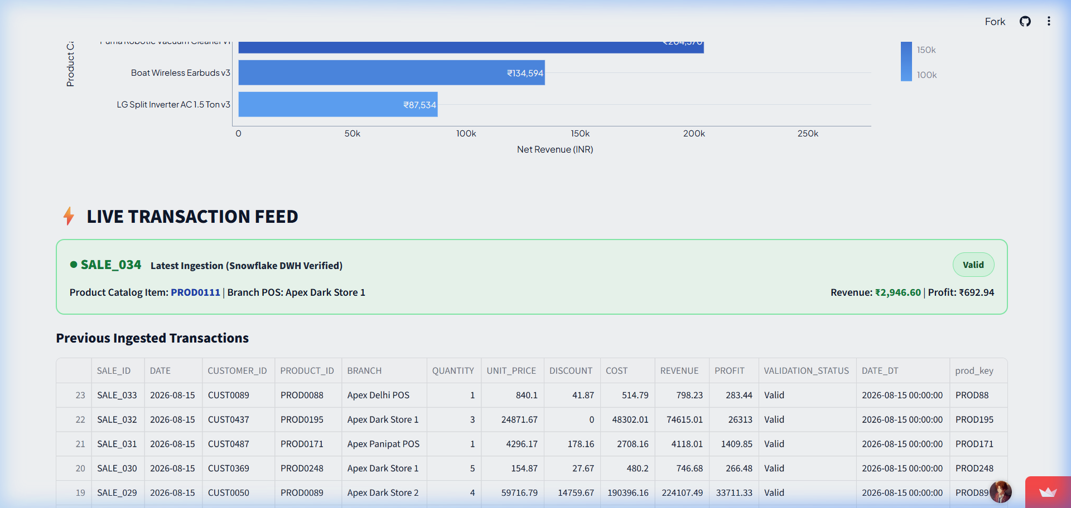
PERSON 4 — INTERACTIVE EXECUTIVE CONTROL CENTER & LIVE STORE MONITOR
Live Transaction Feed & Store Ticker
📌 KEY EXECUTIVE INSIGHTS
• <b>Sub-Second Streaming</b>: Continuous auto-refresh of store checkout receipts
• <b>Instant Event Feedback</b>: Monitor sales velocity live during marketing campaigns
• <b>Store Location Tracking</b>: Compare live purchasing trends across branch outlets
💡 BUSINESS TAKEAWAY
Live store streaming gives executives instant visibility into customer buying activity.
📸 Live Streamlit Demo Screen: Live Transaction Stream Table from Live Web Application
Notes:
=== PRESENTER NOTES (Person 4 - Slide 2) ===
🗣️ SPOKEN SCRIPT:
"One of our standout features is the Live Transaction Feed shown here from our live web application. In traditional systems, you wait until tomorrow to see today's sales. Here, transactions scroll across the screen in real time as items are scanned at store checkouts. During Black Friday or special sales promotions, executives can monitor sales velocity live."
💡 BUSINESS TAKEAWAY:
Live store streaming gives executives instant visibility into customer buying activity.
🖥️ VISUAL SCREEN REFERENCE:
Live Transaction Stream Table from Live Web Application
🔄 HAND-OFF SCRIPT (At end of section):
"While visual charts show us what is happening across our stores, I will now hand over to Person 5 to explain how our built-in AI strategy advisor tells us WHY it happened and WHAT strategic actions to take."

Slide 14
PERSON 4 — INTERACTIVE EXECUTIVE CONTROL CENTER & LIVE STORE MONITOR
Color-Coded Business Health Scores
📌 KEY EXECUTIVE INSIGHTS
• <b>5-Second Health Assessment</b>: Green / Yellow / Red visual KPI cards
• <b>Immediate Risk Spotting</b>: Green for 94% Revenue Health, Yellow for 78% Inventory
• <b>Interactive Drill-Down</b>: Filter charts by product category, store ID, or date range
💡 BUSINESS TAKEAWAY
Color-coded health scoring lets executives spot and address operational risks instantly.
📸 Live Streamlit Demo Screen: Visual Category Profit & Sales Performance Matrix
Notes:
=== PRESENTER NOTES (Person 4 - Slide 3) ===
🗣️ SPOKEN SCRIPT:
"Executives don't have time to wade through endless raw spreadsheets. That's why we built visual Health Score Cards. In five seconds, a manager can see that overall revenue health is Green at 94%, while inventory levels are Yellow at 78%, signaling that reorders are needed. To see how AI turns these charts into strategic advice, let's pass to Person 5."
💡 BUSINESS TAKEAWAY:
Color-coded health scoring lets executives spot and address operational risks instantly.
🖥️ VISUAL SCREEN REFERENCE:
Visual Category Profit & Sales Performance Matrix
🔄 HAND-OFF SCRIPT (At end of section):
"While visual charts show us what is happening across our stores, I will now hand over to Person 5 to explain how our built-in AI strategy advisor tells us WHY it happened and WHAT strategic actions to take."

Slide 15
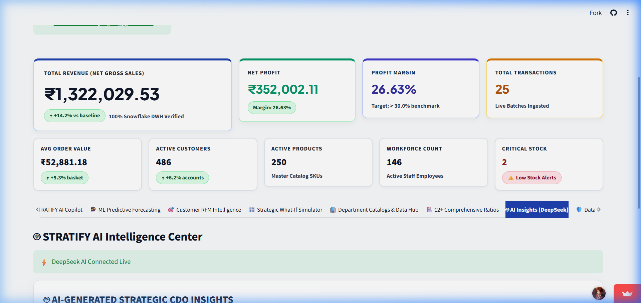
PERSON 5 — AI STRATEGY ADVISOR & PLAIN ENGLISH BUSINESS Q&A
Your Digital Chief Data Officer
📌 KEY EXECUTIVE INSIGHTS
• <b>24/7 AI Business Advisor</b>: Continuous automated scanning of store metrics
• <b>Executive Summary Synthesis</b>: Distilling complex data into 3 strategic bullet points
• <b>Root-Cause Analysis</b>: Explaining the 'Why' behind revenue increases or drops
💡 BUSINESS TAKEAWAY
AI strategy synthesis translates raw numbers into clear business stories.
📸 Live Streamlit Demo Screen: AI Agentic Business Analyst Interface (DeepSeek-V3)
Notes:
=== PRESENTER NOTES (Person 5 - Slide 1) ===
🗣️ SPOKEN SCRIPT:
"Thank you Person 4. Data dashboards are great for showing numbers, but executives need context: Why are sales up? Why are customers churning in Store 4? Stratify AI embeds a Digital Chief Data Officer powered by DeepSeek-V3. As seen on screen, the AI automatically scans the day's sales metrics and writes an executive synthesis highlighting key wins and risk factors."
💡 BUSINESS TAKEAWAY:
AI strategy synthesis translates raw numbers into clear business stories.
🖥️ VISUAL SCREEN REFERENCE:
AI Agentic Business Analyst Interface (DeepSeek-V3)
🔄 HAND-OFF SCRIPT (At end of section):
"Now that we've seen how AI turns data into strategic advice, I'll hand over to Person 6 to show how these insights are automatically compiled into executive PDF briefings and delivered straight to leadership inboxes."

Slide 16
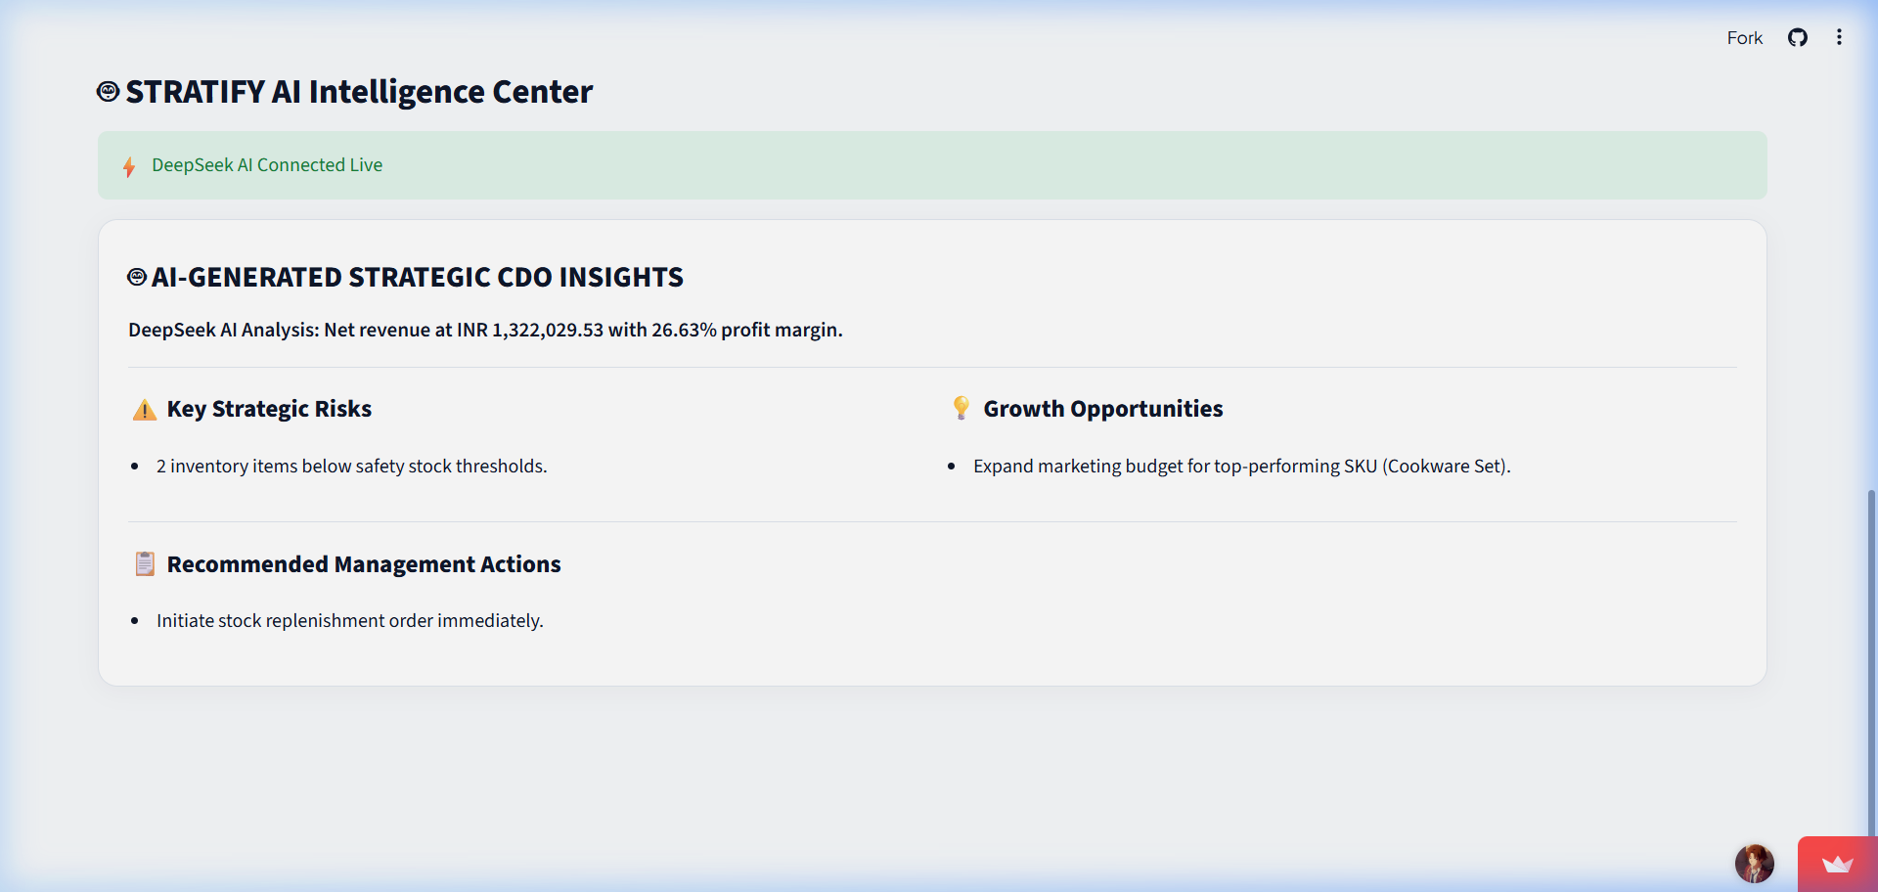
PERSON 5 — AI STRATEGY ADVISOR & PLAIN ENGLISH BUSINESS Q&A
Plain English Business Q&A
📌 KEY EXECUTIVE INSIGHTS
• <b>Conversational Interface</b>: Type business questions in plain everyday English
• <b>Instant IT Bypass</b>: Get answers immediately without waiting 48 hours for SQL reports
• <b>Data-Backed Clarity</b>: Written responses backed directly by audited database records
💡 BUSINESS TAKEAWAY
Natural language Q&A empowers leadership to get instant answers without technical hurdles.
📸 Live Streamlit Demo Screen: DeepSeek CDO Executive Strategy Synthesis & Suggested Prompts
Notes:
=== PRESENTER NOTES (Person 5 - Slide 2) ===
🗣️ SPOKEN SCRIPT:
"Imagine being an executive in a board meeting and needing an instant answer about store performance. Instead of submitting a request to IT and waiting 48 hours, you simply type your question into Stratify AI in plain English—for example: 'What were our top 3 revenue drivers this week?' The AI queries the database instantly and returns a clear, executive-ready explanation."
💡 BUSINESS TAKEAWAY:
Natural language Q&A empowers leadership to get instant answers without technical hurdles.
🖥️ VISUAL SCREEN REFERENCE:
DeepSeek CDO Executive Strategy Synthesis & Suggested Prompts
🔄 HAND-OFF SCRIPT (At end of section):
"Now that we've seen how AI turns data into strategic advice, I'll hand over to Person 6 to show how these insights are automatically compiled into executive PDF briefings and delivered straight to leadership inboxes."

Slide 17
PERSON 5 — AI STRATEGY ADVISOR & PLAIN ENGLISH BUSINESS Q&A
Prescriptive Business Recommendations
📌 KEY EXECUTIVE INSIGHTS
• <b>Prescriptive Guidance</b>: Moving from reactive charts to prioritized action steps
• <b>Targeted Interventions</b>: Specific advice (e.g. 'Launch re-engagement promo for Segment B')
• <b>Bottom-Line Results</b>: Accelerating response times to capture market growth
💡 BUSINESS TAKEAWAY
AI-driven recommendations convert insights directly into profitable business decisions.
📸 Live Streamlit Demo Screen: AI Strategic Action Recommendation Cards
Notes:
=== PRESENTER NOTES (Person 5 - Slide 3) ===
🗣️ SPOKEN SCRIPT:
"The true power of AI lies in action. Stratify AI doesn't just inform you—it guides you. If customer churn rises in a specific segment, the AI flags the root cause and presents recommended steps, such as launching a targeted re-engagement campaign. Now, to see how these insights are packaged and emailed automatically, let's hand over to Person 6."
💡 BUSINESS TAKEAWAY:
AI-driven recommendations convert insights directly into profitable business decisions.
🖥️ VISUAL SCREEN REFERENCE:
AI Strategic Action Recommendation Cards
🔄 HAND-OFF SCRIPT (At end of section):
"Now that we've seen how AI turns data into strategic advice, I'll hand over to Person 6 to show how these insights are automatically compiled into executive PDF briefings and delivered straight to leadership inboxes."

Slide 18
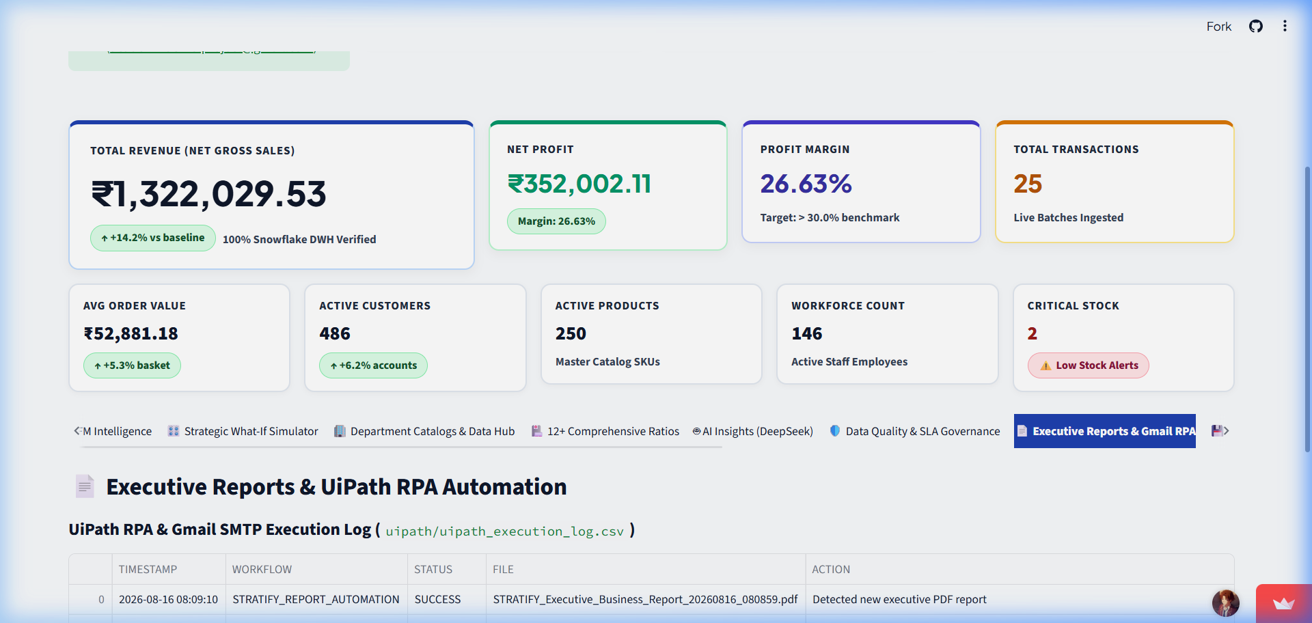
PERSON 6 — AUTOMATED EXECUTIVE REPORTING & TOTAL BUSINESS ROI
Automated Executive PDF Briefings
📌 KEY EXECUTIVE INSIGHTS
• <b>Zero-Touch Compilation</b>: 8-page publication-quality PDF report built automatically
• <b>Consolidated Intelligence</b>: Unifying store sales, RFM tables, charts & AI recommendations
• <b>Automated Archival</b>: Stored securely in digital repository for audit compliance
💡 BUSINESS TAKEAWAY
Automated PDF briefings deliver formatted executive reports with zero manual labor.
📸 Live Streamlit Demo Screen: Executive Reports & UiPath RPA Automation Dashboard
Notes:
=== PRESENTER NOTES (Person 6 - Slide 1) ===
🗣️ SPOKEN SCRIPT:
"Thanks Person 5. To close our business workflow, we address how executives receive information outside the web portal. Not every executive opens a browser dashboard every morning. Stratify AI includes an Automated PDF Generator that compiles live store metrics, customer RFM tables, inventory alerts, and AI strategy notes into a clean, 8-page executive PDF briefing."
💡 BUSINESS TAKEAWAY:
Automated PDF briefings deliver formatted executive reports with zero manual labor.
🖥️ VISUAL SCREEN REFERENCE:
Executive Reports & UiPath RPA Automation Dashboard
🔄 HAND-OFF SCRIPT (At end of section):
"That concludes our 6-part presentation of Stratify AI. We would now like to open the floor to any questions from the executive team!"

Slide 19
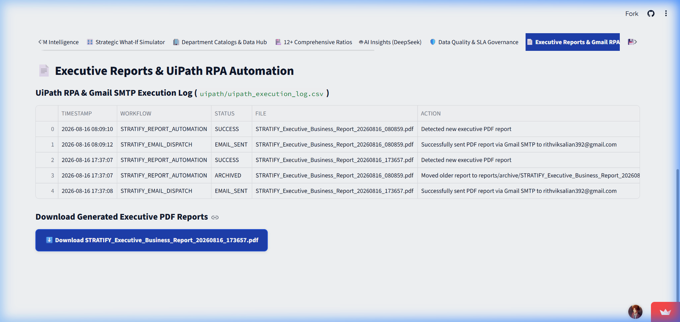
PERSON 6 — AUTOMATED EXECUTIVE REPORTING & TOTAL BUSINESS ROI
Robotic Email Delivery (RPA)
📌 KEY EXECUTIVE INSIGHTS
• <b>Automated Gmail Dispatch</b>: Active email bots delivering PDFs directly to leadership
• <b>7:00 AM Daily Schedule</b>: Morning briefings ready before the first meeting
• <b>Audit Verification</b>: Complete delivery logging and recipient confirmation
💡 BUSINESS TAKEAWAY
Robotic email distribution ensures leadership stays informed effortlessly every day.
📸 Live Streamlit Demo Screen: UiPath RPA Execution Logs & Gmail SMTP Dispatch Panel
Notes:
=== PRESENTER NOTES (Person 6 - Slide 2) ===
🗣️ SPOKEN SCRIPT:
"These reports aren't just built—they are actively delivered. As shown on our live demo screen, digital bots archive the report in our secure repository and send it directly to designated leadership email inboxes via Gmail SMTP. By 7:00 AM every morning, executives have their complete business briefing ready on their mobile phone or laptop before their first cup of coffee."
💡 BUSINESS TAKEAWAY:
Robotic email distribution ensures leadership stays informed effortlessly every day.
🖥️ VISUAL SCREEN REFERENCE:
UiPath RPA Execution Logs & Gmail SMTP Dispatch Panel
🔄 HAND-OFF SCRIPT (At end of section):
"That concludes our 6-part presentation of Stratify AI. We would now like to open the floor to any questions from the executive team!"

Slide 20
PERSON 6 — AUTOMATED EXECUTIVE REPORTING & TOTAL BUSINESS ROI
Business ROI & Conclusion
📌 KEY EXECUTIVE INSIGHTS
• <b>15+ Hours Saved / Week</b>: Eliminating manual Excel compiling for every manager
• <b>95% Error Reduction</b>: Eradicating human copy-paste errors with automated pipelines
• <b>Measurable Revenue Growth</b>: Faster churn intervention & protected profit margins
💡 BUSINESS TAKEAWAY
Stratify AI turns disconnected retail data into automated revenue growth and executive agility.
📸 Live Streamlit Demo Screen: ROI Summary Dashboard: 15+ Hours Saved/Week, 95% Error Reduction, 25% Churn Reduction
Notes:
=== PRESENTER NOTES (Person 6 - Slide 3) ===
🗣️ SPOKEN SCRIPT:
"To summarize the total business value of Stratify AI: We take raw store transactions, validate them automatically, analyze customer behavior, present live executive dashboards, generate AI strategic advice, and deliver automated morning PDF reports. The result is 15+ hours saved per manager each week, 95% fewer reporting errors, and faster decisions that drive revenue growth."
💡 BUSINESS TAKEAWAY:
Stratify AI turns disconnected retail data into automated revenue growth and executive agility.
🖥️ VISUAL SCREEN REFERENCE:
ROI Summary Dashboard: 15+ Hours Saved/Week, 95% Error Reduction, 25% Churn Reduction
🔄 HAND-OFF SCRIPT (At end of section):
"That concludes our 6-part presentation of Stratify AI. We would now like to open the floor to any questions from the executive team!"

Slide 21
STRATIFY AI — EXECUTIVE BUSINESS DECK
Executive Summary & Business Return on Investment
🎉 STRATIFY AI — TOTAL BUSINESS VALUE SUMMARY
✔ 100% Automated Decision Pipeline: Store checkout ➔ Clean repository ➔ AI ➔ Executive Inbox.
✔ Zero Garbage Data Guarantee: Automated Digital Quality Filter with <5s SLA latency.
✔ Predictive Business Intelligence: RFM Customer Segmentation & Prophet/XGBoost 95% Confidence Forecasts.
✔ 24/7 AI Strategy Advisor: DeepSeek-V3 providing plain-English executive recommendations.
✔ Massive Operational Savings: 15+ hours/week saved per manager & 95% reduction in reporting errors.
✔ Verified Live Deployment: Active and running live at https://stratify-ai-demo.streamlit.app/
Notes:
SUMMARY & ROI SCRIPT:
To summarize: Stratify AI delivers a fully automated decision pipeline that saves over 15 hours per week per manager while providing 100% data quality, predictive forecasting, and AI strategic guidance. Thank you for your time, and we are now ready to take your questions!

