Slide 1
IST 652 – Scripting for Data Analysis Electric Vehicle Population in the State of Washington
Project members
Rithvik Segu
Pavan kumar

Slide 2
Goals
In the United States, the electric vehicle market is booming as technology improves day by day, and automakers are struggling to keep up with demand. We may use the dataset to investigate electric vehicle sales in the state of Washington.
Analyzing recent patterns in vehicle purchases based on vehicle kinds and determining which vehicle type is the most popular.

Slide 3
Datasets
We have 2 datasets for our analysis.
Contains statistics on registered electric vehicles in the state of Washington.
The data was obtained from the data.gov website of the United States federal government.
This dataset has in all 17 columns and 109027 entries.
Contains data about the number of electric vehicles that were registered by the Department of Licensing every month.
The data was obtained from the data.gov website of the United States federal government.
This dataset has in all 10 columns and 15817 entries.

Slide 4
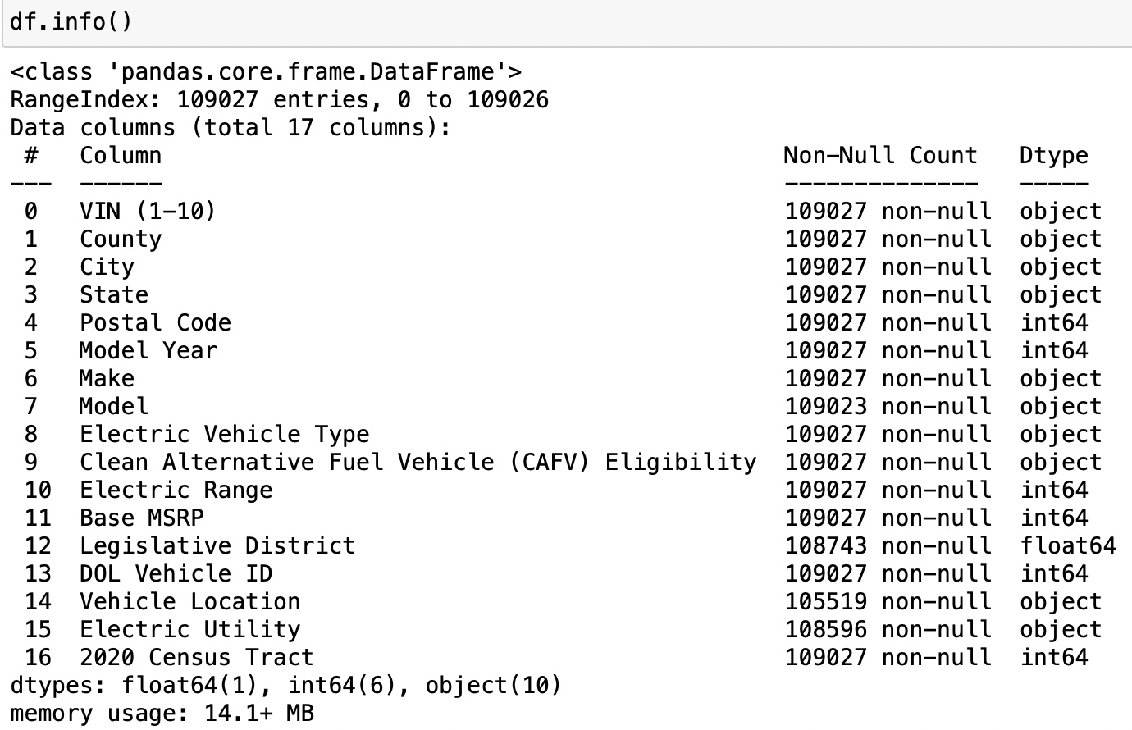
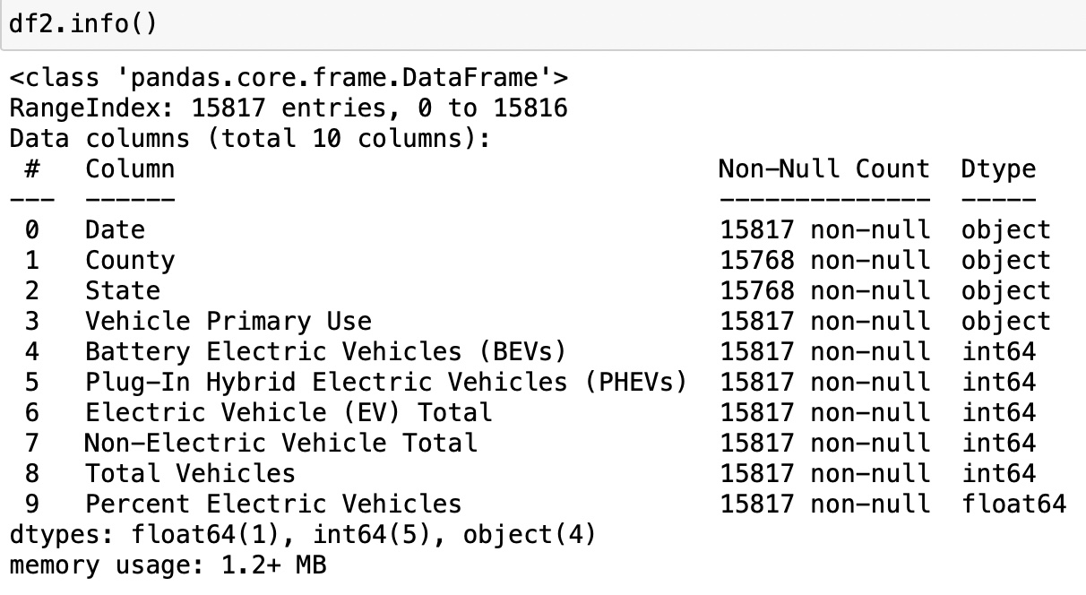
Cleaning the datasets
First, to get the basic information of the dataset we used .info() command and got some basic insights of the datasets.

Slide 5

Cleaning the datasets
Dropped the data which was not from the State of Washington and data for Truck.

Slide 6

Cleaning the datasets
Sorted the values based on the year in which the Electric Vehicle was registered in the ascending order.

Slide 7


Cleaning the datasets
Dropped those rows in which the state of registration was unknown AND TAKING DATA ONLY FROM WASHINGTON STATE.

Slide 8
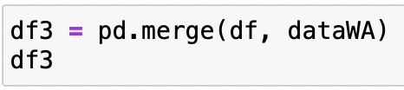
MERGING THE DATA SETS

Slide 9
Data Analysis

Slide 10
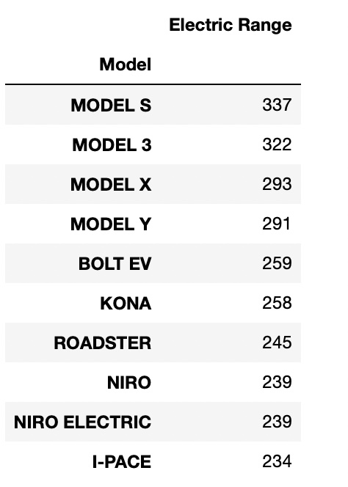
Best car based on the maximum range it can travel in single charge.

Slide 11
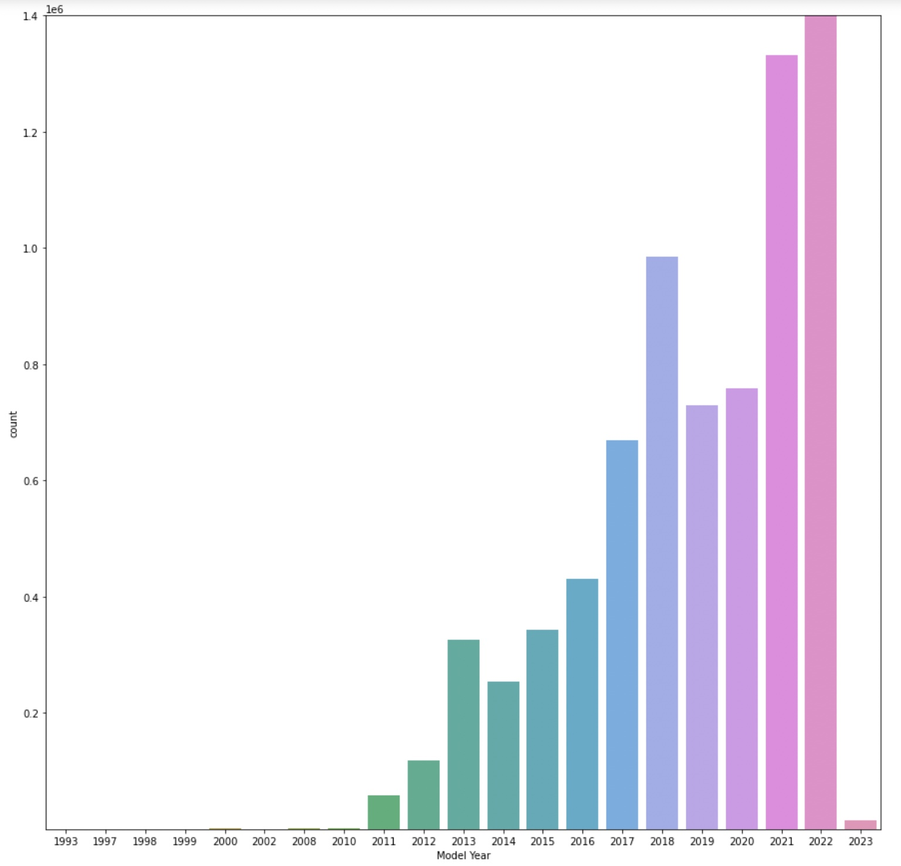
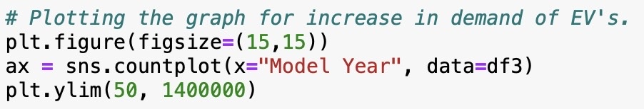
Increase in demand of Electric Vehicles

Slide 12
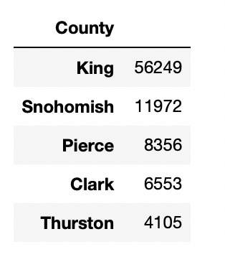
Top counties for Electric vehicle registration

Slide 13
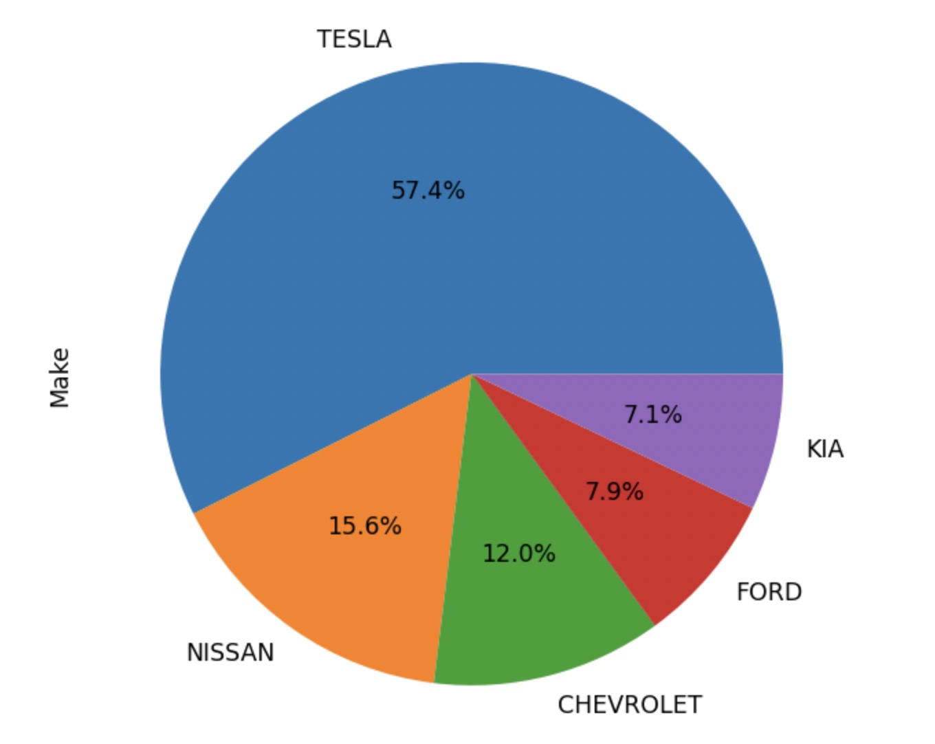

Most popular car brand for Electric Vehicles

Slide 14
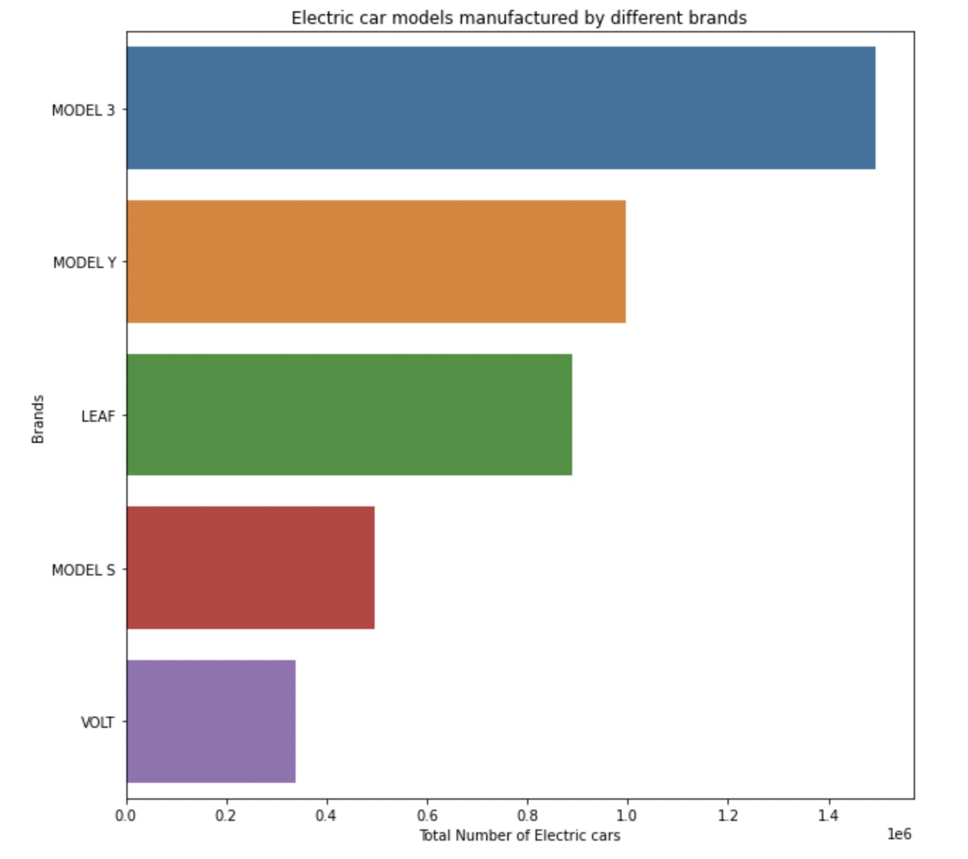
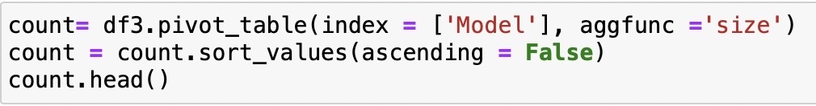
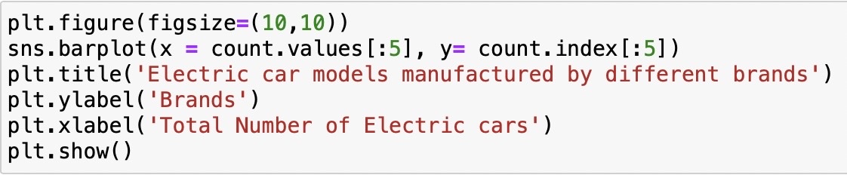
Most popular Electric Vehicle model

Slide 15
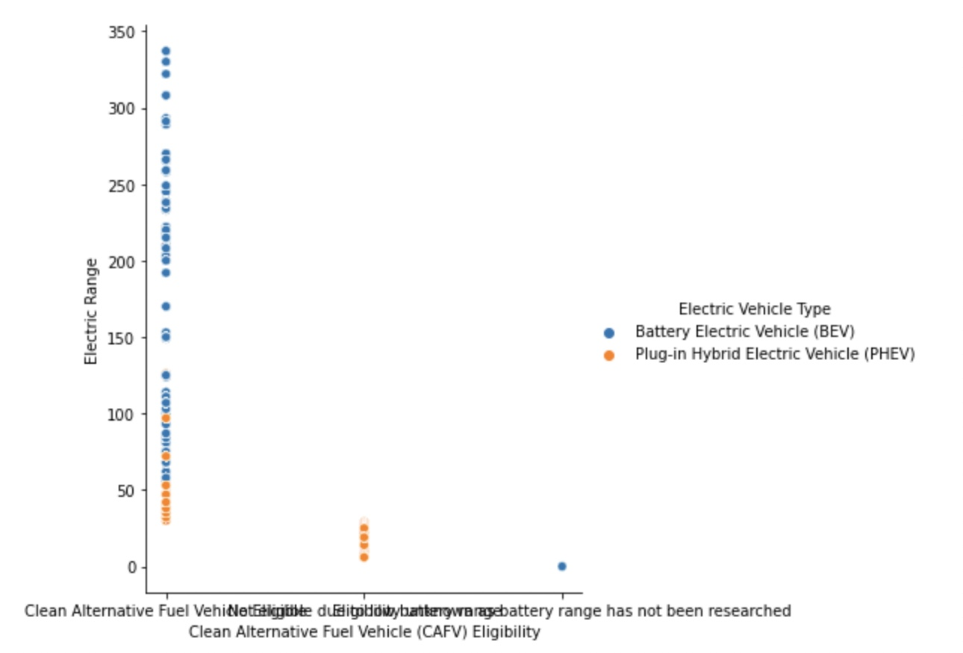
Relation between Electric Vehicle type and the range.

Slide 16
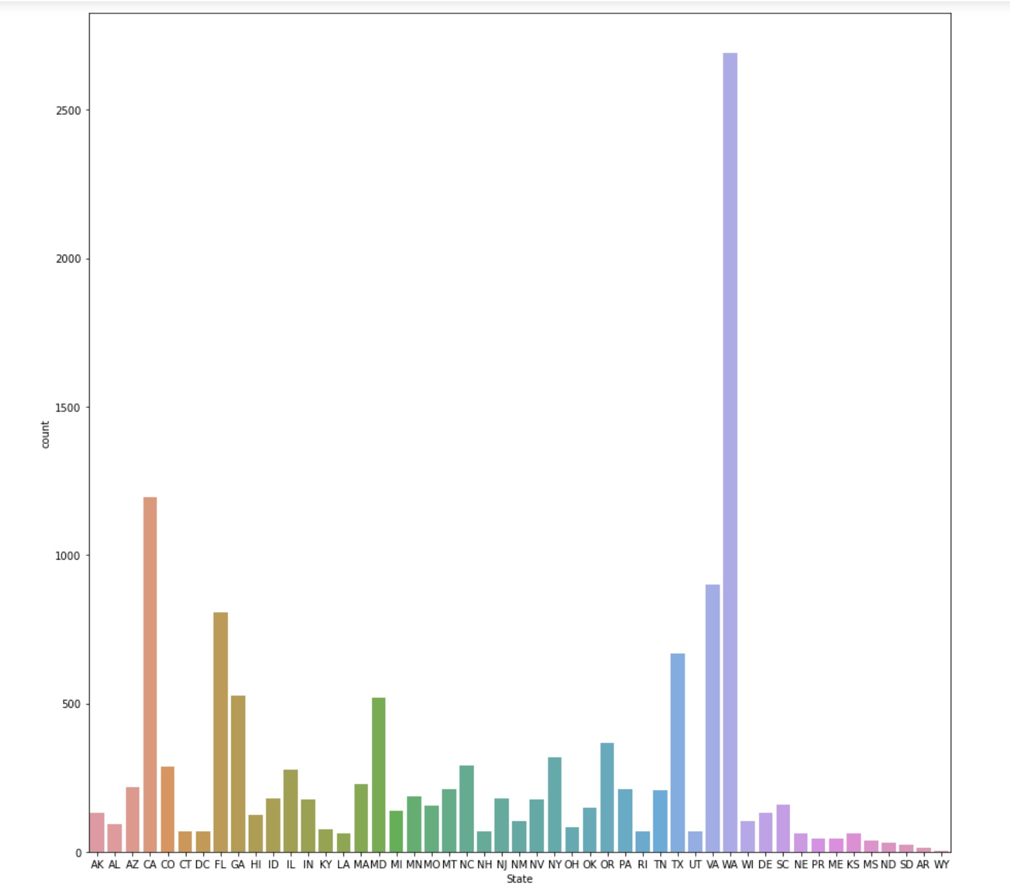


Total sales of EV’s across states

Slide 17
Conclusion
Electric car alternatives are now available from a variety of manufacturers, giving consumers more options than ever before.
Although Electric Vehicles has risen in recent years, the electric vehicle sector has been around for well over 50 years.
Car sales, particularly electric car sales, are predicted to increase, with environmental concerns leading the list of factors influencing electric vehicle purchasers.
In particular, Tesla dominates the EV market.

Slide 18
Thank you

