Slide 1
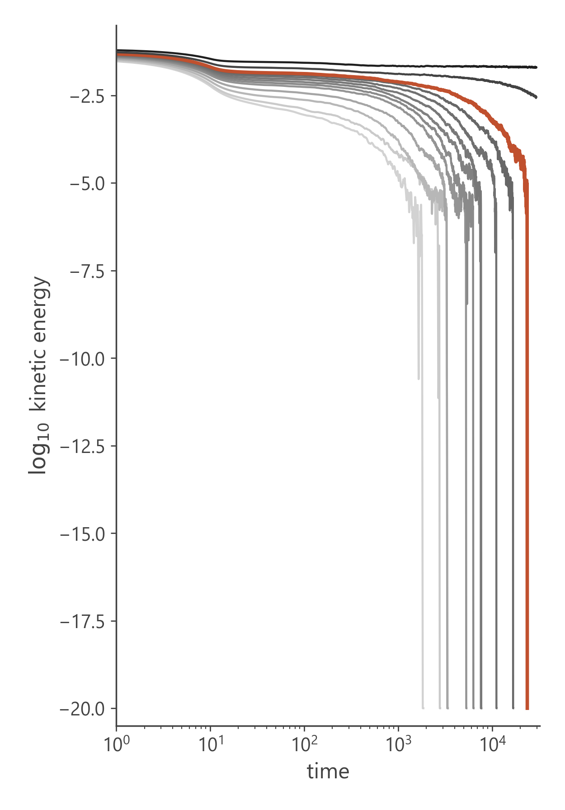
Team B-9
October 2026
Decoding Dense Active Fluids Through Machine Learning
Scaling, Koopman prediction and reduced equations
for kinetic arrest in a dense active glass
Presented by :
Code & data :
Team B-9
github.com/Rithvik188/Compflu
Rithvik Arulprakash · Harshith KV · Vipin Sudhakar · Vijay Murugan

Slide 2
Team B-9
Decoding Dense Active Fluids
Flow or freeze?
f
Dense self-propelled particles each push themselves with an active force f. Packed tightly, every particle is caged by its neighbours.
Strong pushing keeps the system flowing; weak pushing lets it jam and freeze. How the motion dies out near this transition has no closed theory.
Our approach
Learn the dynamics of the kinetic energy K(t) directly from simulations: scaling and master curves, Koopman-operator models, HAVOK and sparse equation discovery.
Self-propelled particle pushing against the cage formed by its neighbours (65 : 35 mixture).
2

Slide 3
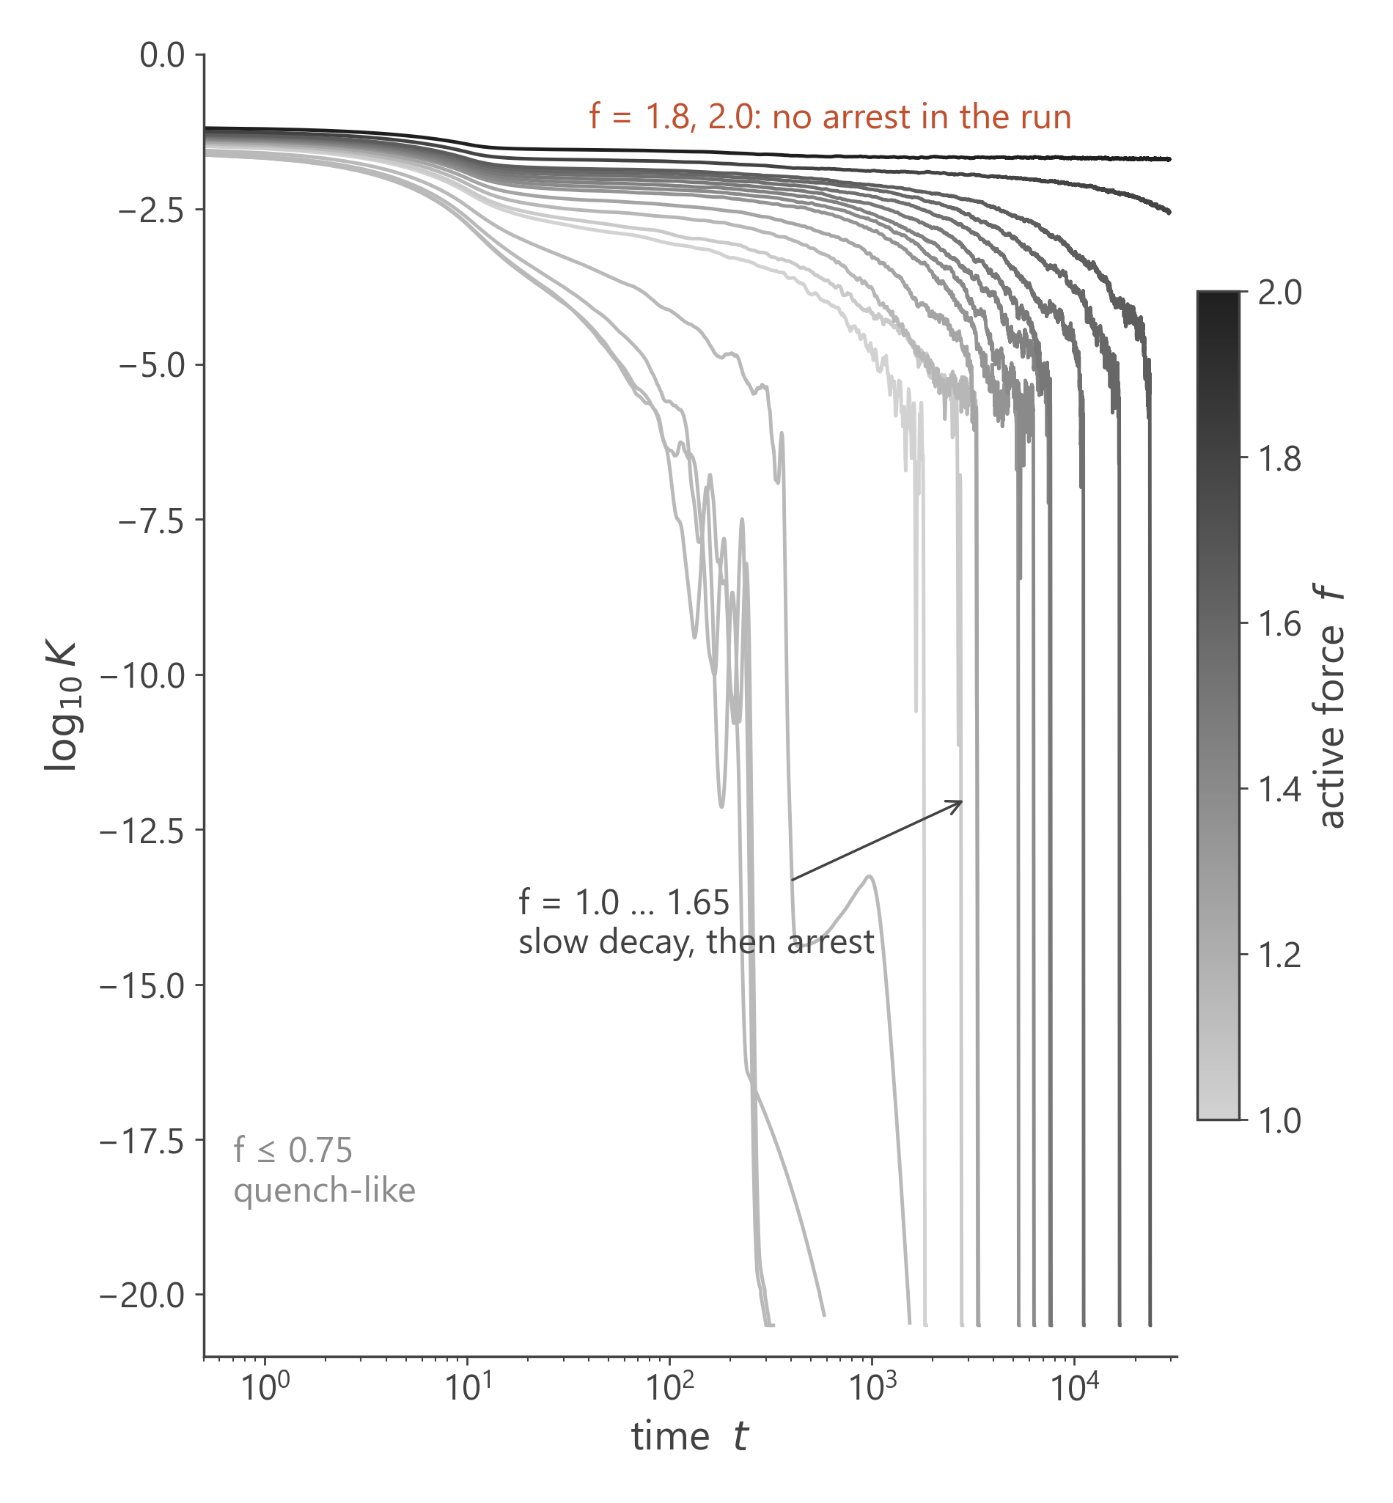
Team B-9
Decoding Dense Active Fluids
System & data
Model
2D Kob–Andersen mixture, 65 : 35, Lennard-Jones
Particles
N = 1000, constant active force f on each
Forces
17 values, f = 0 … 2.0, one simulation each
Signal
mean kinetic energy K(t), Δt = 0.5, up to t ≈ 3×10⁴
We study
log₁₀K: K falls by more than 20 decades
3

Slide 4
Team B-9
Decoding Dense Active Fluids
Two questions, one pipeline
Q1
Q2
Scaling
Prediction
Do all trajectories follow one master curve, and how does the time scale grow with f?
Can Koopman-operator models forecast a K(t) trajectory they have never seen?
17 trajectories
Master curve
HAVOK
Weak SINDy
Koopman
K(t; f)
& critical fits
intermittency
reduced equation
free-running forecasts
Q1
Q1
Q1 · Q2
Q2
Every claim is checked with a test that could fail: baselines, held-out forces, burst-free surrogates and bootstrap intervals.
4

Slide 5
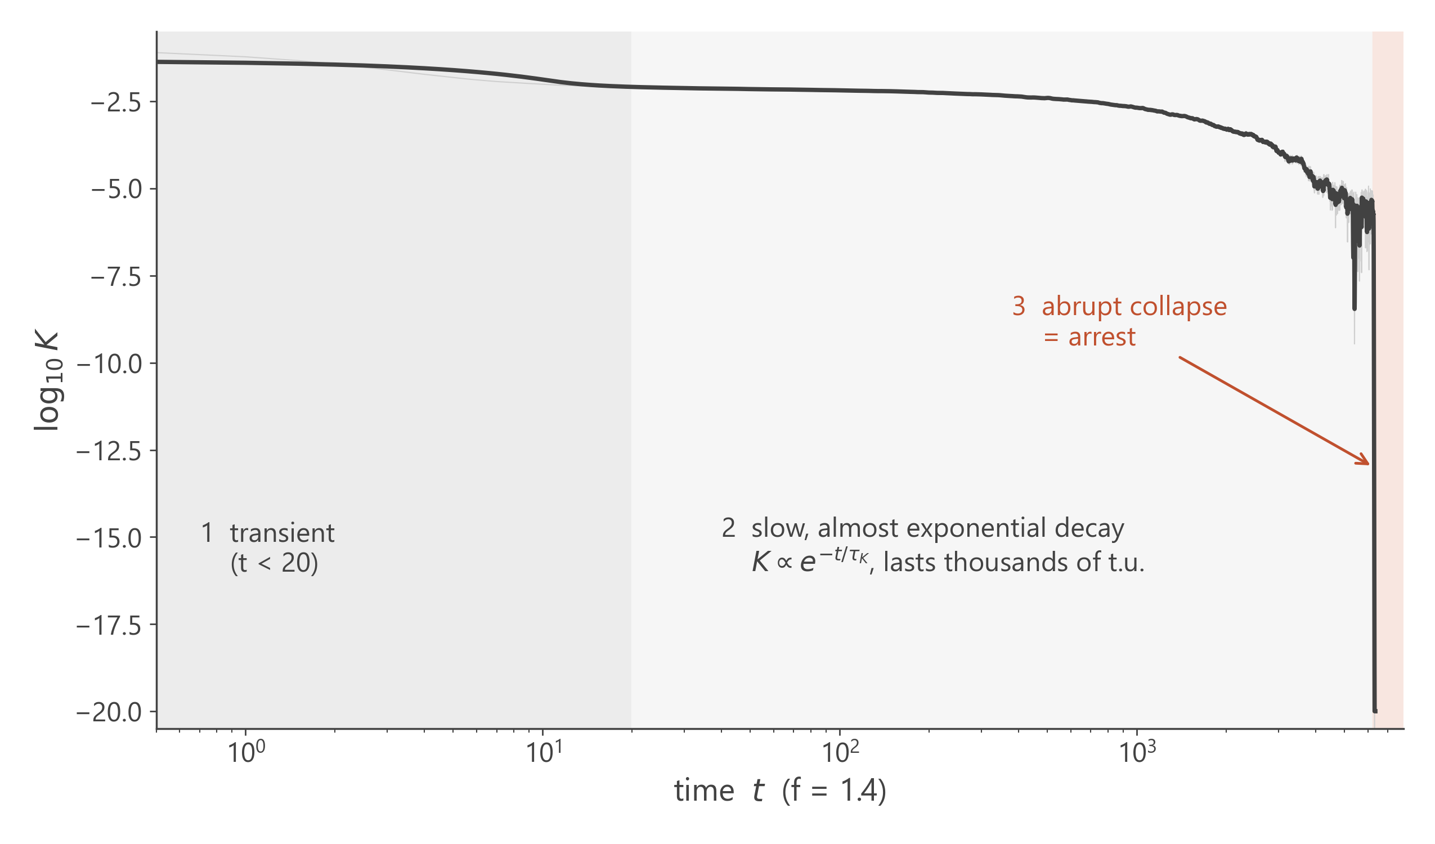
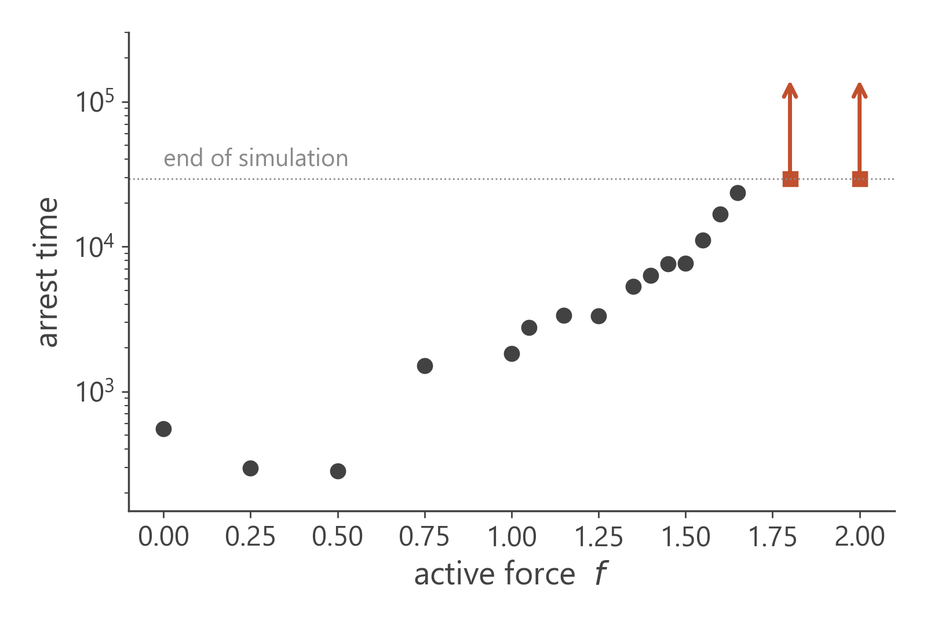
Team B-9
Decoding Dense Active Fluids
Anatomy of an arrest
f = 1.65 still arrests (t ≈ 23 650).
f = 1.8 is still decaying at the end of the run (p < 0.001) → f_{c} > 1.8
5

Slide 6
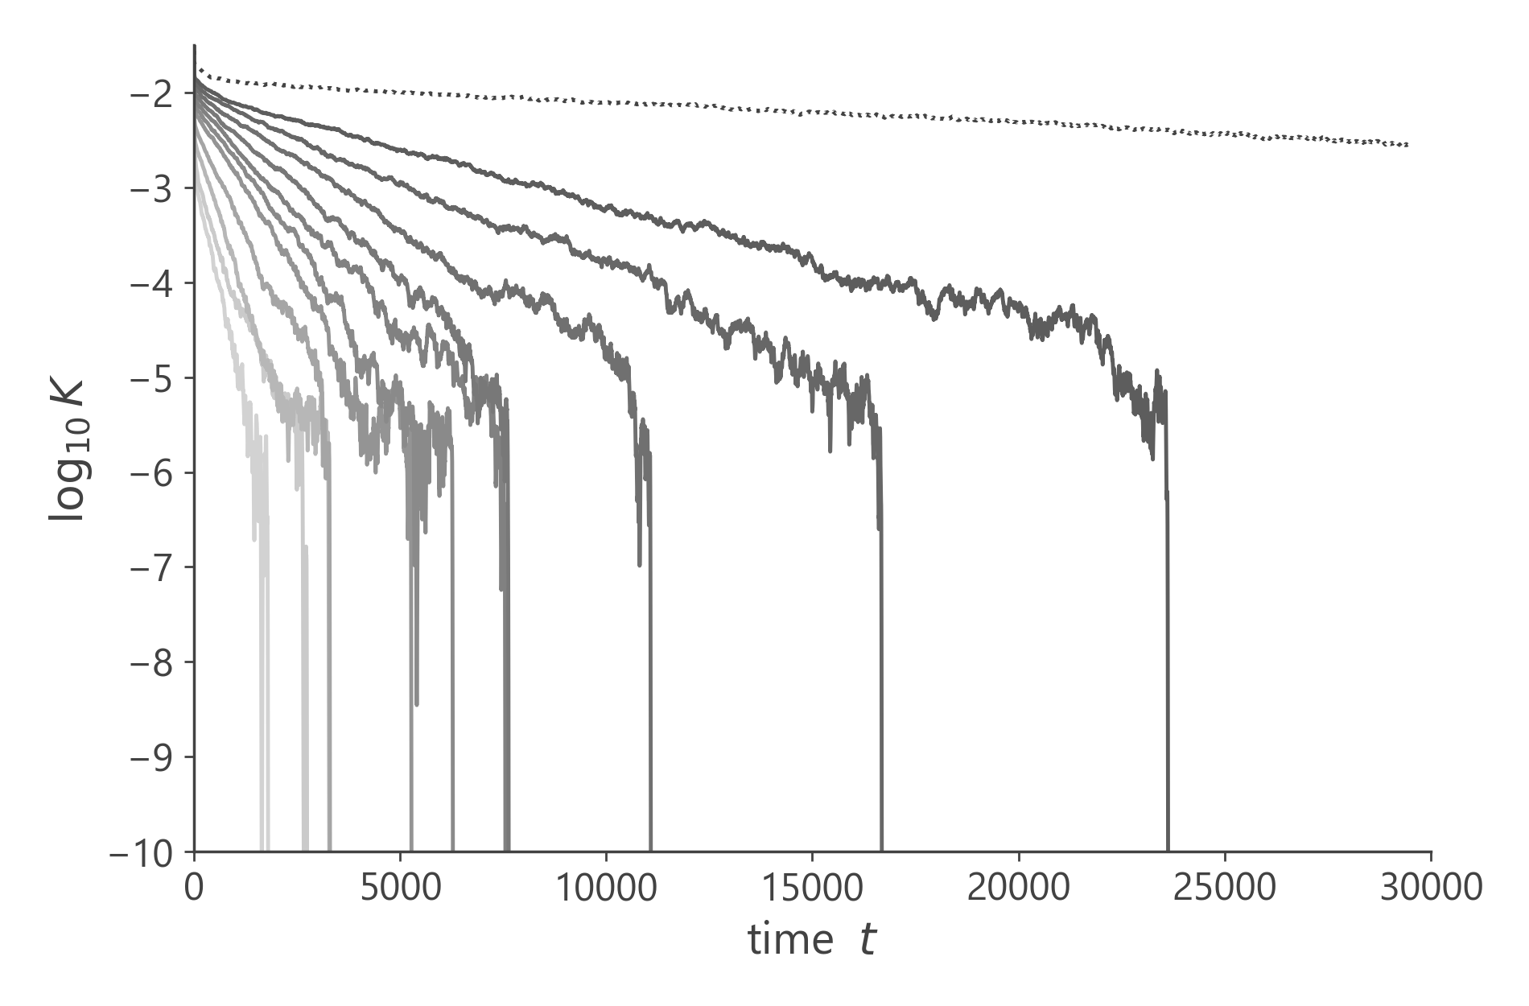
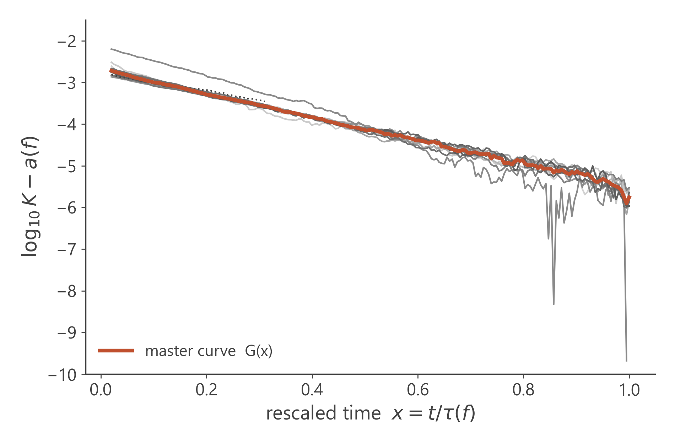
Team B-9
Decoding Dense Active Fluids
Q1 · One master curve
log₁₀K(t, f) = a(f) + G( t / τ(f) )
rescale
spread 1.81
spread 0.030
variance of log K across forces, as simulated
after t → t/τ(f) and a shift a(f) · R² = 0.983
6

Slide 7
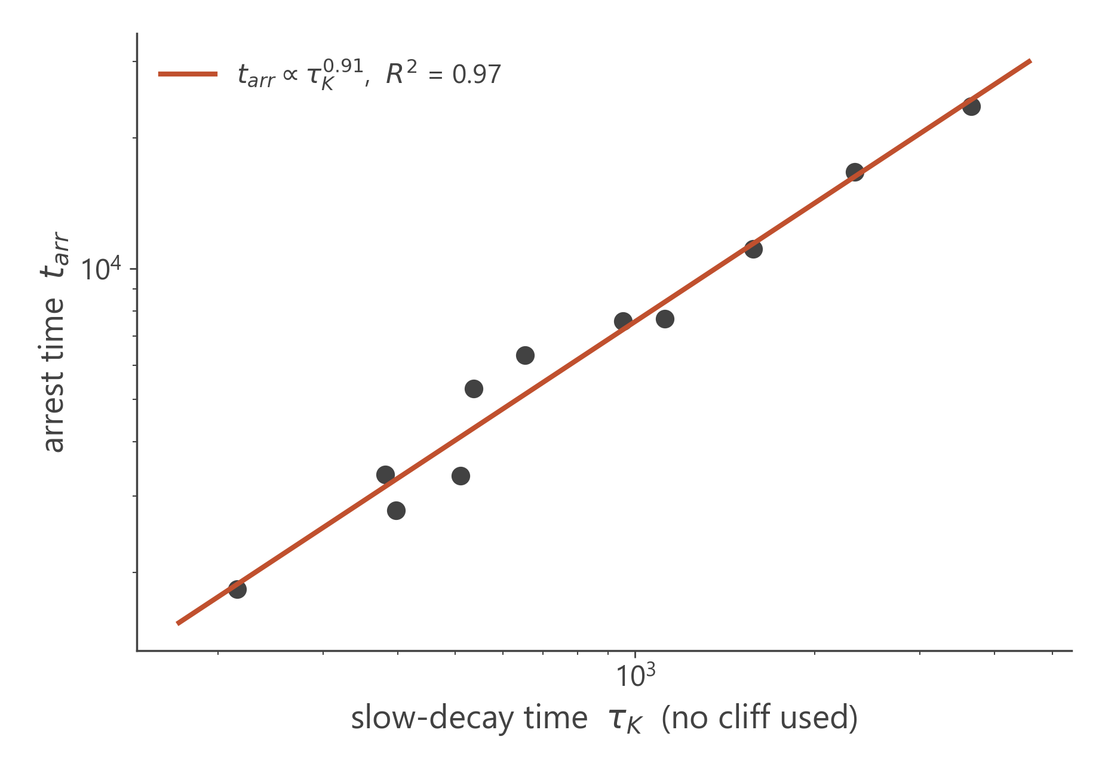
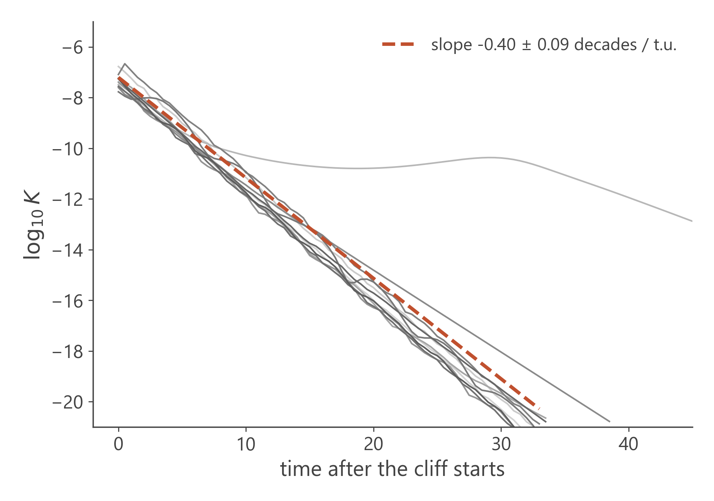
Team B-9
Decoding Dense Active Fluids
Is the collapse real?
Two free numbers per curve is a lot of freedom, so we tested what the collapse never used.
Arrest time follows from the slow decay alone: τ_{K} varies 17×, the ratio t_{arr}/τ_{K} only ±15 %.
After arrest every force collapses at the same rate: 0.40 ± 0.09 decades per time unit.
7

Slide 8
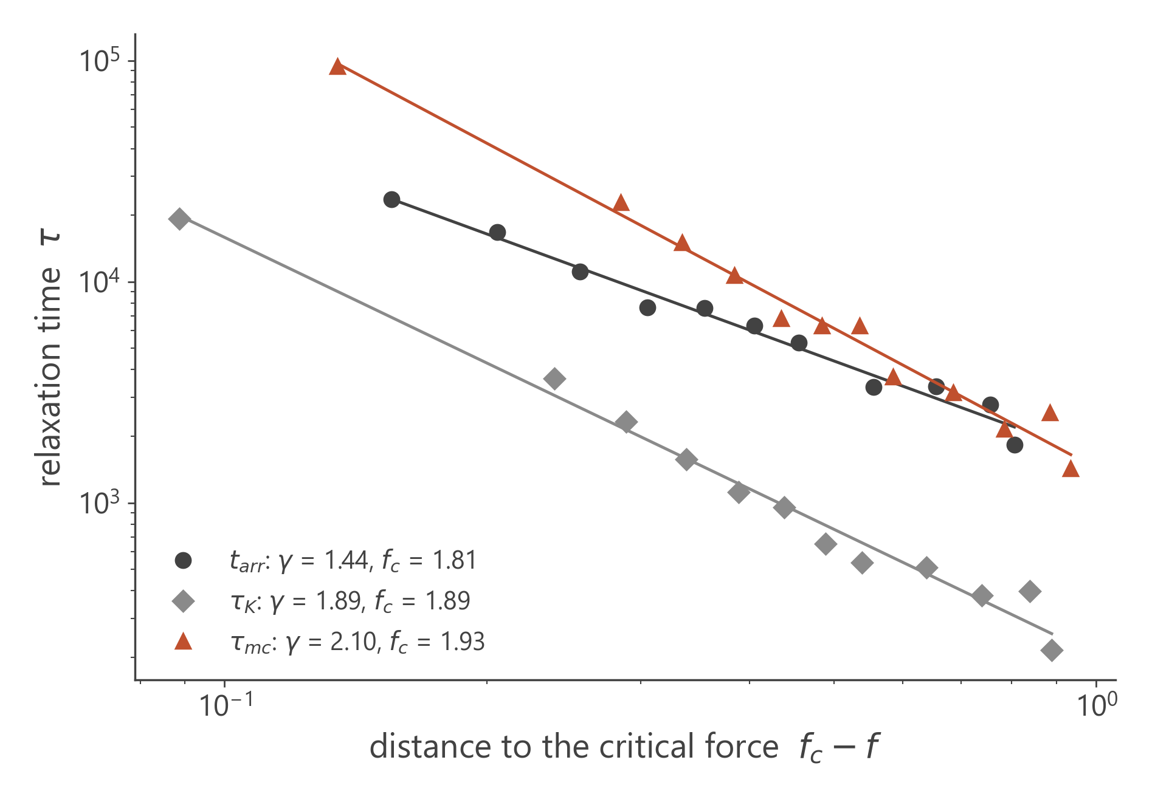
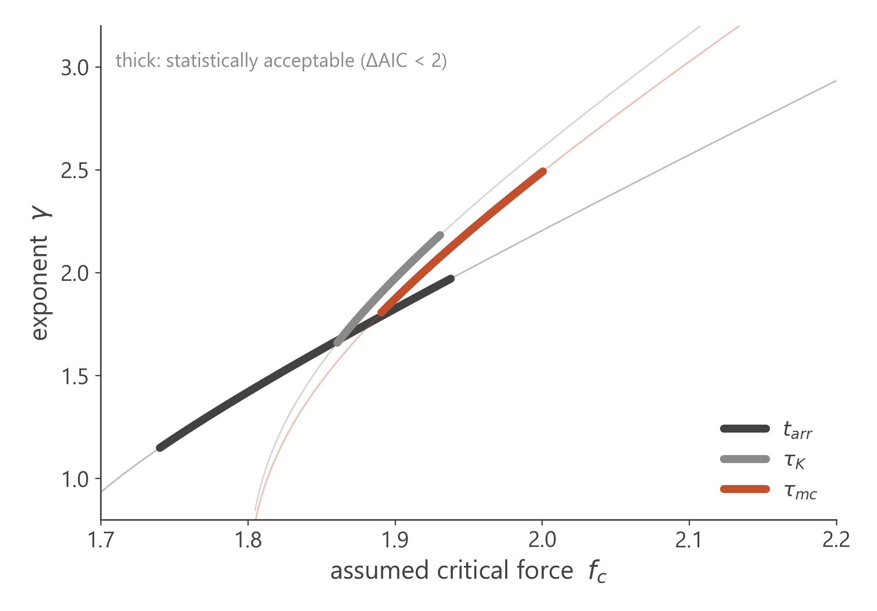
Team B-9
Decoding Dense Active Fluids
Critical slowing down
01. Arrhenius rejected
02. f_{c} ≈ 1.8 – 1.95
03. γ ≈ 1.4 – 2.1
τ grows faster than exponential: ΔAIC = 11–26 for four τ definitions
the critical force lies above every arresting run
power law ≈ VFT; γ and f_{c} trade off against each other
8

Slide 9
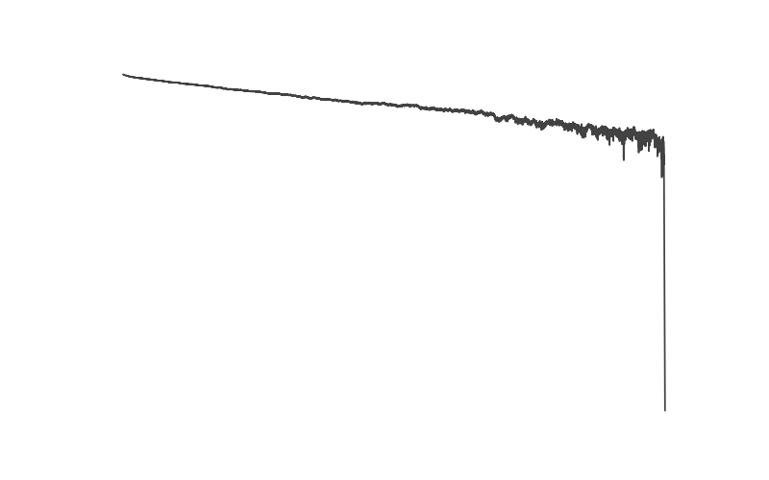
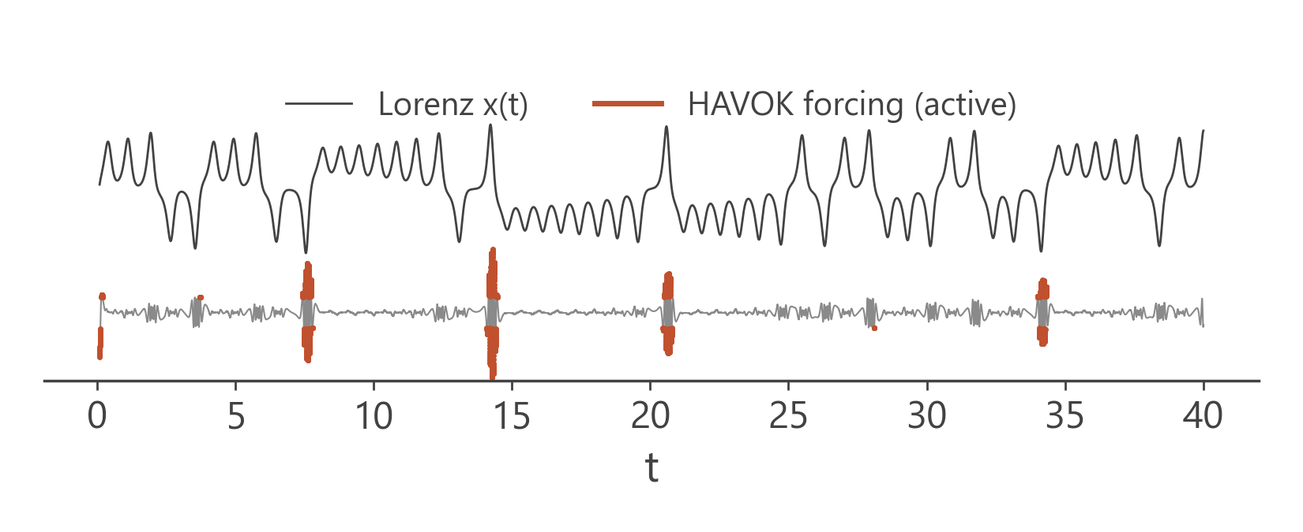
Team B-9
Decoding Dense Active Fluids
HAVOK: linear dynamics + rare kicks
1 Signal
2 Delay matrix
3 SVD
4 Linear model
v_{r} quiet → linear
v_{r} bursts → something sudden
fluctuation of log K
stack 20 t.u. of history
a few dominant patterns v₁ … v_{r}
dv/dt = A v + B v_{r}
Check 1 · Lorenz system: the forcing fires at the lobe switches (2.7× chance).
Check 2 · PyDMD: the open-source implementation gives the same eigenvalue (0.189i vs 0.188i).
Our own implementation of Brunton et al., Nat. Commun. 8, 19 (2017).
9

Slide 10
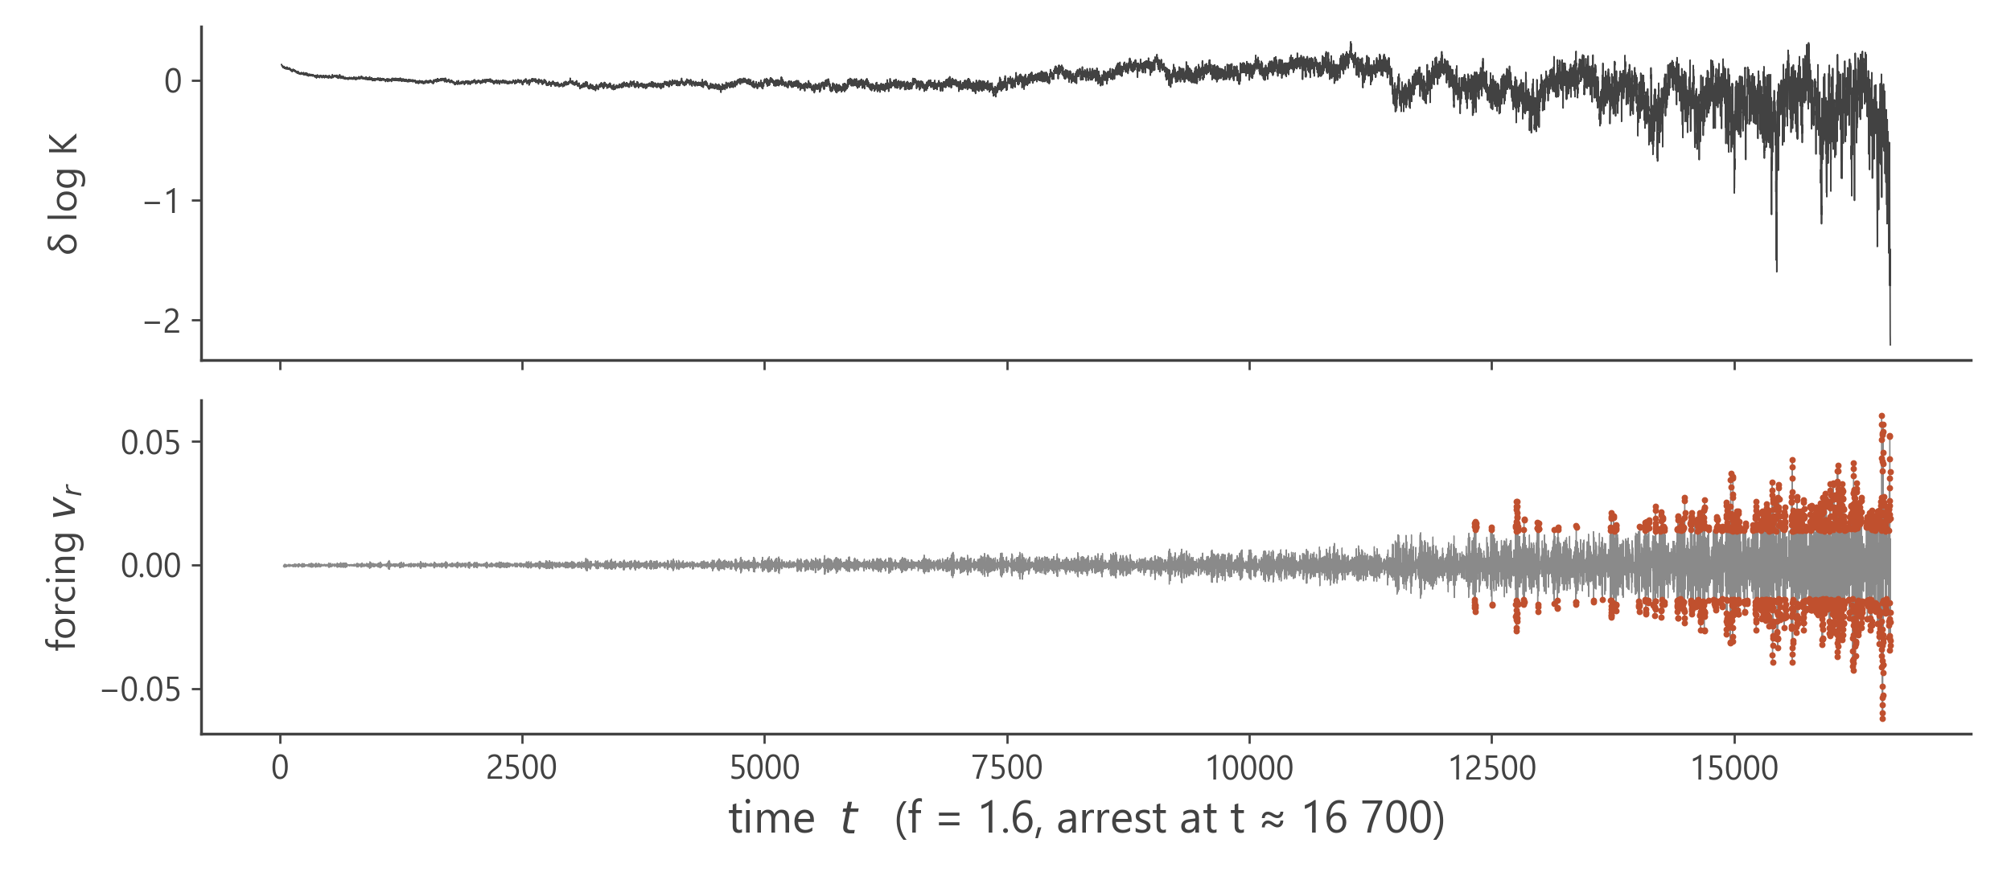
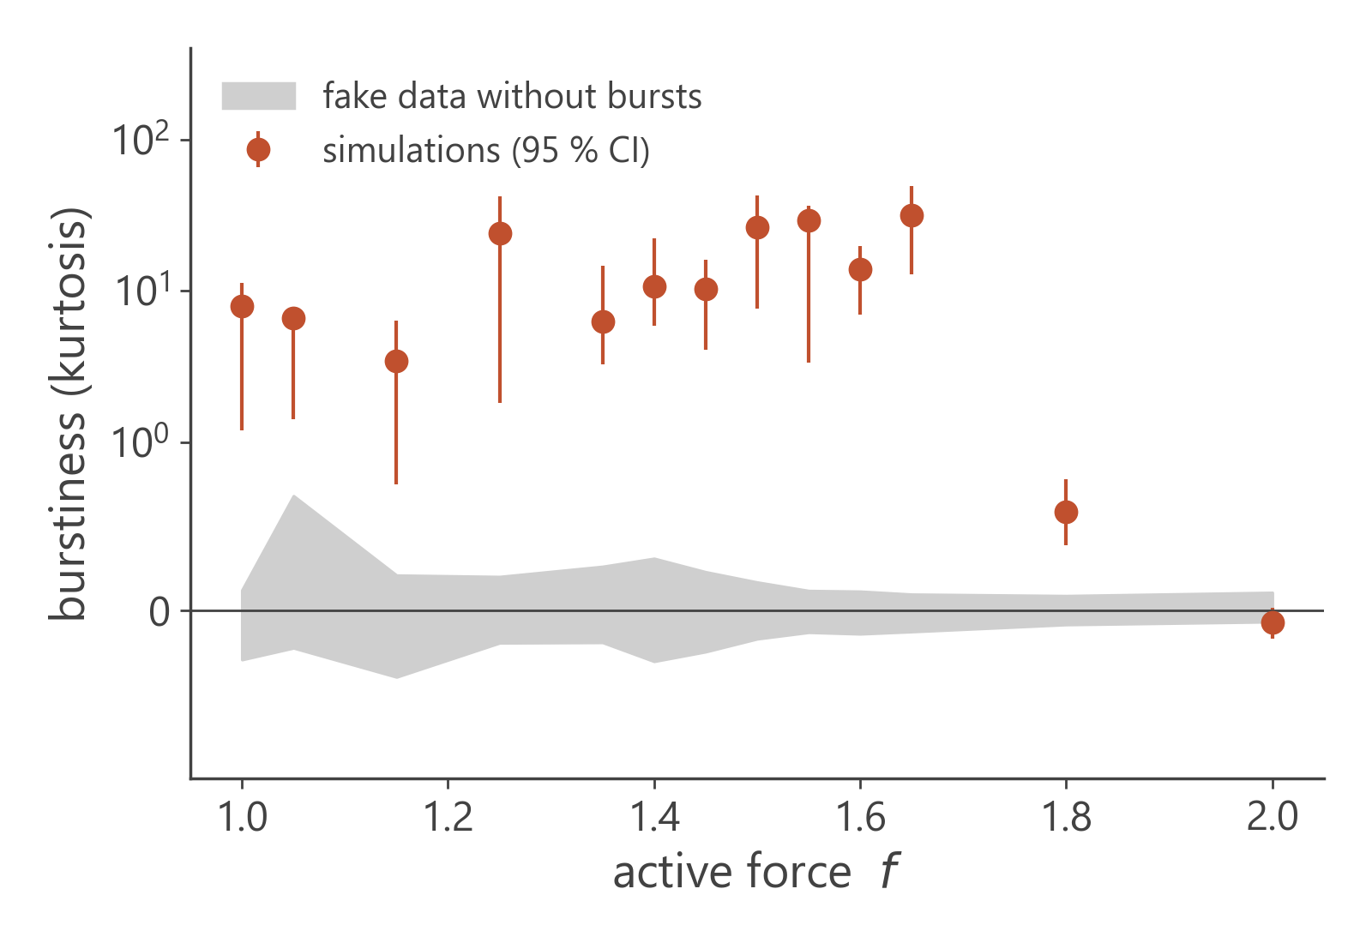
Team B-9
Decoding Dense Active Fluids
Bursts announce the arrest
01.
02.
03.
Bursty only when arresting
Real, not an artefact
An early warning
kurtosis 3.5–32 for every arresting force; Gaussian at f = 2.0
above all 19 burst-free surrogates; same for 3 window sizes
switches on in the last ~20 % and precedes sudden drops 2.9× more often than chance
10

Slide 11
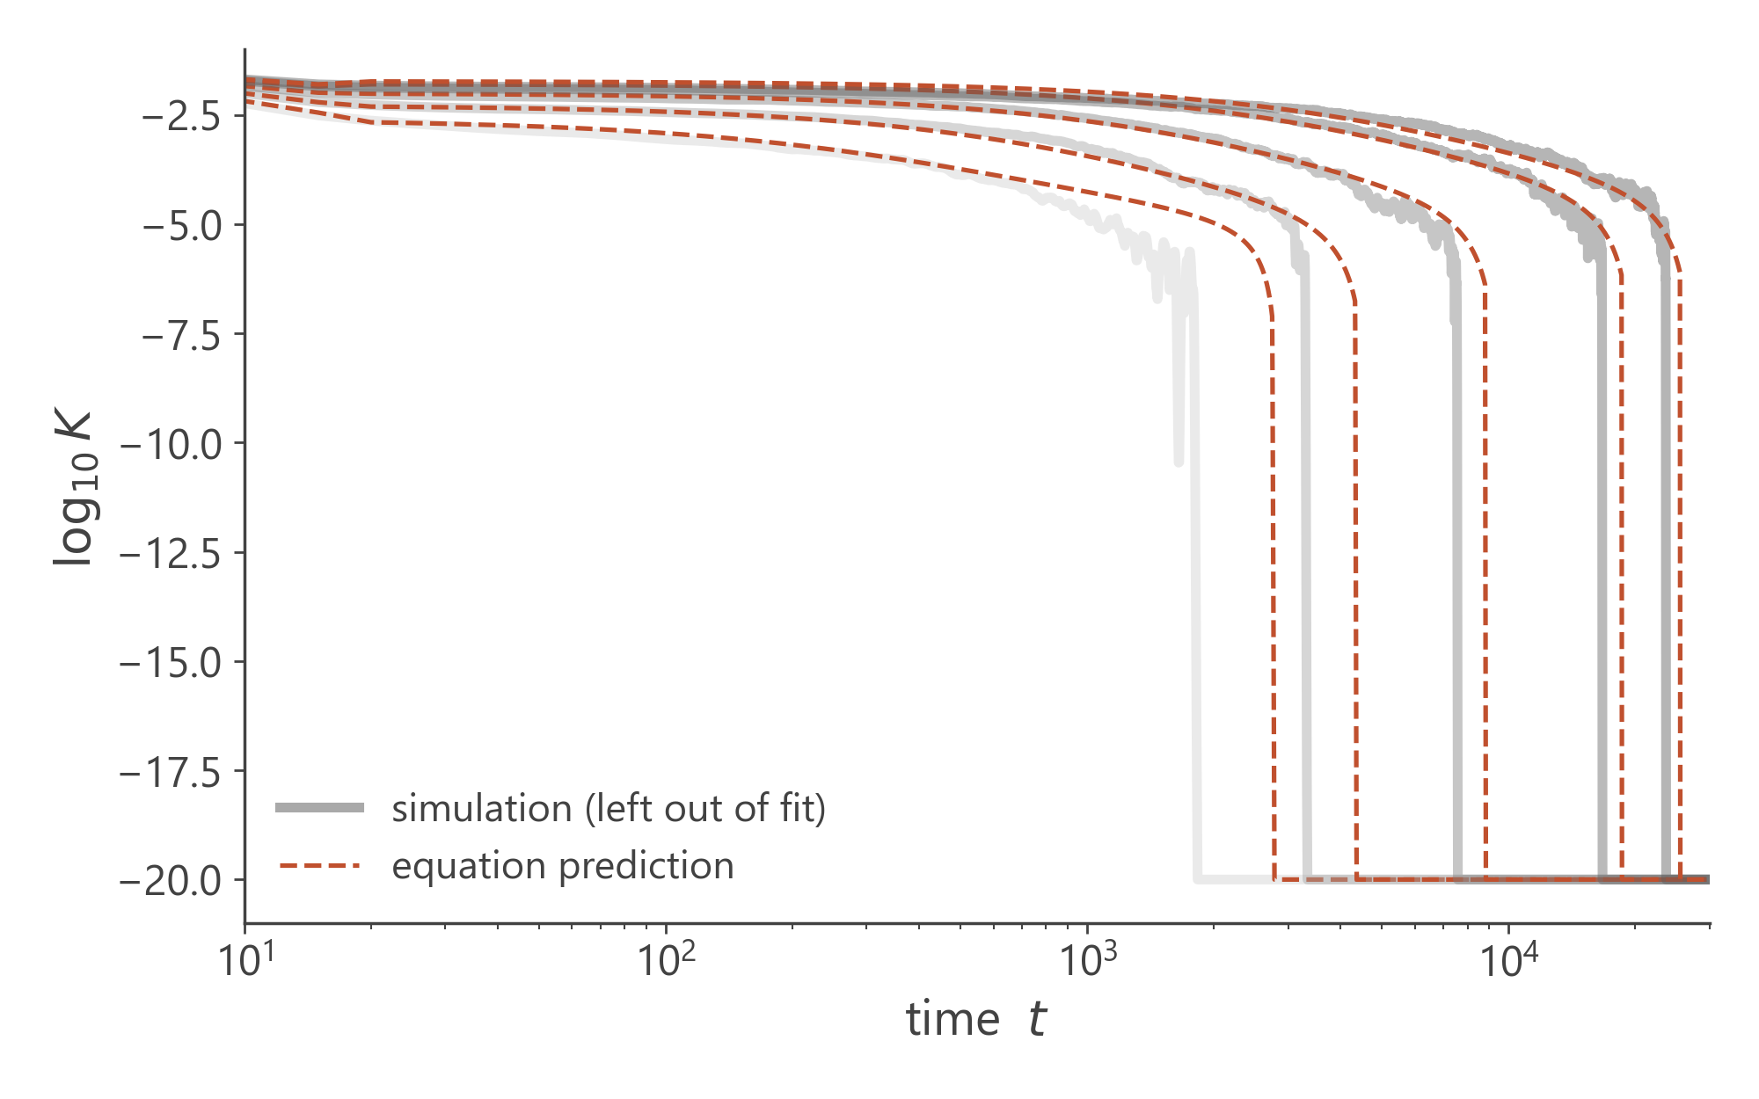
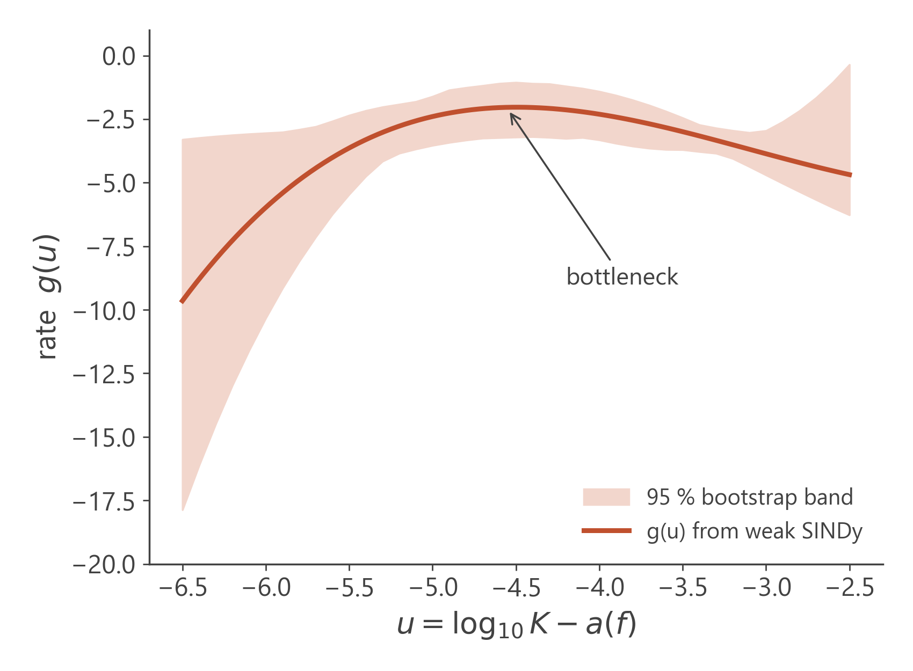
Team B-9
Decoding Dense Active Fluids
A reduced equation for all forces
τ(f) · dy/dt = g( y − a(f) ), y = log₁₀K
g(u) = 7.10u + 2.86u² + 0.307u³ τ(f) = 1433 (1.935 − f)^{−2.10} then collapse at 0.40 decades / t.u.
Weak-form SINDy · a generic polynomial library fails · leave-one-force-out arrest error 17 % · the differential form of the master curve, not a first-principles law
11

Slide 12
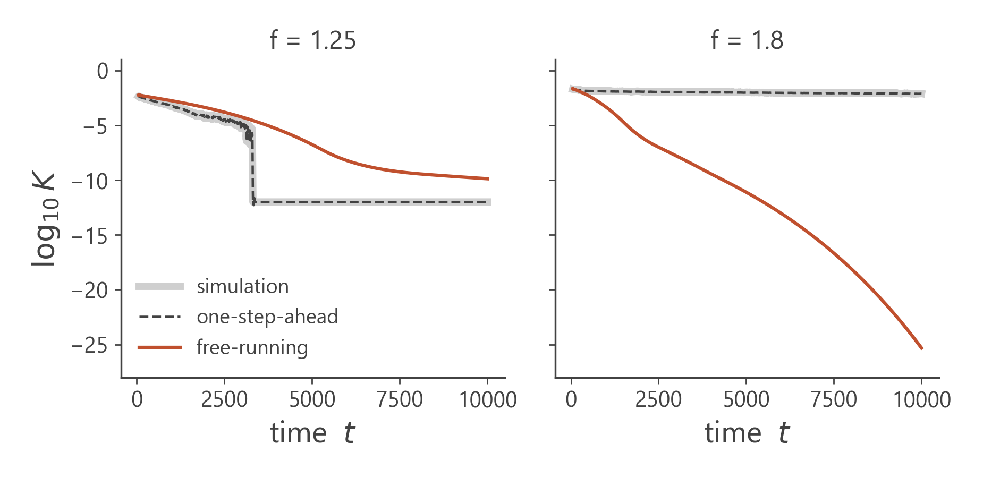
Team B-9
Decoding Dense Active Fluids
Q2 · Predicting runs never seen
(a) Unseen force
whole trajectory predicted from f alone
(b) Given the first part
10 / 25 / 50 %
forecast the rest
Five models, all rebuilt without the test run
One-step-ahead ≠ forecasting.
The same model is 0.02 decades off when shown the true history every step, but 3.5–11.7 decades off when running on its own.
All results here are free-running and leave-one-force-out.
Neighbour baseline
Parametric HDMD
Deep Koopman AE
Master-curve Koopman
Discovered equation
12

Slide 13
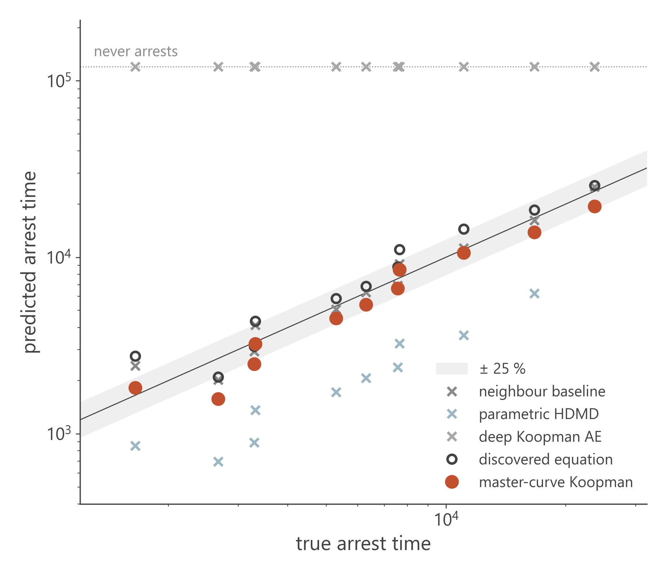
Team B-9
Decoding Dense Active Fluids
Q2 · Forecasting an unseen force
model
median error
missed
false
Neighbour baseline
8% [3%–24%]
0/11
1/2
Parametric HDMD
67% [59%–73%]
1/11
0/2
Deep Koopman AE
100% [100%–100%]
11/11
0/2
Master-curve Koopman
14% [10%–18%]
0/11
0/2
Discovered equation
17% [9%–31%]
0/11
0/2
arrest-time error, 11 arresting forces; false arrests for f = 1.8, 2.0
Linear Koopman operators cannot create the abrupt arrest; the deep Koopman AE drifts.
Scaling-informed Koopman: 14%, no missed or false arrests.
A time-stretched neighbour copy is at least as good inside the range (8%) but fails at the edges.
13

Slide 14
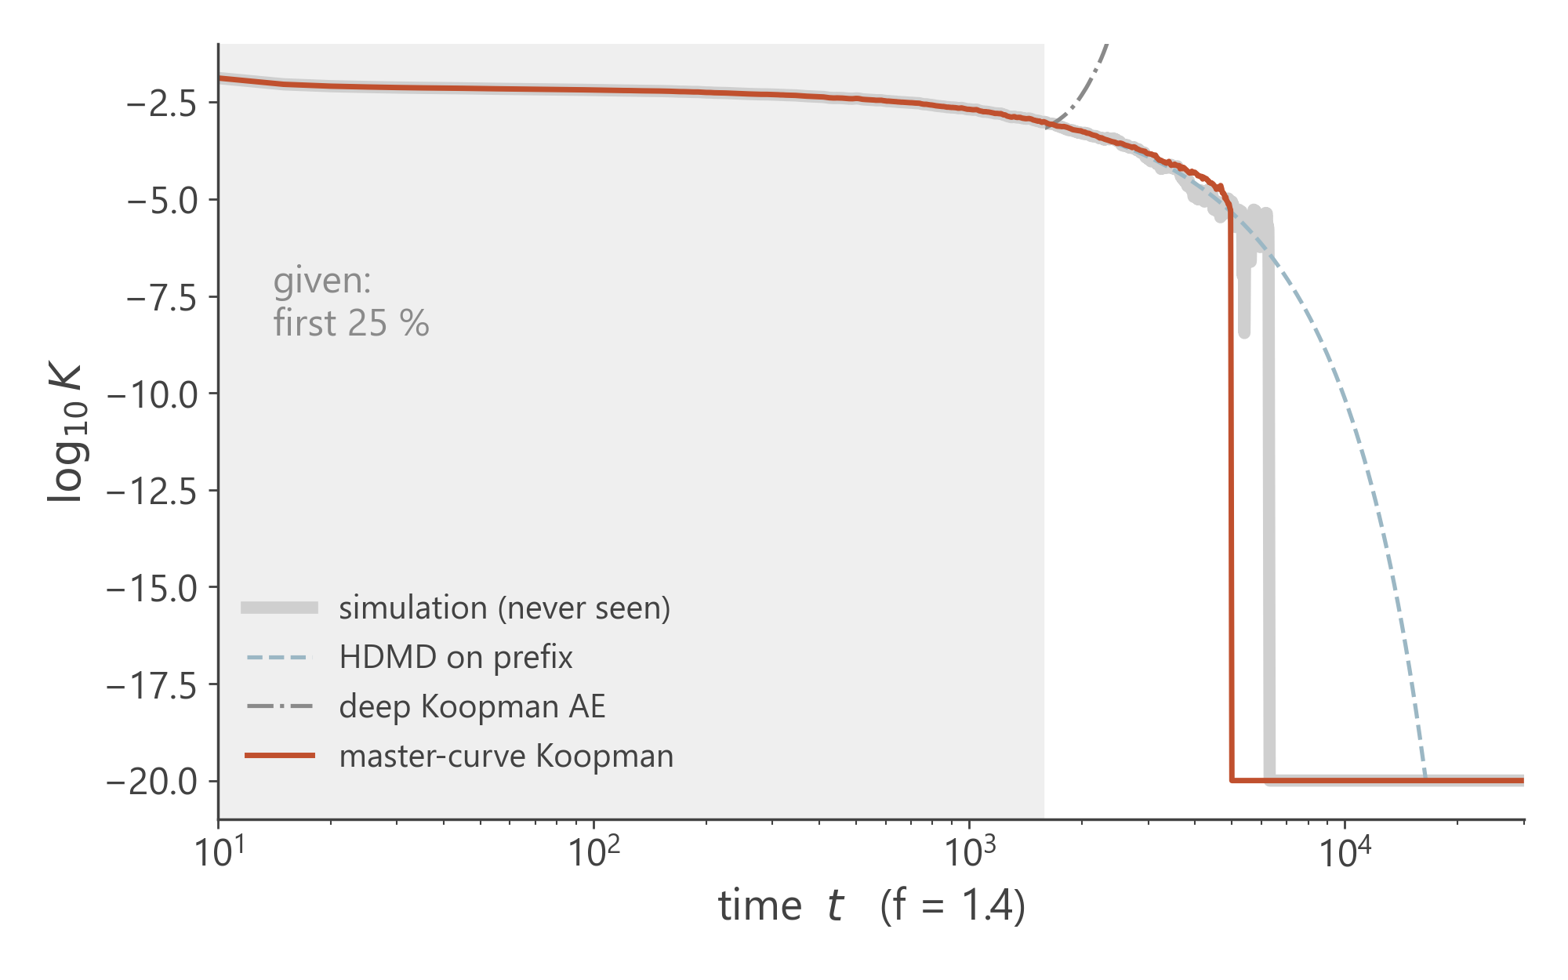
Team B-9
Decoding Dense Active Fluids
Q2 · Forecasting from the first part of a run
Master-curve Koopman, median arrest-time error
10 % given
25 % given
50 % given
20%
15%
13%
HDMD fitted on the prefix (≈ HAVOK without future kicks) and the deep Koopman AE miss most arrests (up to 6 and 11 of 11).
Discovered equation: 60% → 31%.
No missed arrests for the master-curve model at any prefix length.
14

Slide 15
Team B-9
Decoding Dense Active Fluids
How we tested every claim
claim
test that could have failed
result
f = 1.65 arrests; f = 1.8 still decaying
block-bootstrap test of the slope
p < 0.001
one master curve for f = 1.0 – 1.8
predict arrest from slow decay alone; held-out forces
R² = 0.97, ratio ±15 %
τ diverges faster than exponential
AIC against Arrhenius, four τ definitions
ΔAIC = 11–26
f_{c} ≈ 1.8 – 1.95, γ ≈ 1.4 – 2.1
profile, bootstrap, fit windows
range only (degenerate)
intermittent bursts are real
19 burst-free surrogates; 3 window sizes
above all surrogates
reduced equation predicts unseen forces
leave-one-out; synthetic recovery; bootstrap
17 % error
dK/dt = −AK + B f K^{n}
fit n and the sign of B
unphysical (B < 0)
Koopman + master curve forecasts
free-running, leave-one-out, vs baseline
14%; ties baseline inside
supported
partly
rejected
full list of 15 claims in the technical report: 10 supported · 4 partly · 1 rejected
15

Slide 16
Team B-9
Decoding Dense Active Fluids
Take-home messages
01.
Q1 · Scaling
One master curve log₁₀K = a(f) + G(t/τ(f)); τ diverges near f_{c} ≈ 1.8–1.95.
Next steps
Several runs per force → error bars
Blind test: predict f = 1.7, 1.75, 1.85, 1.9 before simulating them
A second system size and density
Compare γ and G with active mode-coupling theory
02.
Q2 · Prediction
Plain Koopman models fail when run freely; a scaling-informed Koopman model predicts unseen runs (14%).
03.
Equation
τ(f) · dy/dt = g(y − a(f)): compact, predictive, data-driven.
04.
HAVOK
Intermittent bursts switch on before arrest: an early-warning signal.
16

Slide 17
Team B-9
October 2026
Thank You
Decoding Dense Active Fluids Through Machine Learning
Questions are very welcome
Presented by :
Code & data :
Team B-9
github.com/Rithvik188/Compflu
Rithvik Arulprakash · Harshith KV · Vipin Sudhakar · Vijay Murugan

Slide 18
Team B-9
Backup
Backup · Critical fits
τ definition
best f_{c}
best γ
acceptable f_{c} (ΔAIC < 2)
acceptable γ
ΔAIC Arrhenius
ΔAIC VFT
arrest time
1.81
1.44
1.74 – 1.94
1.15 – 1.97
+11.1
+0.8
time to K = 10⁻⁵
1.85
1.99
1.78 – 2.00
1.60 – 2.69
+12.0
+0.7
slow-decay time τ_{K}
1.89
1.89
1.86 – 1.93
1.66 – 2.18
+24.2
-2.3
master-curve τ
1.93
2.10
1.89 – 2.00
1.81 – 2.49
+20.4
-0.9
time to K = 10⁻⁴ (biased)
2.02
3.08
1.92 – 2.17
2.58 – 3.85
+16.8
+1.2
time to K = 10⁻³ (biased)
3.00
10.66
2.53 – 3.00
7.57 – 10.66
-6.7
+5.0
HDMD on linear K (biased)
3.00
6.40
2.60 – 3.00
4.83 – 6.40
-6.0
+6.6
τ = A (f_{c} − f)^{−γ} with f_{c} above every fitted force. Times to reach a fixed level mix the f-dependent offset a(f) with the time scale and are therefore biased.
18

Slide 19
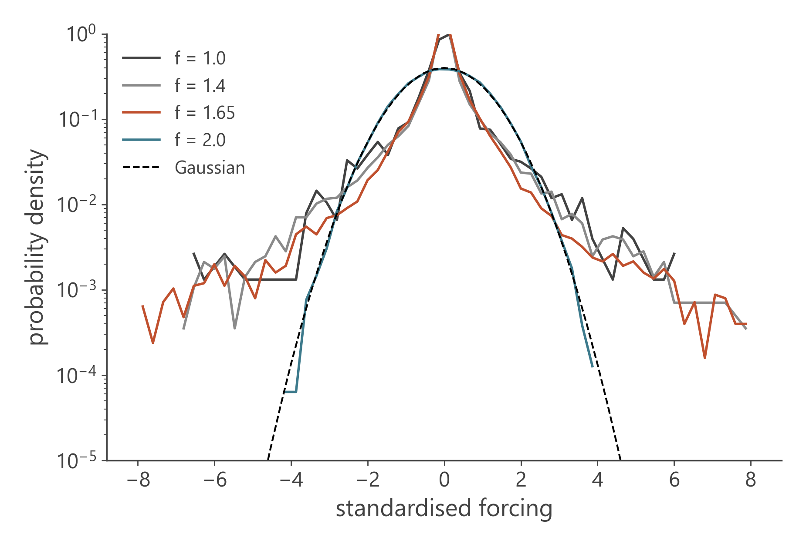
Team B-9
Backup
Backup · HAVOK robustness
delay window
median kurtosis (arresting)
f = 1.8
f = 2.0
drops: hit / chance
10 t.u.
11.7
0.71
-0.00
3.3×
20 t.u.
10.7
0.58
-0.07
2.9×
40 t.u.
9.8
0.46
-0.03
3.1×
Every arresting force has fat-tailed forcing at every window size; f = 2.0 stays Gaussian.
Surrogates: phase-randomised copies with the same power spectrum (Theiler et al., Physica D 1992).
19

Slide 20
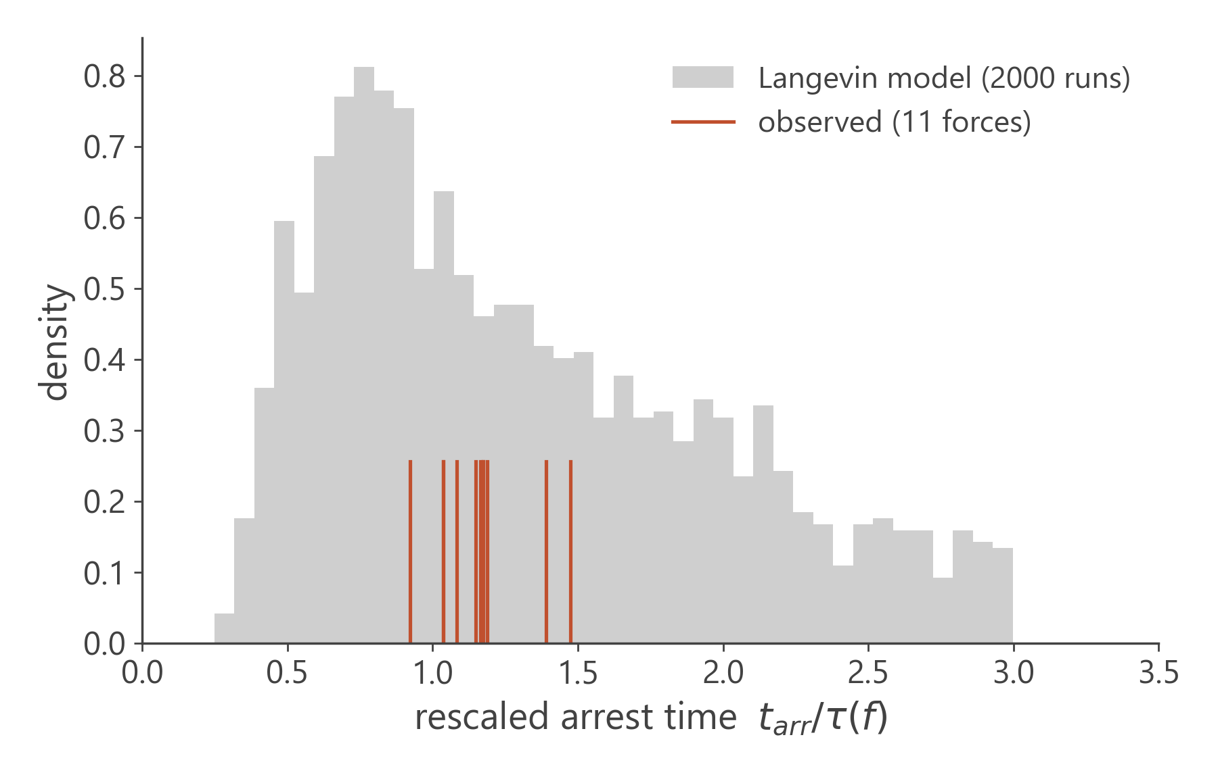
Team B-9
Backup
Backup · Equation details
term
coefficient
95 % bootstrap CI
selected
1
0.000
[-12.02, 64.80]
18 %
u
7.102
[-4.83, 50.00]
99 %
u²
2.859
[-0.62, 11.73]
98 %
u³
0.307
[0.00, 0.89]
89 %
Polynomial degree (leave-one-out arrest error): quadratic 37%, cubic 17%, quartic 14%.
Synthetic test: the correct law is recovered up to twice the data's noise level.
Langevin version: median rescaled arrest time 1.21 vs 1.17 observed; the spread is overestimated.
20

Slide 21
Team B-9
Backup
Backup · Per-force forecast errors
f
Neighbour
Param. HDMD
Deep Koopman
Master curve
Equation
1.0
+47 %
-48 %
no arrest
+10 %
+67 %
1.05
-24 %
-74 %
no arrest
-41 %
-22 %
1.15
-11 %
-73 %
no arrest
-24 %
-5 %
1.25
+25 %
-59 %
no arrest
-2 %
+31 %
1.35
-4 %
-67 %
no arrest
-14 %
+11 %
1.4
+0 %
-67 %
no arrest
-14 %
+9 %
1.45
-8 %
-69 %
no arrest
-12 %
+17 %
1.5
+20 %
-57 %
no arrest
+11 %
+45 %
1.55
+2 %
-67 %
no arrest
-4 %
+31 %
1.6
-3 %
-63 %
no arrest
-17 %
+11 %
1.65
+6 %
no arrest
no arrest
-18 %
+8 %
1.8
false arrest
correct
correct
correct
correct
2.0
correct
correct
correct
correct
correct
relative error of the predicted arrest time; f = 1.0 and f ≥ 1.65 require extrapolation in f
21

Slide 22
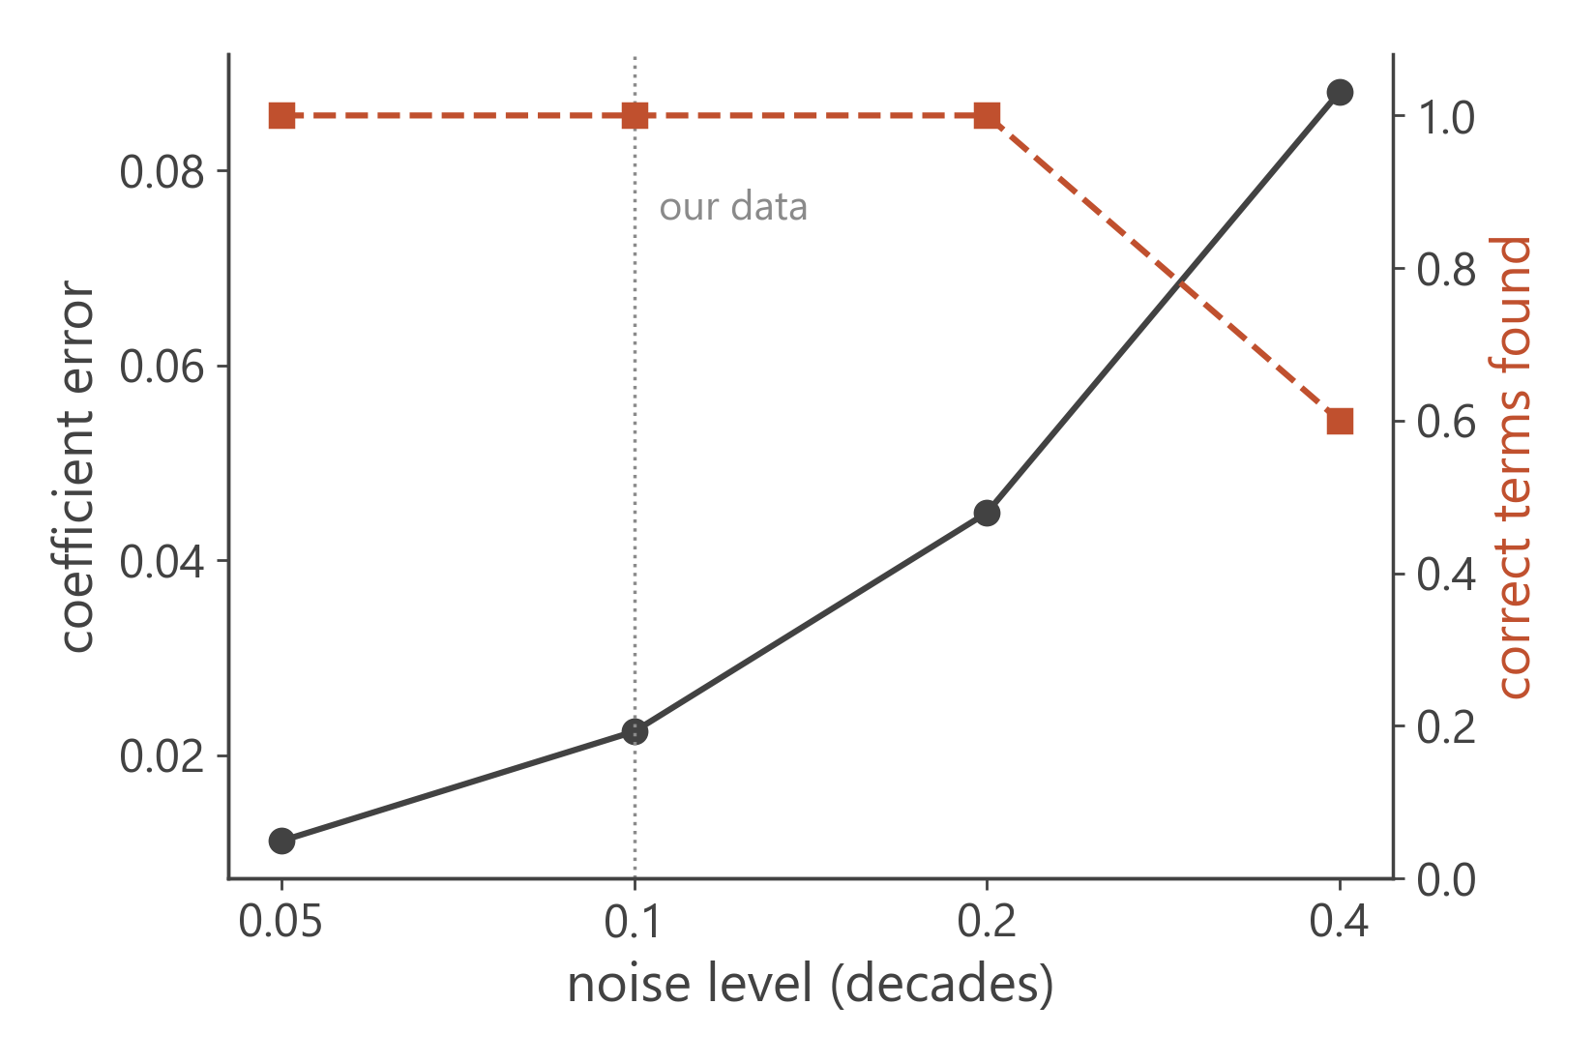
Team B-9
Backup
Backup · Method checks
τ_{K} fit window
γ
f_{c}
R²
t = 20 … 0.70 t_{arr}
1.94
1.893
0.988
t = 20 … 0.85 t_{arr}
1.89
1.889
0.984
t = 20 … 0.95 t_{arr}
1.89
1.889
0.978
t = 100 … 0.70 t_{arr}
1.92
1.891
0.987
t = 100 … 0.85 t_{arr}
1.87
1.887
0.982
t = 100 … 0.95 t_{arr}
1.87
1.887
0.977
Weak SINDy recovers the right terms on synthetic data with the simulations' correlated noise up to 0.2 decades (ours ≈ 0.1).
γ and f_{c} barely move when the slow-stage window is changed.
22

