Slide 1
Legal AEye-Opener
Guide: Assistant Professor P Kokila
Team Members:
Rithvik Muthyalapati PES2UG22CS451
Rohan S PES2UG22CS456
Rishi Subramanya PES2UG22CS445
Rhushya KC PES2UG22CS440

Slide 2
Problem Statement
In the legal domain, individuals often struggle to determine the appropriate sections of the Bharatiya Nyaya Sanhita (BNS) applicable to specific crimes. Legal professionals and law enforcement officers require a quick and efficient way to reference relevant laws based on crime descriptions.
The challenge is to develop an AI-powered legal chatbot that can analyze user-input crime scenarios and provide relevant BNS sections, along with explanations and possible legal actions. The chatbot should be capable of handling diverse crime descriptions, understanding legal terminology, and ensuring accuracy in its responses.

Slide 3
Abstract and Scope
This project aims to develop an AI-powered legal chatbot that utilizes Large Language Models (LLMs) with Retrieval-Augmented Generation (RAG) to provide users with instant, accurate, and context-aware legal assistance. The chatbot processes user-input crime descriptions, retrieves relevant BNS sections from a structured legal database, and generates simplified explanations along with possible legal actions. The use of RAG ensures that the chatbot does not rely solely on pre-trained knowledge but also fetches real-time, up-to-date legal information from trusted sources.
Scope of the Project
Crime Analysis: Accepts user input describing a crime scenario and identifies the relevant legal aspects.
Law Retrieval: Uses RAG to fetch applicable IPC and BNS sections based on user queries.
Legal Explanation: Provides simplified explanations of legal provisions to make them understandable for common users.
Suggested Legal Actions: Offers guidance on the next steps, such as filing a complaint or contacting authorities.
Real-Time Legal Updates: Ensures accuracy by dynamically retrieving legal information from updated sources.
Target Users
General Public – For legal awareness and understanding of laws.
Law Enforcement Officers – For quick reference to legal provisions.
Legal Students & Professionals – To assist in case research.
NGOs & Social Workers – For legal aid and justice advocacy.

Slide 4
Literature Survey
Paper | Methodology | Outcome | Drawbacks
LAWBOT: A Smart User Indian Legal Chatbot using Machine Learning Framework | RASA framework Botpress for overview of chatbot, Longformer for cosine similarity | A chatbot that provides information about previously closed cases. | Provides only information with respect to only previous cases.

Slide 5
Literature Survey
Paper | Methodology | Outcomes | Drawbacks
RAG-Based LLM Chatbot Using Llama-2 | Lama-2-7b model(pre-trained), BERT for embeddings,Chromoa DB,Langchain retriever. | A chatbot that provides advice on legal actions that can be taken for a mentioned action. | Focuses only on domestic violence.

Slide 6
Literature Survey
Paper | Methodology | Outcome | Drawbacks
Generative vs Intent-based Chatbot for Judicial Advice 2024 IEEE 9th International Conference for Convergence in Technology (I2CT) | Generative Chatbot using OpenAI API Intent-based Chatbot using Google’s Dialogflow | Accuracy: Generative: 96% Intent-based: 80% Precision: Generative: 96.67% Intent-based: 90.47% | Generative AI faced challenges in maintaining consistency and precision in responses Intent-based AI demonstrated limited scope posed limitations when confronted with user queries beyond the established intents

Slide 7
Literature Survey
Paper | Methodology | Outcome | Drawbacks
Optimizing Legal Information Access: Federated Search and RAG for Secure AI-Powered Legal Solutions | Federated Learning, Federated Search, ReAct Framework | The ReAct framework can answer legal queries and educate about the legal reasoning | Federated Learning introduces issues like communication costs, non-uniform data distribution, and device reliability. Legal data can often be heterogeneous.

Slide 8
Literature Survey
Paper | Methodology | Outcomes | Drawbacks
Legal Assistance Redefined: Transforming Legal Access with AI-Powered LegalLink 2024 IEEE International Conference on Signal Processing, Informatics, Communication and Energy Systems (SPICES) | Machine Learning Model: 1)Mixtral-8x7B-Instruct-v0.1 2)nomic-embed-text-v1 3)Retrieval Engine | Legal Link reliably delivers accurate results across various legal domains. Metrics collectively suggest moderate performance of the chatbot in generating responses | Limited to only IPC laws and is not trained on the BNS laws.

Slide 9
Dataset
The dataset was obtained by web scraping the BNS chapters and sections from Devgan.in.
The web scraping was done using the beautiful soup library from python.
The web scraped data is summarized using bart-large and passed to the vector embedder all-MiniLM-L6-v2.
The vector embeddings are then stored in ChromaDB, a vector database
The embeddings from the vector database can be accessed via an index file

Slide 10
Data Storage and Pre-Processing
The contents in the web-scraped data are processed and stored in ChromaDB.
BNS sections are stored in a single file, in different fields of the data.
The DB will have the following metadata:
  Law_type
  Chapter number
  Chapter _title
  Section_title
  Section_content
  Section_summary
  Source URL

Slide 11
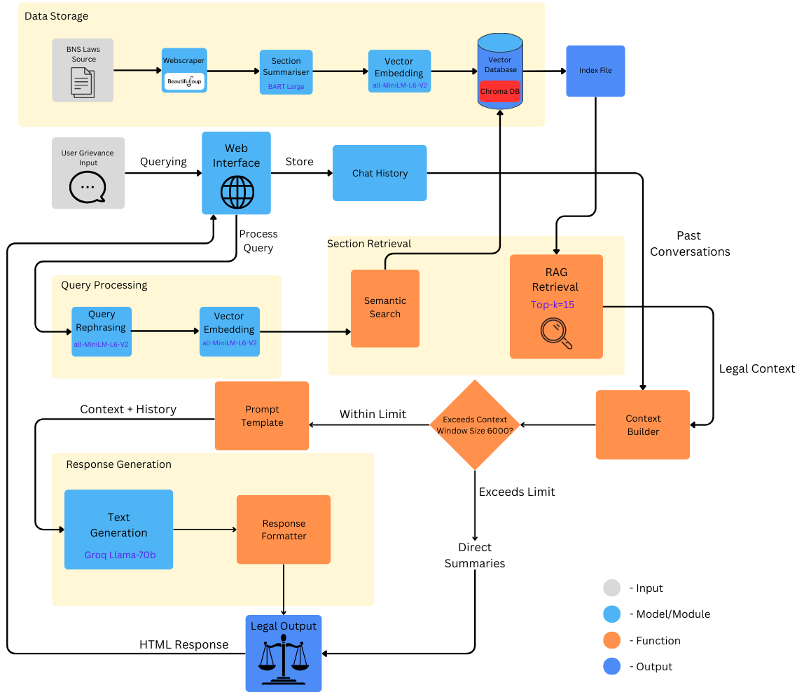
Architecture

Slide 12
Proposed Methodology
The data is gathered by web scraping the BNS sections from Devgan.in
The content, chapter number and section numbers are stored in ChromaDB.
The Content is summarized and stored in ChromaDB.
A query is taken from the user and vector embedded. A semantic similarity search is done to find the closest matches from the DB.
The closest matches are retrieved on the basis of top-k approach.
The retrieved data is used to generate a response for the user query.

Slide 13
Architecture
Workflow Overview (From User Query to Response)
1. User Input (Frontend)
User types a legal query into the chat input on the web interface (e.g., “Tell me about section 302” or “I got hit by a car”).
Submits the query via POST request to /.
2. Request Handling (Flask Backend)
Flask route / receives the request.
Session chat history is initialized if not already present.
3. Input Validation & Preprocessing
Checks if input is empty → returns warning if true.
Applies normalization rules.
Extracts section numbers and ranges using regex:
  from section X to section Y
  section 10, 12, and 14
  Filters valid sections (1–358) and tracks invalid ones.

Slide 14
Architecture
4. Exact Section Match (ChromaDB Lookup)
Retrieves all metadata from ChromaDB collection bns_laws.
Searches for exact matches by section number.
Prepares formatted_results with:
  law_type
  section_summary
  source_url
  match_type = "Exact"
5. Fallback: Semantic Search + Groq LLM
If no exact match found:
Query Rephrasing
  Uses Groq LLM to rephrase the user query into a concise legal version.

Slide 15
Architecture
2. Semantic Vector Search
  Encodes rephrased query with SentenceTransformer.
  Performs vector search on ChromaDB (n_results=15).
  Gathers top relevant context summaries.
3. LLM Response Generation
  Calls Groq LLM with:
    Top section_summary context documents
    Last 5 turns of chat history
    Original user query
  Returns a natural language legal explanation based on context.
6. Response Formatting
If LLM returns a response:
  Add Groq AI result to formatted_results
  Add source URLs if present
If no results:
  Add "❌ No matches found" to response

Slide 16
Architecture
7. Chat History Management
Saves query + response(s) + timestamp to session['chat_history']
Uses markdown() to render summaries with HTML formatting.
8. Rendering (Frontend)
Renders index.html with:
  Current result
  User query
  Session chat history (with summaries formatted as Markdown)

Slide 17
Novelty
Use of BNS laws instead of IPC laws. Recently, IPC has been invalidated but most of the existing chatbots still refer to IPC while responding to queries.
Our legal assistant refers to BNS laws and responds with the appropriate laws.
Our legal assistant also provides actions that can be taken against the criminal instead of just stating the laws under which the orchestrator of the crime can be brought to justice.

Slide 18
Results
This project successfully demonstrates the power of Retrieval-Augmented Generation (RAG) in building a practical, user-centric legal assistant tailored to the needs of the Indian population. By integrating natural language understanding with a robust database of BNS (Bharatiya Nyaya Sanhita) legal sections, the system bridges the gap between complex legal texts and everyday citizens seeking justice.
Our main goal was to educate the common man about the new BNS legal code, and this system achieves that by:
Accepting everyday language queries from users,
Mapping them to relevant legal sections through both exact and semantic matching,
And generating clear, actionable responses using Groq’s LLM.
In addition, the chatbot suggests what steps a victim can take and highlights the legal provisions that protect them, fostering awareness and empowerment. With this tool, we move a step closer to making law more accessible, transparent, and understandable for all, especially those unfamiliar with legal jargon.
The project lays the foundation for scalable legal assistance tools and can be further enhanced by integrating multilingual support, case tracking, and real-time legal updates—continuing our mission to bring legal literacy to every doorstep in India.

Slide 19
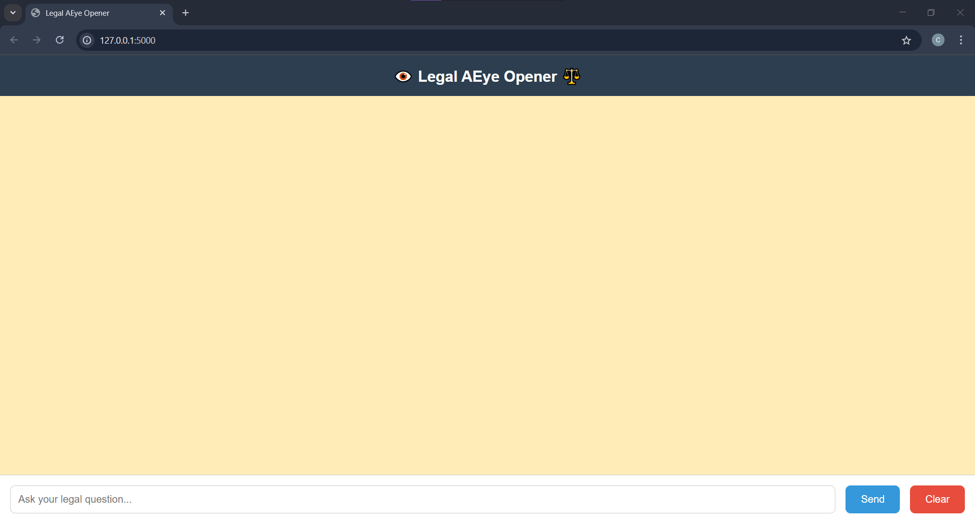
Results

Slide 20
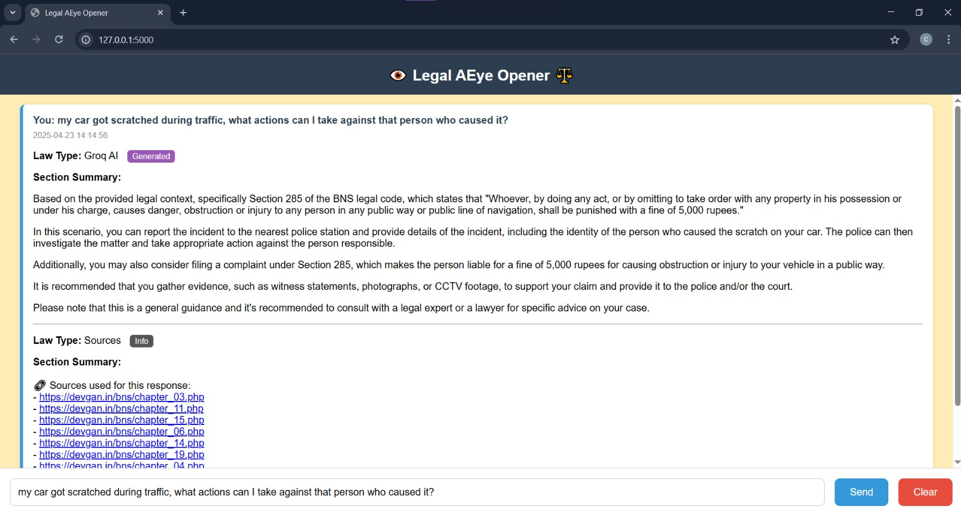
Results

Slide 21
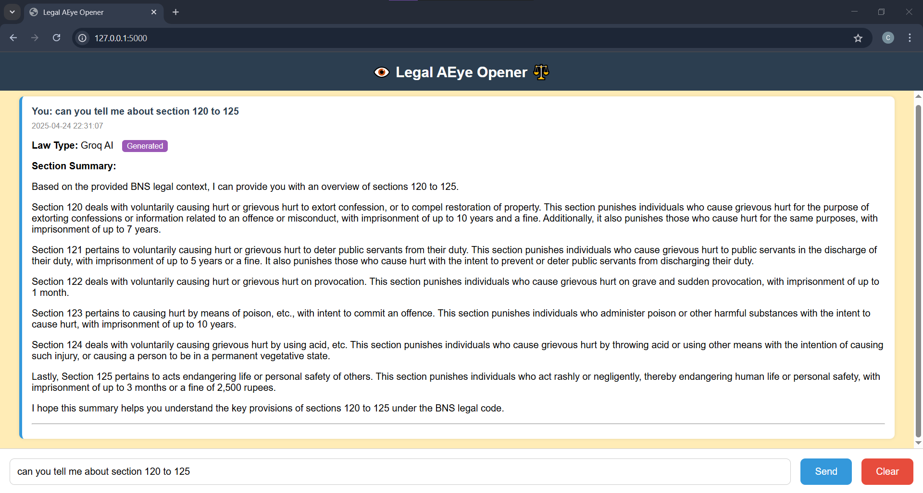
Results

Slide 22
Individual Contribution
Rithvik Muthyalapati | Web Scraping and RAG
Rohan S | Web Design and Response Generation
Rishi Subramanya Nandagiri | Query Processing
Rhushya KC | Embedding and DB Storage

Slide 23
References
LAWBOT: A Smart User Indian Legal Chatbot using Machine Learning Framework
RAG-Based LLM Chatbot Using Llama-2
Generative vs Intent-based Chatbot for Judicial Advice 2024 IEEE 9th International Conference for Convergence in Technology (I2CT)
Optimizing Legal Information Access: Federated Search and RAG for Secure AI-Powered Legal Solutions
Legal Assistance Redefined: Transforming Legal Access with AI-Powered LegalLink 2024 IEEE International Conference on Signal Processing, Informatics, Communication and Energy Systems (SPICES)

Slide 24
Thank You

