Slide 1
⚡
ChargeSpot
EV Charging Availability & Usage Analytics System
CSE494 — Intelligent NoSQL Databases
Academic Task 2 | Lovely Professional University
Python
MongoDB
Streamlit
scikit-learn
PyMongo
🔗 github.com/Rithvikteja123/chargespot
1
Notes:
Welcome everyone. My name is Rithvik Teja and today I'm presenting ChargeSpot — an EV Charging Availability and Usage Analytics System that I built for CSE494. The project uses MongoDB as the database, Python and PyMongo for the backend, and Streamlit for the interface. Let me walk you through what the system does and how I designed it.

Slide 2
Problem Statement
Why do EV drivers and operators need a better system?
🔌
❌
📊
No Central Visibility
Data Inconsistency
No Usage Analytics
Drivers have no way to check which charging connectors are available before arriving at a station.
Without a structured database, connector statuses become incorrect when sessions start and end manually.
Operators cannot identify which stations are heavily used or which connector types need expansion.
ChargeSpot addresses all three problems with a MongoDB document database, PyMongo CRUD operations, and aggregation-based analytics.
2
Notes:
The problem has three parts. First, EV drivers don't know which connector is free before they arrive. Second, without a proper database, connector status gets out of sync when someone starts or ends a charging session. Third, operators have no data to work with — they can't see usage trends or plan maintenance. ChargeSpot solves all three.

Slide 3
Proposed Solution & Objectives
What ChargeSpot does and what it demonstrates
🎯 The Application
📌 Course Objectives Met
✅ Station directory: search and filter 10 EV stations
✅ Manage stations with full Create / Read / Update / Delete
✅ Start, complete, and cancel charging sessions
✅ Auto-sync connector status (available → occupied → available)
✅ Five MongoDB aggregation analytics visualised with Plotly
✅ ML congestion prediction using Decision Tree
→ MongoDB document design (embedded + referenced)
→ $jsonSchema validation at collection level
→ PyMongo CRUD operations (all four)
→ Five aggregation pipelines ($match, $unwind, $group, $lookup…)
→ B-Tree index + explain() performance verification
→ scikit-learn ML integration (explainable Decision Tree)
3
Notes:
ChargeSpot achieves the practical goal — a working EV charging tracker — while demonstrating every database concept required for CSE494. The left side shows what the application does for a user. The right side maps each feature to a specific NoSQL concept. So the project is not just a demo; it's a full course requirement checklist.

Slide 4
Technology Stack
Python · MongoDB · Streamlit · scikit-learn
🗄️
MongoDB 7.0
🐍
Python 3.14
🔌
PyMongo 4.19
🌐
Streamlit 1.66
NoSQL document database
Application logic & service layer
Python driver — CRUD & aggregations
Reactive web UI with custom CSS
📊
Plotly 7.1
🤖
scikit-learn 1.9
🐼
Pandas 3.1
🔐
python-dotenv
Interactive bar, donut, pie charts
Decision Tree congestion predictor
Tabular data formatting
Secure .env config management
4
Notes:
These eight technologies form the complete stack. MongoDB stores the data. Python and PyMongo connect to it. Streamlit builds the web interface without requiring any HTML or JavaScript. Plotly draws the analytics charts. scikit-learn provides the machine learning model. Pandas helps display tables, and python-dotenv keeps the database URI out of the code.

Slide 5
MongoDB Database Design
chargespot_db · stations collection · charging_sessions collection
📦 stations (Embedded Connectors)
🗂️ charging_sessions (Referenced)
{
"station_id": "CS001",
"name": "Campus North Hub",
"city": "Phagwara",
"status": "operational",
"charging_speed_kw": 60,
"connectors": [
{ "connector_id": "C1",
"connector_type": "CCS2",
"power_kw": 60,
"status": "available" },
{ "connector_id": "C2", ... }
]
}
{
"session_id": "SESS-1001",
"station_id": "CS001", ← reference
"connector_id": "C2",
"vehicle_id": "EV-NEXON-01",
"started_at": ISODate(...),
"ended_at": null,
"energy_kwh": 12.4,
"status": "in_progress"
}
→ Sessions grow without bound over time
→ Embedding would breach MongoDB 16 MB doc limit
→ Separate collection → independent indexes + $group
→ $lookup joins sessions ↔ stations in aggregations
✅ Connectors embedded — always fetched with the station (1:Few)
5
Notes:
The database has two collections. Stations embed connectors because a station always has a small fixed number of connectors — two to five — and we always fetch them together. Charging sessions are stored separately because they grow without limit. If we embedded sessions inside the station document, we would eventually hit MongoDB's 16 megabyte document size limit. The foreign key is station_id, which we use in $lookup aggregations.

Slide 6
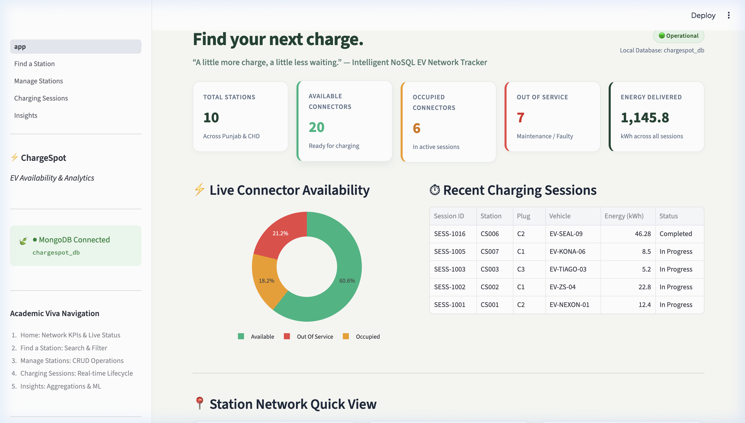
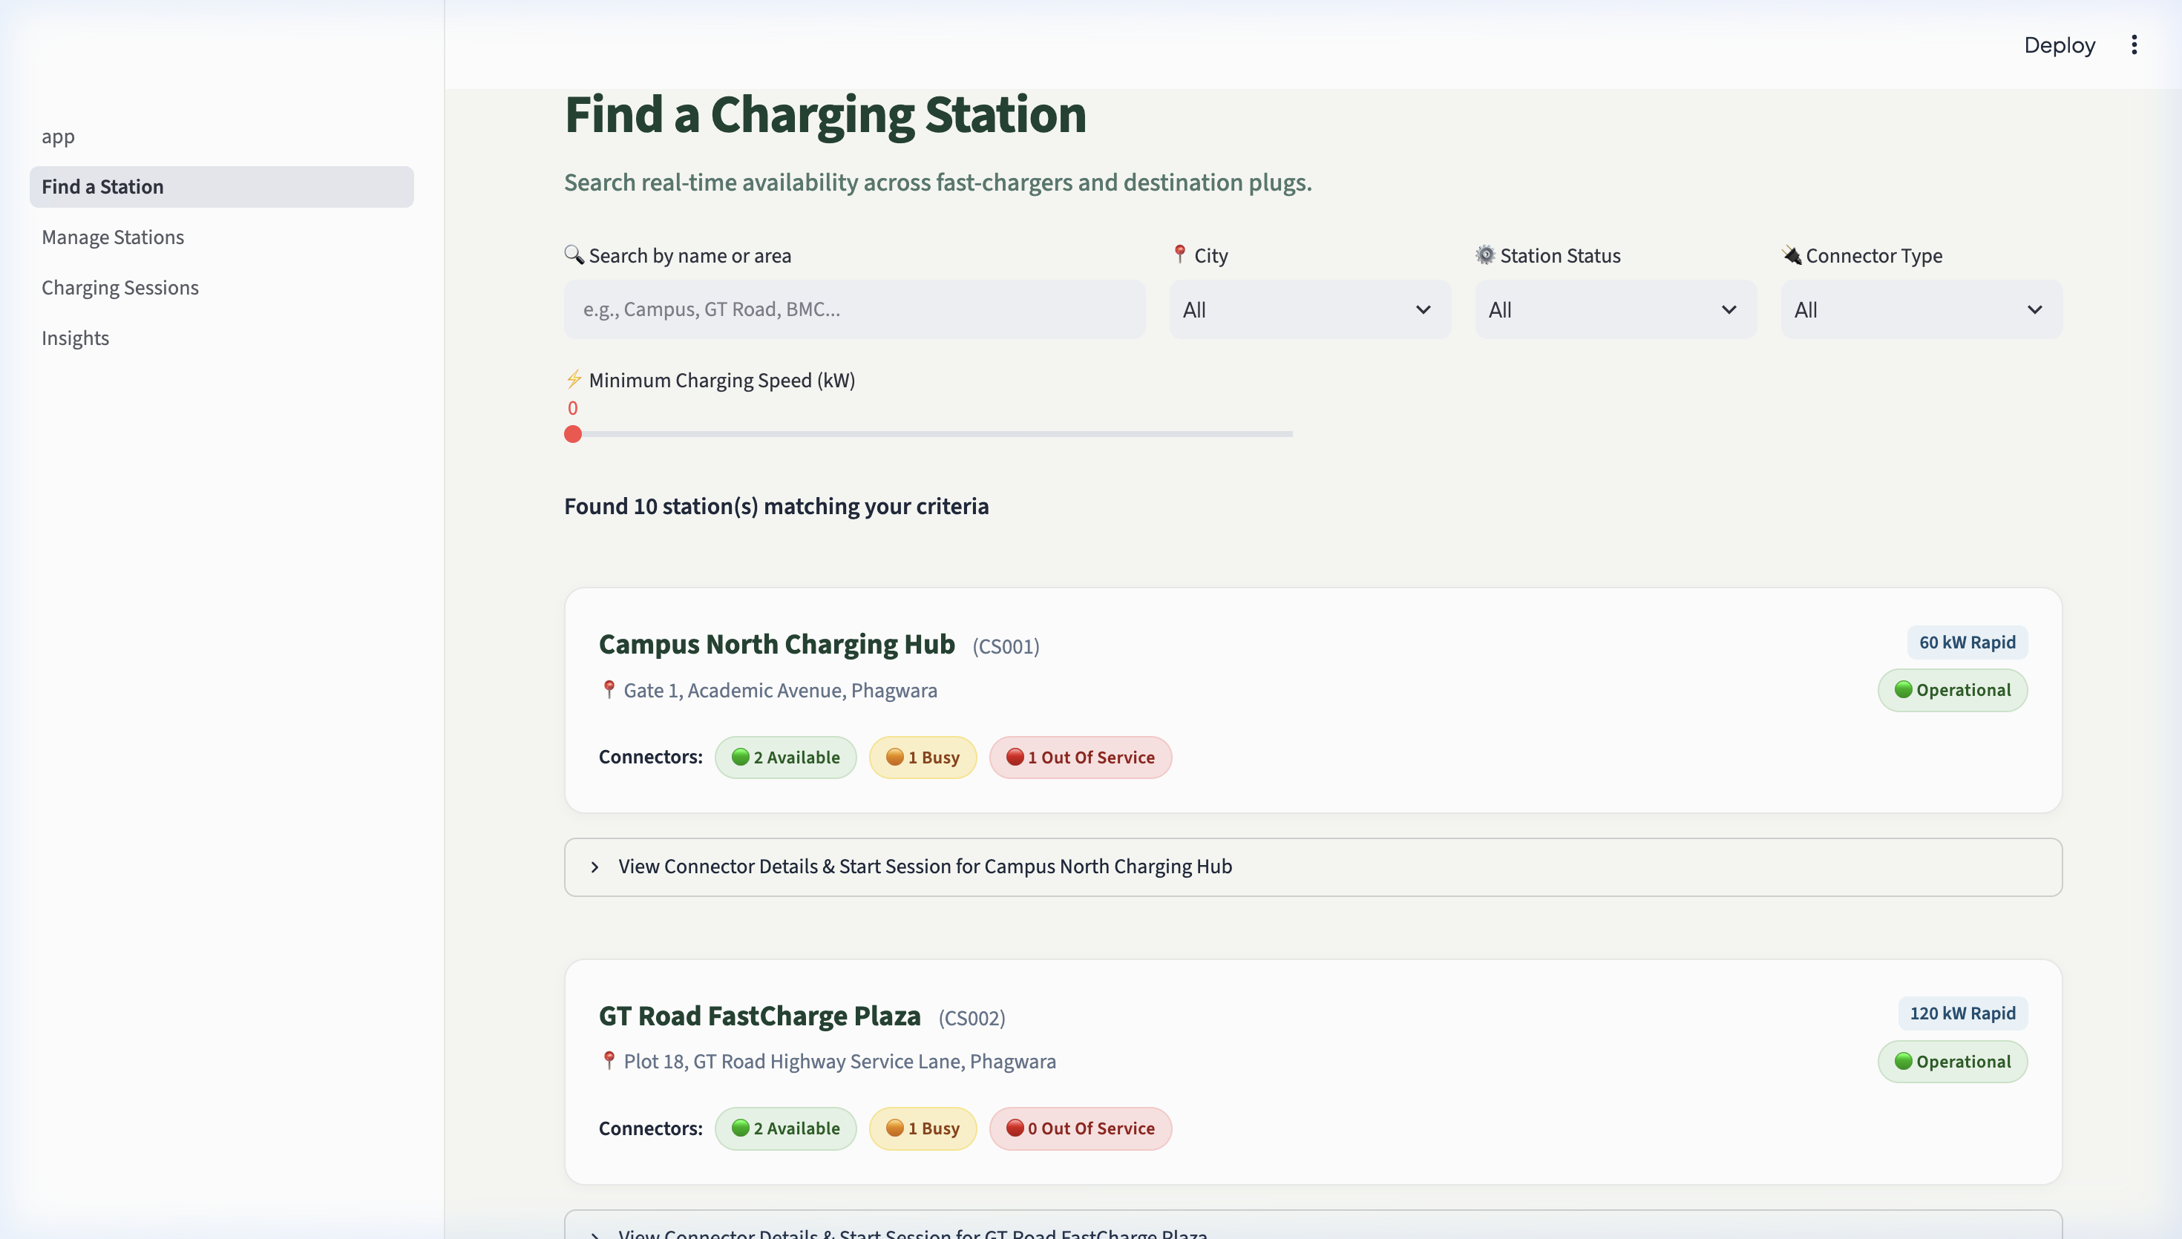
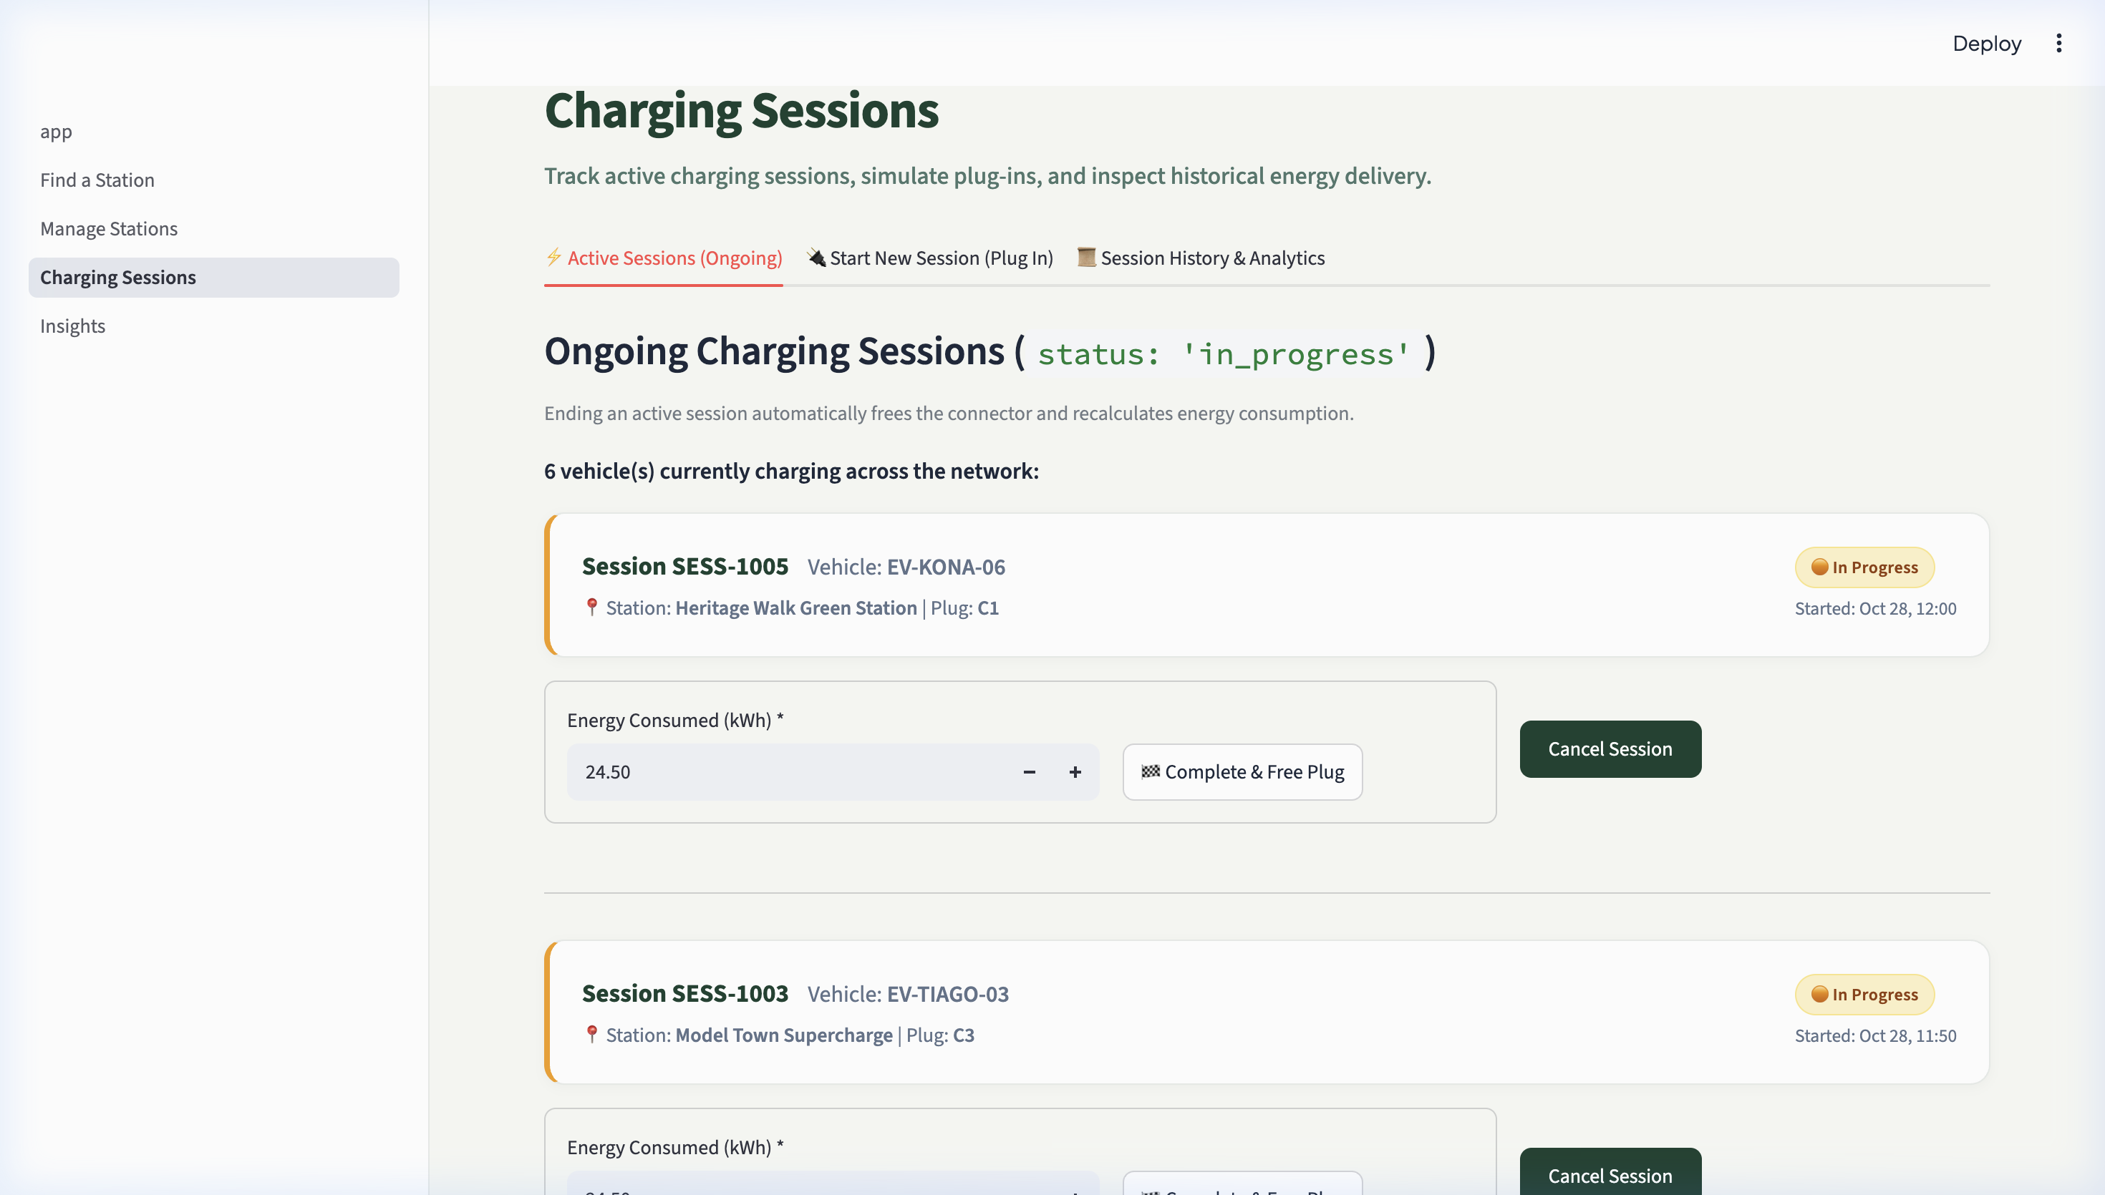
Application Modules & Interface
Five pages — Home · Find · Manage · Sessions · Insights
🏠 Home
🔍 Find
⚙️ Manage
⚡ Sessions
📊 Insights
KPI dashboard
& live status
Search &
filter stations
Full CRUD
operations
Lifecycle
management
Aggregations
& ML
Find a Station — search, city/status/speed filters, connector badges
Home Dashboard — KPI cards, live donut chart, recent sessions
6
Charging Sessions — start, complete, cancel with connector sync
Notes:
The application has five pages. The home dashboard shows the network health at a glance — total stations, available connectors, and energy delivered — all pulled from MongoDB aggregation pipelines. The Find page lets users search by city, connector type, and minimum charging speed. The Sessions page manages the full session lifecycle. When a session starts, the connector immediately transitions to occupied. When it ends, it returns to available.

Slide 7
CRUD · Validation · Indexing · Aggregation Pipelines
All four database operations + five analytics pipelines verified
🛠️ CRUD & Validation
📈 5 Aggregation Pipelines
› CREATE insert_one() — add station + $jsonSchema check
› READ find() / find_one() — compound regex query
› UPDATE update_one($set) — metadata + connectors.$.status
› DELETE delete_one() — blocked if active sessions exist
› $jsonSchema rejects: negative speed, bad enum, empty connectors
› IXSCAN confirmed via explain() — O(log N) vs O(N) COLLSCAN
① Connector status count ($unwind → $group)
② Energy by station ($match → $group → $lookup → $project → $sort)
③ Most-used stations ($group → $lookup → $sort → $limit)
④ Session status breakdown ($group → $project)
⑤ Connector standard pricing ($unwind → $group → $sort)
VERIFIED OUTPUT:
available: 20 · occupied: 6 · out_of_service: 7
Top station: CS004 — 247.97 kWh · 9 sessions
CCS2: 18 connectors · Avg Rs. 17.08 / kWh
7
Notes:
This slide covers the database operations and analytics. For CRUD, each operation uses a specific PyMongo method. The update for connectors uses the dollar positional operator — that's the dollar sign in connectors dot dollar dot status — which updates only the matched connector inside the embedded array. For schema validation, I tested a deliberately invalid document — negative speed, wrong status enum, empty connector array — and MongoDB rejected it with a WriteError. For aggregations, the most complex one is Pipeline 2 which chains five stages including a $lookup join between the sessions and stations collections.

Slide 8

Machine Learning — Station Busy Predictor
DecisionTreeClassifier · 91.3% accuracy on synthetic demo data
🎛️ Input Features
● Hour of day (0–23)
● Day type (Weekday / Weekend)
● Charging speed (kW)
● Connector count
● Is peak hours
🌳 Model Setup
→ 600 synthetic samples · seed=42 (reproducible)
→ 75 / 25 train-test split · stratify=y
→ Max depth = 4 · Accuracy = 91.3%
⚠️ Academic Disclaimer
91.3% is evaluated on synthetic / demo data only. Real-world accuracy would require re-training on actual charging logs. The model never writes to MongoDB.
8
Notes:
For the machine learning component, I used a Decision Tree classifier because it produces interpretable rules — I can explain exactly why the model predicted a station as busy. The model takes five inputs: the hour, whether it's a weekend, the charger speed, the number of connectors, and whether it's a peak period. I generated 600 synthetic training samples. The split is 75% training, 25% test, with stratification to keep the busy and not-busy ratio equal in both sets. The 91.3% accuracy is on this synthetic data — I want to be clear that this has not been tested on real charging network logs. Also importantly, the model only reads station attributes — it never writes to the database.

Slide 9
Testing & Verified Results
Automated test suites: test_crud.py · test_aggregations.py
✅ All 14 Tests Passed
Terminal Output (test_crud.py)
TC-01
$jsonSchema rejects invalid document
✓ MongoDB Connection Verified.
TEST 1: Schema Validation Rejection
Msg: 'Validation failed: Document failed'
✓ PASSED
TEST 5: Session Start + Connector Sync
Session 'SESS-TEST-999' started!
Connector 'C1' is now occupied.
✓ PASSED
TEST 6: Referential Integrity Guard
Cannot delete CS999: 1 active session.
✓ PASSED
TEST 9: Index explain() — IXSCAN
Stage: FETCH (input: IXSCAN)
✓ PASSED
ALL 9 TESTS PASSED!
TC-02
insert_one() creates station CS999
TC-03
find_one() reads station correctly
TC-04
update_one($set) updates speed to 120 kW
TC-05
Session start → connector: occupied
TC-06
delete_one() blocked by active session
TC-07
Session end → connector: available
TC-08
delete_one() cleans up test records
TC-09
explain() confirms IXSCAN on station_id
TC-10–14
All 5 aggregation pipelines verified
9
Notes:
I wrote two automated test files. test_crud.py has nine tests and test_aggregations.py has five tests — one per pipeline. For the CRUD tests, I first deliberately submit an invalid document to prove that MongoDB's schema validator rejects it. Then I test each operation in order: create, read, update, session start with connector sync, deletion protection while a session is active, session end with connector restoration, and finally deletion of the test records. Test 9 calls explain() and confirms the query planner chose IXSCAN instead of COLLSCAN. All 14 tests passed.

Slide 10
Conclusion & Future Scope
What was built · What was demonstrated · What comes next
✅ What Was Achieved
🚀 Future Scope
✓ Hybrid MongoDB document model with clear design rationale
✓ $jsonSchema validation rejected invalid data at DB level
✓ All 4 CRUD operations with referential integrity guard
✓ 5 aggregation pipelines — data stays in the database
✓ B-Tree index verified via explain() (IXSCAN)
✓ Explainable ML congestion predictor — 91.3% on demo data
✓ Polished Streamlit UI across 5 functional pages
→ Real OCPP charging station API integration
→ Geospatial search with MongoDB $geoNear + maps
→ Role-based login for operators and drivers
→ Real-time connector updates via WebSocket / MQTT
→ Re-train ML on real charging network data
→ Docker + CI/CD pipeline for deployment
10 stations · 33 connectors · 42 sessions · 1,145.85 kWh delivered · 91.3% ML accuracy
Thank you — Questions welcome!
🔗 github.com/Rithvikteja123/chargespot
10
Notes:
To conclude — ChargeSpot demonstrates every course requirement for CSE494 in one working application: document design, validation, CRUD, indexing, aggregation, and machine learning. The database contains 10 stations, 33 connectors, and 42 session records. All 14 automated tests passed. The verified energy delivered across all completed sessions is 1,145 kilowatt-hours. For future work, the most impactful improvement would be connecting to a real OCPP charging API so the data reflects actual station activity. I'm happy to take any questions about the database design, the aggregation pipelines, or the machine learning module.

