Slide 1
JAVA MINI PROJECT
Personal Bank Ledger
Statement Generator
A simple, structured way to record transactions and generate statements.
K. Rithwik
Roll No. 2620040124
PROBLEM SOLVING USING PROGRAMMING (JAVA)
2026

Slide 2
Abstract
A simple Java program for keeping personal money records organized.
INPUT
Users can enter deposits and withdrawals with the date, description and amount. The program checks the entries, updates the balance and displays a clear transaction statement.
Date • Description • Type • Amount
PROCESS
Validate, store, sort and summarize
PROJECT GOAL
Make it easier to track money received, money spent and the remaining balance.
OUTPUT
Ledger view • Balance • Statement
Sample figures are illustrative only.
K. Rithwik • 2620040124
02

Slide 3
Understanding the Problem Statement
The problem
Manual records are hard to search and summarize. A ledger tool keeps transactions organized and balances easy to verify.
01 Record
02 Calculate
03 Report
Record deposits and withdrawals with date, details and amount.
Update and display the running balance.
Show transaction history and generate statements.
PROJECT OBJECTIVE
Build a menu-driven Java program with validation and file storage.
K. Rithwik • 2620040124
03

Slide 4
CO 1 — Problem Solving & Java Fundamentals
Use Java variables, expressions and console input to solve the ledger problem.
Inputs
Algorithm
Java basics
Transaction date, description, type and amount
Read → validate → process → display
Primitive types, operators, Scanner and formatted output
HOW IT APPLIES
Capture
→
Validate
→
Process
→
Report
CO1: Analyze a problem and implement its algorithm in Java.
K. Rithwik • 2620040124
04

Slide 5
CO 2 — Control Flow: Selection & Iteration
Use decisions and loops for menus and validation.
Menu
Decisions
Loops
Add transaction • View ledger • Generate statement • Exit
Select deposit or withdrawal; reject invalid amounts
Repeat menu until the user chooses to exit
HOW IT APPLIES
Capture
→
Validate
→
Process
→
Report
CO2: Apply selection and iteration constructs.
K. Rithwik • 2620040124
05

Slide 6
CO 3 — Methods, Recursion & Arrays
Use reusable methods to process transaction records.
Methods
Arrays / lists
Processing
addTransaction(), calculateBalance(), printStatement()
Store and traverse transaction records
Count entries, total deposits and total withdrawals
HOW IT APPLIES
Capture
→
Validate
→
Process
→
Report
CO3: Modularize code and process arrays or lists.
K. Rithwik • 2620040124
06

Slide 7
CO 4 — Object-Oriented Design & Exceptions
Model transactions with classes and handle invalid operations safely.
Classes
Encapsulation
Exceptions
Transaction and BankLedger model the domain
Keep fields private; expose safe methods
Handle invalid input and file errors gracefully
HOW IT APPLIES
Capture
→
Validate
→
Process
→
Report
CO4: Apply OOP concepts and exception handling.
K. Rithwik • 2620040124
07

Slide 8
CO 5 — Strings, Algorithms & File I/O
Validate text and save records for later use.
String handling
Algorithms
File I/O
Trim descriptions; validate dates and transaction types
Search records and sort by transaction date
Read and write ledger records using Files / Path
HOW IT APPLIES
Capture
→
Validate
→
Process
→
Report
CO5: Process strings, use algorithms and store data in files.
K. Rithwik • 2620040124
08

Slide 9
CO 6 — Collections, Lambdas & Streams
Use collections and streams to filter and summarize transactions.
Collections
Stream pipeline
Reports
ArrayList for ordered entries; Map for summaries
Filter by date/type, sort and collect results
Count transactions and aggregate deposits / withdrawals
HOW IT APPLIES
Capture
→
Validate
→
Process
→
Report
CO6: Use collections, lambdas and streams to process data.
K. Rithwik • 2620040124
09

Slide 10
Conclusion
A practical Java application built from core concepts.
RELIABILITY
The application organizes transactions and generates statements using Java fundamentals, control flow, methods, OOP, file handling and collections.
Validate entries and handle errors.
CLARITY
Show transactions and balance changes.
Test with sample transactions and verify balances.
EXTENSIBILITY
Add search, date filters and export options.
Every balance should match the transaction history.
K. Rithwik • 2620040124
10

Slide 11
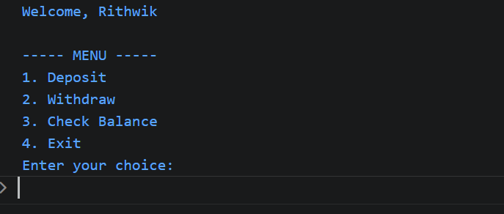
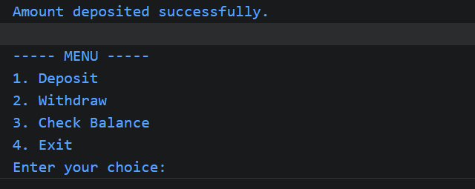
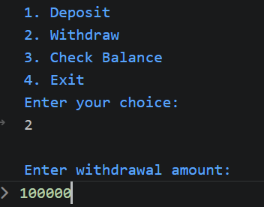
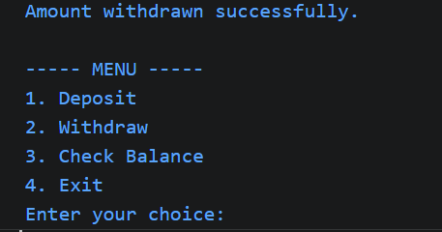
Program Output Screenshots
Actual console output: menu, deposit, withdrawal, and transaction flow.
K. Rithwik • 2620040124
11

Slide 12
Thank You
Personal Bank Ledger Statement Generator
Thank you for your time and attention.
K. Rithwik • Roll No. 2620040124
PROBLEM SOLVING USING PROGRAMMING (JAVA)
12

