Slide 1

SALES / LEAD CONVERSION INTELLIGENCE SYSTEM
For Small and Medium Enterprises
SECOND PROJECT REVIEW
Presented by:
Thoomu Rithwik Reddy
Vadla Dinesh Achary
Bathula Shivani
- 1608-24-737-004
- 1608-24-737-026
- 1608-24-737-302
Since the first review
ML model trained and evaluated
Backend, database and dashboard built
WhatsApp, website and email connected
Tested end to end with live messages
Project Guide: Ms. T. Vijayalaxmi
Department of Information Technology
Notes:
Introduce the team and guide. Say that Review 1 was the design; Review 2 shows the working system: trained model, backend, dashboard and live WhatsApp.

Slide 2






PROJECT OVERVIEW
What the system does: customer enquiries from WhatsApp, the business website and email become leads automatically. Each lead gets a chance of buying from a trained ML model, adjusted by what the customer wrote, a HIGH / MEDIUM / LOW priority with the reason, an automatic answer to price and product questions, and a follow-up draft the salesperson edits and sends.
Leads from every channel
ML lead scoring
Reads the message
WhatsApp (Twilio), website enquiry form, email webhook and manual entry
Calibrated gradient boosting on 9,240 real leads: 81.5% accuracy, 83.7% recall
Buying signals change the chance: price, "book this week", only "Hi", not interested
WhatsApp assistant
Business setup & dashboard
Learns from results
Collects name, occupation, product; answers price, specs, availability, delivery
Owner adds products and policies; team sees leads, follow-ups and analytics
Retrains by itself after every 10 Converted / Not Converted leads
Notes:
One sentence for the whole system, then the six parts that are now built. Emphasise that every number shown later comes from the working system.

Slide 3




SYSTEM ARCHITECTURE
Lead sources
FastAPI backend · Orchestrator
WhatsApp
via Twilio
REST API & webhooks
signature check · validation
1. Lead Analysis
cleans the data
2. Lead Scoring (ML)
profile chance
3. Conversation
buying signals
4. Conversion Prediction
final chance + priority
React Dashboard
My Business · Leads · Add Lead · Follow-ups · Analytics · Connect
Website form
/enquiry
5. Follow-up
who is due today
6. Message
editable draft
JSON
Email
forwarding service
7. Analytics
numbers & charts
WhatsApp assistant
answers from catalogue
Add Lead
salesperson
salesperson reviews and sends
Learning loop: retrain after every 10 outcomes
SQLite leads · business · products
Models lead_model.pkl · message_model.pkl
Notes:
Left to right: four lead sources reach the FastAPI backend through the API or webhooks (Twilio signature checked). The Orchestrator runs the agents, saves to SQLite, and the React dashboard reads everything as JSON. Outcomes feed the learning loop.

Slide 4
FLOW CHART
Customer sends a message
Scoring (every message)
ML model → profile chance
Signals → final chance
New phone number?
No
Add message to the existing lead
Saved in SQLite, shown on dashboard
Priority HIGH / MEDIUM / LOW + reason
Yes
Create lead, welcome, ask name
Follow-up due? Draft message
Ask email → occupation → product (from owner's list)
Asked price, specs, stock, delivery?
No
Converted?
Salesperson edits → Send on WhatsApp
Ask: "May I know your concern?"
Yes
Bot answers from the product list
Outcome saved → retrain after 10
Notes:
Walk the chart: a new number gets the question flow; a known number's message is added to its lead. Price and product questions are answered by the bot from the owner's list, others go to the team. Every message is scored; the salesperson sends the follow-up and records the outcome, which drives retraining.

Slide 5





MODULE DESIGN
Lead Analysis Agent
Lead Scoring Agent
Conversion Prediction
Cleans form / message data: trims text, Title Case names, lower-case email
Trained ML model gives the profile chance and the top 3 reasons
Combines profile chance with signals into the final chance and priority
agents.analyse_lead
LeadScoringAgent
apply_signals
Conversation Agent
Follow-up Agent
Message Agent
Finds buying signals in the customer's words, with typo correction
HIGH due after 1 day, MEDIUM 3, LOW 7; closed leads never due
Template per priority + one line per signal; salesperson edits
analyse_conversation
needs_follow_up
draft_message
Analytics Agent
Dashboard
Orchestrator
Leads by channel, priority, status; conversion rate of finished leads
React pages for owner and sales team, Connect page for channels
Runs the agents in order for every request and saves the result
analytics
frontend/src/pages
app.py
Notes:
All nine modules from the first review are now implemented; the grey line under each shows where it lives in the code.

Slide 6
DATA FLOW
Training (once, and after new outcomes)
Leads.csv
9,240 real leads, 37 columns
Clean data
remove leakage & IDs
6 features
what a form can collect
Train & calibrate
monotonic gradient boosting
Evaluate
fixed test set, 1,848 leads
lead_model.pkl
model + cut-offs saved
model loaded
Live scoring (every enquiry)
Enquiry
WhatsApp · web · email
Lead Analysis
clean + map fields
ML model
profile chance
Signals
odds × weights
Final chance
priority + reason
SQLite → Dashboard
follow-up draft
Feedback
Salesperson marks Converted / Not Converted → every 10 outcomes the profile model is retrained (kept only if better on the test set) and the message model learns from the customers' own words (used once 15 + 15 chats and AUC ≥ 0.60).
Notes:
Two paths: training builds the model file from the dataset; live scoring uses that file for every enquiry. Outcomes recorded by the team flow back to retrain both models.

Slide 7
HOW ONE ENQUIRY IS SCORED
Input (WhatsApp): "I need detail specfications and price of the car, I want to book this week" · Working Professional · chose Hyundai Creta SX
1
Clean & fix typos "specfications" → specifications; fields mapped to the dataset's values
Result on the dashboard
93%
2
ML profile chance WhatsApp + Working Professional + chatted → 76%
3
Buying signals Wants to buy soon (× 2.5) · Asked about price (× 1.6) · product in list
HIGH priority
Profile 76% +17% from the message
4
Combine in odds 76% → odds 3.17; 3.17 × 2.5 × 1.6 = 12.7 → 93%
The same customer saying only "Hi" → 52% (MEDIUM). "Not interested" → LOW.
5
Priority & action 93% ≥ 56% → HIGH; bot sends Creta price & specs; draft ready
Notes:
Explain with one real lead: the model gives 76% from the profile, the message raises the odds by 2.5 and 1.6, the result is 93% and HIGH. Odds keep the answer between 0 and 100% and make one signal matter more for a middle lead than for a sure one.

Slide 8
ML MODEL & RESULTS
Calibrated, monotonic gradient boosting · tested on 1,848 leads never used for training
81.5%
83.7%
79.5%
0.778
Accuracy
correct buy / not-buy calls
Recall
of real buyers were flagged
HIGH were right
HIGH leads that really bought
F1-score
balance of precision & recall
Design choices that keep it honest
Leakage removed: Tags, Lead Quality (written after the sale)
Only 6 inputs a real form can fill
More time / visits never lowers the score
Calibrated: "60%" ≈ 60 of 100 such leads buy
Cut-offs learned: MEDIUM 40%, HIGH 56%
Notes:
These are measured on a fixed test set the model never saw. Recall matters most: missing a buyer loses a sale. Removing leakage lowered the headline accuracy but made the model honest.

Slide 9
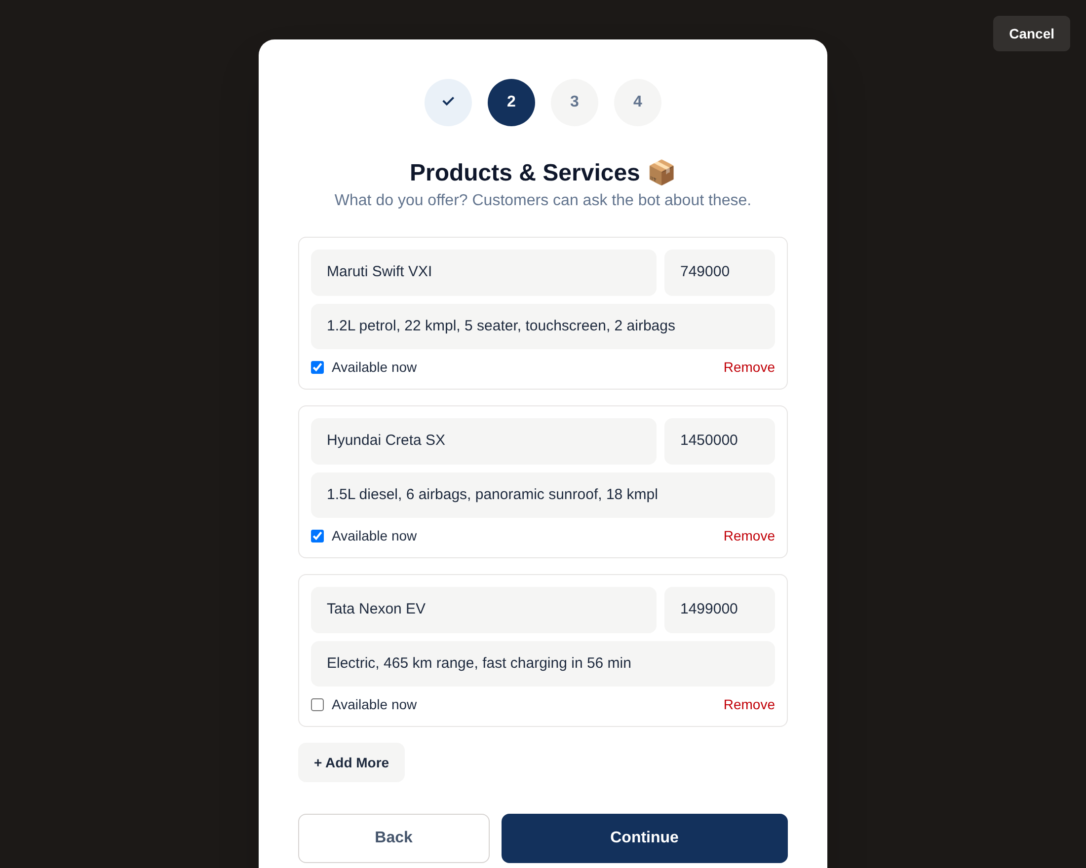
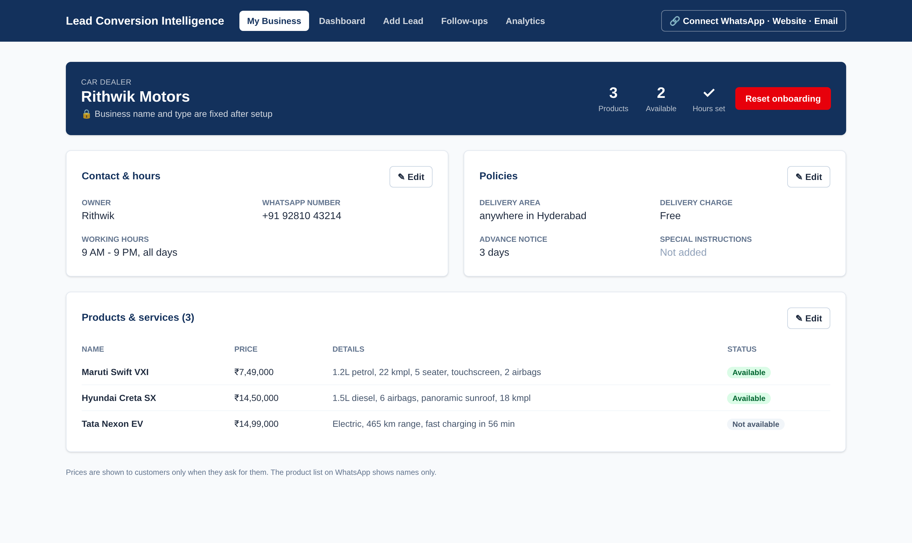
UI DESIGN
First visit: 4-step business setup (products shown)
My Business: read-only overview, Edit per section, name & type locked
React + Tailwind CSS · same validation as the backend · works on phone screens · every number comes from the API
Notes:
The owner sets up the business once in four steps; afterwards My Business shows the details with Edit buttons. The bot uses this product list to answer customers.

Slide 10
















IMPLEMENTATION TOOLS
Languages & libraries
Services & testing
Twilio WhatsApp Sandbox
send / receive WhatsApp
Python 3.12
core language
FastAPI
REST API + webhooks
scikit-learn
model & evaluation
pandas
data cleaning
cloudflared tunnel
public link for webhooks
NumPy
numerical work
Pydantic
input validation
React 19
dashboard
Tailwind CSS
styling
joblib · Uvicorn
model file · server
test_system.py · Playwright
automatic & browser tests
Vite
frontend build
SQLite
database
Git & GitHub
version control
VS Code
editor
Notes:
Python and FastAPI for the backend, scikit-learn for the model, React and Tailwind for the dashboard, SQLite for storage. Twilio connects WhatsApp; cloudflared gives the laptop a public link.

Slide 11
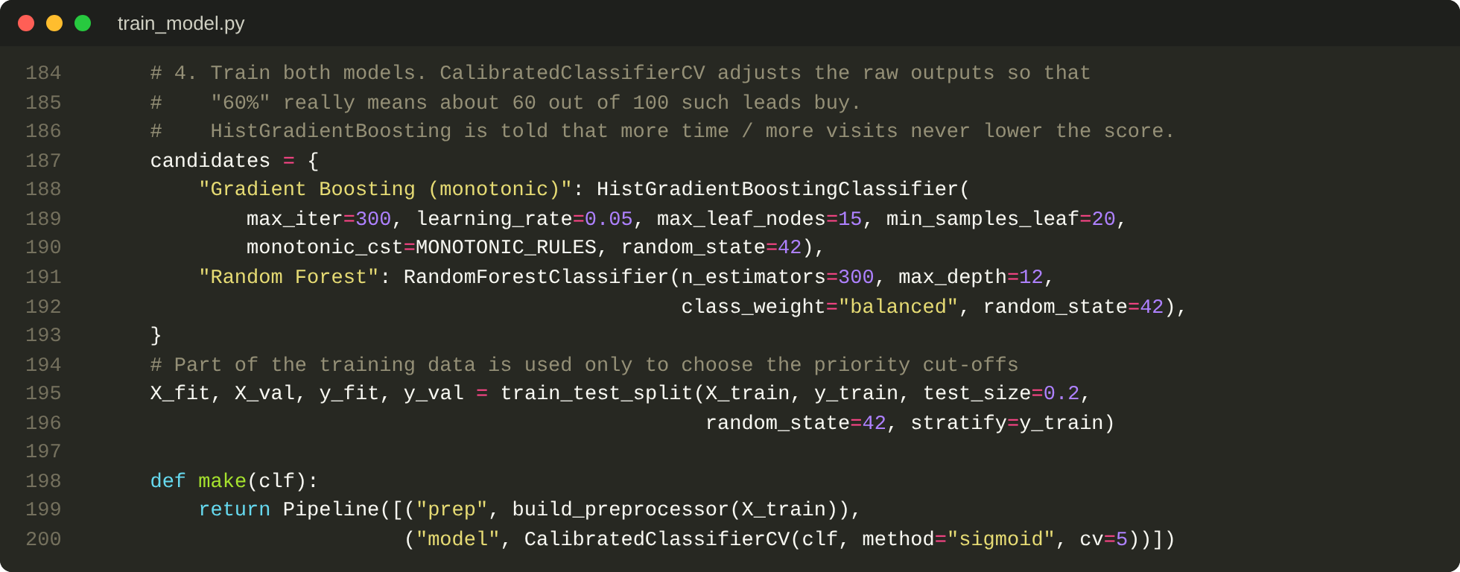
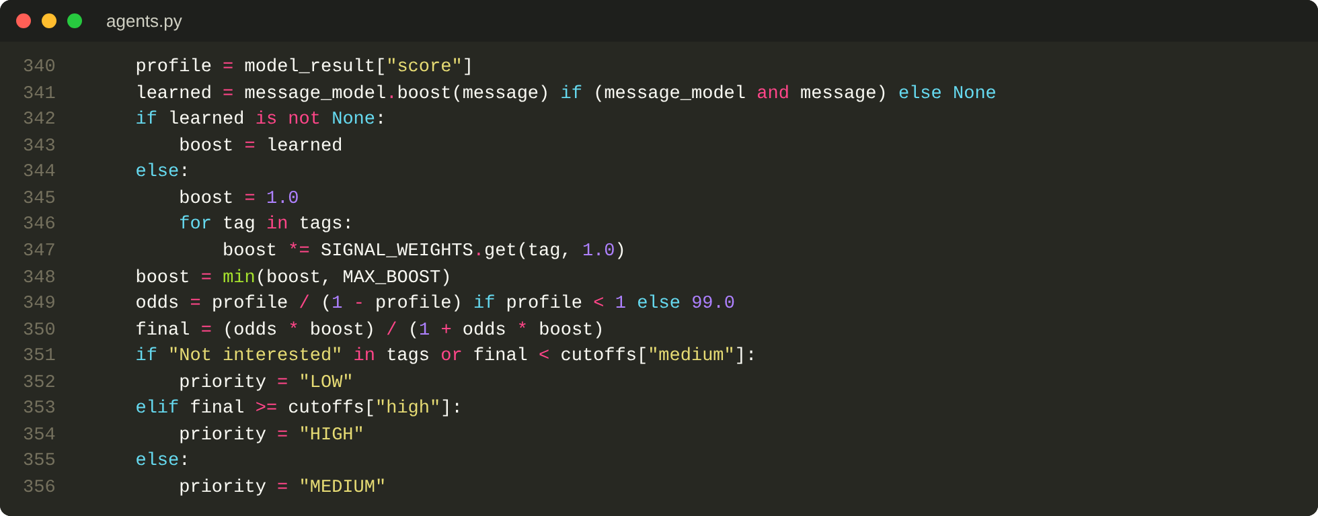
CODE SNIPPETS
train_model.py – two models compared; calibrated; more time never lowers the score
agents.py – profile chance × signal weights (in odds) → final chance and priority
2,500+
27
8
4
lines of Python
API endpoints
React pages
lead channels
Notes:
Left: training compares gradient boosting and random forest inside one pipeline and calibrates them. Right: the core of the Conversion Prediction agent.

Slide 12
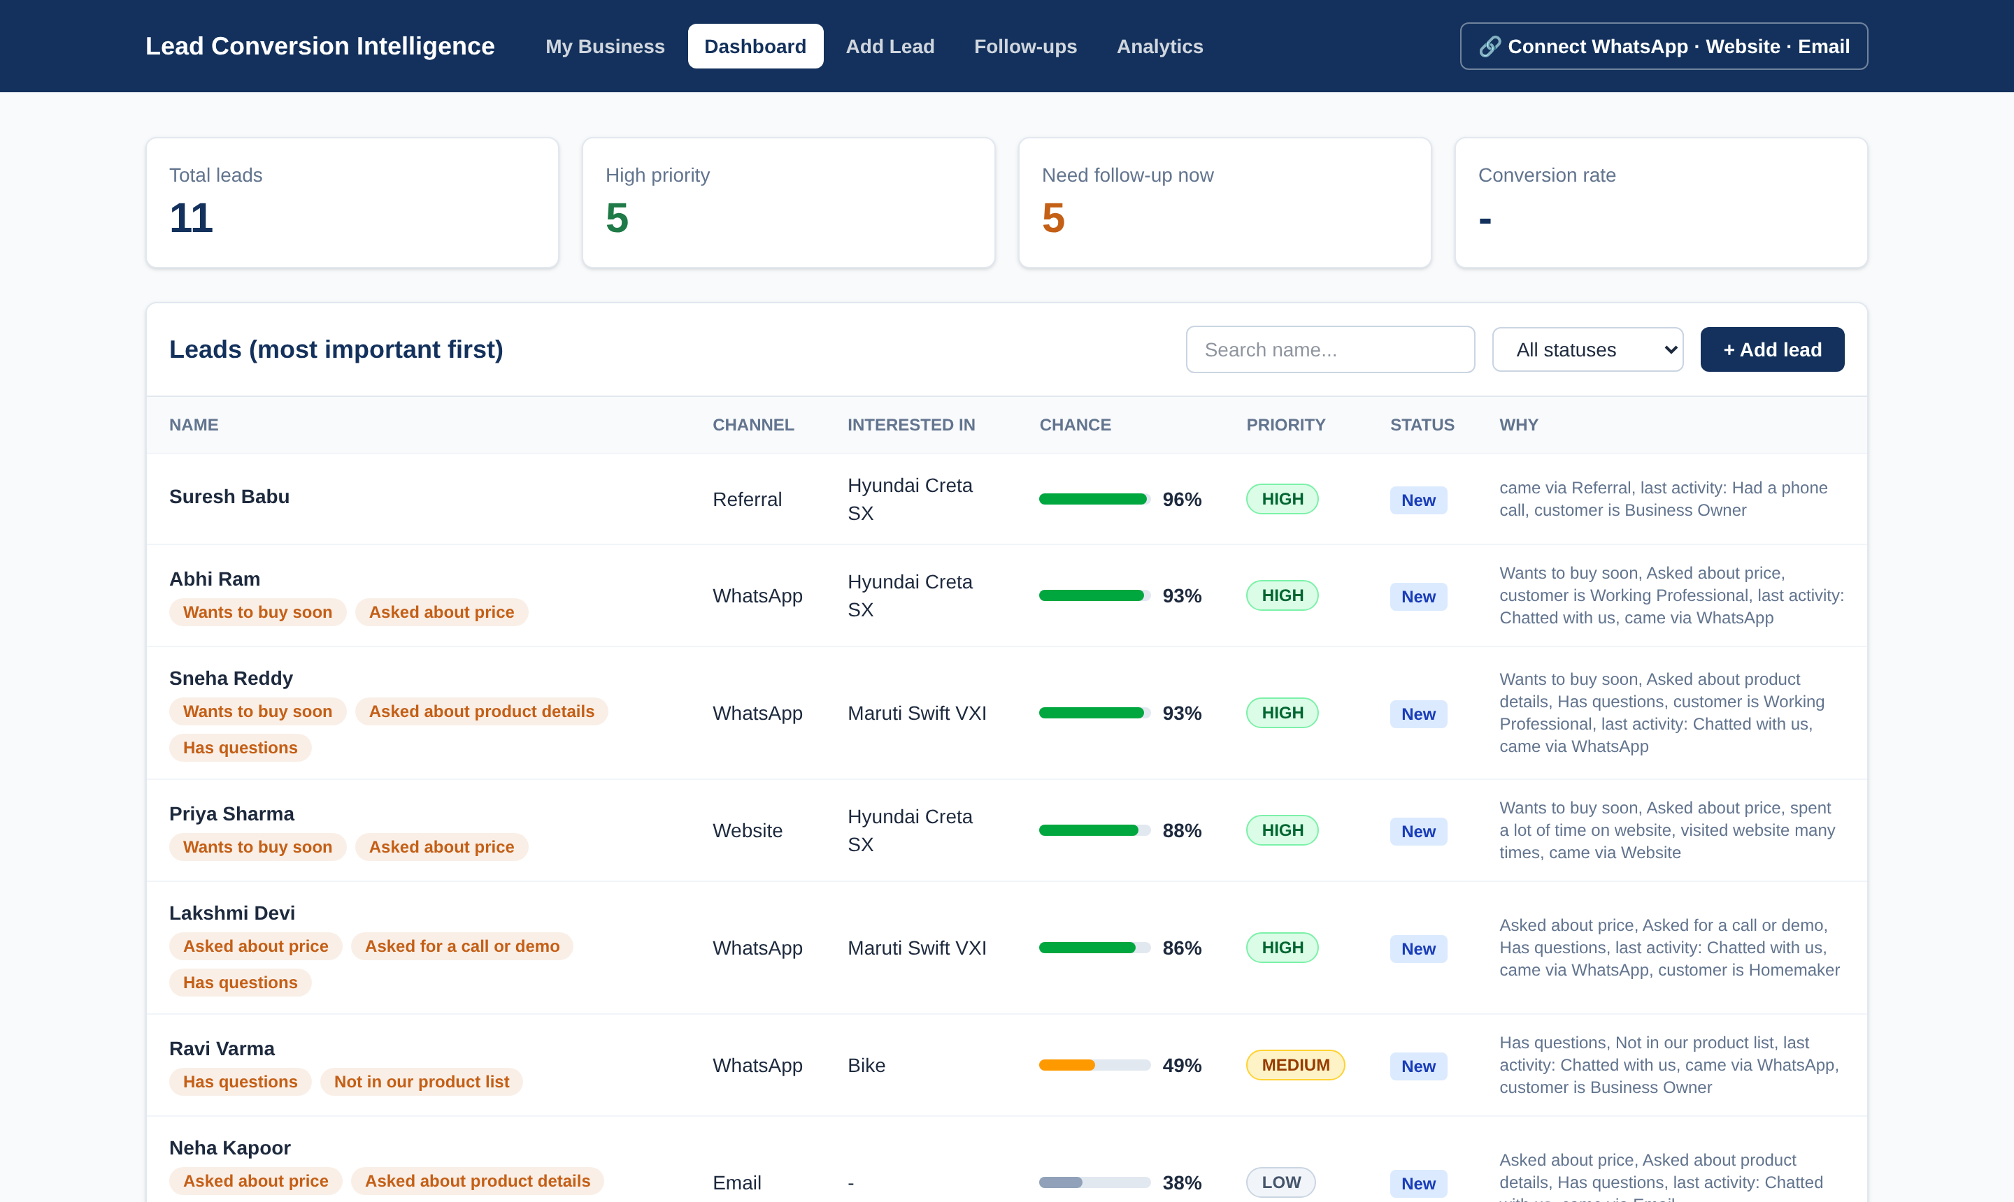
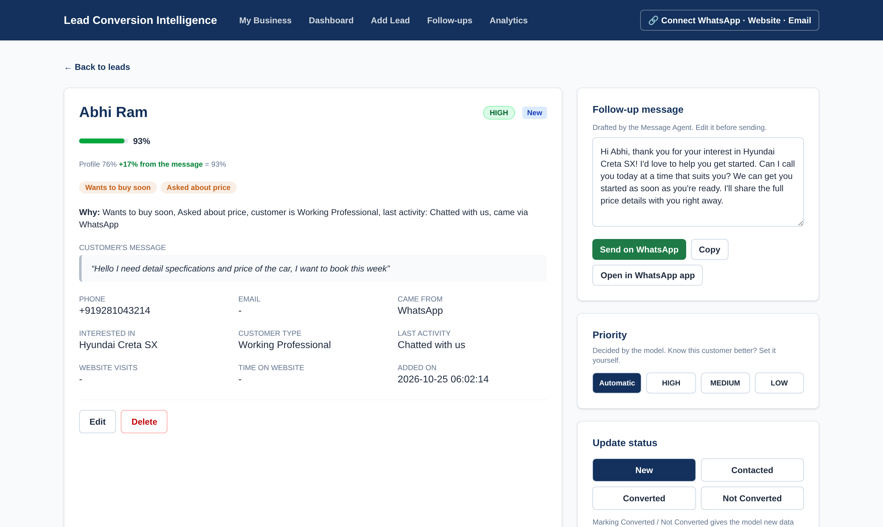
OUTPUT: LEAD DASHBOARD
Leads sorted HIGH first, with chance, tags and reason
Lead details: profile 76% + 17% from the message = 93%, editable draft
Sample run with 11 leads from all channels: a referral after a phone call scored 96%, a WhatsApp buyer asking price and booking 93%, "just looking" on the website 4%, a customer who only said "ok" 12%, and "do you have bikes?" at a car dealer was tagged Not in our product list.
Notes:
Show how the list is ordered and how each score is explained. Point to the breakdown line on the details page.

Slide 13
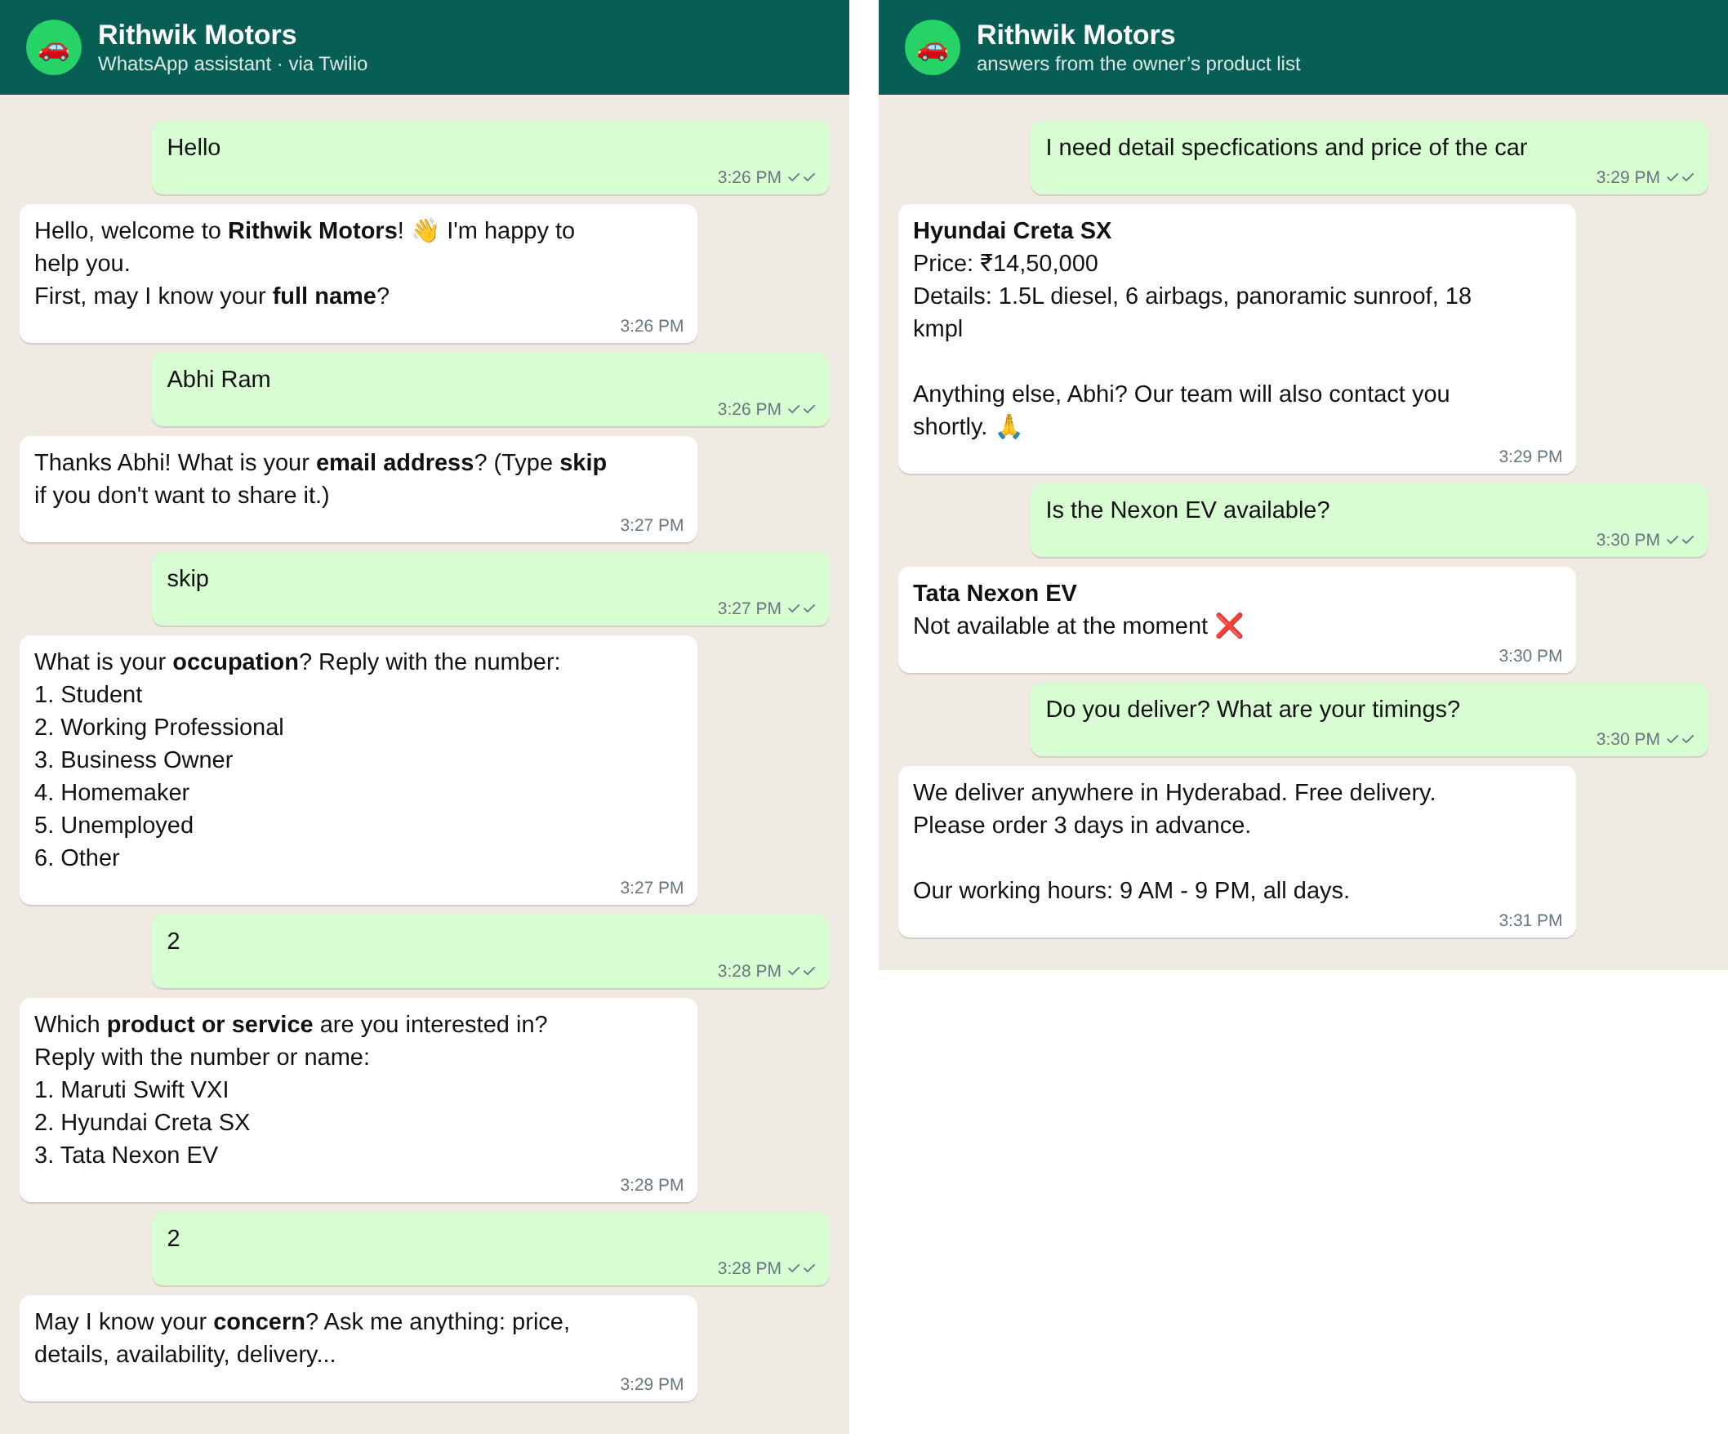
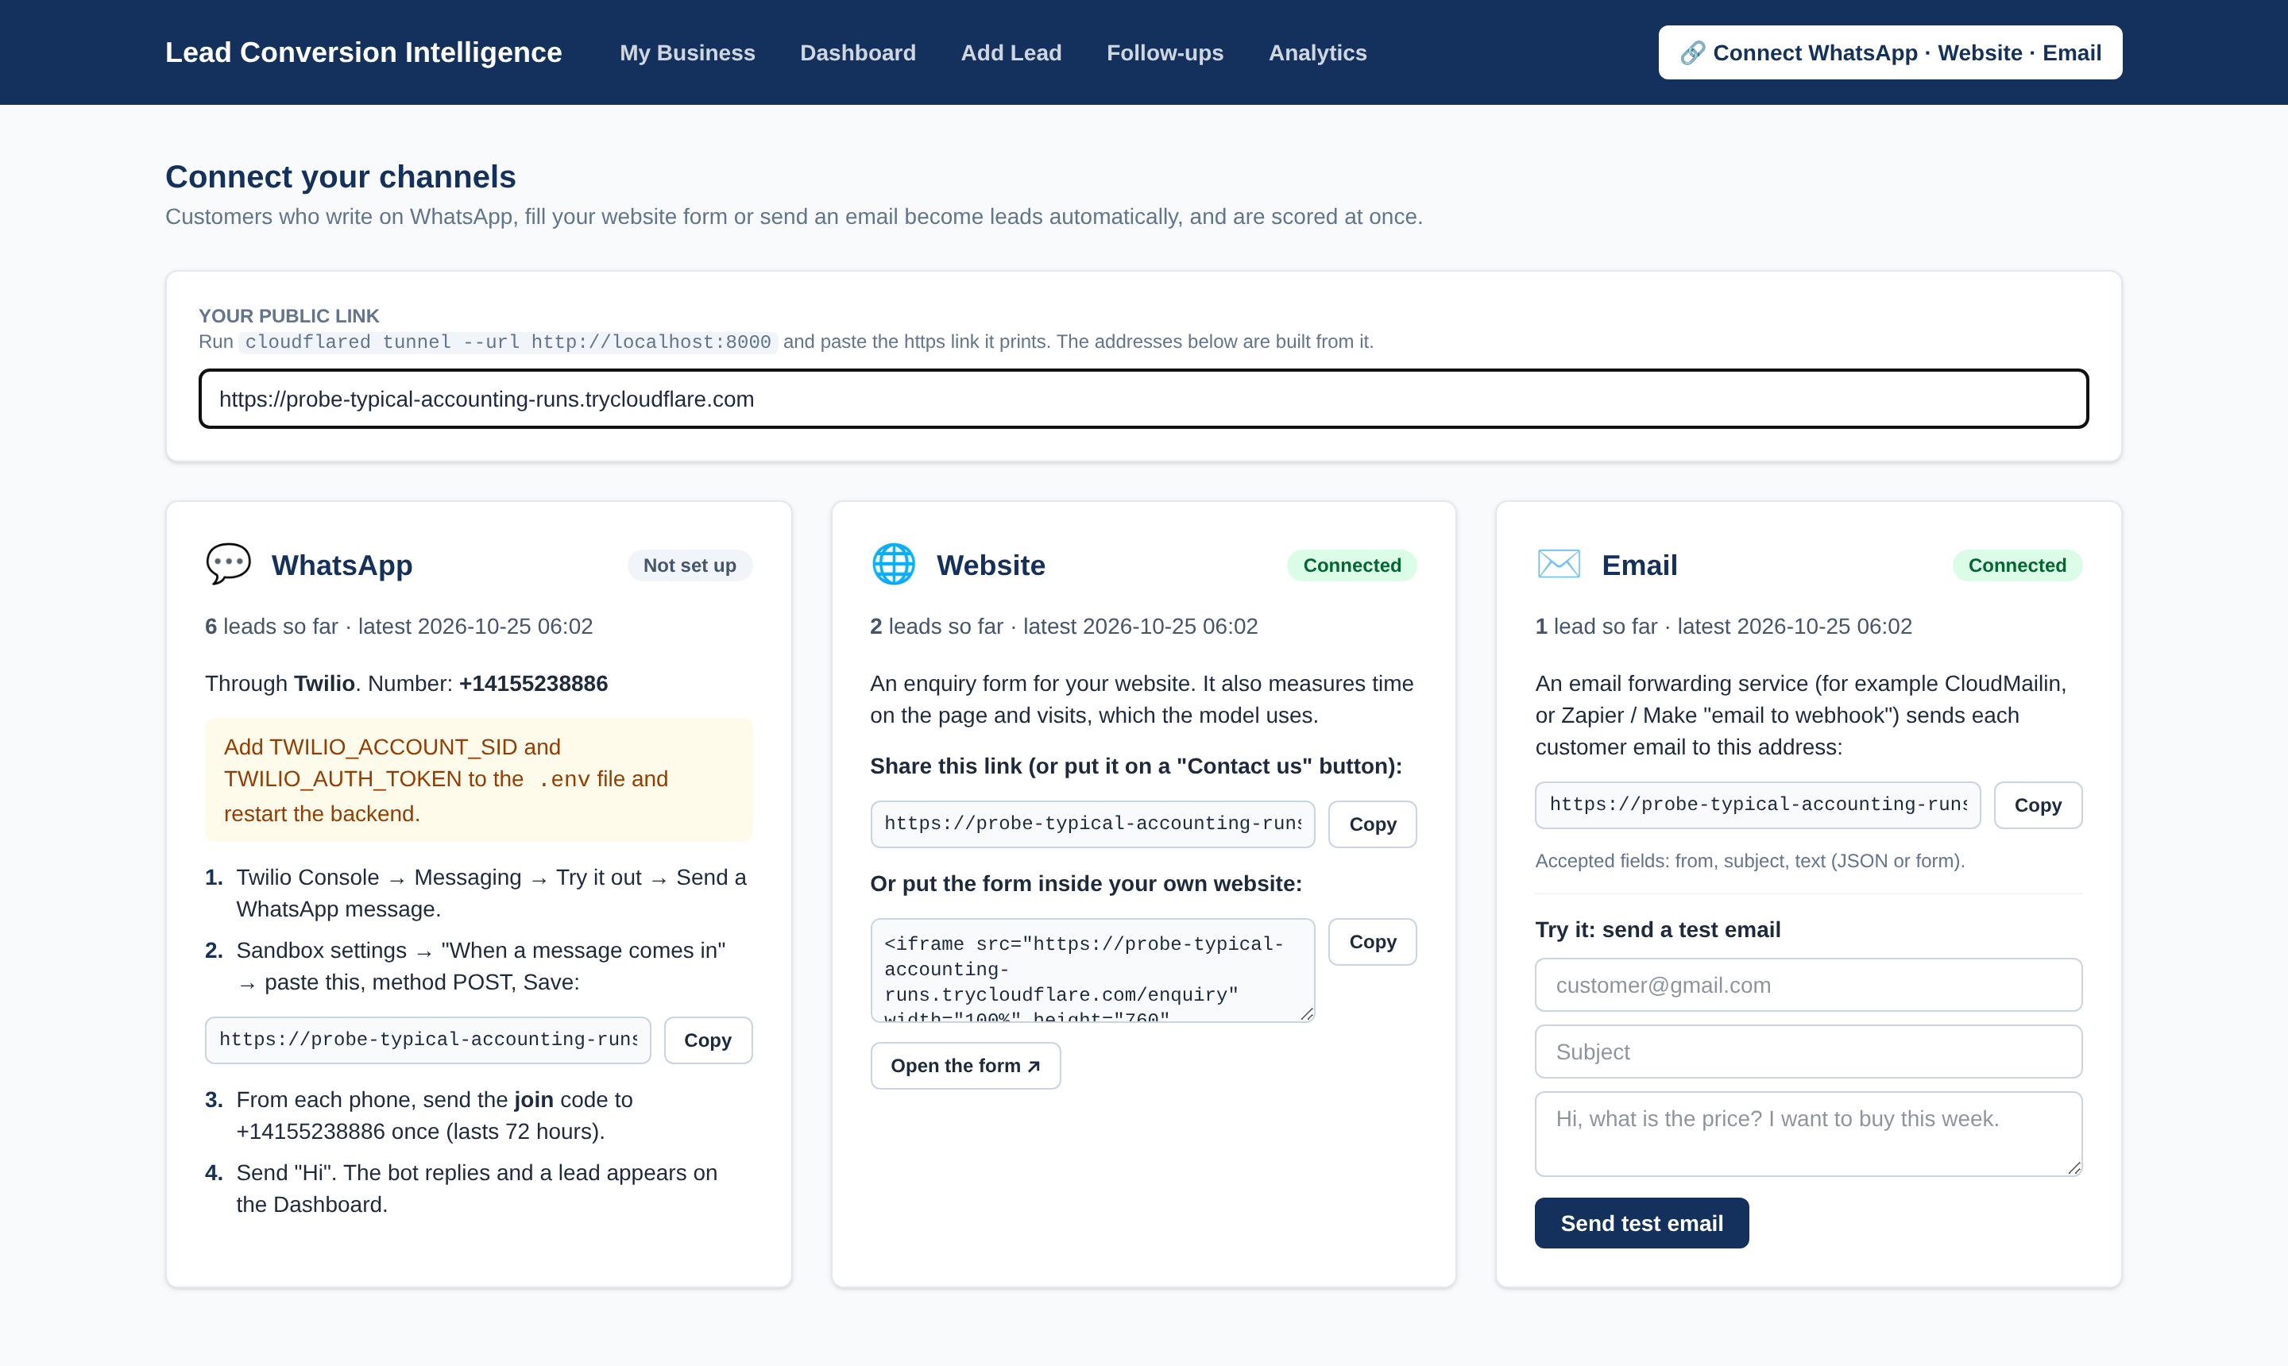
OUTPUT: WHATSAPP ASSISTANT & CHANNELS
Connect page: status, lead counts and addresses for each channel
Product list shows names only; price only when asked
Understands typos; answers mid-flow questions
Discounts and special requests go to the team
Real replies from our backend: questions, then price, specs, stock, delivery
Notes:
The chat is produced by our backend. Tested live on the Twilio sandbox with real phones; the Connect page shows each channel's status.

Slide 14

TESTING
Test | What is checked | Result
Conversation Agent | 50+ customer messages and the signals they must / must not give | All correct
Lead scenarios | 26 typical leads and the priority each should get | 26 / 26
Consistency rules | more time or visits never lowers the score; working professional ≥ unemployed | All hold
Product-list rule | products not sold lower the score; normal questions do not | 12 / 12
Webhooks & security | Twilio signature valid → 200, fake → 403; email sender invalid → 422 | Pass
Learning loop | auto-retrain after 10 outcomes; priority override survives re-scoring | Pass
Browser & live tests | onboarding, editing, Connect page, phone layout; real WhatsApp phones | Pass
ALL TESTS PASSED
python test_system.py
Bugs the tests caught
"Hi" saved as the customer's name
"book this week" wrongly flagged as a product we don't sell
score dropping when time on site rose
Notes:
One command runs over a hundred checks. Each bug found was fixed and a test added so it cannot come back.

Slide 15
CHALLENGES FACED
Challenge
How we solved it
Data leakage: Tags and Lead Quality gave >90% "accuracy"
Removed columns filled after the sale → honest 81.5%
Empty form fields pulled every score to ~26%
Trained on 6 collectable inputs; unknown fields averaged
More time on the website sometimes lowered the score
Monotonic constraint + automatic consistency tests
No public dataset of real messages with outcomes (AUC 0.58–0.61)
Explainable signal weights + model that learns from own chats
Twilio limits, changing tunnel links, typos in messages
Simulator, root webhook, clear Connect page; typo correction
Notes:
Each challenge came from testing the real system; the solution is in the code and covered by tests.

Slide 16

CONCLUSION & FUTURE WORK
Conclusion
Future work
We built a working lead intelligence system for small businesses: enquiries from WhatsApp, website and email are captured automatically, scored by a calibrated ML model trained on real lead data, and adjusted by what the customer actually wrote.
Every score comes with a reason, the WhatsApp assistant answers routine questions from the owner's product list, and the salesperson stays in control of every message sent.
The system keeps learning from the business's own results instead of relying on unsuitable public data.
Cloud deployment
fixed domain, PostgreSQL, login
Own WhatsApp number
Meta Cloud API / Twilio Sender
Telugu, Hindi, Hinglish
multi-language signals
Optional LLM drafts
with rule-based fallback
Notes:
Summarise in three points: captures, scores and explains, keeps learning. Then the four next steps.

Slide 17
THANK YOU
Questions are welcome
Thoomu Rithwik Reddy
Vadla Dinesh Achary
Bathula Shivani
Guide: Assistant Professor T. Vijayalaxmi · Department of Information Technology

