Slide 1
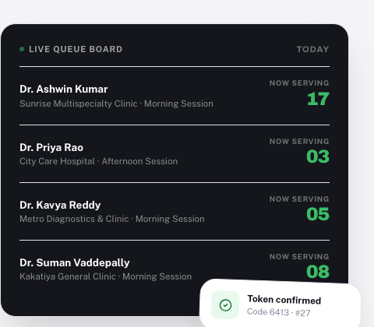
VisitNow
LIVE IN HYDERABAD · WARANGAL · BENGALURU
Skip the wait.
Not the doctor.
The queue infrastructure for local clinics and hospitals in India.
Built, working, and demoed live in this deck.
Investor overview · August 2026 · Confidential

Slide 2
THE PROBLEM
Every local clinic runs on the same broken promise: “come at 10, we'll see you.”
!
!
!
!
Patients wait blind
Two queues, one counter
Owners fly blind
Doctors split across clinics
The only way to check the queue is to stand in it. Nobody can see how far back they really are.
Walk-ins and online bookings are tracked separately. Reception is the only place they meet, and only on paper.
No daily revenue, no doctor performance, no patient history. Just a register and a guess.
A doctor working two shifts at two clinics has no single view of their own patients or their own earnings.
VisitNow
02 / 18

Slide 3
THE INSIGHT
A token beats an appointment. It's the one thing nobody built properly.
Every patient gets a real numbered token the moment they book: online, at the counter, or from a scheduled visit. All three land in one line.
One queue, no exceptions
No slot to defend
Every token, however it was created, joins the same line in the same call order.
A token holds a place. Patients walk in when the queue is actually close, not an hour early to be safe.
Doctors, not clinics, are the unit
Live for the whole room
One doctor covering two clinics sees both queues and both paychecks, without merging them into noise.
Patient, receptionist, doctor, and owner all watch the same number move, at the same time.
VisitNow
03 / 18

Slide 4
HOW IT WORKS
From search to seen, in four steps.
01
02
03
04
Find your doctor
Get your token
Track it live
Walk in on time
Search by doctor, specialty, or clinic. See who's live now and who opens later today.
Pick a payment method, confirm the fee breakdown, get a real numbered token in seconds.
Watch position update as the doctor's queue moves. No refreshing, no guessing.
Show up when actually close to being called, and show the 4-digit code at the desk.
No fixed slot. A token holds the place, and patients show up when it's actually close.
VisitNow
04 / 18

Slide 5
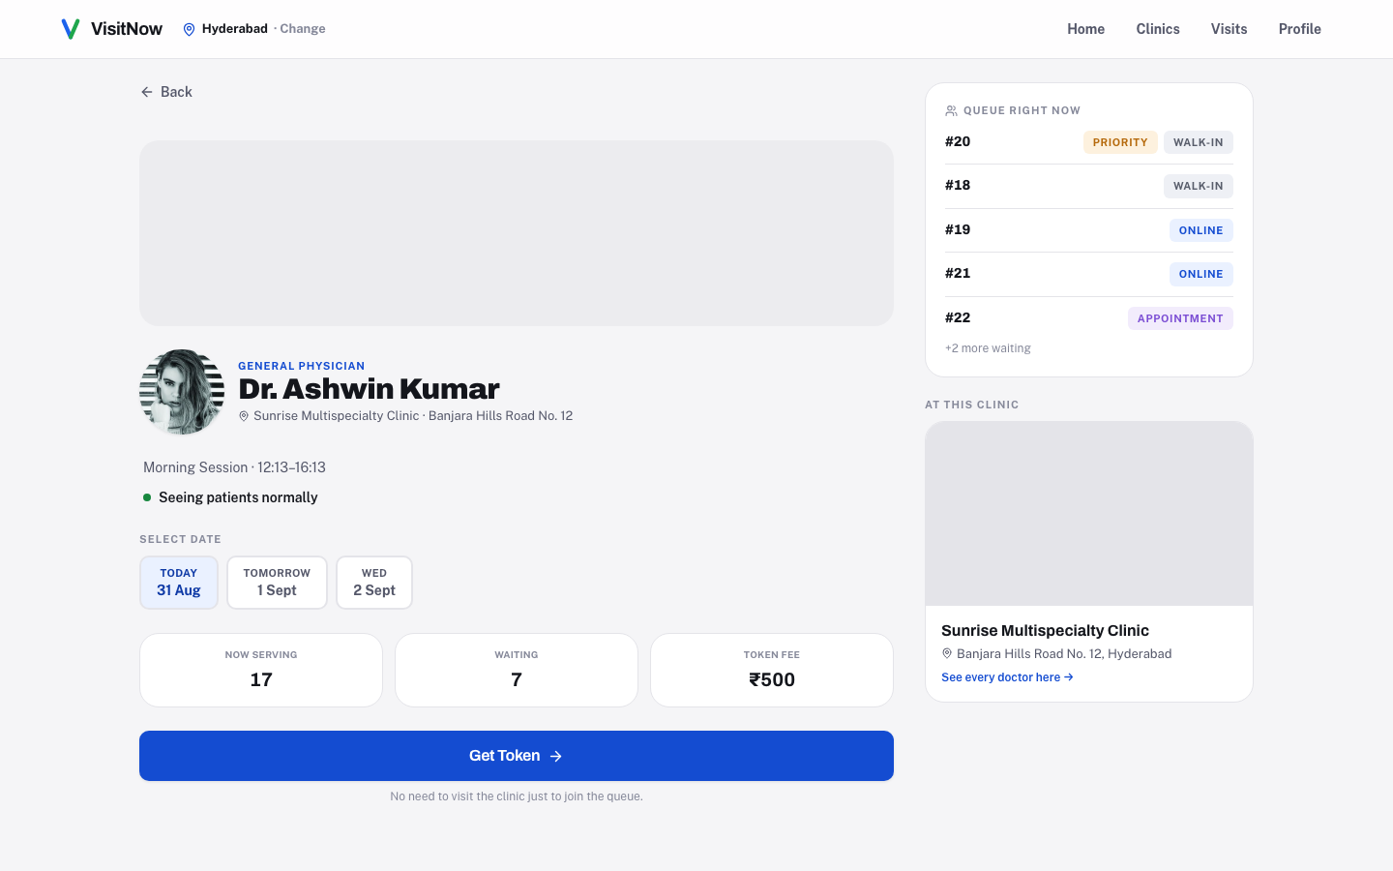
PRODUCT WALKTHROUGH
Patients see the actual line before they leave the house.
▪ Search by doctor, specialty, or clinic, and see exactly who is live right now.
▪ One page: now serving, how many are waiting, and today's fee, before committing to anything.
▪ The same live number reception sees at the counter is exactly what the patient sees on their phone.
▪ Cancel or track a token from the same screen. No phone call to the clinic, ever.
VisitNow
05 / 18

Slide 6
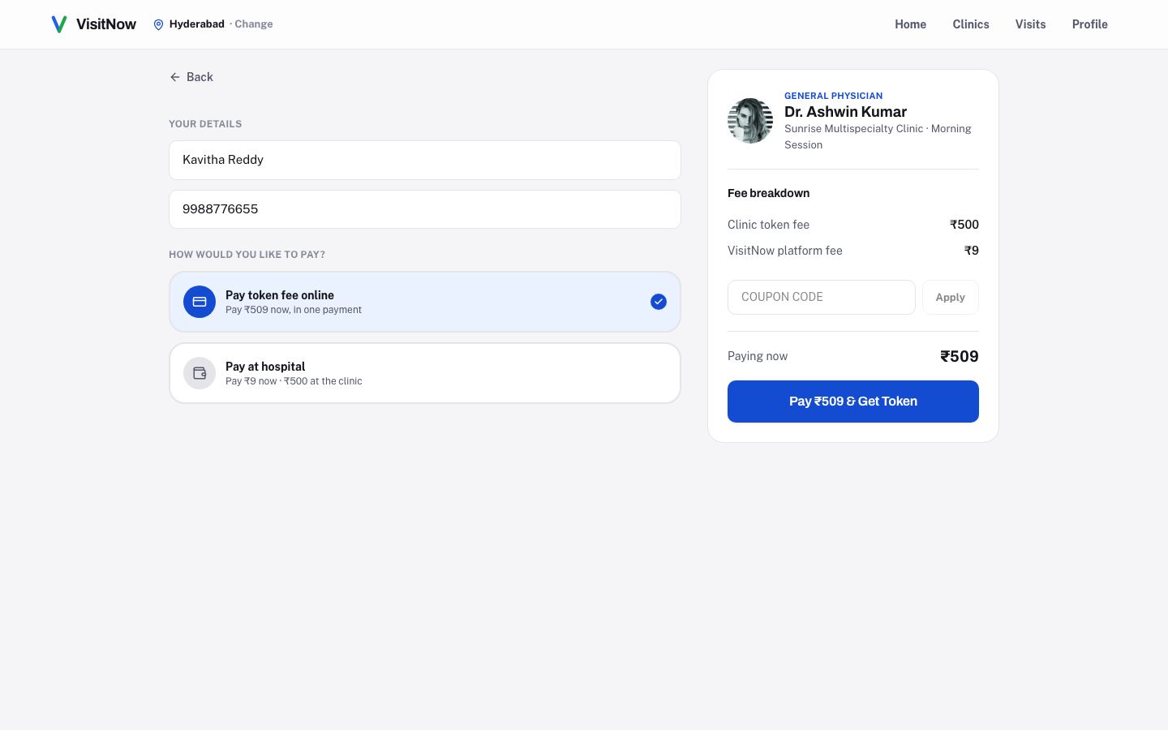
PRODUCT WALKTHROUGH
Two ways to pay. One fee nobody has to negotiate.
▪ Pay the full token fee online in one step, or pay ₹9 now and settle the clinic's fee at the counter.
▪ The clinic sets and keeps its own price. VisitNow's own cut is a flat ₹9, on every token, always.
▪ Coupons apply at checkout instantly, but the real discount is recalculated and verified on the server before a token is ever issued.
▪ A 4-digit code confirms every online token. Reception looks it up; it was never meant to be a login.
VisitNow
06 / 18

Slide 7
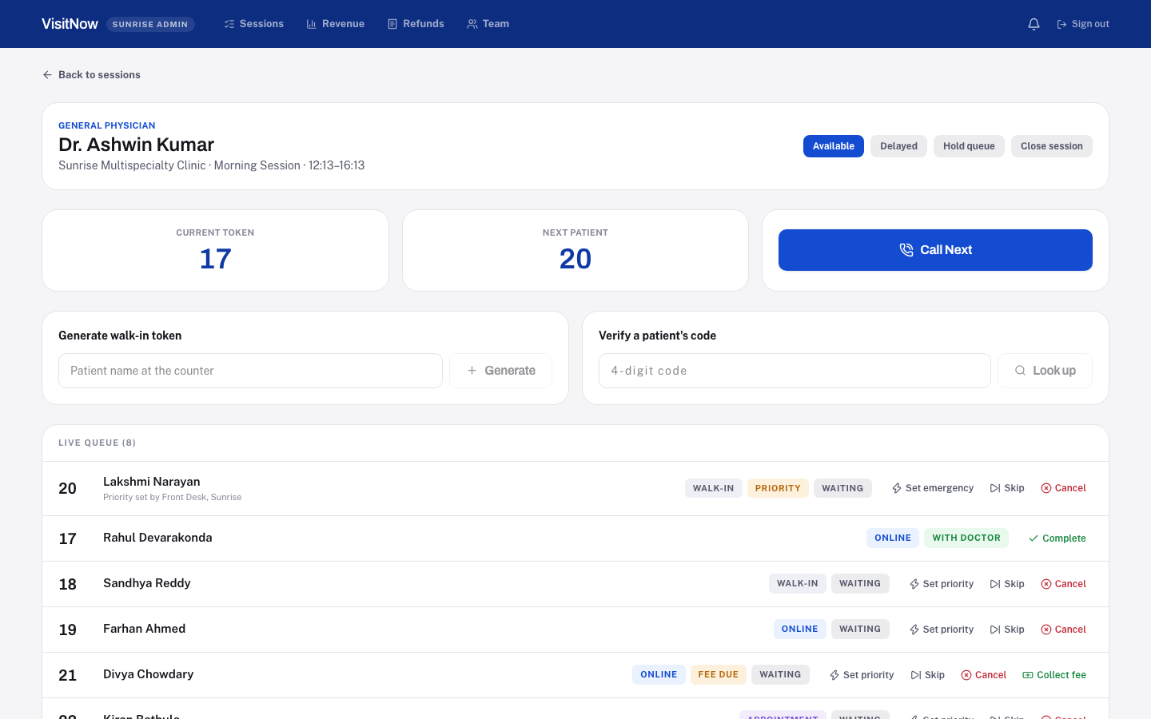
PRODUCT WALKTHROUGH
Reception runs the entire day from one screen.
▪ Call next, mark complete, skip, or flag priority, in an order the system enforces, not memory.
▪ Generate a walk-in token or verify a patient's 4-digit code without leaving the queue view.
▪ Collect a pay-at-hospital fee in person, recorded permanently against the staff member who took it.
▪ A back button and clear context on every screen. This is a tool for a busy desk, not a demo mockup.
VisitNow
07 / 18

Slide 8
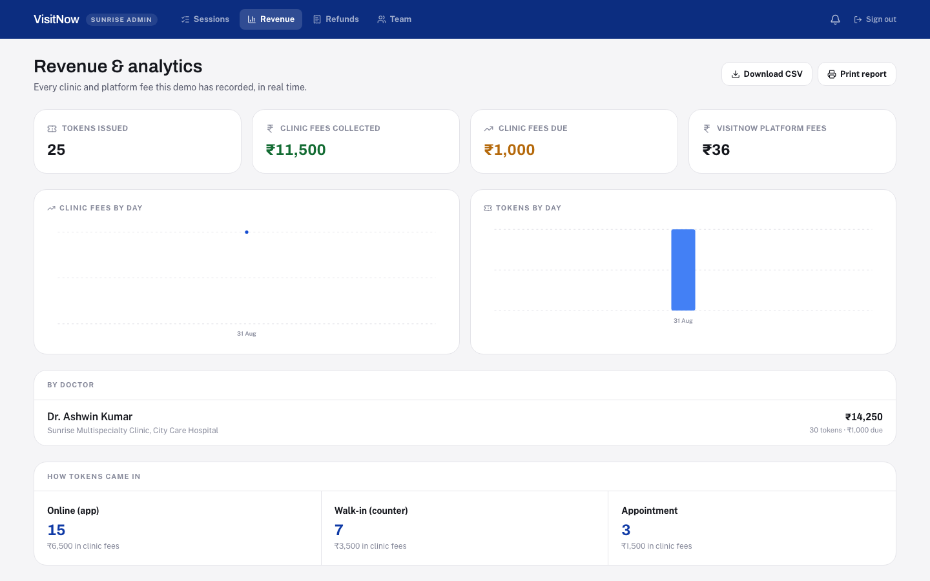
PRODUCT WALKTHROUGH
Owners finally see their own numbers, not a guess.
▪ Live totals: tokens issued, clinic fees collected, fees still due, and what VisitNow itself earned.
▪ Day-by-day trend charts for revenue and volume, not one number frozen at the end of the month.
▪ One click to a CSV or a print-ready report, built from the same records the queue runs on.
▪ Nothing here is a second copy of the truth. Every figure is computed fresh from the live queue.
VisitNow
08 / 18

Slide 9
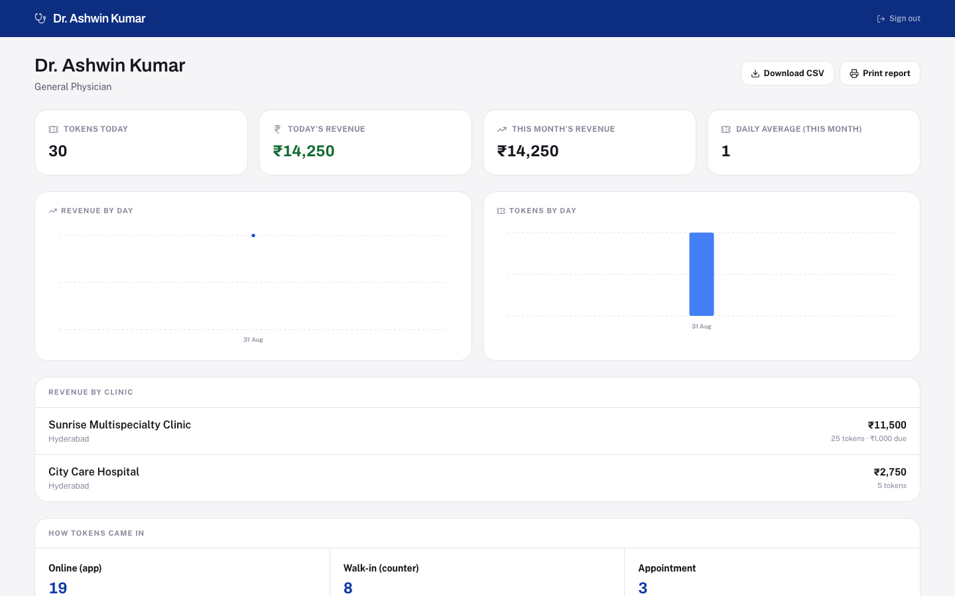
PRODUCT WALKTHROUGH
A doctor's own P&L, across every clinic they work.
▪ Today's revenue, this month's revenue, and a daily-average token count, at a glance.
▪ Revenue split by clinic: Dr. Kumar sees ₹11,500 from one hospital and ₹2,750 from another, never one blended number.
▪ A breakdown of how patients actually reach the queue: online, walk-in, or a converted appointment.
▪ The same downloadable, printable report a hospital owner gets, scoped to just this one doctor.
VisitNow
09 / 18

Slide 10
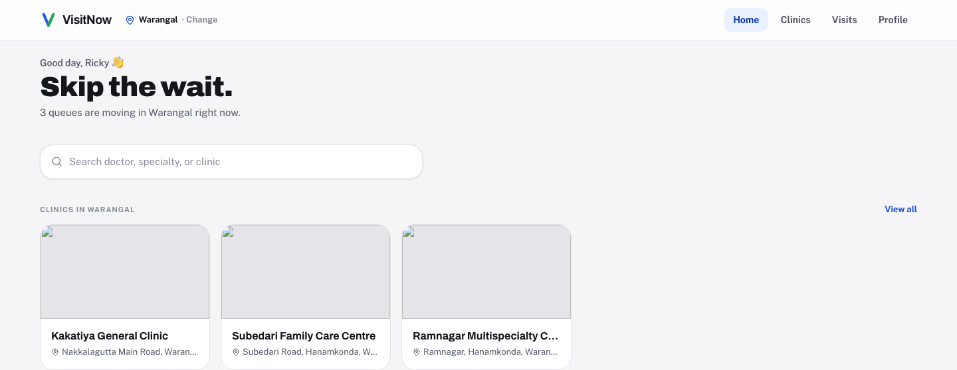
PROOF, NOT A PROMISE
Warangal runs the exact same product as Hyderabad. Nothing was rebuilt to get there.
3
cities live today
9
partner clinics
19
doctors seeing patients
Demo environment, seeded to show real multi-tenant scale.
VisitNow
10 / 18

Slide 11
PLATFORM
Every hospital is a walled garden. Every login, a boundary.
Five account types, each scoped to exactly what it should see, and never anything else.
Super Admin
App owner
Runs the whole platform and onboards every new hospital, personally or through their own team.
Super Admin Staff
VisitNow team
Holds only the modules the owner hands them: Hospitals and Doctors for one person, Payments for another.
Hospital Admin
Hospital owner
Owns everything inside their one hospital. Nothing outside it exists to them.
Hospital Staff
Reception, cashier
Same idea, one level down. A front-desk login gets Queue and Tokens; a cashier gets Payments and Refunds.
Doctor
Clinician
Sees their own queue and their own revenue, across every clinic they actually work at.
VisitNow
11 / 18

Slide 12
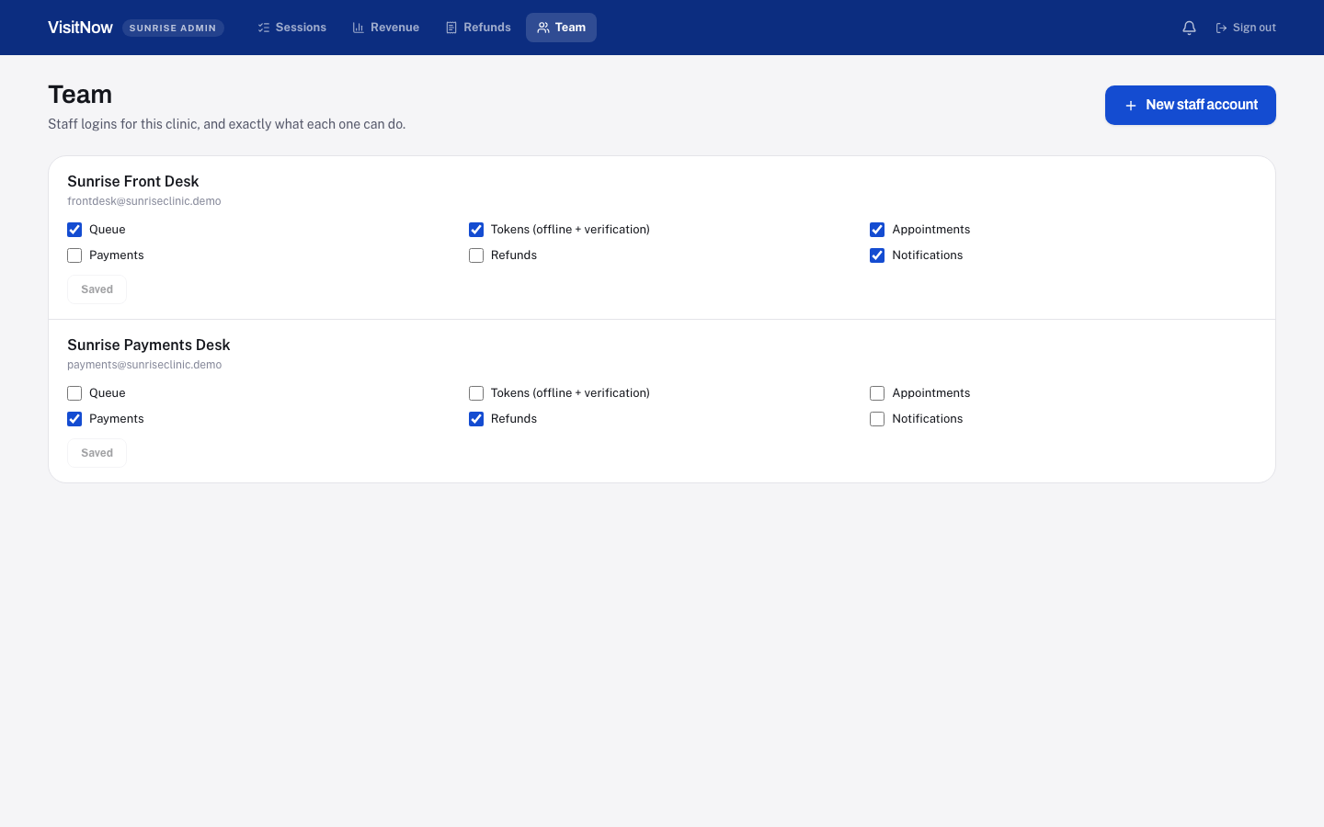
PLATFORM
Access isn't a role. It's a list, and only the owner controls it.
▪ A new staff login starts with zero permissions. The owner grants exactly what that job needs, module by module.
▪ Reception gets Queue, Tokens, and Appointments. A cashier gets Payments and Refunds. Never the whole console by default.
▪ Every permission is checked twice: once in the interface, and again on the server, on every single request.
▪ Editing permissions is never delegable, not even to a staff account that already holds everything else.
VisitNow
12 / 18

Slide 13
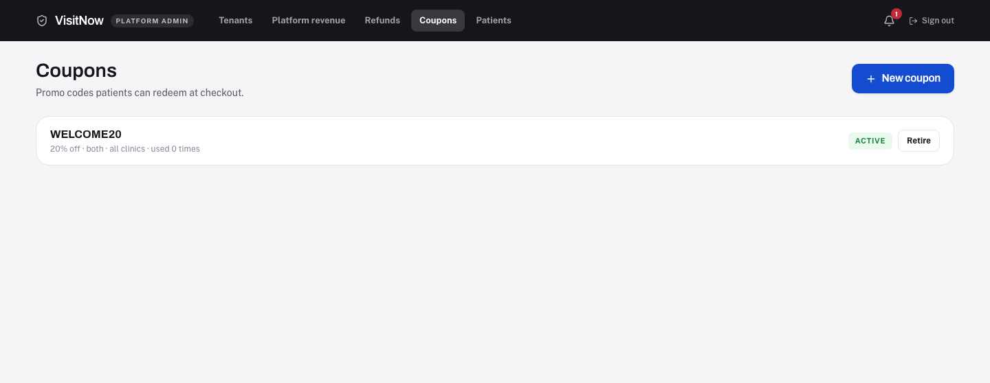
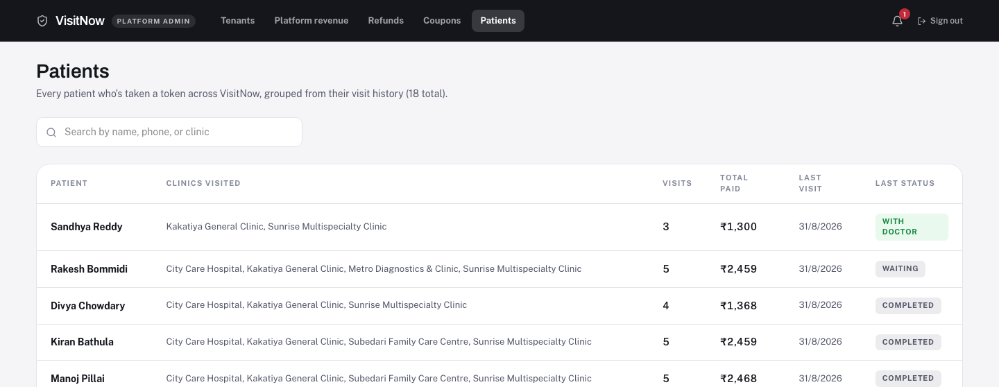
GROWTH TOOLS
Two growth levers, already built in, not sketched on a roadmap slide.
Coupons
Patient CRM
Percent or flat, scoped to one clinic or the whole platform. The real discount is recalculated on the server, never trusted from the browser.
Every patient across every clinic, grouped by real visit history: how many visits, how much paid, where they've been seen.
VisitNow
13 / 18

Slide 14
BUSINESS MODEL
₹9 a token. No cut of the clinic's own price.
PER ONLINE TOKEN
WHY IT SCALES
₹9
▪ Revenue tracks token volume, not deal size. No rate to negotiate hospital by hospital.
▪ A flat fee removes the one objection every clinic raises about digital tools: “are you taking a cut of my margin.”
▪ Coupons and settlements are already-built levers to drive volume and manage payouts.
▪ Walk-in tokens run through the same queue before a patient ever pays online, so VisitNow becomes the clinic's operating system first, and the payment layer second.
VisitNow's own fee. Fixed. Never a percentage of the clinic's price.
Clinic keeps its own fee, in full
Set by the clinic, paid online or at the counter. VisitNow never touches it.
VisitNow
14 / 18

Slide 15
TECHNOLOGY
Built to scale, not to be replaced in six months.
Frontend
Backend
Access control
▪ React 19 + Vite + TypeScript
▪ Tailwind v4, a custom design system
▪ Native responsive web: one codebase, every screen size
▪ Live polling keeps every screen current without a refresh
▪ Node.js + Express + TypeScript
▪ REST API, one clear route per action
▪ Queue order, fees, and refunds all enforced server-side
▪ Every write is re-validated on the server. The client is never trusted
▪ Real accounts, checked server-side on every request
▪ Role + module permission model, not fixed roles
▪ Ownership and capability checked as two separate rules
▪ Anti-escalation rules enforced at the route level
VisitNow
15 / 18

Slide 16
UNDER THE HOOD
Whichever door a patient walks through, they land in the same line.
Online
Walk-in
Appointment
Booked from the app, paid ahead or at the counter
Generated at reception, in person
A scheduled slot, converted the moment it arrives
One queue. One call order. One token number.
Priority is layered on top (emergency, then priority, then regular), and only a staff account can assign it. A patient can never self-declare an emergency. Every transition (waiting to called to in progress to completed) is enforced server-side, so the console can never show an impossible state.
VisitNow
16 / 18

Slide 17
WHAT'S NEXT
The product works today. Here's what funding buys next.
Payments
Notifications
A real payment gateway (Razorpay/Cashfree) in place of today's simulated checkout.
Real SMS/push/WhatsApp delivery in place of today's in-app activity log.
Settlements
Coverage
Automated payout runs to clinics, on top of the settlements module already scaffolded.
More cities, more clinics. The onboarding flow already supports it; this is a go-to-market problem, not an engineering one.
Native apps
Deeper analytics
iOS/Android wrappers around the same responsive product, for patients and reception alike.
Predictive wait times from real historical consult data, once there's a real history to learn from.
VisitNow
17 / 18

Slide 18
VisitNow already works.
Token-first queueing, real multi-tenant hospital operations, and a genuine permission system.
Built, not promised. We're ready to put it in front of more clinics.
Thank you.
VisitNow
18 / 18

